Slide 1
Climate Change: What Should We Do About It?
CAS Spring Meeting – The Broadmoor
May 19, 2015
Lisa Dilling, Stu Mathewson and Doug Collins

Slide 2
Outline
Discuss issues with this framing of adaptation research from two perspectives:
lessons from usable science research
lessons from hazards research
Implications for barriers to adaptation beyond lack of knowledge

Slide 3
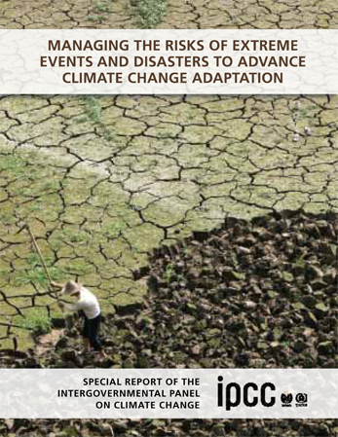
SREX and proactive action for DRR/adaptation
Society is facing increasing financial losses from disasters.
“Disasters are associated more and more with lesser-scale physical phenomena that are not extreme in a physical sense” (p. 34)
This is being driven by an increase in underlying vulnerability.

Slide 4
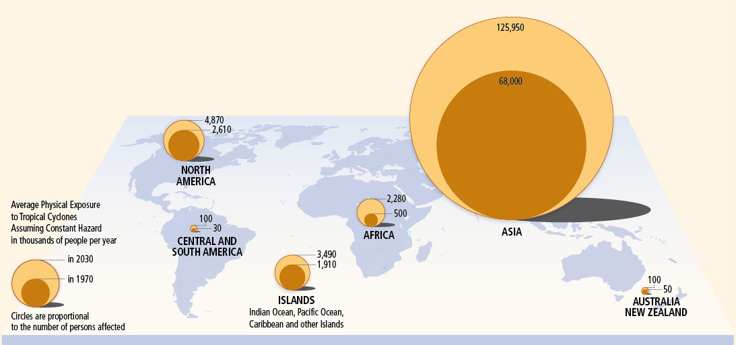
Changing Exposure to tropical cyclones (constant hazard)
SREX Figure 4-1
SREX Figure 4-1
SREX Figure 4-1
SREX Figure 4-1

Slide 5
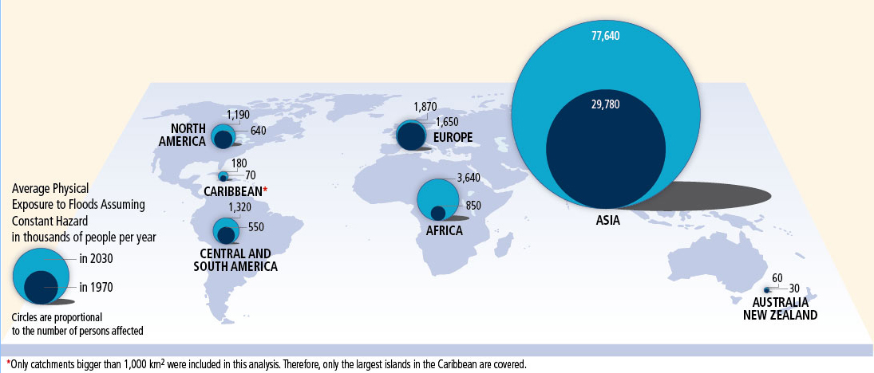
Changing Exposure to Floods (constant hazard)
SREX Figure 4-2
SREX Figure 4-1
SREX Figure 4-1
SREX Figure 4-1

Slide 6
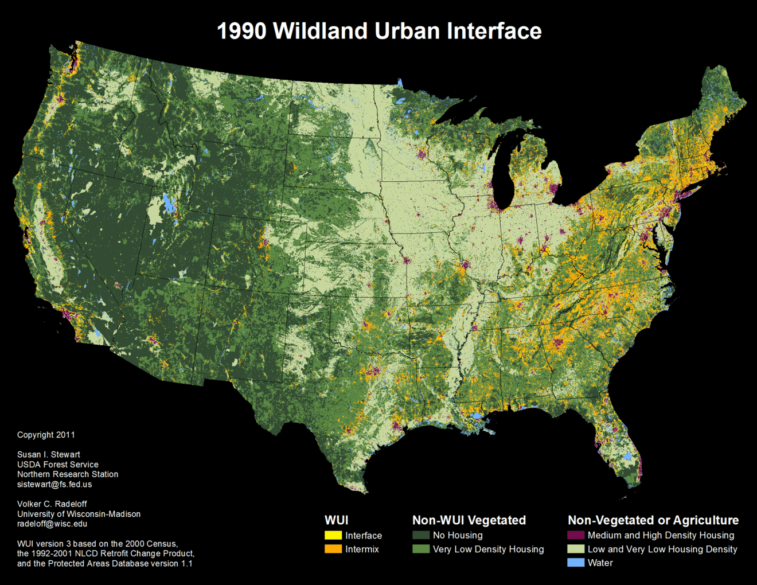

Slide 7
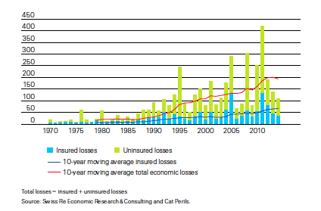
Increasing financial losses (US$ Billions)
Source: Swiss Re Sigma, No 2/2015, Figure 4

Slide 8
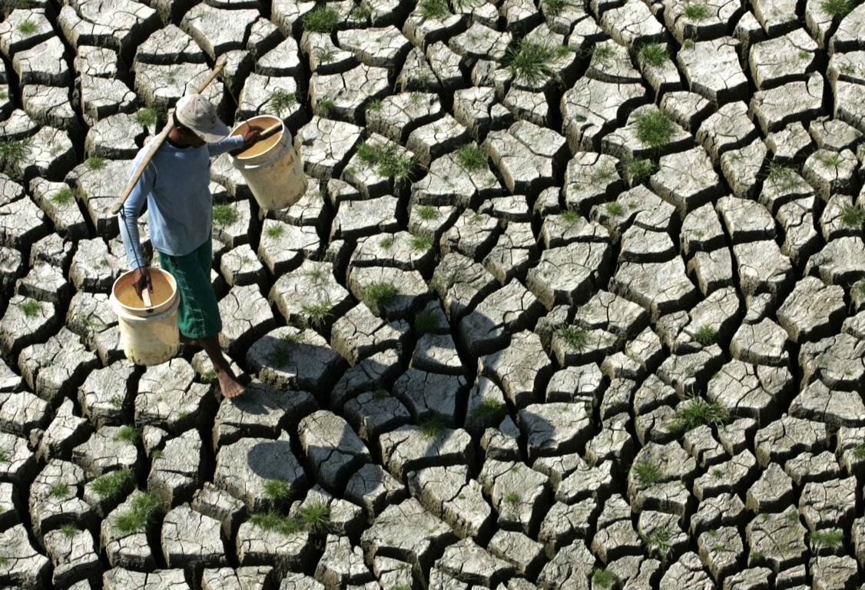
What is adaptation?
From the IPCC: Adaptation is “adjustment in ecological, social, or economic systems in response to actual or expected climatic stimuli and their effects or impacts”

Slide 9
With a changing climate comes a greater demand for proactive adaptation processes (Amundsen et al. 2010)
Is this simply a matter of providing advance knowledge?
Can we expect to improve on our existing record of acting proactively in the face of risk?
What are the potential barriers in the policy arena to acting preventatively?

Slide 10
Knowledge gaps (IPCC WGII)
Costs and benefits
What’s relevant for decision makers
Social drivers of vulnerability
Extremes, disasters
Assumptions
Intersection of adaptations and economy-wide indicators
Indicators’ usefulness
How development policies affect vulnerability to CC
Limits to adaptation
How to measure progress
Connection between mitigation and adaptation

Slide 11
Creating Usable Science
Understanding the context is critical
New mechanisms of interdisciplinary work with potential users are needed
Challenge our own assumptions and science policies

Slide 12
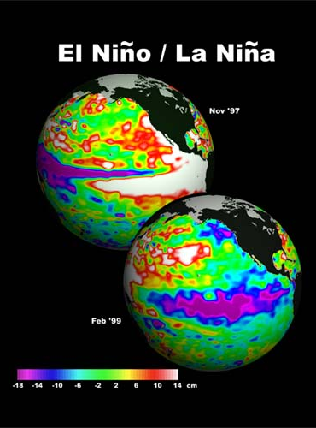
What we know from other fields on providing
usable science
Creating and supplying science that is useful in a particular context is not a given
To be successful at providing useful information to decision-makers requires research and a deliberate approach

Slide 13
What is usable science?
Science that meets the changing needs of decision makers
Addressing societal goals through research often requires advances in fundamental knowledge– they can go hand in hand
=> A complement to basic and applied science

Slide 14
What shapes the usability of science?
Contextual Factors [related to context of application]
Institutional or organizational factors
Fit to policy goals
Organizational culture and reward structures
Cultural context of use
Availability of alternate courses of action
Dilling and Lemos 2011

Slide 15
What shapes the usability of science?
Intrinsic Factors [related to production of information itself]
Awareness of the decision context
Skill, timeliness, relevant scale
Trust in forecasts and providers
Accessibility (including availability, language, graphical representations, understanding and comprehension
Dilling and Lemos 2011

Slide 16
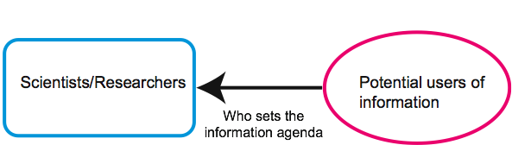
Science “Push”
Demand “Pull”
Iterativity and coproduction

Slide 17
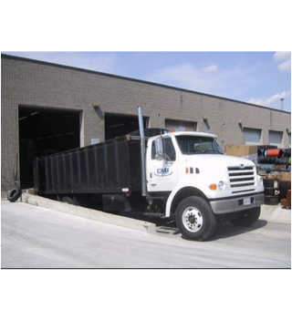
Implications for science processes
∅
Decision support cannot be an afterthought
Has to be ongoing and iterative with potential users
Requires deliberate planning and explicit recognition of goals
Avoid the “loading dock” mentality!
Dilling and Lemos 2011

Slide 18
...BUT... Still many examples where knowledge is available, relevant, “usable”, and still not acted upon. Actively ignored. Or politely ignored.

Slide 19
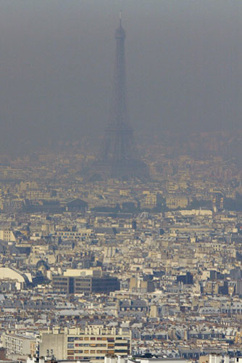
2003 Heat wave in France/Europe
At least 15,000 people died in France alone/70,000 across Europe
Elderly, women, infirm
In 2003, review of 1000 cases of heat waves
Warnings issued
Anecdotes that a few organizations did heed warnings and saved lives.
Poumadère et al. 2005; Robine et al. 2008

Slide 20
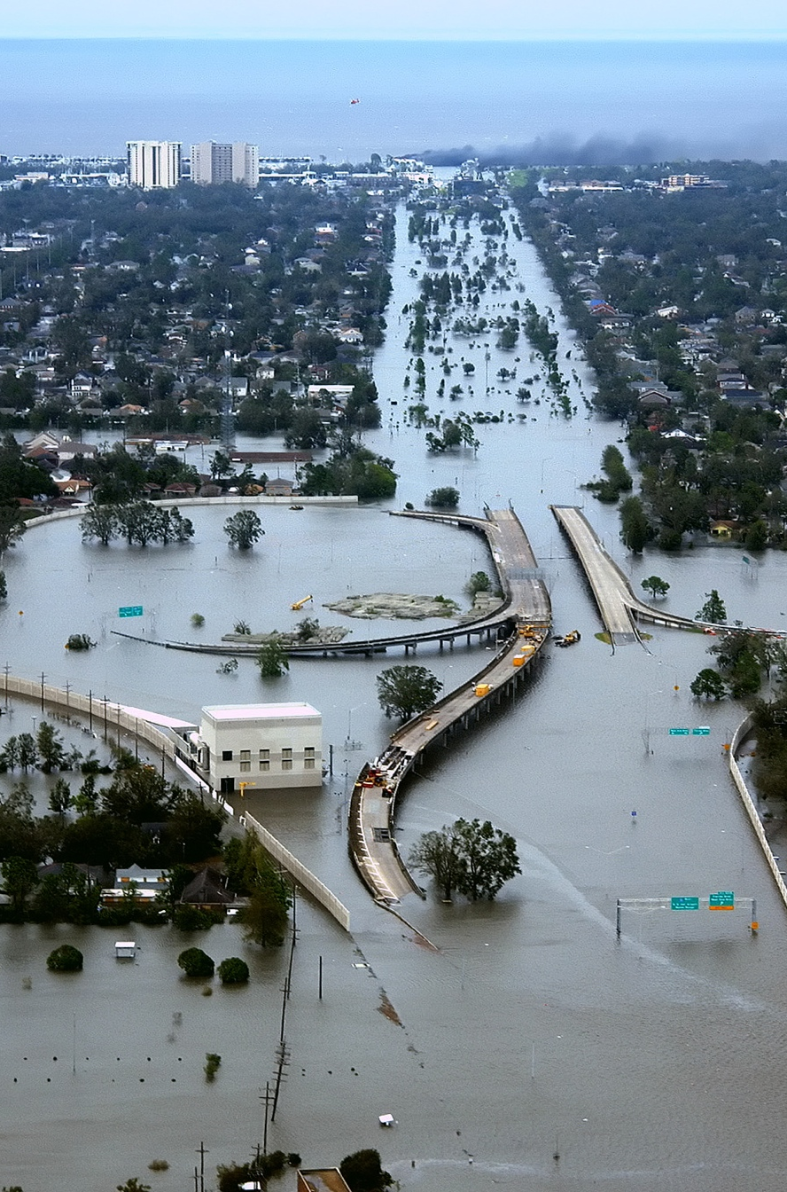
2005 Hurricane Katrina, US
Over 1800 deaths
African-American, elderly, poor, infirm,
5 years later people still in trailers
Large outmigration
Lasting economic, social impacts

Slide 21
“Most predicted disaster in American history” ~ Cigler 2007 From the local newspaper in 2002: “Amid this maelstrom, the estimated 200,000 or more people left behind in an evacuation will be struggling to survive. Some will be housed at the Superdome, the designated shelter in New Orleans for people too sick or infirm to leave the city. Others will end up in last-minute emergency refuges that will offer minimal safety. But many will simply be on their own, in homes or looking for high ground” ~ McQuaid and Schleifstein 2002

Slide 22
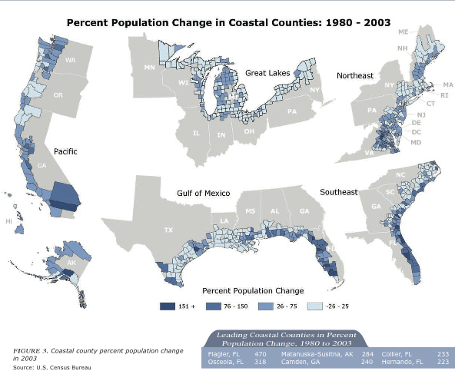
Many other examples from hazards literature
Habitation of erosive coastal zones
Habitation of mud-slide prone areas
Habitation of repeatedly flooded areas
Habitation of hurricane prone areas
“We will rebuild” policy as response to disaster
... and so on.

Slide 23
What is the problem?
No definitive sense of what decision makers around the country actually need in the way of adaptation research information
Hazards research suggests that even with good advance information, action is not always taken to mitigate hazards
=> Even with the production of “usable science”, we may well be unprepared for climate change impacts. We need to begin asking some (perhaps) tougher questions.

Slide 24
Barriers to reducing risk
Wide range of acceptance or resistance to challenges of risk management
Previous disasters do not always result in risk reduction activities as a response
Effective strategies such as changes in land use policy, zoning, acquisition of land are controversial, resisted and often not enforced
Individuals whether by choice or not do not always act to reduce their own risk, e.g. not evacuating in times of risk
From SREX 5.3.3

Slide 25
Risk reduction a political choice
“…underlying vulnerability remains high ... and economic and development trends continue to raise the stakes and present a choice: risk can be denied or faced, and adaptation can be forced or chosen. A reduction in the disaster risks associated with weather and climate extremes is therefore a question of political choice…”
SREX chapter 8

Slide 26
How might policy processes discourage preventative behavior, e.g. adaptation?
A certain amount of tolerance for risk, accompanied by policy support for risky behavior (e.g. lack of restrictive zoning, disaster relief funds, subsidized insurance, etc.)
Acknowledging climate change as a risk may be politically risky (depending on region)
Loss of property value as a result of government decisions can result in legal liability

Slide 27
More reasons cont.
Acting would require spending limited funds in ways that conflict with other goals
No political reward for adaptation decisions
time scale of political process and payoff
vulnerable people can be less politically active/voting power/campaign support
Inconvenient or conflicts with powerful or vocal interests
Challenges institutional status quo

Slide 28
Is tolerance for risk a problem for adaptation to climate change?... Possibly…
When making decisions for others
When those who stand to gain do not bear the risk
When power and vulnerability are not located in the same place/among the same group
When others (the public collective?) pay for individual choices to live with risk
When individuals have no choice in where they live
When short-term gains outweigh longer-term exposure
When the known risk profile changes (e.g. climate change)

Slide 29
Climate Index Development Structure
Climate Change Committee
Actuaries from the CAS, AAA, SOA & CIA
Climate Index Working Group

Slide 30
Actuaries Climate Index - Goals
Create an objective index that measures changes in climate over recent decades
Educate the insurance industry and the general public on the impact of climate change
Easy to understand, but not simplistic
Promote our profession

Slide 31
ACI Basics
Initial focus US and Canada
Hope to gradually add other parts of world where good data is available – Mexico, Europe, Australia…
Publish index and related information on web
Focus on measuring frequency and intensity of extremes rather than averages
Express changes as standardized anomalies, e.g.,
X’ = (X – X_{ref}) / σ_{ref}(X) = ΔX / σ_{ref}(X)
Six variables we are planning to use, all by 2.5°grid (275km x 275km at equator), summarized by 12 regions and by country :
Temperature (highs and low separately),
Precipitation, Drought
Wind,
Sea level

Slide 32
Extreme Temperatures Indices
Global Historical Climatological Network (GHCN) – global, land station-based, gridded dataset, daily from 1950-present (GHCN-Daily)
GHCNDEX indices* based on the above:
TX90 = 90%ile warm days
TN90 = 90%ile warm nights
TX10 = 10%ile cold days
TN10 = 10%ile cold nights
The average of % anomalies relative to the 1961-1990 reference period for T90 and T10:
Standardized anomaly (T10ʹ similar): T90 ʹ = ΔT90 / σ_{ref}(T90)
* Produced as part of the CLIMDEX project by the Climate Change Research Centre, at The University of New South Wales, Australia.

Slide 33
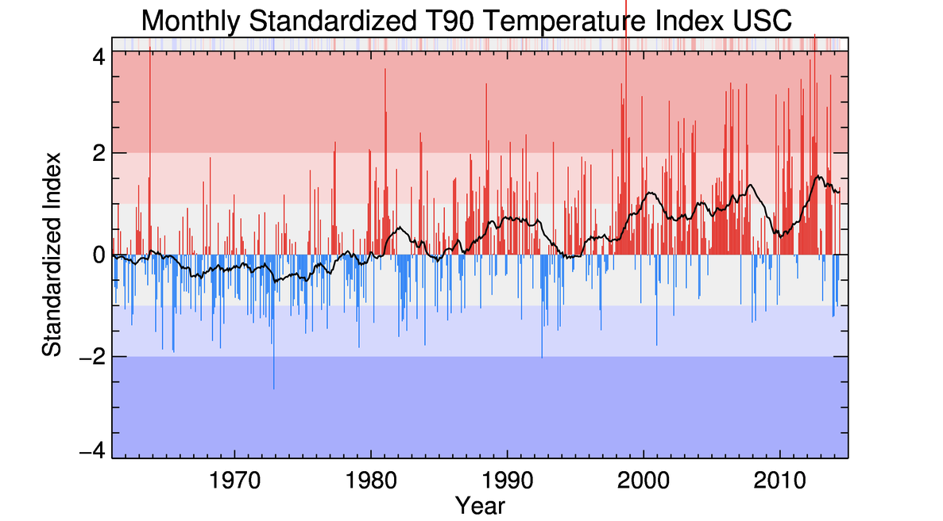
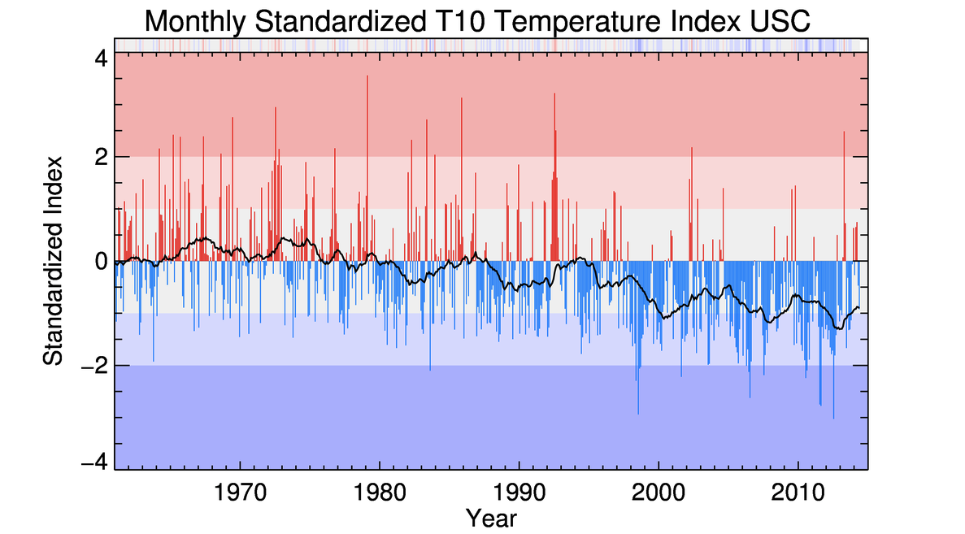
Standardized T90 and T10, US and Canada

Slide 34
Extreme Precipitation Indices
GHCNDEX monthly maximum five-day precipitation data
Heavy precipitation index, P’ = ΔRx5day / σ_{ref}(Rx5day)
GHCNDEX, consecutive dry days (CDD) = Max days per year with <1mm precipitation
Drought index = 1 value of CDD/year
Linear interpolation to obtain monthly
D’ = ΔCDD / σ_{ref}(CDD)

Slide 35
Wind Power Index
Index derived from NOAA Earth System Research Laboratory data:
Daily mean wind speeds
WP = (1/2)*ρ*w³ Where ρ is air density, w is daily mean wind speed
W’ = ΔWP90 / σ_{ref}(WP90)
Where WP90 is the monthly frequency of the 90th percentile or higher of daily wind power

Slide 36
Sea Level Index
At tide gauge stations along US and Canada coast
Data provided by Permanent Service for Mean Sea Level (PSMSL), part of the UK’s National Oceanography Center
Data matched to grids used for other variables
Index reflects portion of each region represented by coastal grids
Land movements removed from tide gauge measurements to produce index reflecting sea movements only
Sʹ = ΔS / σ_{ref}(S)

Slide 37
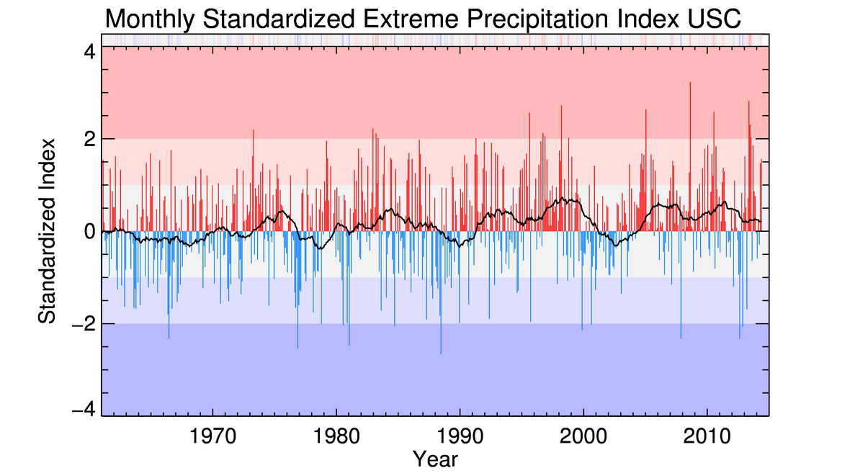
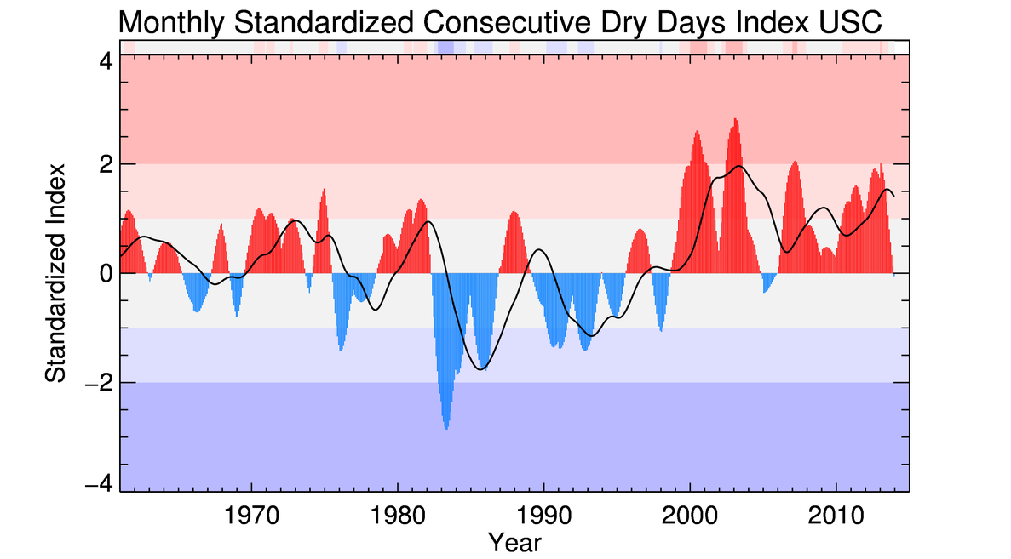
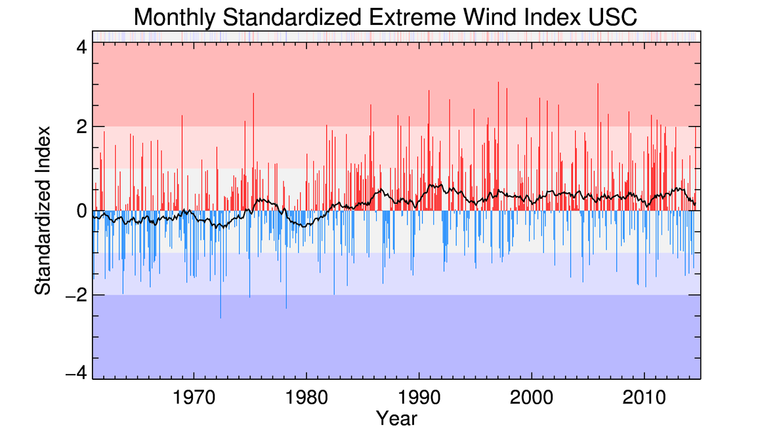
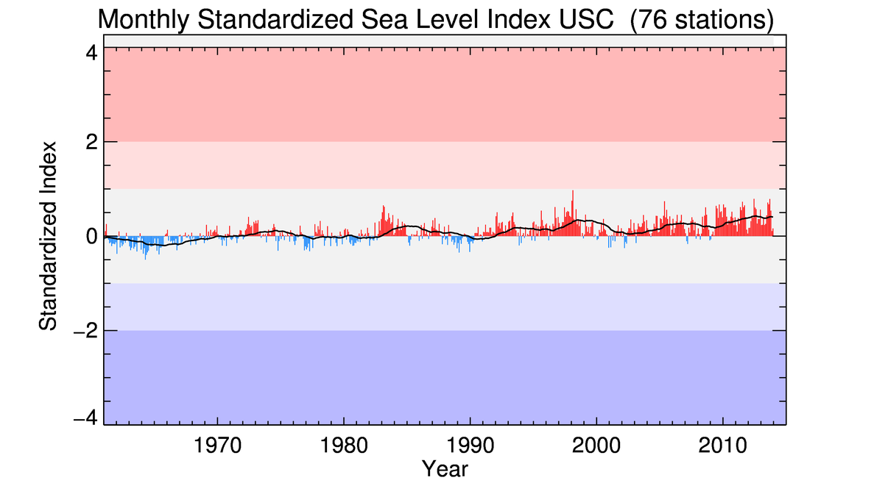
ACI Precipitation, Wind and Sea Level Components

Slide 38
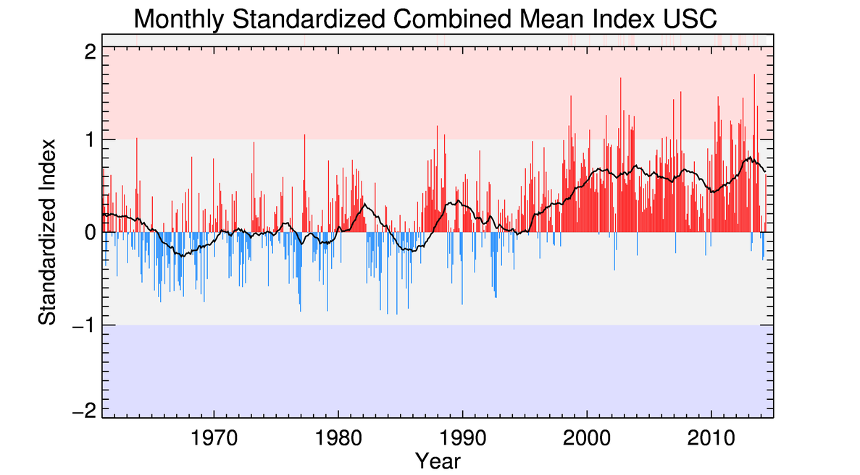
Composite ACI Index
Unweighted average of standardized anomalies
ACI = (T90′ –T10′ + P′ + D′ + W′ + S′) / 6

Slide 39
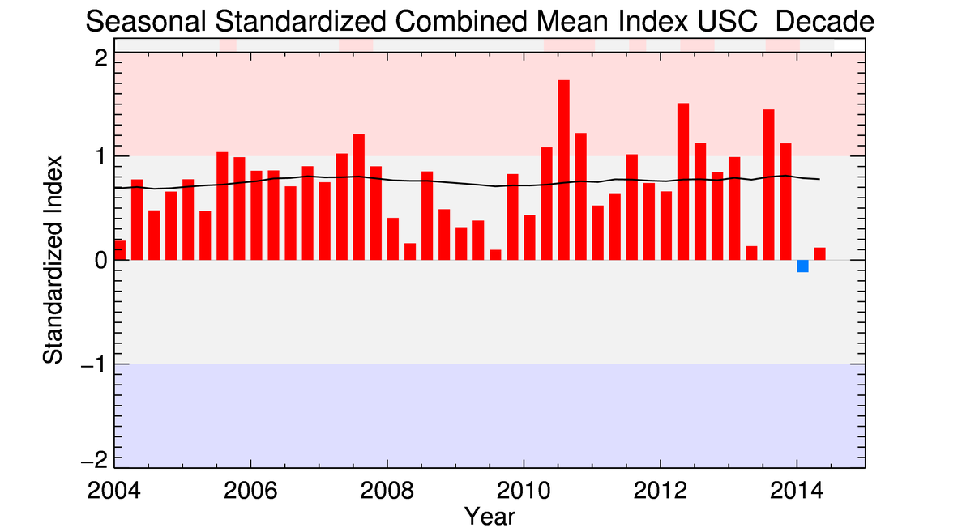
Composite ACI – Latest Decade by Season

Slide 40
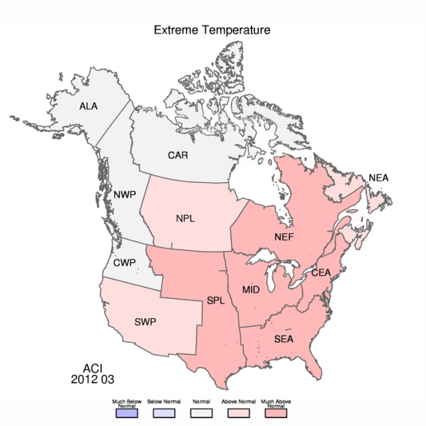
Region Map

Slide 41
Actuaries Climate Risk Index
Combine components of ACI with exposure measure (population) to produce “physical exposure”
Measure correlation of economic losses by peril to the physical exposure
Using SHELDUS data for economic losses, mortality and morbidity in the US
Canadian Disaster Database, compiled by Public Safety Canada
Goal is to produce an index especially useful to the insurance industry

Slide 42
Actuaries Climate Risk Index - Methodology
Regression analysis of damages and ACI components by region (statistically significant relationships found)
Mortality and morbidity vs. heat (3/12)
Flood damages vs. maximum 5-day precipitation (8/12)
Crop damages vs. consecutive dry days (1/12)
Wildfire damages vs. consecutive dry days (2/12)
Wind damages vs. wind power (7/12)
Proxies or no index for regions with no finding of statistically significant relationships
Create historical impacts index (HII)
Scale to an index ranging from 1-9

Slide 43
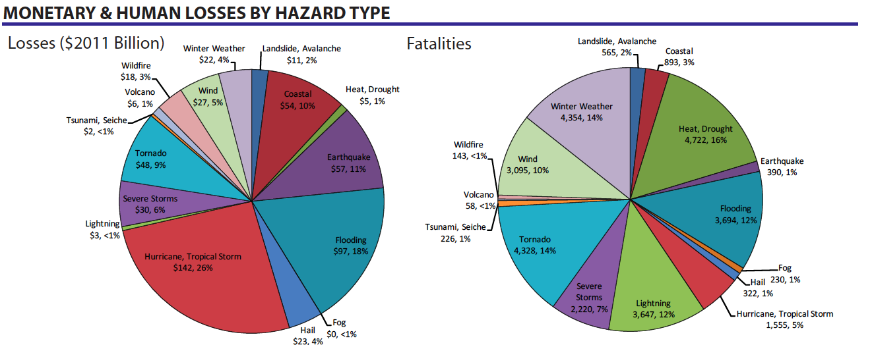
SHELDUS Data Summary 1960-2011
Source: http://hvri.geog.sc.edu/SHELDUS/docs/Summary_1960_2011.pdf

Slide 44
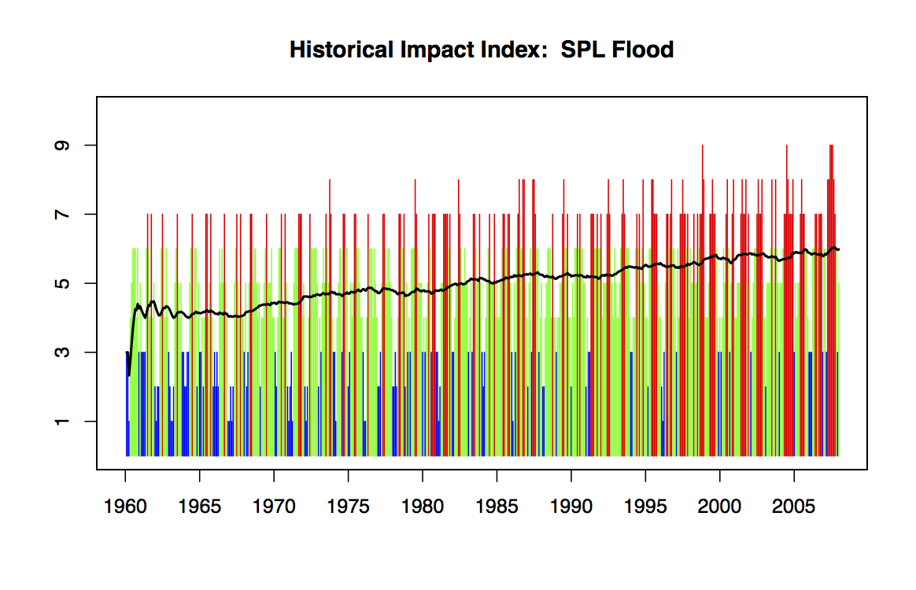
Actuaries Climate Risk Index – Sample Plot of HII

Slide 45
ACI Communication & Roll-out Schedule
Website prototype completed by Solterra
Actual website build by Matrix Group beginning soon
Proposed timetable: website platform complete in 3 months
SOA doing index calculations, CIWG handling content
Launch thereafter
Website contents
Charts of index components and composite indices
Maps of variation by 12 regions
Commentary in English and French
Index data available for download
Links to related information
Quarterly press releases once website is ready
Talking points, FAQ, assigned team to handle press inquiries

Slide 46
ACRI Roll Out
Complete formulation of ACRI
Create prototype website
Build ACRI portion of actual website
Quarterly index releases in tandem with ACI
Periodic articles in actuarial magazines

Slide 47
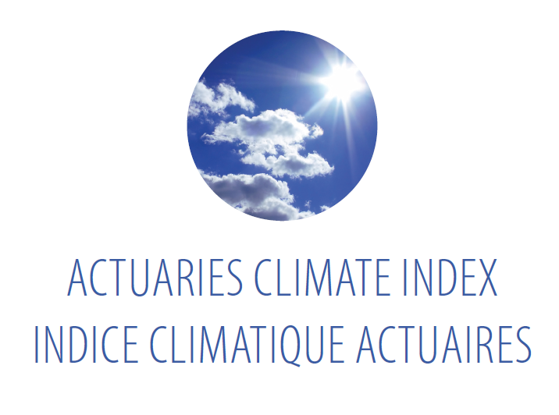
Websites and Logo
English
www.ClimateRiskHub.org and .com
www.ActuariesClimateIndex.org and .com
French
www.CarrefourRisquesClimatiques.org and .com
www.IndiceClimatiqueActuaires.org and .com

Slide 48
Potential Uses, Further R & D
Potential uses
Inform the debate
Compare weather and climate
Analysis of data
Adding regions
Will actuarial organizations elsewhere take lead?
Had preliminary talks recently with IFoA in UK
Could link or add to our website
Call paper program after launch
Funded research

Slide 49
How Can We Leverage This Work?
What significant issues does the insurance industry face due to climate change?
Varies for property, liability, life, health
Incorporating new trends into pricing
Incorporating higher risk into pricing and ERM
Coverage & availability
Underwriting, investment and claim strategy
Timetable and urgency of mitigation, remediation
Managing climate change risk using the ACI & ACRI
Education
Data analysis

Slide 50
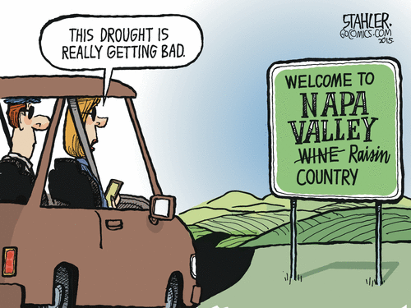
Jeff Stahler’s View…

Slide 51
Index Resources
Donat, M. G., et al. 2013. Global land-based datasets for monitoring climatic extremes. Bulletin of the American Meteorological Society, July, 997-1006, doi:10.1175/BAMS-D-12-00109.1.
Hansen J., et al. 1998, A Common Sense Climate Index: Is Climate Changing Noticeably? PNAS, 95, 4113-4120.
Peduzzi, P., et al. 2009, Assessing global exposure and vulnerability towards natural hazards: the Disaster Risk Index. Natural Hazards and Earth System Sciences, 9, 1149-1159.
Solterra Solutions, Determining the Impact of Climate Change on Insurance Risk and the Global Community, Phase I: Key Climate Indicators, November 2012. Available at: www.casact.org/research/ClimateChangeRpt_Final.pdf
Data sources:
GHCNDEX: www.climdex.org
GHCN-Daily: www.ncdc.noaa.gov/oa/climate/ghcn-daily/
Sea Level: www.psmsl.org/data/obtaining/
Wind: www.esrl.noaa.gov/psd/data/gridded/datancep.reanalysis.html
Economic Losses: http://webra.cas.sc.edu/hvriapps/sheldus_setup/sheldus_login.aspx http://www.publicsafety.gc.ca/cnt/rsrcs/cndn-dsstr-dtbs/

