Slide 1
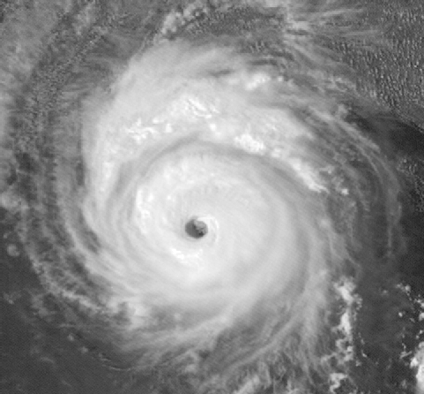
Atlantic Basin Seasonal Hurricane Prediction
Phil Klotzbach
Department of Atmospheric Science
Colorado State University
CAS Annual Meeting
May 20, 2015

Slide 2
Outline
Introduction
Atlantic Basin Multi-Decadal Hurricane Variability
Recent Downturn in US Landfalling Hurricane Activity
2015 Atlantic Basin Seasonal Outlook

Slide 3
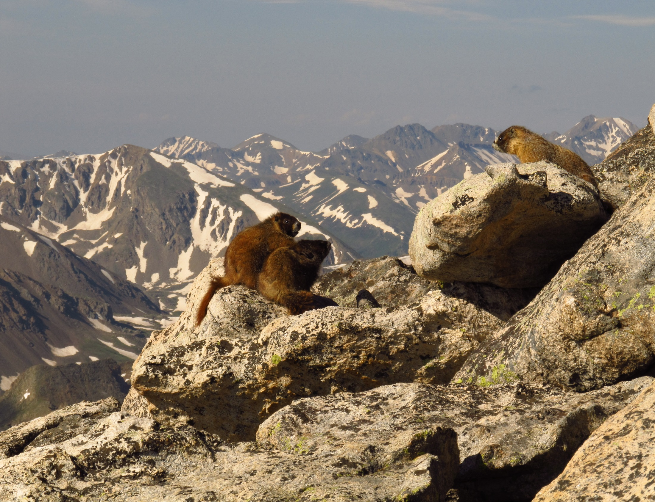

Slide 4
“It's tough to make predictions, especially about the future”
HOWEVER…
“You can see a lot by looking”
Yogi Berra

Slide 5
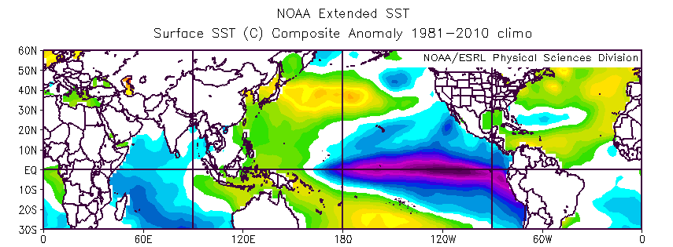
August – October SSTs: Ten Most Active – Ten Least Active Atlantic Hurricane Seasons Since 1950

Slide 6
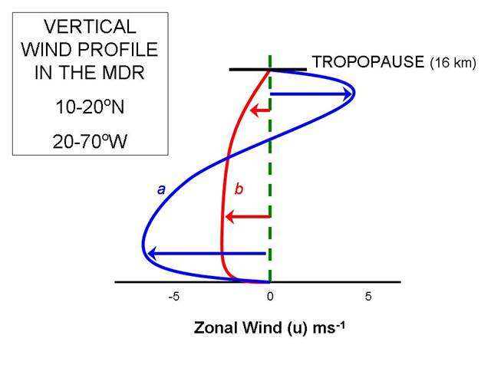
b – La Niña
a – El Niño

Slide 7
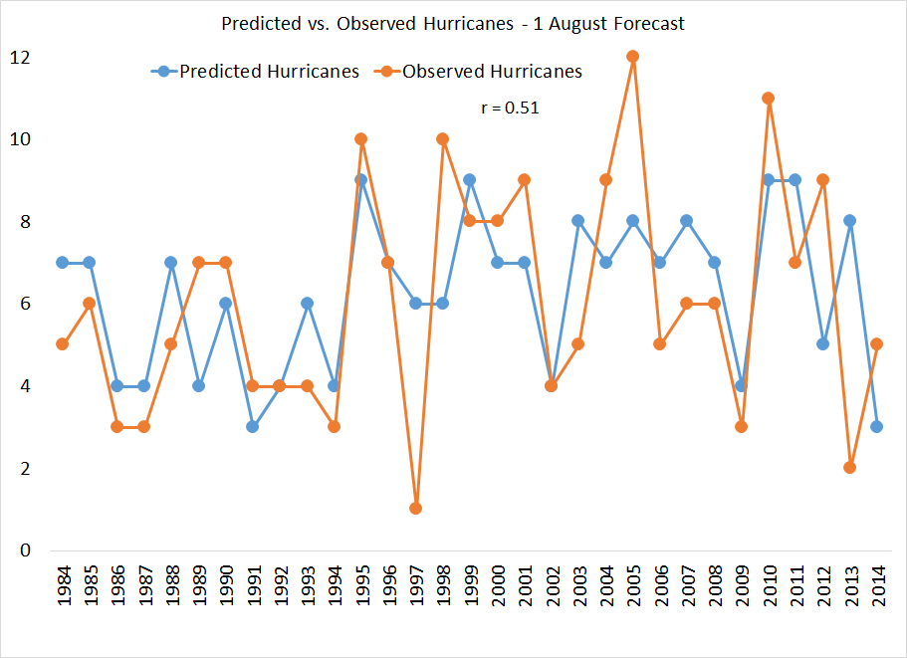

Slide 8
Atlantic
Basin
Multi-decadal
Hurricane
Variability

Slide 10
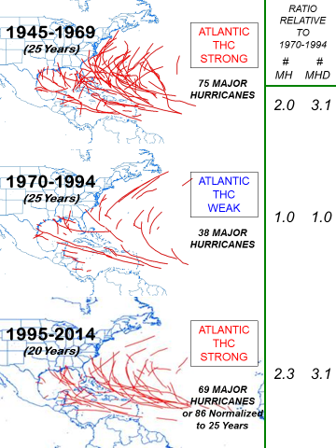

Slide 11
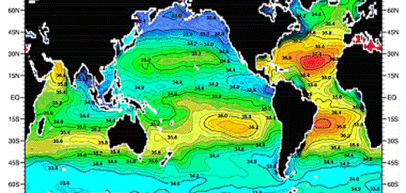
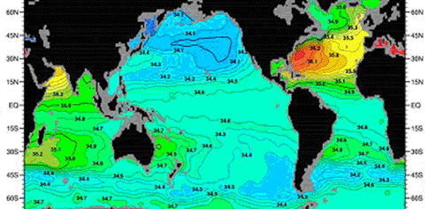
SALINITY
SURFACE
SALINITY
500
METERS

Slide 12
THC (or AMO)
STRONG
THC (or AMO)
WEAK

Slide 13
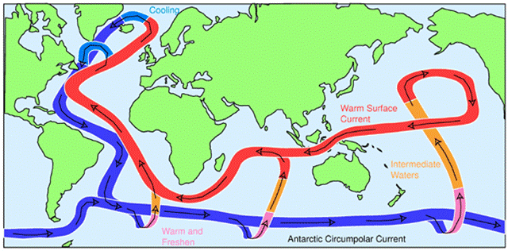
H
H
3
1
2
Courtesy of John Marshall (MIT)

Slide 14
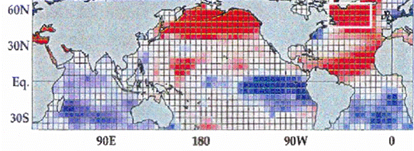
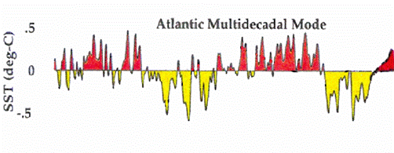
?
1860 1900 1940 1980 2020
Goldenberg et al. (2001)

Slide 15
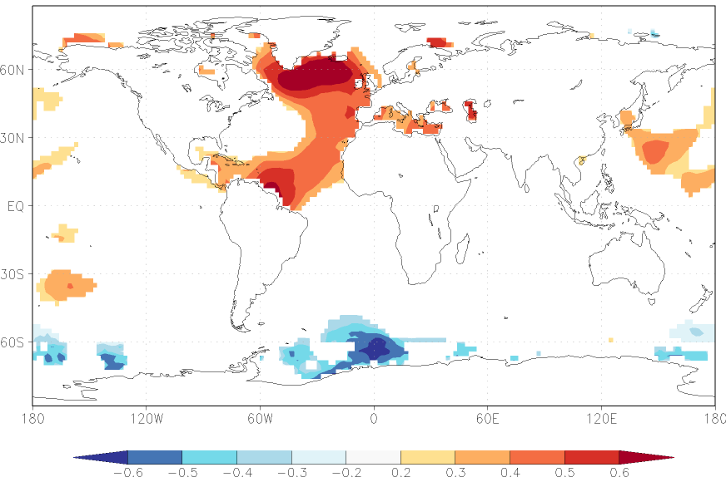
Annual Correlation (1950-2014) between SST and 0-400 Meter Averaged Salinity (50-60°N, 50-10°W)

Slide 16
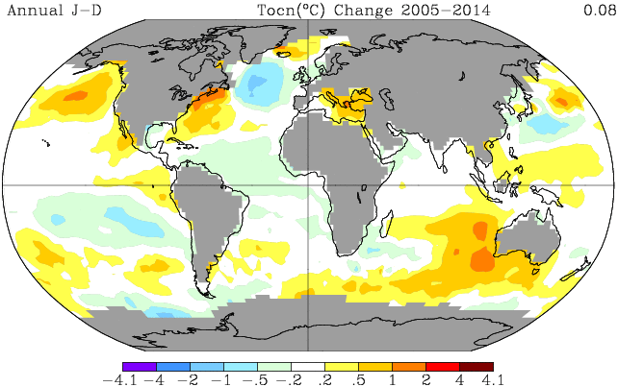
Linear Trend in Annual Sea Surface Temperature (2005-2014)

Slide 17
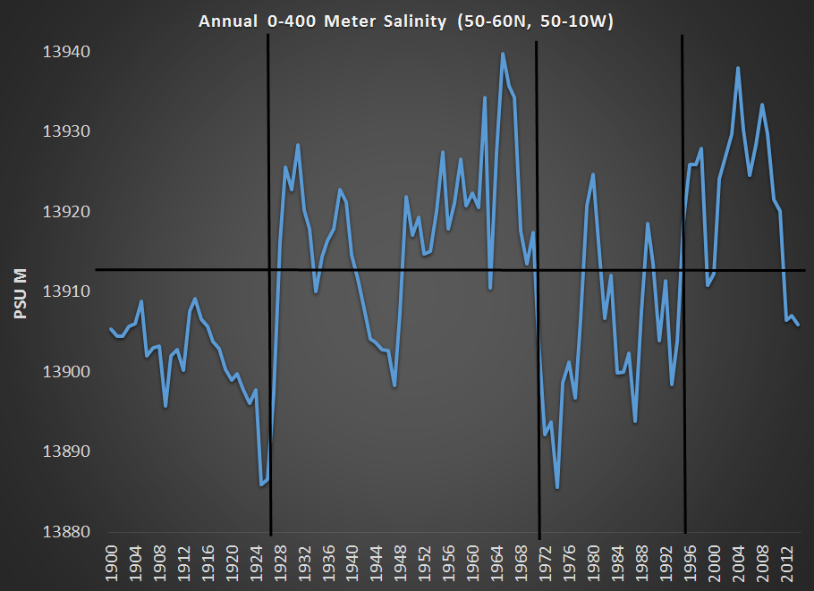

Slide 18
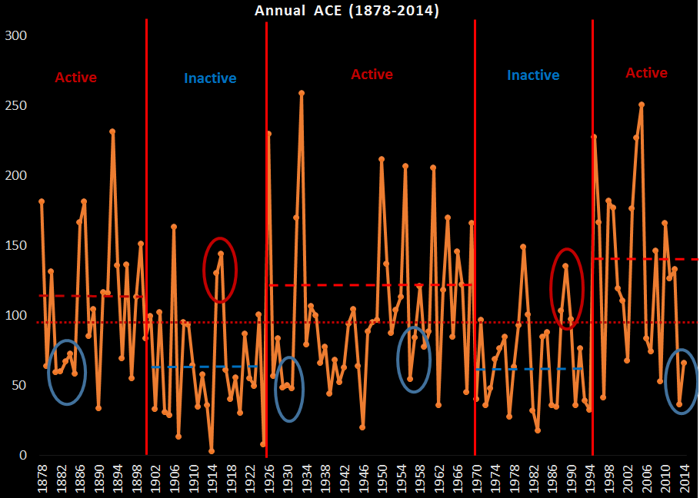

Slide 19
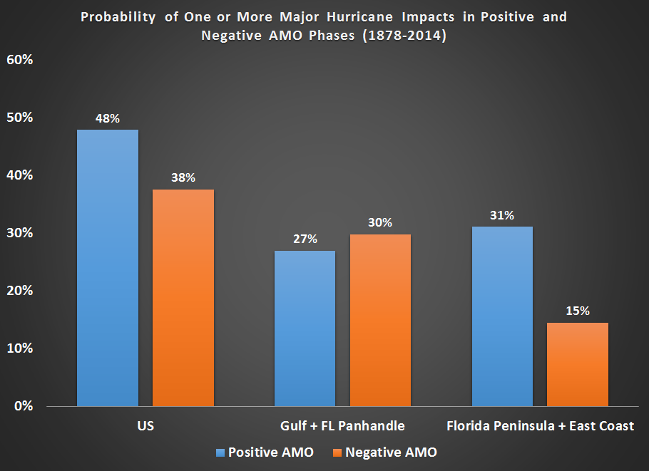

Slide 20
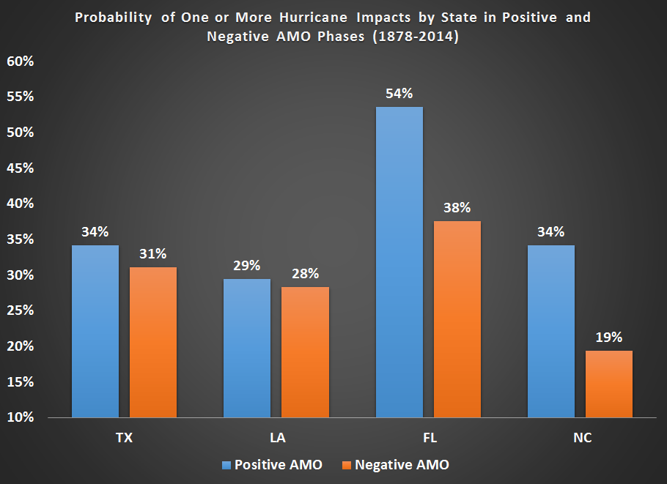

Slide 21
Recent
US
Hurricane
Landfall
Luck

Slide 22
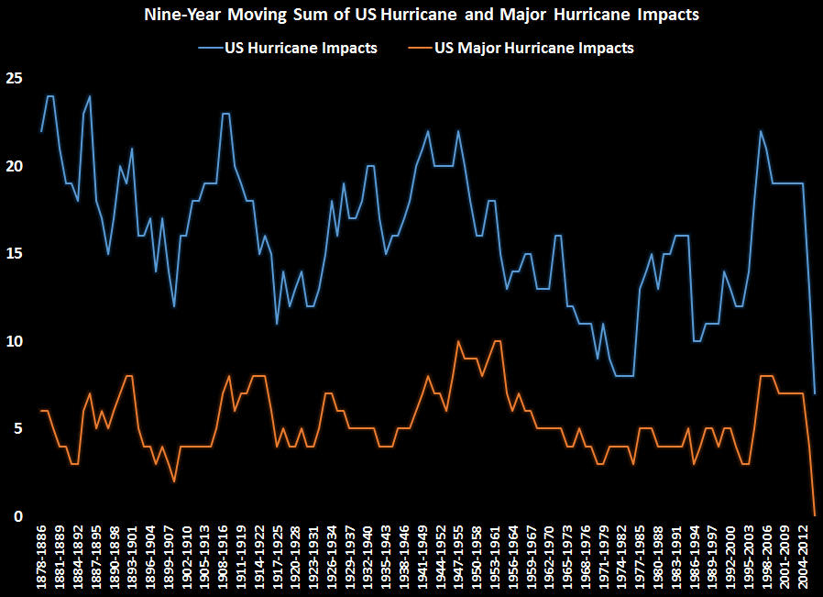

Slide 23
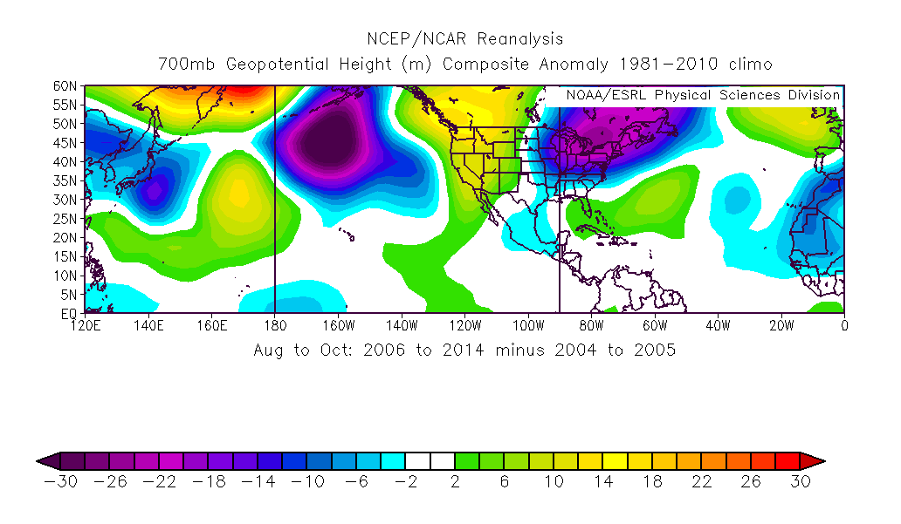

Slide 24
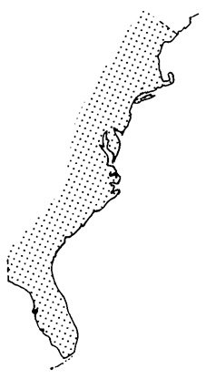
FL PENINSULA + EAST COAST MAJOR HURRICANE IMPACTS
1915-1964 50 YEARS 22 MH
1965-2014 50 YEARS 9 MH
54
38
55
93
54
85
54
55
96
60
59
89
28
04
49
33
47
21
45
26
05
48
29
04
92
44
60
50
65
19
35
40% as frequent

Slide 25
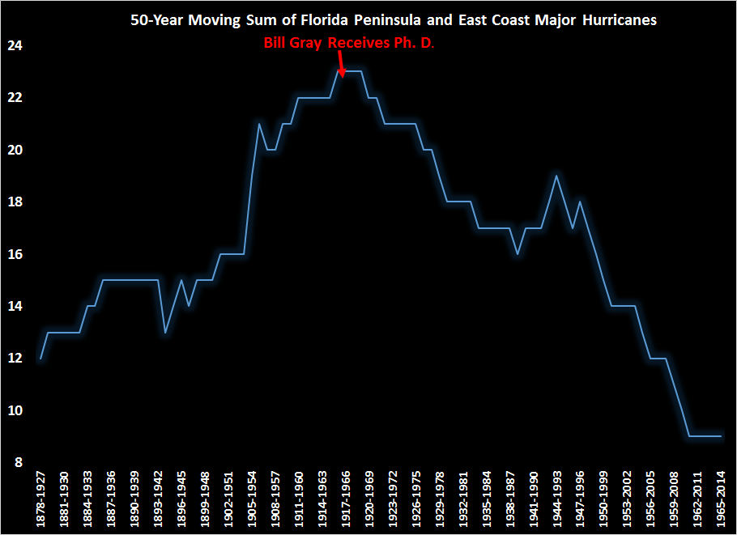

Slide 26
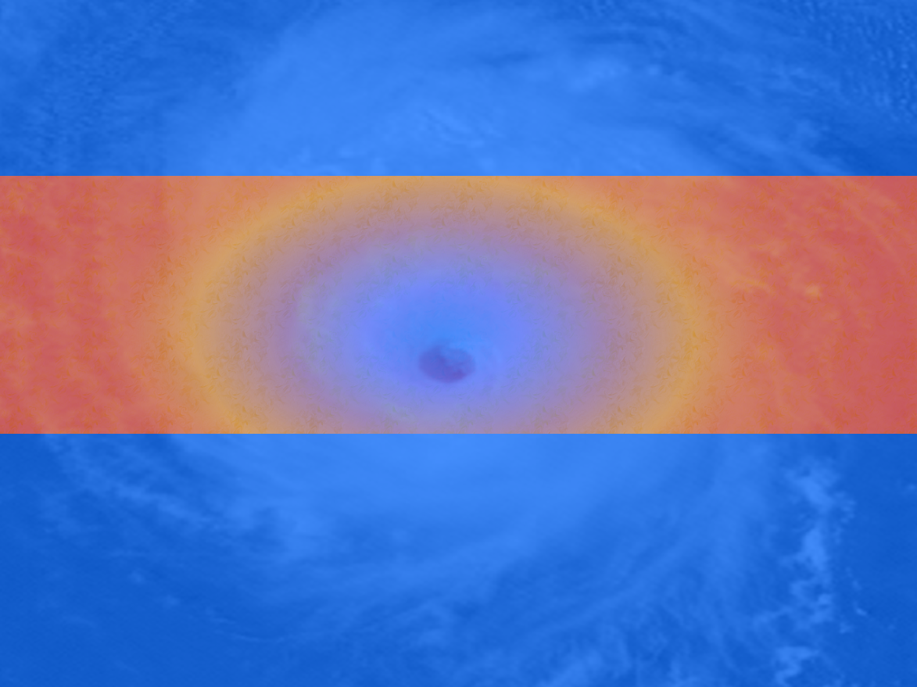
2015 Atlantic Hurricane Season Initial Outlook
Notes:
Lexington Insurance 07-09
4/23/2015
26

Slide 27
2015 FORECAST AS OF 9 APRIL 2015
Forecast Parameter | Statistical Forecast | Final Forecast | 1981-2010 Median
Named Storms (NS) | 7.4 | 7 | 12.0
Named Storm Days (NSD) | 28.0 | 30 | 60.1
Hurricanes (H) | 3.5 | 3 | 6.5
Hurricane Days (HD) | 9.0 | 10 | 21.3
Major Hurricanes (MH) | 0.7 | 1 | 2.0
Major Hurricane Days (MHD) | 0.4 | 0.5 | 3.9
Accumulated Cyclone Energy (ACE) | 38 | 40 | 92
Net Tropical Cyclone Activity (NTC) | 44 | 45 | 103

Slide 28
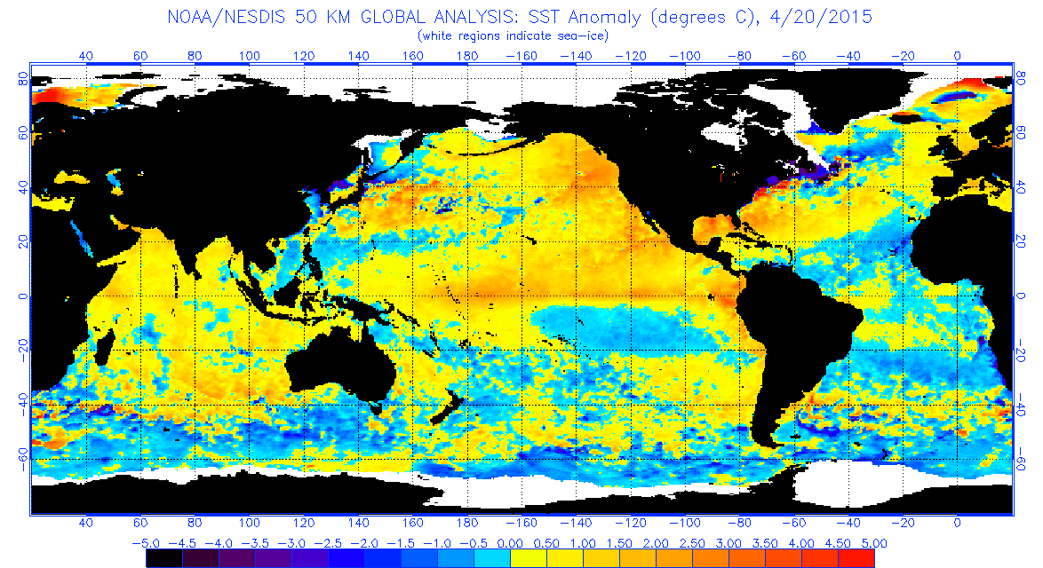
Current Global Sea Surface Temperature Anomaly Map

Slide 29
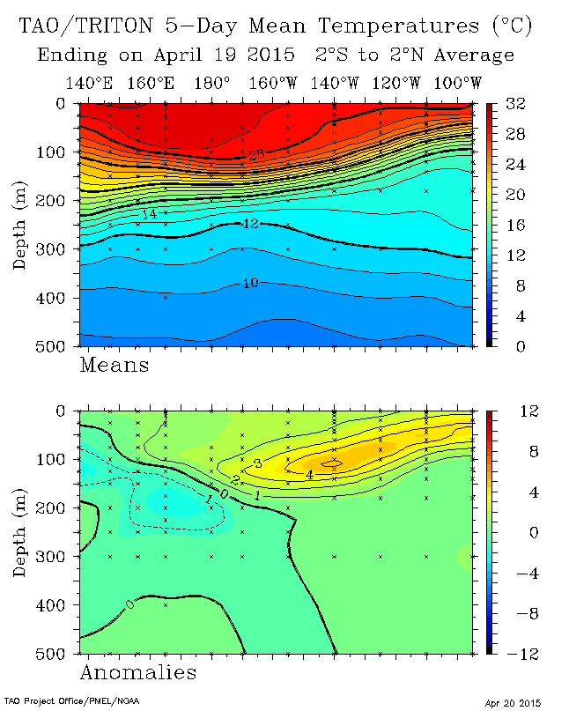

Slide 30
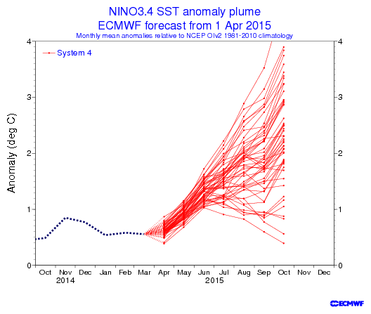
El Niño
Neutral

Slide 31
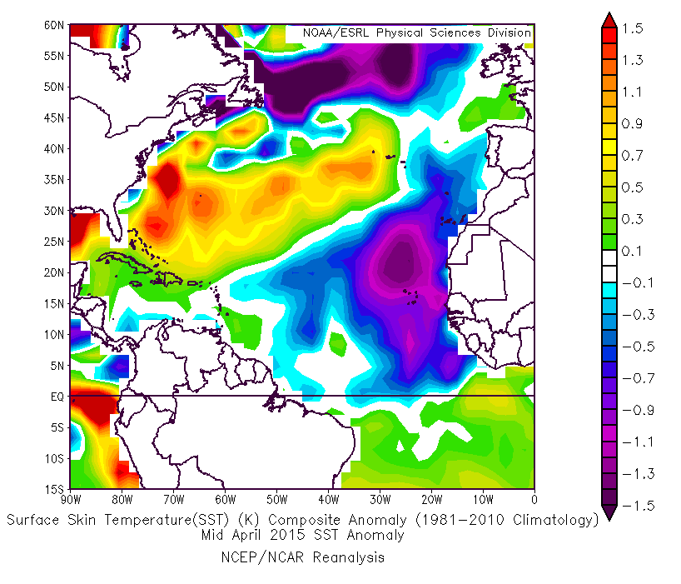
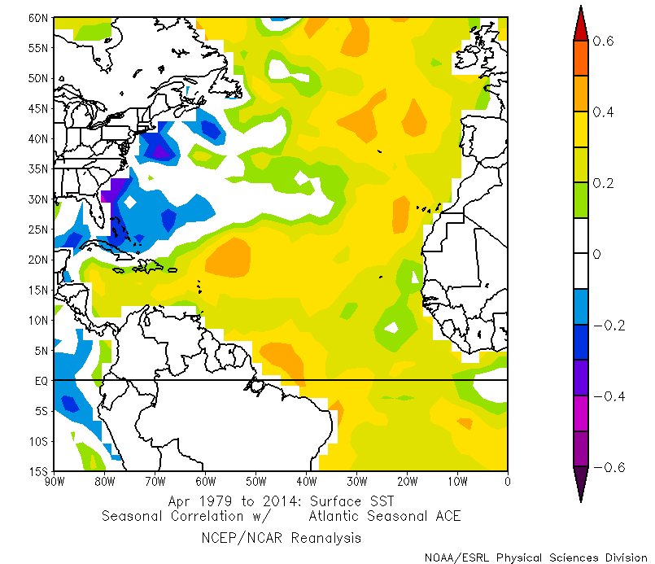
Current SST Pattern – Mid-April 2015
April SST Pattern Correlated with Seasonal Atlantic ACE

Slide 32
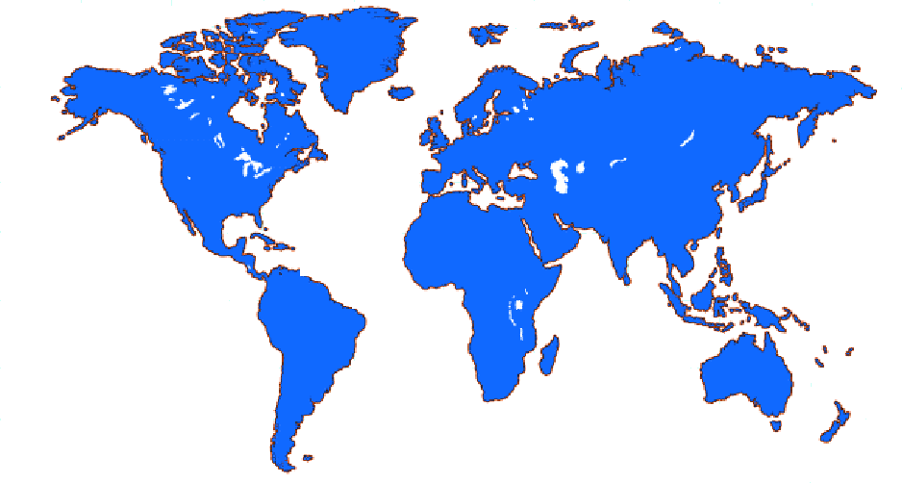
New April Forecast Predictors
March
SLP
ECMWF SST Forecast
2`
1`
4`
EQ.
3`
`
Jan-Mar SST
February-March SLP

Slide 33
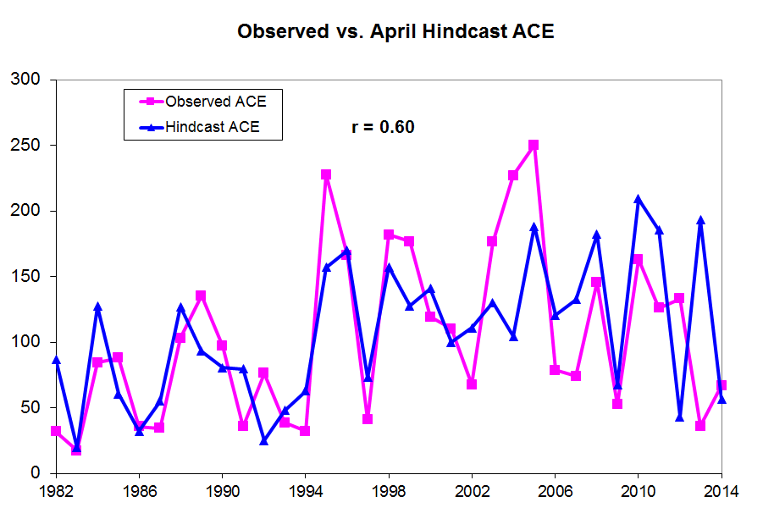

Slide 34
BEST ANALOG YEARS FOR 2015 (APRIL FORECAST)
 | NS | NSD | H | HD | MH | MHD | ACE | NTC
1957 | 8 | 38.00 | 3 | 21.00 | 2 | 6.50 | 84 | 86
1987 | 7 | 37.25 | 3 | 5.00 | 1 | 0.50 | 34 | 46
1991 | 8 | 24.25 | 4 | 8.25 | 2 | 1.25 | 36 | 58
1993 | 8 | 30.00 | 4 | 9.50 | 1 | 0.75 | 39 | 52
2014 | 8 | 35.00 | 6 | 17.25 | 2 | 3.50 | 66 | 81
MEAN | 7.8 | 32.9 | 4.0 | 12.3 | 1.6 | 2.6 | 52 | 65
2015 Forecast | 7 | 30 | 3 | 10 | 1 | 0.50 | 40 | 45

Slide 35
2015 PROBABILITIES FOR AT LEAST ONE MAJOR (CATEGORY 3-4-5) HURRICANE LANDFALL IN EACH OF THE FOLLOWING AREAS (20th CENTURY PROBABILITIES IN PARENTHESES)
Entire U.S. coastline – 28% (52%)
U.S. East Coast including Peninsula Florida – 15% (31%)
Gulf Coast from the Florida Panhandle westward to Brownsville – 15% (30%)
Caribbean (10-20°N, 60-88°W) – 22% (42%)
Notes:
Lexington Insurance 07-09
4/23/2015
35

Slide 36
Landfalling Hurricane Web Application
Currently Available at the following URL:
http://www.e-transit.org/hurricane
In partnership with the GeoGraphics Laboratory – Bridgewater State University, Bridgewater MA
Notes:
Lexington Insurance 07-09
4/23/2015
36

Slide 37
2015 Probabilities (20th Century Probabilities in Parentheses)
State | Hurricane Impact Prob. | MH Impact Prob.
Florida | 27% (51%) | 10% (21%)
Louisiana | 15% (30%) | 5% (12%)
Massachusetts | 3% (7%) | 1% (2%)
Mississippi | 5% (11%) | 2% (4%)
New York | 3% (8%) | 1% (3%)
North Carolina | 14% (22%) | 3% (8%)
Texas | 16% (33%) | 5% (12%)
Notes:
Lexington Insurance 07-09
4/23/2015
37

Slide 38
2015
Forecast Schedule
Date | 9 April | 1 June | 1 July | 3 Aug
Seasonal Forecast | X | X | X | X
Notes:
Lexington Insurance 07-09
4/23/2015
38

Slide 39
Contact Info:
Phil Klotzbach
Email: philk@atmos.colostate.edu
Web: http://tropical.atmos.colostate.edu
Twitter: @philklotzbach
Facebook: CSU Tropical Meteorology Project
Notes:
Lexington Insurance 07-09
4/23/2015
39

Slide 40
Arago’s Admonition:
“Never, no matter what may be the progress of science, will honest scientific men who have regard for their reputations venture to predict the weather.”
Notes:
Lexington Insurance 07-09
4/23/2015
40

