Slide 1
Inflation From All Angles
A Bunch of Inflation-Related Stuff We Thought Was Interesting
Or . . .
Casualty Actuarial Society Spring Meeting
Colorado Springs, CO
May 18, 2015
Download at www.iii.org/presentations
Steven Weisbart, PhD, chief economist/James Lynch, FCAS MAAA, chief actuary
Insurance Information Institute ♦ 110 William Street ♦ New York, NY 10038
Tel: 212.346.5533 ♦ Cell: 917.359.3908 ♦ jamesl@iii.org ♦ www.iii.org

Slide 2
What’s the Best Way to Measure Past Inflation?
2

Slide 3
Change* in the Consumer Price Index, 2004–2015
For two months in 2008, led by gasoline, the general price level was rising at a 5.5% pace
Lately, core CPI is rising at a 1.8%
y-o-y pace
When gas prices dropped, the general price level was briefly lower than a year prior
Over the last decade, prices generally rose about 2% per year.
*Monthly, year-over-year, through March 2015. Not seasonally adjusted.
Sources: US Bureau of Labor Statistics; National Bureau of Economic Research (recession dates); Insurance Information Institutes.
3
12/01/09 - 9pm
eSlide – P6466 – The Financial Crisis and the Future of the P/C
Notes:
3

Slide 4
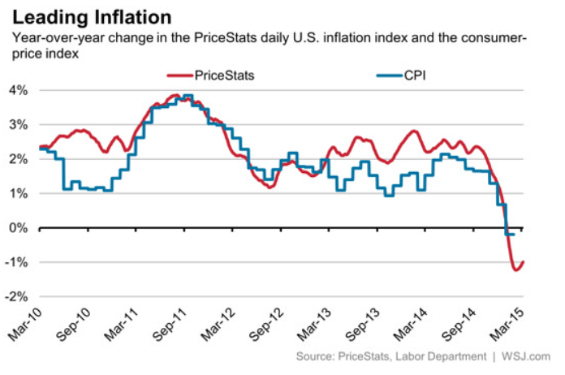
The “Billion Prices” Project Tracks Daily Price Changes for Internet Purchases
Source: http://blogs.wsj.com/economics/2015/03/13/the-billion-prices-project-thinks-inflation-may-have-turned-a-sharp-corner/

Slide 5
Change* in the Consumer Price Index and Core CPI, 1990–2014, Semi-annually
For a half year at a time, the Core CPI has generally stayed within
a range of 2% - 2.5% since 1997
Over the last 18 years, prices generally rose about 2% per year.
*Semi-annually, through 2014:2H. Not seasonally adjusted.
Sources: US Bureau of Labor Statistics; National Bureau of Economic Research (recession dates); Insurance Information Institute.
5
12/01/09 - 9pm
eSlide – P6466 – The Financial Crisis and the Future of the P/C
Notes:
5

Slide 6
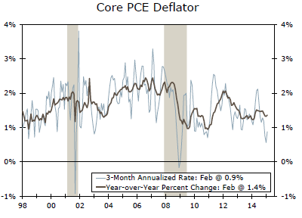
The PCE Deflator
The y-o-y core PCE price index has stayed between 1% and 2% for 15 years

Slide 7
Y-o-Y Percent Change in Core PCE Price Index, Monthly, 2010–2015
Jan. 2012: 2.1%
Dec. 2010: 0.9%
In December 2010, prices were falling. But the trend of price changes can change fairly quickly, even in a time of weak economic growth. Prices began rising in January 2011 and kept doing so for 13 months.
Sources: U.S. Department of Commerce, Bureau of Economic Analysis, at http://www.bea.gov/iTable/iTable.cfm?reqid=12&step=1&acrdn=2#reqid=12&step=1&isuri=1 Table 2.4.4U
Insurance Information Institute.
7
12/01/09 - 9pm
eSlide – P6466 – The Financial Crisis and the Future of the P/C
Notes:
7

Slide 8
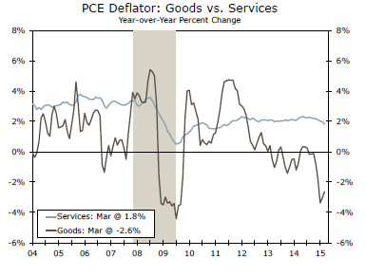
PCE Deflator: Goods vs. Services
The price spike in 2011 was caused by a spike in the price of goods, while services prices were stable
The price index for goods is much more volatile than the price index for services

Slide 9
What About the “Fed’s Printing Money”?
Shouldn’t We Track Changes in,
or the Size of, the Money Supply
for Signs of Incipient Inflation?
9

Slide 10
Should We Focus on Price Changes in a More Granular Way?
10

Slide 11
Prices for Hospital Services:
12-Month Change,* 1998–2014
December 2014
Inpatient services +5.5% Outpatient services +4.5%
Prices for Hospital Services have risen at an annual rate of 4% or more for the last 15 years, while the general price level rose by 2%/year.
*Percentage change from same month in prior year; through December 2014; seasonally adjusted
Sources: US Bureau of Labor Statistics; National Bureau of Economic Research (recession dates); Insurance Information Institute.
11
12/01/09 - 9pm
eSlide – P6466 – The Financial Crisis and the Future of the P/C
Notes:
11

Slide 12
Constant Quality Price Index for Single Family Houses Under Construction, Monthly, 2006-2015
Price Index,
Jan. 2005 = 100
Prices began dropping in April 2007—
9 months before the Great Recession started
Annual Price Changes
2006: +6.0%
2007: +0.9%
2008: -3.5%
2009: -5.0%
2010: -1.7%
2011: +1.0%
2012: +1.0%
2013: +6.5%
2014: +6.7%
The current rise began in Feb.
2012
Note: Recession indicated by gray shaded column. Price changes in 2015 are preliminary
Sources: Census Bureau at https://www.census.gov/construction/cpi/ ; NBER (recession dates); I.I.I.
12
12/01/09 - 9pm
eSlide – P6466 – The Financial Crisis and the Future of the P/C
Notes:
12

Slide 13
P/C Industry Homeowners Claim Frequency, US, 1997-2013
Claims Paid per 100 Exposures
Sources: Insurance Research Council, “Trends in Homeowners Insurance Claims,” p.41; Insurance Information Institute

Slide 14
P/C Industry Homeowners Average Claim Severity, Inflation-adjusted, 1997-2013
2013 dollars
Inflation-adjusted, HO average claim severity is now over twice what it was in 1997.
Sources: Insurance Research Council, “Trends in Homeowners Insurance Claims,” 2015 edition, p. 41; BLS inflation calculator,
with Insurance Information Institute calculations

Slide 15
Price Changes for Nonresidential Maintenance & Repair, Monthly, 2010-2015
Y-o-Y Price Changes
The effect of repair costs on claims depends on when the work is priced.
Annual Price Changes
2011: +1.3%
2012: +1.4%
2013: +1.8%
2014: +2.2%
Prices for nonresidential maintenance & repair have been rising slowly since 2011. Price data for 2015 are preliminary.
Sources: US Bureau of Labor Statistics, Producer Price Index Series Id: PCU2381MR2381MR; Insurance Information Institute

Slide 16
What about Wage Trends? Isn’t that a Major Cause of Inflation?
16

Slide 17
Indexed Cost of Total Compensation per Hour Worked, Quarterly, 2004-2014
Index: 2004:Q1 = 100
Following 2008, compensation has grown slightly faster than the CPI
Note: Recession indicated by gray shaded column.
Sources: Bureau of Labor Statistics; NBER (recession dates); I.I.I.
17
12/01/09 - 9pm
eSlide – P6466 – The Financial Crisis and the Future of the P/C
Notes:
17

Slide 18
Cost of Total Compensation per Hour Worked, Quarterly, 2004-2014
Prices began dropping in April 2007—
9 months before the Great Recession started
The current rise began in Feb.
2012
Note: Recession indicated by gray shaded column.
Sources: Bureau of Labor Statistics; NBER (recession dates); I.I.I.
18
12/01/09 - 9pm
eSlide – P6466 – The Financial Crisis and the Future of the P/C
Notes:
18

Slide 19
What’s the Best Way to Forecast Future Inflation?
19

Slide 20
Inflation Forecasts in Econometric Models, 2015- 2020
There seems to be general agreement: the CPI will rise by about 2.3% for the next 5 years…
…but the FOMC is forecasting the PCE Inflation rate to be 0.6%-0.8% in 2015, 1.7%-1.9% in 2016, and 1.9% to 2.0% in 2017.
In the Blue Chip survey, the range of CPI forecasts for 2015 is -1.0% to +1.5%. For 2016 it is +1.0% to +3.2%.
20
Sources: Blue Chip Economic Indicators (3/2015 issue); Wells Fargo Economics Group Interest Rate Weekly, May 6, 2015; Insurance Information Institute

Slide 21
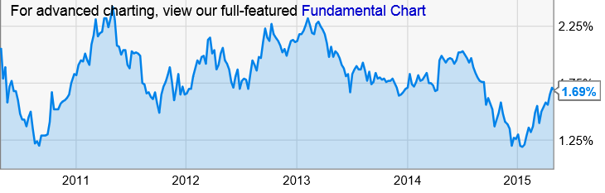
The Bond Market’s Recent* Expectation of U.S. Inflation in the Next Five Years
At the start of 2013 the bond market thought inflation was likely to rise at a 2.25% clip.
Current expectations are for inflation over the next 5 years are near 1.75% per year.
The chart was derived by subtracting the TIPS 5-year yield (which has no inflation component) from the yield for the 5-year U.S. Treasury note (which, at least in theory, includes anticipated inflation).
Source: http://ycharts.com/indicators/5_year_tipstreasury_breakeven_rate ; I.I.I.

Slide 22
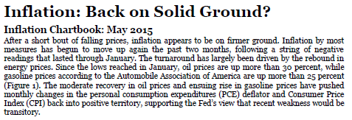
Has the Upward Inflation Spike Begun?
“Inflation by most measures has begun to move up again the past two months, following a string of negative readings that lasted through January.”
Source: Inflation: Back on Solid Ground? Wells Fargo Economics Group, Special Commentary, May 4, 2015; I.I.I.

Slide 23
Inflation and P/C Insurer Investments
If Expected Inflation Remains Low,
Will Bond Yields Be Mired at Levels
Last Seen in the 1950s?
23

Slide 24
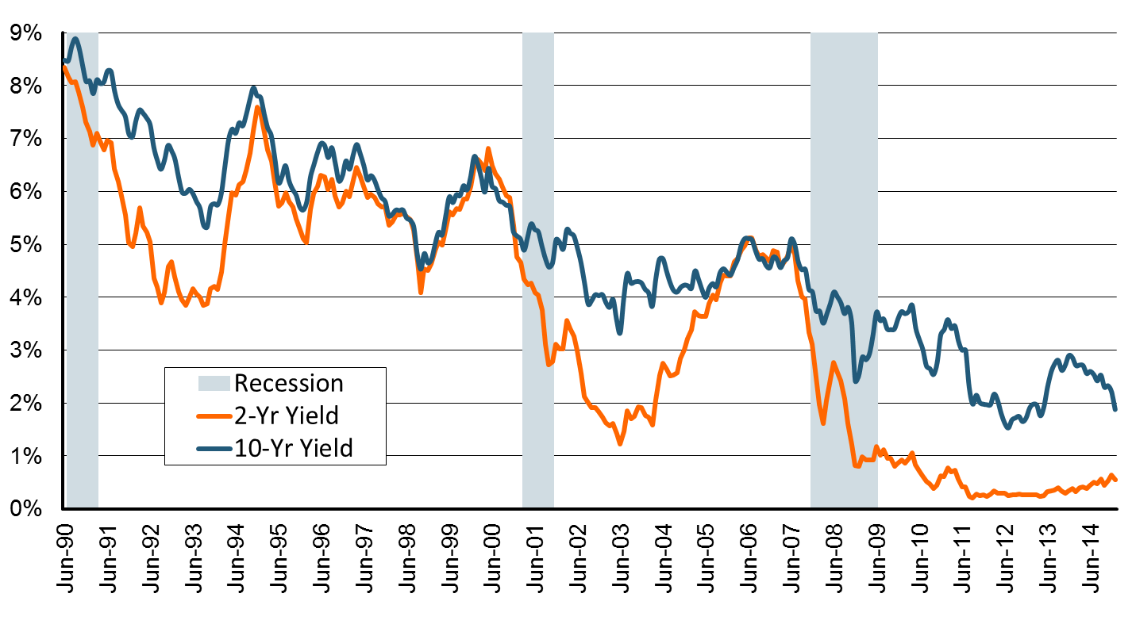
U.S. Treasury 2- and 10-Year Note Yields*: Monthly, 1990–2015
Yields on 10-Year U.S. Treasury Notes have been essentially below 5% for over a decade.
U.S. Treasury 10-year note yields “spiked”
Since roughly 80% of P/C bond/cash investments are in 10-year or shorter durations, most P/C insurer portfolios will have low-yielding bonds for years to come.
*Monthly, constant maturity, nominal rates, through January 2015.
Sources: Federal Reserve Bank at http://www.federalreserve.gov/releases/h15/data.htm.
National Bureau of Economic Research (recession dates); Insurance Information Institutes.
24
12/01/09 - 9pm
eSlide – P6466 – The Financial Crisis and the Future of the P/C
Notes:
24

Slide 25
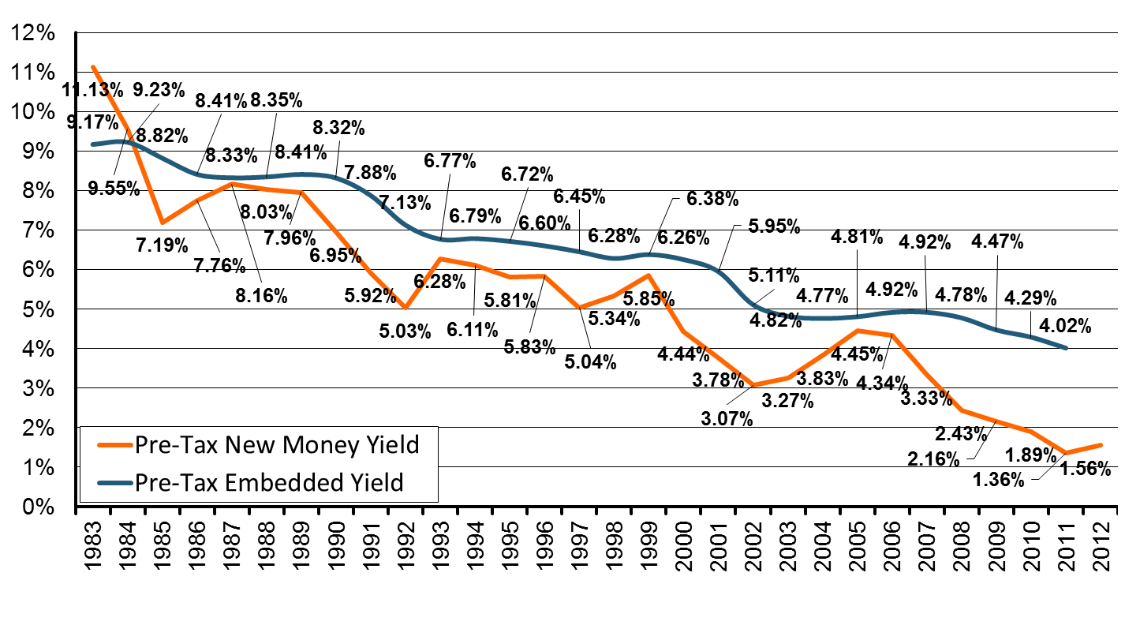
New Money vs. Embedded Yields,
U.S. Insurers, 1983-2012
Falling yields means less investment income, putting upward pressure on rates.
As long as new money rates are below the rates of maturing bonds,
the portfolio yield will continue to sink.
Sources: NCCI, Insurance Information Institute.
25
12/01/09 - 9pm
eSlide – P6466 – The Financial Crisis and the Future of the P/C
Notes:
25

Slide 26
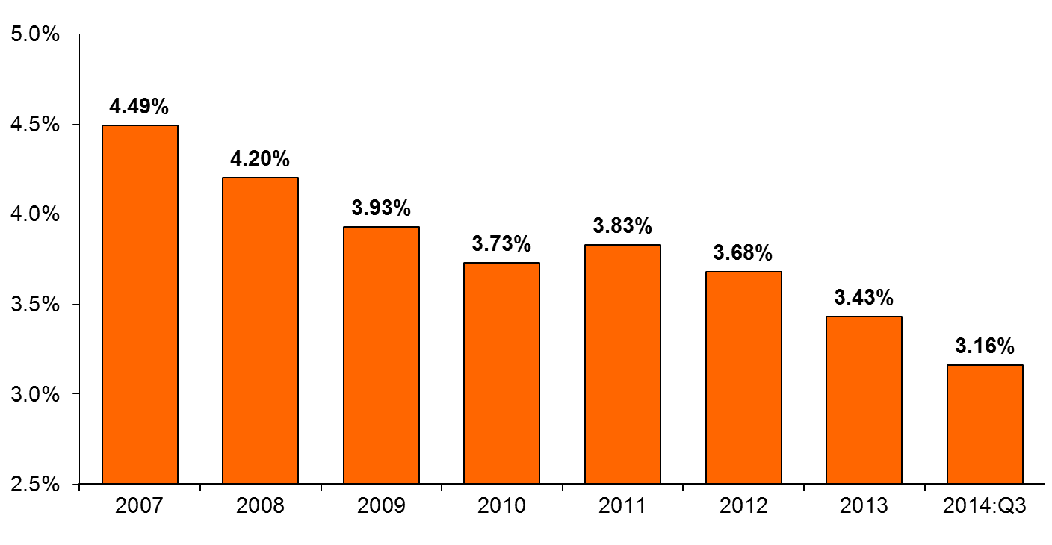
Net Yield on P/C Insurer Invested Assets, 2007-2014:Q3
Since year-end 2007, P/C Insurer net yields dropped by 133 basis points. This downtrend is likely to continue as older, higher-yielding bonds mature and are replaced by lower-yielding ones.
Sources: NAIC, via SNL Financial; I.I.I.

Slide 27
Distribution of Bond Maturities,
P/C Insurance Industry, 2005-2014
The main shift over these years has been from longer maturities to shorter maturities, but the 2013-14 data suggest a shift back has begun. The 2014 distribution resembles that at year-end 2009.
Sources: SNL Financial; Insurance Information Institute.

Slide 28
Bonds Rated NAIC Quality Category 3-6 as a Percent of Total Bonds, 2003–2014
From 2006-07 to year-end 2012, the percentage of lower-quality bonds in P/C industry portfolios doubled
There are many ways to capture higher yields on bond portfolios.
One is to accept greater risk, as measured by NAIC bond ratings.
The ratings range from 1 to 6, with the highest quality rated 1.
Even in 2014, over 95% of the industry’s bonds were rated 1 or 2.
Sources: SNL Financial; Insurance Information Institute.

Slide 29
Property/Casualty Insurance Industry Investment Gain: 1994–2014:Q3¹
$ Billions
Investment gains in 2013 were the highest in the post-crisis era
Low interest rates in 2013 caused investment income to keep falling
but realized investment gains were up sharply.
The financial crisis caused investment gains to fall by 50% in 2008.
¹ Investment gains consist primarily of interest, stock dividends and realized capital gains and losses.
* 2005 figure includes special one-time dividend of $3.2B;
Sources: ISO; Insurance Information Institute.

Slide 30
Moody’s AAA Seasoned Bond Yields vs. CPI, 1954-2014
The gap is narrowing
As a general rule, the CPI trend drives bond yields.
Sources: BLS, https://research.stlouisfed.org/fred2/data/AAA.txt ; Insurance Information Institute.
30
12/01/09 - 9pm
eSlide – P6466 – The Financial Crisis and the Future of the P/C
Notes:
30

Slide 31
What Inflation Doesn’t Measure
The Idea:
Trend ≥ Inflation
(And Always Will Be)
31

Slide 32
Case Study: Inflation in Auto Prices
CPI-U: New Cars
1997 to Present: No Inflation
1984 to 1997: 2.6% Annual Inflation
According to Government, Auto Prices Have Been ‘Flat’ for Nearly Two Decades.
Not Seasonally Adjusted. 1982-84 = 100.
Sources: Bureau of Labor Statistics, Insurance Information Institute.

Slide 33
Inflation in Auto Prices
CPI-U: New Cars vs. New Car Expenditures
Which Is Better Trend Index?
Great Recession
Basis of Settlement When Car Is Totaled
According to Government, Auto Prices Have Been ‘Flat’ for Nearly Two Decades. But New Car Expenditues Are Up 35%.
Expenditure Indexed to CPI-New Autos as of January 1997. Not Seasonally Adjusted. For CPI, 1982-84 = 100.
Sources: Bureau of Economic Analysis, Insurance Information Institute.

Slide 34
Auto Prices vs. Auto Inflation
% Increase, 1990-2013
From 1990 to 2013, Actual New Car Prices Rose Three Times Faster Than New Car Inflation Rate.
Not Seasonally Adjusted. 1982-84 = 100.
Sources: Bureau of Economic Analysis; Bureau of Labor Statistics; Calculations by Insurance Information Institute.

Slide 35
Auto Prices vs. Auto Inflation
% Increase
Auto Price Increases Regularly Outstrip Inflation.
The Difference: Safety Improvements, Conveniences.
Not Seasonally Adjusted.
Sources: The People History; Bureau of Labor Statistics; Calculations by Insurance Information Institute.

Slide 36
BLS Quality Adjustments
Safety Improvements
  Airbags
  Seatbelts
Mechanical/electrical
  Braking Improvements
  Battery Life
Durability
  Stronger Bumpers
  Flexible Body Panels
Comfort/convenience Changes
  Remote Door Locks
  GPS Systems

Slide 37
Typical Adjustments
(2013-14 Model Years)
These All Affect Price of Car, But Not Auto CPI.
$540 in Safety Changes.
Changes Above Would Increase Car Price By $1,220. CPI Impact – 0%.
Sources: Bureau of Labor Statistics, Insurance Information Institute.

Slide 38
Auto Price Change: Quality vs. Inflation
Value of Improvements > Change in Price, so Inflation is Negative.
Sales Year Is to Model Year as Calendar Year Is to Policy Year
Sources: Bureau of Labor Statistics, Insurance Information Institute.

Slide 39
Other Adjustments (A Quiz)
It Doesn’t Change PV(Car)!
Adjustment | Counted As Inflation | Not Counted As Inflation
Mix of Model Years Within Sales Year
Environmental (Clean Air Regs.)
Rebates
Concessions (Negotiation)
Low Interest Financing
It’s an Apples-to-Apples Comparison!
It’s A Pigovian Tax!
Of Course It Is!
Of Course It Is!

Slide 40
Lessons Learned
Trend Is Always Higher Than Inflation

Slide 41
Inflation vs. Trend (The Sequel)
The Idea:
Trend ≥ Inflation
(Except When It Isn’t)
41

Slide 42
An Example: Homeowners
Since 2009: 0.3 Points/Yr Above CPI.
Paid Severity in 2013 dollars
1997-2009: 6.8 Points/Year Above CPI.
There Can Be Periods Where CPI > Severity Change.
Sources: Insurance Research Council, “Trends in Homeowners Insurance Claims,” 2015 edition, p. 41; BLS inflation calculator,
with Insurance Information Institute calculations

Slide 43
Another Example: WC Medical
Average Annual Growth, 2002-09
WC Medical Severity: 6%
Medical CPI: 4%
…But Since 2010 WC Medical Severity has Closely Tracked the Medical CPI
Sources: CPI and Med CPI from US Bureau of Labor Statistics, WC med severity from NCCI based on NCCI states.

Slide 44
Another Example: WC Indemnity
Similar to Medical Benefits – Suddenly Tracking Inflation
NCCI data on WC severity is based on the states where NCCI provides ratemaking services. Excludes the effects of deductible policies.
Sources: NCCI, BLS, from Current Population Survey.

Slide 45
And One Last Example: PD Liability
Annual Change, 2005 through 2014
Severity Converged in 2009 . . .
. . . And Diverged in 2013
Aftermath of Great Recession
Source: ISO/PCI Fast Track data, Bureau of Labor Statistics, Insurance Information Institute.

Slide 46
How Could Inflation > Trend?
Δ Severity = Δ Quality + Δ Inflation
  Base Case: Δ Severity > Δ Inflation
  Δ Severity < Δ Inflation Implies . . .
  . . . Δ Quality < 0.0
  Are Cars Getting Worse?
  NAH!!!!
Better Insurance Claims Control?
Safer Cars Eliminate Expensive Claims?
We Do Need to Think About Impact When
Δ Severity → Δ Inflation – Will It Diverge Again?

Slide 47
Bodily Injury: Severity, Frequency Trend Are Moderating
Annual Change, 2005 through 2014
Cost Pressures Will Increase if BI Severity Increases Continue or Frequency Ticks Up
Source: ISO/PCI Fast Track data; Insurance Information Institute

Slide 48
No-Fault (PIP) Liability: Adverse Trends
May Be Moderating*
Annual Change, 2005 through 2014
Multiple States Have Experienced Severe Fraud and Abuse Problems in their No-Fault Systems, Especially FL, MI, NY and NJ
*No-fault states included are: FL, HI, KS, KY, MA, MI, MN, NY, ND and UT.
**2013 figure is for the 4 quarters ending in 2013:Q3.
Source: ISO/PCI Fast Track data; Insurance Information Institute

Slide 49
Collision Coverage: Severity & Frequency Trends Are Both Rising
Annual Change, 2005 through 2014
The Recession, High Fuel Prices Helped Temper Frequency and Severity, But this Trend Will Likely Be Reversed Based on Evidence from Past Recoveries
Source: ISO/PCI Fast Track data; Insurance Information Institute

Slide 50
Comprehensive Coverage: Severity
Trends Are Unfavorable
Annual Change, 2005 through 2014
Weather Creates Volatility for Comprehensive Coverage
Source: ISO/PCI Fast Track data; Insurance Information Institute

Slide 51
What About Loss Reserves?
The Idea:
Inflation Lags Long-Term Average,
And So Does Loss Trend
51

Slide 52
Loss Development Factors
Age to Age Reported Loss Development Factors - P&C Industry
Accident Year | 12 - 24 Months | 24 - 36 Months | 36 - 48 Months | 48 - 60 Months | 60 - 72 Months | 72 - 84 Months | 84 - 96 Months | 96 - 108 Months | 108 - 120 Months
2001 | 2.0677 | 1.4502 | 1.3170 | 1.1979 | 1.0866 | 1.0839 | 1.0762 | 1.0756 | 1.0517
2002 | 1.8992 | 1.5481 | 1.2450 | 1.1726 | 1.1063 | 1.0549 | 1.0730 | 1.0529 | 1.0307
2003 | 1.8481 | 1.5093 | 1.2143 | 1.1685 | 1.1060 | 1.0649 | 1.0781 | 1.0525 | 1.0516
2004 | 1.8071 | 1.3148 | 1.3307 | 1.1333 | 1.1198 | 1.1036 | 1.0531 | 1.0552 | 1.0406
2005 | 1.6358 | 1.5082 | 1.3227 | 1.2186 | 1.1718 | 1.0813 | 1.0572 | 1.0675 | 1.0535
2006 | 1.6401 | 1.4941 | 1.3249 | 1.1397 | 1.0859 | 1.0767 | 1.0803 | 1.0672
2007 | 1.8650 | 1.4456 | 1.3850 | 1.1379 | 1.1152 | 1.0426 | 1.0425
2008 | 1.8177 | 1.4458 | 1.1900 | 1.1542 | 1.0903 | 1.0720
2009 | 1.7207 | 1.3274 | 1.2050 | 1.1175 | 1.0926
2010 | 2.0081 | 1.2872 | 1.2918 | 1.1531
2011 | 1.7579 | 1.4266 | 1.2254
2012 | 1.8335 | 1.4336
2013 | 1.7573
Averages | 12 - 24 Months | 24 - 36 Months | 36 - 48 Months | 48 - 60 Months | 60 - 72 Months | 72 - 84 Months | 84 - 96 Months | 96 - 108 Months | 108 - 120 Months
Industry - All Years Wtd | 1.8186 | 1.4290 | 1.2763 | 1.1586 | 1.1073 | 1.0716 | 1.0656 | 1.0620 | 1.0458
Industry - 5 Years | 1.8155 | 1.3841 | 1.2594 | 1.1405 | 1.1112 | 1.0752 | 1.0623 | 1.0591 | 1.0456
Industry - 3 Years Wtd | 1.7811 | 1.3782 | 1.2405 | 1.1423 | 1.1005 | 1.0624 | 1.0591 | 1.0633 | 1.0485
Weighted | 1.8051 | 1.3971 | 1.2587 | 1.1471 | 1.1063 | 1.0697 | 1.0623 | 1.0615 | 1.0466
Manual Selected | 1.8051 | 1.3971 | 1.2587 | 1.1471 | 1.1063 | 1.0697 | 1.0623 | 1.0615 | 1.0466
Low Inflation
Low Inflation & Trend
Note Downward Trend
All Factors Have Low Inflation. Past Three Years Have Low Trend.
Source: Other Liability-Occurrence Factors From SNL Financial, Insurance Information Institute

Slide 53
What If Inflation, Trend Return?
15.2% of Stated Reserves
Some Economists Advocate Targeting A 2-Point Higher Inflation Rate
10.9% of Stated Reserves
7.2% of Stated Reserves
5.3% of Stated Reserves
3.4% of Stated Reserves
Source: Calculations by Insurance Information Institute using 2014 Industry Data from SNL Financial.

Slide 54
Which Lines Are Most Vulnerable to 2% Spike in Inflation/Trend?
Distribution of Reserve Increase By Line of Business

Slide 55
Which Lines Are Most Vulnerable to 2% Spike in Inflation/Trend?
Increase By % of Stated Reserve
Some of These Lines Are Already Redundant Industrywide.
Source: Calculations by Insurance Information Institute using 2014 Industry Data from SNL Financial.

Slide 56
Inflationary Miscellany
The Idea:
We Had A Couple of Interesting Slides That Didn’t Fit Anywhere Else
56

Slide 57
Auto Insurance Expenditures vs. Auto Insurance Inflation, 1995-2012
But Auto Insurance Inflation Has Been 2 to 4 Points Higher Than NAIC Since 2005
CPI for Auto Insurance Has Roughly Matched NAIC Expenditure Data from 1995-2004 . . .
Reasons for the Gap: Higher Deductibles, Lower Limits, Fewer Buying First-Party Coverage?
Sources: NAIC for 1995-2012; BLS for auto price changes; I.I.I.

Slide 58
If Frequency Is Falling, Why Does Auto Insurance Keep Costing More?
Safer Cars . . . .
. . . That Cost More to Repair.
Down 55%!
Sources: Insurance Institute for Highway Safety, Insurance Services Office, Insurance Information Institute.

Slide 59
Auto Claims Have Grown Faster Than Inflation for 50 Years
Percentage Change, 1963-2013
Sources: Insurance Services Office, Bureau of Labor Statistics, calculations by Insurance Information Institute.

Slide 60
The Price of Gas, 2014-2015
Avg. Price /Gallon
Even after rebound, prices remain 30% below the July peak.
Until July, gas prices were persistently high
From July through December, gas prices fell virtually every week
Over the Course of the Second Half of the 2014 Calendar Year,
Gas Prices Fell 34%.
Price is Weekly U.S. All Grades All Formulations Retail Gasoline Prices
Sources: Federal Energy Administration (http://www.eia.gov/petroleum/gasdiesel/ ); I.I.I.

Slide 61
Do Changes in Gas Prices
Affect Miles Driven? 2000-2014
Avg. Price
Miles Driven
/Gallon
(Billions)
Focus On 2014
2002-2007: People Drive More Despite Higher Prices
Lots of Factors Affect Miles Driven: State of Economy, Weather, Gas Prices, Etc.
Sources: Federal Energy Administration (http://www.eia.gov/petroleum/gasdiesel/ ); *gas prices and miles driven through December
Federal Highway Administration (http://www.fhwa.dot.gov/ohim/tvtw/tvtpage.cfm ); I.I.I.

Slide 62
Do Changes in Gas Prices Affect Miles Driven? A Look at 2014
Avg. Price
% Chg. in Miles Driven
/Gallon
… Four Months Later, Mileage Starts to Surge.
June-July: Gas Prices Peak …
Still Lower Gas Prices Imply Surge Will Continue.
Prior research on the relationship between gas prices and miles driven says that, in the short run, an increase in gas prices produces little change in miles driven. No recent research on the effect of price drops.
Sources: Federal Energy Administration (http://www.eia.gov/petroleum/gasdiesel/ ); *gas prices and miles driven through December
Federal Highway Administration (http://www.fhwa.dot.gov/ohim/tvtw/tvtpage.cfm ); I.I.I.

Slide 63
Something Unusual is Happening:
Miles Driven*, 1990–2015
Billions
Some of the growth in miles driven is due to population growth:
1997 vs. 1992: +5.1%
2002 vs. 1997: +7.4%
2007 vs. 2002: +4.7%
2012 vs. 2007: +3.4%
A new record in January 2015: miles driven was below the prior peak for 87 straight months—
over 7 years! Previous record was in the early 1980s (39 months).
*Moving 12-month total. The 2015 figure is through January 2015.
Note: Recessions indicated by gray shaded columns.
Sources: Federal Highway Administration (http://www.fhwa.dot.gov/policyinformation/travel_monitoring/tvt.cfm);
National Bureau of Economic Research (recession dates); Insurance Information Institute.
63
12/01/09 - 9pm
eSlide – P6466 – The Financial Crisis and the Future of the P/C
Notes:
63

Slide 64
Insurance Information Institute Online:
www.iii.org
Thank you for your time
and your attention!
Twitter: twitter.com/@III_Research

