Slide 1
CAS Ratemaking and Product Management Seminar- March 2012
RR-2: Risk LOAD/COST OF CAPITAL: HOW REINSURERS CONSIDER THESE IN REINSURANCE RATES FOR PROPERTY CAT COVERS
Ira Robbin, PhD

Slide 2
CAS Antitrust Notice
The Casualty Actuarial Society is committed to adhering strictly to the letter and spirit of the antitrust laws. Seminars conducted under the auspices of the CAS are designed solely to provide a forum for the expression of various points of view on topics described in the programs or agendas for such meetings.
Under no circumstances shall CAS seminars be used as a means for competing companies or firms to reach any understanding – expressed or implied – that restricts competition or in any way impairs the ability of members to exercise independent business judgment regarding matters affecting competition.
It is the responsibility of all seminar participants to be aware of antitrust regulations, to prevent any written or verbal discussions that appear to violate these laws, and to adhere in every respect to the CAS antitrust compliance policy.

Slide 3
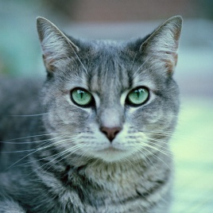
Disclaimers and Cautions
No statements of the Endurance corporate position or the position of any prior employers will be made or should be inferred.
No liability whatsoever is assumed for any damages, either direct or indirect, that may be attributed to use of the methods discussed in this presentation.
Writing CAT covers is risky – results may be catastrophic to your bottom line.
Examples are for illustrative purposes only. Do not use the results from any example in real-world applications.
There may be a quiz at the end – so pay attention!

Slide 4
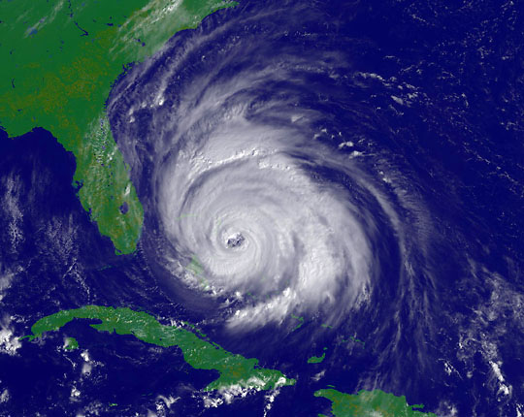
Agenda
-A Mix of Theory and Practice
CAT Pricing Process Fundamentals
  Event Loss Table
  Random Trials
CAT Context
Pricing Overview
Basic Equations
Required Capital Paradigms
Order Dependence and Reference Portfolios
Risk Measures
  Properties
  Take your pick
  Ranking definitions of Var and TVaR
Conclusions

Slide 5
Event Loss Table

Slide 6
Occurrence Exceeding Probability OEP
EP(k) = Prob(Largest Loss in a Year will equal or exceed the kth largest loss in the event table)

Slide 7
Random Trials

Slide 8
AEP and OEP PML from Ordered Trials
PML = Probable Maximum Loss
AEP = Annual Exceeding Probability
OEP = Occurrence Exceeding Probability

Slide 9
Context
CAT Pricing is part of the process of writing CAT business, but not the only part.
Pricing models give indications – the market sets the price.
Risk Management sets limits on PMLs and TIV/Limit Aggregations by peril/zone .
  Compliance monitoring essential
Business bunched –lots of 1/1s. Quotes go out with authorized shares. By the time an account is bound, the portfolio has changed.
Selection problem is constrained optimization: Reinsurers looks to get most profitable portfolio with smallest risk. No one prices that way.

Slide 10
Pricing Overview
Emerald City Pricing: Don’t look at that man behind the curtain
  Different vendor models
  Some adopt new versions –others wait.
  Differences in data quality
  Loading factors
Non-modeled CAT events (Thai flood): Not always priced
  Ostrich Excuse - “It was not in the model”
  Hiding-in-Plain-Sight Swan - May not show up on risk management radar – obvious after the fact.
Pricing Method Flavors: Different ways of translating model stats into indicated prices.
  Can’t we just all agree?

Slide 11
Basic Equations
P= E[X]+ RL(X)
    P = Indicated premium prior to expense loading
    X = CAT Loss
    RL(X) = Risk Load
RL(X) = r_{target}*C(X)
C(X) = Required Capital
RORAC Approach
  Universally used in actual CAT Treaty pricing

Slide 12
What is the right way to compute Required CAT Capital?

Slide 13
Required Capital Paradigms
Standalone: C(X) = ρ (X) , where is ρ (X) is a risk measure.
Incremental: Let T be the existing portfolio
    C(X|T) = ρ (T+X) - ρ (T),
Real Allocation
          C(X|T) = A(X,T) *ρ (T+X)

Slide 14
Order Dependence and Reference Portfolios
Order Dependence – Pricing depends on the order in which accounts are priced (Mango)
  Universe A : Zoe’s CAT Treaty is priced first at $100 then Jessica’s CAT Treaty is priced next at $150
  Universe B: Jessica’s CAT Treaty is priced first at $100 then Zoe’s CAT Treaty is priced next at $150
A major problem for Incremental methods
A small problem for Allocation methods
Not a problem for Standalone
Reference Portfolio Cure
  Portfolio fixed over a given period
  How often should it be updated??

Slide 15
Risk Measure:
Definitions and properties
A risk measure, ρ, is a monotonic function that maps a real-valued random variable, X, to a non-negative number, ρ (X), such that:
Risk Measure Basic Properties
Non-negative: ρ(X) ≥ 0
Monotonic Premium: If X₁ ≤ X₂, then
E[X₁]+ρ(X₁) ≤ E[X₂]+ ρ(X₂)
A risk measure is pure if it maps constants to zero: ρ(c) = 0

Slide 16
Risk Measure:
Coherence properties
Scalable: ρ(λX) =λ⋅ρ(X)
Translation Invariant: ρ(X+ α) = ρ(X)
Subadditive: ρ(X₁ + X₂) ≤ ρ(X₁ ) + ρ( X₂)
Some academicians refuse to refer to a function as a risk measure unless it is coherent
Most academicians uses reverse signs ( X represents the value of assets instead of CAT losses)

Slide 17
Risk Measures: Take Your Pick
Variance: Var(X) =E[(X-μ)² ]
Semivariance: Var⁺(X): E[(X-μ)² | X≥ μ ]*Prob(X ≥ μ )
Standard Deviation: σ = Var ^{½} (X)
Semi Standard Deviation: σ ⁺ = Var ⁺ ^{½} (X)
Value at Risk: for 0<< 1 , VaR() = sup{x| F(x)≤ }
Tail Value at Risk: TVaR() = conditional mean for all x values associated with the tail, 1- , of probability
Excess Tail Value at Risk: XTVaR() = TVaR() - μ
Distortion Risk Measure: (Wang) E*[X] = E[X*] where F*(x) = g(F(X)) for g a distortion function
Excess Distortion Risk Measure: E*[X] –E[X]

Slide 18

Ranking Definition of VaR and TVaR on Random Sample Data
Let X₁ ≥ X_{2 …} ≥ X_{n} be an ordering of n trials of X
Suppose k = (1 - )n
Note TVaR is not necessarily equal to the Conditional Tail Expectation (CTE) when the data is discrete.
CTE() = E[X|X>VaR() ]

Slide 19
TVaR and CTE -not the same

Slide 20
VaR Subadditivity-Epic Fail

Slide 21
Real Allocation Approaches
Stand-alone Risk Measure as Allocation Base
Marginal Risk Measure as Allocation Base
  Adjusted for Order Dependence (Mango)
Game theory –(LeMaire) Allocation of Portfolio Consolidation Benefit
Co-Measures – (Kreps)
Percentile Allocation (Bodoff)

Slide 22
Co-VaR Instability

Slide 23
Conclusions
Target return on required capital is the basis for reinsurer pricing indications.
Debate is over required capital
A profusion of methods and approaches
Tail focus and portfolio dependence are key areas of disagreement.
Some of the most popular methods fail to satisfy one or more basic properties

