Slide 1
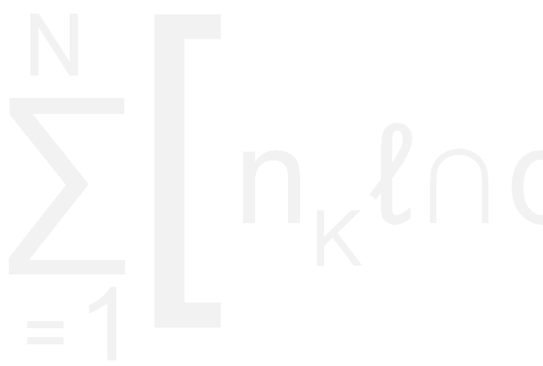
Interaction Detection in GLM – a Case Study
Chun Li, PhD
ISO Innovative Analytics
March 2012

Slide 2

Agenda
Case study
Approaches
  Proc Genmod, GAM in R, Proc Arbor
Details
Summary
Notes:
For more information visit us online at www.iso.com or join the conversation on Twitter or Linkedin.

Slide 3
Case Study
Personal Auto loss prediction
  Pure premium prediction (GLM – Tweedie)
  Inputs:
    Environment components
    Vehicle components
    Driver components
    Household components
  Objective is to detect interactions among the components to further improve model performance
Notes:
For more information visit us online at www.iso.com or join the conversation on Twitter or Linkedin.

Slide 4
Components
Environment (frequency and severity for each)
Traffic density
Traffic composition
Traffic generators
Weather
Experience and trend
Vehicle
ISO Symbol relativity
Price new relativity
Model year relativity
Body style and dimension
Performance and safety
Theft
Weather
Animal
Glass
All other perils
Driver
Driver characteristics (age, gender, marital, good student etc)
Violation history
Claim history
Household
Usage/mileage
Household composition
Notes:
For more information visit us online at www.iso.com or join the conversation on Twitter or Linkedin.

Slide 5
Challenges
There are many different approaches that can be used to detect interactions
The approach we selected was based on our requirements that:
  interaction detection be completed in a timely manner
    despite the large number of observations (>1 million) and large number of interaction pairs (>300)
  all variables in the final model (including interactions) be interpretable
  the final model (including interactions) be built in the form of a SAS GLM model
Notes:
For more information visit us online at www.iso.com or join the conversation on Twitter or Linkedin.

Slide 6
Approach
Step I
Automated pair-wise selection
Based on standalone contribution
Step II
Manual selection from Step I results
Based on marginal contribution in GLM
Step III
Validation/Refinement/Finalization
Step 0
Build main effect model
Aim to model the residual using interaction terms
* We’ll be focusing on Step I
Notes:
For more information visit us online at www.iso.com or join the conversation on Twitter or Linkedin.

Slide 7
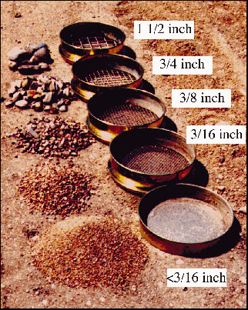
Step I - Details
The purpose of Step I is to separate significant interaction pairs from insignificant ones, so that we can focus on those that have higher potential.
The principle is to add each pair to the model to predict the residual, measure their contribution, and rank the pairs based on contribution.
Notes:
For more information visit us online at www.iso.com or join the conversation on Twitter or Linkedin.

Slide 8
Step I - Details
Three methods are used
  Proc Genmod in SAS
  GAM in R
  Proc Arbor (Regression Tree) in SAS
Notes:
For more information visit us online at www.iso.com or join the conversation on Twitter or Linkedin.

Slide 9
Proc Genmod in SAS
Use main effect model as offset
Add a component pair to the model
Use ‘Increase in Gini’ as the performance metric
Created SAS macro to loop through all component pairs and output these pairs ranked according to the performance metric
Notes:
For more information visit us online at www.iso.com or join the conversation on Twitter or Linkedin.

Slide 10
Gini Definition
A measure of model predictiveness
Focuses more on rank ordering than spot value
Definition:
Sort the population by model score
Calculate the % of accumulative exposure and loss from low to high score (least risky to most risky)
Chart the points using % exposure as x-axis and % loss as y-axis
Gini is defined as 2 times the area between the diagonal line and the curve
Notes:
For more information visit us online at www.iso.com or join the conversation on Twitter or Linkedin.

Slide 11
Proc Genmod in SAS
Interaction terms
  Both linear
  Both binned
  One linear and one binned
The linear assumption is based on the fact that the components (or sometimes, the log transformation of the components) are developed in the way that they have linear relationship with the target.
Notes:
For more information visit us online at www.iso.com or join the conversation on Twitter or Linkedin.

Slide 12
GAM in R
GAM = Generalized Additive Model
  In R package: mgcv
  Able to do Tweedie distribution with Log link
  Fits splines
  Multi-dimentional smoothing for interactions
    Smoothing classes: s(a, b)
    Tensor product smoothing: te(a, b)
Notes:
For more information visit us online at www.iso.com or join the conversation on Twitter or Linkedin.

Slide 13
Illustration of interaction surface
te(X1, X2)
Notes:
For more information visit us online at www.iso.com or join the conversation on Twitter or Linkedin.

Slide 14
GAM in R
Use main effect model as offset
Add a component pair to the model
Use ‘Decrease in AIC’ as the performance metric
Create R process to loop through all possible component pairs and output these pairs ranked according to the performance metric
Notes:
For more information visit us online at www.iso.com or join the conversation on Twitter or Linkedin.

Slide 15
Proc Arbor in SAS
Proc Arbor in SAS
  The same algorithm behind EMiner’s Decision Tree Node
  Can be part of a programmable process
    Loop through component pairs
    Build model
    Evaluate model performance
Notes:
For more information visit us online at www.iso.com or join the conversation on Twitter or Linkedin.

Slide 16
Proc Arbor in SAS
Proc Arbor in SAS
  Use residual of main effect mode as target
  Build regression tree using a pair of components
  Performance metric
    sqrt(MSE*Leaf_Count)
  Created SAS macro to loop through all possible component pairs and output these pairs ranked according to the performance metric
Notes:
For more information visit us online at www.iso.com or join the conversation on Twitter or Linkedin.

Slide 17
Example – Collision Coverage
Drivers in the low household relativity segment should have the driver relativity adjusted higher, and high lower.
Notes:
For more information visit us online at www.iso.com or join the conversation on Twitter or Linkedin.

Slide 18
Example – Collision Coverage
In the location where the loss experience is low, the weather relativity needs to be adjusted lower, and high higher
Notes:
For more information visit us online at www.iso.com or join the conversation on Twitter or Linkedin.

Slide 19
Summary
Most of the significant pairs are captured by proc Genmod method
  Closest to the final model format
Both GAM in R and proc Arbor detect additional significant interaction pairs
  Need to convert to the format that Proc Genmod can handle
Notes:
For more information visit us online at www.iso.com or join the conversation on Twitter or Linkedin.

Slide 20
Take away
The methodologies described can be applied generally to variable selection processes
  May need to do variable de-correlation process beforehand (eg. variable clustering)
Significantly reduces the time/effort needed for variable selection
Notes:
For more information visit us online at www.iso.com or join the conversation on Twitter or Linkedin.

Slide 21
Q & A
Questions?
Contact: cli@iso.com

