Slide 1
Beginner’s Roadmap to Working
with Driving Behavior Data

Slide 2
CAS Antitrust Notice
The Casualty Actuarial Society is committed to adhering strictly to the letter and spirit of the antitrust laws. Seminars conducted under the auspices of the CAS are designed solely to provide a forum for the expression of various points of view on topics described in the programs or agendas for such meetings.
Under no circumstances shall CAS seminars be used as a means for competing companies or firms to reach any understanding – expressed or implied – that restricts competition or in any way impairs the ability of members to exercise independent business judgment regarding matters affecting competition.
It is the responsibility of all seminar participants to be aware of antitrust regulations, to prevent any written or verbal discussions that appear to violate these laws, and to adhere in every respect to the CAS antitrust compliance policy.

Slide 3
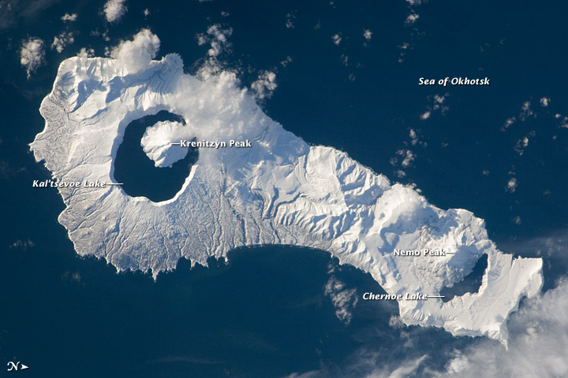
Portrait of a Risky Driver
Image Credit: NASA Earth Observatory

Slide 4
The Basics
Usage-Based Insurance
Vehicle Telematics
Driving Behavior Data

Slide 5
Part One
Origins, Destinations, and Roadblocks

Slide 6
Objectives
Segmentation
Selection
Mitigation
Behavior Modification
Research and Policy

Slide 7
Paradigms
Critical Conditions
Télématique
“Causal” Rating Variables
Pay-at-the-Pump

Slide 8
Computerization of Cars
Micro-processors
Sensors
GPS
OBD-II
GPRS

Slide 9
Early Practitioners
Texas-only Pilot
Utility-Bill Functionality
Reactions
Discontinuation

Slide 10
Intellectual Property
Patents
State Street Bank
Bilski
Litigation

Slide 11
Privacy
Use Cases
Misuses of DBD
IBM Framework
EDR Laws
Regulatory Levels

Slide 12
Part Two
Infrastructure

Slide 13
Design
Business Model
Physical Resources
Knowledge Base
Pilot Tests

Slide 14
Hardware
Feature Set
Costing v. Granularity
Deployment
Installation

Slide 15
Communications
Methods
Frequency
Trigger
Smartphones

Slide 16
Requirements
Flexibility
Capacity
Statistical Software
Value-Added Services

Slide 17
Security
Perils of Warehousing
Access Controls
Encryption
Retention

Slide 18

Part Three
Navigating the Data

Slide 19
Raw Data
 |  | Degrees | Degrees
Obs | UTC | Latitude | Longitude | MPH | Miles | Seconds | Gallons
1 | 20:15:00 | 49.50 | 154.50 | - | 0.0 | 0 | 0.00
2 | 20:20:00 | 49.45 | 154.49 | 40 | 3.6 | 300 | 0.14
3 | 20:25:00 | 49.41 | 154.43 | 82 | 8.8 | 600 | 0.35
4 | 20:30:00 | 49.36 | 154.30 | 77 | 15.0 | 900 | 0.57
5 | 20:35:00 | 49.33 | 154.19 | 38 | 20.7 | 1200 | 0.72
6 | 20:40:00 | 49.35 | 154.14 | 42 | 24.7 | 1500 | 0.82
7 | 20:45:00 | 49.35 | 154.13 | 43 | 25.2 | 1800 | 0.83
8 | 20:50:00 | 49.36 | 154.08 | 38 | 28.5 | 1800 | 0.91
9 | 20:55:00 | 49.34 | 154.01 | 32 | 33.5 | 2400 | 1.04
10 | 21:00:00 | 49.33 | 153.97 | 28 | 36.0 | 2760 | 1.10

Slide 20
Events
Passive
20:15:00 | Ignition On
20:15:15 | Shift into Drive
21:00:15 | Shift into Park
21:00:30 | Ignition Off
Aggressive
20:15:30 | Acceleration | 0.8 g-force
20:22:00 | Cornering | 0.5 g-force
20:28:00 | Braking | -0.9 g-force
20:34:00 | Cornering | -0.5 g-force
20:46:00 | Braking | -0.6 g-force
Image Credit: NASA Earth Observatory

Slide 21
Driving States
 |  | Vehicle | Degrees | Degrees |  | Incr.
Obs. | UTC | Status | Latitude | Longitude | Miles | Miles | Accel | Brake | Corner
Trans. | 20:15:15 | Idling | 49.50 | 154.50 | 0.0 | 0.0 | - | - | -
Event | 20:15:15 | Driving | 49.50 | 154.50 | 0.0 | 0.2 | 0 | 0 | 0
Event | 20:15:30 | Driving | 49.50 | 154.50 | 0.4 | 1.8 | 1 | 0 | 0
2 | 20:20:00 | Driving | 49.45 | 154.49 | 3.6 | 2.6 | 0 | 0 | 0
Event | 20:22:00 | Driving | 49.43 | 154.46 | 5.6 | 2.6 | 0 | 0 | 1
3 | 20:25:00 | Driving | 49.41 | 154.43 | 8.8 | 3.4 | 0 | 0 | 0
Dummy Record:
No Mileage Allocated to Idling
Rolling Average
{( 3.6 – 0.4) + (0.4 – 0.0 )} ÷ 2 = 1.8
Bucketing:
Facilitates
Aggregation

Slide 22
Enrichment
Conversions and Metrics
Snapping and Mapping
Traffic and Weather
QC Checks

Slide 23
Driving Portfolio
Vehicle | Term | Status | Date | Time
Jim’s Car | Jan - Jun, 2012 | Driving | Weekday | AM Peak
LC Band | Road Type | From Garage | Weather | Visibility
5 | Freeway | 11 - 15 Mil. | Flurries | Average
Speed (mph) | vs. Limit | vs. Flow | Fatigue | Fuel Econ.
85 – 90 | 22.5 – 27.5 | 17.5 – 22.5 | 11 - 15 mins. | 25 - 30 mpg
Mileage | Time (mins.) | Fuel (gals.) | Harsh Accel. | Harsh Brake
3.1 | 2.5 | 0.11 | 0 | 1

Slide 24

Part Four
Applications

Slide 25
Pricing
Causative Rating Variables
Interactions
Operators and Driving Habits
Classification

Slide 26
Underwriting
Scoring
Tiering
Verification
Transferability

Slide 27
Claims
FNOL
Coaching
Fraud Tools
Civil Engineering

Slide 28
Going Live
Data Ownership
Regulatory Filings
Marketing
What is your roadmap to success?

Slide 29
Notes:
For more information visit us online at www.verisk.com or join the conversation on Twitter or Linkedin.

