Slide 1
CAS 2015 Reinsurance Seminar
Assessing & Reinsuring Cyber Risks
Dr Raveem Ismail DPhil, MSc by Research, MPhys (Oxon), MInstP
Ariel Re (Bermuda) raveem.ismail@arielre.com

Slide 2







Relevant background
Oxford. Physics and Atmospheric Physics (microphysical modelling, volcanoes, aviation emissions, cirrus cloud).
Exclusive Analysis (now part of IHS). Political Risk/Violence consulting.
Aon Benfield. Terrorism Model Lead.
Validus/Talbot. Terrorism & War Underwriting Analyst.
Ariel Re. Specialty Treaty Underwriter.

Slide 3
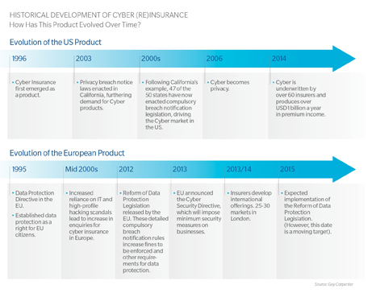
The cyber insurance market
Not new.
Exclusions: NMA 2914, NMA 2915, CL 380.
Lloyd’s risk code CY in 2013.
No longer purely an FI / privacy hacking issue.
Focus now: “malicious” cyber, and BI not just PD.

Slide 4
Attributes
The parallels with natural hazards do not hold.
Exposure is rapidly changing, and is connected in hidden ways: non-geographic accumulation*.
The parallels with physical assets do not hold either.
Self-certification is not an option!
Therefore difficult to model:
“The current state of cyber modeling is like trying to use the count of arrests for a crime to figure out the dollar losses from theft. They are related, but not in all the ways you want…”**.

Slide 5
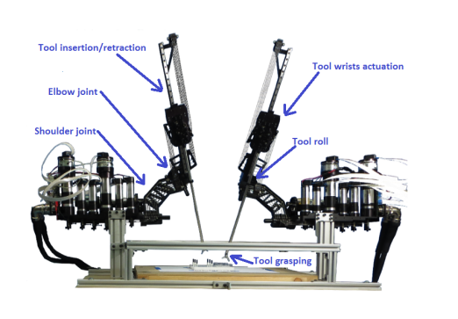
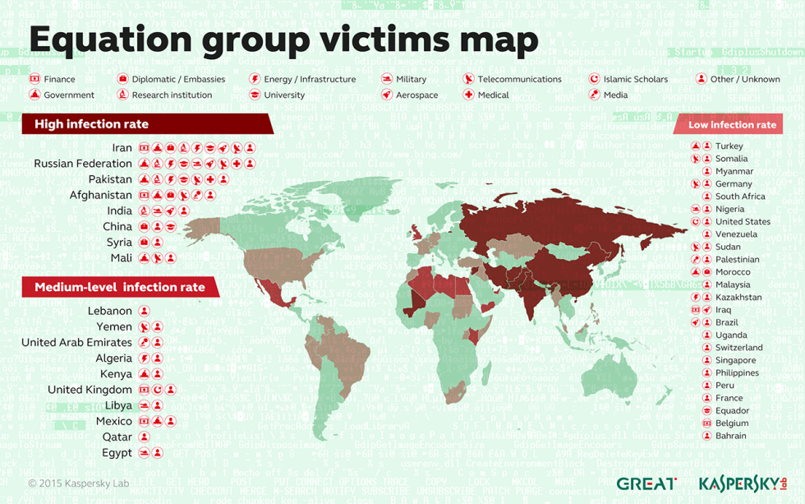
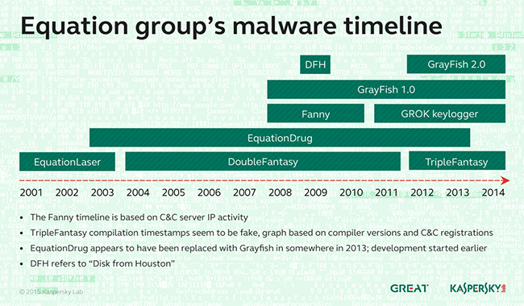
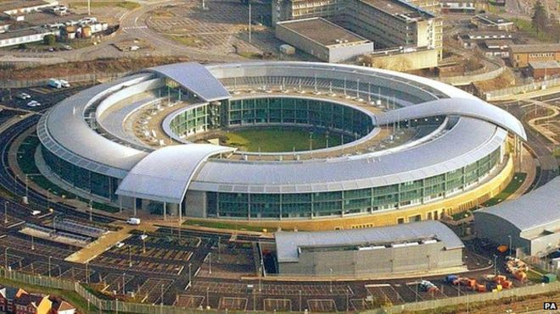
A few cyber developments
Internet Of Things (IOT). E.g., surgical devices*.
Hacking even “air-gapped” (physically isolated) networks, systems and devices possible.
Many sophisticated actors. Including governments**.
Post-Snowden behavior changes: minimal/non-existent***.
Potential catastrophes: aeroplane hacking^, Equation Group^^.

Slide 6
Thoughts for the future
Not an opportune point in the insurance cycle.
Yet to see a credible cost-effective accumulation method and auditing process for insureds.
Loss experience needed.
Work with governments and credible third parties.
Data, when it comes, should come quickly.

