Slide 1
New Approaches for Managing Cyber Risk

Slide 2
Agenda
AIR Model for Cyber Risk
AIR modeling framework
Data partners
Roadmap
Cyber data standards
Overview of the cyber market

Slide 3
The Worldwide Cyber Insurance Market Is Growing Rapidly
“Cyber is a new risk and it is a concern, Lloyd’s is at the heart of cyber attacks, providing coverage right now. It’s going to grow dramatically ”
Inga Beale, CEO, Lloyd’s of London, Oct. 2014
“Cyber Insurance: Maybe next year turns into I need it now”
Betterley Report, June 2014
“Former U.S. Homeland Security Secretary Tom Ridge has teamed with reinsurance brokerage Guy Carpenter & Co. L.L.C. to offer a cyber security and insurance product”
Business Insurance, Oct. 2014
Sources: Betterley Report / Advisen

Slide 4
What Exposes Organizations to Cyber Risk? A Breach Is One Critical Type of Hazard
In the office
At offsite data storage sites
In the “cloud”
Direct losses when intellectual property is stolen, data destroyed, or operations interrupted
Indirect losses when data proprietary to its clients is compromised
Reputational losses
Physical damage

Slide 5
Facts About Cyber Coverage
What is typically covered?
Legal fees
Forensics
Notification and call center
Credit monitoring
Public relations fees
Limits
Low, in the low millions
Exclusions
Evaluation strategy
Driven by industry, company size, etc.
Companies offer network analyses

Slide 6
AIR’s Stochastic Modeling Framework Can Be Applied to Cyber
HAZARD
VULNERABILITY
Event Generation
Intensity Calculation
FINANCIAL
Damage Estimation
Limit
Loss Calculation
Exposure Information
Deductible
Policy Conditions
Policy Conditions

Slide 7
Risk Based Security (RBS) Selected as Incident Data Provider
Has developed a database of over 16,000 historical worldwide cyber incidents
Based in Richmond, Virginia
Publically disclosed clients include AIG and Willis

Slide 8
Risk Based Security Data Examples

Slide 9
BitSight Collaboration will Give the AIR Model Several Key Benefits
Analyzes public traffic on the Internet to unobtrusively give scores to companies
Based in Cambridge, Massachusetts
Founded by several MIT graduates
Publically disclosed clients include AIG and Liberty

Slide 10
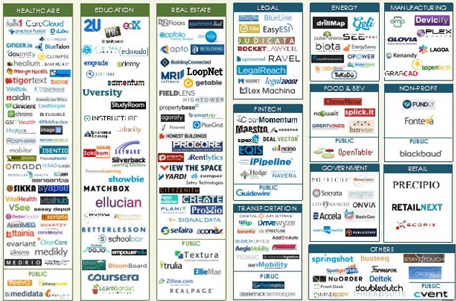
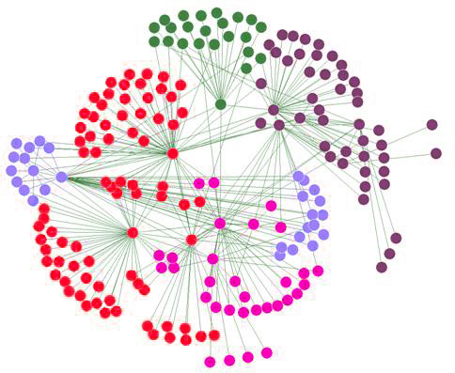
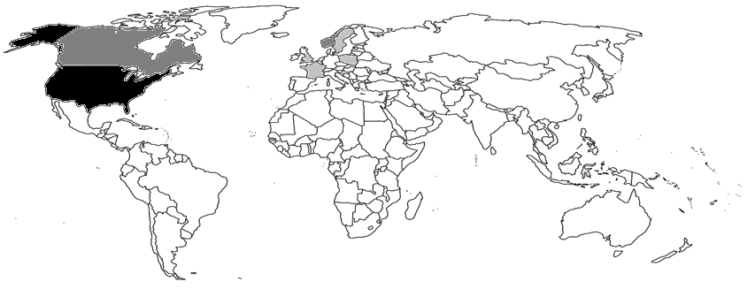
AIR’s Collaboration with BitSight Will Provide Many Benefits to Clients

Slide 11
AIR Is Collaborating With Several Cyber Insurance Carriers

Slide 12
The Verisk Enterprise Offers AIR Unique Resources, Information, and Data
ISO Cyber Program
Argus
Cyber Forum
Information Sharing and Analysis Centers
Maplecroft

Slide 13
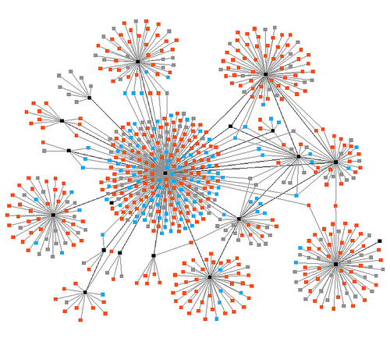
AIR Categorizes Risks by Exposure Type

Slide 14
Cyber Insurance Record
Company Information
Insurance Coverages
Assets / Storage
Data
Transfer

Slide 15
Minimum Data Required to Run Model: Industry, Revenue, and Insurance Information
Industry
Revenue
Insurance

Slide 16
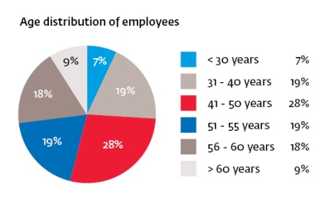
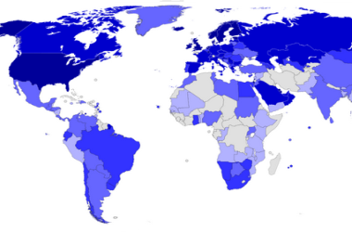
Company Information—Detailed
Industry
Recovery Plans
Demographics
Revenue
Security
$£€

Slide 17
Multiple Insurance Coverages Will be Supported
Insurance Coverages
Physical
Website Publishing Liability
Programming Errors and Omissions
Extortion
Public Relations
Security Breach Expense
Business Interruption
Replacement of Electronic Data
Fines
Security Breach Liability

Slide 18
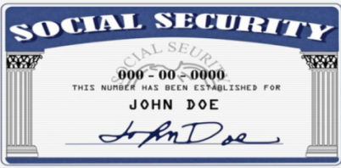
Data Are the Basis of Potential Cyber Losses
Type
Country of Origin
Number and Value
Asset / Storage Record
Transfer Record

Slide 19
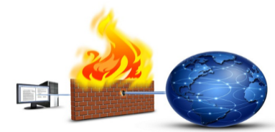
Storage Can Lead to Aggregation Risks
Type
Security
OS Type
Cloud

Slide 20
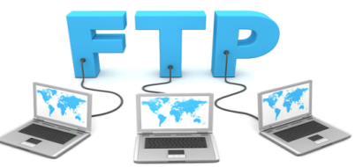
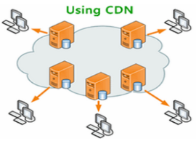
Transferring Data Introduces Additional Vulnerabilities
Type
Security
Service / Vendor Type
Cloud
Notes:
Types of Transfer include: - Web Application, Email, Vendor, Intranet, Point-of-sale network, FTP, SCADA
-- again replacement value – BI, Fixed recovery costs

Slide 21
Developing a Cyber IED Will Allow the Model to Account for “Unknowns”
Most refined results are obtained when every field of an exposure record is correctly filled in
But what if we have only some of the information that completely describes an exposure?
AIR’s Cyber Model will populate “unknown” fields with values derived from our planned Cyber Industry Exposure Database
Data | Type | Record Value | Country of Origin | Ownership
 | Credit Card | ? | ? | ?
 | PII | ? | US | ?
Annual Revenue | Total | % from Internet | % Domestic | % Foreign
 | 1,300,000,000 | ? | ? | ?
Data | Type | Record Value | Country of Origin | Ownership
 | Credit Card | $225 | US | 3rd Party
 | PII | $99 | US | 1st Party
Company Revenue | Total | % from Internet | % Domestic | % Foreign
 | 1,300,000,000 | 17% | 72% | 28%
Notes:
Unknown functions/fields are key, since many clients may not be able to collect each bit of information
Talk about life insurance ads

Slide 22
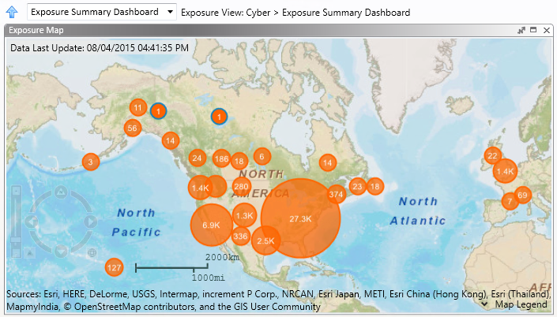
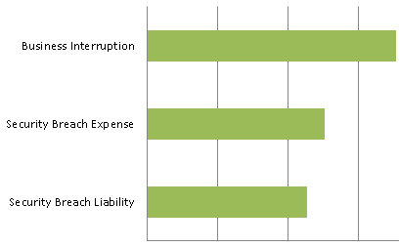
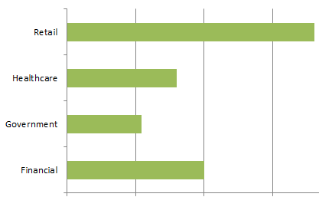
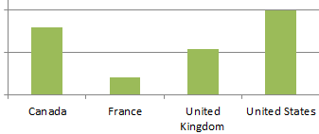
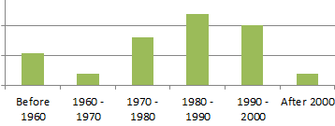
Mock-up of Cyber Exposure Aggregation and Accumulation in Touchstone
Distribution of Limits by Coverage
Distribution of Records by Industry
Distribution of Revenue by Geography
Distribution of Employees by Age Band

Slide 23
Studies Provide Data for Our Prototype Model
NetDiligence
Symantec
Notes:
NetDiligence study 2013 (N=88)

Slide 24
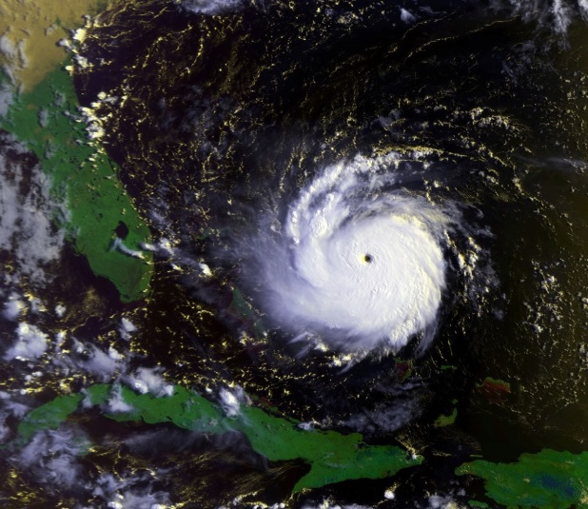
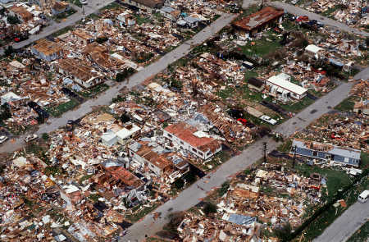
The “Hurricane Andrew” of Cyber Is Coming
Notes:
Perfect Storm:
The Organization for Economic Cooperation and Development (OECD) worries about “perfect storm conditions” in which “two different cyber-events occur at the same time, or a cyber-event tak[es] place during some other form of disaster or attack”.
Directed Attack Against Energy Industry
Emergency shutdown controls are too easily bypassed, potentially leading to a release of oil or gas, which could quickly create a fire or explosion.
In the US, 40% of cyber-attacks on critical infrastructure assets in 2012 were aimed at energy assets.
Understand correlation between policies
Carriers don’t understand correlations between insureds that exist due to the use of cloud service providers
Understand cyber “Hurricane Andrew”
A large cyber event affecting many insureds simultaneously
don’t know what a large cyber event that affects many policy holders simultaneously would look like

Slide 25
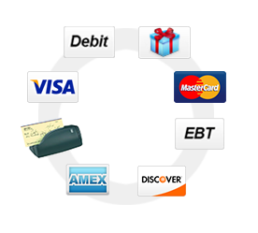
Aggregation Is More than the Cloud

Slide 26
AIR’s Prototype Cyber Framework and Its Roadmap
Catalog
Frequency of attack data from sample VERIS breach database
Vulnerability
10 key basic risk factors, including company industry and encryption
Loss
Loss per record information from Symantec, accounting for risk features
Exposure
Over 400 companies in our sample exposure database
Getting Internet footprint data from BitSight
BitSight score as real-time secondary features in model
Partnering with insurance companies to receive cyber loss data
Signed with RBS to get a comprehensive dataset
Stochastically generated breach events
Modelling of loss aggregation scenarios
Model
Results and reports available through consulting studies
Will be in Touchstone in the future
Deterministic and probabilistic results
Framework calibrated to the reported loss from the 2013 Target breach
Open data standards schema released and implemented in Touchstone
Creating a 100K catalog using all available data
Signed with BitSight
Relative vulnerabilities between industry, company size, etc.
Building a cyber industry exposure database

