Slide 1
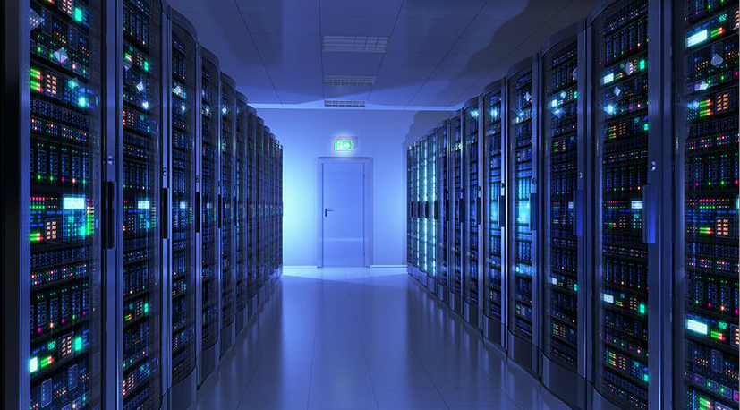

Cyber Insurance
The role of analytics in supporting the acceptance of cyber exposure
A presentation to C.A.S
By David Ovenden
  Oct 2015

Slide 2

Agenda
    Introduction
    Background
      Coverage types
      Actors
      Vectors
    Why is this a difficult class of business
    The anatomy of a hack
    How can analytics support

Slide 3
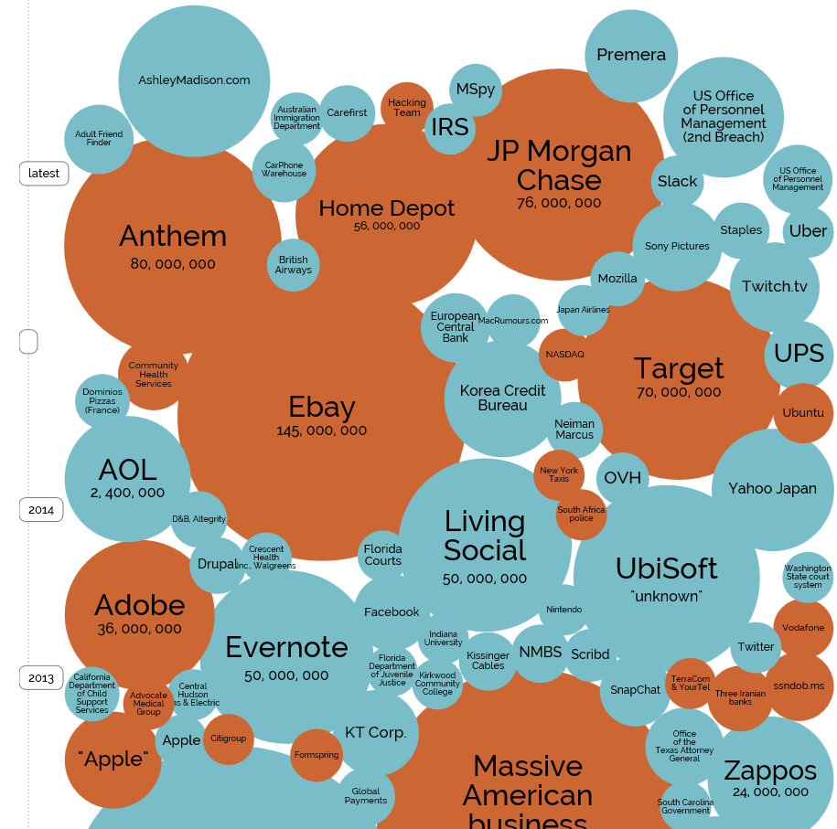
Background
    A few names that have had security issues recently
    Hacking is becoming an increasingly mainstream occurrence
    The cost of data breaches is escalating
    The impact can be catastrophic
    State actors are undoubtedly involved
    The subject matter is not well understood within the insurance industry
    Our lives and business interactions are digital
    Insurance solutions lag behind the issue
Source: Information is beautiful

Slide 4
Some UK Government research
90%
of large organisations
69%
of large organisations
74%
38%
of small organisations
of small organisations
Had a security breach
Were attacked by an unauthorised outsider last year
Year on year increase
Year on year increase
30%
of large organisations
39%
of large organisations
16%
27%
of small organisations
of small organisations
Were hit by a DoS attacks in the last year
Believe they have insurance that would cover a breach
Year on year decrease
Year on year decrease
Source: UK Government Report on Information Security

Slide 5
Actors and Vectors
buster
thomas
tigger
robert
soccer
batman
test
pass
killer
hockey
george
charlie
andrew
michelle
love
sunshine
jessica
6969
pepper
daniel
access
123456789
654321
joshua
maggie
starwars
silver
    Vandals
    Thrill Seekers
    Show offs
    Thieves
    Organised crime
    Hacktivist
    Industrial espionage
    State craft
    The unaware
    Direct Hacks
    Mass Attack
    Infection / Virus
    DDOs
    Social Engineering
    Inside jobs
    Accidents
    Poor practices
    Physical peril

Slide 6
Coverage types
password
123456
12345678
1234
qwerty
12345
dragon
pussy
baseball
football
letmein
monkey
696969
abc123
mustang
michael
shadow
master
jennifer
111111
2000
jordan
superman
harley
1234567
hunter
trustno1
Underlying Exclusion
Specialist Coverage
    First Party
      Loss, damage or corruption of data
      Business interruption following a loss
      Costs, fines and penalties
      Reconstruction of data
    Third Party
      Professional indemnity
      Libel
      General liability
      Breach of privacy
      D&O
Comprehensive Data exclusions
Most products exclude “cyber cat”

Slide 7
Why is this so difficult?
amanda
orange
biteme
freedom
computer
sexy
thunder
nicole
ginger
heather
hammer
summer
corvette
taylor
austin
1111
merlin
matthew
121212
golfer
cheese
princess
martin
chelsea
patrick
richard
    First Party
    Volume of activity
    Potential aggregations
    Lack of knowledge
    Difficult claims settlement
    Lack of partnerships
    Limited pull or push
    Limits required
    Better opportunities?
    Third Party
    Understanding
    Difficulty policing
    Poor history
    Limits required
    Emerging legal environment
    Lack of data

Slide 8
Realistic analytical support
asdfgh
sparky
cowboy
camaro
anthony
matrix
falcon
iloveyou
bailey
guitar
jackson
purple
scooter
phoenix
aaaaaa
morgan
tigers
porsche
mickey
maverick
cookie
nascar
peanut
justin
131313
money
boomer
    Understanding the data resources available
    Setting the Data strategy
    Pricing with limited data
    Modelling appetite and disaster scenarios (EMLs)
    Catastrophe potential
    Decision support
    Portfolio management analytics
Underwriting & Claims Expertise
Analytical
Expertise
IT Security
Expertise

Slide 9
Building IP around Cyber within your organisation
    Bring together a range of external data sources relevant for your target segment, potentially including breach data segmented by:
      Underlying technology
      Industry sector
      Suppliers
      Size / scale
      Sensitivity of the data
      Policy limits selected
      Credit score
      Cross reference physical security
    Automation v Security Surveys
      Unless you have big data (unstructured data) expertise collect as much objective structured data as possible from your IT partners
    Work closely with your underwriters to ensure analytical rigour
    If you have a portfolio of this risk, make sure it is actively managed

Slide 10
An example commercial analytics environment
Outcomes
Interactive case level decision support
Integrated Commercial
data environment
Market data (CMA)
UW and Pricing Analytics
Radar
Quote engine(s)
Augmented renewal lists
Policy MI
Performance data
Decision support
Claims MI
Client data
Broker data
Industrialised technical reporting
Portfolio Analytics
Interactive Product dashboard
External Financial Data
External Cyber data sources
Interactive Regional dashboard
Interactive Broker dashboard

Slide 11
Questions?

