Slide 1
Antitrust Notice
The Casualty Actuarial Society is committed to adhering strictly to the letter and spirit of the antitrust laws. Seminars conducted under the auspices of the CAS are designed solely to provide a forum for the expression of various points of view on topics described in the programs or agendas for such meetings.
Under no circumstances shall CAS seminars be used as a means for competing companies or firms to reach any understanding – expressed or implied – that restricts competition or in any way impairs the ability of members to exercise independent business judgment regarding matters affecting competition.
It is the responsibility of all seminar participants to be aware of antitrust regulations, to prevent any written or verbal discussions that appear to violate these laws, and to adhere in every respect to the CAS antitrust compliance policy.

Slide 2
Can Insurers Remain Sustainable
as Risk Profiles Shift?
Rodney J. Taylor, J.D., P.E., CPCU, CLU, ARM
Managing Director – Aon Environmental Services

Slide 3
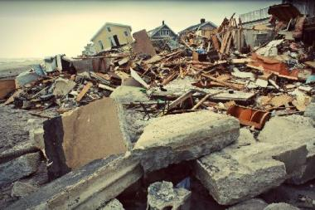
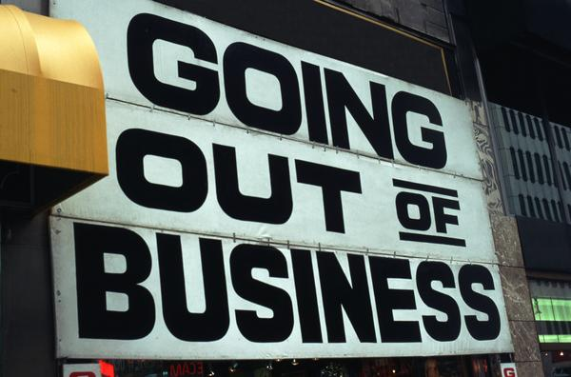
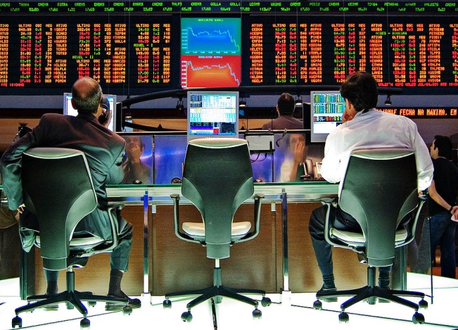
Insurance & Sustainability
Insurers have 3 areas of concern regarding sustainability
Insurance policies that are exposed to sustainability-related risks
Sustainability of their own business model
Sustainability of investment portfolios

Slide 4
Insurance & Sustainability
How is insurance related to sustainability?
Insurance addresses 3 components of sustainability:
Financial performance
Environmental impacts
Social factors

Slide 5
Insurance & Sustainability
Financial performance
Every insurance policy aims at financial sustainability
Reimburse losses for bodily injury and property damage
Allow insured to rebuild damaged facilities
Pay defense costs for third-party claims
Make up for lost income during interruption of business
Pay for errors in executive decision-making
Provide loss control services
Sustainability of insurance programs depend on accurate identification and assessment of risks and adjusting pricing accordingly

Slide 6
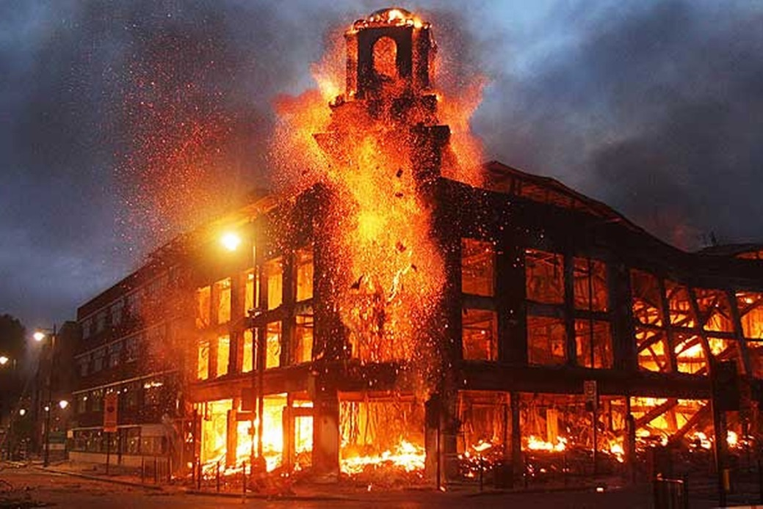
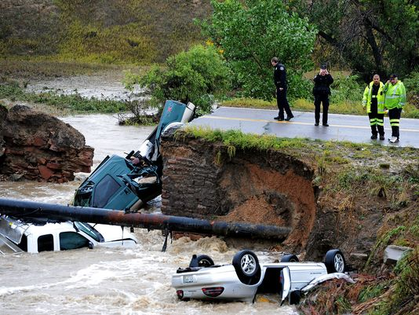
Insurance & Sustainability
Example – Property insurance is purchased to assure funds will be available in the event of a fortuitous physical damage event that would bankrupt a business that is not insured

Slide 7
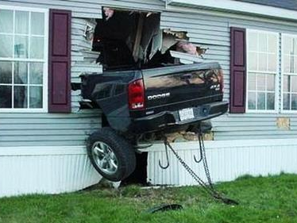
Insurance & Sustainability
Example – Liability insurance is purchased to provide funds for defense and indemnity for claims arising out of bodily injury or property damage to third parties

Slide 8
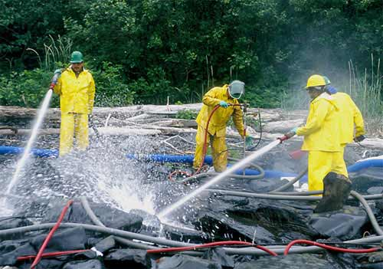
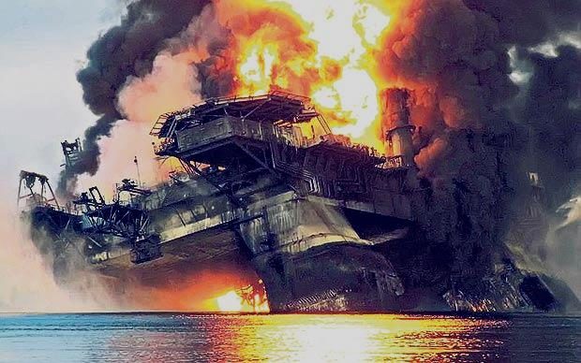
Insurance & Sustainability
Example – Environmental insurance responds to claims that operations of the insured released hazardous materials into the environment

Slide 9
Insurance & Sustainability
Financial Sustainability - Risks insured in current policies may be impacted by sustainability factors (no exclusions for floods, windstorms or wildfires)
Insurers will only be able to sustain underwriting if they can raise rates enough to pay for newly identified risks
Since insurance is regulated, drastic price adjustments may not be allowed by states
Where rates remain inadequate, insurers may have no choice but to withdraw from the marketplace

Slide 10
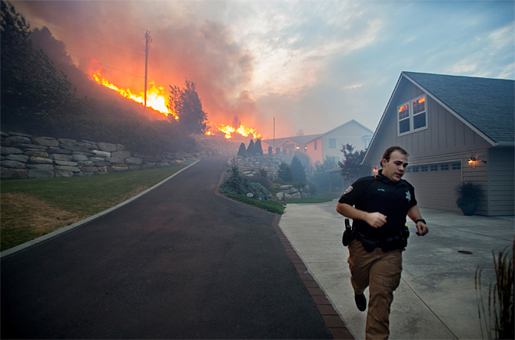
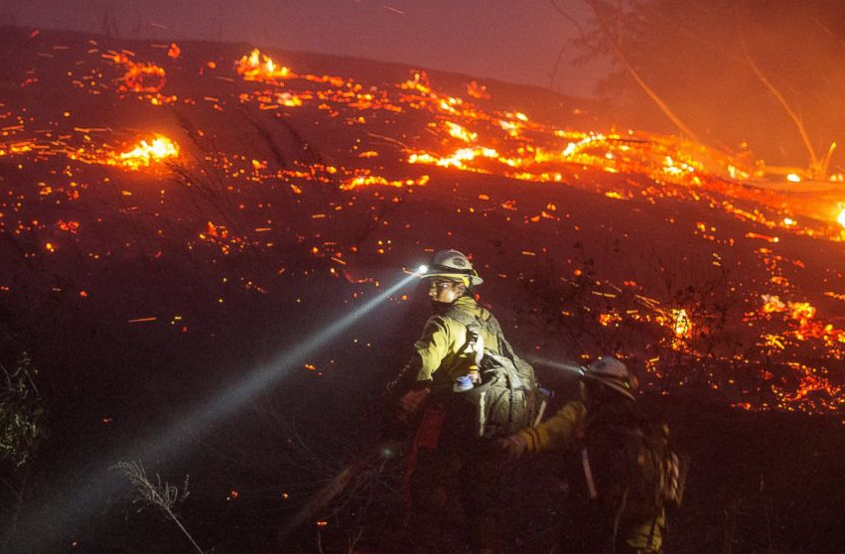
Insurance & Sustainability
Example – Property insurers writing fire coverage for homes in Washington and Oregon.
Losses are covered by homeowners policies.
Result – Raise prices or drop exposed properties

Slide 11
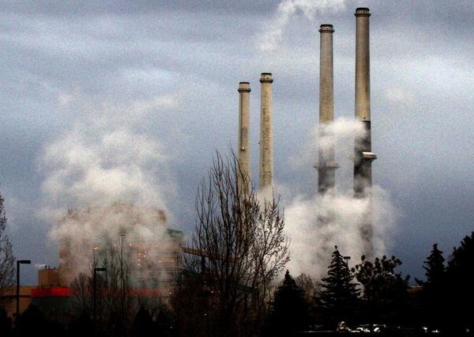
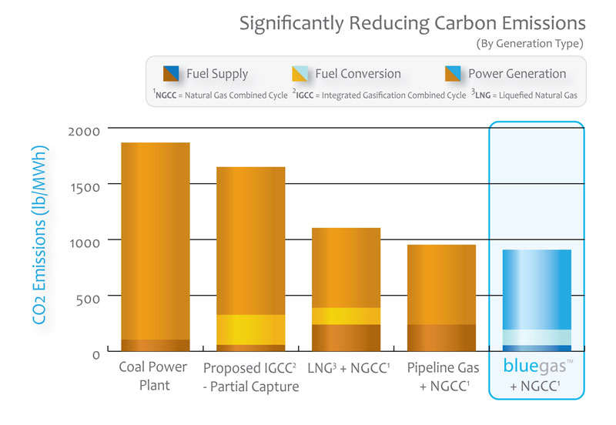
Insurance & Sustainability
Example – Professional liability underwriters covering consultants that calculate consumer energy savings or GHG emissions
Raise rates for new risks or do not insure firms engaged in GHG consulting

Slide 12
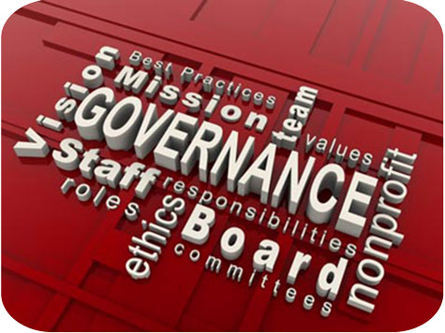
Insurance & Sustainability
Example – D&O insurers writing corporations that have new duties to disclose risks associated with sustainability of business practices.
Charge additional premium or add exclusions to the policy

Slide 13
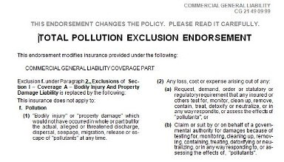
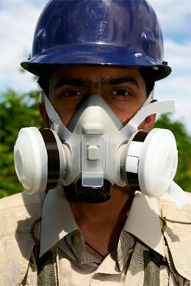
Insurance & Sustainability
Environmental Risk Factors
Most insurers have successfully avoided environmental risks by using Pollution Exclusions in CGL and Excess Liability Policies

Slide 14
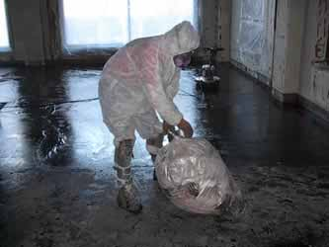
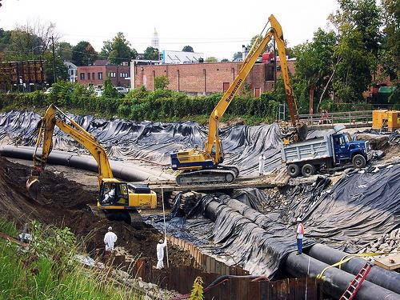
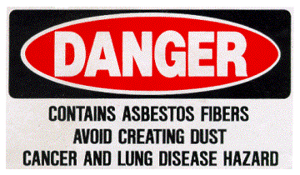
Insurance & Sustainability
Historically risks have not been sustainability driven, but have arisen out of asbestos, CERCLA cleanups, etc.

Slide 15
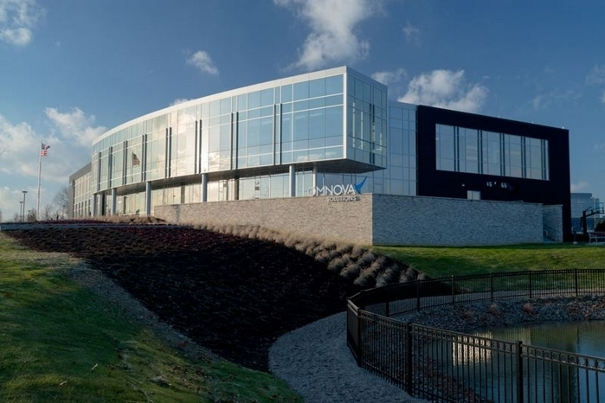
Insurance & Sustainability
In the future, exclusions may not protect insurers from being involved in sustainability-related risks
Example – Green building claims arising out of loss of productivity and rental income may not be deemed to be excluded by Pollution Exclusions (Exclude only “industrial pollution”)

Slide 16
Insurance & Sustainability
Environmental Insurance
Created to fill the gap in coverage caused by Pollution Exclusions
Underwritten by technically skilled insurance professionals
Even though it was written to avoid catastrophic risks, the product was nearly destroyed by “unexpected” claims (CERCLA in mid-1980s)
Claims-made forms offer underwriters a chance to reconsider the risks they insure each renewal
What we do not know is what risks may arise in the future that may be deemed to be insured pollution losses

Slide 17
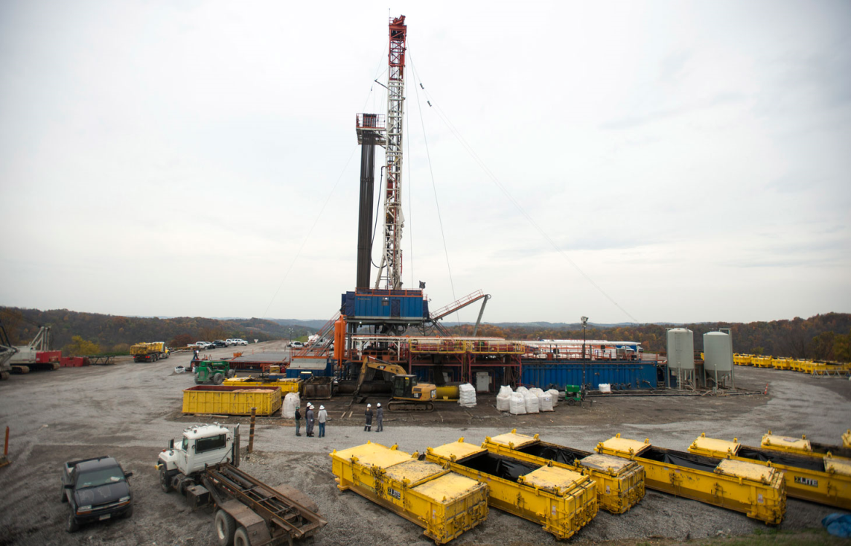
Insurance & Sustainability
We do not know what risks may arise in the future that may be deemed to be insured pollution losses

Slide 18
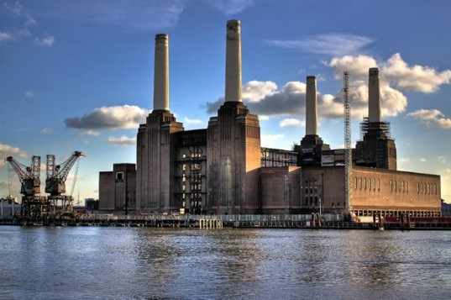
Insurance & Sustainability
Examples of Possible Future “Environmental” Claims related to sustainability issues
Replacement of fleet of fossil fuel power plants due to emissions of GHGs may be deemed to be an insured pollution loss

Slide 19
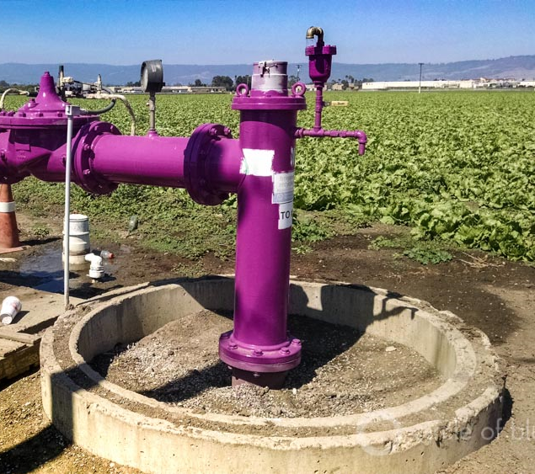
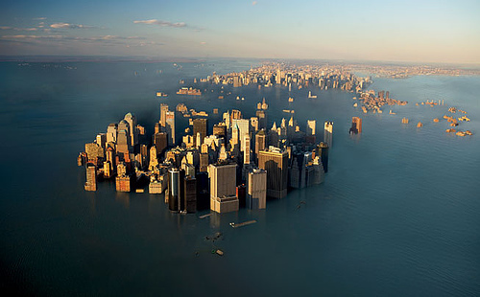
Insurance & Sustainability
Losses to fresh water supplies due to incursion of salt water due to sea level rise may be deemed to be due to pollution of groundwater

Slide 20
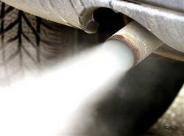
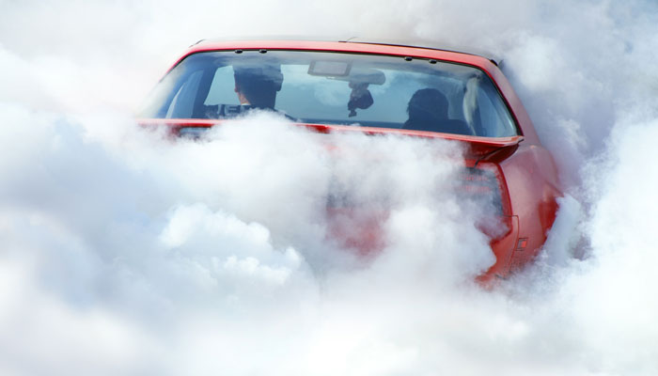
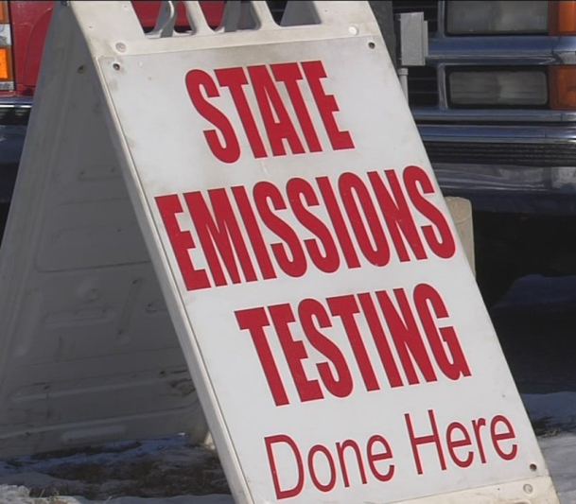
Insurance & Sustainability
If automakers are ultimately found to be partly to blame for changes in weather and resulting damage, insurers may have to pay for portions of losses due to emissions prior to Pollution Exclusions

Slide 21
Insurance & Sustainability
Social Factors of Sustainable Insurance Policies
Many aspects of social risk are currently insured by a variety of insurance policies, including:
CGL – personal and advertising injury
EPL – Employment practices and discrimination
D&O – Executive decisions regarding corporate policies and disclosure of material information
Unlike other coverages, D&O may be subject to early claims for sustainability issues
Do not need to prove emissions have caused climate change or more sever storms
Just that the decision makers did not see what other similarly situated people saw

Slide 22
Insurance & Sustainability
As an underwriter, what do you need to know about sustainability?
Do your current policies cover risks that can be impacted by shifts in risk profiles?
Are you pricing coverage to reflect the present and future costs of losses?
Are there barriers to increasing costs to cover losses if experience becomes less favorable?
What options are available to resolve issues?
Reinsurance for catastrophes
Exclusions
Pricing changes
Exit the market

Slide 23
Insurance & Sustainability
Sustainability of the Insurer’s Business Model
Downturn of 2007/2008 made businesses aware of their vulnerability to risks that had not previously been considered
Automakers that were ranked among the most sustainable companies would have gone out of business if they were not bailed out
Insurers and banks also discovered that high risk secondary market trades were vulnerable to changes in the value of underlying assets such as real estate
It is not clear that regulatory changes have solved this problem or just masked it until the next cycle

Slide 24
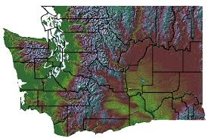
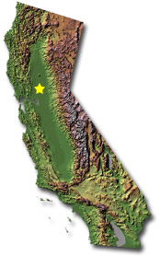
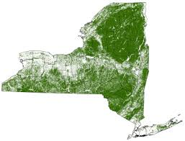
Insurance & Sustainability
Insurance regulators have also taken an interest in the sustainability of insurer’s business plans
NAIC asked insurance companies in 3 states to evaluate and report climate change risks as part of their licensing requirements

Slide 25
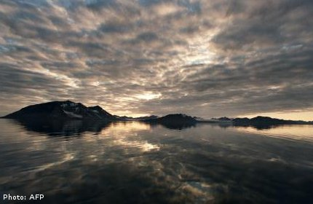
Insurance & Sustainability
Results of NAIC Climate Risk Surveys:
A small percentage of the insurers demonstrated strong leadership in assessing and addressing climate change risks
Vast majority had no strategy and were poorly prepared to address:
Investment risks
Mitigation of risks
Financial solvency
Emissions
Carbon footprint
Engaging consumers

Slide 26
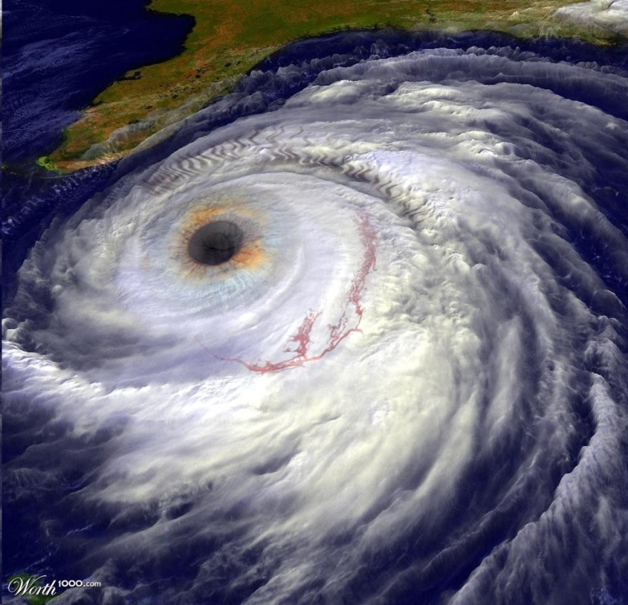
Insurance & Sustainability
Follow-ups by NAIC and CERES indicate no change in insurers’ preparedness and vulnerability to future disruptions
2014 Munich Re study results:
Weather-related losses increased 400% since 1980
Total losses in the time period were $600 billion
Losses in last 5 years have increased dramatically
Experts predict increase in frequency and severity of losses for the foreseeable future

Slide 27
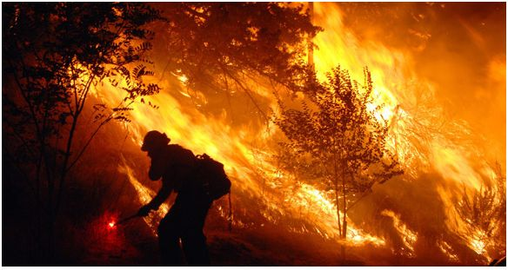
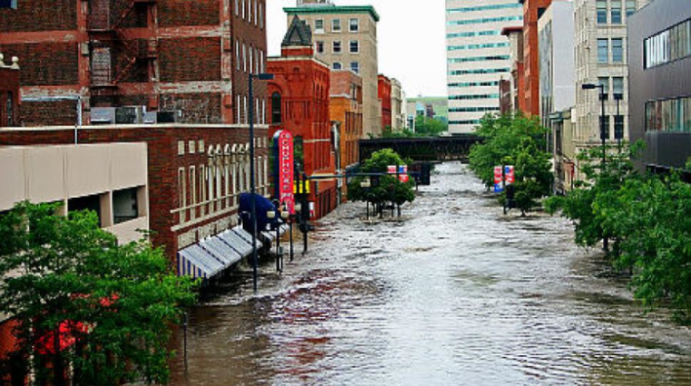
Insurance & Sustainability
Related Concept – Vulnerability of Insurer’s Investment Portfolio to Sustainability Risks
Main problem is lack of tools necessary to include climate risk in analysis of investments
Sources available include:
Carbon Disclosure Project
Corporate Sustainability Reports
Sustainability Scoring Reports
Global Reporting Initiative

Slide 28
Insurance & Sustainability
Examples related to climate change:
Severe weather can result in property damage, disrupt operations, affect transportation of raw materials and finished goods
Other less apparent consequences:
Increased claims activity will drive insurance costs up and result in higher deductibles/SIRs
Availability of insurance may become a problem if previously rare losses become the new norm (i.e., wildfires in California, Washington and Oregon)

Slide 29
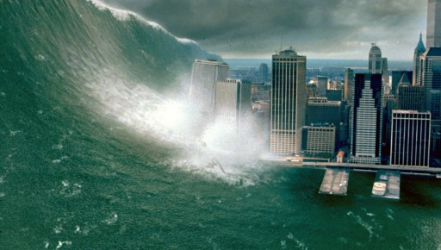
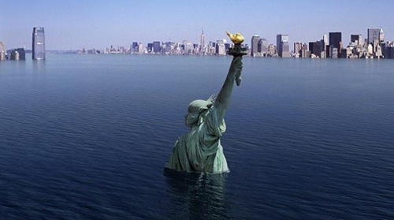
Insurance & Sustainability
All businesses are not created equal when it comes to vulnerability to climate change risks
Factors that should be considered by investors on an industry-by-industry basis include the following:

Slide 30
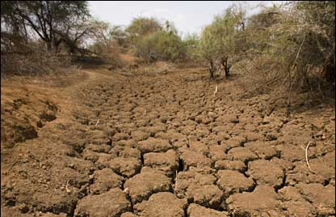
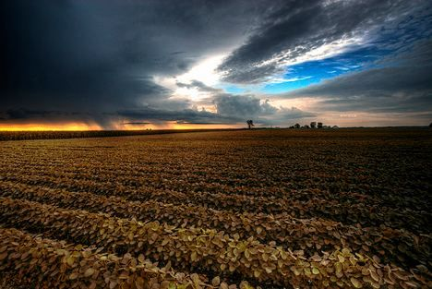
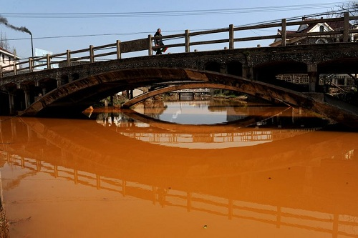
Insurance & Sustainability
Agriculture, Food Processing and Beverages

Slide 31
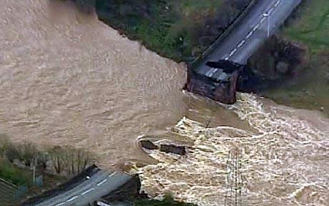
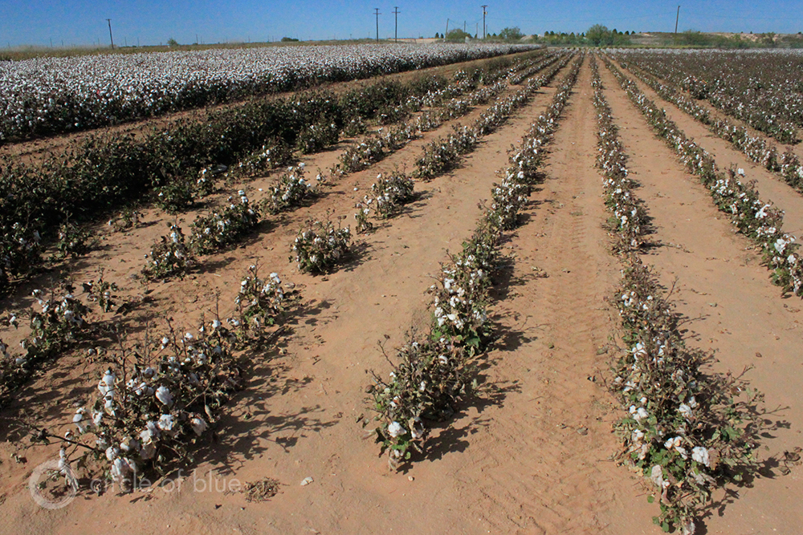
Insurance & Sustainability
Apparel Industry

Slide 32
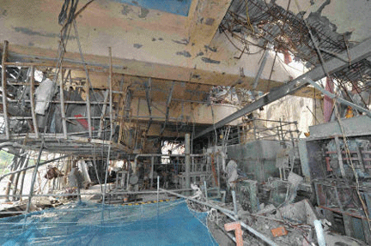
Insurance & Sustainability
Electric Power

Slide 33
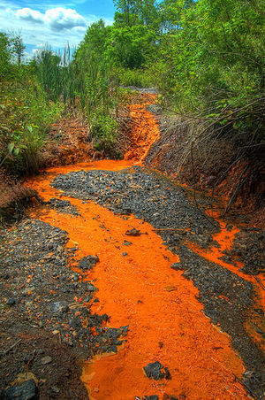
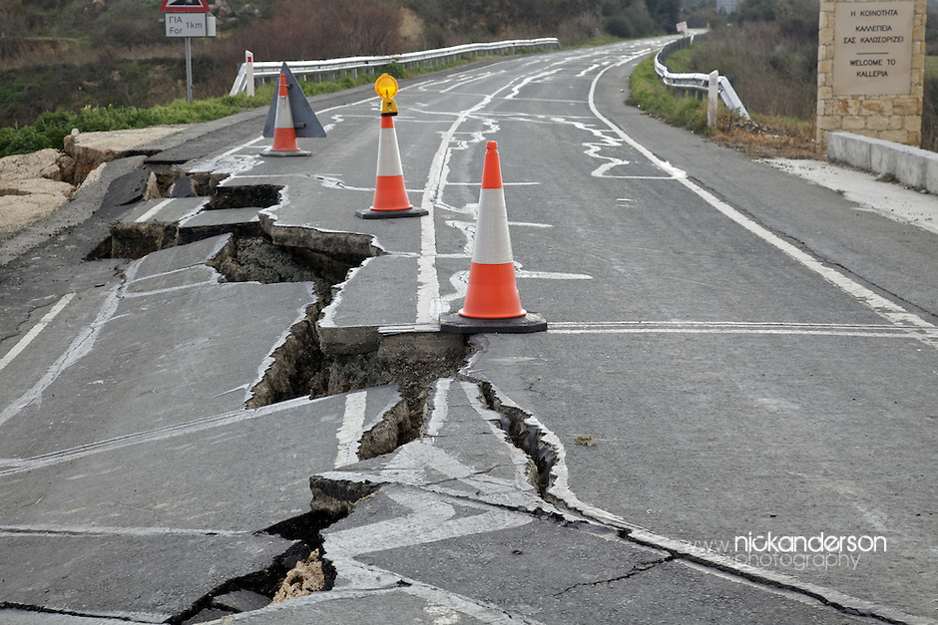
Insurance & Sustainability
Mining and Mineral Processing

Slide 34
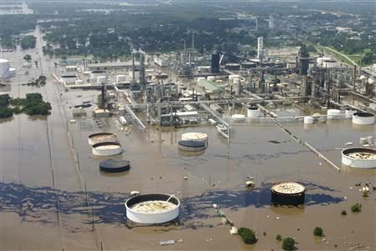
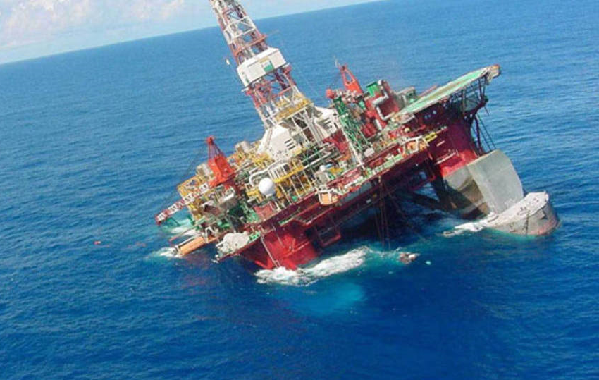
Insurance & Sustainability
Oil and Gas Exploration

Slide 35
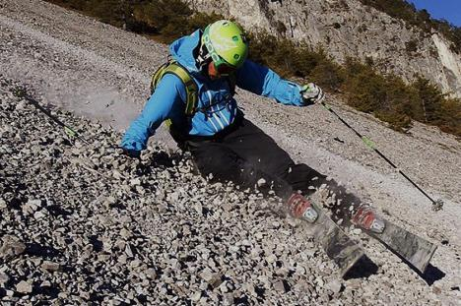
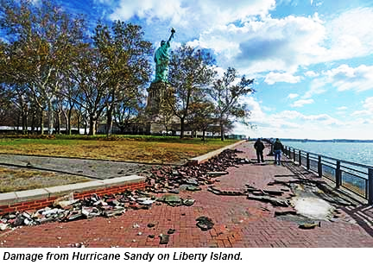
Insurance & Sustainability
Tourism

Slide 36
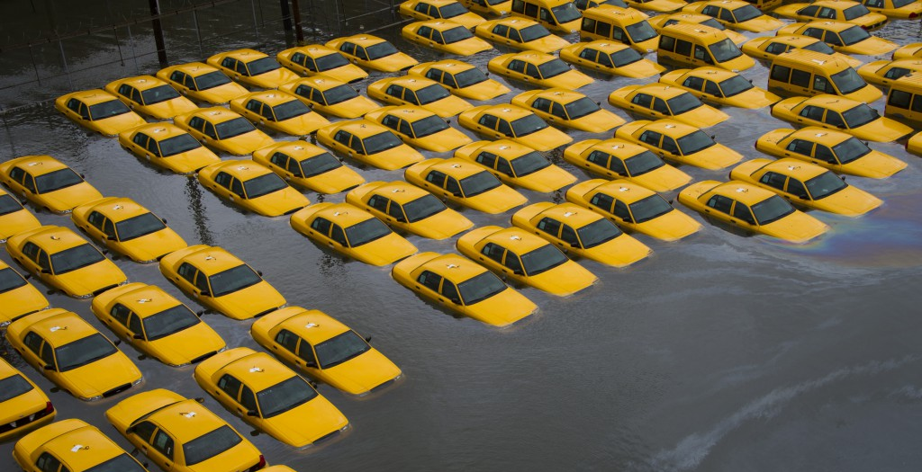
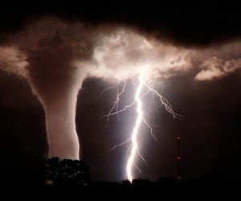
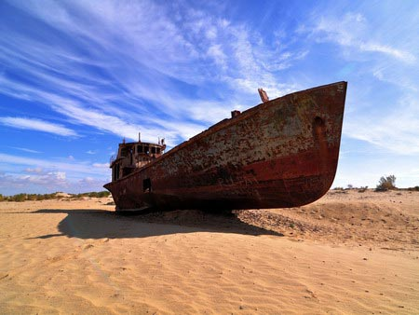
Insurance & Sustainability
Insurance

Slide 37
Insurance & Sustainability
Conclusions and Recommendations
Insurers cannot manage risks they have not identified and quantified
The challenge for underwriters, actuaries, claims managers, brokers and risk managers is to develop tools to identify sustainability risks
The challenge for managers is to be able to adapt to a changing set of circumstances to become a sustainable insurer

Slide 38
Insurance & Sustainability
Specific Actions:
Become an expert on sustainability risks of your industry segment
Look at trends to determine future risks – do not depend on the past
Brokers can increase their value to clients by understanding both risks and coverages
Those responsible for reporting and disclosure should strive to make their company one of the exceptions that is prepared for sustainability risks
Develop sustainable investment strategies

Slide 39
Insurance & Sustainability
Every journey begins with a first step

