Slide 1
Man Vs. Machine?
Do Actuaries Have the Correct Skills to Leverage Machine Outputs in Future Foresight (forecasting)?

Slide 2


What kind of analyst is needed for the future? The need is well beyond number crunching.
DATA
BETTER DATA?

Slide 3
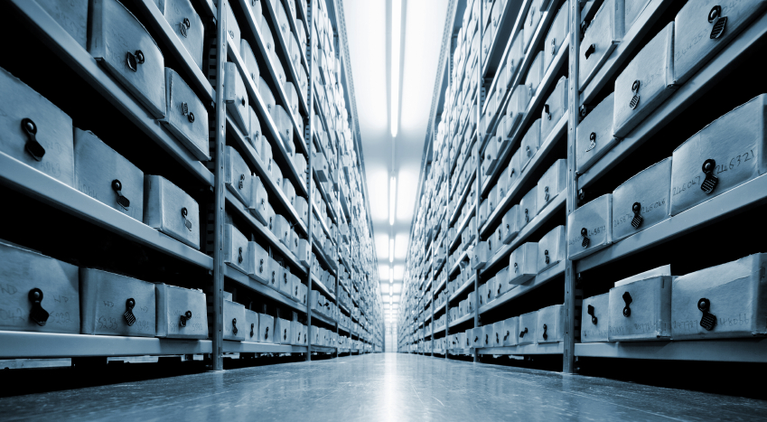
One Premise: Machine evolution has outstripped the ability of most analyst’s to handle output.

Slide 4
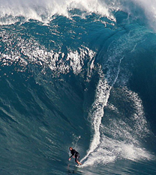
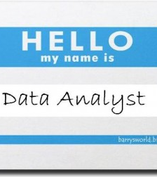
Second Premise: Machine and model evolution will require two different TYPES of analyst.

Slide 5
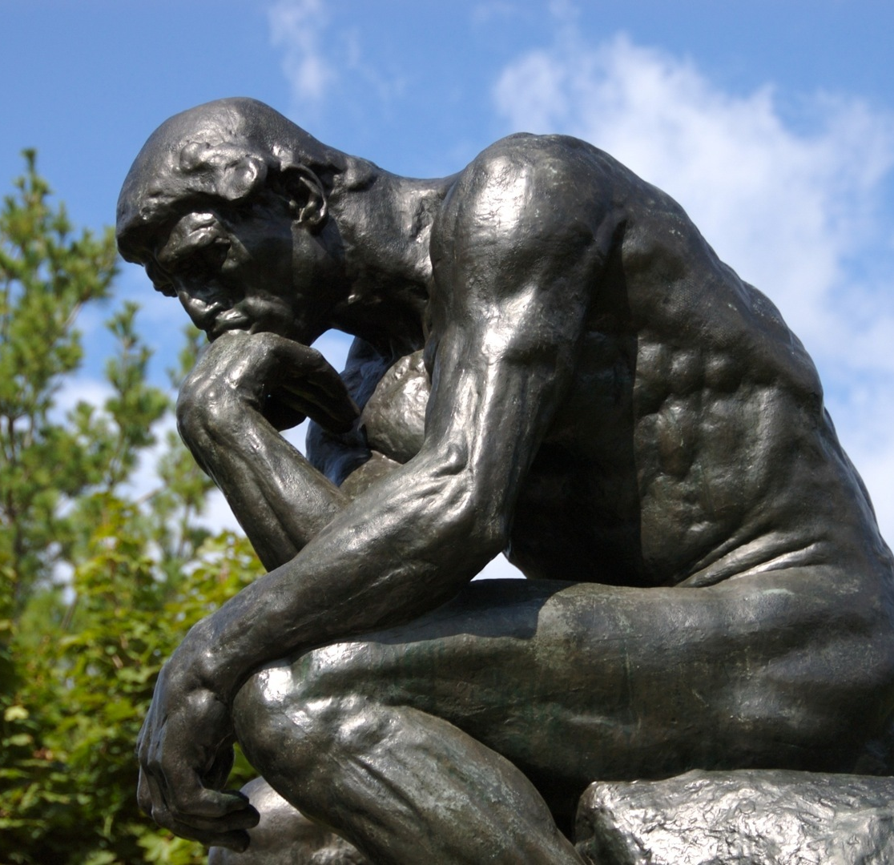
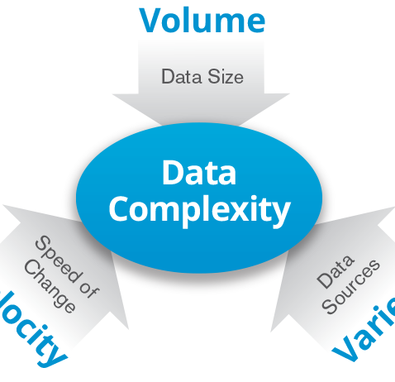
Man AND Machine
The Thinker
The Future of Data?

Slide 6
Guntram F. A. Werther, Ph.D. Professor, Temple University
Discuss interface issues of math (analytics) and effective human skill at foresight as a future TRAINING issue.
Discuss the benefits and weaknesses of technology-based tools without denigrating their value in future foresight.
Specific things YOU can do to improve practice.

Slide 7
Why these CAS Goals?
One goal of technology-enabled forecasting & assessment is to produce industrial scale automated solutions with GOOD assessment & futures foresight…
Another (frankly) is to reduce sunk cost learning (reading 10,000 good books plus getting solid experience across multiple fields; for example) that analysts need to engage in to get VERY GOOD at analysis / forecasting.

Slide 8
Two Futures Results
Industrial scale automated run-of-the-mill solutions will not need much human involvement for common tasks ➔ Many of you are out of a job.
Big picture, very complex, nuanced and/or socio-culturally entangled questions require people who can do that ➔ Learn more than math/models.

Slide 9
Future Results (2)
The demand for analysts is rising rapidly with the demand for understanding – UNDERSTANDING – increasing volumes and complexities of data AND THEIR COMPLEX REAL WORLD IMPLICATIONS.
You UNDERSTAND ➔ HIGH PAY
YOU DON’T ➔ AUTOMATION/LOW PAY

Slide 10
People who better UNDERSTAND have:
Known characteristics: Age, Type of Experience, “Knowledge of the board.”
Integrative and synthetic thinking ability: They are patternists, multi-disciplinary and non-herd (risk taking) thinkers.
They integrate ‘soft’ and ‘hard’ data to generate “String” or “Thread” ➔ “See” the emerging story in the information.

Slide 11
Why Should Integrative Learning be a CAS Goal?
Produce holistically capable entry-level practitioners able to leverage excellent technical (arithmetic) skills with excellent (cross-disciplinary, soft and nuanced) synthesis skills.
Train to improve experienced practitioners in holistic approaches➔ Improve Practice.

Slide 12
Why? An Actuarial View.
“I think the more sophisticated the model, the more care you have to take. Generally, the more sophisticated the model, the more difficult it is for decision makers to actually use the results.” Kevin Madigan , PwC (Towers Watson)
Knowing the math won’t do it for you: models are “tools” ➔ nothing more.

Slide 13
- And Wow!!!! -
“Nobody is making any decisions today that are much different than they were making 100 years ago or 50 years ago, including in the insurance industry.” Kevin Madigan
“How did you make it before you had fancy computer models? So why throw all those other tools away? It’s not like those tools aren’t any good. It’s that these models just give you even more tools.” Kevin Madigan

Slide 14
My View: The ‘Anthropological’ Corporation (organization).
The change, hazards and risks you are seeing are NOT 20th Century “normal” ➔ Forecasting Crises.
For many key technological firms, between 10% and 35% of senior manager time is now spent on “community relations” hazard management issues ➔ Costing billions and failed projects globally.
The military and intelligence communities have the tech ➔ They admit they lack the understanding.

Slide 15
What World Are You In?
It is 2015 and we are at ‘war’ with various tribes, ethnic nations and a caliphate: And not winning.
The global economy and many societies are a mess, and not finding “normal” solutions ➔ Why?
One of the best selling books of the decade is Capital in the 21st Century. ➔ Income inequality.
A socialist, Donald Trump and a BLACK REPUBLICAN are among the leading Presidential candidates in the USA; etc., etc.

Slide 16
Know ALL method limits
“Not to put too fine a point in it, one could say that the real picture consists in nothing but exceptions to the rule.” Carl Jung
“All models (all methods) are wrong” Frans Valk, GE ➔ “They are not the world.” Derman and Wilmot ➔ Harness their usefulness despite (model) assumptions Madigan
“The level of healthy skepticism towards their (model’s) results is decreasing” Kevin Madigan

Slide 17
Repeating Myself: Top Practitioners…
Are “patternists”…Hence are entangled and embedded “generalists.” ➔ See the story.
Use multiple methods and approaches.
Have “knowledge of the board.” Kahneman
Are synthesizers ➔ Achieve TRUE fusion.
See “what can and cannot be.” Berlin

Slide 18
MY MINDSET ON THIS:
Nothing I hope to convey is meant to minimize the value of advances in arithmetics, technology, or devalue the skills of people excellent in using them…. But…
‘Humane’ skill - entangled contextual judgment – is a key to real insight/foresight improvement.

Slide 19
MY MINDSET ON THIS (2)
If each method is a BIASED tool➔ Leverage this in useful ways➔ Crisis Emergence (Werther 2013)
If each social system is a BIASED solution set ➔ Understand its contextually unique ways ➔ Profiling change processes approach.
If context matters (as does the way (path) by which solutions are uniquely pursued) ➔ Then the real goal is to see and foresee the “play.” P.S. Wells.
No Machine can yet parse this difficult terrain. How do some experts do it?

Slide 20
Developing “String”
Societal systems are not random or atomized ➔ What are the meta rules? Architectures? Styles?
As specifically biased connected orders (syndromes) ➔ What are THE styles of morphing (shape shifting) during their change process?
As which syndrome is it now entangled (history)?
What can this syndrome become or not become? ➔ Skepticism about Change.

Slide 21
Knowledge of the Board
Avoid Atomism ➔ Patternist & Syndromes thinking
Knowledge that is Deep and Broad. ➔ Pursue varied rather than only specialized learning.
Experiential knowledge ➔ many iterations of ‘instances.’ ➔ Beware of qualitative shifts.
Heavy sunk cost learning across multiple realms ➔ Endless learning, iteration and integration.

Slide 22
Do NOT ‘Get’ Data
Integration is NOT ABOUT “GETTING” DATA or anything else.
IT IS about folding in and iteratively (re)assessing what comes ➔ Surfer Pic
Note that no single model / approach is particularly useful in this task.

Slide 23
Multiple Perspectives
Since every method / model / approach is a biased one, the output of any approach is just ONE VIEW.
How does it fit into the ecosystem of views?
How does it fit into what we know about the way, or path, by which this syndrome (system) changes?
Does it fit the story line?

Slide 24
See the ‘fit’ of things
What is its “IDEA”?
How is it arranged / organized as a system (syndrome)?
What are the change processes by which it deals with normal, crisis and post-crisis situations?

Slide 25
At the End of the Day.
Each model output is ONE data point – ONE BIASED OPTIC – to be folded in to what is previously known.
For futures assessment, the changes of the individual optics (model outputs, etc.) with respect to each other is FAR more useful than any single measure.

Slide 26
The “Play” is the thing.
How things are embedded, entangled and emergent WITHIN THEIR PARTICULARLY BIASED SYSTEM (syndrome) and within its particular change process is the thing to study.
Most changes, even most so-called “black swans,” are not random events emerging out of nowhere.

Slide 27
How Do You Learn This?
As best you can, increasingly read and study OUTSIDE your core area of experience ➔ Areas likely to affect it.
Get work experience outside your core area. You cannot integrate what you do not know.
Try to think within and across patterns.

Slide 28
The Good / Bad News
GOOD: We have much more data / information and far better technical means of assessing it than ever before.
BAD: We have the same old analysts.
BAD: They are more narrowly trained than before.

Slide 29
The Good / Bad News (2)
Bad: We are tasked (experienced) less broadly and are typically more specialized.
Bad: We think more / better tools offer solutions: Tools are still just tools, yet many analysts are today less skeptical of them.

Slide 30
Two Closing Comments
Alexis de Tocqueville and his friends called the U.S. Civil War’s timing CORRECTLY AS TO THE DAY (election of 1860) correctly FROM FIVE YEARS PRIOR using newspapers that took months to arrive.
In the same way, Sir Edmund Burke correctly forecast the consequences of the French Revolution.
EVERY ECONOMIC MODEL FAILED TO FORECAST THE 2007/2008 ECONOMIC DECLINE; And much more.

Slide 31
- Respect your Elders -
Any Questions?
It wasn’t the machine, but rather the ‘man’.

