Slide 1
CAS Diversity Panel
Moderator: Roosevelt Mosley
Panelists: Nancy Braithwaite
Arthur Randolph
Marcela Granados
David Terne’
CAS Annual Meeting - November 2015
Philadelphia PA

Slide 2
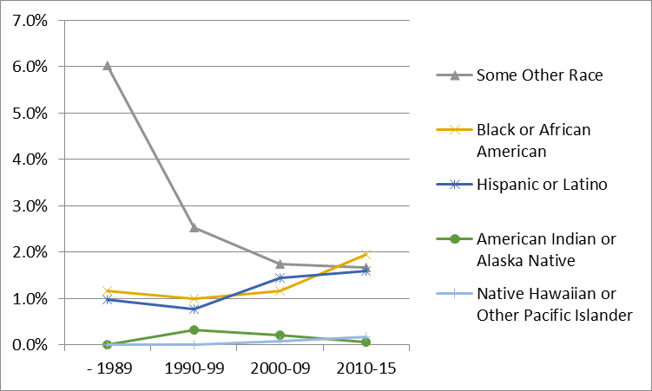
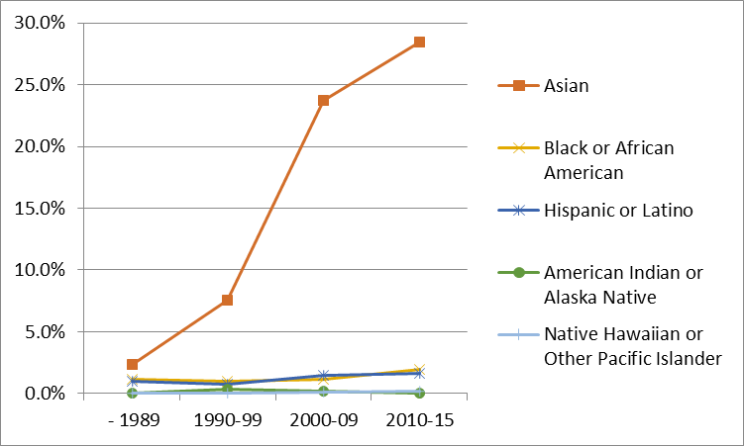
Ethnicity by Membership Class

Slide 3
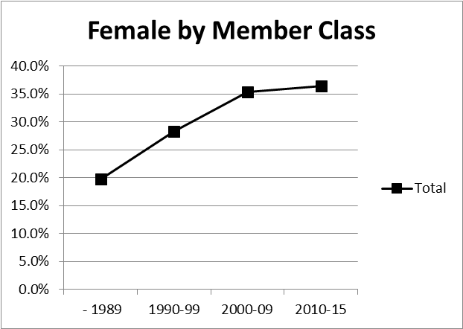
Gender by Membership Class

Slide 4
Lifetime ACAS

