Slide 1
Southwest Actuarial Forum
Interactions and Saddles
Serhat Guven, FCAS, MAAA
June 10, 2011

Slide 2
Agenda
Background
Interactions
Saddles
Validation

Slide 3
Background
SIMPLE MODEL
Relationship between rating levels of one factor is constant for all levels of other rating variables
Assume two rating variables
  Age: Youthful, Adult (Base), Mature, Senior
  Gender: Male (Base), Female
Simple Model: Age + Gender
Male
Female
Youthful
β₀+ β_{Y}
β₀+ β_{Y} + β_{F}
Adult
β₀
β₀+ β_{F}
Mature
β₀+ β_{M}
β₀+ β_{M} + β_{F}
Seniors
β₀+ β_{S}
β₀+ β_{S} + β_{F}
5 Parameters

Slide 4
Background
SIMPLE MODEL
Simple Model: Age + Gender
Male
Female
Youthful
β₀+ β_{Y}
β₀+ β_{Y} + β_{F}
Adult
β₀
β₀+ β_{F}
Mature
β₀+ β_{M}
β₀+ β_{M} + β_{F}
Difference between male and female is the same regardless of age
Seniors
β₀+ β_{S}
β₀+ β_{S} + β_{F}
5 Parameters

Slide 5
Interactions
INTERACTION MODEL
Relationship between rating levels of one rating factor is different for all levels of another rating variable
Assume two rating variables
  Age: Youthful, Adult (Base), Mature, Senior
  Gender: Male (Base), Female
Simple Model: Age + Gender
Interaction: Age + Gender+Age.Gender
Male
Female
 | Male | Female
Youthful | β₀+ β_{Y} | β₀+ β_{Y} + β_{F}+ β_{YF}
Adult | β₀ | β₀+ β_{F}
Mature | β₀+ β_{M} | β₀+ β_{M} + β_{F}+ β_{MF}
Seniors | β₀+ β_{S} | β₀+ β_{S} + β_{F}+ β_{SF}
Youthful
β₀+ β_{Y}
β₀+ β_{Y} + β_{F}
Adult
β₀
β₀+ β_{F}
Mature
β₀+ β_{M}
β₀+ β_{M} + β_{F}
Seniors
β₀+ β_{S}
β₀+ β_{S} + β_{F}
5 Parameters
8 Parameters

Slide 6
Background
INTERACTION MODEL
Interaction: Age + Gender+Age.Gender
 | Male | Female
Youthful | β₀+ β_{Y} | β₀+ β_{Y} + β_{F}+ β_{YF}
Adult | β₀ | β₀+ β_{F}
Mature | β₀+ β_{M} | β₀+ β_{M} + β_{F}+ β_{MF}
Seniors | β₀+ β_{S} | β₀+ β_{S} + β_{F}+ β_{SF}
Youthful males are significantly higher than youthful females – resulting structure is still volatile
8 Parameters

Slide 7
Background
Why are interactions present
  Because that's how the factors behave
  Because the multiplicative model can go wrong at the edges
    1.5 * 1.4 * 1.7 * 1.5 * 1.8 * 1.5 * 1.8 = 26!
Interaction challenges
  Identification
    Given n factors there are n choose 2 possible interactions to study
  Simplification
    Once an interaction has been identified the structure needs to be simplified to avoid overfitting

Slide 8
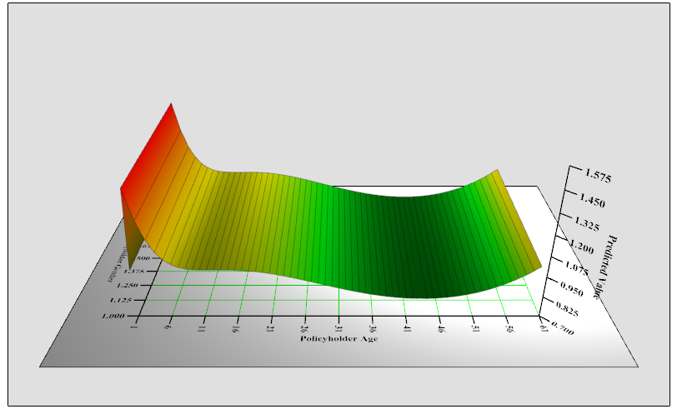
Interactions
Age x Gender
  Main effects construction
Gender
β
β
−
β
β
β
β
β
β
β
β
−
−
−
−
−
−
−
−
−
−
β
−
−
−
−
−
−
−
−
−
−
β
−
−
−
−
−
−
−
−
−
−
−
−
−
−
−
−
−
−
−
−
−
Age
β
−
−
−
−
−
−
−
−
−
−
β
−
−
−
−
−
−
−
−
−
−
β
−
−
−
−
−
−
−
−
−
−
β
−
−
−
−
−
−
−
−
−
−
β
−
−
−
−
−
−
−
−
−
−
β
−
−
−
−
−
−
−
−
−
−

Slide 9
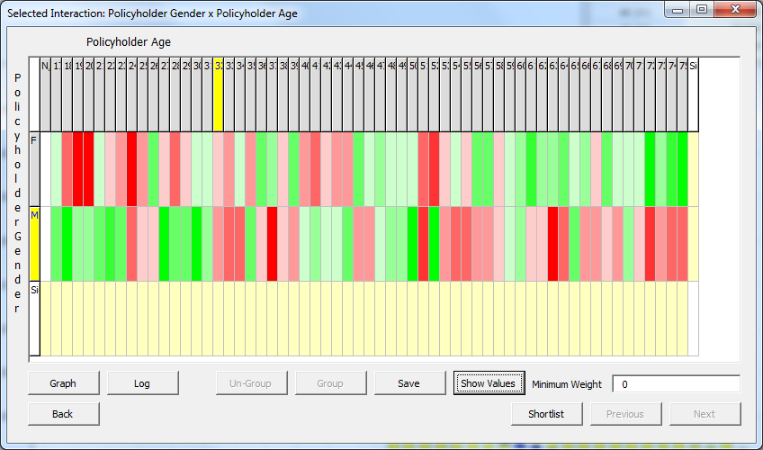
Interactions
Imbalances within the cells exists – suggesting some form of interaction

Slide 10
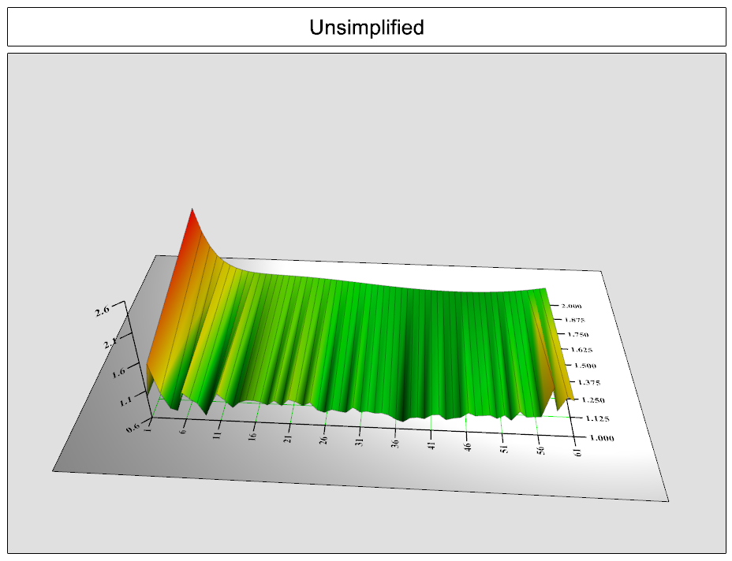
Interactions
Age x Gender
  Full Interaction
Gender
β
β
−
β
β
β
β
β
β
β
β
β
β
−
β
β
β
β
β
β
β
β
β
β
−
β
β
β
β
β
β
β
β
β
β
−
β
β
β
β
β
β
β
−
−
−
−
−
−
−
−
−
−
−
Age
β
β
β
−
β
β
β
β
β
β
β
β
β
β
−
β
β
β
β
β
β
β
β
β
β
−
β
β
β
β
β
β
β
β
β
β
−
β
β
β
β
β
β
β
β
β
β
−
β
β
β
β
β
β
β
β
β
β
−
β
β
β
β
β
β
β

Slide 11
Interactions
Rating Area x Vehicle Value
  Interaction needs to be simplified
Vehicle Value
Vehicle Value
Vehicle Value
β
β
−
β
β
β
β
β
β
β
β
β
−
β
β
β
β
β
β
β
β
−
−
−
−
−
−
−
−
−
−
β
β
β
−
β
β
β
β
β
β
β
β
−
−
−
−
−
−
−
−
−
−
β
β
β
−
β
β
β
β
β
β
β
β
−
−
−
−
−
−
−
−
−
−
β
β
β
−
β
β
β
β
β
β
β
Rating Area
−
−
−
−
−
−
−
−
−
−
−
−
−
−
−
−
−
−
−
−
−
−
Rating Area
β
−
−
−
−
−
−
−
−
−
−
Rating Area
β
β
β
−
β
β
β
β
β
β
β
β
−
−
−
−
−
−
−
−
−
−
β
β
β
−
β
β
β
β
β
β
β
β
−
−
−
−
−
−
−
−
−
−
β
β
β
−
β
β
β
β
β
β
β
β
−
−
−
−
−
−
−
−
−
−
β
β
β
−
β
β
β
β
β
β
β
β
−
−
−
−
−
−
−
−
−
−
β
β
β
−
β
β
β
β
β
β
β
β
−
−
−
−
−
−
−
−
−
−
β
β
β
−
β
β
β
β
β
β
β

Slide 12
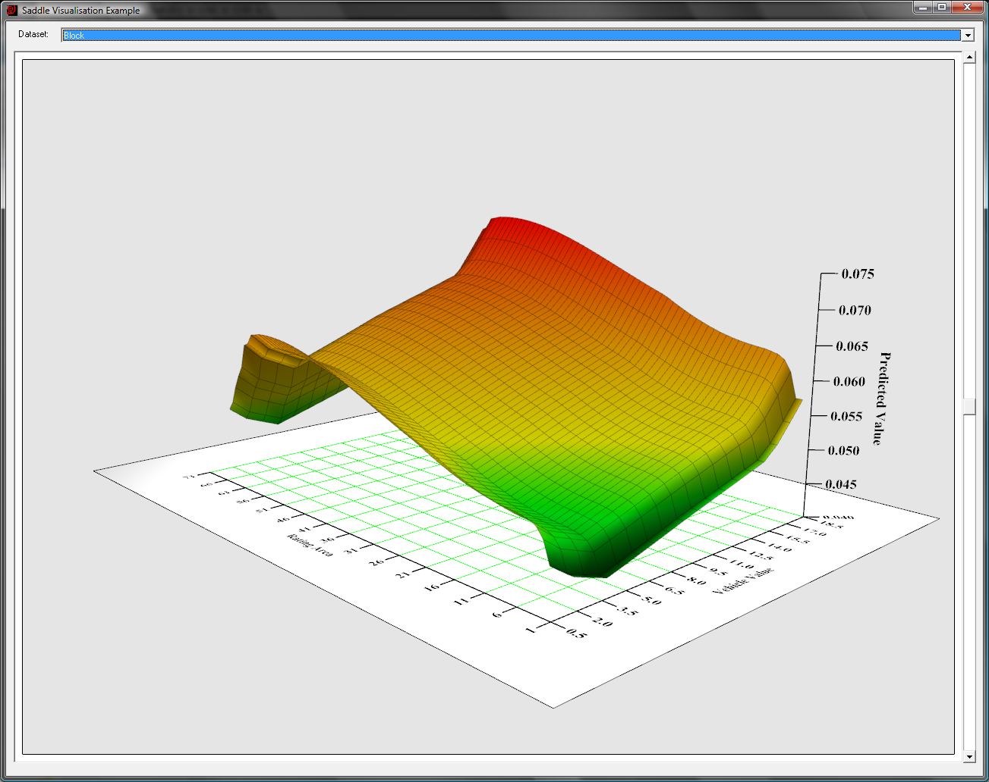
Interaction
Rating Area x Vehicle Value
  Main effect model

Slide 13
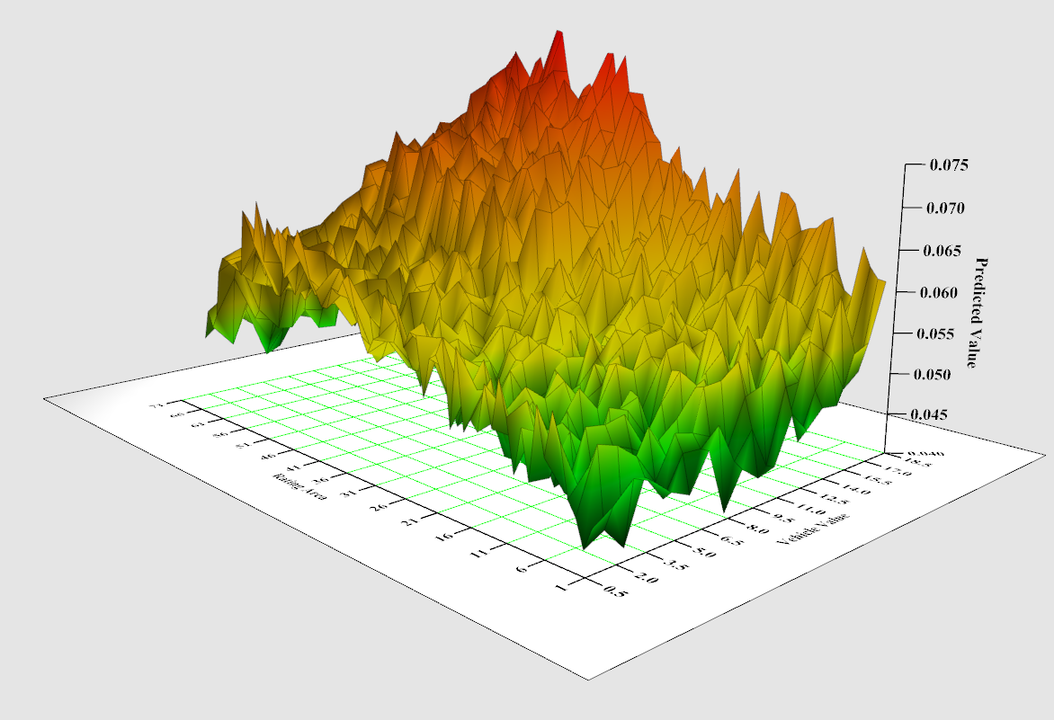
Interaction
Rating Area x Vehicle Value
  Full Interaction

Slide 14
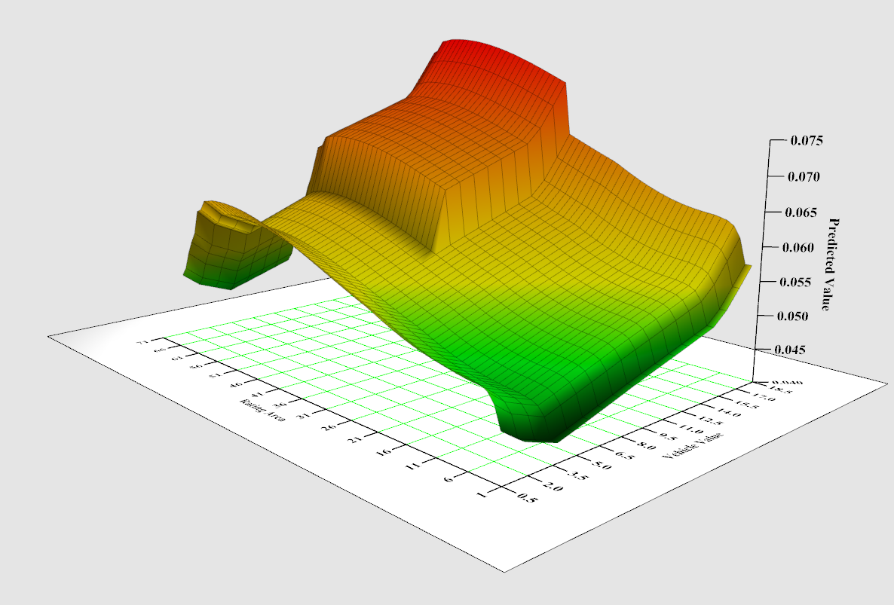
Interactions
Rating Area x Vehicle Value
  Simplification emphasizes interaction strength

Slide 15
Saddles
Quadrant saddle: revisiting an simple main effect model

Slide 16
Saddles
Quadrant saddle: interaction terms twist the paper

Slide 17
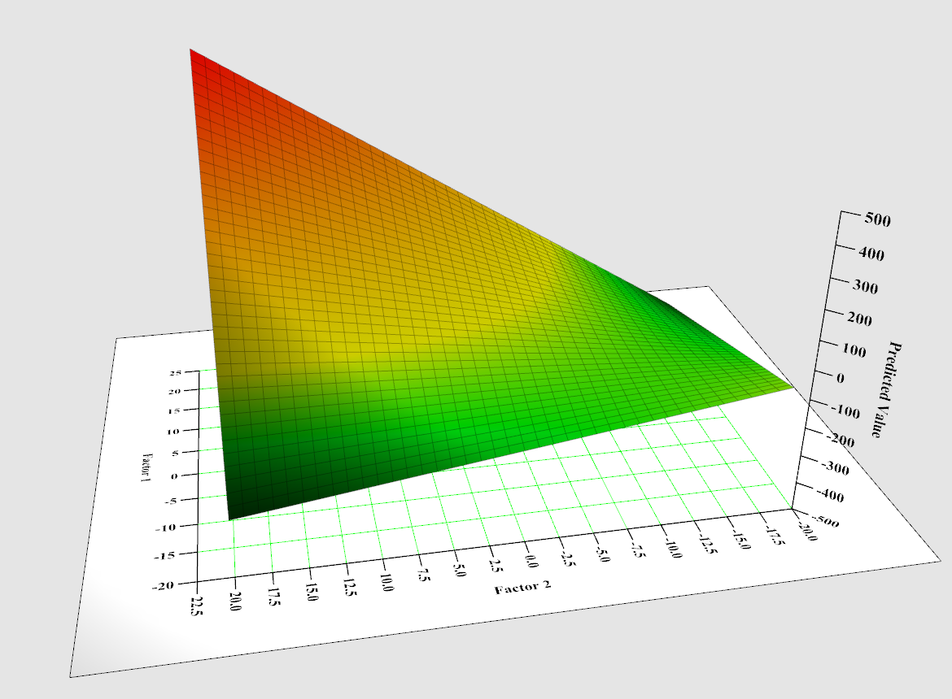
Saddles

Slide 18
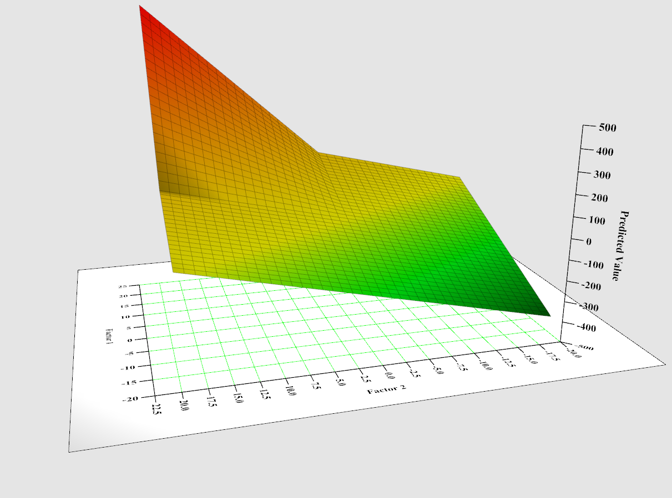
Saddles

Slide 19
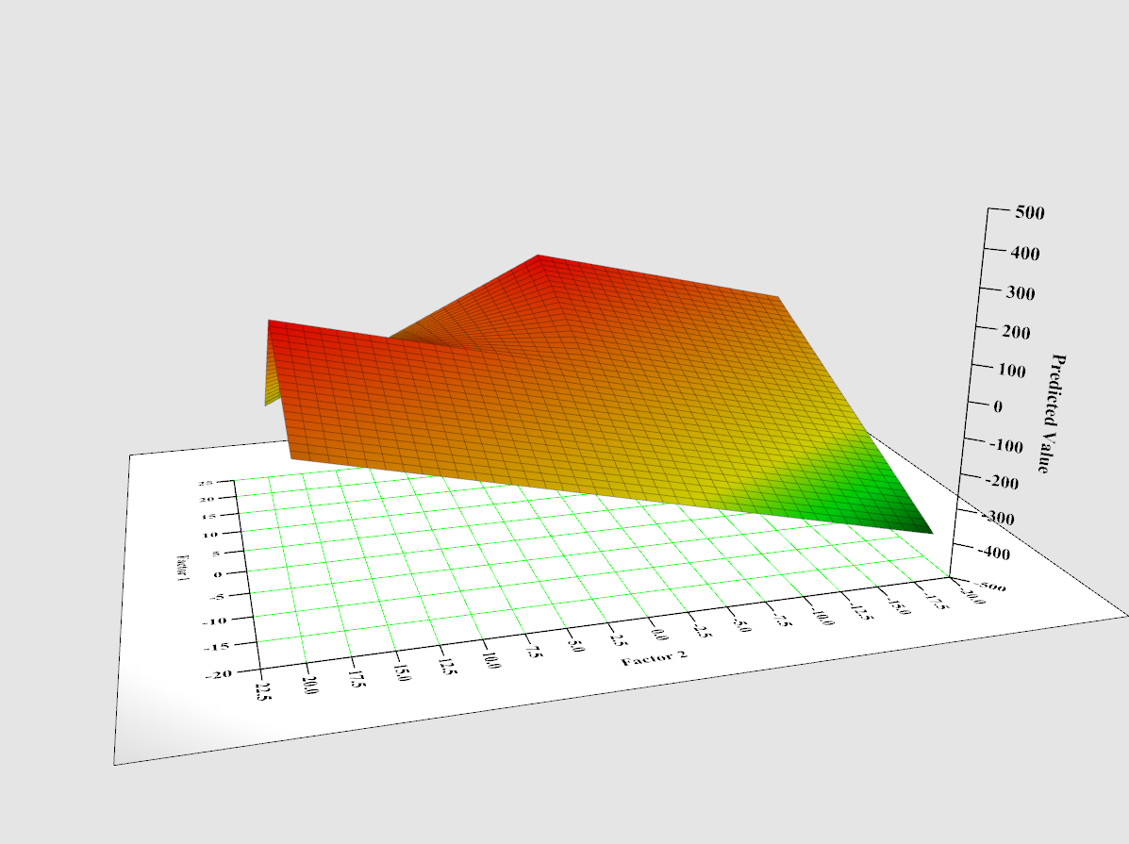
Saddles

Slide 20
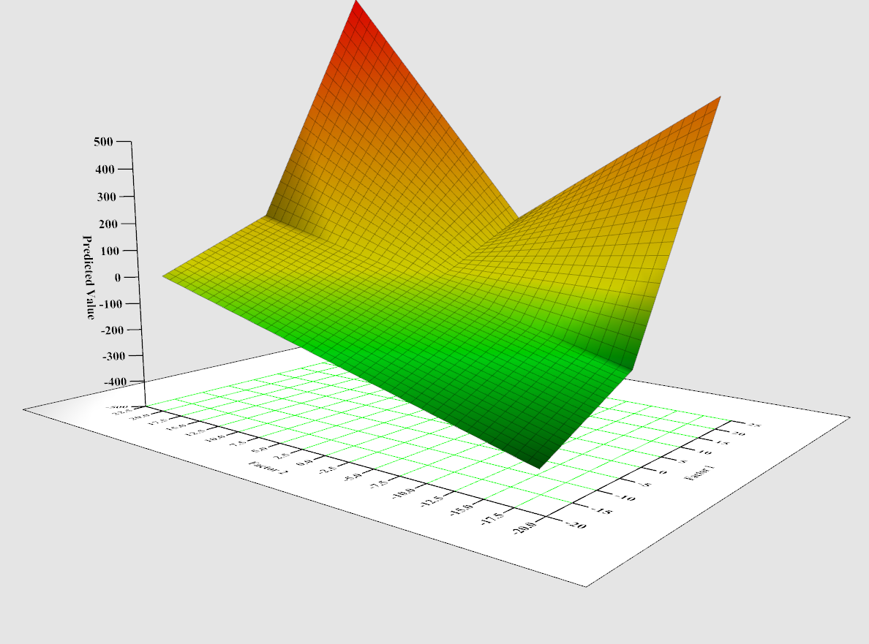
Saddles

Slide 21
Saddles
Transforming predictors into single parameter variates
Response
Factor Levels

Slide 22
Saddles
Transforming predictors into single parameter variates
Response
β
Factor Levels

Slide 23
Saddles
Parameterization
Simple Model: Age + Gender
Variate Model: α₁*β_{Age} + α₂*β_{Gender}
Male
Female
Male
Female
Youthful
β₀+ β_{Y}
β₀+ β_{Y} + β_{F}
Youthful
β₀+ α₁*β_{Y}
β₀+ α₁*β_{Y} + α₂*β_{F}
Adult
β₀
β₀+ β_{F}
Adult
β₀
β₀+ α₂* β_{F}
Mature
β₀+ β_{M}
β₀+ β_{M} + β_{F}
Mature
β₀+ α₁*β_{M}
β₀+ α₁*β_{M} + α₂*β_{F}
Seniors
β₀+ β_{S}
β₀+ β_{S} + β_{F}
Seniors
β₀+ α₁*β_{S}
β₀+ α₁*β_{S} + α₂* β_{F}
5 Parameters
3 Parameters
Fitted values from both structures are the same
Variates
  X-Values are the beta parameters from the simple model
  Coefficient should be 1.000

Slide 24
Saddles
Parameterization
  Nonlinear terms introduced via interaction among variates
Full Saddle: α₁*β_{Age} + α₂*β_{Gender} + α₃*β_{Age} * β_{Gender}
 | Male | Female
Youthful | β₀ + α₁*β_{Y} | β₀+ α₁*β_{Y} + α₂*β_{F} + α₃*β_{Age} * β_{Gender}
Adult | β₀ | β₀+ α₂* β_{F} + α₃*β_{Age} * β_{Gender}
Mature | β₀+ α₁*β_{M} | β₀+ α₁*β_{M} + α₂*β_{F} + α₃*β_{Age} * β_{Gender}
Seniors | β₀+ α₁*β_{S} | β₀+ α₁*β_{S} + α₂* β_{F} + α₃*β_{Age} * β_{Gender}

Slide 25
Saddles
Advantages
  Non linear variate parameter
    Easier to validate
    Simpler shape
  Useful in identifying interactions in more volatile structures
    High dimensional factors
    N-way interaction structures
    Severity models
Disadvantages
  Difficult to detect interactions when a factor is not a main effect

Slide 26
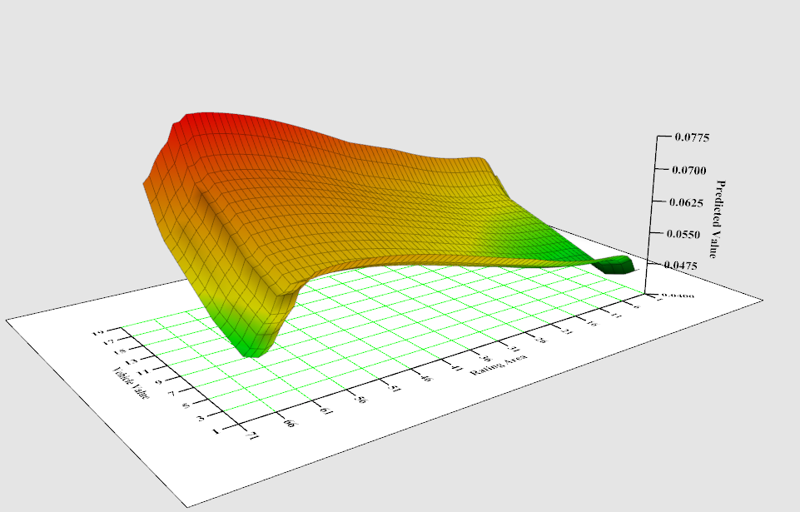
Saddles
Rating Area x Vehicle Value Revisited

Slide 27
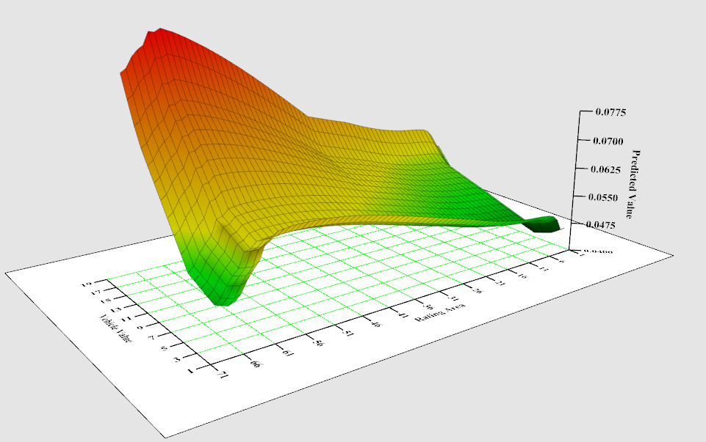
Saddles
Rating Area x Vehicle Value Revisited

Slide 28
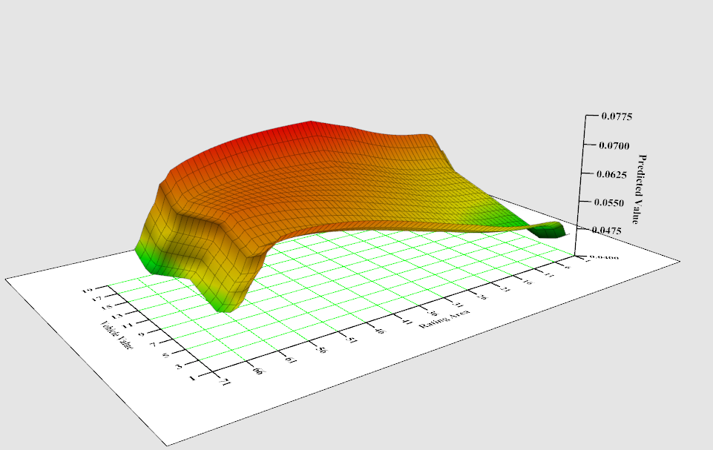
Saddles
Rating Area x Vehicle Value Revisited

Slide 29
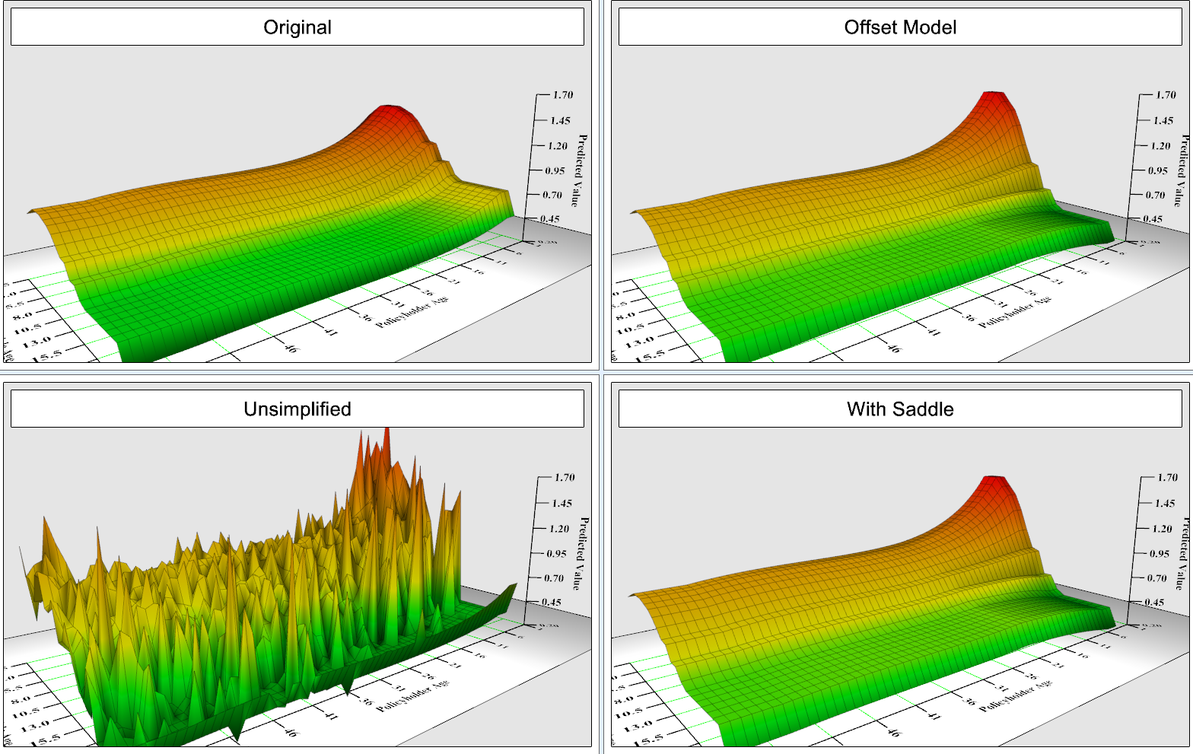
Saddles
Driver Age x Vehicle Age

Slide 30
Validation
Model Comparison
  Auto frequency: Out of sample

Slide 31
Validation
Model Comparison
  Auto frequency: Out of time

Slide 32
Validation
Model Comparison
  Renewals: Out of sample

Slide 33
Conclusion
Interactions are an important part of the model creation process
Interactions have their own challenges
  Identification
  Simplification
  Dimensionality
Effort needed in simplifying and validating identified interaction
  Saddles use the framework of variate vectors in the design matrix to quickly simplify and validate new interaction terms

