Slide 1
Building an Economic Capital Model
Susan witcraft
09.18.2015
Notes:
Title Slide

Slide 2
Overview
Platform
Economic scenarios
Underwriting
Investment returns
Operational risks
Financial statements & reporting

Slide 3
Platform
Type of platform
  Spreadsheet
  Coded software
  Blend
Source of platform
  License
  Build

Slide 4
Economic Scenarios
Economic Scenario Generator (ESG) is mathematical model of
    Yield curves for different types of bonds
    Inflation rates
    Stock returns
    Gross domestic product
    Other economic variables
  And their interrelationships
Options for obtaining scenarios
    Buy
    Rent
    Build
Stochastic jump process
Brownian Motion
Vasicek Model
Ornstein-Uhlenbeck Process

Slide 5

Underwriting
Exposure volatility
Price volatility
Parameter risk
Non-cat losses
Claim cost trend
Catastrophes
Reinsurance
Emerging risks
Correlations
Calendar year effects
Peery Foundation

Slide 6
Underwriting: Exposure Volatility
By how much will underlying exposure written in year differ from “baseline” or Plan?
Can talk to business leaders
Compare actual vs. Plan written premium (ex. price impacts) historically

Slide 7
Underwriting: Pricing Volatility
By how much will underlying pricing and terms on exposure written in year differ from “baseline” or Plan?
  Can talk to business leaders
  Compare actual vs. Plan rate changes historically
Important to consider projection period of model
  One year volatility
  Underwriting cycle model

Slide 8
Underwriting: Parameter Risk
Emanates from uncertainty surrounding selection of parameters in model
Often focused on mean
Drivers:
  Inherent nature of underlying business
  Credibility of historical information available for analysis
Can review total volatility of historical results and back out unexpected inflation, process and pricing risk
Can look at statistical measures of goodness of fit
Requires a lot of judgment

Slide 9
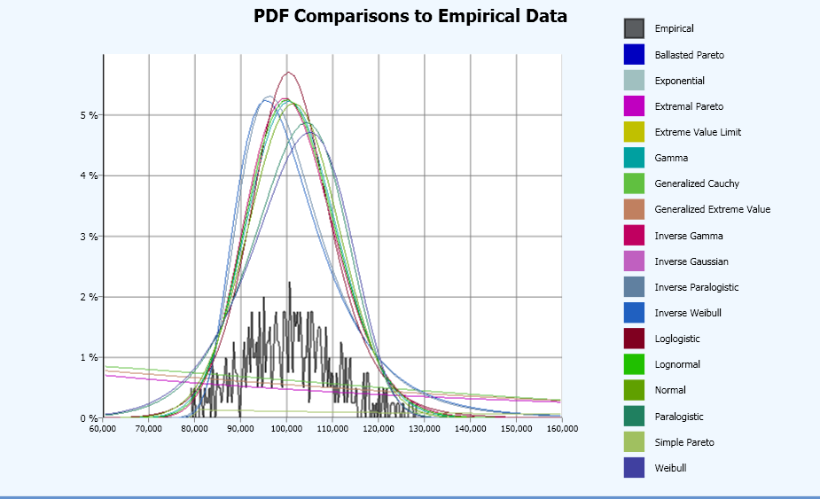
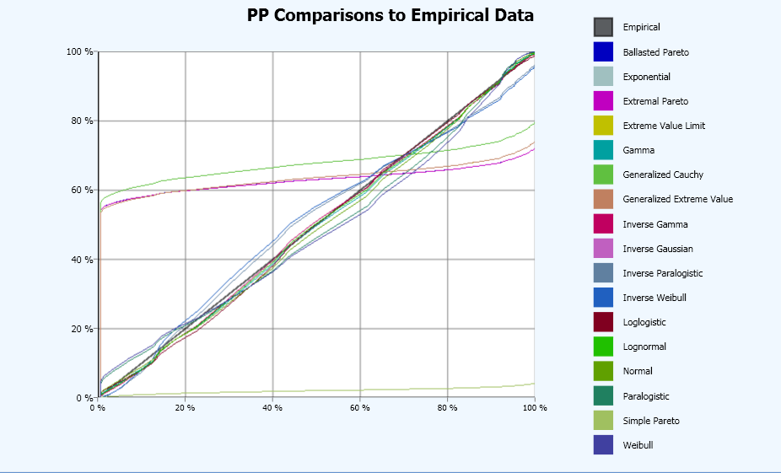
Underwriting: Non-Cat Losses
Use probability distributions to describe size and amount of claims
  Look at industry data
  Analyze company data
  Fit distributions to company data
  Select distribution based on judgment and credibility
Often look at individual large claims and aggregation of small claims

Slide 10
Underwriting: Claim Cost Trend
Model parameters generally assume “expected” claim cost trend
Want to incorporate unexpected claim cost trend
Often modeled by calendar year of payment
Usually relate claim cost trends to inflations from ES
  Can be primary source of correlation between investment returns and underwriting
  Often difficult to parameterize due to volatility in insurance trends
  Therefore have significant subjective component in addition to statistical analysis

Slide 11
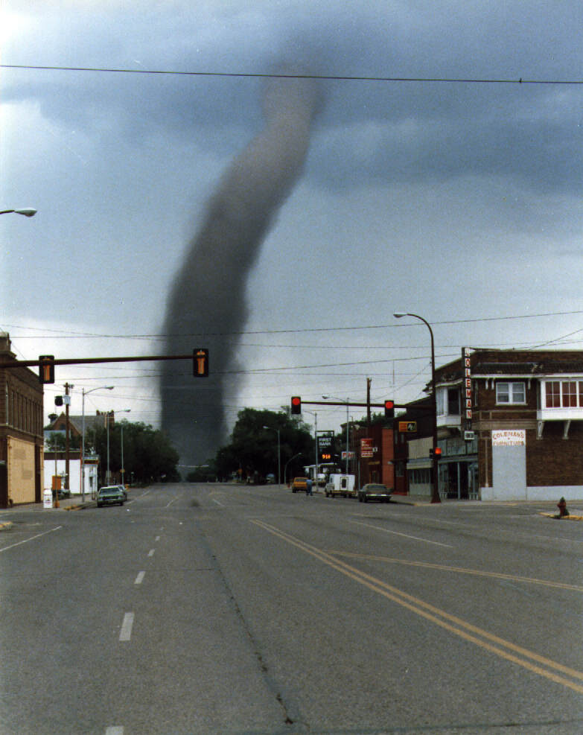
Underwriting: Catastrophes
Modeled perils
Need to consider strengths and weaknesses of models relative to business written
Can use one vendor or blend results from more than one vendor
Non (or poorly) modeled perils
Build own model
Create scenarios and assign rough probabilities
Something is often better than nothing

Slide 12

Underwriting: Reinsurance
Modeling can be done on either net or gross and ceded basis
  I prefer gross and ceded, but depends on questions to be answered
Need to understand coverage, terms and pricing of all reinsurance contracts
  Limits and attachment points
  Corridors and/or sliding scale commissions
  Reinstatement premiums
  Allocation of ceded premium
Default and dispute risk
  Can relate to economy, cats, casualty reserve cycle
Aci Construction

Slide 13
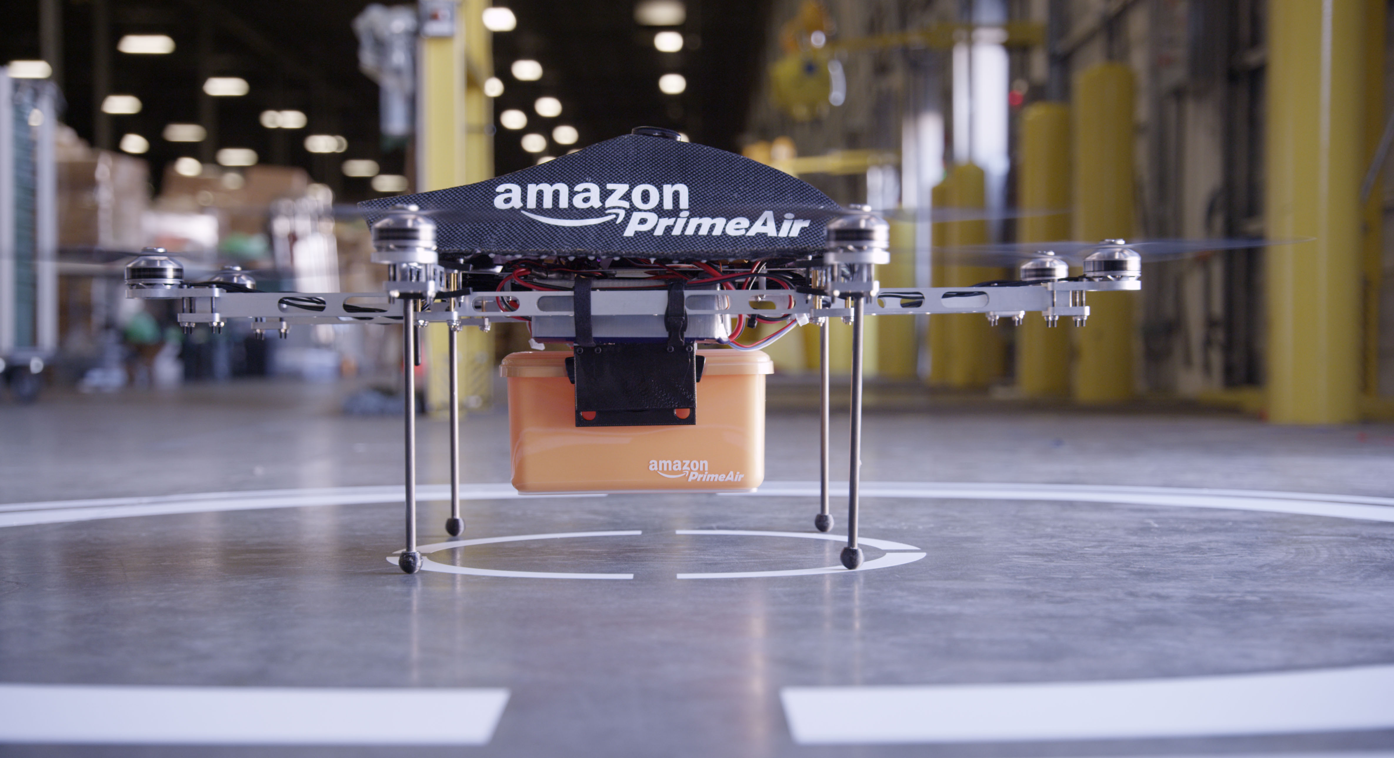
Underwriting: Emerging Risks
By their nature don’t have data or information to model “well”
Can exclude and identify in limitations
Can construct scenarios and assign approximate probabilities
Can incorporate only in stress testing and not stochastic modeling

Slide 14
Underwriting: Correlation
Underwriting correlation: Losses from some business segments are likely to be higher than expected when losses from another business segment are higher than expected
  Can look at historical data, industry benchmarks
  Apply lots of judgment
Try to use only where can’t find causal drivers

Slide 15
Underwriting: Calendar Year Effects
Current accident year
So far focused on ultimate loss volatility
Need to think about how much will have emerged by the end of each calendar year and how that information will be reflected in actuarial and management estimates
Incoming reserves
Change in estimate for each projection year in model
Range of possible outcomes – not range of reasonable estimates
Look at historical data
Mack, Bootstrap, GLM and related models on triangles
GLM model on individual claim data

Slide 16
Investment Returns
Return assumptions usually from economic scenarios
Again – economic scenarios are key correlation driver between underwriting and investments
Granularity
Ranges from individual security to large classes (e.g., bonds, stocks, cash)
Choice depends on:
  Purpose of model
  Homogeneity within each class
  Importance of measuring liquidity
  Run time of model
  Granularity of return assumptions in economic scenarios

Slide 17
Operational Risks
Need to define Operational Risk for your purposes, ranging from:
Cost of true operational errors
Anything that could cause results to deviate from the Plan not considered elsewhere in model
Approaches
Flat percentage of capital
Percentages of premium, reserves or other measure of risk
Historical analysis of operational risk experience

Slide 18
Reporting & Financial Statements
Financial Statements
Economic, GAAP and/or Stat
Choice determined by model or project purpose
May include related metrics such as RBC, BCAR, S&P Capital, Leverage Ratios
Reporting
Not really part of the model itself
Most critical component for successful acceptance of economic capital modeling: Communicating the results in a useful & understandable manner!

Slide 19
Building an Economic Capital Model
Susan witcraft
09.18.2015
Notes:
Title Slide

