Slide 1
CASstudentcentral.org
Rising in the Actuarial Profession through the CAS
September 18, 2015
Jennifer Weiner, Zach Brogadir,
Josie Fix & Ben Markowski

Slide 2
Outline
What is an Actuary?
Why be an Actuary?
What skills are needed to be an Actuary?
What is the difference – CAS and SOA?
How do you become an Actuary?
What do Property/Casualty Actuaries do?
How can I find out more?
Notes:
Notes to Presenter: There are 56 slides within this presentation that span across audiences with varying levels of actuarial knowledge. We recommend that you review the slides and make adjustments to the presentation based on the expected level of the audience and time allotted. There are slides that will be relevant to students with little-to-no actuarial knowledge that won’t be as relevant to actuarial majors, and vice versa. We have provided some guidance below regarding the recommended audience level for specific slides. You are welcome to update this presentation any way you see fit. You can remove slides and add additional slides of your own.
Slide Guidance:
Slides 3-10: The early slides covering the first two bullets are most appropriate for presentations to non-actuarial majors who are seeking to learn about the actuarial career. These slides can be consolidated or eliminated for students already studying actuarial science.
Slides 25-35: There are 10 slides covering the CAS Basic Education material. This information is likely too detailed for non-actuarial majors, and can be consolidated to include slide 25 and slide 33.

Slide 3
Outline
What is an Actuary?
Why be an Actuary?
What skills are needed to be an Actuary?
What is the difference – CAS and SOA?
How do you become an Actuary?
What do Property/Casualty Actuaries do?
How can I find out more?

Slide 4
What is an Actuary?
A business professional who deals with the financial impact of risk and uncertainty
Analyzes, manages and measures the financial implications of future risk
Develops and validates models and communicate results to guide decision-making

Slide 5
Areas of Work
Insurance Industry
  Property and casualty (P/C)
  Life and annuities
Employee Benefit Industry
  Retirement benefits
  Health benefits
Financial Services Industry
  Banks, investments, risk management
  Mergers & Acquisitions
Government
  Social Security
  Regulation of insurance companies

Slide 6
Typical Actuarial Projects
Property/Casualty: Estimating the amount of money to be set aside for insurance claims that have not been paid
Life Insurance: Designing and pricing life insurance products
Health Benefits: Setting HMO premium rates.
Retirement Systems: Pricing the cost of increasing retirement benefits
Finance & Investments: Portfolio diversification studies

Slide 7
Outline
What is an Actuary?
Why be an Actuary?
What skills are needed to be an Actuary?
What is the difference – CAS and SOA?
How do you become an Actuary?
What do Property/Casualty Actuaries do?
How can I find out more?

Slide 8
Why be an Actuary?
High earnings potential
Graduate school not required – no loans to repay
Advance by examinations – no “glass ceiling”
Advancement opportunities expand throughout career
Professional interactions – “Front Office” role
Variety of avenues to choose
Newsworthy projects
High demand – less sensitive to economic cycles
Job security
Overall, a highly ranked profession
  Actuary is rated the #1 job in America, according to a 2013 CareerCast.com report.

Slide 9
Career Outlook
Employment growth for consulting actuaries
Development of new financial tools
Growing ability to model risks
Growth in the health services industry
Growth in risk management

Slide 10
Study Benefits
Paid Study Time (100 – 120 hours per exam is not uncommon)
Raises or bonuses for each exam ($2,000 - $5,000 range)
Company pays for exam materials, seminars, exam fees, etc.
Notes:
Varies by co.

Slide 11
Outline
What is an Actuary?
Why be an Actuary?
What skills are needed to be an Actuary?
What is the difference – CAS and SOA?
How do you become an Actuary?
What do Property/Casualty Actuaries do?
How can I find out more?

Slide 12
What Skills are Needed?
Keen analytical, project management and problem solving skills
Good business sense
Solid communication skills (oral & written)
Strong computer skills
Knowledge of math and finance

Slide 13
Actuarial Skill Set:
A Question of Balance
Technical Competence
  Ability to apply actuarial techniques
  Synthesis skills
  Critical thinking/informed judgment
Ability to communicate effectively
  Relevance: A business perspective
  Articulate judgments, assumptions, limitations
  Audience may vary – Sr. Management vs. Peers

Slide 14
Outline
What is an Actuary?
Why be an Actuary?
What skills are needed to be an Actuary?
What is the difference – CAS and SOA?
How do you become an Actuary?
What do Property/Casualty Actuaries do?
How can I find out more?

Slide 15
CAS and SOA
Two learned bodies
  Casualty Actuarial Society (CAS), focus on property/casualty
  Society of Actuaries (SOA), traditional focus on life, health, and pensions
Very different theoretical focus
  P&C – loss generation much less certain
  Life – generally loss producing phenomenon reasonably known

Slide 16

Casualty Actuarial Society
World’s only actuarial organization focused exclusively on property and casualty risks
Celebrated 100th anniversary in 2014
Vibrant community and unmatched resources help CAS members advance their careers
6500+ members worldwide, and growing

Slide 17
Why CAS?
What makes us different?
Tangibles
  Depth of training
  Salaries
  Employment opportunities
Intangibles
  A Leader
  Culture and Community
  Spirit of volunteerism
  Core Values

Slide 18
CAS Core Values
Collaboration
Collegiality
Community
Creativity/Intellectual Curiosity
Excellence
Integrity
Professionalism
Practical Applications

Slide 19
Salaries for FCAS vs. FSA
Used with permission from Ezra Penland Actuarial Recruitment (http://www.ezrapenland.com/salary/)

Slide 20
Membership Statistics
Notes:
Just FCAS & ACAS

Slide 21
A Global Society
2014 Geographic Distribution
United States | 5,505 | Switzerland | 30
Canada | 598 | Hong Kong | 28
Bermuda | 119 | Singapore | 23
United Kingdom | 55 | Germany | 14
China | 65 | Other | 86

Slide 22
CAS Members by Type of Employment

Slide 23
Top Employers of CAS Members
Company or Organization | Number Employed | % of CAS membership
Liberty Mutual Group | 271 | 4.2
The Travelers Companies | 230 | 3.5
Zurich (including Farmers) | 205 | 3.1
Towers Watson | 119 | 1.8
Marsh (including Guy Carpenter & Oliver Wyman) | 118 | 1.8
Milliman, Inc. | 114 | 1.7
The Hartford | 110 | 1.7
Intact Insurance Company | 101 | 1.5
ACE | 90 | 1.4
CNA Insurance Companies | 89 | 1.4
AON | 89 | 1.4

Slide 24
Outline
What is an Actuary?
Why be an Actuary?
What skills are needed to be an Actuary?
What is the difference – CAS and SOA?
How do you become an Actuary?
What do Property/Casualty Actuaries do?
How can I find out more?

Slide 25
Current CAS Syllabus to Reach ACAS (Until Fall 2016)
Validation by Educational Experience (VEE):
  VEE-Applied Statistical Methods
  VEE-Corporate Finance
  VEE-Economics
Two CAS Online Courses:
  Online Course 1—Risk Management and Insurance Operations
  Online Course 2—Insurance Accounting, Coverage Analysis, Insurance Law, and Insurance Regulation
Course on Professionalism
Exams
Notes:
This slide provides an overview of the requirements leading to the ACAS credential, or Associate of the Casualty Actuarial Society.
By earning this credential, you become a member of the CAS.
Note that
* VEE requirements are identical to SOA
* Online Courses introduce basic insurance operations and information on the business environment
* All actuaries must follow a Code of Professional Conduct, and perform in accordance with actuarial standards that are applicable to our work.
The Course on Professionalism is designed to make candidates aware of the requirements for the conduct of the actuary in the performance of his or her professional duties

Slide 26
Current CAS Syllabus to Reach ACAS (Until Fall 2016)
Required CAS Learning Objectives Met Through Following Exams | CAS Exams
P—Probability FM—Financial Mathematics MFE—Models for Financial Economics C— Construction and Evaluation of Actuarial Models | Exam LC*—Models for Life Contingencies and Statistics Exam ST —Statistics and Stochastic Modeling Exam 5—Basic Techniques for Ratemaking and Estimating Claim Liabilities Exam 6—Regulation and Financial Reporting (Nation Specific) Actuarial Institute of Chinese Taipei, Canada, and United States *CAS accepts waiver for MLC Exam
Notes:
This slide provides an overview of the requirements leading to the ACAS credential, or Associate of the Casualty Actuarial Society.

Slide 27
CAS Preliminary Education
For CAS learning objectives currently addressed through Exams 1/P, 2/FM, 3F/MFE, and 4/C, CAS will grant waiver to candidates who receive credit for exams offered by other organizations deemed to cover CAS learning objectives in acceptable depth and breadth.
  Society of Actuaries
  Actuaries Institute (Australia)
  Actuarial Society of South Africa
  Canadian Institute of Actuaries
  Institute and Faculty of Actuaries (UK)
  Institute of Actuaries of India
Notes:
Can go through the next slides in more detail if there is interest during the Q&A

Slide 28
CAS Preliminary Education
Since January 1, 2014, CAS has been offering two unique preliminary examinations
  LC, covering life contingencies and survival models
  ST, covering statistics and stochastic modeling
The are administered exclusively by the CAS

Slide 29
Upcoming Changes – Exam S
Consolidating material contained on current ST, LC, and the VEE on Statistics into a new comprehensive exam
Exam will also cover Generalized Linear Models
Topics and coverage:
  Probability Models (Stochastic Processes & Survival Models) 20-40%
  Statistics (2nd semester of a 2-semester undergraduate course on Probability and Statistics) 20-40%
  Extended Linear Models (NEW!) 25-40%
  Time Series with Constant Variance (ARIMA) 5-10%
Notes:
Briefly mention, again can go into more detail if needed…in the Q&A

Slide 30
Upcoming Changes – Exam S
Candidate Credit on August 31, 2015 |  |  | Action Required by August 31, 2016 to Earn Credit for new Exam S
Exam ST | Exam LC | Stats VEE
✓ | ✓ | ✓ | Credit granted. No candidate action required.
✓ | ✓ |  | Complete the Applied Statistical Methods VEE.
✓ |  | ✓ | Pass Exam LC.
✓ |  |  | Pass Exam LC and complete the Applied Statistical Methods VEE.
 | ✓ | ✓ | Pass Exam ST.
 | ✓ |  | Pass Exam ST and complete the Applied Statistical Methods VEE.
 |  | ✓ | Candidate must take full Exam S.
 |  |  | Candidate must take full Exam S.

Slide 31
CAS Syllabus to Reach ACAS
(After Fall 2016)
Validation by Educational Experience (VEE):
  VEE-Applied Statistical Methods
  VEE-Corporate Finance
  VEE-Economics
Two CAS Online Courses:
  Online Course 1—Risk Management and Insurance Operations
  Online Course 2—Insurance Accounting, Coverage Analysis, Insurance Law, and Insurance Regulation
Course on Professionalism
Exams
Notes:
This slide provides an overview of the requirements leading to the ACAS credential, or Associate of the Casualty Actuarial Society.

Slide 32
CAS Syllabus to Reach ACAS
(After Fall 2016)
Required CAS Learning Objectives Met Through Following Exams | CAS Exams
P—Probability FM—Financial Mathematics MFE—Models for Financial Economics C— Construction and Evaluation of Actuarial Models | Exam S—Statistics and Probabilistic Models Exam 5—Basic Techniques for Ratemaking and Estimating Claim Liabilities Exam 6—Regulation and Financial Reporting (Nation Specific) Actuarial Institute of Chinese Taipei, Canada, and United States
Notes:
This slide provides an overview of the requirements leading to the ACAS credential, or Associate of the Casualty Actuarial Society.

Slide 33
Current CAS Syllabus to Reach FCAS
ACAS plus:
Exam 7—Estimation of Policy Liabilities, Insurance Company Valuation, and Enterprise Risk Management
Exam 8—Advanced Ratemaking
Exam 9—Financial Risk and Rate of Return
Notes:
Additional requirements for Fellowship in the CAS, the highest mark of distinction for actuaries who work in the property/casualty actuarial profession.
Our credential is unmatched for its rigor, integrity, and relevance – attributes that employers and regulators value. That reputation extends to our members, who consider us to be THE professional society for P&C actuaries.

Slide 34
CAS Preliminary Education: Changes
CAS believes these changes:
  Align preliminary educational objectives to the appropriate coverage for these topics
  Recognize the increasing importance of statistics in property/casualty actuarial practice
  Allow the CAS to focus on exams that validate knowledge that is uniquely relevant to property/casualty actuaries

Slide 35
Current CAS Syllabus to Reach CERA
Meet all requirements for CAS Associateship,
Have credit for CAS Exam 7 and Exam 9,
Successfully complete the three-day Enterprise Risk Management and Modeling Seminar for CERA Qualification, and
Successfully complete Exam ST9, Enterprise Risk Management Specialist Technical, of the Institute and Faculty of Actuaries (U.K.).
Notes:
The CAS also offers a credential for those who work in risk management, called CERA, or Chartered Enterprise Risk Analyst. These are the current requirements for CERA.
Additional information on CAS admissions and exams can be found on the CAS Web Site.

Slide 36
Outline
What is an Actuary?
Why be an Actuary?
What skills are needed to be an Actuary?
What is the difference – CAS and SOA?
How do you become an Actuary?
What do Property/Casualty Actuaries do?
How can I find out more?

Slide 37

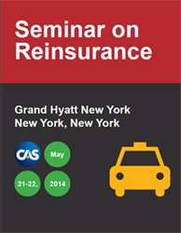

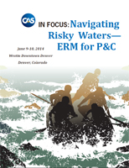
What do Property/Casualty Actuaries do?
Ratemaking
Reserving
Predictive modeling
Reinsurance
ERM

Slide 38
Ratemaking / Pricing
Are current rates meeting our objectives?
Are some classes performing better or worse than others?
How do driving patterns influence risk of loss?
How does an insured’s loss experience influence its premium?
How does price sensitivity enter into loss cost projections?

Slide 39
Loss Reserving
What is the company’s unpaid claim liability as of 12/31/14?
  Best estimate, central estimate, key assumptions
What is the probability distribution of unpaid claims as of 12/31/14?
Role with Audit Committee for governance (management influence on amounts booked, independence of actuarial function)

Slide 40
Capital Adequacy
How adequate is company surplus to respond to adverse results (e.g., loss reserves higher than estimate)?
How much capital is required to support different types of business?
How does portfolio diversification enter into economic capital requirements?

Slide 41
Reinsurance
(Insurer) What are risk/reward trade-offs related to different reinsurance structures?
(Reinsurer) Pricing and reserving issues, but with much less data.

Slide 42
Enterprise Risk Management
Enterprise-wide view of risk that allows insurers to identify, quantify, and manage risk on a more holistic basis
Risk identification and related management and mitigation
ERM integration into governance, strategy and decision-making
Board and Audit Committee responsibilities

Slide 43
Trends
Liability and property risks arise daily
Digitalization and “big data”
Increasingly sophisticated predictive models
Enterprise risk management, terrorism
Globalization, international businesses and risks, global instability
Climate change, volatility, crop insurance
Population shifts, hazard prone areas
Social media, automated vehicles, healthcare
Unmanned commercial aircraft, cyber liability, the aging population
Notes:
There’s always new stuff to insure… and people are always coming up with new and inventive ways to sue each other!

Slide 44
Many Paths to Success
academic
regulator
stable schedule
people oriented
management
reinsurance
reserving
ERM
insurance
reserving
broking
insurance
ratemaking
reinsurance
pricing
service
agency
consulting
banking/
investment
travel and variety
data intensive

Slide 45
Outline
What is an Actuary?
Why be an Actuary?
What skills are needed to be an Actuary?
What is the difference – CAS and SOA?
How do you become an Actuary?
What do Property/Casualty Actuaries do?
How can I find out more?

Slide 46

You’re Invited…
join online today at www.CASstudentcentral.org
Notes:
CAS has launched a new student member program for university students called CAS Student Central.
CAS Student Central is devoted to giving you - the next generation of casualty actuaries - the tools and expertise you will need to make the transition from classroom to career.
Your future starts here. For 100 years strong, CAS has been the bedrock of the property and casualty actuarial profession. We are now proud to offer our uncompromising standards of unmatched expertise and professional integrity to the many students around the world who have made the decision to be an actuary.
CAS Student Central exemplifies our deep commitment to you and our resolve to mentor and guide you through the maze of curricula and rigorous exams that ultimately lead to a challenging and rewarding career.
But you only have access if you join, and I encourage everyone to go online and join today at CASStudentCentral.org.
CAS cares about your career. We know you take your career seriously, and so do we. We know you’re striving for excellence and distinction now to position yourself for a strong start.
As the gold standard for casualty actuaries, CAS wants to nurture the next generation and help jumpstart your success. From skill-building and support preparing for the rigorous exams to providing networking opportunities with professionals in the field around the globe, we are here for you, and we look forward to welcoming you into our community.
Thank you!

Slide 47
CAS Student Central
Membership program for university students:
  No Membership fee
  Access to resources including P&C internship listings, CAS Curriculum Guide, Case Studies, Online Community
  Free webinars created specifically for students
  Invitations to free networking events including student programs at CAS meetings and Seminars
  Approximately 3,000 student members from 350 schools
Notes:
To qualify as a member of CAS Student Central, you must meet the following qualifications:
1. Be enrolled as an undergraduate or graduate student at a college or university
2. Provide a university-based email address
3. Provide the name and contact information of a university professor who can verify your student status, if necessary
It’s that easy.
Even better, there are no membership dues, and we’ll automatically renew your membership each year.
By joining CAS Student Central, you’re going to have access to resources, like webinars and networking events.
CAS Student Central will be your roadmap because it will provide study tools, career resources

Slide 48
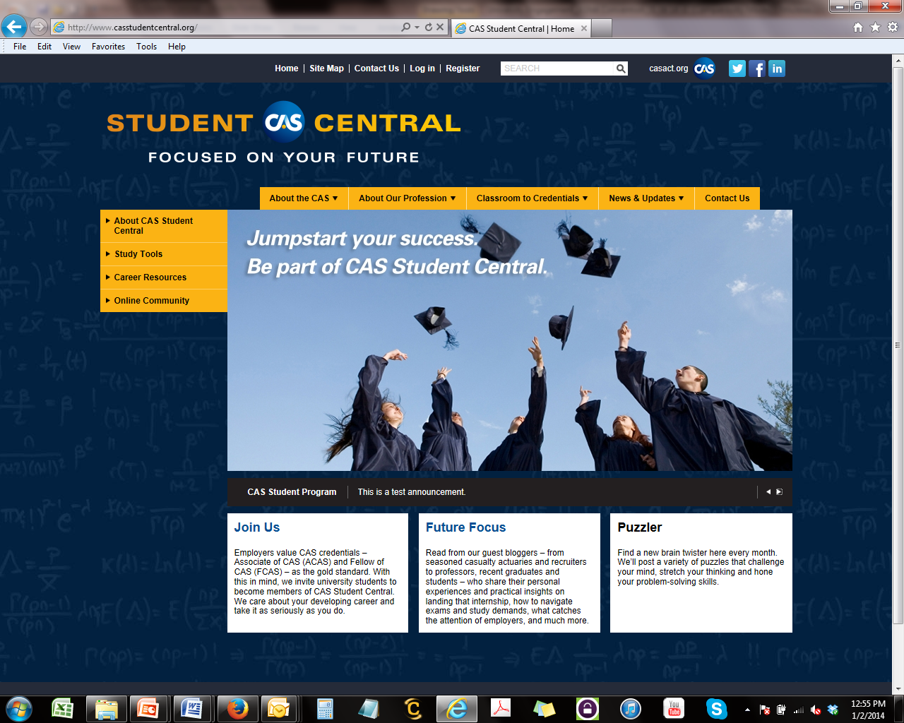
Notes:
CAS has created a new website to support the new student member program, which you can access at CASstudentcentral.org
Here you’ll find a lot of resources and information geared specifically to students preparing for a career as an actuary.

Slide 49
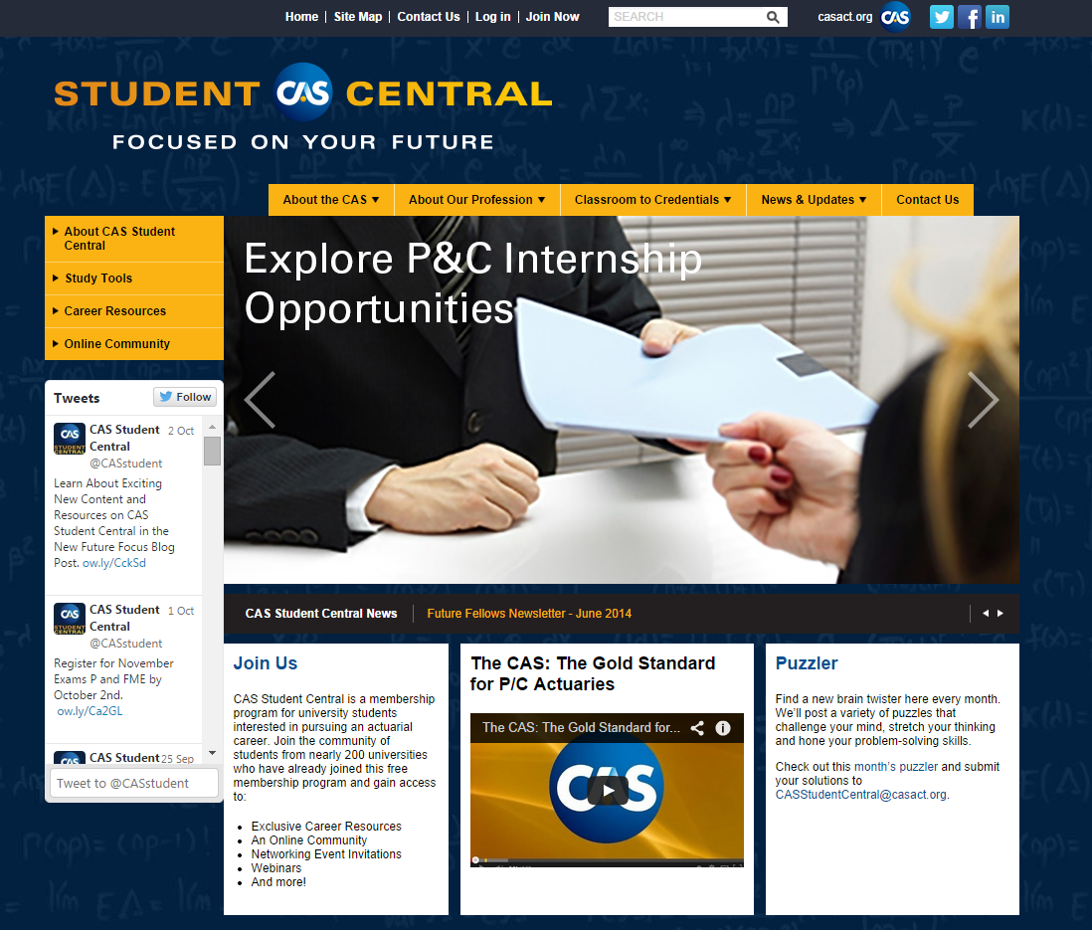
Notes:
CAS has created a new website to support the new student member program, which you can access at CASstudentcentral.org
Here you’ll find a lot of resources and information geared specifically to students preparing for a career as an actuary.

Slide 50
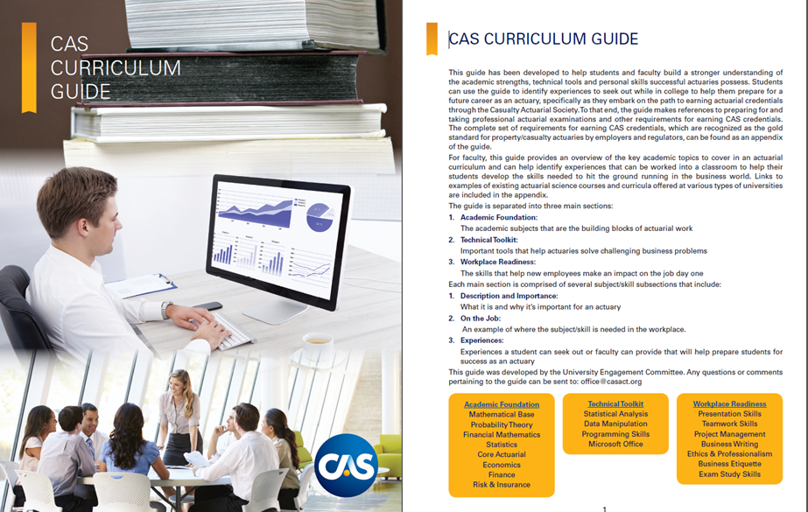
CAS Curriculum Guide
Notes:
-Each main section is comprised of several subject/skill subsections that include:
Description and Importance: What it is and why it’s important for an actuary,
On the Job: An example of where the subject/skill is needed in the workplace.
Experiences: Experiences a student can seek out or faculty can provide that will help prepare students for success as an actuary.
-For faculty, this guide provides an overview of the key academic topics to cover in an actuarial curriculum and can help identify experiences that can be worked into a classroom to help their
students develop the skills needed to hit the ground running in the business world.

Slide 51
CAS Case Studies
Case Study Topics:
  Probability
  Catastrophe Modeling
  Warranties
  Liabilities
  Auto Insurance
  Case Studies include Facilitator’s Guide, Presentation Slides, Recording, and Excel Workbook

Slide 52
CAS Student Central
Online Community
Future Focus Blog shares insights and tips (example posts):
  CAS to Roll Out New Statistics Preliminary Exam
  Strategies to Assist with Your Job Search – Advice from Actuarial Recruiters
  How to Get the Most Out of Networking Events at the 2015 ASNA Convention – and Beyond
Connect with other student members
CAS member directory will give you a sense of how far and wide, broad and deep our network is.
Receive latest news and updates from the CAS
Notes:
Another nice feature of the program is the online community.
Community is a core value of the CAS, and we’ve created an online community for members of CAS Student Central.
This slide describes the kinds of things that you’ll find in that community. There is a blog that will feature guest bloggers from CAS members to students like you.
You’ll have access to the CAS member directory, as well as the members of CAS Student Central to help you connect and network.
There’s a discussion forum, a calendar of important dates, an online poll, all designed to engage and inform.

Slide 53
Educational Opportunities for Student Central Members
Webinars held fall and spring semesters
  Topics have included: Excel and R for Actuaries and Career Paths in the Property and Casualty Actuarial Profession
  Student programs at CAS meetings/seminars:
    CAS Spring and Annual Meetings
    Ratemaking and Product Management Seminar
    Seminar on Reinsurance
    Casualty Loss Reserve Seminar

Slide 54
Additional Resources for Students Beyond CASstudentcentral.org
CAS - casact.org
Be An Actuary - BeAnActuary.org
American Academy of Actuaries - actuary.org
Salary Surveys
  ezrapenland.com
  dwsimpson.com

Slide 55
CAS Trust Scholarship Program casact.org/trustscholarship
Scholarship for students pursing a career in casualty actuarial science.
Up to 3 scholarships awarded per academic year
  1st Place Scholarship: $10,000
  Runner-Up Scholarships: $5,000 each if selected
Application opens in November and is due early March
  Includes: application, essay, recommendation letters, and official transcript
Visit the CAS website for eligibility requirements
  Must be a member of CAS Student Central and have sat for 1 actuarial exam
  To learn about other scholarship opportunities explore CASstudentcentral.org and BeAnActuary.org!

Slide 56
CASstudentcentral.org
Notes:
Thank You!

