Slide 1
Professionalism Considerations Regarding Price Optimization
Midwest Actuarial Forum
St. Paul, Minnesota
September 18, 2015
James Lynch, FCAS MAAA, chief actuary
Insurance Information Institute ♦ 110 William Street ♦ New York, NY 10038
Tel: 212.346.5533 ♦ Cell: 917.359.3908 ♦ jamesl@iii.org ♦ www.iii.org

Slide 2
Oh, Boy, Is This Controversial
Before We Start . . .
2

Slide 3

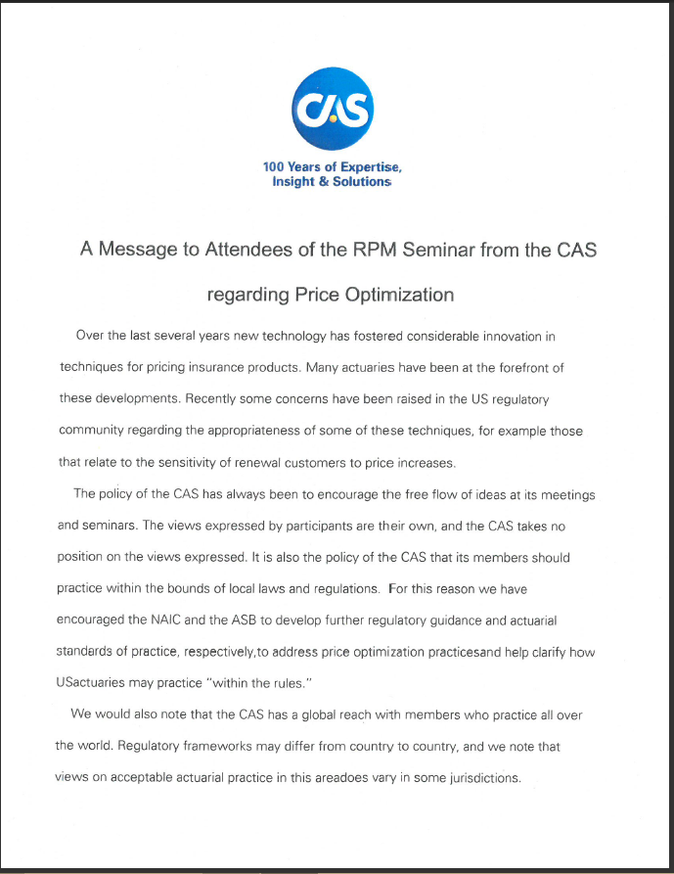
How Controversial?
Banned/Questioned in Eight States (MD, OH, IN, CA, FL, ME, PA, NY, VT, WA, DC)
NAIC Studying (CATF)
CAS, AAA, ASB
“The Views Expressed by Participants Are Their Own, and the CAS Takes No Position on the Views Expressed. It Is Also the Policy of the CAS that Its Members Should Practice Within the Bounds of Local Laws and Regulations.”

Slide 4
So Obviously . . .
The Views Expressed In This Presentation Are Not Necessarily Those of the Insurance Information Institute or Its Member Companies Or Affiliates, Including the Casualty Actuarial Society. . . .
. . . Or Me For That Matter.
Professionalism Alert
  Breaking the Law Violates the Code of Conduct.
Competence Alert
  I Haven’t Personally Completed a Rate Filing in 20 Years.

Slide 5
What Is Price Optimization?
5

Slide 6
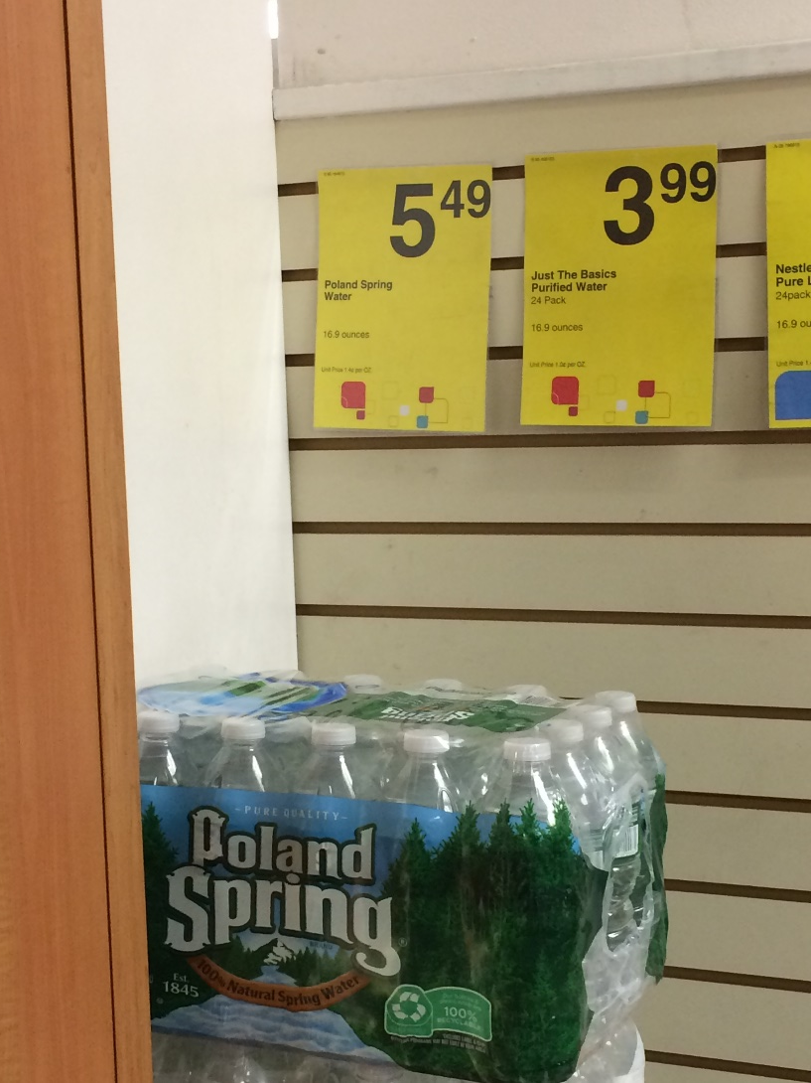
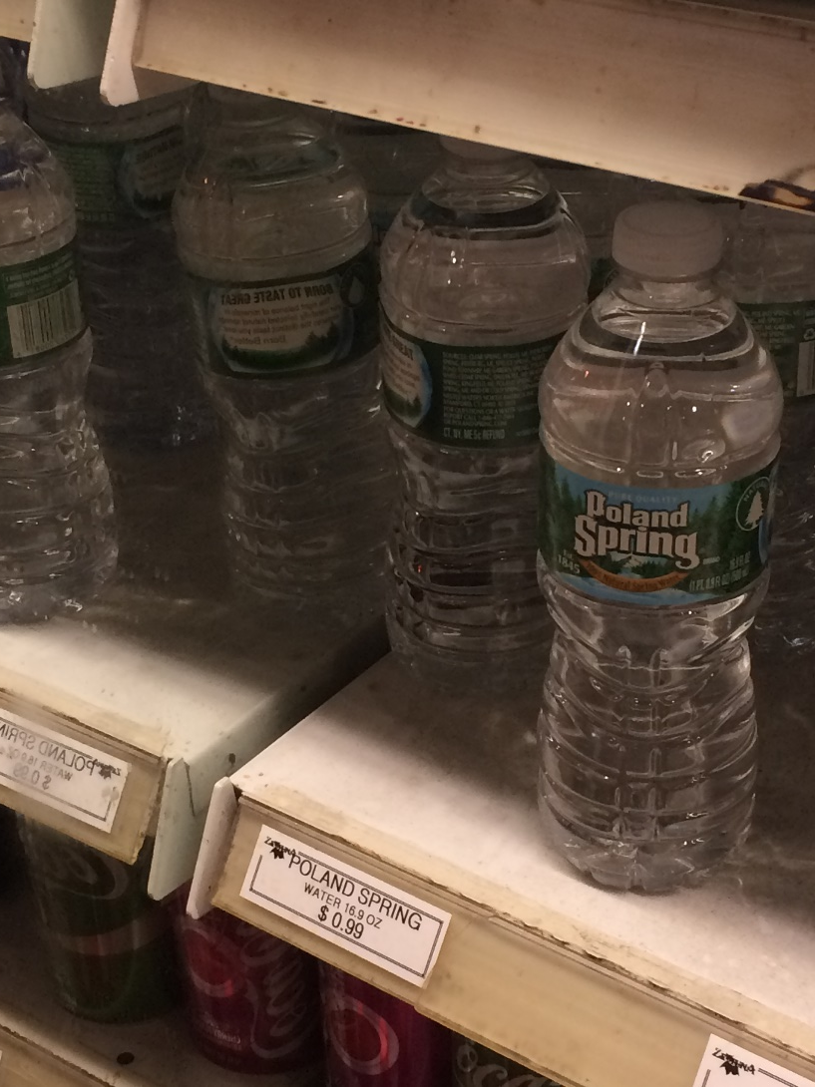
Shopping for Water
1.4 Cents Per Ounce ($5.49 for 24 Bottles)
5.9 Cents Per Ounce ($23.76 for 24 Bottles)
U.S. Insurers Don’t Do This!!!
320% Price Difference! Does It Cost $18.25 to Unpack the Bottles and Keep Them Cold?

Slide 7
Pricing Water vs. Pricing Insurance
Pricing H₂0
Pricing Insurance
It’s cold – charge more.
It’s near the front of the store – charge more.
It’s easy to carry – charge more.
It’s Memorial Day – charge less.
“What the market will bear.”
Expected value of future costs
Provides for all costs of risk transfer
Provides for all costs of individual risk transfer
Reasonable rate estimates all future costs of risk transfer
SOURCE: CAS Statement of Ratemaking Principles (1988).
None of These Are Related to Projected Expenses
All of These Are Related to Projected Expenses
For Most Products, Supply and Demand Set Price–But Not In Insurance.

Slide 8
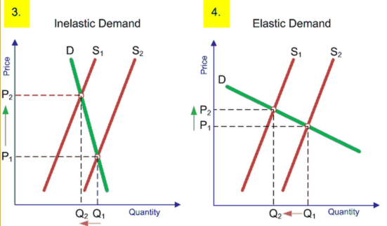
Elasticity of Demand
Predicting Supply and Demand
Econ 101: How Much Will Sales Fall If Price Rises?
Steep Demand Curve → Consumer Doesn’t Care Much If Prices Rise
Companies That Know the Slope Can Price Smarter
This Is Normal In Other Industries – But Not Insurance
Example: Gasoline
Example: Shell Gasoline
Now Computers Can Model Elasticity of Demand. It’s Common Outside Insurance.

Slide 9
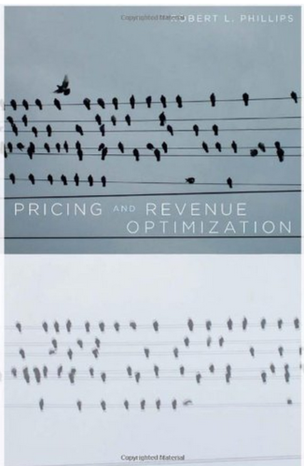
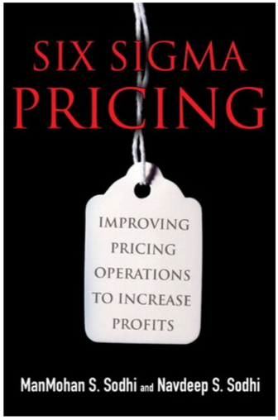
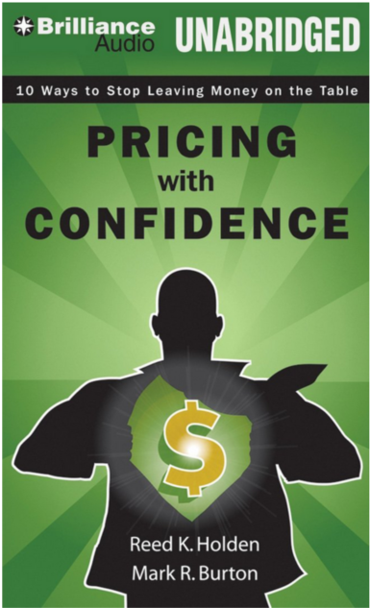
Enter the Optimizers (c. 2005-2010)
“…to provide the right price for every product to every customer segment through every channel and to update those prices over time …”
-- Robert Phillips (2005)
“…ensuring the prices are not too low or too high in different transactions relative to guidelines lends itself perfectly to Six Sigma.”
-- Sodhi and Sodhi (2007)
Holden and Burton (2008) show “how to fully exploit the value your company offers customers. This is a proven plan for increasing sales without sacrificing profits.”

Slide 10
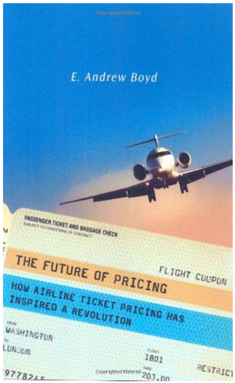
Not Just Water . . .
Computer-Driven Dynamic Pricing Sets Rates for:
  Hotels
  Airline Tickets
  Uber Rides
Prices Change
  Weekly
  Daily
  Instantaneously
U.S. Insurers Change Rates 1-2 Times A Year
Not Surprised Are You? We Are Used to Seeing Price Optimization in Other Products.

Slide 11
What Did Insurers Do?
11

Slide 12
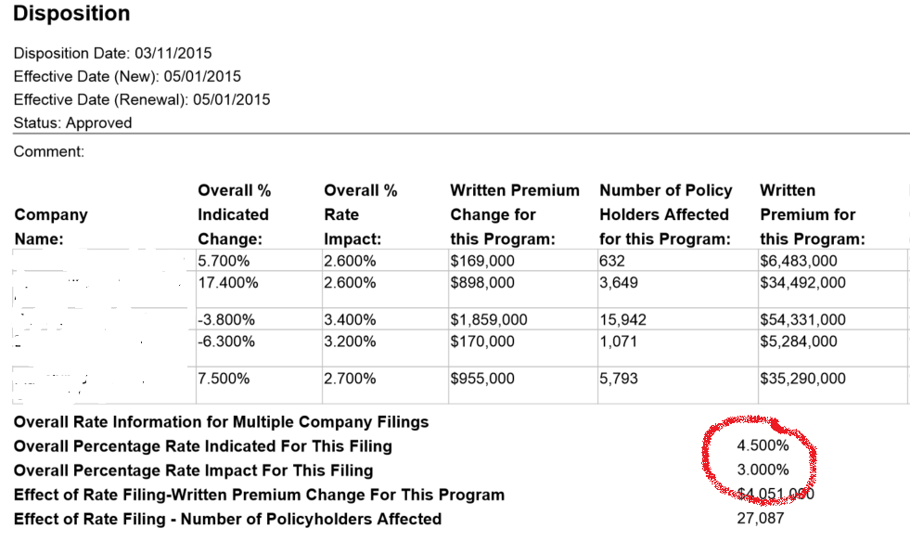
Do Rates Adhere to Projected Loss?
Companies Rarely Take the Indicated Rate
Regulators Are Generally OK With That.
REDACTED
Could This Be Considered Price Optimization?
Sources: System for Electronic Rate and Form Filing (SERFF) via SNL Financial; Insurance Information Institute.
How Does This Practice Conform to Ratemaking Principles?

Slide 13
Other Adjustments (Optimizations?)
By the Insurer
  Young Drivers Undercharged – Don’t Want to Lose the Parents (Class Plan)
  Implementation of New Class Plan – Minimize Rate Shock (Individual)
  Post-Merger Rate Stabilization Factor (Individual)
Insurers Have Been Adjusting Rates for Reasons Unrelated to Loss for Decades. Actuaries Justified This Professionally.

Slide 14
Other Adjustments (Optimizations?)
By Government
  Proposition 103 (20% Rate Rollback) - 1988
  Flood Insurance (18% Cap on Rate Increases) - 2014
  Limit/Ban on Age/Gender As Rating Variable (~Seven States) - Ongoing
All Adjustments Unrelated to Expected Loss (but Mandated).

Slide 15
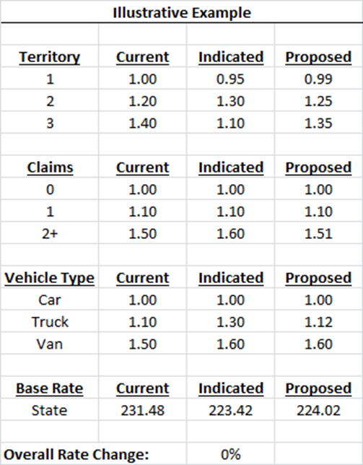
Other Class Plan Disconnects (1)
3 Territories
3 Vehicle Types
3 Claim Bands
1 Vehicle in Each Territory/Vehicle/Claim
All Proposed Factors Between Current & Indicated
It Is. You’ll See.

Slide 16
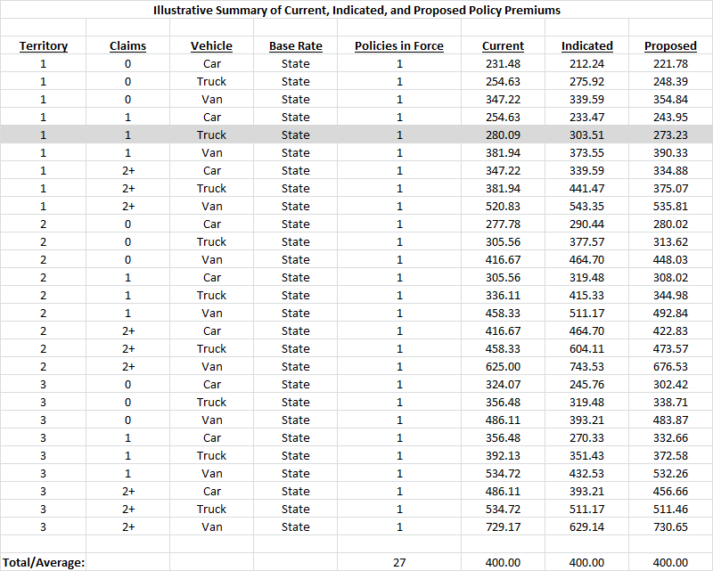
Other Class Plan Disconnects (2)
See? No Overall Rate Change

Slide 17
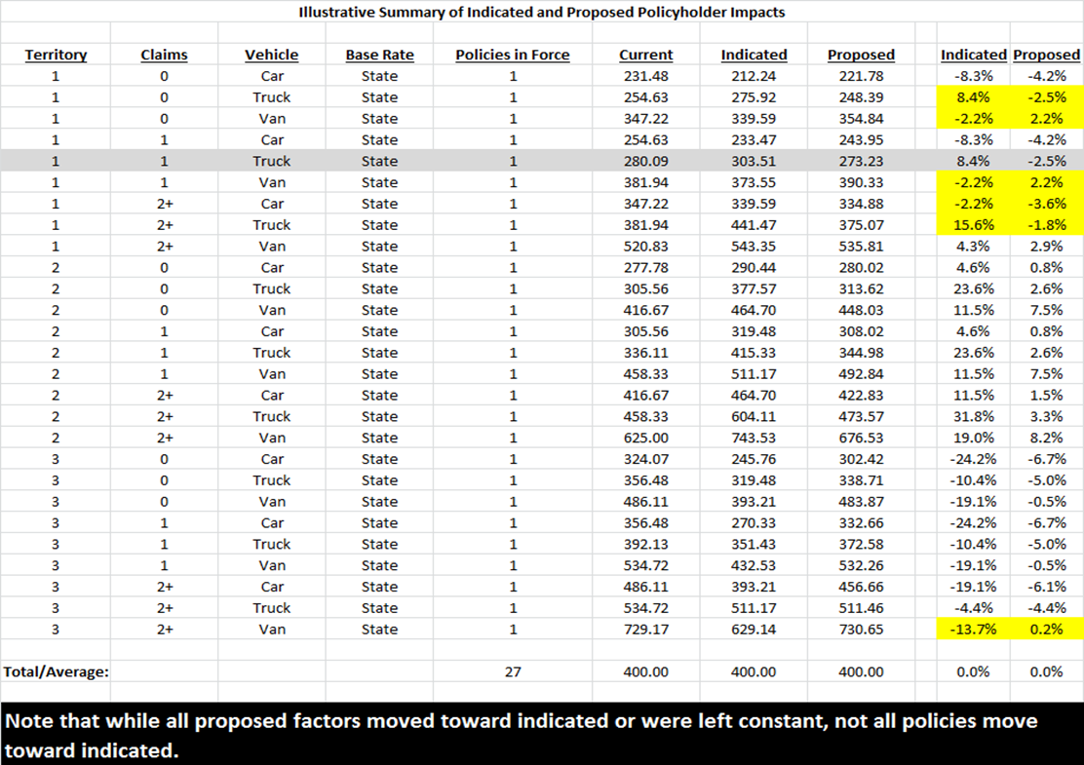
Other Class Plan Disconnects (3)
Given No. of Unique Class Plan Buckets, This Seems Inevitable

Slide 18
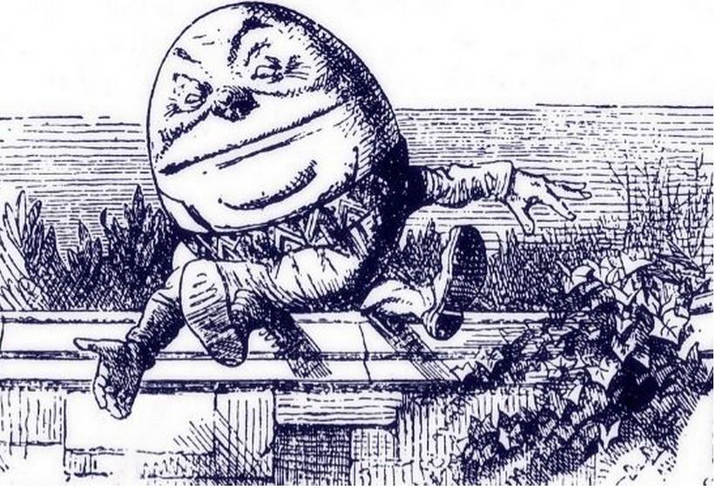
Price Optimization Defined
Earnix (P.O. Vendor):
  “systematic and statistical method to help an insurer estimate a rating plan factoring in a competitive environment.”
  “using mathematical algorithms to determine optimal values of rating factors to meet business goals and constraints.”
“When I use a word,’ Humpty Dumpty said in rather a scornful tone, ‘it means just what I choose it to mean — neither more nor less.’
’The question is,’ said Alice, ‘whether you can make words mean so many different things.’
’The question is,’ said Humpty Dumpty, ‘which is to be master — that’s all.”

Slide 19
Price Optimization Defined
Earnix (P.O. Vendor):
  “a systematic and statistical way to help an insurer determine a rate plan that better fits the competitive environment, within actuarial and regulatory standards.”
“When I use a word,’ Humpty Dumpty said in rather a scornful tone, ‘it means just what I choose it to mean — neither more nor less.’
’The question is,’ said Alice, ‘whether you can make words mean so many different things.’
’The question is,’ said Humpty Dumpty, ‘which is to be master — that’s all.”

Slide 20
Price Optimization Defined
My Emphasis.
Maryland - “varying rates based on factors other than risk of loss, including, but not limited to:
    “a) The likelihood that a policyholder will engage in activities that result in policy turnover; and
    “b) The willingness of a policyholder to pay a higher premium compared to other policyholders.”
“When I use a word,’ Humpty Dumpty said in rather a scornful tone, ‘it means just what I choose it to mean — neither more nor less.’
’The question is,’ said Alice, ‘whether you can make words mean so many different things.’
’The question is,’ said Humpty Dumpty, ‘which is to be master — that’s all.”

Slide 21
Price Optimization Defined
New York – “the practice of varying rates based on factors other than those directly related to risk of loss, for example, setting rates or factors based on an insured’s likelihood to renew a policy or on an individual’s or class of individuals’ perceived willingness to pay a higher premium relative to other individuals or classes”
“When I use a word,’ Humpty Dumpty said in rather a scornful tone, ‘it means just what I choose it to mean — neither more nor less.’
’The question is,’ said Alice, ‘whether you can make words mean so many different things.’
’The question is,’ said Humpty Dumpty, ‘which is to be master — that’s all.”

Slide 22
Price Optimization Defined
Ohio–“While price optimization has no absolute definition, it generally refers to an insurer’s practice of varying premiums based upon factors that are unrelated to risk of loss in order to charge each insured the highest price that the market will bear.”
“When I use a word,’ Humpty Dumpty said in rather a scornful tone, ‘it means just what I choose it to mean — neither more nor less.’
’The question is,’ said Alice, ‘whether you can make words mean so many different things.’
’The question is,’ said Humpty Dumpty, ‘which is to be master — that’s all.”

Slide 23
Price Optimization Defined
California–“any method of taking into account an individual’s or class’s willingness to pay a higher premium relative to other individuals or classes.”
“When I use a word,’ Humpty Dumpty said in rather a scornful tone, ‘it means just what I choose it to mean — neither more nor less.’
’The question is,’ said Alice, ‘whether you can make words mean so many different things.’
’The question is,’ said Humpty Dumpty, ‘which is to be master — that’s all.”

Slide 24
Price Optimization Defined
Florida–“a process for modifying the insurance premium that would otherwise be charged to an insured or class of insureds in order to maximize insurer retention, profitability, written premium, market share, or any combination of these while remaining within real world constraints.”
“When I use a word,’ Humpty Dumpty said in rather a scornful tone, ‘it means just what I choose it to mean — neither more nor less.’
’The question is,’ said Alice, ‘whether you can make words mean so many different things.’
’The question is,’ said Humpty Dumpty, ‘which is to be master — that’s all.”

Slide 25
Price Optimization Defined
NAIC (Draft)–“…the advent of sophisticated data mining tools and pricing models have allowed actuaries to provide more objective, quantitative information about the judgmental aspects of the rate-setting process instead of relying primarily on anecdotal evidence as has been the case in the past. This process is now referred to as “price optimization.”
“When I use a word,’ Humpty Dumpty said in rather a scornful tone, ‘it means just what I choose it to mean — neither more nor less.’
’The question is,’ said Alice, ‘whether you can make words mean so many different things.’
’The question is,’ said Humpty Dumpty, ‘which is to be master — that’s all.”

Slide 26
How Is P.O. Different From the Past?
Traditional Approach
Price Optimization
Rate = Base Rate x Rating Variables
Rating Variables: Age/gender/territory/etc.
More Adjustments: Qualitative Assessment
Basis for More Adjustments: Judgment
Rate = Base Rate x Rating Variables
Rating Variables: Age/gender/territory/etc.
More Adjustments: Qualitative + Quantitative
Basis for More Adjustments: Judgment + P.O. Modeling
SOURCE: Adapted from NAIC, Price Optimization White Paper (August 15, 2015, draft).

Slide 27
How Is P.O. Different From the Past?
Proponents
Opponents
It’s Not, Except Software Replaces Subjective Process
  May Make Rates More Stable
Allowed Under Current Actuarial Standards of Practice [Statement of Principles?], State Laws
Gouges Customers, Particularly Those Who Shop Less
  “Loyalty Penalty”
  Poor People
Conflicts With State Rating Laws
  ‘Not to Be Excessive, Inadequate, Unfairly Discriminatory’
Each Side Has Counterarguments, of Course.

Slide 28
Does Statement of Principles Allow Price Optimization?
28

Slide 29
Professionalism Break
Does Statement of Principles Allow Price Optimization?
The principles in this Statement are limited to that portion of the ratemaking process involving the estimation of costs associated with the transfer of risk.
“Ratemaking should provide for the costs of an individual risk transfer so that equity among insureds is maintained.” (Reasonable, not excessive, not inadequate, not unfairly discriminatory)
Justification Via Considerations?
  Mix of Business – “…distributional changes in deductibles, coverage limitations or type of risks that may affect the frequency or severity of claims.”
What I’m Looking At. (You Might Disagree.)
SOURCE: CAS Statement of Ratemaking Principles (1988).

Slide 30
Professionalism Break
Justification Via Considerations?
  Operational Changes – “Changes in the underwriting process, claim handling, case reserving and marketing practices that affect the continuity of the experience.”
  Other Influences – “The impact of external influences on the expected future experience should be considered. . .” (seems to focus on residual markets, etc.)
  Actuarial Judgment – “…may be applied throughout the ratemaking process…”

Slide 31
Professionalism Break
Foreshadowing Alert.
§ IV. Conclusion
  “The actuary, by applying the ratemaking principles in the Statement, will derive an estimation of the future costs associated with the transfer of risk. Other business considerations are also a part of ratemaking.” [U/W, Marketing, Law, Claims, Etc.]
Reality Alert: It’s A Static Model.
Of Course, These Are the Old Principles . . .

Slide 32
The Triple-I Players Present
Do Actuaries Make Rates?
32

Slide 33

Actuary
“My Analysis Shows We Need to Raise Rates 5%.”

Slide 34

Underwriter
“We Might As Well Close Up Shop Right Now.”

Slide 35

Agent
“You’re Killing Me”

Slide 36

Senior Management
“Don’t Get Married to Your Model.”

Slide 37
Repeat As Needed Until . . .
The End
Moral: Ratemaking Is a Collaboration
37

Slide 38


A Collaboration
Indication – Modeled Amount
Technical Price (“Rate”)
Street Price (“Price”)

Slide 39


Professionalism Break No. 2
Statement of Ratemaking Principles Is Changing
  Distinguish Between Principles (Worldwide) and Practices (Country-specific)
  Separate Estimation of Rate From Setting of Rate
ASB Developing U.S. Standard of Practice
CAS (Constitution) Vs. ASB (Local Law)
Images: Ten Commandments photo By Ji-Elle (Own work) [GFDL (http://www.gnu.org/copyleft/fdl.html) or CC BY-SA 3.0 (http://creativecommons.org/licenses/by-sa/3.0)], via Wikimedia Commons; U.S. Code photo By Tony Webster (Own work) [CC BY-SA 3.0 (http://creativecommons.org/licenses/by-sa/3.0)], via Wikimedia Commons
SOURCE: Notes from “The Standards and Principles: ‘They are a Changin,’’” 2015 Ratemaking and Product Management Seminar.

Slide 40

Principles Need to Apply Everywhere
In UK, Insurers Face
  Fewer Regulatory Restrictions
  (RBS Scrapping Practice; Others May Follow)
No One in the U.S. Does This - Or Wants To.
Laws, Standards Vary By Country. Actuarial Playbook Has to Reflect That.

Slide 41
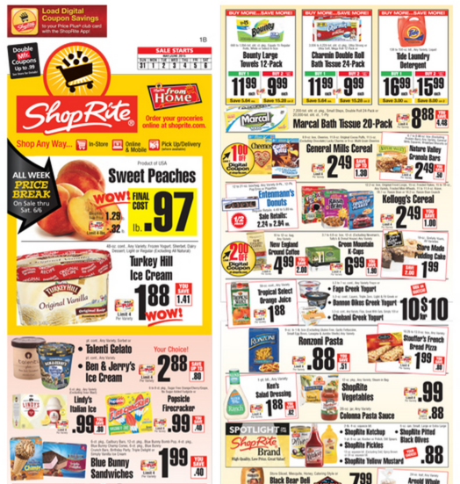
Principles Need to Apply Everywhere
U.S. Insurers Have. . .
Infrequent (Annual) Rate Changes
Traditionally Optimized in Tiny Adjustments
No Use for Coupons
INSURANCE
Can’t Do This in The U.S.
INSURANCE

Slide 42
Professionalism Break No. 2
CURRENT: Ratemaking is the process of establishing rates used in insurance or other risk transfer mechanisms.
PROPOSED: Ratemaking is the process of establishing future costs associated with the transfer of risk in insurance or other risk transfer mechanisms.
Distinguishes Between Technical Price, “Street Price”
Current Principles
Proposed Principles
4 Sections – Definitions, Principles, Considerations, Conclusion
3 Sections (Considerations Moved to Standards of Practice)

Slide 43
Professionalism Break No. 2
CURRENT/PROPOSED: The actuary, by applying informed actuarial judgment and the ratemaking principles in this Statement, will derive an estimation of the future costs associated with the transfer of risk. Other business considerations are also a part of ratemaking insurance pricing.
Replaces ‘Ratemaking’ With ‘Insurance Pricing’
Some are dismayed
“…dismantling the cost-based standard as the bedrock of the actuarial profession . . .
“It is shocking to me as a Fellow of the CAS that the Society would propose a set of principles that [implies actuaries] not only have no impact on the prices that policyholders will pay, but acts to remove the actuary from the central role she has in ratemaking today.”
But For Reserving Actuaries, The Distinction May Sound Familiar.

Slide 44


New Reserving Standard
Statement of Principles
Regarding
Property and Casualty
Loss and Loss Adjustment
Expense Reserves
1988-2014
Statement of Principles Regarding Property and Casualty Unpaid Claims Estimates
Born May 6, 2015
Image from Cliparts.co.
Image from Clipart Panda.

Slide 45
The Triple-I Players Present
Do Actuaries Set Reserves?
45

Slide 46
Actuary
“My Analysis Shows We Need to Raise Reserves 5%.”

Slide 47
CFO
“There Goes My Bonus.”

Slide 48
Underwriter
“There Goes My Bonus – And I’ll Be Fired.”

Slide 49
Senior Management
“No One Wants to Lose Their Bonus or Their Job.”

Slide 50
Repeat As Needed Until . . .
The End
Moral: Loss Reserving Is a Collaboration
50

Slide 51
Professionalism Break No. 3
Old Reserving Principles
New Reserving Principles
4 Sections – Definitions, Principles, Considerations, Conclusion
3 Sections (Considerations Moved to Standards of Practice)
Implicit Is the Difference Between Estimate and Booked
OLD: A loss reserve is a provision for its related liability.
NEW: Unpaid Claims Estimate: An actuary’s estimate of the unpaid amount required to make the future loss and/or loss adjustment expense payments related to a defined group of claims

Slide 52
Professionalism Break No. 3
CAS on Unpaid Claims Estimates
“The principal objective of revising the original Principles was to update them and to revise them where necessary to contain principles only, not standards of practice.
“This newly adopted Statement is not intended to provide prescriptive practice guidance to actuaries. Such practice guidance for actuaries has been developed in the U.S., for example, by the Actuarial Standards Board (U.S.) in the form of Actuarial Standards of Practice.”
The Same Sort of Reasoning Applies to Ratemaking.

Slide 53
Homework
CATF August Draft on Price Optimization: http://naic.org/documents/committees_c_catf_exposure_150815_price_optimization_white_paper.pdf
Ratemaking Principles
  Current http://casact.org/professionalism/standards/princip/sppcrate.pdf
  Proposed http://www.casact.org/professionalism/SoP-Ratemaking-Discussion-Draft_October2014.pdf
Ratemaking Standards (Exposure Draft) http://www.actuarialstandardsboard.org/wp-content/uploads/2014/12/Ratemaking_expsoure_draft_sept2014.pdf
Reserve Principles
  Old http://casact.org/professionalism/standards/princip/sppcloss.pdf
  New
  http://www.casact.org/professionalism/standards/princip/SOP-Regarding-Property-and-Casualty-Unpaid-Claims-Estimates_Final%204-22-2015.pdf

Slide 54
Summary
Price Optimization Is A Controversial Activity.
  About 10 States Ban/Question the Practice.
  Closely Studied in U.S. Insurance Circles.
Ratemaking Principles Are Changing. Reserving Principles Changed.
  Removing Nation-Specific Guidance.
  Bedrock CAS Principles Apply Everywhere
  Practice Guidelines Tend to Be Nation-Specific (ASB in US)
Don’t Break the Law
Old Ratemaking Principles Are the Law in Most States.

Slide 55
Insurance Information Institute Online:
www.iii.org
Thank you for your time
and your attention!
Twitter: twitter.com/@III_Research

