Slide 1
Midwest Actuarial Forum
THE WHY, WHO, WHAT, and HOW of the WCRA
September 18, 2015

Slide 2
WHY the WCRA was Created
WHO the WCRA Is
WHAT the WCRA Does
HOW the WCRA is Funded, Reserved, and Priced

Slide 3
WHY was the WCRA Created?
Dramatic changes in Minnesota’s workers’ compensation system took place in the 1970s
Workers’ compensation costs were rapidly escalating: increasing inflation, no benefit caps
Workers’ compensation reinsurers couldn’t reliably project their costs
Workers’ compensation reinsurance was either unavailable or extremely costly

Slide 4
Result?
WCRA established by the Legislature in 1979 to
  Assure availability of work comp reinsurance
  Maintain reasonable work comp reinsurance costs
  Provide expert claim management of serious work comp claims
  Gather and share data on long-term work comp claims

Slide 5
WHO We’re Not
Not a State agency
No State appropriations/no State obligations
No State ownership

Slide 6
WHO Is the WCRA?
The WCRA is an independent nonprofit association composed of all Minnesota workers’ compensation insurers and self-insurers (currently have 644 members)
WCRA members
Insurers | 73%
Private self-insurers | 11%
Public self-insurers | 16%
Notes:
Exposures from 7/31/2015 Exposure Table, about the same for 2013-2015

Slide 7
WCRA Governance
WCRA governed by Board of Directors consisting of insurer, self-insurer, employee, employer, public, and state official representatives
WCRA management reports to the WCRA Board of Directors
25 staff members
Claims, premium, actuarial, finance and investments, information systems, support
Annual expense ratio: < 9%

Slide 8
WCRA Regulator
WCRA is regulated by the Commissioner of Labor and Industry, who
  Approves all members of the Board of Directors and appoints five positions
  Approves WCRA rates
  Approves surplus distributions or assessments of members
  Approves changes in the WCRA Plan of Operation and Reinsurance Agreement

Slide 9
WCRA Reinsurance Protection
WCRA covers ALL other WC medical and indemnity benefits
WCRA REINSURANCE
WORKERS’ COMP INSURER covers the first $490,000, $980,000, or $1,960,000 of WC benefits and buys WCRA reinsurance to cover larger claims
WC INSURANCE
EMPLOYER buys workers’ compensation insurance or self-insures
Seriously injured EMPLOYEE

Slide 10
WHAT Does the WCRA Do?
Provides members with 100 percent reimbursement of statutory losses in each loss occurrence in excess of the low, high, or super retention limit, whichever is selected by the member
* Retentions are indexed to the state average weekly wage
2015 Retention Levels*
Low | $490,000
High | $980,000
Super | $1,960,000

Slide 11
Key Features of WCRA Coverage
Unlimited statutory coverage per occurrence
Full terrorism coverage including NBCR
Covered by TRIA
No MAOLs (maximum any one life)
No reporting cutoffs

Slide 12
WHAT the WCRA Does (and Doesn’t) Do
WCRA doesn’t manage claims; members do
WCRA claims staff audits and reimburses claims to members for amounts in excess of their selected retention limits
WCRA provides members with expert advice on claims management, medical treatment, and rehabilitation for severe injuries
WCRA provides various calculators to assist members in claim evaluation/settlement review

Slide 13
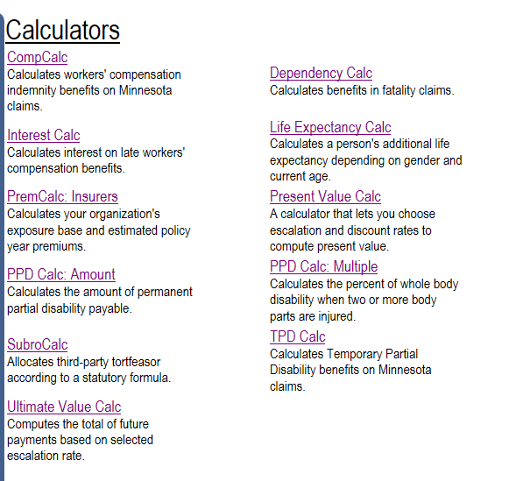
Available Calculators on WCRA Website
Notes:
New

Slide 14
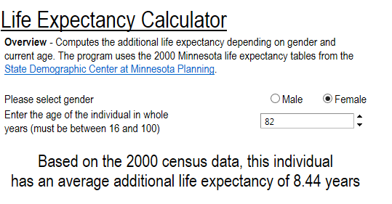
Available Calculators on WCRA Website

Slide 15
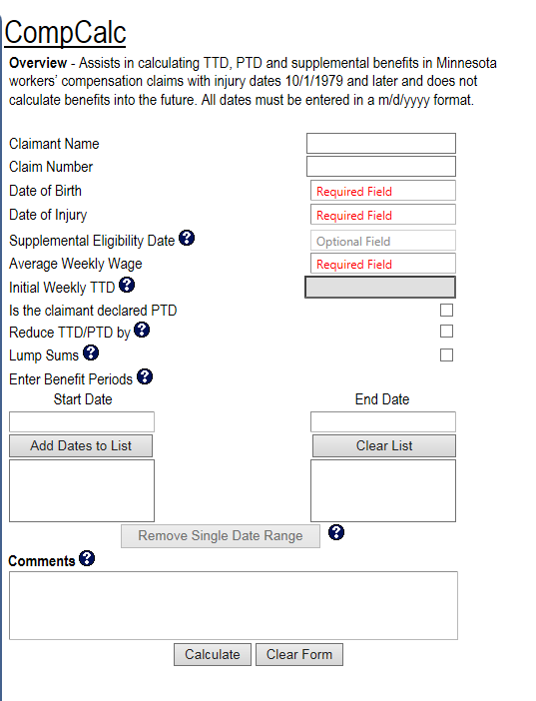
Available Calculators on WCRA Website

Slide 16
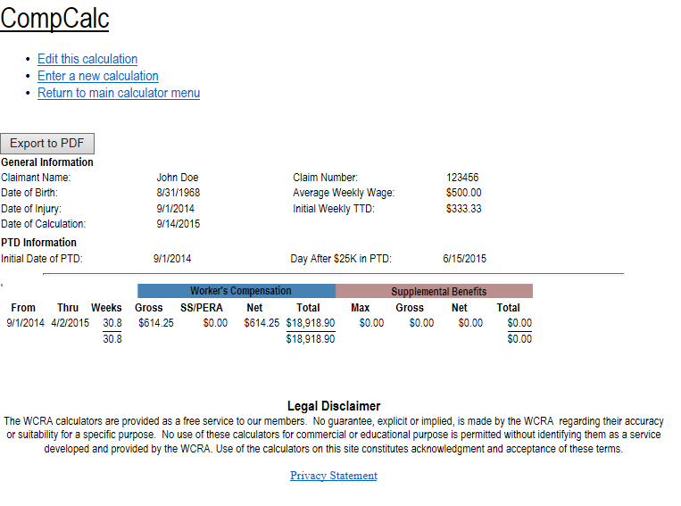
Available Calculators on WCRA Website

Slide 17
Since 1979, more than 22,000 claims have been filed with the WCRA on behalf of seriously injured workers, and more than $1.20 billion in claims has been reimbursed.
Notes:
As of 12/31/2014:
WCRA paid total: $1,197 million
Claim numbers: 21,944

Slide 18
Key Financial Results : 1979-2014
COST
Total premiums paid by members |  | $1.6 |  | billion
BENEFITS
Total claims paid to date |  | $1.2 |  | billion
Net capital distributions/assessments |  | $1.0 |  | billion
PAID BENEFITS |  | $2.2 |  | billion
Discounted Reserves |  | $1.8 |  | billion
TOTAL BENEFITS |  | $4.0 |  | billion
Notes:
Surplus distribution = $1.23 billion
Assessments = $0.268 billion

Slide 19
HOW is the WCRA Funded?
No state appropriations
Members pay annual premiums based on exposure
Premiums invested; expected rate of return of 6.5 percent per year
Actual average rate of return: ~10 percent per year since 1979

Slide 20
HOW is the WCRA Reserved?
Unique to WCRA:
  Case reserves are established for all claims using WCRA cash flow model
    Provides for consistency
    Key assumptions include claimant age, projected indemnity payments, projected medical payments, mortality, escalation rates (trend) for indemnity and medical, discount rate
  Use of cash flow model provides ability to re-reserve individual claims rather than using aggregate adjustment methods.

Slide 21
HOW is the WCRA Reserved?
Reserves are determined by retention based upon a variety of methods:
  Accident year multiplicative approach
  Report year method
    Case reserve development by report year
    PLUS provision for “true” IBNR
  Pricing model method
Reserves are analyzed at 3rd quarter and year-end and projections are reviewed by Actuarial Committee and approved by Board of Directors for inclusion in financials.
Financial statements carry discounted reserves. Follow GAAP not statutory accounting rules.

Slide 22
HOW is the WCRA Reserved?
Unique to WCRA:
  Loss development triangles are “restated” or adjusted to provide development that best matches attributes of claims at various points in time, e.g.:
    Adjust reserves to current trend and mortality assumptions
    Adjust for benefit level changes (e.g., pre-10/1/1995 law, indemnity benefits did not terminate at age 67)
    Adjust for known reporting backlogs, etc.
  The restatement process removes distortions so that “full” triangles can be used for developing any given accident year.

Slide 23
HOW is the WCRA Reserved?
High Retention
AY | Age 15 | Age 16 | Age 17 | Age 18 | Age 19 | Age 20 | Age 21 | Age 22 | Age 23 | Age 24
1991 | 141,424 | 145,591 | 143,230 | 149,889 | 143,804 | 141,512 | 134,166 | 133,190 | 132,001 | 139,158
1992 | 96,334 | 98,066 | 100,740 | 106,128 | 95,452 | 89,769 | 86,917 | 89,364 | 85,733
1993 | 67,415 | 56,312 | 57,874 | 60,138 | 57,529 | 54,619 | 57,951 | 58,903
1994 | 52,354 | 55,574 | 55,870 | 59,954 | 55,498 | 55,647 | 52,473
1995 | 69,431 | 75,134 | 67,437 | 65,596 | 67,796 | 68,945
1996 | 25,638 | 24,277 | 28,164 | 28,020 | 27,609
1997 | 32,928 | 31,345 | 27,131 | 28,658
1998 | 35,761 | 35,332 | 32,282
1999 | 35,834 | 36,716
2000 | 44,475

Slide 24
HOW is the WCRA Reserved?
High Retention Restated for ‘95 Law
AY | Age 15 | Age 16 | Age 17 | Age 18 | Age 19 | Age 20 | Age 21 | Age 22 | Age 23 | Age 24
1991 | 77,990 | 81,247 | 80,183 | 86,531 | 82,571 | 84,727 | 81,479 | 83,614 | 80,677 | 87,161
1992 | 48,548 | 54,832 | 58,109 | 61,213 | 52,549 | 50,015 | 49,320 | 52,448 | 51,371
1993 | 54,698 | 42,929 | 44,287 | 49,424 | 47,422 | 44,447 | 47,195 | 47,606
1994 | 40,215 | 42,814 | 42,557 | 47,151 | 43,458 | 43,386 | 38,371
1995 | 57,658 | 64,136 | 57,456 | 54,806 | 53,866 | 55,317
1996 | 25,638 | 24,277 | 28,164 | 28,020 | 27,609
1997 | 32,928 | 31,345 | 27,131 | 28,658
1998 | 35,761 | 35,332 | 32,282
1999 | 35,834 | 36,716
2000 | 44,475

Slide 25
HOW is the WCRA Reserved?
High Retention
AY | 15-16 | 16-17 | 17-18 | 18-19 | 19-20 | 20-21 | 21-22 | 22-23 | 23-24
1991 | 1.03 | 0.98 | 1.05 | 0.96 | 0.98 | 0.95 | 0.99 | 0.99 | 1.05
1992 | 1.02 | 1.03 | 1.05 | 0.90 | 0.94 | 0.97 | 1.03 | 0.96
1993 | 0.84 | 1.03 | 1.04 | 0.96 | 0.95 | 1.06 | 1.02
1994 | 1.06 | 1.01 | 1.07 | 0.93 | 1.00 | 0.94
1995 | 1.08 | 0.90 | 0.97 | 1.03 | 1.02
1996 | 0.95 | 1.16 | 0.99 | 0.99
1997 | 0.95 | 0.87 | 1.06
1998 | 0.99 | 0.91
1999 | 1.02
Wtd Avg | 1.00 | 0.98 | 1.04 | 0.95 | 0.98 | 0.97 | 1.01 | 0.98 | 1.05
Cum | 0.96 | 0.96 | 0.98 | 0.94 | 0.99 | 1.01 | 1.04 | 1.03 | 1.05

Slide 26
HOW is the WCRA Reserved?
High Retention Restated for ‘95 Law
AY | 15-16 | 16-17 | 17-18 | 18-19 | 19-20 | 20-21 | 21-22 | 22-23 | 23-24
1991 | 1.04 | 0.99 | 1.08 | 0.95 | 1.03 | 0.96 | 1.03 | 0.96 | 1.08
1992 | 1.13 | 1.06 | 1.05 | 0.86 | 0.95 | 0.99 | 1.06 | 0.98
1993 | 0.78 | 1.03 | 1.12 | 0.96 | 0.94 | 1.06 | 1.01
1994 | 1.06 | 0.99 | 1.11 | 0.92 | 1.00 | 0.88
1995 | 1.11 | 0.90 | 0.95 | 0.98 | 1.03
1996 | 0.95 | 1.16 | 0.99 | 0.99
1997 | 0.95 | 0.87 | 1.06
1998 | 0.99 | 0.91
1999 | 1.02
Wtd Avg | 1.01 | 0.98 | 1.05 | 0.94 | 0.99 | 0.97 | 1.03 | 0.97 | 1.08
Cum | 1.03 | 1.02 | 1.03 | 0.98 | 1.04 | 1.05 | 1.08 | 1.05 | 1.08

Slide 27
HOW is the WCRA Reserved?
High Retention Effect of Restating for ‘95 Law
Cumulative LDFs
Age | Raw | Restated | % Diff
23-24 | 1.05 | 1.08 | 2%
22-24 | 1.03 | 1.05 | 2%
21-24 | 1.04 | 1.08 | 4%
20-24 | 1.01 | 1.05 | 4%
19-24 | 0.99 | 1.04 | 6%
18-24 | 0.94 | 0.98 | 4%
17-24 | 0.98 | 1.03 | 6%
16-24 | 0.96 | 1.02 | 6%
15-24 | 0.96 | 1.03 | 7%

Slide 28
HOW does the WCRA Price?
Rates are determined for each retention
Exposure to which rates are applied is Designated Statistical Reporting Premium (DSR) x 1.2
  DSR = Payroll x MWCIA published loss costs x experience rating mod
  For self insurers, same formula but experience rating mod is calculated by WCRA
2015 exposure: $1,348,000,000

Slide 29
2015 WCRA Rates as Percent of Exposure
Low Retention ($490,000): 9.35%
High Retention ($980,000): 5.55%
Super Retention ($1,960,000): 2.75%
All rates include a subsidy for Assigned Risk Plan experience
Premium for 2015 = $67.8 million based upon 27/17/56 percent exposure mix for low, high, and super retentions, respectively

Slide 30
HOW Does the WCRA Price?
Rates are determined using a frequency x severity approach
Frequency derived based upon WCRA experience
Severity determined by simulation model

Slide 31
HOW Does the WCRA Price?
Pricing model input assumptions nonfatal claims severity:
  Empirical distribution for medical benefits based upon MWCIA and WCRA data
  Worker age
  Life expectancy
  Minimum weekly benefit (PT claims)
  Probability of settlement and settlement percentages

Slide 32
HOW Does the WCRA Price?
Pricing model input assumptions fatal claims severity:
  Average medical expense
  Life expectancy for spouse
  Dependency status
  Worker age
  Dependent(s) age(s)
  Age children’s benefits end (21 or 25)
  Minimum indemnity benefits

Slide 33
HOW Does the WCRA Price?
Output of pricing model:
  Probability of exceedance for each retention and accident year
  Excess severity by retention and accident year

Slide 34
HOW Does the WCRA Price?
Output of Pricing Model
 | Undiscounted Mean--Nonfatal Claims
AY | Low |  | High |  | Super
 | Prob Exceed | XS Severity | Prob Exceed | XS Severity | Prob Exceed | XS Severity
2014 | 0.88 | 1,699,000 | 0.58 | 1,979,000 | 0.27 | 2,778,000
2015 | 0.89 | 1,798,000 | 0.59 | 2,077,000 | 0.29 | 2,879,000
2016 | 0.89 | 1,895,000 | 0.61 | 2,168,000 | 0.30 | 2,965,000
 | Discounted Mean--Nonfatal Claims
AY | Low |  | High |  | Super
2014 | 0.88 | 281,000 | 0.58 | 218,000 | 0.27 | 215,000
2015 | 0.89 | 297,000 | 0.59 | 228,000 | 0.29 | 221,000
2016 | 0.89 | 316,000 | 0.61 | 241,000 | 0.30 | 232,000

Slide 35
HOW Does the WCRA Price?
Determining frequency:
  Frequency assumptions for pricing year are derived as we don’t have enough information to directly determine ground up frequencies.

Slide 36
HOW Does the WCRA Price?
Determining frequency:
  For each accident year within retention:
    Ultimate loss*/Pricing model excess severity = Implied # of excess claims
    Implied # of excess claims/Probability of exceedance = Implied # of ground-up claims
    Implied # of ground-up claims/Exposure = Frequency
  Frequencies by accident year within retention are then exponentially trended to pricing year.
  * From prior year-end reserve study.

Slide 37
HOW Does the WCRA Price?
Determining frequency:
 | (A) | (B) | (C) | (D) | (E) | (F) | (G) | (H)
 |  | Nonfatal Pricing--Low Retention |  |  |  |  | Frequency
 |  |  | Excess | Implied | Probability | Implied
Accident | Workers | Ultimate | Severity | XS | of | Ground up | Claims / | Exponential
Year | (100,000's) | Loss | (000) | Claim Cnts | Exceedance | Claim Cnts | Worker | Fitted
1996 | 4.98 | 30,226 | 515 | 58.7 | 0.76 | 77.5 | 15.56 | 16.64
2011 | 3.71 | 44,155 | 1,169 | 37.8 | 0.84 | 45.0 | 12.12 | 11.81
2012 | 3.44 | 38,762 | 1,231 | 31.5 | 0.85 | 37.1 | 10.80 | 11.54
2013 | 3.53 | 42,915 | 1,315 | 32.6 | 0.86 | 38.0 | 10.78 | 11.28
2014 | 3.62 | 55,821 | 1,436 | 38.9 | 0.88 | 44.3 | 12.25 | 11.03
 |  |  |  |  |  |  | Trend: | -2.3%
 |  |  |  |  |  | 2016 Frequency: |  | 10.54

Slide 38
HOW Does the WCRA Price?
Nonfatal Claims Per Worker/Low Retention:

Slide 39
HOW Does the WCRA Price?
Determining Rates (projected):
    Nonfatal Projected Loss = Projected Nonfatal Frequency x Number of Workers x Probability of Exceedance x Discounted Excess Nonfatal Severity
    PLUS
    Fatal Projected Loss = Projected Fatal Frequency x Number of Workers x Probability of Exceedance x Discounted Excess Fatal Severity
    PLUS
    Loss Expense and General Expense
    ALL DIVIDED BY
    Projected Exposure
    EQUALS
    Indicated Rate (before credibility)

Slide 40
FINAL NOTES
WCRA losses are discounted for reserving and pricing purposes using a portfolio rate of return (6.5%)
  With average payouts of 30 years or more, pricing year discounted loss is 9% to 19% of undiscounted loss
  Key factor in WCRA having the ability to charge less to members than traditional reinsurers
The WCRA targets capital between -10% and +60% of discounted reserves. Capital levels outside this band may result in assessments or distributions of/to members.

Slide 41
FINAL NOTES
For additional information about WCRA operations, services, calculators, governance, etc.:
www.wcra.biz

