Slide 1
Innovations in Personal
Lines Ratemaking
Rich Yocius
VP Actuarial Services & Chief Actuary, AAIS
Midwestern Actuarial Forum
September 26, 2014

Slide 2


A story…

Slide 3
Discussion Outline
Historical perspective on rating plan innovation
Examples of notable changes in the past
Recent trends
Role of actuaries in driving, evaluating, and supporting rate refinement

Slide 4
Historical Perspective

Slide 5
PL Competitive Market through the 1980s
Very similar classifications
Similar classification assignments across companies (e.g. similar age breakouts for auto)
Very similar policy contracts
Similar coverage options
With similar rating plans, rate competition happened by leveraging differences in factors or overall rate level
Used marketing and underwriting to drive fewer subsidized risks and more subsidizing risks
Develop company niches to take advantage of rating plan inefficiencies and expense differences

Slide 6
Traditional Rating Variables
Homeowners | Private Passenger Auto
Territory | Territory
Fire Protection Class | Age, Gender, Marital Status
Construction Type | Usage (annual mileage, pleasure/work)
Protective Device Credits | Driving Record
Age of Home | Multi-car
Occupancy (single or multi-family) | Basic Vehicle Characteristics (symbols)
Coverage (AOI, deductible, optional endorsements) | Coverage (limits, deductibles, optional coverages
Multi-Line/Multi-Policy Discounts

Slide 7
Notable Innovations
1939: Allstate introduces auto rating by age, mileage and use
Late-1950s: Companies began introducing rating by driving record
1987: Allstate introduces Allstate Advantage Discount – tiered discount including multi-policy/multi-line
1991: Progressive pilots the use of credit/insurance score (full-scale rollout in 1996)
Mid-1990s: Companies begin using cat modelling for HO rates in the wake of Hurricane Andrew
2004: Progressive pilots usage-based insurance
2005: Allstate introduces “Your Choice Auto” package, including accident forgiveness, deductible rewards, safe driving bonus and new car replacement (for an additional premium)

Slide 8
Recent Innovations

Slide 9
Changing tides in PL innovation
Companies developing and marketing non-traditional rating variables
Even when common rating variables are used, there is divergence in classification assignments
  Proprietary insurance scoring (credit) models
  Definition of “married” in auto classification
  Telematics – devices, scores, frequency of updates, etc.
  HO By Peril – different perils and rating plans
  Tiering programs
“Upsell” options for future benefits – pay more now to save later
Increased use of incentives for not having (or filing) a claim
  Vanishing deductibles
  Claim-free rebates/refunds
New coverage options
  ID Theft
  New/newer car replacement

Slide 10
So, what changed?
More, better data
Improved computing capabilities
Application of advanced statistical techniques to insurance
Advertising arms race
Quote aggregators
Comparative raters
Ease of comparison shopping
Commoditization of auto and homeowners insurance – price becoming more critical to shoppers

Slide 11
Recent Innovations
Usage-based insurance/telematics
By-peril rating for homeowners
Price optimization
Roof type rating
Cross-product rating variables (e.g. using auto characteristics for rating homeowners)
“Green” discounts
  Paperless
  Hybrid/electric
Early shopper/advance purchase discounts
Paid-in-full discounts
Occupation rating
Affinity discounts

Slide 12
Recent Innovations – Some behavioral
Usage-based insurance/telematics
By-peril rating for homeowners
Price optimization
Roof type rating
Cross-product rating variables (e.g. using auto characteristics for rating homeowners)
“Green” discounts
  Paperless
  Hybrid/electric
Early shopper/advance purchase discounts
Paid-in-full discounts
Occupation rating
Affinity discounts

Slide 13
By Peril Homeowners
Enables varying rating classifications and factors by covered peril (e.g. roof type for wind/hail perils)
Requires loss detail by cause of loss
How many perils to rate separately?
Which rating factors should apply to which perils?
How should the rating factors vary by peril?
Post-implementation data needs

Slide 14
Auto Telematics/Usage Based Insurance
Different technologies used by carriers
Fulfillment and communication issues
Varying data elements used to produce score
Discounts only vs. discounts & surcharges
Frequency of score updates
Post-implementation data needs

Slide 15
Changing paradigms
Loss-based analysis
Loss- and expense-based analyses
Policy term analysis
Lifetime value analysis
Simple, understandable, intuitive
Complicated, interdependent, “black box”

Slide 16
Changing paradigms
Policy
view
Household
view
“Build it and they will come”
Rating plans as part of broader product management
Little customer control over class assignment
Customers can affect their rate classifications

Slide 17
Untapped Opportunities?
Autonomous Vehicles – Google self-driving cars
Self-parking cars/park assist
Improved vehicle safety and crash avoidance technologies
Improved occupant protection technologies
Text/cell blocking apps
Transportation Network Companies – Uber/Lyft
Carsharing services – Zipcar/car2go
By Peril rating for other lines
Smarthome technologies
Senior “brain training” software

Slide 18
Common Objections to New Rating Variables
Lack of cause → effect relationship
Social or market acceptability
Perceived fairness
Disparate impact
Verifiability
“That’s the way we’ve always done it.”
Difficult to explain to sales force/customers

Slide 19
Actuaries’ Role

Slide 20
Sources of Rating Plan Refinement Ideas
Data mining and exploration, including text mining
External data
Marketing strategies
Sales force
Customers – especially complaints
Competitors
Cultural/Social trends
Technology trends

Slide 21
A Young Person’s Perspective…
“What is your company going to sell once cars stop getting into accidents?”

Slide 22
Is your company/client ready for this?
Quantity and quality of available data
Willingness to accept and/or address policyholder impacts
Investment in the discovery process
Investment in implementation
Appetite for change
Market leader or follower?
Willingness to be in the limelight, possibly negatively
Willingness to be wrong – exit strategy

Slide 23
Implementation Issues
Collected but previously unused data
  Assess validity
  Utilize external sources
Non-collected data
  Proactive – contact customers for necessary information
  Reactive – inform customers of discount and rely on them to contact you

Slide 24
Implementation Issues (continued)
Overlap/interdependence with existing rating plans
Managing Rate Impacts
  Selection of rating factors
  Rate transition/capping
  Use of multiple companies (open/closed strategy)
Is past performance indicative of future results?

Slide 25

Consider the three-point shot…

Slide 26
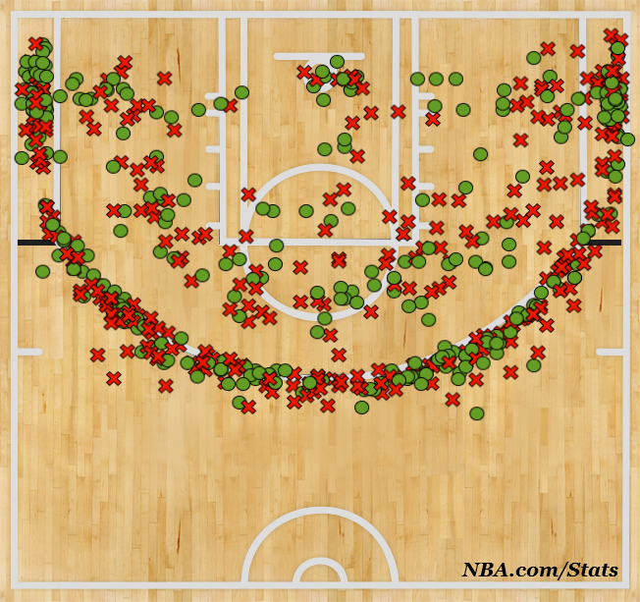
Consider the three-point shot…

Slide 27
Consider the three-point shot…
Will consumers change their behavior with the introduction of an incentive to do so (lower rates)?
Will that change how the segment will perform going forward?

Slide 28
CAS Ratemaking Principles
Principle 4: A rate is reasonable and not excessive, inadequate, or unfairly discriminatory if it is an actuarially sound estimate of the expected value of all future costs with an individual risk transfer.
Principle 3: A rate provides for the costs associated with an individual risk transfer.
Principle 2: A rate provides for all costs associated with the transfer of risk.
Principle 1: A rate is an estimate of the expected value of future costs.

Slide 29
ASOP 12 – Risk Classification
Considerations in Selection of Risk Characteristics
Relationship to Outcomes
Causality
Objectivity
Practicality
Applicable Law
Industry Practices
Business Practices
Considerations in Establishing Risk Classes
Intended Use
Actuarial Considerations Adverse Selection Credibility Practicality
Other Considerations Applicable law Industry practices Business practices
Reasonableness of results

Slide 30
Relationship to Outcomes – ASOP 12
“A relationship between a risk characteristic and an expected outcome, such as cost, is demonstrated if it can be shown that the variation in actual or reasonably anticipated experience correlates to the risk characteristic. In demonstrating a relationship, the actuary may use relevant information from any reliable source, including statistical or other mathematical analysis of available data. The actuary may also use clinical experience and expert opinion.
“Rates within a risk classification system would be considered equitable if differences in rates reflect material differences in expected cost for risk characteristics.” (emphasis added)

Slide 31
Causality – An Example
Consider a cohort of auto insurance consumers with the following characteristics:
Good physical condition
Superior eyesight
Excellent reaction times
Extensive driver training
Comfortable with latest auto technologies
How would you expect this group to perform relative to the general driving population?

Slide 32

Causality – An Example
Consider a cohort of auto insurance consumers with the following characteristics:
Good physical condition
Superior eyesight
Excellent reaction times
Extensive driver training
Comfortable with latest auto technologies
How would you expect this group to perform relative to the general driving population?

Slide 33
Causality – ASOP 12
“While the actuary should select risk characteristics that are related to expected outcomes, it is not necessary for the actuary to establish a cause and effect relationship between the risk characteristic and expected outcome in order to use a specific risk characteristic.” (emphasis added)

Slide 34
Industry Practices – ASOP 12
“When selecting risk characteristics, the actuary should consider usual and customary risk classification practices for the type of financial or personal security system under consideration.” (emphasis added)

Slide 35
ASOP 12 – Communications and Disclosures
In addition to complying with ASOPs 23 (Data Quality) and 41 (Actuarial Communications), actuary should disclose:
Significant limitations due to compliance with applicable law
Significant departure from industry practices
Significant limitations created by business practices
A determination by the actuary that experience indicates a significant need for change, such as changes in the risk classes or the assigned values
Expected material effects of adverse selection, including any recommendations to mitigate the potential impact
Whether any material assumption or method was prescribed by law*
Reliance on other sources*
Disclosure if the actuary has deviated materially from the guidance of ASOP 12*
*Per guidance in ASOP 41

Slide 36
Role for Actuaries
Lead…
Follow…
Get out of the way!

Slide 37
Role for Actuaries
Lead…
Follow…
Don’t get out of the way!

Slide 38
Lead
Understand company/client goals and objectives
Mine available data to identify opportunities to drive competitive advantage
Monitor industry trends to help protect against adverse selection
Identify measures of success and an exit strategy
Tell the story! -- help your business partners understand the opportunity, value, risk, and dependencies

Slide 39
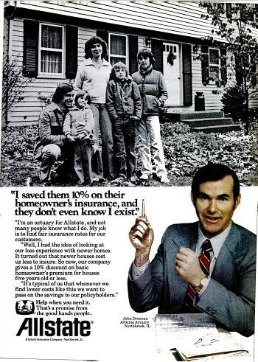
Allstate Magazine Ad
1978

Slide 40
Allstate Magazine Ad
1978
“I’m an actuary for Allstate, and not many people know what I do. My job is to find fair insurance rates for our customers.
“Well, I had the idea of looking at our loss experience for newer homes. It turned out that newer houses cost us less to insure. So now, our company gives a 10% discount on basic homeowner’s premium for houses five years old or less.”

Slide 41
Follow
Listen – understand what the business partner is proposing and why
Be open to new ideas
Are there other tools to achieve the desired outcome?

Slide 42
Don’t get out of the way
Stand up for the CAS Statement of Principles and ASOP 12
Test for reversals and counterintuitive results
Explore non-rate opportunities to leverage findings or enhance offering
  Marketing strategy
  Underwriting guidelines
  Partnership opportunities
Manage rate impacts arising from introduction of new rating variables
Work with regulators to secure approval

Slide 43
A Non-Actuary’s Perspective…
“You actuaries think it’s your job to save us from ourselves.”
-Anonymous Underwriting SVP

Slide 44
Rich Yocius, FCAS, MAAA, CPCU
VP and Chief Actuary
American Association of Insurance Services
richy@aaisonline.com
630-457-3203

