Slide 1
The Commercial P/C Insurance Industry: Issues & Outlook
Midwest Actuarial Forum Spring Meeting
Chicago, IL
March 20, 2015
Steven N. Weisbart, Ph.D., CLU, Senior Vice President & Chief Economist
Insurance Information Institute ♦ 110 William Street ♦ New York, NY 10038
Tel: 212.346.5540 ♦ Cell: 917.494.5945 ♦ stevenw@iii.org ♦ www.iii.org

Slide 2
Insurance Industry:
Financial Update & Outlook
2014 Was a Reasonably Good Year
2013 Was the Industry’s Best Year
in the Post-Crisis Era
2

Slide 3
P/C Industry Net Income After Taxes
1991–2014E
2005 ROE*= 9.6%
2006 ROE = 12.7%
2007 ROE = 10.9%
2008 ROE = 0.1%
2009 ROE = 5.0%
2010 ROE = 6.6%
2011 ROAS¹ = 3.5%
2012 ROAS¹ = 5.9%
2013 ROAS¹ = 10.3%
2014 ROAS¹ = 7.6%
Net income rose strongly (+81.9%) in 2013 vs. 2012 on lower cats, capital gains
$ Millions
ROE figures are GAAP; ¹Return on avg. surplus. Excluding Mortgage & Financial Guaranty insurers yields a 7.7% ROAS through 2014:Q2, 9.8% ROAS in 2013, 6.2% ROAS in 2012, 4.7% ROAS for 2011, 7.6% for 2010 and 7.4% for 2009.
Sources: A.M. Best, ISO; Insurance Information Institute

Slide 4
Back to the Future: P/C Insurance
Industry Profitability, 1950 – 2014*
ROE
1970-90: Peak ROEs were much higher in this period while troughs were comparable. High interest rates, rapid inflation, economic volatility all played roles
1950-70: ROEs were lower in this period. Low interest rates, low inflation, “Bureau” rate regulation all played a role
1990-2010s: Déjà vu. Excluding mega-CATs, this period is very similar to the 1950-1970 period
1977:19.0%
1987:17.3%
2006:12.7%
1972:13.7%
1997:11.6%
2013 10.4%
1950:8.0%
1966-67: 5.5%
1959:6.8%
2014:H1 7.6%
1969: 3.9%
1957: 1.8%
1965: 2.2%
1975: 2.4%
1984: 1.8%
1992: 4.5%
2001: -1.2%
*Profitability = P/C insurer ROEs. 2011-14 figures are estimates based on ROAS data. Note: Data for 2008-2014 exclude mortgage and financial guaranty insurers. 2014 figure is through Q3.
Source: Insurance Information Institute; NAIC, ISO, A.M. Best.

Slide 5
P/C Insurance Industry
Combined Ratio, 2001–2014:Q3*
Relatively Low CAT Losses, Reserve Releases
Higher CAT Losses, Shrinking Reserve Releases, Toll of Soft Market
As Recently as 2001, Insurers Paid Out Nearly $1.16 for Every $1 in Earned Premiums
Heavy Use of Reinsurance Lowered Net Losses
Relatively Low CAT Losses, Reserve Releases
Avg. CAT Losses, More Reserve Releases
Sandy Impacts
Best Combined Ratio Since 1949 (87.6)
Cyclical Deterioration
Lower CAT Losses
* Excludes Mortgage & Financial Guaranty insurers 2008--2014. Including M&FG, 2008=105.1, 2009=100.7, 2010=102.4, 2011=108.1; 2012:=103.2; 2013: = 96.1; 2014:9M = 97.7.
Sources: A.M. Best, ISO.

Slide 6
A 100 Combined Ratio Isn’t What It
Once Was: Investment Impact on ROEs
A combined ratio of about 100 generates an ROE of ~7.0% in 2012/13, ~7.5% ROE in 2009/10,
10% in 2005 and 16% in 1979
Combined Ratio / ROE
Lower CATs helped ROEs in 2013
Combined Ratios Must Be Lower in Today’s Depressed
Investment Environment to Generate Risk Appropriate ROEs
* 2008 -2014 figures are return on average surplus and exclude mortgage and financial guaranty insurers. 2014:9M combined ratio including M&FG insurers is 97.7; 2013 = 96.1; 2012 =103.2, 2011 = 108.1, ROAS = 3.5%.
Source: Insurance Information Institute from A.M. Best and ISO Verisk Analytics data.

Slide 7
Return on Net Worth (RNW) All Lines: 2004-2013 Average
Commercial lines have tended to be more profitable than personal lines over the past decade
Personal lines
Source: NAIC; Insurance Information Institute.

Slide 8
RNW All Lines by State, 2004-2013 Average:
Highest 25 States
The most profitable states over the past decade are widely distributed geographically, though none are in the Gulf region
Profitability Benchmark: All P/C
US: 7.9%
Source: NAIC; Insurance Information Institute.

Slide 9
RNW All Lines by State, 2004-2013 Average:
Lowest 25 States
Some of the least profitable states over the past decade were hit hard by catastrophes
Source: NAIC; Insurance Information Institute.

Slide 10
Performance by Segment and by State
10
Notes:
10

Slide 11
Net Premium Growth: Annual Change,
1971—2016F
(Percent)
1975-78
1984-87
2000-03
Net Written Premiums Fell 0.7% in 2007 (First Decline Since 1943) by 2.0% in 2008, and 4.2% in 2009, the First 3-Year Decline Since 1930-33.
2015-16F: 4.0%
2014E: 3.9%*
2013: 4.6%
2012: +4.3%
*Actual figure based on data through Q3 2014.
Shaded areas denote “hard market” periods
Sources: A.M. Best (historical and forecast), ISO, Insurance Information Institute.

Slide 12
Commercial Lines Combined Ratio, 1990-2015F*
Commercial lines underwriting performance is expected to improve as improvement in pricing environment persists
*2007-2012 figures exclude mortgage and financial guaranty segments.
Source: A.M. Best (1990-2014F); Conning (2015F) Insurance Information Institute.

Slide 13
Commercial Auto Combined Ratio: 1993–2015F
Commercial Auto is Expected to Improve as Rate Gains Outpace Any Adverse Frequency and Severity Trends
Sources: A.M. Best (1990-2014F);Conning (2015F); Insurance Information Institute.

Slide 14
Commercial Multi-Peril Combined Ratio: 1995–2015F
Commercial Multi-Peril Underwriting Performance is Expected to Improve in 2013 Assuming Normal Catastrophe Loss Activity
*2013F-2012F figures are Conning figures for the combined liability and non-liability components..
Sources: A.M. Best; Conning; Insurance Information Institute.

Slide 15
General Liability Combined Ratio:
2005–2015F
Commercial General Liability Underwriting Performance Has Been Volatile in Recent Years
Source: Conning Research and Consulting.

Slide 16
Direct Premiums Written: Comm. Lines
Percent Change by State, 2007-2013
Top 25 States
Only 30 states showed any commercial lines growth from 2007 through 2013
Growth Benchmarks: Commercial
US: 1.3%
Sources: SNL Financial LLC.; Insurance Information Institute.

Slide 17
Direct Premiums Written: Comm. Lines
Percent Change by State, 2007-2013
Bottom 25 States
Nearly half the states have yet to see commercial lines premium volume return to pre-crisis levels
States with the poorest performing economies also produced the most negative net change in premiums of the past 6 years
Sources: SNL Financial LLC.; Insurance Information Institute.

Slide 18
Cyber Risk: a Rapidly Emerging Exposure for Businesses
Also Growing Interest from
Media & Public Policymakers
18

Slide 19
Data Breaches 2005-2014, by Number of Breaches and Records Exposed
# Data Breaches/Millions of Records Exposed
Millions
The Total Number of Data Breaches Rose 28% While the Number of Records Exposed Was Relatively Flat (-2.6%)
19
* 2014 figures as of Jan. 12, 2014 from the ITRC.
Source: Identity Theft Resource Center.

Slide 20
Worldwide Cybersecurity Spending, 2011- 2016F
($ Billions)
Cybersecurity spending increased by an estimated $5.2B in 2014, $5.8B in 2015 and $6.3B in 2016
Cybersecurity Spending Is Rising Sharply, Up by About 8%+ Annually through 2016—a Projected Increase of $12.1 Billion from 2014 to 2016
20
Source: Gartner Group; Insurance Information Institute; Adapted from Wall Street Journal: “Financial Firms Boost Cybersecurity Funds,” Nov. 17, 2014.

Slide 21
Data/Privacy Breach:
Many Potential Costs Can Be Insured
Data Breach Event
Costs of notifying affecting individuals
Defense and settlement costs
Lost customers and damaged reputation
Cyber extortion payments
Costs of notifying regulatory authorities
Regulatory fines at home & abroad
Business Income Loss
Forensic costs to discover cause
Source: Zurich Insurance; Insurance Information Institute
21

Slide 22
The Three Basic Elements of Cyber Coverage: Prevention, Transfer, Response
Loss Prevention
Post-Breach Response
(Insurable)
Loss Transfer (Insurance)
Cyber risk management today involves three essential components, each designed to reduce, mitigate or avoid loss. An increasing number of cyber risk products offered by insurers today provide all three.
Source: Insurance Information Institute research.
22

Slide 23
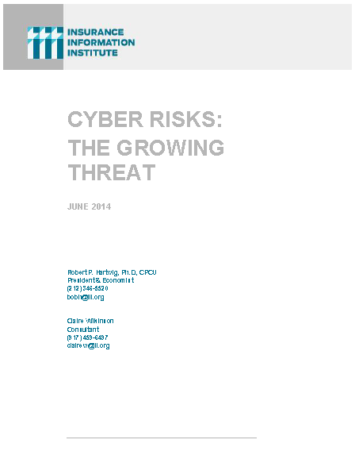
I.I.I. Released its Second Cyber Report in 2014: Cyber Risk: The Growing Threat
I.I.I.’s 2nd report on cyber risk released June 2014
Provides information on cyber threats and insurance market solutions
Global cyber risk overview
  Quantification of threats by type and industry
Cyber security and cost of attacks
Cyber terrorism
Cyber liability
Insurance market for cyber risk
3rd Report in Q2 2015

Slide 24
Investment Performance:
A Key Driver of Profitability
Depressed Yields Will Continue
to Affect Underwriting & Pricing
24

Slide 25
Distribution of Invested Assets: P/C Insurance Industry, 2013
$ Billions
Total Invested Assets = $1.5 Trillion
Source: Insurance Information Institute Fact Book 2015, A.M. Best.

Slide 26
U.S. Treasury 2- and 10-Year Note Yields*: Monthly, 1990–2015
Yields on 10-Year U.S. Treasury Notes have been essentially below 5% for over a decade.
U.S. Treasury 10-year note yields “spiked”
Since roughly 80% of P/C bond/cash investments are in 10-year or shorter durations, most P/C insurer portfolios will have low-yielding bonds for years to come.
*Monthly, constant maturity, nominal rates, through February 2015.
Sources: Federal Reserve Bank at http://www.federalreserve.gov/releases/h15/data.htm.
National Bureau of Economic Research (recession dates); Insurance Information Institutes.
26
12/01/09 - 9pm
eSlide – P6466 – The Financial Crisis and the Future of the P/C
Notes:
26

Slide 27
Book Yield on Property/Casualty Insurance Invested Assets, 2007–2016F
(Percent)
Book yield in 2014 is down 114 BP from pre-crisis levels
The yield on invested assets continues to decline as returns on maturing bonds generally still exceed new money yields. Interest rate increases are unlikely until mid-to-late 2015, and increases are expected to be small for a while.
Sources: Conning.

Slide 28
Distribution of Bond Maturities,
P/C Insurance Industry, 2004-2013
The main shift over these years has been from longer maturities to shorter maturities, but the 2013 data suggest a shift back has begun. The 2013 distribution resembles that at year-end 2009.
Sources: SNL Financial; Insurance Information Institute.

Slide 29
Property/Casualty Insurance Industry Investment Income: 2000–2014¹
Investment earnings are still below their 2007 pre-crisis peak
($ Billions)
Due to persistently low interest rates,
investment income fell in 2012, 2013 and 2014.
¹ Investment gains consist primarily of interest and stock dividends. *2014 figure is estimated based on annualized data through Q3.
Sources: ISO; Insurance Information Institute.

Slide 30
P/C Insurer Net Realized
Capital Gains/Losses, 1990-2014:Q3
Realized capital gains rose sharply as equity markets rallied in 2013-14
($ Billions)
Insurers Posted Net Realized Capital Gains in 2010 - 2014 Following Two Years of Realized Losses During the Financial Crisis. Realized Capital Losses Were a Primary Cause of 2008/2009’s Large Drop in Profits and ROE
Sources: A.M. Best, ISO, Insurance Information Institute.
30
12/01/09 - 9pm
eSlide – P6466 – The Financial Crisis and the Future of the P/C
Notes:
30

Slide 31
Property/Casualty Insurance Industry Investment Gain: 1994–2014E¹
($ Billions)
Investment gains in 2014 will rival the post-crisis high reached in 2013
Total investment gains were flat in 2014 because low interest rates offset realized capital gains
¹ Investment gains consist primarily of interest, stock dividends and realized capital gains and losses.
* 2005 figure includes special one-time dividend of $3.2B;
Sources: ISO; Insurance Information Institute.

Slide 32
Reduction in Combined Ratio Necessary to Offset 1% Decline in Investment Yield to Maintain Constant ROE, by Line*
Lower Investment Earnings Place a Greater Burden on Underwriting and Pricing Discipline
*Based on 2008 Invested Assets and Earned Premiums
**US domestic reinsurance only
Source: A.M. Best; Insurance Information Institute.
32
12/01/09 - 9pm
eSlide – P6466 – The Financial Crisis and the Future of the P/C
Notes:
32
This shows the drop in Combined Ratio for each line of business that would be needed to maintain a constant ROE, given a 1-percentage-point drop in investment yield

Slide 33
Interest Rate Forecasts: 2015 – 2020
3-Month Treasury
10-Year Treasury
Yield (%)
A normalization of interest rates is unlikely until 2017-18
– a full decade after the onset of the Financial Crisis and Great Recession.
Sources: Blue Chip Economic Indicators (3/15 issue); Insurance Info. Institute.

Slide 34
CAPITAL/CAPACITY
Capital Accumulation Has Multiple Impacts
34

Slide 35
Policyholder Surplus,
2006:Q4–2014:Q3
Drop due to near-record 2011 CAT losses
($ Billions)
2007:Q3
Pre-Crisis Peak
Surplus as of 9/30/14 stood at a record high $673.9B
The industry now has $1 of surplus for every $0.73 of NPW,
close to the strongest claims-paying status in its history.
2010:Q1 data includes $22.5B of paid-in capital from a holding company parent for one insurer’s investment in a non-insurance business .
The P/C insurance industry entered 2015
in very strong financial condition.
Sources: ISO, A.M .Best.
35
12/01/09 - 9pm
eSlide – P6466 – The Financial Crisis and the Future of the P/C
Notes:
35

Slide 36
Premium-to-Surplus Ratio:
1985–2014*
(Ratio of NWP to PHS)
The larger surplus is in relation to premiums—the lower the P:S ratio—and the great the industry’s capacity to handle the risk it has accepted
Surplus as of 9/30/14 was $0.75:$1, a near-record low (at least in modern history)
9/11, Recession & Hard Market
The Premium-to-Surplus Ratio Stood at $0.75:$1 as of
9/30/14, a Record Low (at Least in Recent History)
* As of 9/30/14.
Source: A.M. Best, ISO, Insurance Information Institute.

Slide 37
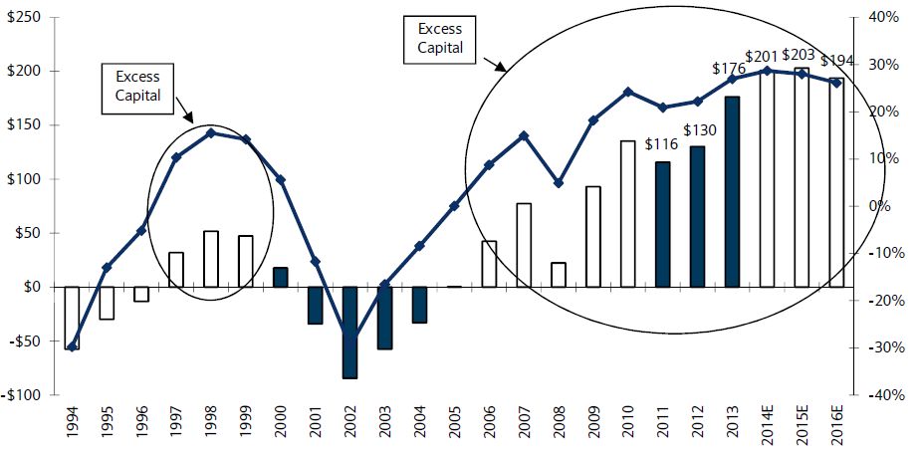
US P/C Insurance Industry Excess Capital Position: 1994–2016E
Barclay’s suggests that excess is about $200B (~30%)
Surplus Redundancy (Deficiency)
Percent Redundancy (Deficiency)
The Industry’s Strong Capital Position Suggests Insurers Are in a Good Position to Increase Risk Appetite, Repurchase Shares and Pursue Acqusitions
Source: Barclays Research estimates.

Slide 38
Alternative Capital
New Investors Continue to Change the Reinsurance Landscape
First I.I.I. White Paper on Issue Will Be Released Q1 2015
38

Slide 39
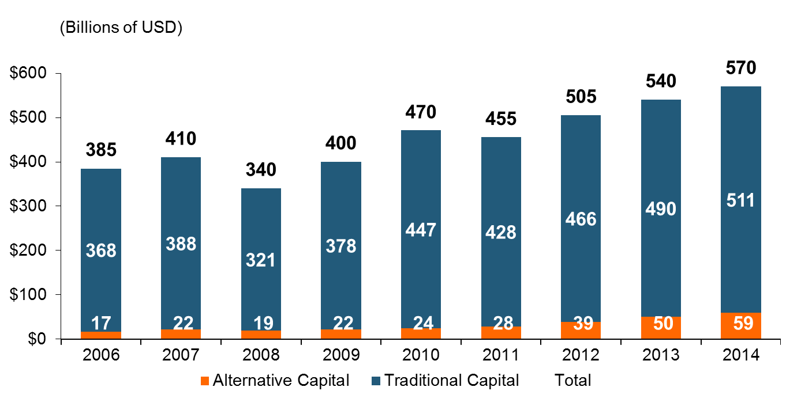
Global Reinsurance Capital (Traditional and Alternative), 2006 - 2014
Total reinsurance capital reached a record $570B in 2013, up 68% from 2008.
But alternative capacity has grown 210% since 2008, to $50B. It has more than doubled in the past three years.
2014 data is as of June 30, 2014.
Source: Aon Benfield Analytics; Insurance Information Institute.

Slide 40
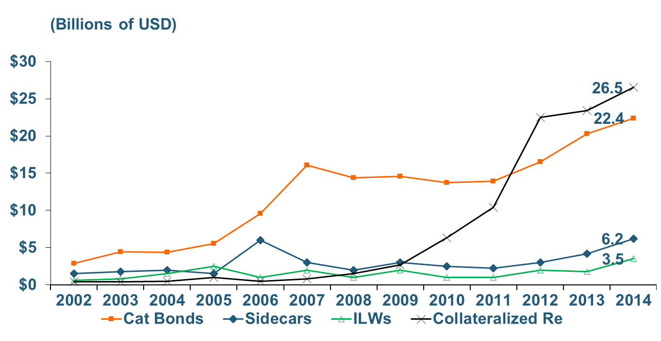
Growth of Alternative Capital Structures, 2002 - 2014
Collateralized Re’s Growth Has Accelerated in the Past Three Years.
Collateralized Reinsurance and Catastrophe Bonds Currently Dominate the Alternative Capital Market.
2014 data is as of June 30, 2014.
Source: Aon Benfield Analytics; Insurance Information Institute.

Slide 41
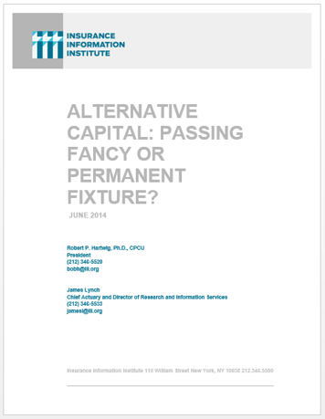
I.I.I. Will Release its First Report on Alternative Capital During Q1 2015
Issue of alternative capital in (re)insurance has received increased attention in recent years
Significant structural changes in property catastrophe reinsurance space
Questions addressed include:
  Sources of new capital
  Reasons/Drivers of growth
  New structures
  Impact of major triggering event(s)
  Impacts of higher interest rates
  Cat bond yield compression
Forthcoming: Q1 2015

Slide 42
Questions Arising from Influence of Alternative Capital
What Will Happen When Investors Face Large-Scale Losses?
What Happens When Interest Rates Rise?
Does ILS Have a Higher Propensity to Litigate?
How Much Lower Will Risk Premiums Shrink/ROLs Fall?
Will There Be Spillover Into Casualty Reinsurance?
Will Alternative Capital Drive Consolidation?

Slide 43
The Strength of the Economy Will Influence P/C Insurer Growth Opportunities
Growth Will Expand Insurer Exposure Base Across Most Lines
43

Slide 44
Real U.S. Quarterly GDP Growth
Since the “Great Recession
Since the Great Recession ended, even 3% real growth (at an annual rate) in a quarter has been unusual. It happened only 7 times in 22 quarters, but 4 of those 7 were in the most recent 6 quarters.
Data are quarterly changes at annualized rates. 2014:Q4 is revised estimate
Sources: US Department of Commerce, at http://www.bea.gov/national/index.htm#gdp ; Insurance Information Institute.

Slide 45
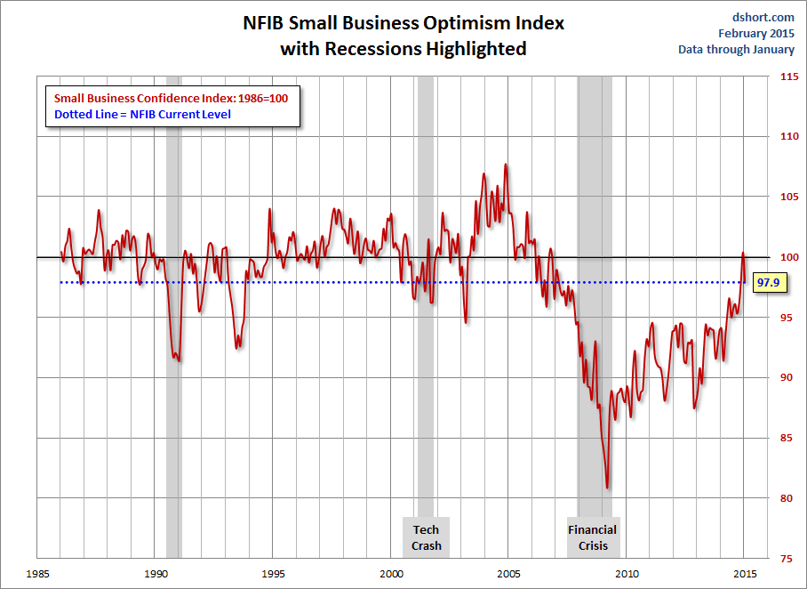
NFIB Small Business Optimism Index
January 1985 through January 2015
Source: National Federation of Independent Business at http://www.advisorperspectives.com/dshort/charts/indicators/Sentiment.html?NFIB-optimism-index.gif ; Insurance Information Institute.

Slide 46
Business Bankruptcy Filings: Still Falling
(1994:Q1 – 2014:Q3)
(Thousands)
New Bankruptcy Law Takes Effect
Below pre-recession level
Recessions in orange
Business bankruptcies in 2014 were below both the Great Recession levels and the 2003:Q3-2005:Q1 period (the best five-quarter stretch in the last 20 years). Bankruptcies restrict exposure growth in all commercial lines.
Sources: U.S. Courts at http://www.uscourts.gov/uscourts/Statistics/BankruptcyStatistics/BankruptcyFilings/2013/0913_f2q.pdf ; Insurance Information Institute
46
12/01/09 - 9pm
eSlide – P6466 – The Financial Crisis and the Future of the P/C
Notes:
46

Slide 47
Index of Total Industrial Production:*
A Near Peak as of December 2014
Many economists expect business investment to rise in 2015
December 2014 Index at 106.5
Peak at 100.82 in December 2007 (officially the 1st month of the Great Recession)
Insurance exposures for industrial production will continue growing in 2015, and commercial insurance premium volume with them. Y-o-Y growth to December 2014 was 4.6%. Both production and premium volume growth for 2015 should exceed this.
*Monthly, seasonally adjusted, through December 2014 (which is preliminary). Index based on year 2007 = 100
Sources: Federal Reserve Board at http://www.federalreserve.gov/releases/g17/ipdisk/ip_sa.txt .
National Bureau of Economic Research (recession dates); Insurance Information Institute.
47
12/01/09 - 9pm
eSlide – P6466 – The Financial Crisis and the Future of the P/C
Notes:
47

Slide 48
Business Fixed Investment is Forecast to Grow Steadily in 2015-16, Fueling Commercial Exposure Growth
Business investment will drive commercial property and liability insurance exposures and should drive employment and WC payroll exposures as well (with a lag)
Growth Rate
Sources: Wells Fargo Economic Group; Insurance Information Institute.

Slide 49
Labor Market Trends
We’re Now Gaining Jobs at a Strong Pace, Mainly in the Private Sector
49

Slide 50
Monthly Change in Nonfarm Employment, 2011 – 2015*
Average Monthly Gain
2011: 173,600 2012: 186,300 2013: 194,250 2014: 259,700
Thousands
If job growth continues at the recent pace
we will add over a million new workers every four months.
*Seasonally adjusted. Jan 2015 and Feb 2015 are preliminary data.
Sources: US Bureau of Labor Statistics; Insurance Information Institute

Slide 51
Unemployment and Underemployment Rates: Still Too High, But Falling
January 2000 through February 2015, Seasonally Adjusted (%)
U-6 went from 8.0% in March 2007 to 17.5% in
October 2009
U-6 was 11.0% in Feb. 2015.
“Headline” unemployment was 5.5% in February 2015. 4% to 6% is “normal.”
For U-6, 8% to 10% is “normal.”
High unemployment and underemployment still constrain overall economic growth, but the job market is now clearly improving.
Source: US Bureau of Labor Statistics; Insurance Information Institute.
51
12/01/09 - 9pm
eSlide – P6466 – The Financial Crisis and the Future of the P/C
Notes:
51

Slide 52
Nonfarm Payroll (Wages and Salaries):
Quarterly, 2005–2014:Q3
Billions
Latest (2014:Q3) was $7.46 trillion, a new peak--$1.21 trillion above 2009 trough
Prior Peak was 2008:Q3 at $6.54 trillion
Growth rates
2011:Q3 over 2010:Q3: 4.1%
2012:Q3 over 2011:Q3: 3.2%
2013:Q3 over 2012:Q3: 3.6%
2014:Q3 over 2013:Q3: 4.4%
Recent trough (2009:Q1) was $6.23 trillion, down 5.3% from prior peak
Note: Recession indicated by gray shaded column. Data are seasonally adjusted annual rates.
Sources: http://research.stlouisfed.org/fred2/series/WASCUR; National Bureau of Economic Research (recession dates); Insurance Information Institute.
52
12/01/09 - 9pm
eSlide – P6466 – The Financial Crisis and the Future of the P/C
Notes:
52

Slide 53
Payroll vs. Workers Comp Net Written Premiums, 1990-2014P
Payroll Base* WC NWP
$Billions $Billions
7/90-3/91
3/01-11/01
12/07-6/09
WC premium volume dropped two years before the recession began
WC net premiums written were down $14B or 29.3% to $33.8B in 2010 after peaking at $47.8B in 2005
Continued Payroll Growth and Rate Gains Suggest WC NWP Will Grow Again in 2015
*Private employment; Shaded areas indicate recessions. WC premiums for 2014 are I.I.I. estimates..
Sources: NBER (recessions); Federal Reserve Bank of St. Louis at http://research.stlouisfed.org/fred2/series/WASCUR ; NCCI; I.I.I.

Slide 54
U.S. Insured Catastrophe Loss Update
2014 Had Below-Average CAT Activity
54

Slide 55
U.S. Insured Catastrophe Losses
($ Billions, $ 2013)
2012 was the 3rd most expensive year ever for insured CAT losses
2013-14 were welcome respites from 2011-12, which were among the costliest years for insured disaster losses in U.S. history. Longer-term trend is for more—not fewer—costly events.
$15.3 billion in insured CAT losses estimated for 2014
*Through 12/31/14.
Note: 2001 figure includes $20.3B for 9/11 losses reported through 12/31/01 ($25.9B 2011 dollars). Includes only business and personal property claims, business interruption and auto claims. Non-prop/BI losses = $12.2B ($15.6B in 2011 dollars.)
Sources: Property Claims Service/ISO; Insurance Information Institute.
55
12/01/09 - 9pm
eSlide – P6466 – The Financial Crisis and the Future of the P/C
Notes:
55

Slide 56
Inflation Adjusted U.S. Catastrophe Losses by Cause of Loss, 1994–2013¹
Wind/Hail/Flood (3), $14.6
Fires (4), $5.5
Other (5), $0.2
Insured cat losses from 1993-2012 totaled $386.7B, an average of $19.3B per year or $1.6B per month
Geological Events, $18.4
Terrorism, $24.8
Winter Storms, $24.7
Hurricanes & Tropical Storms, $159.1
Tornado share of CAT losses is rising
Wind losses are by far cause the most catastrophe losses, even if hurricanes/TS are excluded.
Events Involving Tornadoes (2), $139.3
Catastrophes are defined as events causing direct insured losses to property of $25 million or more in 2013 dollars.
Excludes snow.
Does not include NFIP flood losses
Includes wildland fires
Includes civil disorders, water damage, utility disruptions and non-property losses such as those covered by workers compensation.
Source: ISO’s Property Claim Services Unit.

Slide 57
Top 16 Most Costly Disasters in U.S. History
(Insured Losses, 2013 Dollars, $ Billions)
Superstorm Sandy in 2012 was the last mega-CAT to hit the US
Includes Tuscaloosa, AL, tornado
Includes Joplin, MO, tornado
12 of the 16 most expensive events in U.S. history have occurred over the past decade
Sources: PCS; Insurance Information Institute inflation adjustments to 2013 dollars using the CPI.

Slide 58
Insurance Information Institute Online:
www.iii.org
Thank you for your time
and your attention!

Slide 59
P/C Industry: Loss Reserve-to-Surplus Ratio, 1971-2014:Q3
Inflation, Liability Crisis Increased Reserves, Plunging Stock Prices Depleted Surplus
The Property/Casualty Industry Adjusted Its Risk Portfolio in Response to Risk-Based Capital Requirements Implemented in 1994.
Source: Calculations from A.M. Best data by Insurance Information Institute.

Slide 60
Recovery in Capacity Utilization is a Positive Sign for Commercial Exposures
March 2001 through Dec. 2014
“Full Capacity”
The US operated at 79.7% of industrial capacity in Dec. 2014, well above the June 2009 low of 66.9% but is still below pre-recession levels.
Percent of Industrial Capacity
Hurricane Katrina
The closer the economy is to operating at “full capacity,” the greater the inflationary pressure
March 2001-November 2001 recession
December 2007-
June 2009 Recession
60
Source: Federal Reserve Board statistical releases at http://www.federalreserve.gov/releases/g17/Current/default.htm.
Notes:
60

