Slide 1
Usage Based Insurance: Trends and Considerations in the Current Personal Auto Market
Midwestern Actuarial Forum
Spring 2015 Meeting
Kathryn Walker, FCAS, MAAA, CPCU
Gary Wang, FCAS, MAAA
March 23, 2015

Slide 2
About the presenters
Kathryn A. Walker, FCAS, MAAA, CPCU
15 years of property/casualty experience
Consulting actuary in the Chicago office
Gary Wang, FCAS, MAAA
18 years of property/casualty experience
Consulting actuary in the Bloomington office

Slide 3
Discussion topics
The current UBI landscape
A survey of current UBI offerings
Customer segmentation
Telematics data and technology
Into the Wild – A New Frontier for the Actuary
UBI strategy and program considerations
Customer Response to Usage-Based Insurance
Urban Traveler- UBI in the City

Slide 4
The current UBI landscape

Slide 5
Understanding UBI landscape - major US programs
Major companies
Allstate: Drivewise®
American Family: mySafetyValetSM
Esurance: DriveSenseTM
Hartford: TrueLane
National General: Low-Mileage Discount
Nationwide: SmartRide®
Progressive: Snapshot DiscountSM
Safeco: Rewind®
State Farm: Drive Safe & SaveTM (In-Drive®)
Travelers: IntelliDrive®

Slide 6
Understanding UBI landscape - major US programs
Types of programs
Mileage based
Behavior based
Value added services
Discounts
Most give enrollment discount of 5 – 10%
Usage based discount of up to 50%

Slide 7
Number of personal auto UBI programs by state
Data as of September 2014
Companies included: Progressive, State Farm, Allstate, Hartford, Esurance, Travelers , National General, Nationwide, DTRIC and Metromile

Slide 8
Metromile per-mile insurance program
Policies written by insurers in the National General Insurance Group
Monthly base rate plus cents per mile
Mileage capped
150 miles/day CA, IL and OR
250 miles/day WA

Slide 9
Customer segments and behavior
Customer segments
Teenage drivers
Young adult operators
Millennial
New families
Empty nesters
Senior operators
Behavior
Saving money
Self-selection
Environmentally friendly
Decrease in car ownership levels
Ride sharing/car sharing

Slide 10
Types of telematics data
Usage
Basic usage data
Mileage
Behavior
Measures vehicle behavior on road
Time of day
Geospatial
Measures conditions of and surrounding vehicle
Operating state of vehicle
Acceleration/deceleration
Speed
Location
Weather
Road type
Traffic

Slide 11
Mobile app solutions
The mobile app option is quickly becoming a viable alternative to the traditional OBD solutions
The overarching issues with the mobile app solution
Amount of time the app is off
Phone off
Phone not present in vehicle
The inability to guarantee data captured relate to the driver and vehicle
Passenger in car pooling situations
Public transit

Slide 12
Mobile app solutions – considerations
Price of the solution
Upfront cost, in time and money
Per driver/vehicle/policy cost
Completeness of the solution
Comparison against the OBD alternative
Accuracy against actual results
Correlation to claims potential

Slide 13
Into the Wild –
A New Frontier for the Technical Actuary

Slide 14
UBI – a strategy for success
Internal
Understanding various options and approaches for launching a UBI program
External
Understanding UBI landscape
Strategy
Articulate a UBI strategy consistent with company strategy and goals
Research customer demand and industry trends
Develop the data and analytics plan required for a successful program
Identify market triggers that would signal key timing for market entry
Evaluate potential investment given the company distribution model and value proposition
Notes:
NEED 2 MINUTES HERE
3 key components – Internal Considerations, External Considerations, and the actual strategy development
INTERNAL – involving all key stakeholders; gain understanding and consensus as this impacts all parts of an organization
EXTERNAL:
UBI options are expanding – devices, mobile solutions, data, analytics, scoring
Customers - Vendors – Research – Cost – Technology
UBI STRATEGY:
- First bullet point is essentially a precept of UBI Implementation – Company must understand their own goals & value proposition and incorporate a UBI strategy that aligns with it and supports those goals
- Companies need to focus on their existing clients and target market; i.e. marketing for millennials vs. baby boomers
– strategy will drive selection of all UBI elements including technology chosen, data collected, and analytics process
-
- Market entry is a key concern; first adopters (Progressive); 2nd wave – Early Majority (Liberty Mutual, State Farm, etc.); Late Majority (next entrants); final group will be market share defenders who are forced to have a UBI program to maintain competitive position & avoid adverse selection (similar to credit scoring)

Slide 15
UBI – Strategic Considerations
Product Positioning
Telematics Devices
UBI Data
Rating Considerations
Program Monitoring
Market Entry Considerations
Customer service & support
Driver feedback
Driver scoring
Value-added services
Premium discount
Privacy considerations
On-board devices
Smartphone
Cost focus
Data focus
Barriers to entry / Market cycle
Key metrics
Notes:
Balance of Premium discounting and value-adding services
Simplest version of UBI is basic mileage verification
Discounts also based on driver behaviors
In the absence of UBI as a mechanism to increase premiums for drivers with riskier habits, is discounting a viable long-term solution?
Use of Value Adding services to create a more comprehensive UBI product offering
Largest expense of UBI is devices & data
options available, but technology is rapidly changing
→→→ requires a strategy with a flexible solution
Data – in the absence of restrictions (expenses), insurers would collect all data
BUT, data collection is expensive & time-consuming; external data needs to be configured & new data being added
Driver Scoring issues – how to solve?
How to gain competitive advantage?
Driver Feedback – 80% of people know that they are above average drivers, so feedback is imperative in a discount program
Improving driver behaviors: need to provide periodic useful feedback
Teen Safety – promote responsible habits
Education: drivers, agents, general population
Rating Considerations vs Privacy Considerations
Insurer would prefer ALL of the info while customers don’t want to feel monitored or watched

Slide 16
Market entry considerations
Barriers to entry
Entry considerations – what signs support entering UBI market
Identification of key metrics
Notes:
All industries have barriers to entry – competition, cost, knowledge/expertise, regulators, consumers
Considerations
– Understanding market cycle (Innovators, early adopters, early majority, late majority, market defenders/laggards)
Reduced costs to make entry viable
Consumers – gaining acceptance
Key Metrics
Preparation for entry – quantity of data; prelim scorecard; market acceptance;
Market conditions - # of key competitors adopting; projected rollout

Slide 17
Market entry considerations
Competitive position
s
Innovation
Consumer response
Market share
Expenses
Internal challenges
Legal considerations

Slide 18
Customer Response to Usage Based Insurance An Analysis of Social Media Sentiments
September 2014
Notes:
Review survey results
Recap initial study & methodology
2013 study; Twitter data (review of individual tweets)
5M insurance tweets; 3500 tweets for Progressive Snapshot
Categorize: user status, sentiment, positive, complaints, misconceptions, savings
CONCLUSIONS
UBI is here to stay, and will be a game-changer
UBI has the potential for significant growth
Potential growth will not be achieved, however, without listening closely to the voice of the customer
Ultimately, will help create a more positive customer experience and improve the potential for UBI long-term
2014 Update: Additional data (3000 tweets); addition of UK data

Slide 19
Sentiment of comment
Notes:
Positive – increase in percentage of non-customers positive reaction to Snapshot, slight decrease in positive reaction of customers
Negative –

Slide 20
Customer positive responses
Well defined customer value proposition
Customer Recommendations
Notes:
Two additional items which were big in the UK
1. Commented about positive customer about 22% of the time
2. Led to a significant amount of recommendations on social media

Slide 21
Non-customer negative responses
“That snapshot thing by Progressive just seems like an easy way for the govt to spy on you.“
Notes:
Largest Issues in the UK
Customer Service Issues
Uncompetitive premiums
Crossover effect – entire experience has to be good
Takeaways
Privacy – while the general trend is that over time privacy will become less of an issue, there is not much if anything insurance companies are going to be able to do about those thinking that the government is spying on you
Misunderstanding & Rate Going Up – better job of explaining, don’t understand from commercials what the program is
Concerned About Results – self selection element, nothing really to do here
Customer Complaints – Driving, Device beeping, Snapshot evaluation process, Installation, Annoying, Premium Change

Slide 22
Savings
“Thought I earned a 30% discount through the @Progressive snapshot only to learn that policy rates went up the amount of my discount #notcool.”

Slide 23
Urban Traveler – UBI in the City

Slide 24
Usage-Based Insurance Apps
6 month evaluation of Driveway UBI app
Smartphone-based
I’m a Good Driver!

Slide 25
Annual Mileage
Projection is 13,000 miles vs. an average of 12,000
35 miles per day?!?
Recommendations
Use public transportation
Drive less
Car pool
Where am I driving?

Slide 26
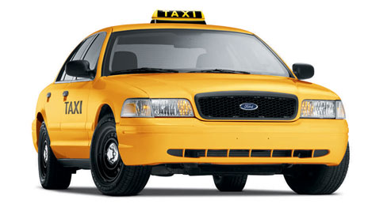
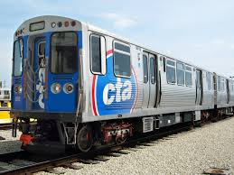
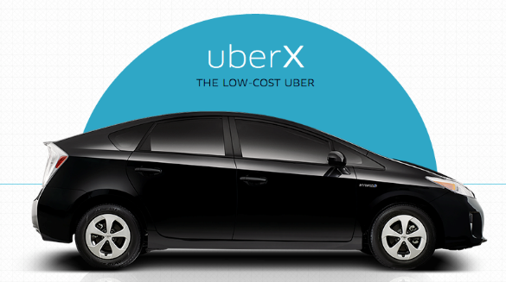
In my world….
2012 Toyota Highlander
Purchased: August 2012
Odometer reading: 3,248 miles
March 2015
Odometer reading: 11,276 miles
8,028 total miles over 31 months =
8.5 miles per day
260 miles per month
3,100 miles per year

Slide 27
How does the Urban Traveler travel?

Slide 28
Average Driving Scores
BEST
WORST

Slide 29
Overall Trip Scores vs. Trip Distance

Slide 30
Performance vs. Trip Distance

Slide 31
Overall Trip Score vs. Trip Distance

Slide 32
Conclusions
Mobile app solution has become a strong contender
Existing programs continue to expand into new states
Successful UBI Implementation requires alignment with company value propositions
Positive progress has been made in customer awareness
UBI lessons learned will come both domestically & abroad
Consumer experience is imperative
Notes:
Demographics – identify positive segments, these customers can be targeted and ultimately become brand evangelists to convert other customer segments
Customer concerns remain, some can be overcome and some will be tough to overcome

Slide 33
Thank you for your time and attention
Katey Walker, FCAS, MAAA, CPCU
kwalker@pinnacleactuaries.com
630-457-1298
Gary Wang, FCAS, MAAA
gwang@pinnacleactuaries.com
309-807-2331
Check us out: http://www.pinnacleactuaries.com
Resource Knowledge Center
Blog

