Slide 1
Cyber Risk
www.pwc.com
Recent Trends and Insurance Considerations
March 2015

Slide 2

–

Slide 3

–
Cyber Risk – Recent Trends and Insurance Considerations

Slide 4
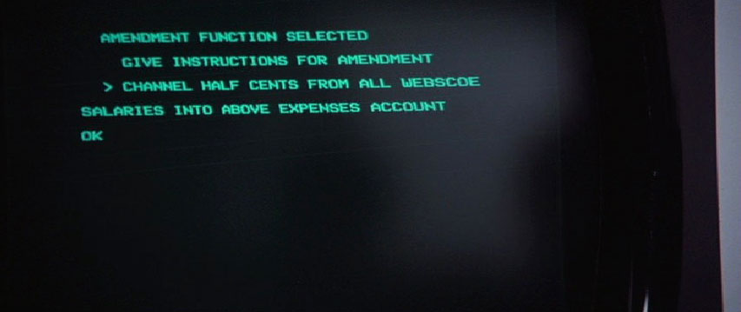
–
Cyber Risk – Recent Trends and Insurance Considerations

Slide 5

–
Cyber Risk – Recent Trends and Insurance Considerations

Slide 6

–
Cyber Risk – Recent Trends and Insurance Considerations

Slide 7
Agenda
Notable Cyber Attacks
Regulatory Responses to Attacks
Cyber Insurance
Claims Handling Considerations
Lessons Learned

Slide 8
Section 1
Notable Cyber Attacks

Slide 9
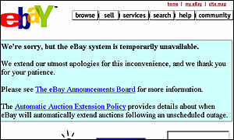
mafiaboy
Notable Cyber Attacks
Cyber Risk – Recent Trends and Insurance Considerations

Slide 10
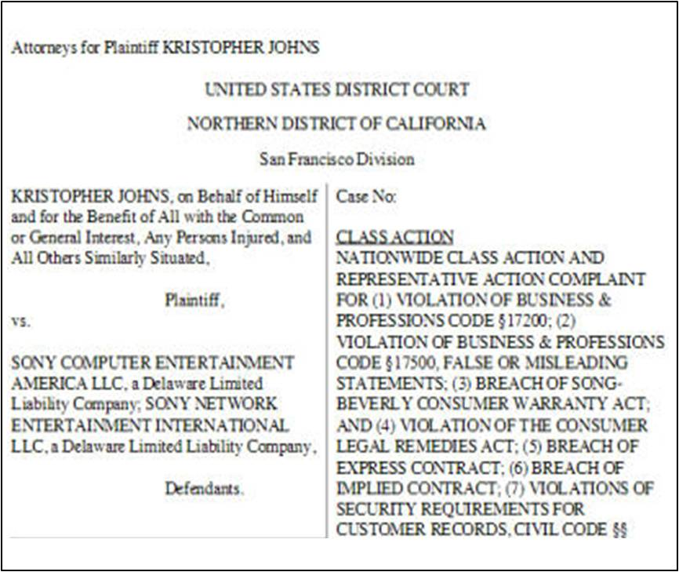
Sony Playstation Data Breach
Notable Cyber Attacks
Kristopher Johns et al (Plaintiff)
Class Action
vs
Sony Computer Electronic Entertainment America LLP et al (Defendant)
Cyber Risk – Recent Trends and Insurance Considerations

Slide 11
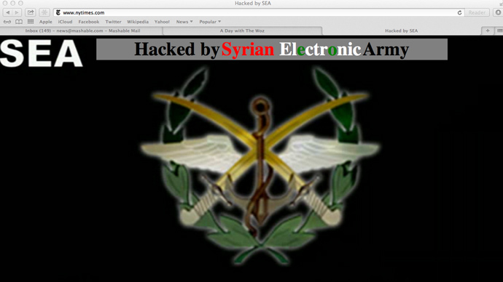
New York Times Website Attack
Notable Cyber Attacks
Cyber Risk – Recent Trends and Insurance Considerations

Slide 12
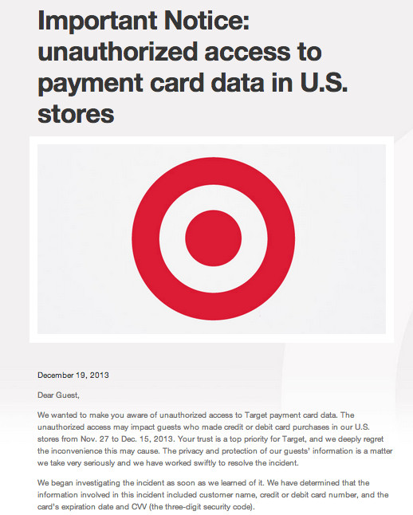
Target Cyber Attack
Notable Cyber Attacks
Cyber Risk – Recent Trends and Insurance Considerations

Slide 13

Sony pictures Attack
Notable Cyber Attacks
Cyber Risk – Recent Trends and Insurance Considerations

Slide 14
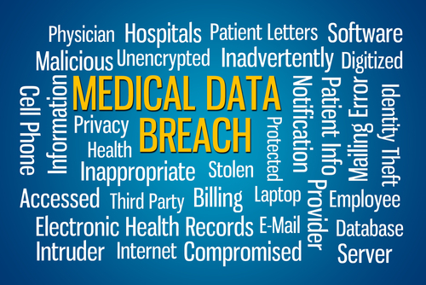
Anthem data breach
Notable Cyber Attacks
Cyber Risk – Recent Trends and Insurance Considerations

Slide 15

Cisco 2014 Annual Security Report
Notable Cyber Attacks
Cyber Risk – Recent Trends and Insurance Considerations

Slide 16
Section 2
Regulatory Responses to Cyber Attacks

Slide 17

Regulatory Responses to Cyber Attacks
Cyber Risk – Recent Trends and Insurance Considerations

Slide 18

NIST Cybersecurity Framework
Regulatory Responses to Cyber Attacks
Cyber Risk – Recent Trends and Insurance Considerations

Slide 19
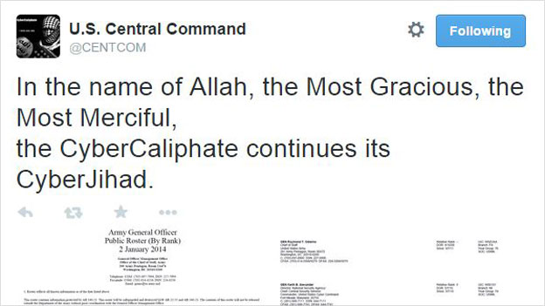
Federal and state regulations
Regulatory Responses to Cyber Attacks
Cyber Risk – Recent Trends and Insurance Considerations

Slide 20
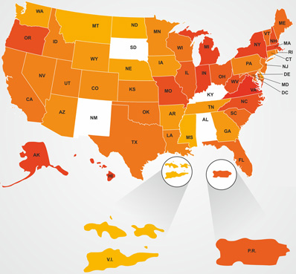
Federal and state regulations
Regulatory Responses to Cyber Attacks
Cyber Risk – Recent Trends and Insurance Considerations

Slide 21
Section 3
Cyber Insurance

Slide 22
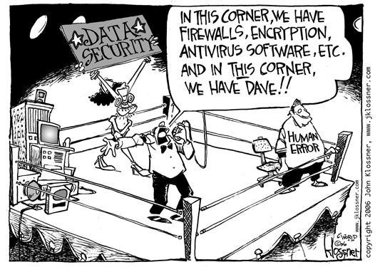
Cyber Insurance
Cyber Insurance
Cyber Risk – Recent Trends and Insurance Considerations

Slide 23
Cyber Insurance
Cyber Insurance
This insurance does not apply to:
Access Or Disclosure Of Confidential Or Personal Information
“Personal and advertising injury” arising out of any access to or disclosure of any person’s or organization's confidential or personal information, including patents, trade secrets, processing methods, customer lists, financial information, credit card information, health information or any other type of non public information.
This exclusion applies even if damages are claimed for notification costs, credit monitoring expenses, forensic expenses, public relations expenses or any other loss, cost or expense incurred by you or others arising out of any access to or disclosure of any person's or organization's confidential or personal information.
New Data Breach Exclusions & Endorsements
Cyber Risk – Recent Trends and Insurance Considerations

Slide 24
Cyber Insurance
Cyber Insurance
Notable Coverage Decisions
Notable Coverage Decisions
Cyber Risk – Recent Trends and Insurance Considerations

Slide 25
Cyber Insurance
Cyber Insurance
What about D&O
Cyber Risk – Recent Trends and Insurance Considerations

Slide 26
Cyber Insurance
Cyber Insurance
What about D&O… Maybe??
Cyber Risk – Recent Trends and Insurance Considerations

Slide 27
Cyber Insurance
Cyber Insurance
Cyber Insurance
Cyber Risk Policies
Cyber Risk – Recent Trends and Insurance Considerations

Slide 28
Cyber Insurance
Cyber Insurance
Cyber Liability – First Party Policies
Cyber Risk – Recent Trends and Insurance Considerations

Slide 29
Cyber Insurance
Cyber Insurance
Cyber Liability – Third Party Policies
Cyber Risk – Recent Trends and Insurance Considerations

Slide 30
Cyber Insurance
Cyber Insurance
Cyber Risk Policies
Cyber Risk – Recent Trends and Insurance Considerations

Slide 31
Section 4
Claim Handling Consideration

Slide 32

Cyber Insurance
Claim Handling Considerations
Beware of Clouds
Cyber Risk – Recent Trends and Insurance Considerations

Slide 33
Cyber Insurance
Claim Handling Considerations
Future Trends
Cyber Risk – Recent Trends and Insurance Considerations

Slide 34
Section 5
Lessons Learned

Slide 35
Lessons Learned
  Notable Cyber Attacks
  Regulatory Responses to Attacks
  Cyber Insurance
  Claims Handling Considerations
Cyber Risk – Recent Trends and Insurance Considerations

Slide 36
Lessons Learned
Cyber Risk – Recent Trends and Insurance Considerations

Slide 37
Thank You
This publication has been prepared for general guidance on matters of interest only, and does not constitute professional advice. You should not act upon the information contained in this publication without obtaining specific professional advice. No representation or warranty (express or implied) is given as to the accuracy or completeness of the information contained in this publication, and, to the extent permitted by law, PricewaterhouseCoopers LLP, its members, employees and agents do not accept or assume any liability, responsibility or duty of care for any consequences of you or anyone else acting, or refraining to act, in reliance on the information contained in this publication or for any decision based on it.
© 2015 PricewaterhouseCoopers LLP. All rights reserved. In this document, “PwC” refers to PricewaterhouseCoopers LLP which is a member firm of PricewaterhouseCoopers International Limited, each member firm of which is a separate legal entity.

