Slide 1
Alternative Capital and Risk Transfer Trends
March 24, 2015
Parr Schoolman FCAS, MAAA, CERA

Slide 2


Alternative Capital
Positive or Scary Innovation?
http://www.innocentive.com/blog/wp-content/uploads/2014/08/Innovation_Bulb_Text.jpg
http://3.bp.blogspot.com/-3ofidSRSlwA/T4XxTnTtG7I/AAAAAAAAAA0/DiDlTO1xDOM/s1600/Redo_Frankenstein.jpg

Slide 3
Alternative Capital Markets
What Are We Talking About?
A risk-linked debt security that transfers a specified form of catastrophe risk from a sponsor company to investors
Catastrophe Bonds
Collateralized Reinsurance
A reinsurance agreement that is fully collateralized, typically by unrated third party capital
Side Cars
A limited purpose company created to assume a pre-defined portion of insurance policies from an issuing insurance carrier
Collateralized ILW’s
A fully collateralized Industry Loss Warranty, which is a contract that pays out for events greater than a pre-defined loss threshold

Slide 4
Overview of Catastrophe Bond Structure
Special Purpose Vehicle (“SPV”) established to write a reinsurance agreement
  Entity exists solely to write the specific transaction
Investors purchase bonds issued by the SPV
  Investors receive interest income on the invested funds plus a premium (interest spread) for the risk assumed
  Funds raised collateralize the reinsurance agreement
No Loss Events
  Principal repaid to investors with interest, as planned
Loss Events
  Insured (sponsor) has transferred catastrophe risk and receives loss payment from the SPV
  Insufficient funds in the SPV to fully repay investors (i.e. full or partial default)
Sponsor
Reinsurance
Agreement
Reinsurance
Premium
Investors
Principal At-Risk Variable Rate Notes
Outstanding Principal Amount at Redemption
Issuer:
Special Purpose Vehicle (SPV)
Note Proceeds
Collateral
Trust Account
Reference Rate +
Interest Spread
Collateral Management Options:
a. Money Market Funds
b. Gov’t-backed Notes
Aon Benfield Securities, Inc.
Proprietary & Confidential
3

Slide 5
Alternative Market Development
As of December 31,2014
63.8
49.7
USD Billions
44.0
27.5
21.8
22.3
23.6
17.1
18.9
8.4
10.5
5.4
7.4
Non-traditional market capital has increased 28 percent since year end 2013 to USD63.8B
Source: Aon Benfield Securities, Inc.

Slide 6
Reinsurance Supply
Alternative Market Development
As of December 31,2014
25%
CAGR
21%
CAGR
Source: Aon Benfield Securities, Inc.
5

Slide 7
Catastrophe Bond Issuance by Year (years ending December 31)
8,380
8,227
7,471
6,280
5,470
5,275
4,600
3,471
2,830
2,135
1,860
1,143
Source: Aon Benfield Securities, Inc.

Slide 8

ILS Market Relative to US Debt Market
As of March 16,2015
Outstanding U.S. Debt Market
Source: SIFMA, Aon Benfield Securities, Inc.

Slide 9
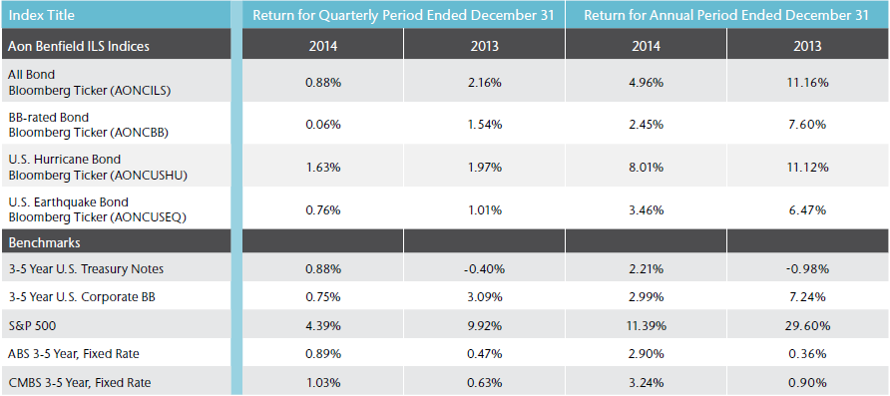
Aon Benfield ILS Indices
Source: Aon Benfield Securities Inc., Bloomberg
The 3-5 Year U.S. Treasury Note Index is calculated by Bloomberg and simulates the performance of U.S. Treasury notes with maturities ranging from three to five years.
The 3-5 Year BB Cash Pay U.S. High Yield Index is calculated by Bank of America Merrill Lynch (BAML) and tracks the performance of U.S. dollar denominated corporate bonds with a remaining term to final maturity ranging from three to five years and are rated BB1 through BB3. Qualifying securities must have a rating of BB1 through BB3, a remaining term to final maturity ranging from three to five years, fixed coupon schedule and a minimum amount outstanding of $100 million. Fixed-to-floating rate securities are included provided they are callable within the fixed rate period and are at least one year from the last call prior to the date the bond transactions from a fixed to a floating rate security.
The S&P 500 is Standard & Poor’s broad-based equity index representing the performance of a broad sample of 500 leading companies in leading industries. The S&P 500 Index represents price performance only, and does not include dividend reinvestments or advisory and trading costs.
The ABS 3-5 Year, Fixed Rate Index is calculated by BAML and tracks the performance of U.S. dollar denominated investment grade fixed rate asset backed securities publicly issued in the U.S. domestic market with terms ranging from three to five years. Qualifying securities must have an investment grade rating, a fixed rate coupon, at least one year remaining term to final stated maturity, a fixed coupon schedule and an original deal size for the collateral group of at least $250 million.
The CMBS 3-5 Year, Fixed Rate Index is calculated by BAML and tracks the performance of U.S. dollar denominated investment grade fixed rate commercial mortgage backed securities publicly issued in the U.S. domestic market with terms ranging from three to five years. Qualifying securities must have an investment grade rating, at least one year remaining term to final maturity, a fixed coupon schedule and an original deal size for the collateral group of at least $250 million.
The performance of an index will vary based on the characteristics of, and risks inherent in, each of the various securities that comprise the index. As such, the relative performance of an index is likely to vary, often substantially, over time. Investors cannot invest directly in indices.
While the information in this document has been compiled from sources believed to be reliable, Aon Benfield Securities has made no attempts to verify the information or sources. This information is made available “as is” and Aon Benfield Securities makes no representation or warranty as to the accuracy, completeness, timeliness or sufficiency of such information, and as such the information should not be relied upon in making any business, investment or other decisions. Aon Benfield Securities undertakes no obligation to update or revise the information based on changes, new developments or otherwise, nor any obligation to correct any errors or inaccuracies in the information. Past performance is no guarantee of future results. This document is not and shall not be construed as (i) an offer to sell or a solicitation of an offer to buy any security or any other financial product or asset, or (ii) a statement of fact, advice or opinion by Aon Benfield Securities.

Slide 10
Catastrophe Bond Market Participants
Issuers, Buyers
As of March 13,2015
Issuer Type
Investor Category (2014)¹
¹ Aon Benfield Securities’ analysis of investor category and geographic attributes includes only those transactions which the firm participated for 2014
Source: Aon Benfield Securities, Inc.

Slide 11
Catastrophe Bond Market
Exposure and Trigger Type
As of March 13,2015
Contribution By Peril / Region
Trigger Type
Source: Aon Benfield Securities, Inc.

Slide 12
Catastrophe Bond Market
Distribution of Modeled E(Loss) and Ratings
As of March 13,2015
Expected Loss Band
Ratings (S&P)
  Average expected loss is 1.9% compared to an average coupon of 6.4%
Source: Aon Benfield Securities, Inc.

Slide 13
Historical Issuance Trendlines Since 2012
As of December 31,2014
Aggregate U.S. Multi-Peril
Occurrence U.S. Multi-Peril
% Change | 1.00% | 2.00% | 3.00% | 4.00%
2012 - 2013 | -55% | -47% | -42% | -37%
2013 - 2014 | -5% | -14% | -20% | -23%
% Change | 1.00% | 2.00% | 3.00% | 4.00%
2012 - 2013 | -37% | -34% | -33% | -32%
2013 - 2014 | -20% | -17% | -15% | -14%
U.S. Named Storm
U.S. Earthquake
% Change | 1.00% | 2.00% | 3.00% | 4.00%
2012 - 2013 | -37% | -33% | -31% | -29%
2013 - 2014 | 6% | -1% | -5% | -7%
% Change | 1.00% | 2.00% | 3.00% | 4.00%
2012 - 2013 | -36% | -35% | -35% | -35%
2013 - 2014 | -9% | -8% | -8% | -8%
Source: Aon Benfield Securities, Inc.
12

Slide 14
ILS Benchmark Spreads Relative to BB Corporate
As of December 31,2014
Expected Returns: ILS vs. BB Corp^{1,2}
¹ Expected BB Corp Return: Yield less S&P Default Rate
² Expected ILS Return: Yield less Expected Loss
Returns are converging towards other similarly rated debt securities, with default triggers that have much less correlation to the general economy
Source: Aon Benfield Securities, Inc., Bloomberg, Miu

Slide 15
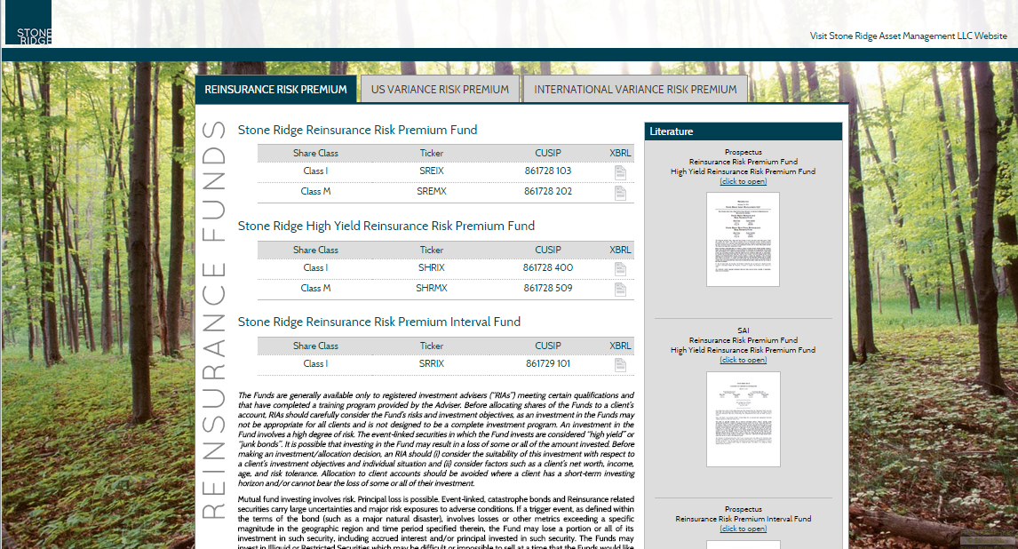
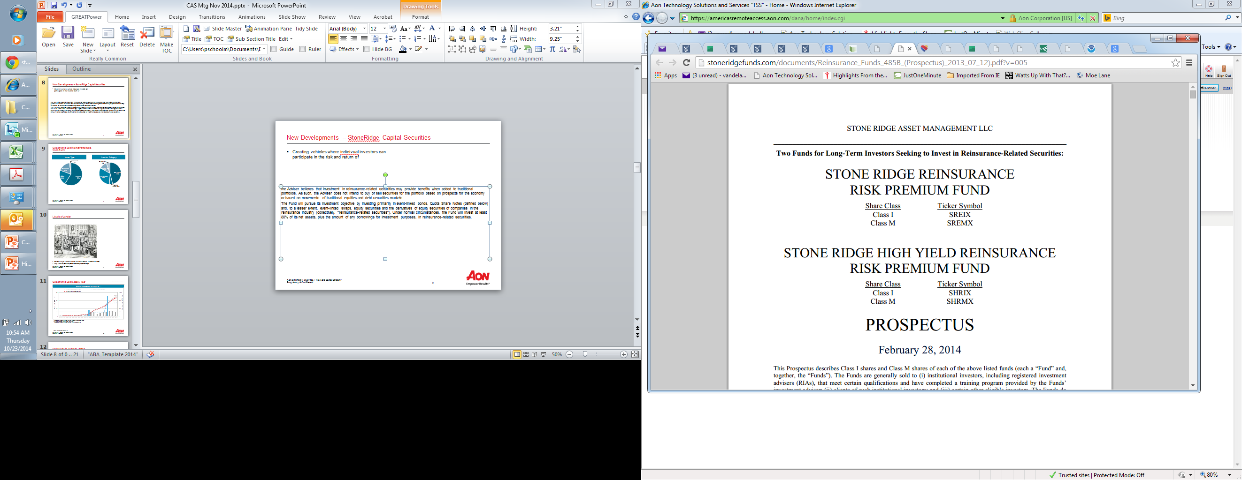
Insurance Risk Investment Funds
New Development Example
Funds being developed to allow individual investors to participate in the risk and return of reinsurance related securities
http://stoneridgefunds.com/
Stone Ridge High Yield Reinsurance Risk Premium Fund Prospectus:
“… Because the risks in reinsurance-related securities – largely related to natural disasters such as earthquakes and hurricanes – are not similar to the risks investors bear in traditional equities and debt markets, the Adviser believes that investment in reinsurance-related securities may provide benefits when added to traditional portfolios. …”

Slide 16
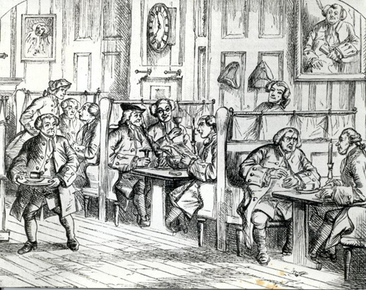
Insurance Risk as a Direct Investment
Not So New Example
Edward Lloyd’s coffee house on Tower Street, established 1688
http://www.lloyds.com/lloyds/about-us/history/lloyds-buildings

Slide 17
Historical Losses
As of March 13,2015
Year | Event | Transaction | Issuance Size (millions) | Loss Details
1999 | Europe Windstorm Lothar | Georgetown Re | $44.5 | Final Loss: Returned ~ 97% of principal on 3/1/2002
2005 | Hurricane Katrina | KAMP Re | $190.0 | Final Loss: Returned ~ 25% of principal on 12/14/2010
2005 | Hurricane Katrina and Buncefield explosion | Avalon Re Class C | $135.0 | Final Loss: Class C: Returned ~ 90% of principal on 6/7/2010; Class A and B experienced no loss
2008 | Lehman Bros 2008 | Ajax Re | $100.0 | Final Loss: Returned ~ 25.5% of principal on 5/8/2009
 |  | Willow Re B | $250.0 | Final Loss: Returned ~ 87.5% of principal on 6/16/2010
 |  | Newton Re 2008 | $150.0 | Final Loss: Returned ~ 93.75% of principal on 1/7/2011; note holders accepted assignment of the collateral
 |  | Carillon Re A-1 | $51.0 | Final Loss: Returned ~ 37.5% of principal on 1/8/2010
2008 | Hurricane Ike | Nelson Re G | $67.5 | Final Loss: Returned 100% of principal March 2013
2011 | Japan earthquake | Muteki | $300.0 | Full loss of principal
2011 | Japan earthquake | Vega Capital 2010 Class D | $42.6 | ~$16mn loss to reserve account. No loss of principal
2011 | Severe Thunderstorm | Mariah Re 2010-2 | $100.0 | Full loss of principal
2011 | Severe Thunderstorm | Mariah Re 2010-1 | $100.0 | Full loss of principal
Source: Aon Benfield Securities, Inc.

Slide 18
Catastrophe Bond Loss by Year
As of December 31,2014
Modeled and Actual Loss by Year^{1,2}
¹ Modeled loss value determined with near/medium term rates when noted
² Actual loss excludes $147M Credit Loss 2008
Source: Aon Benfield Securities, Inc.

Slide 19
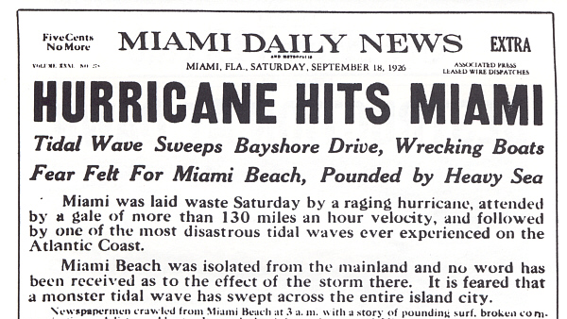
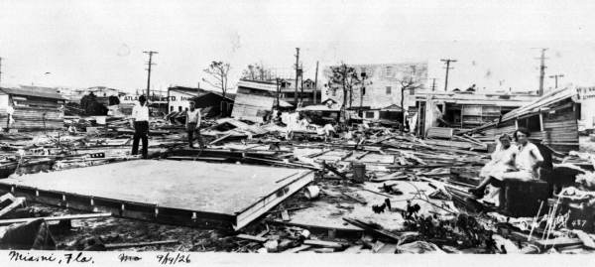
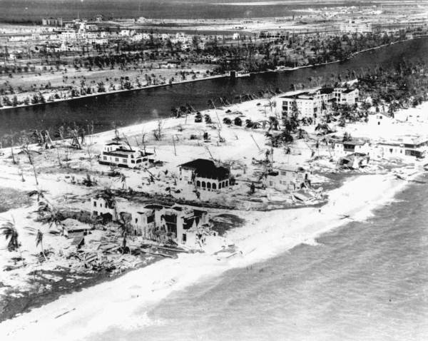
Catastrophe Stress Event Estimate
1926 Great Miami Hurricane
http://www.srh.noaa.gov/images/mfl/events/1926hurricane/miami_damage_1926.jpg
http://www.tropmet.com/images/gallery%20images/hurricane%20florida%201926/1926_007.jpeg
Insured Loss Estimate Recast:
$120+B Insurance Industry Loss
Ceded Loss ~ $50B-$55B
Cat Bond Market Loss ~ $2B
http://www.srh.noaa.gov/images/mfl/events/1926hurricane/miami_beach2.jpg
Source: Aon Benfield Analytics, Aon Benfield Securities, Inc.;
Bonds at risk as of September 25, 2014

Slide 20
Catastrophe Stress Event Estimate
Other Examples
Stress Event | Recast Insured Loss | Estimated Ceded % | Estimated Catastrophe Bond Market Loss
1926 Great Miami Hurricane | ~ $120B | 42%-47% | ~$2.0B
1992 Hurricane Andrew | ~ $60B | 40%-45% | ~$0.8B
1938 Long Island Express Hurricane | ~ $30B - $40B | 40%-45% | ~$2.0B
1811 New Madrid Earthquake | ~ $110B-$120B | 25%-30% | ~$4.0B
Stressed scenario loss impact well within catastrophe bond annual issuance rate
Source: Aon Benfield Analytics, Aon Benfield Securities, Inc.;
Bonds at risk as of September 25, 2014

Slide 21
Perspectives on Risk
Size Affects What Matters
Sources: SIFMA, SNL, Bloomberg, Aon Benfield Securities, Inc.

Slide 22
Conclusion
Why should we expect alternative capital to be a positive innovation for the insurance risk space?
There is an economic rationale for the securities, even if interest rates rise
  Catastrophe risk is not correlated to the economic cycle, making catastrophe risk linked assets a diversifying asset class
  Cat Bond terms are spreads above LIBOR …yields will increase with interest rates
  The ILS market is still extremely small relative to the total debt market and the institutional investor asset base
Track record: ILS structures have been tested, as losses have occurred without market dislocation
  Bonds have been triggered historically and the market has continued to grow/evolve
  Yields are converging towards similarly rated debt securities with defaults characteristics that are less correlated to the general economy
  Catastrophe risk models have a more stable foundation than credit risk models
Stress testing the market for significant catastrophe events demonstrates loss estimates that are much less than issuance capacity

Slide 23
Any Questions?
Contact Information:
Parr Schoolman FCAS, MAAA, CERA
Sr. Managing Director
Aon Benfield Analytics
+1.312.381.5553
parr.schoolman@aonbenfield.com

