Slide 1
The Expert Witness: When Expectations Collide
CASE Mar 24, 2015
Richard Fein, PhD, FCAS, MAAA RIF Consulting, LLC

Slide 2
Introduction
Context of Professionalism
Required by CAS Standards and Code
It’s what defines Actuaries as a profession
Professionalism and Ethics are in the air
Professionalism and Ethics are in the news!
Questioned in the media
Highlighted in the professional journals
Identified in both as concerning
News -
Vaccines – bad science
Climate change – opaque science/manipulated in some cases
Capital Markets Risk Mgt - bad (fill in your own blanks)

Slide 3
The Actuary’s Context-Litigation
You are a professional – conferred by society
Arena in which experts are commonly employed
You have obligations & expectations – from where?
Stakeholders have expectations which may conflict with your own and your professionalism
Standards are not detailed for all situations
Your statements are for the record
Are actually 6 types of statements

Slide 4
Six Statements
What you want to say
What you mean
What you actually say
What is recorded
What others heard
What others say you meant

Slide 5
What is a Profession
Good site: Bob Kizlik reference on my site
Occupationally related; specific area of need
Decision making support
Performance standards and CE’s
High level of public trust
Society grants the authority to practice
Professional accepts personal responsibility and accountability
Legal requirements by venue

Slide 6
What is an Expert Witness…
One who knows more and more about less and less
An expert is one who has made all of the mistakes that can be made in a narrow area - Bohr
An expert is a person who avoids small errors as he sweeps on to the grand fallacy.
An expert is someone who knows all of the answers if you ask the right questions

Slide 7
What is an Expert Witness…
An expert can be found to testify to the truth of almost any factual theory no matter how frivolous
If the world should blow itself up, the last audible voice would be that of the expert saying that it can’t be done
It is quite apparent that experts are readily available to present essentially frivolous theories in an effort to defeat summary judgment or to create reasonable doubt
Usually I like my expert to be around 50 years old, have some gray in his hair, wear a tweedy jacket and smoke a pipe.” (presentation skills vs subject competence

Slide 8
What is an Expert Witness…
An expert’s function is precisely this: to provide the judge and jury with a ready-made inference which the judge and jury, due to the technical nature of the facts, are unable to formulate

Slide 9
Actuarial Expert Witness
Form of participation
Expert report
Fact witness
Expert witness
Review and conclude on someone else’s work
Provide advice
Can be largely educational…likely more
Created inherently by circumstances
Fact witness
Statements or actions

Slide 10
Who are the Stakeholders?
Principal for whom report is prepared
Counsel; Opposing counsel ; your own counsel
Judge & Jury
Panel
Public
Profession
Anyone to whom report could reasonably be exposed, read and used
Caution!
Yourself
Whatever sources of moral and ethical standards that apply personally should apply here

Slide 11
Types of Expectations
Relevant to a material fact
Testimony would assist the jury
Witness must be qualified
Testimony must be reliable and have a proper basis for the opinion – ASOP’s & more…
Probative value must not be substantially outweighed by dangers of confusion ,undue consumption of time or unfair prejudice
NB: Expert testimony in most cases will be the difference between winning and losing

Slide 12
Types of Expectations
An expert’s function is precisely this: to provide the judge and jury with a ready-made inference which the judge and jury, due to the technical nature of the facts, are unable to formulate.

Slide 13
Expert’s View??

Slide 14
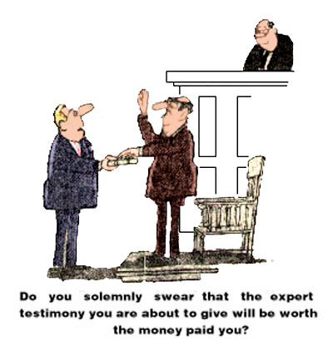
Principal’s View??

Slide 15
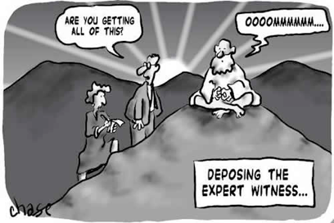
Counsel’s View??

Slide 16
Grounds for Exclusion
Authoritative sources rejecting method
Significant data which was ignored
Similar situations in which specific expert was excluded
Affidavit of another expert

Slide 17
Rules Governing Experts
Federal
Rule 702
Daubert exclusions
State specific
By agreement – case specific
ASOP’s & Principles & Code of Conduct

Slide 18
Rule 702 Federal Rules of Evidence Testimony by Expert Witness
(a) the expert’s scientific, technical, or other specialized knowledge will help the trier of fact to understand the evidence or to determine a fact in issue;
(b) the testimony is based on sufficient facts or data;
(c) the testimony is the product of reliable principles and methods; and
(d) the expert has reliably applied the principles and methods to the facts of the case.

Slide 19
Daubert – Basis for Exclusion 1993 Decision
(1) whether the expert's technique or theory can be or has been tested—that is, whether the expert's theory can be challenged in some objective sense, or whether it is instead simply a subjective, conclusory approach that cannot reasonably be assessed for reliability;
(2) whether the technique or theory has been subject to peer review and publication;
(3) the known or potential rate of error of the technique or theory when applied;
(4) the existence and maintenance of standards and controls; and
(5) whether the technique or theory has been generally accepted in the scientific community.

Slide 20
Guiding Codes, ASOP’s Principles
Statements of Principles
Ratemaking, Reserving
Old, but embedded
ASOP’s – Know them
Codes of Conduct
Others
Courts
State/Federal Rules & History
Personal Codes

Slide 21
Forms
Expert Report
Review another expert’s report
Specific conclusions
Disclose to what you will testify
Specific vs. general
Deposition
Trial examination
Cross examination
Documents

Slide 22
When do Expectations Collide
Stakeholder expectations
The way you communicate is essential
Logos, pathos, ethos (7 habits of persuasive speakers, John Coleman ref: Mark Saunders@towerswatson.comTowers Watson presentation; Aristotle’s Appeals)
Listening skills are even more important – especially when speaking for the record
Is this a game? Do you plan ahead?

Slide 23
McClenehan’s Principles, Mostly…
Understand the subject matter
Don’t get caught up in the zeal of the advocate who employs you
Disclose
Who represents you??
Your role may be mainly educational – use simple and unambiguous language
Communication of technical concepts must be comprehensible to laymen
Caution
You are not responsible for the outcome but can only offer a sound basis for making a determination
Caution
Know your area of practice

Slide 24
McClenehan’s Principles, Mostly…
Know your standards of practice (principles, codes) - Important
Know your case and your role
Challenges created by attorneys
Attempting to paraphrase
Attempting to stretch or bend
Attempting to summarize
Don’t guess
May be required to answer hypotheticals
Don’t try to anticipate the strategy
Don’t get “cute”

Slide 25
Your Statements Are for the Record:
what you want to say
what you mean
what you actually say
what is recorded
what others heard
what others say you meant
Caution
As long as you use, FCAS - bounded

Slide 26
Examples…
The actual results show the actuary who signed SAO didn’t do a professional analysis
Results exceeded estimate therefore ASOP’s were violated
The professional and business manager promoted goals of company – Advocate?
The point estimate turned out to be “way” too low – take advantage of uncertainty
The actuary didn’t use all of the available information

Slide 27
Examples…
The actuary didn’t select appropriate methods
The actuary didn’t select reasonable assumptions
The actuary failed to live up to the Codes of Conduct
Content of report does not show why the actuary selected the assumptions only how applied
Put a triangle in front of an actuary – project answer – that’s what actuaries do…what?

Slide 28
Examples…
The actuary failed to show a range
The range is too small
The data was not valid and the actuary should have known
Actuary should have known the intended use of the work
“I don’t use statistical indicators such as goodness of fit. Wouldn’t know how to use…”
The parameters were calculated by (staff, software, others…)

Slide 29
Examples…
“Yes, there is no applicable data, but that is my estimate of an assumption…( solely using my experience as an actuary”)
“Actuarial judgment permits me to make assumptions without relevant data”
“The actuary violated the Codes of Conduct and Standards of Practice”
“I was not required nor asked to provide a range”

Slide 30
Expert Witness Matters
You are a professional
In an arena in which experts are commonly employed
You have obligations
Your statements are for the record: what you want to say, what you mean, what you actually say, what is recorded, what others heard, what others say you meant
Stakeholders have expectations which may conflict with professionalism

Slide 31
Final Comments/Questions
Statements made as FCAS are subject to legal challenges – that is the climate
Treat seriously, but do not overstate challenges
You may be most knowledgeable…
… that’s not enough
Take personal responsibility for work product
It’s a proud and highly regarded profession

Slide 32
Q&A

