Slide 1
Experience Rating for Workers Compensation:
A Look Back at the First Century
Presented by:
Tony DiDonato, FCAS, MAAA
Director & Senior Actuary, NCCI
C.A.S.E.
March 24, 2015
Boca Raton, FL

Slide 2
Experience Rating for Work Comp Introduction
Experience Rating for Workers Compensation (WC) was in use by 1915
This presentation highlights some of the major features of the WC experience rating plans over the years and how they’ve changed
The focus of this review is on:
NCCI ER Plans, although several predecessor plans will also be discussed
Major features and high-level formula changes
2

Slide 3
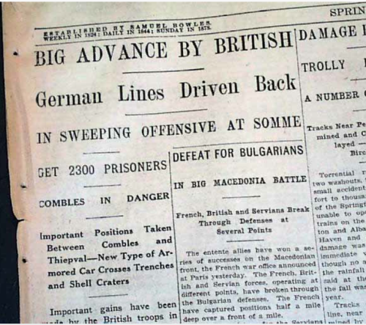
The Year Was ... 1916
3

Slide 4
Experience Rating for Work Comp
1916: Plan A
Adjusted Loss Ratio (LR) was first computed using the following severities:
Indemnity: (Actual weekly award) x (Assumed avg weeks by injury type)
Medical: Assumed avg med cost by injury type
Neutral zone: 40-65% … no Mod
Formula (not subject to Schedule Rating)
LR < 40%: % Credit = (40-LR)/40 x 25*
LR > 65%: % Debit = (LR-65)/35 x 25* … capped at 25%
Issue - didn’t distinguish between risk sizes
Large risks with LR just above 40% got no credit
Small risks with near-zero claim expectation got large credit
*Max credit/debit used (rather than 25%) if subject to schedule rating … in which case the credit varied by risk size because the schedule rating max credit/debit varied by risk size; Max 40% credit for ER and schedule rating combined
4

Slide 5
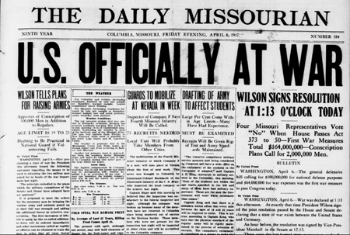
The Year Was ... 1917
5

Slide 6
Experience Rating for Work Comp
1917: Plan B
Fatal and PTD injuries treated separately from others and a flat charge was used for their severity
All Other injury types treated similar to Plan A with the Neutral zone slightly changed to 45-65%
An overall Mod was derived by combining the results from these two injury groupings
Maximum credits and debits varied according to 7 size-of-rate groups
6

Slide 7
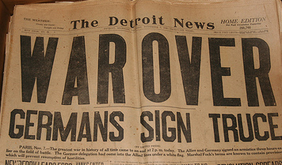
The Year Was ... 1918
7

Slide 8
Experience Rating for Work Comp
1918: Plan D
Actual losses now used but adjusted to level of rates (premiums) used in ER formulas
Fatal and PTD indemnity losses continue to be treated separately from the All Other injury grouping
Expected loss varied for each of these two groups and by size-of-rate (accomplished via Table B applied to premium)
Credibility introduced
Precursor of current plan
The following Mod formula was applied to each of the two separate injury groups:
P + z(p – P), where:
P = Manual Premium (expected loss)
p = Indicated Premium (adjusted actual loss)
z = P / (P + K)
The K-values varied by state and for the two different claim groups and were developed on the basis of judgment
8

Slide 9
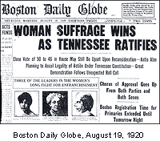
The Year Was ... 1920
9

Slide 10
Experience Rating for Work Comp
1920 (NCCI) Plan
Expected loss now varies by class
Overall Mod formula unchanged but z-credibility formula changed for the All Other injury group:
z = (P + C) / (P + K + C)
However, z=1 (for both injury groups) if premium >= $80,000 (self-rated)
10

Slide 11
The Year Was ... 1923
11

Slide 12
Experience Rating for Work Comp
1923 Plan
Actual and Expected loss split into primary and excess components
Actual split through the use of Table A “normal” values; excess portion of Fatal and PTD not used
Expected loss split by class through the use of Table B
Z-credibility calculation returns to: Z = P / (P + K) … separately for primary and excess loss
Credibility-weighted losses then calculated from:
L = A*Z + E*(1-Z)
separately for primary and excess loss
Mod adjustment = (L - E) / E
L and E represent combined primary and excess loss
$80,000 self-rating point changed and made gradual
12

Slide 13
The Year Was ... 1940
13

Slide 14
Experience Rating for Work Comp
1940 Plan
3 equally-weighted years of experience vs 5 weighted years being used since 1928
Indemnity and medical treated on a combined basis
Multi-split Plan introduced; formula assigns variable amount to primary depending on size of claim:
Primary portion of first $500 layer of claim = 500
Primary portion of next $500 layer of claim = 500(2/3)
Primary portion of next $500 layer of claim = 500(2/3)², etc.
(Primary maxes out at 1500 in above)
ELRs and D-ratios introduced
14

Slide 15
Experience Rating for Work Comp
1940 Plan …continued …
Weights and Ballasts introduced as a new way to reflect credibility; a risk = 3 times eligibility threshold would get a max 25% debit for a single claim
Underlying Z_{p} changed again: Z_{p} = E / (E_{p}+WE_{e}+B)
Z_{e} = W*Z_{p}
Mod = A_{p} + B + W*A_{e}
E_{p} + B + W*E_{e}
W=0 for risks with E < 2 x (Fatal and PTD avg benefit value) … thus, for majority of risks:
Mod = A_{p} + B
E_{p} + B
15

Slide 16
The Year Was ... 1961
16

Slide 17
Experience Rating for Work Comp
1961 Plan
Current version of Mod formula adopted:
Mod = A_{p} + W*A_{e} + (1-W)*E_{e} + B
E + B
Primary = Actual Loss x 3,750
Actual Loss + 3,000
if Actual Loss <750, then all primary
(primary maxes out at 3,750 in above)
Underlying formula for primary credibility once again reverts back to:
Z_{p} = E/(E+B)
17

Slide 18
The Year Was ... 1977
18

Slide 19
Experience Rating for Work Comp
1977 Plan
Primary Loss redefined as:
Primary = Actual Loss x 10,000
Actual Loss + 8,000
if Actual Loss <2000, then all primary
(primary maxes out at 10,000 in above)
19

Slide 20
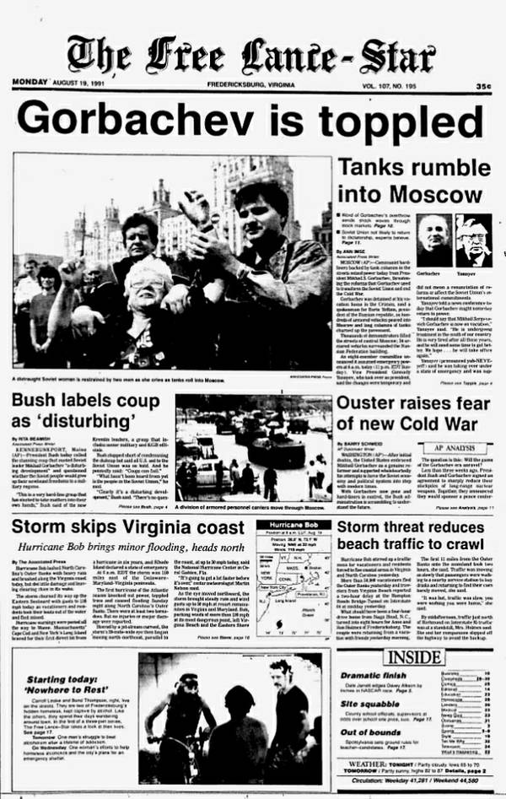
The Year Was ... 1991
20

Slide 21
Experience Rating for Work Comp
1991: RERP (Revised Experience Rating Plan)
Primary Loss redefined again … single split point used:
Primary = first $5,000 of each claim
21

Slide 22
The Year Was ... 1998
22

Slide 23
Experience Rating for Work Comp
1998: ERA (Experience Rating Adjustment)
Medical-only claims reduced by 70%
Reduction comes after the primary/excess split applied
E.g. A $7,000 med-only claim would result in $1,500 primary and $600 excess
Proposed indexing the split point as needed
23

Slide 24
The Year Was ... 2013
THE DAILY PLANET
www.dailynews.com
THE WORLD’S FAVORITE NEWSPAPER
2013 Edition
CAS Celebrates Centennial Next Year!
Plan To Attend
The CAS Centennial Celebration is not your average Annual Meeting! Plan to attend this once-in-a-lifetime event and help celebrate 100 years of expertise, insight, and solutions.
The celebration will take place at the NY - Hilton Midtown in New York City, November 9-12, 2014.
Meeting Overview
On November 7, 1914 the Casualty Actuarial and Statistical Society held its first meeting in New York City with 97 charter members as Fellows. Now 100 years later with more than 6,200 members, the Casualty Actuarial Society is back in the Big Apple to celebrate our first century and explore the challenges and opportunities that face us in the next.
24

Slide 25
Experience Rating for Work Comp
2013: E-1402 (Increase and Index of Split Point)
$5,000 split point increased to $15,000 plus severity indexation
A 3-year transition utilized
2013 split point: $10K
2014 split point: $13.5K
2015 split point: $15.5K
2016 and subsequent: severity-indexed value
25

Slide 26
Thank You!
Notes:
USA

