Slide 1
Heteroskedasticity in Loss Reserving
CASE Fall 2012

Slide 2
What’s the proper link ratio?
Cumulative Paid @12 Months | Cumulative Paid @24 Months | 12-24 month LDF
21,898 | 56,339 | 2.5728
22,549 | 59,459 | 2.6369
23,881 | 60,315 | 2.5256
25,897 | 71,409 | 2.7574
23,486 | 59,165 | 2.5192
27,029 | 60,778 | 2.2486
25,845 | 60,543 | 2.3425
25,415 | 54,791 | 2.1559
32,804 | 59,141 | 1.8029
Notes:
We start off with something really boring. Given a set of nine accident years and, consequently nine development factors, what’s the proper link ratio? It’s a large pile of numbers and I’m challenged to make much sense of it. So, let’s look at a graph.

Slide 3
Notes:
This is the same information as was presented in the table, but in graphical form. There’s a slight change in that now we’re looking at subsequent incremental losses, rather than subsequent cumulative. That’s because cumulative losses are always correlate and we’d rather they weren’t. If that explanation doesn’t suffice, Leigh Halliwell can elaborate.
The red line indicates the new observation for which we need an estimate.

Slide 4
Notes:
As I’m sure you always do when presented with information like this, you will presume that the best way to predict that new value is by fitting a line through the origin and assuming that the responses vary proportional to the square root of the predictors.

Slide 5
Notes:
So now, having fit three lines, we

Slide 6
And the boring version
Method | LDF
Simple average | 2.3958
Weighted average | 2.3686
Unweighted least squares | 2.3375
All of those estimators are unbiased.
Which one is efficient?
Notes:
What’s unweighted least squares? We’ll get to that.

Slide 7
You’re not weighting link ratios.
You’re making an assumption about the variance of the observed data.
Notes:
There will be someone who will ask about having particular ratios in or out of the estimate. I am (almost) completely opposed to this. If there is an element of the stochastic process which you feel ought to be reflected, then model it.

Slide 8
Notes:
By the way, the actual result is plotted using the black line.

Slide 9
So how do we articulate our variance assumptions?

Slide 10
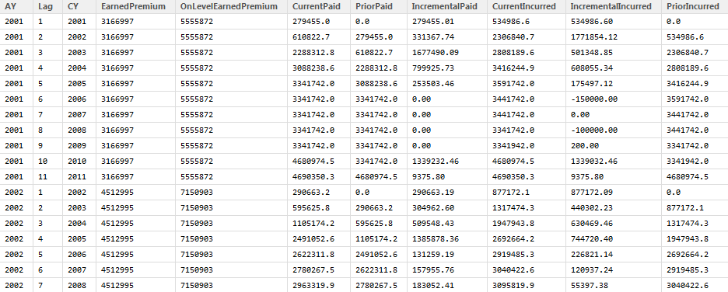
A triangle is really a matrix
A variable of interest (paid losses, for example) presumed to have some statistical relationship to one or more other variables in the matrix.
The strength of that relationship may be established by creating models which relate two variables.
A third variable is introduced by categorizing the predictors.
Development lag is generally used as the category.

Slide 11

The response variable will generally be incremental paid or incurred losses.
We assume that error terms are homoskedastic and normally distributed
The design matrix may be either prior period cumulative losses, earned premium or some other variable. Columns are differentiated by category.
Calibrated model factors are analogous to age-to-age development factors.

Slide 12
21,898 | 56,339 | 78,457 | 92,820 | 101,261 | 103,929 | 107,855 | 111,901 | 112,388 | 111,727
22,549 | 59,459 | 82,918 | 98,768 | 105,504 | 110,649 | 113,833 | 116,691 | 116,055
23,881 | 60,315 | 85,828 | 98,656 | 106,590 | 110,107 | 113,159 | 113,243
25,897 | 71,409 | 95,443 | 111,051 | 120,780 | 124,499 | 124,352
23,486 | 59,165 | 81,511 | 96,077 | 107,063 | 109,505
27,029 | 60,778 | 80,161 | 89,707 | 92,374
25,845 | 60,543 | 76,743 | 82,470
25,415 | 54,791 | 64,854
32,804 | 59,141
40,409

Slide 13
Loss Reserving &
Ordinary Least Squares Regression
A Love Story

Slide 14
Murphy variance assumptions
LSM
WAD
SAD
Murphy: Unbiased Loss Development Factors

Slide 15
Or, More Generally
The multivariate model may be generally stated as containing a parameter to control the variance of the error term.
α is not a hyperparameter. Fitting using SSE will always return α = 0
Notes:
By the way, our use of the alpha term satisfies our desire to weight towards or against specific link ratios. Murphy, Bardis and Majidi demonstrate how particular link ratios may or may not be valid in the context of the multivariate linear model. Selection of a link ratio beyond particular bounds is a de facto rejection of the assumptions of normal error terms.

Slide 16
Intuition
  Losses vary in relation to predictors
  Loss ratio variance looks different
Observation
  Behavior of a population
  Diagnostics on individual sample (Breusch-Pagan test)
Notes:
So, if alpha is not a parameter which we calibrate, then how do we select it? Intuition would seem to support the simple average development (to me, anyway).

Slide 17
In 2011, Glenn Meyers & Peng Shi published NAIC Schedule P results for 132 companies. The object was to create a laboratory to determine which loss reserving method was most reliable.

Slide 21
Observation of an Individual Sample
Breusch-Pagan Test
Use regression to diagnose your regression
Does the variance depend on the predictor?
Regress squared residuals against the predictor

Slide 22
An F-test determines the probability that the coefficients are non-zero.

Slide 24
Caveats
Caveats
Non-normal error terms render B-P meaningless!
Chain ladder utilizes stochastic predictors
Earned premium has not been adjusted

Slide 25
Conclusions
Breusch-Pagan test is not strongly persuasive across the total data set.
Homoskedastic error terms would support unweighted calibration of model factors.
Probably more important to test functional form of error terms. Kolmogorov-Smirnov etc. may test for normal residuals.

Slide 26
State your model and your underlying assumptions.
Test those assumptions.
Stop using models whose assumptions don’t reflect reality!
Statisticians have been doing this for years. Easy to steal leverage their work.

Slide 27
“Abandon your triangles!”
-Dave Clark
CAS Forum 2003

Slide 28
https://github.com/PirateGrunt/CASE-Spring-2013
PirateGrunt.com
http://lamages.blogspot.com/

