Slide 1
PEBELS:
Policy Exposure Based Excess Loss Smoothing
Liberty Mutual Group
Marquis J. Moehring

Slide 2
Outline
Background
Goal
PEBELS Defined
PEBELS Derived (PPR Generalized)
Applications
Summary

Slide 3
My Challenge
Strong Regional Focus
State/Program Large Loss Provisions
Low Credibility
High Heterogeneity

Slide 4
This Should be Easier
No applicable method in literature
ILFs for Liability
ELFs for Workers Compensation
Nothing for Commercial Property or Homewners!

Slide 5
Goal of PEBELS
PEBELS = Property Large Loss Exposure Segmentation
Meet my challenge
New applications!
Deceptively difficult
  No clear limit
  Multiple non-linearities
  Additional nuances
  Practical considerations

Slide 6

PEBELS Defined
Defined as ${PEBEL}_{i}=P_{i}∗{ELR}_{i}∗{EF}_{i}$
$P_{i}∗{ELR}_{i}$ = ${E(L}_{i})=Total Expected Loss$
${EF}_{i}=G(x_{u}$)-$G\left(x_{l}\right)=Percentage of{E(L}_{i})in layer$

Slide 7
Exposure Curve

Slide 8
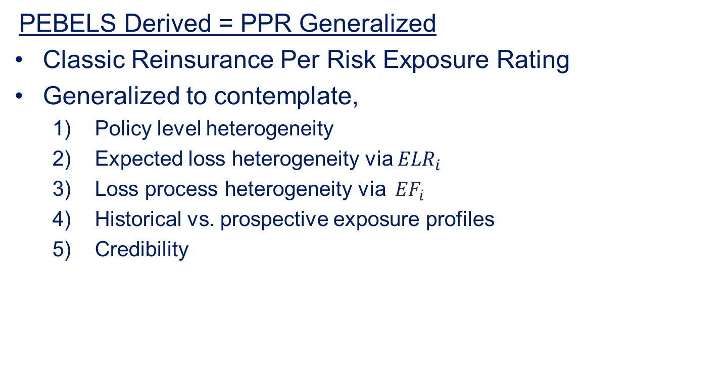
PEBELS Derived
PEBELS Derived = PPR Generalized
Classic Reinsurance Per Risk Exposure Rating
Generalized to contemplate,
  Policy level heterogeneity
  Expected loss heterogeneity via ${ELR}_{i}$
  Loss process heterogeneity via ${ EF}_{i}$
  Historical vs. prospective exposure profiles
  Credibility

Slide 9
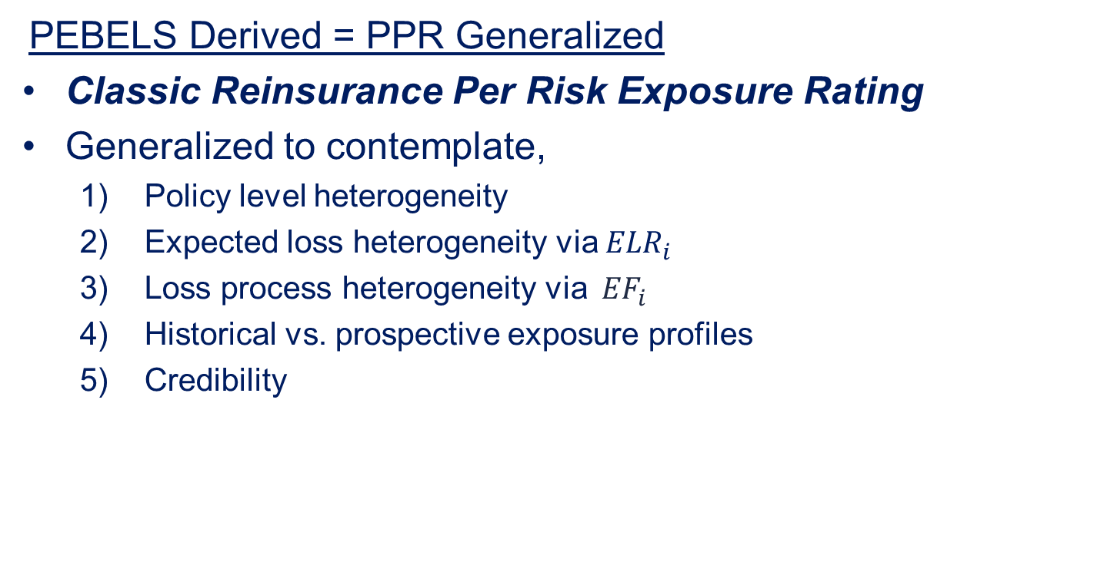
PEBELS Derived
PEBELS Derived = PPR Generalized
Classic Reinsurance Per Risk Exposure Rating
Generalized to contemplate,
  Policy level heterogeneity
  Expected loss heterogeneity via ${ELR}_{i}$
  Loss process heterogeneity via ${ EF}_{i}$
  Historical vs. prospective exposure profiles
  Credibility

Slide 10
Reinsurance Per Risk Exposure Rating
Insured Value Range ($000s) | Midpoint ($000s) | Retention as a % of Insured value | Retention + Limit as a % of Insured value | Exposure Factor | Subject Premium | Expected Loss Ratio | Expected Primary Losses | Expected Reinsurer Losses
20-100 | 60 | 167% | 833% | 0% | 682,000 | 65% | 443,300 | 0
100-250 | 175 | 57% | 286% | 26% | 161,000 | 65% | 104,650 | 27,209
250-1,000 | 625 | 16% | 80% | 41% | 285,000 | 65% | 185,250 | 75,953
1,000-2,000 | 1,500 | 7% | 33% | 33% | 1,156,000 | 65% | 751,400 | 247,962
Grand Total |  |  |  |  | 2,284,000 | 65% | 1,484,600 | 351,124

Slide 11
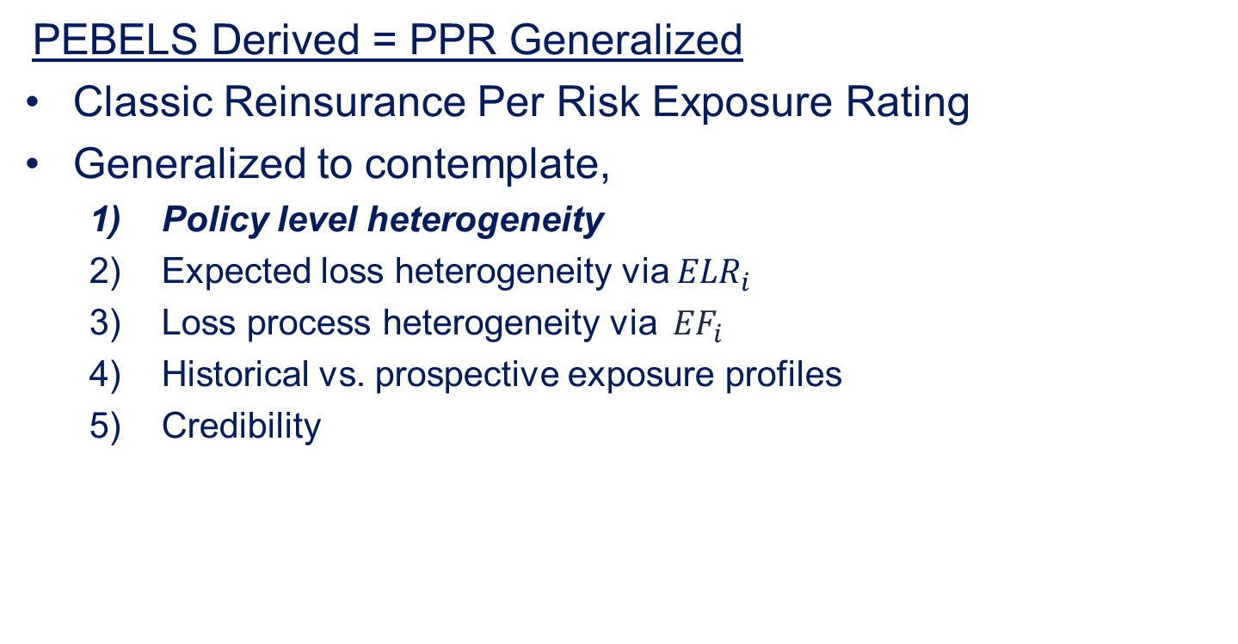
PEBELS Derived
PEBELS Derived = PPR Generalized
Classic Reinsurance Per Risk Exposure Rating
Generalized to contemplate,
  Policy level heterogeneity
  Expected loss heterogeneity via ${ELR}_{i}$
  Loss process heterogeneity via ${ EF}_{i}$
  Historical vs. prospective exposure profiles
  Credibility

Slide 12
Per Policy Generalization
Insured Value Range ($000s) | Midpoint ($000s) | Retention as a % of Insured value | Retention + Limit as a % of Insured value | Exposure Factor | Subject Premium | Expected Loss Ratio | Expected Primary Losses | Expected Reinsurer Losses
20-100 | 60 | 167% | 833% | 0% | 682,000 | 65% | 443,300 | 0
100-250 | 175 | 57% | 286% | 26% | 161,000 | 65% | 104,650 | 27,209
250-1,000 | 625 | 16% | 80% | 41% | 285,000 | 65% | 185,250 | 75,953
1,000-2,000 | 1,500 | 7% | 33% | 33% | 1,156,000 | 65% | 751,400 | 247,962
Grand Total |  |  |  |  | 2,284,000 | 65% | 1,484,600 | 351,124

Slide 13
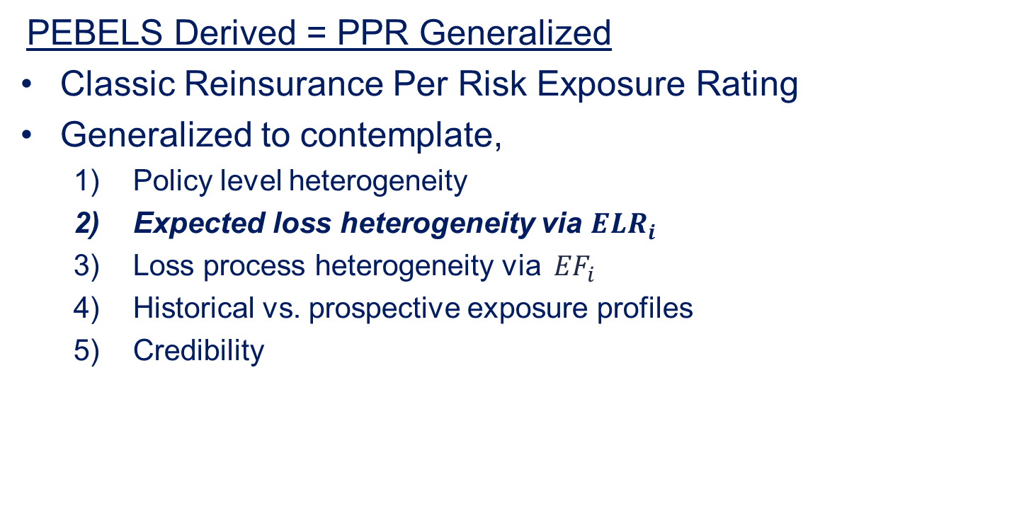
PEBELS Derived
PEBELS Derived = PPR Generalized
Classic Reinsurance Per Risk Exposure Rating
Generalized to contemplate,
  Policy level heterogeneity
  Expected loss heterogeneity via ${ELR}_{i}$
  Loss process heterogeneity via ${ EF}_{i}$
  Historical vs. prospective exposure profiles
  Credibility

Slide 14
Heterogeneity Generalization
Insured Value Range ($000s) | Midpoint ($000s) | Retention as a % of Insured value | Retention + Limit as a % of Insured value | Exposure Factor | Subject Premium | Expected Loss Ratio | Expected Primary Losses | Expected Reinsurer Losses
20-100 | 60 | 167% | 833% | 0% | 682,000 | 65% | 443,300 | 0
100-250 | 175 | 57% | 286% | 26% | 161,000 | 65% | 104,650 | 27,209
250-1,000 | 625 | 16% | 80% | 41% | 285,000 | 65% | 185,250 | 75,953
1,000-2,000 | 1,500 | 7% | 33% | 33% | 1,156,000 | 65% | 751,400 | 247,962
Grand Total |  |  |  |  | 2,284,000 | 65% | 1,484,600 | 351,124

Slide 15

Heterogeneity Generalization
$${PEBEL}_{i}=P_{i}∗{ELR}_{i}∗{EF}_{i}$$
Expected catastrophe loss
Risk loads
Rate adequacy
State: | House
X | 65.0%
Y | 65.0%
Z | 40.0%

Slide 16
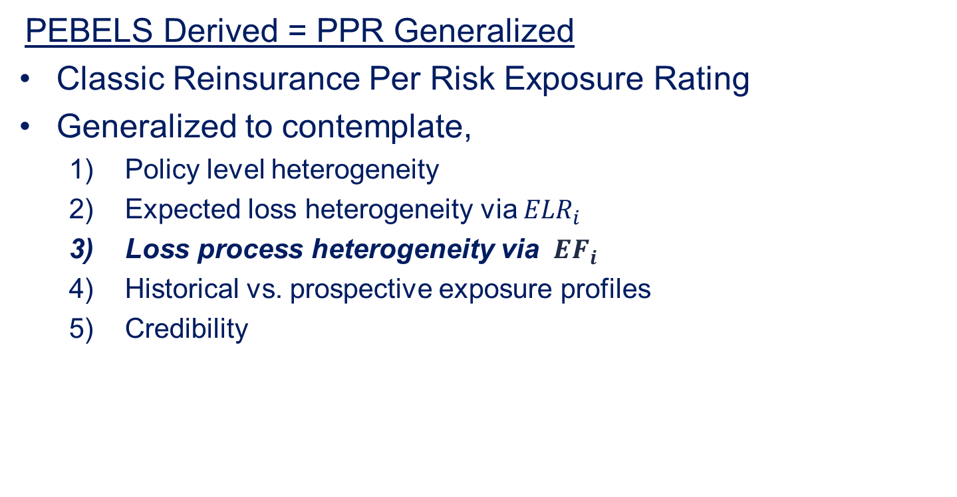
PEBELS Derived
PEBELS Derived = PPR Generalized
Classic Reinsurance Per Risk Exposure Rating
Generalized to contemplate,
  Policy level heterogeneity
  Expected loss heterogeneity via ${ELR}_{i}$
  Loss process heterogeneity via ${ EF}_{i}$
  Historical vs. prospective exposure profiles
  Credibility

Slide 17
Heterogeneity Generalization
Insured Value Range ($000s) | Midpoint ($000s) | Retention as a % of Insured value | Retention + Limit as a % of Insured value | Exposure Factor | Subject Premium | Expected Loss Ratio | Expected Primary Losses | Expected Reinsurer Losses
20-100 | 60 | 167% | 833% | 0% | 682,000 | 65% | 443,300 | 0
100-250 | 175 | 57% | 286% | 26% | 161,000 | 65% | 104,650 | 27,209
250-1,000 | 625 | 16% | 80% | 41% | 285,000 | 65% | 185,250 | 75,953
1,000-2,000 | 1,500 | 7% | 33% | 33% | 1,156,000 | 65% | 751,400 | 247,962
Grand Total |  |  |  |  | 2,284,000 | 65% | 1,484,600 | 351,124

Slide 18
Exposure Curve

Slide 19
Exposure Curve
Dispersed: e.g. Estate / University Campus

Slide 20
Exposure Curve
Dispersed: e.g. Estate / University Campus
Concentrated: e.g. Barn / Minimart

Slide 21
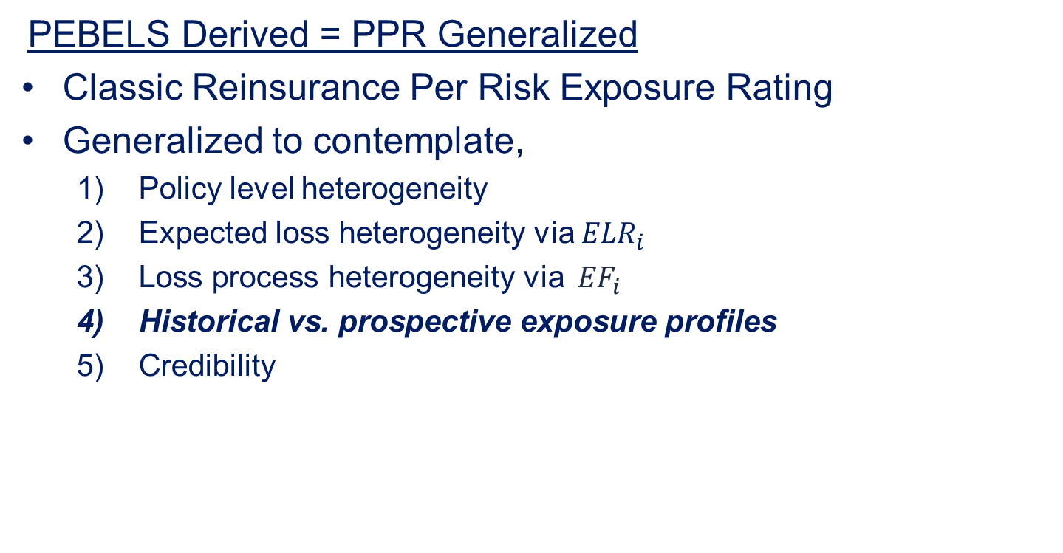
PEBELS Derived
PEBELS Derived = PPR Generalized
Classic Reinsurance Per Risk Exposure Rating
Generalized to contemplate,
  Policy level heterogeneity
  Expected loss heterogeneity via ${ELR}_{i}$
  Loss process heterogeneity via ${ EF}_{i}$
  Historical vs. prospective exposure profiles
  Credibility

Slide 22
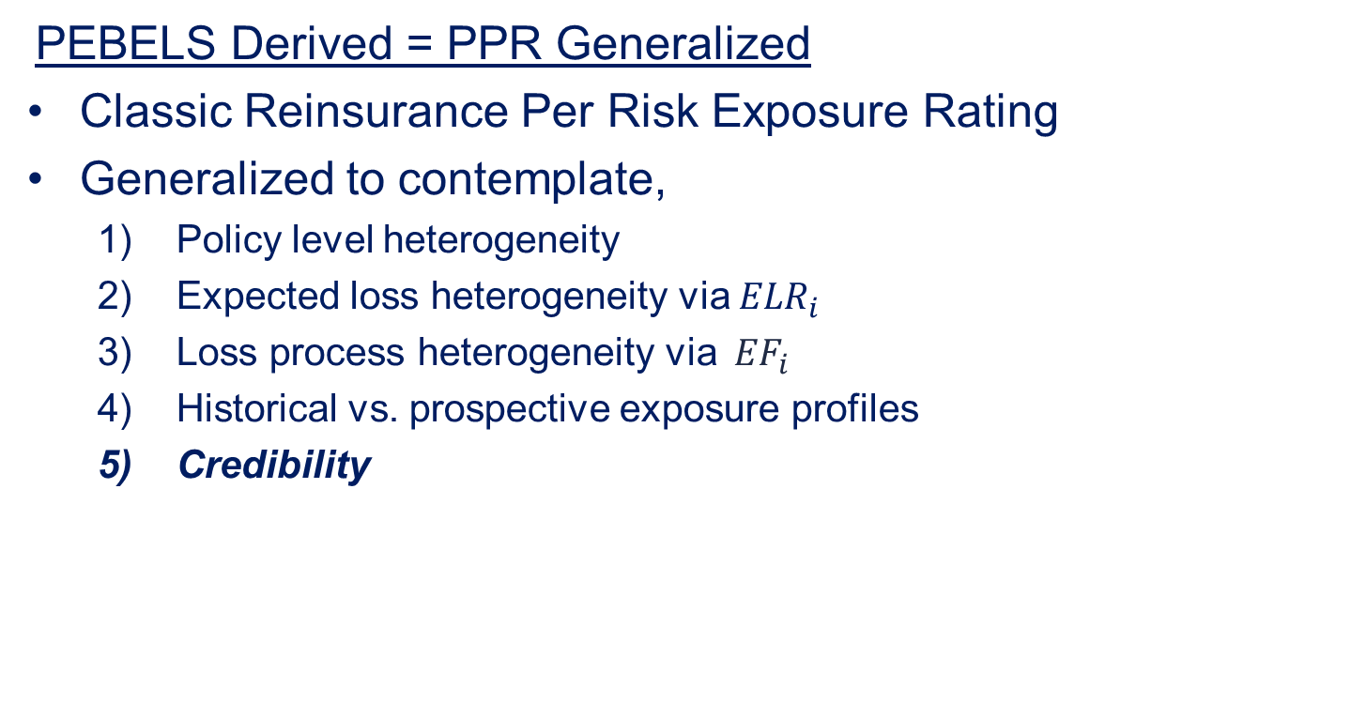
PEBELS Derived
PEBELS Derived = PPR Generalized
Classic Reinsurance Per Risk Exposure Rating
Generalized to contemplate,
  Policy level heterogeneity
  Expected loss heterogeneity via ${ELR}_{i}$
  Loss process heterogeneity via ${ EF}_{i}$
  Historical vs. prospective exposure profiles
  Credibility

Slide 23
Applications
Indications
Motivated PEBELS
Allocate large losses to state and program
  Low credibility
  High heterogeneity in underlying exposures

Slide 24
Applications
Adjusted Modeled Catastrophe AALs
Traditionally assume AAL linear with IV
This contradicts
  Theory presented
  Ludwig’s study of Hurricane Hugo
Implies bias between Personal & Commercial
Can adjust AALs with PEBELS

Slide 25
Applications
Predictive Models
Hypothesize that PEBELS
More predictive of large loss than IV
Most predictive for highly skewed perils
Most predictive in severity/excess models

Slide 26
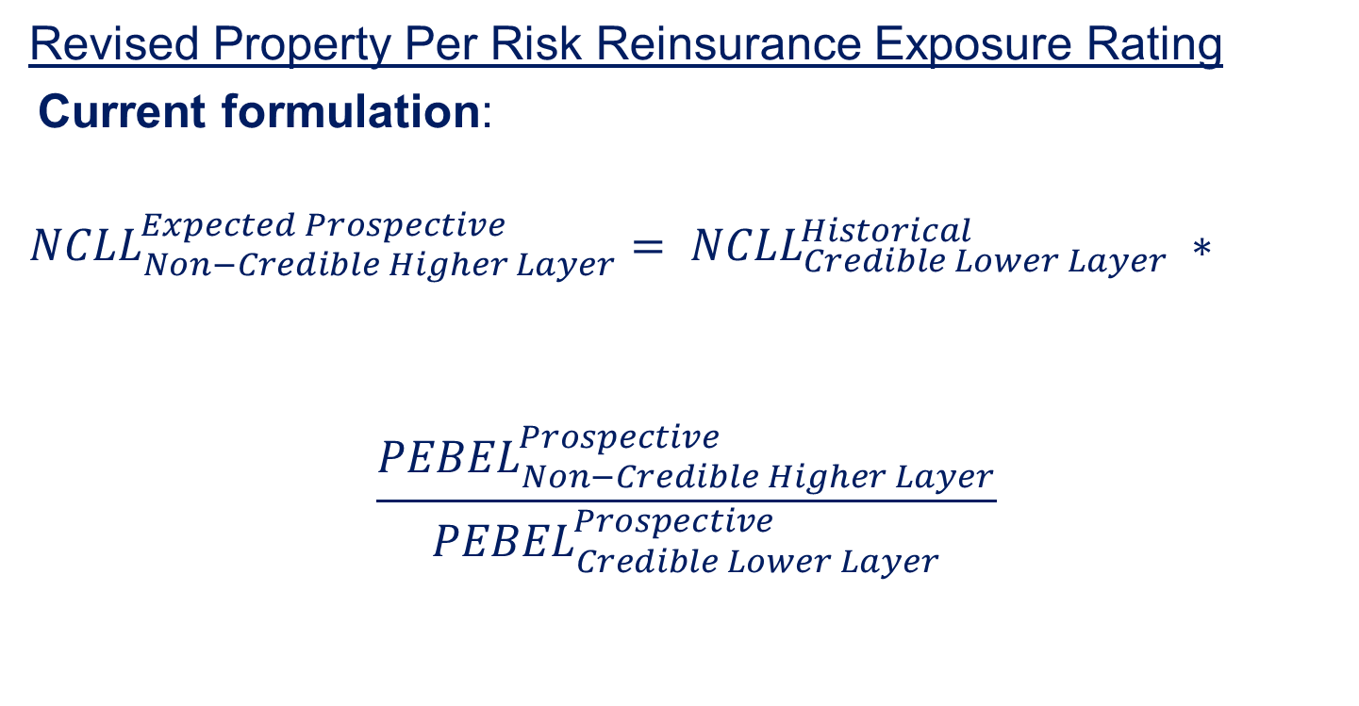
Applications
Revised Property Per Risk Reinsurance Exposure Rating
Current formulation:
$${{NCLL}_{Non−Credible Higher Layer}^{Expected Prospective}= NCLL}_{Credible Lower Layer}^{Historical} ∗$$
$$\frac{{PEBEL}_{Non−Credible Higher Layer}^{Prospective}}{{PEBEL}_{Credible Lower Layer}^{Prospective}}$$

Slide 27
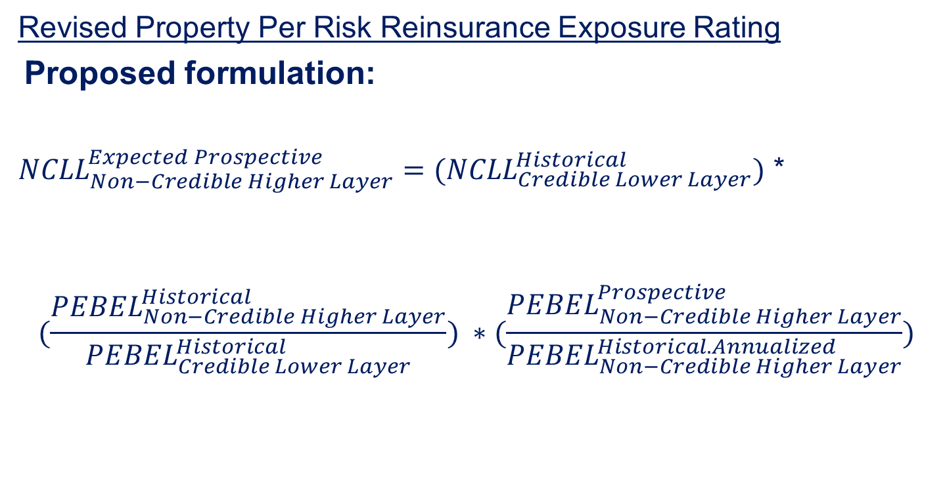
Applications
Revised Property Per Risk Reinsurance Exposure Rating
Proposed formulation:
${{NCLL}_{Non−Credible Higher Layer}^{Expected Prospective}=(NCLL}_{Credible Lower Layer}^{Historical})$ *
$$(\frac{{PEBEL}_{Non−Credible Higher Layer}^{Historical}}{{PEBEL}_{Credible Lower Layer}^{Historical}}) ∗(\frac{{PEBEL}_{Non−Credible Higher Layer}^{Prospective}}{{PEBEL}_{Non−Credible Higher Layer}^{Historical. Annualized}})$$

Slide 28
Summary
PEBELS = Property Large Loss Exposure Segmentation
Only game in town
Quantifies messy non-linearities
Multiple applications
  Indications
  Catastrophe Modeling
  Risk Segmentation

Slide 30
Historical vs. Prospective
Selecting exposure profile for the application?
Prospective (current inforce)
  Catastrophe modeling
  Reinsurance quotes
Historical (“earned” over experience period)
  Loss ratio ratemaking
  Revised per risk reinsurance exposure rating

Slide 31
Historical vs. Prospective
Loss ratio ratemaking examples
State in run-off scenario
State newly entered scenario
Both scenarios lead to skewed state indications
Even small shifts will distort indications

Slide 32
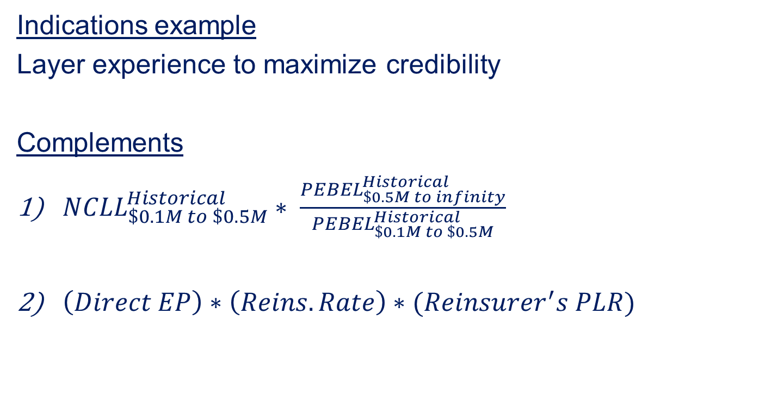
Credibility
Indications example
Layer experience to maximize credibility
Complements
${NCLL}_{\$0.1M to \$0.5M}^{Historical}∗ \frac{{PEBEL}_{\$0.5M to infinity}^{Historical}}{{PEBEL}_{\$0.1M to \$0.5M}^{Historical}}$
$\left(Direct EP\right)∗\left(Reins. Rate\right)∗(Reinsurer^{′}s PLR)$

Slide 33
Appendix
Misc. Topics
Exposure curve considerations
Data limitations and NLE
Methods in common usage

