Slide 1
The NCCI Experience Rating Plan: the Recent Revision, and a Fresh Perspective
Penglin Huang
3/30/2012

Slide 3
Agenda
Introduction to Workers Compensation
The NCCI experience rating plan (“the ER plan”)
The ER plan viewed from the predictive modeling perspective
Summary

Slide 4
Introduction to Workers Compensation
Notes:
Charlie Champlin’s movie: Modern Time

Slide 5
The basics of Workers Compensation
Based on a unique legal concept: true no-fault coverage
Covers workplace injury: medical expense and lost income
Heavily regulated at both state level and federal level
Heavily right-skewed in size of loss distribution
Long-tailed in loss development pattern (significant inflation risk)

Slide 6
A basic WC rating example: “Northwest Roofing “
Roofer
Driver
Office clerks
Payroll: $1,000, 000 $100,000 $100,000
Loss cost: $9.5 $5.0 $0.5
(per $100 payroll)
1,000,000/100*9.5 + 100,000/100*5.0 + 100,000/100*0.5
$10,500
x
LCM: 1.4
x
E-Mod: 0.922
$13,553 “Bureau standard premium”
Schedule mod
Premium discount
Expense constant
surcharges
$12,487 the final premium

Slide 7
II. The NCCI experience rating plan (“the ER plan”)
Notes:
The picture is intended to say that from now on, the focus is on ER plan only, rather than any other rating plans or rating elements.

Slide 8
The basic idea: Actual vs. Expected
Excess layer
Actual loss
$5,000
(“Split Point”)
Primary layer
The larger the risk, the more credible the excess layer
Further stabilized by a Ballast value

Slide 9
E-Mod calculation: the formula
E-Mod = $\frac{Ap+WAe+\left(1−W\right)Ee+B}{E+B}$
Ap: Actual primary loss
Ae: Actual excess loss
E: Expected loss
Ee: Expected excess loss
W: Weighting value, differ by state and risk size
B: Ballast value
Notes:
Actual versus expected
Split point
Frequency versus severity
Size of risk

Slide 10
To support E-Mod calculation, NCCI files the following:
ELR (differs by class)
D-ratio (differs by class)
A lookup table for weighting value (W)
A lookup table for ballast value (B)
G value (index for average claim size)
$E= \sum_{classes}{\frac{payroll}{100}}$ * ELR
Ee $= \sum_{classes}{\frac{payroll}{100}}$ * ELR * (1 - D-ratio)

Slide 11
E-Mod calculation: an example
Actual
Expected
Roofer
Driver
Office clerks
Payroll: $1,000, 000 $100,000 $100,000
ELR ($100 payroll): $6.5 $3.0 $0.3
D-ratio 0.13 0.18 0.20
E (expected loss) 1,000,000/100*6.5 + 100,000/100*3.0 + 100,000/100*0.3 = $68,300
Ee (expected excess loss) 1,000,000/100*6.5*0.87 + 100,000/100*3.0*0.82 + 100,000/100*0.3*0.8= $59,250
From E (expected loss) = $68,300, look up W=0.12, B=$24,500
Notes:
Need to explain the following:
30% for med-only
Absolute cap for each claim, differing by states

Slide 12
E-Mod calculation: An example (continued)
E-Mod = $\frac{Ap+WAe+\left(1−W\right)Ee+B}{E+B}$
= $\frac{6500+0.12∗20300+\left(1−0.12\right)∗59250+24500}{68300+24500}$
= 0.922

Slide 13
The recent revision of the ER plan
Background
In the past 20 years, split point has been fixed ($5,000)
But average claim cost has tripled:
$2,527 in 1988 $8,787 in 2011
Source of data: NCCI circular E-1402

Slide 14
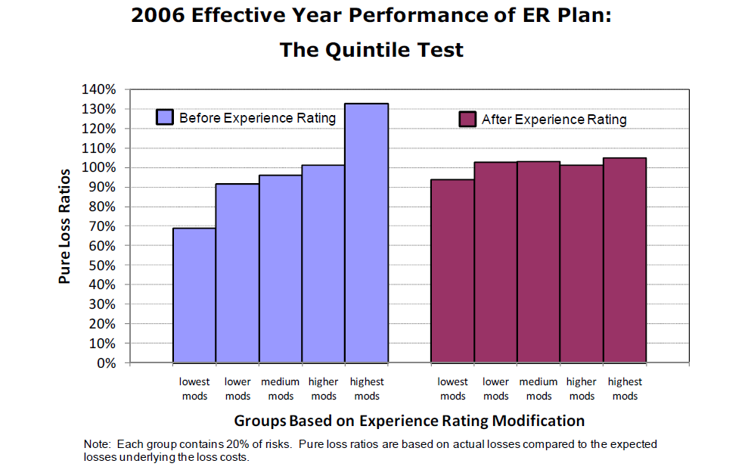
© Copyright 2010 National Council on Compensation Insurance, Inc. All Rights Reserved.

Slide 15
The recent revision of the ER plan
NCCI’s proposal:
Increase the Split Point from $5,000 to $15,000 over a three-year transition period
Then continue to increase on an annual basis using a countrywide inflation index
The Impact:
E-Mod will shift further way from 1.00
E-Mod will more fully capture the predictive info from past loss experience
The ER plan will become more responsive
Revenue neutral

Slide 16
The NCCI ER plan is mandatory
NCCI
Experience data
Insurer
E-Mod

Slide 17
III. How the NCCI experience rating plan can be viewed from the predictive modeling perspective

Slide 18
Some initial thoughts
The purpose of the ER plan is individual risk equity
Quintile test is essentially a lift curve analysis
Can the ER plan be viewed using
the predictive modeling framework?
Notes:
Mention that predictive modeling is used in insurance pricing, to predict freq, severity or loss ratio, target is to achieve individual risk equity, and that lift curve analysis is widely used to evaluate model fit

Slide 19
lift curve analysis: a measure of model fit
Procedure of constructing a lift curve
Using the model under consideration to score a dataset,
thus generating a predicted value for each observation
Sort the scored observations based on the predicted value, from low to high
Divide the sorted dataset into five or ten groups
Within each group, calculate the group average predicted value and observed value
A good model
A bad model

Slide 20
© Copyright 2010 National Council on Compensation Insurance, Inc. All Rights Reserved.

Slide 21
The lift curve of ER plan based on NCCI’s Quintile Test result (2006 effective year data)

Slide 22
Elements of the predictive modeling framework
Purpose: individual risk equity
How to evaluate model fit: Quintile test lift curve analysis
The target variable: Y=?
The model form:
E(Y) = ?
Error function: e(Y) = Y – E(Y) = ?
Predictors: ?

Slide 23
The target variable
Y = Loss Ratio Relativity = Loss Ratio / Avg Loss Ratio
Loss Ratio = $\frac{loss}{\sum_{classes}{(\frac{payroll}{100}∗loss cost)}}$
Note: Y is not inflation-sensitive
Notes:
When loss ratio relativity is predicted, it is directly used as E-Mod, so that after
the application of E-Mod, loss ratios are equal among different groups of risks
From users’ perspective, the ER plan is already implemented; the building process and fine-tuning process are not generally visible
The denominator for the Loss Ratio formula if the $10,500 number in the next slide

Slide 24
A basic WC rating example: “Northwest Roofing “
Roofer
Driver
Office clerks
Payroll: $1,000, 000 $100,000 $100,000
Loss cost: $9.5 $5.0 $0.5
(per $100 payroll)
1,000,000/100*9.5 + 100,000/100*5.0 + 100,000/100*0.5
$10,500
x
LCM: 1.4
x
E-Mod: 0.922
$13,553 “Bureau standard premium”
Schedule mod
Premium discount
Expense constant
surcharges
$12,487 the final premium
Notes:
The purpose of this slide is to explain the denominator of the Loss Ratio formula in the prior slide

Slide 25
The model form
E(Y) = $\frac{Ap+WAe+\left(1−W\right)Ee+B}{E+B}$ for eligible risks
e(Y) ≡ Y – E(Y) ~ ? cannot be identified
Note:
1. The functional form for E(Y) is not linear;
2. The specification of the error function e(Y) is critical in the predictive
modeling framework (to formulate the likelihood function)
Notes:
Note that there is premium eligibility threshold

Slide 26
Predictors
Claim frequency
Claim severity
Type of claims
Size of risk
Risk state
Class code
E(Y) = $\frac{Ap+WAe+\left(1−W\right)Ee+B}{E+B}$
Important plan parameters:
Premium eligibility threshold
Split point
Notes:
Some comments about class plan:
1-dimensional
Based on type of industry
Serves as the primary step toward individual risk equity
ELRs and D-ratios (may need to show an example of a state page)
Claim frequency (fully credible)
Claim severity (partial weight)
Type of claims (med-only or not)
Size of risk (reflected in the calculation of W and B)
Risk state (state differences in average claim severity is recognized)
Class code (different D-ratios in different classes, so class variable is involved)

Slide 27
Elements of the predictive modeling framework
Purpose: individual risk equity
How to evaluate model fit: Quintile test lift curve analysis
The target variable: Y = Loss Ratio Relativity prior to application of E-Mod
The model form:
E(Y) = $\frac{Ap+WAe+\left(1−W\right)Ee+B}{E+B}$
Error function: e(Y) = Y – E(Y) = ?
Predictors:
Claim frequency
Claim severity
Type of claims
Size of risk
Risk state
Class code

Slide 28
Further justification of the recent ER plan revision: from the new perspective
E(Y) = $\frac{Ap+WAe+\left(1−W\right)Ee+B}{E+B}$
The target variable (loss ratio relativity) is immune to inflation
But the split point is a fixed dollar amount ($5,000)
So the performance of the ER plan is going to deteriorate over time
And the revision is headed to the right direction

Slide 29
The value of the new framework
Allow more flexible model forms to be considered
Allow more statistically sound modeling techniques
Provide a fresh perspective to better understand the ER plan

Slide 30
IV. Summary
The NCCI ER plan
The recent revision
Split Point indexed to inflation
The ER plan becomes more responsive to loss experience
The new perspective
Further justifies the proposed Split Point increase
Views the ER plan in a more modern framework

Slide 31
Questions?

Slide 32
Loss Cost
A simplified WC premium algorithm
Loss Cost Multiplier
E-Mod
Schedule Mod
Premium Discount
Individual risk equity
Overall
Pricing
level
Expense Constant
Surcharges
Final Premium
Notes:
point out that the experience mod and schedule mod are intended to adjust the class rate for individual risk characteristics affecting expected losses, while the premium discount and expense constant are intended to adjust the class rate for individual risk characteristics affecting expenses.

