Slide 1
CT’s Health Insurance Marketplace
Jason Madrak Chief Marketing Officer

Slide 2
Getting Started
Began in July 2011
Substantial state-wide involvement and coordination
Comprehensive consumer research and input
Secured the right resources

Slide 3
What is an Insurance Exchange
Online store where health plans compete and offer services efficiently to individuals and small employers
Provides level playing field for health plans to comply with benefit requirements and consumer protections
Facilitates competition based on price, quality, and value

Slide 4
Key Affordable Care Act Provisions
No medical underwriting
No denial of coverage due to a pre-existing condition
Elimination of industry and gender rating
Minimum coverage requirements (Essential Health Benefits)
Strict limits on out-of-pocket expenditures
Minimum medical loss ratio (“MLR”) established
Quality rating standards and enrollee information
Extensive preventative services provided at no cost
Rates must be set for entire benefit or policy year
Qualified plans evaluated and given seal of approval
Plans organized in metal tiers

Slide 5
Why do you need healthcare coverage?
Protects you and your family against financial catastrophe
Cost of one-day inpatient hospital stay in CT: $2,154
Majority of bankruptcies are related to medical bills
Uninsured people are more than twice as likely to delay or skip needed care
Uninsured people are less likely to have access to preventive care services
http://kff.org/health-reform/fact-sheet/the-uninsured-and-the-difference-health-insurance/
http:// kff.org/other/state-indicator/expenses-per-inpatient-day /

Slide 6
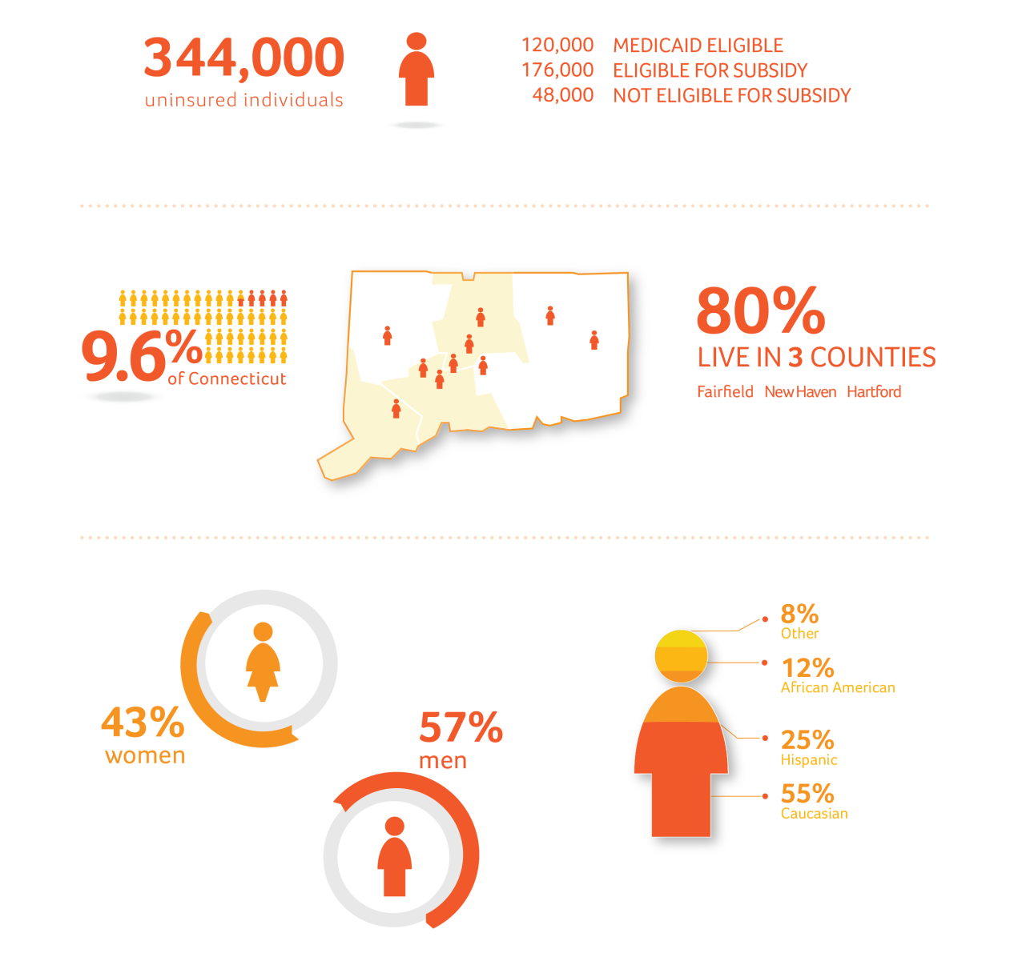
The 2013 Uninsured Marketplace
Source: Thomson Reuters

Slide 7
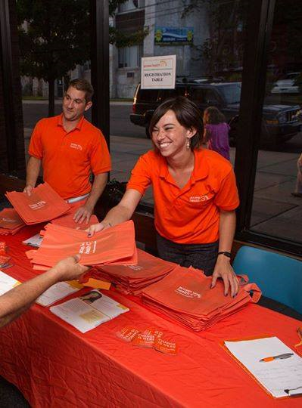
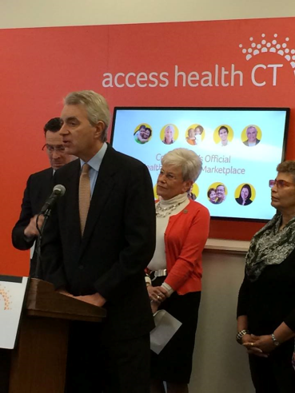
We Got Started Early
Field outreach actually began in October of 2012
Partnered with NBC to promote a series of open town hall meetings to begin raising awareness
Early start promoted openness, transparency, unpaid media coverage and brand building
More than 25 “Health Chats” were conducted in Q4-12 and Q1-13

Slide 8
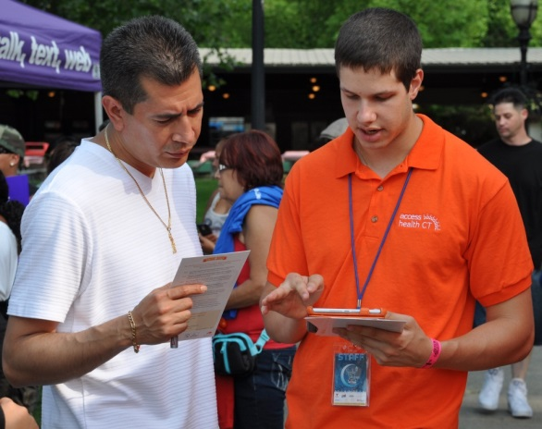
Substantial Summer Outreach Activity
Outreach efforts focused on both brand building and lead capture
More than 16,000 leads were captured between June and September of 2013

Slide 9
Moving Awareness
Access Health CT conducted three rounds of state wide polling to gauge awareness and understanding (n=850+ each round).
Compared with pre-media baseline results in June, awareness of the state’s health insurance marketplace nearly doubled by launch.
Have you ever heard of Access Health CT?

Slide 10
Multiple Channels Utilized to Engage the Uninsured
Campaign goals were achieved through activity in 6 major tactical groups, as seen below. Interplay and overlap between them was substantial, with an estimated 5+ “touches” on average occurring for each individual who enrolls.
1
Mass Media - PR
2
Exchange Field Activity
3
Licensed Brokers
Web
5
4
Navigator/
Assister
Program
Call
Center
6

Slide 11
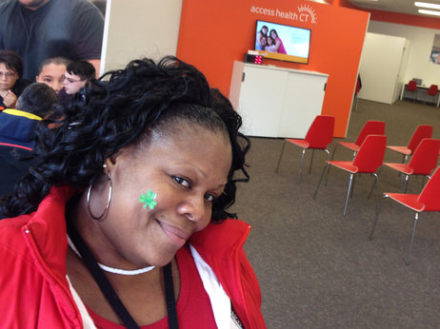
Being Innovative
Retail stores stats:
15,191 visitors
7,639 enrollments (a 50% close rate)
58% where for commercial plans
Additionally, 79 mobile enrollment fairs were executed:
4,302 attendee’s
2,278 enrollments (a 53% close rate)
54% where for commercial plans
“DeLisa Tolson signed up for health insurance at a retail store set up by Connecticut's exchange. She says she was so happy with the experience, she told all her friends”
http://www.npr.org/blogs/health/2014/03/24/292315954/connecticut-customers-rush-to-retail-store-to-buy-obamacare

Slide 12
Strong Support
Support has also built over the past year. 80% of residents now say they support the creation of Access Health CT
Do you support or oppose the creation of Access Health CT - a place residents can go to compare health insurance plans and see if they qualify for savings?

Slide 13
Future Use is High
More than two-thirds (68%) say they would recommend the marketplace to someone searching for insurance. 86% say they would consider Access Health CT if they lost their insurance..
Would you ever recommend AHCT to someone you know is looking for insurance?
If you lost your health insurance, would you consider going to AHCT to look for insurance?

Slide 14
First Year Results
3.59 million: The current CT state population
286,000: Previous number of uninsured residents (from Kaiser)
7.9%: the uninsured rate when open enrollment began
_______________________________________________________________
256,666: Current number of people enrolled through Access Health CT
53%: Overall number of enrollee’s who were previously uninsured
138,834: Number of previously uninsured residents who now have coverage
________________________________________________________________
4.0%: the new uninsured rate in CT
147,166: the number of state residents remaining without coverage

Slide 15
Access Health CT is for you if...
You need healthcare coverage
Your employer doesn’t insure you
You work for yourself
You’ve been denied insurance due to a pre-existing condition
You’re insured but looking for cost savings

Slide 16
Access Health CT Enrollment Begins November 15
Only place for CT residents to get a tax credit from government, if eligible.
See if you qualify for Medicaid and enroll if you do
Single place to compare plans and enroll – online, by phone, with a broker or community enrollment partner
Features name-brand insurance plans approved by CT Insurance Department

Slide 17
How Does the Exchange Work
1
Review Available Options
Carrier
Medicaid
6
2
Process Application
Enter and Verify Data With “Hub”
5
3
Complete Enrollment
Display Plan Options
4
Select Plan

Slide 18
Enrollment Dates
Coverage can begin as early as
Open enrollment
Nov 15
2014
Feb 15
2015
January 1
2014

Slide 19
Ready to help you…
Call: Access Health CT has a full time call center to answer any questions you might have, as well as help you enroll right over the phone (855-805-4325)
Click: Our website is available 24/7 to provide guidance and provide tools and services to help you enroll (Accesshealthct.com)
Find in-person assistance: Access Health partners with a host of organizations to provide in person help in your community
(855-805-4325)
(Accesshealthct.com)
New Britain:
200 Main Street
New Haven:
55 Church Street

Slide 20
Do you qualify for financial help?
up to $94,200
up to $45,960
Eligible for Financial Help*
up to $43,567
up to $15,856
Eligible for Medicaid*
Single
Family of 4
* Eligibility will depend on actual income level and household size.

Slide 21
Get covered or you may be required to pay a penalty
2014
2015
2016
$95
or 1% of income,* whichever is greater
(Example: 1% of an annual income of $50,000 = $500)
$325
or 2% of income,* whichever is greater
Example: 2% of an annual income of $50,000 = $1,000)
$695
or 2.5% of income,* whichever is greater
Example: 2% of an annual income of $50,000 = $1,250)
* Income over the individual’s federal income tax return filing threshold

Slide 22
Change is here

