Slide 1
Knowing where events are going to happen
Howard A Kunst, FCAS MAAA
Chief Actuary, CoreLogic Spatial Solutions
CANE – September 2014

Slide 2

Antitrust Notice
The Casualty Actuarial Society is committed to adhering strictly to the letter and spirit of the antitrust laws. Seminars conducted under the auspices of the CAS are designed solely to provide a forum for the expression of various points of view on topics described in the programs or agendas for such meetings.
Under no circumstances shall CAS seminars be used as a means for competing companies or firms to reach any understanding –expressed or implied – that restricts competition or in any way impairs the ability of members to exercise independent business judgment regarding matters affecting competition.
It is the responsibility of all seminar participants to be aware of antitrust regulations, to prevent any written or verbal discussions that appear to violate these laws, and to adhere in every respect to the CAS antitrust compliance policy.

Slide 3
Session Objectives
What determines the short term vs long term frequency?
Geographical accuracy
  Models predict where the events are more likely to occur
  Geocoding accuracy – understanding granular data
Validation of recent history of events
  Hail
  Tornado
  Wildfire
Combination of multiple perils – Single Risk Score

Slide 4
Understanding where events can happen
What affects the short term frequency of events?
  Climate change – frequency of events and geographic distribution
  Solar activity
  Heat – sunk in the earth, stored in oceans
  Drought conditions / Abundance of precipitation
  Time elapsed since last event
  Random variation
It’s almost impossible to predict exactly when and where the next event is going to happen
  But if you can predict the locations with the highest risk for an event, isn’t that just as much or more important for setting a natural catastrophe plan/strategy?
Notes:
Kunst, Howard 12:26 PM
something for you to think about . . . what "things" affect the short term frequency of natural catastrophe events?
as opposed to our long term estimates of risk
climate change?
time elapsed since last event?
random variation?
solar activity?
Kolk, Stephen 12:44 PM
You pose a good question. The answer will be different depending on which specific natural catastrophe is at issue
Kunst, Howard 12:44 PM
I'm working on my presentation for the November CAS meeting
Kolk, Stephen 12:46 PM
Weather-related cats, driven by global warmth, have short-term frequency factors of climate change, solar cycle, heat-sunk in the earth, heat stored in oceass (La Nina)
Wildfire will be affected by fuel available and some recent period of moisture (restraining ignition) or drought (drying vegation out and making match-sticks)
So Wildfire vegetation has a multi-year growth cycle, whereas drought or not is probably a shorter term factor
Kunst, Howard 12:49 PM
vegetation growth is a "time elapsed" variable
Kolk, Stephen 12:50 PM
Hurricanes and storm surge are affected by tides (thanks to the moon) and Gulf Stream warmth and ocean conditions throughout the Atlantic.
There's some stream of consciousness blather of mine. Does it help?
Kunst, Howard 12:50 PM
yes . . that helps
Kolk, Stephen 12:51 PM
We need to collect our blather on this topic. From reading the MRC example recently, we need to learn and use a Wiki to gather this blather into organized insights.
Kunst, Howard 12:52 PM
I am saving this with my ppt
Kolk, Stephen 12:53 PM
Are you going to conceptualize and build a Fourier series for the frequency of each natural catastrophe?

Slide 5
Knowing where events are going to happen
Scientists gather information on the both short/long term factors that increase/decrease the likelihood of natural catastrophic events
Models are developed that set a risk level for every location across the US – extremely granular (10 meter grids)
Revisions are made annually to adjust for more recent information (ie vegetation changes / drought conditions for Wildfires)
Ongoing validation on the accuracy of the models by comparing where recent events have occurred to the estimated risk levels
  Do the actual events in fact occur in the higher risk areas that we expected?
Notes:
First, obviously have to determine which factors actually do influence whether or not an event is going to happen, along with the historical records.
Flood, wildfire, even earthquake probabilities can change yearly depending on recent events. For example, the flash floods in CO earlier this fall may have been influenced by a lack of vegetation in the elevations west of Boulder, due to recent wildfires.

Slide 6
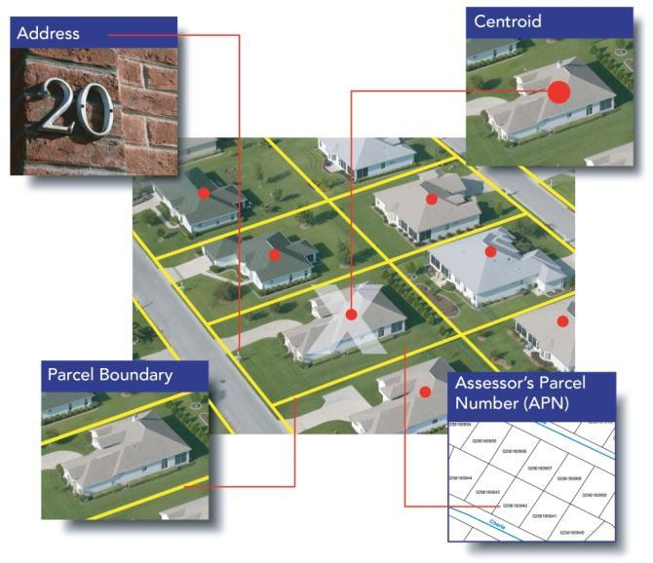
The importance of granularity
What is Parcel Data?
Parcel boundary data represents the legal extents of each taxable U.S. property address.
There are an estimated 145 million privately owned parcels in the U.S.
CoreLogic has converted and normalized about 140 million parcels from state, county, city, and town sources
As these digital parcel boundaries become available they are rapidly being incorporated into applications to enhance:
  Geocoding accuracy
  Risk assessment
  Risk concentration
  Many other uses where “granular” accuracy is important
Notes:
Geospatial accuracy is the key to getting the proper scores at the location (flood, wildfire)
CoreLogic has the largest Parcel database
Provides a better representation than using street addresses for navigation

Slide 7
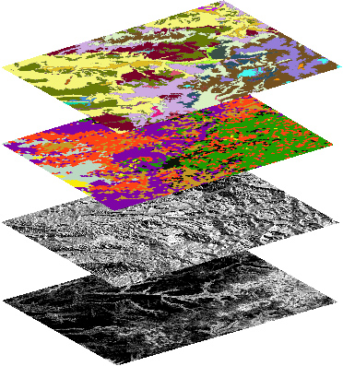
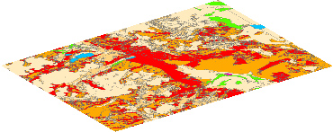
Wildfire Risk Determination
Data Elements
Data Granularity
Digital Elevation Model (DEM)
Satellite Imagery
Vegetation Condition Class data
Input cell size based on 30m grid
All layers sampled at 30m
Wildfire Risk
Vegetation
Slope
20% of Total Risk
Composition Class
Topography
Aspect
Aspect
Fuel Load
Slope
80% of Total Risk
Fuel
Condition Class
Wildfire Risk
Notes:
Combining the last 2 slides – knowing what factors influence the risk, and then getting it down to a granular level. Takes a lot of computing time to run through every grid and compute the risk levels across the entire US
An example of how the granularity filters down to a parcel level
With wildfire, even a couple hundred foot differential in geocoding could have a significant influence on the risk level.

Slide 8
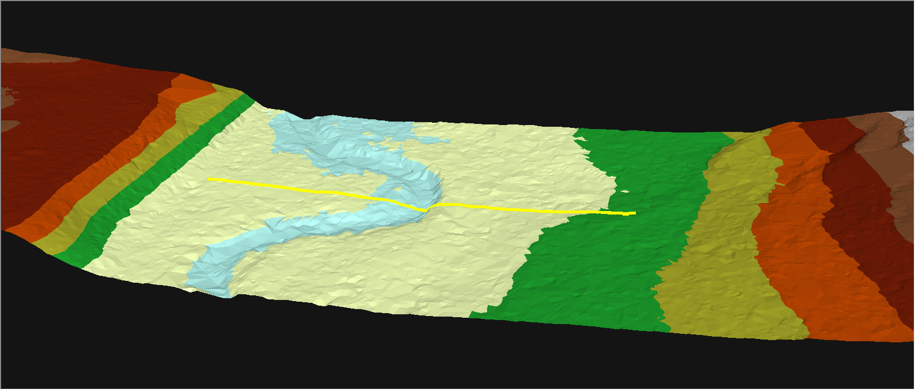
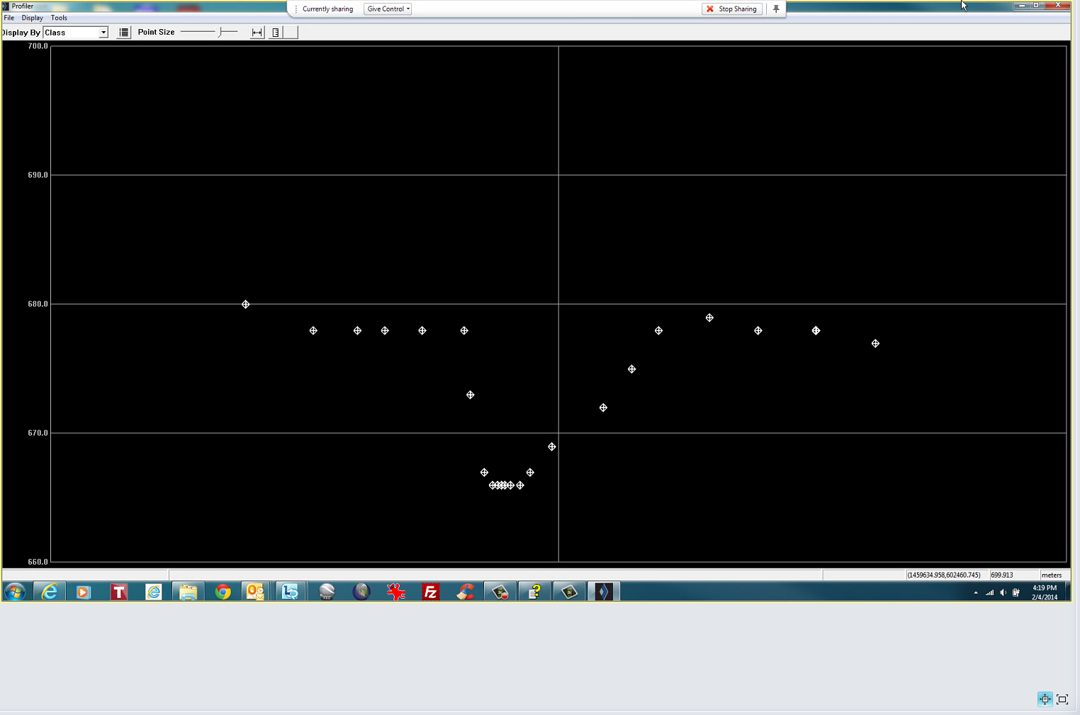
NC QL2 LiDAR (2014)
River
Floodplain
Floodplain
Cross-Section
30m Profile
QL2 nearly mirrors existing high precision survey data
10m Profile
4m Profile
QL2 – 0.3m Profile
Actual Survey Elevations

Slide 9
Severe Convective Storms (SCS)
Severe Convective Storms (SCS) refer to Tornado, Hail and Straight Line Wind events
Prior to recent events, less attention given to SCS vs Hurricane and Earthquake
  Tornados and the storms that generate tornados account for more than half of the insured catastrophic losses (57%) that occur each year in the U.S. – and extend beyond “Tornado Alley”
Frequency of observed events has increased
  Growing population
  Better observational tools (Doppler radar, etc.)
  Rising global temperature?
Notes:
Additionally, flash flooding can result from these events as well
The “Super Outbreak” in April 2011 was the largest ever recorded, 4th deadliest, most expensive tornado outbreak recorded; most of it outside of Tornado alley and was perceived to be an anomaly
Growing population = more potential observers

Slide 10
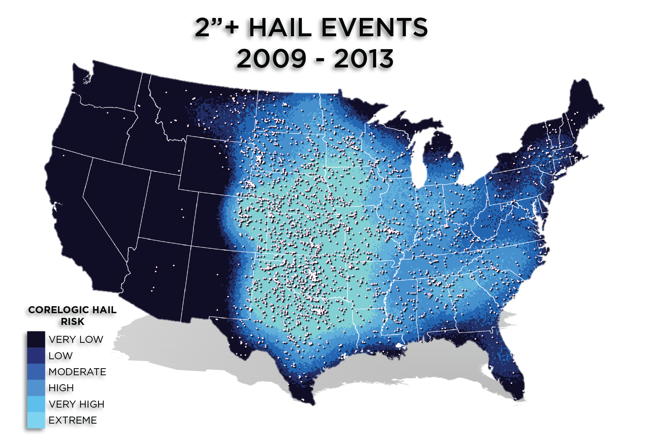
Notes:
The tables on this page quantify the data shown on the previous map
50.9% - over half of the large 2+ inch hail events occurred in areas CoreLogic classifies as extreme (which covers only 16.7% of area)

Slide 11
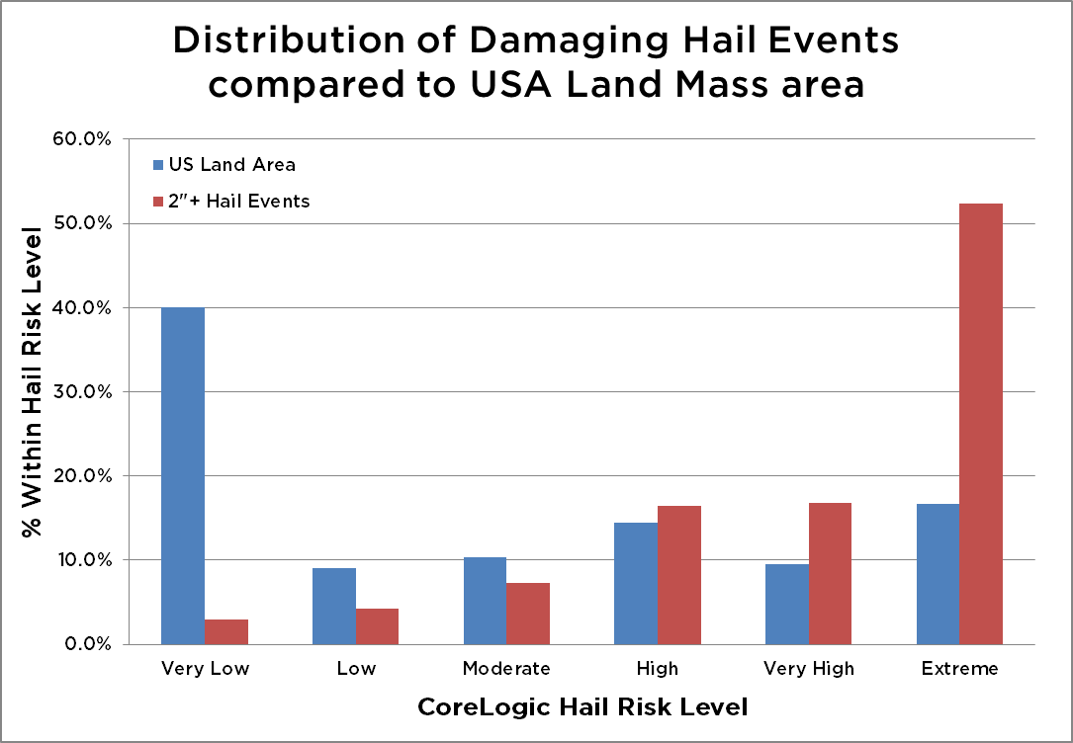
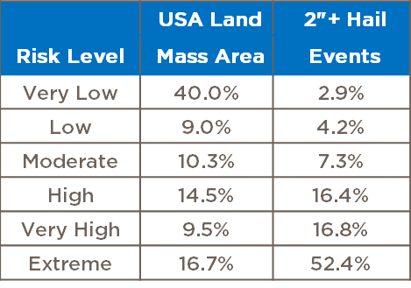
Distribution of 2”+ Hail events
52.4% of Damaging Hail events occur in areas with Extreme Hail Risk levels
85.6% of Damaging Hail events occur in areas of High, Very High or Extreme Hail Risk; those areas are only 40.7% of the land area of the USA.
Notes:
The tables on this page quantify the data shown on the previous map
50.9% - over half of the large 2+ inch hail events occurred in areas CoreLogic classifies as extreme (which covers only 16.7% of area)

Slide 12
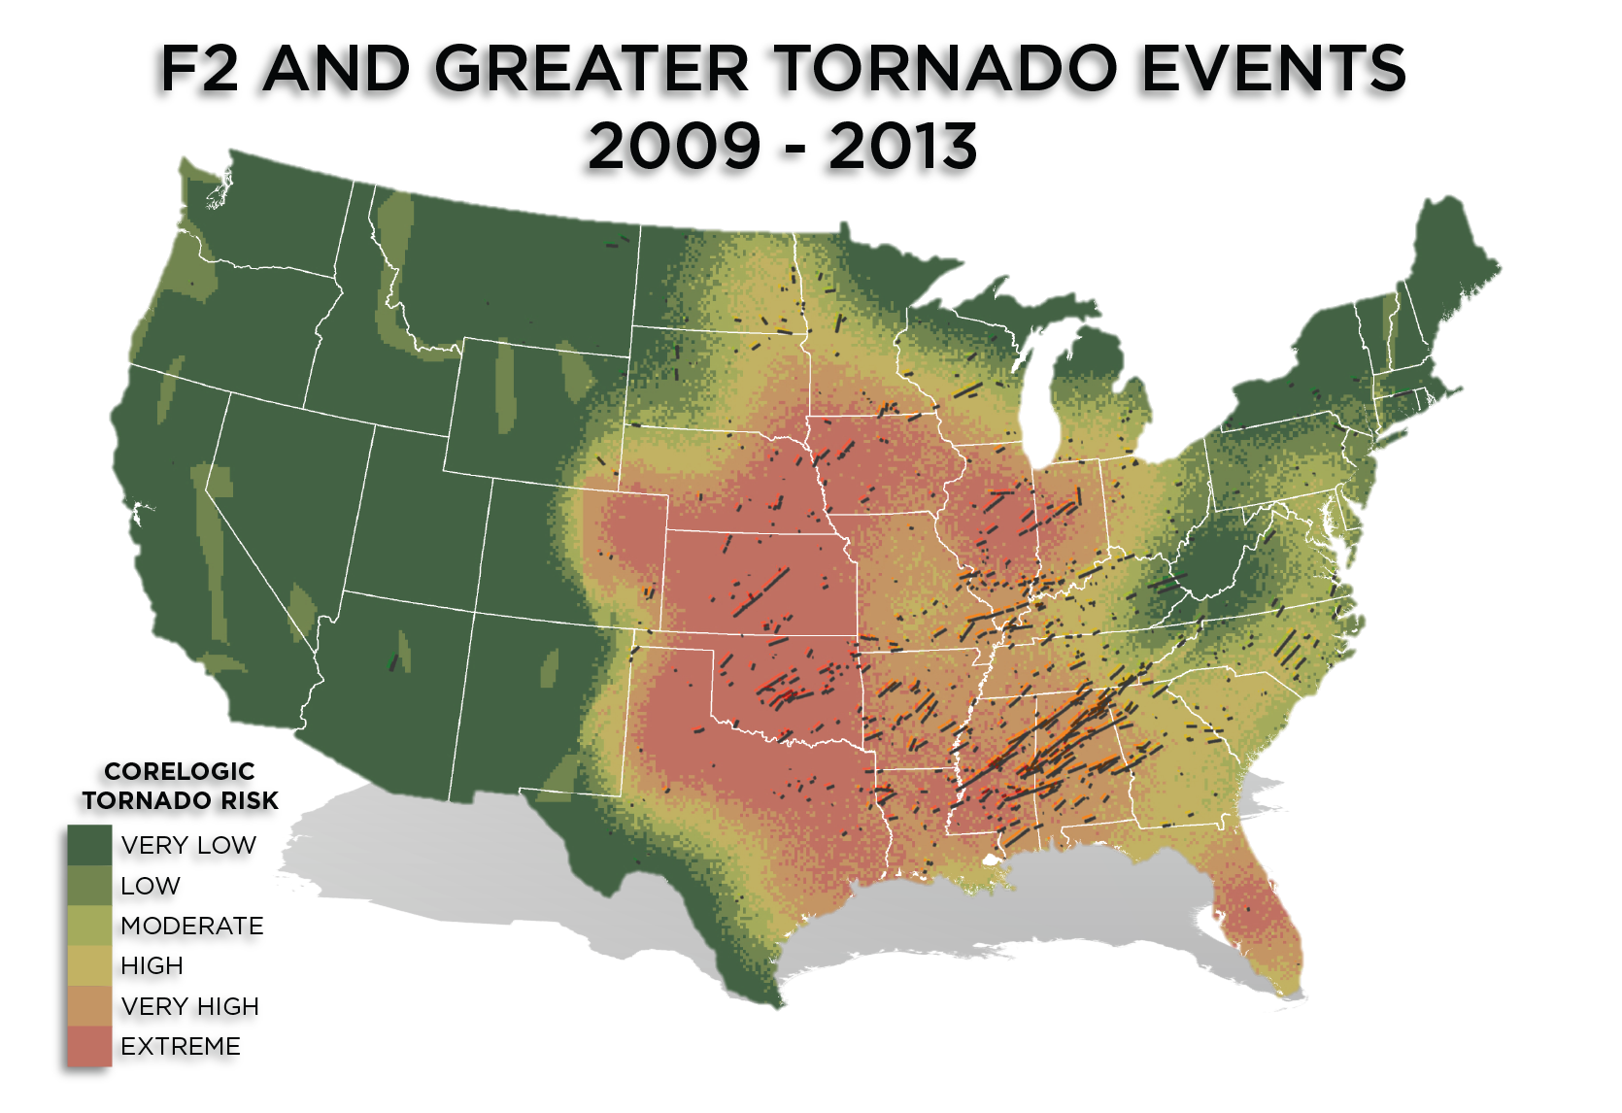

Slide 13
Annual EF0-EF5 Tornadoes
Notes:
1991 to 2010 events; does not include the 2011 Super Outbreak
FLORIDA has the highest number of tornadic events per area; all tornado sizes and not just large ones; Kansas #2
Illinois 3
MS #4
Iowa #5; these are the top 5 in most lists that I have seen;
Here’s the big shocker - OK actually #6!
DC shows a high level, but it’s a small sample area

Slide 14
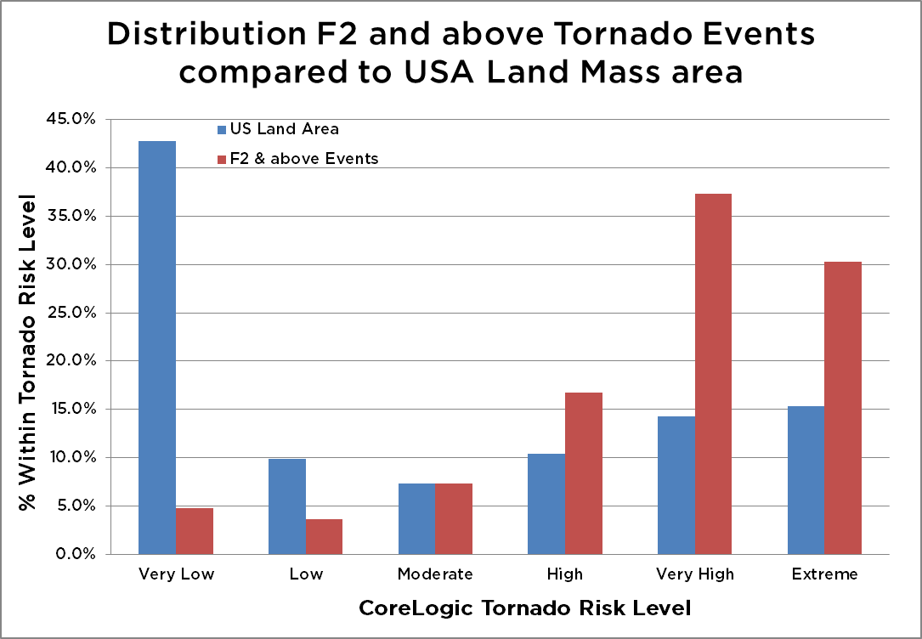
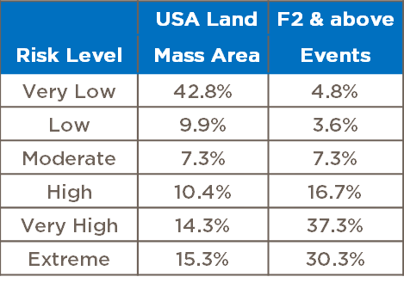
Distribution of F2 and above Tornado events
30.3% of F2 and higher events occur in areas with Extreme Tornado Risk levels
84.3% of F2 and above events occur in areas of High, Very High or Extreme Risk; those areas are only 40.0% of the land area of the USA.
Notes:
Tabular form from the first map of events with CoreLogic Risk scores
Very few F2 and above occur in Low/very low, only 7.7% in those areas that cover over ½ of the USA
2/3rds occur in Very high/extreme

Slide 15
Overview - CoreLogic Wildfire Hazard Risk Report
Drought conditions (only 5 states in the western U.S. recorded precipitation at or above average in 2012) and high temperatures impact the number of wildfires
67,664 Wildfires in 2012
9,326,000 acres burned in 2012
For 2000-2008, on average over 2,500 structures destroyed each year, compared with less than 1,000 per year for all prior decades
Over 1,260,000 residential properties in the western U.S are currently located in High or Very High Wildfire risk areas, with a value of more than $189 billion
Notes:
Wildfire – growing risk as drought conditions increase, more homes built into higher risk areas (closer to the Wildland urban interface)
Thru 09/13, lower activity compared to 2012
Wildfire follows cyclical pattern; cool wet weather causes vegetation to grow, which then becomes more fuel
Studies show that lightning is still the major ignition source relative to acres burned
# structures destroyed by wildfire has increased each decade since the 1960’s

Slide 16
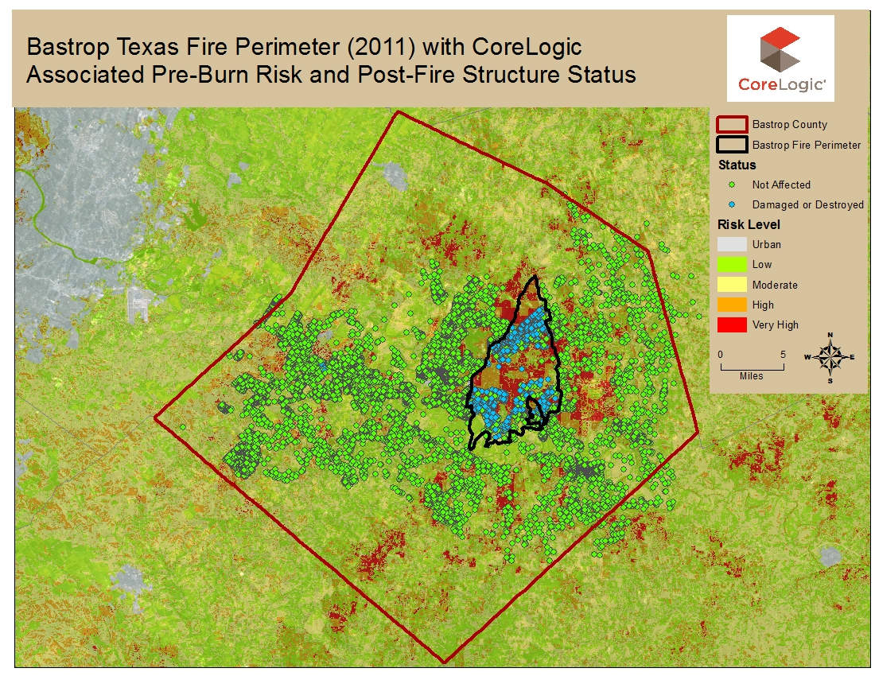
Wildfire – Bastrop County, TX
Notes:
Bastrop county – showing area where fire occurred in 2011, and the distribution of homes included in our study

Slide 17
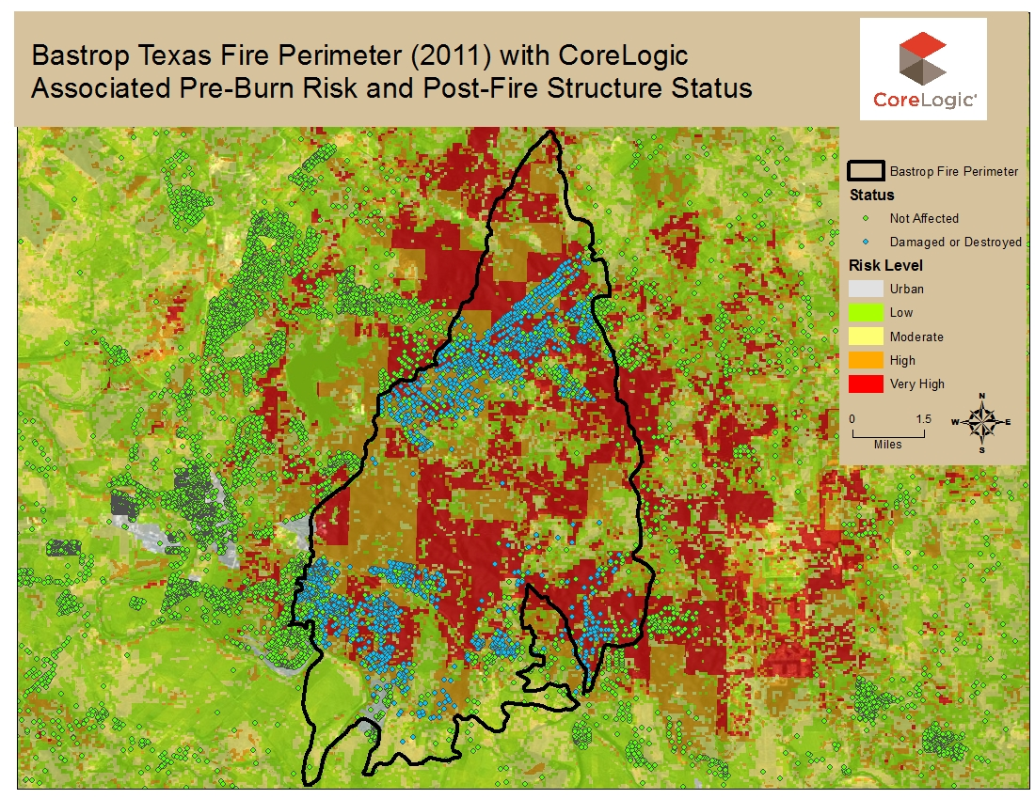
Wildfire – Bastrop County, TX
Wildfire – Bastrop County, TX
Notes:
If we zoom in on the actual burn perimeter, you can see that a majority of the area within the perimeter was classified as high risk
There were homes within the burn area that were unaffected

Slide 18
Wildfire – Bastrop County TX
% of properties damaged increases with Wildfire Risk Score
Damage % varies across Very High Risk scores, but increasing
% of properties damaged or destroyed, by WF score
Wildfire Risk Score summary
Notes:
Study included 16,731 properties distributed across the entire county
We performed a Bayesian analysis; did the scores do a good job?
1) did it predict which locations would be more likely to be damaged
2) did it predict which locations had a low risk?
Both the table and the graph show that as the Wildfire risk level increased, so did the frequency of loss for that group.
This is just one example, but we have others that show similar results – that the model does a very good job of assessing the risk to wildfires.

Slide 19
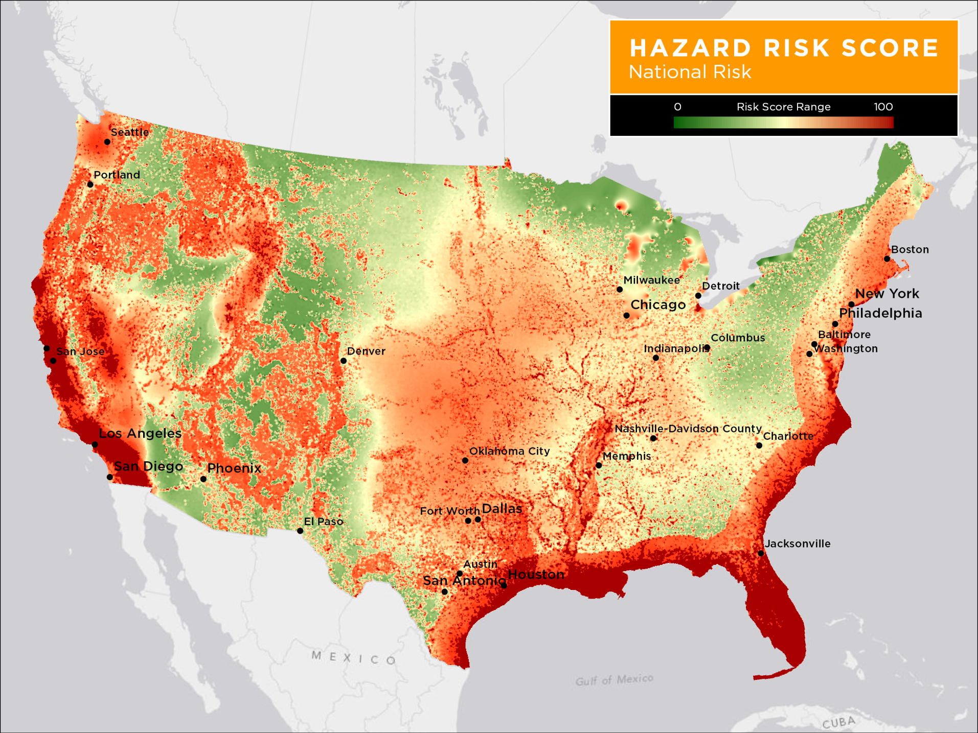
Hazard Risk Score Summary
Notes:
So, if we lump a number of individual hazards together, and find a way to normalize their scores, what would a map of the combined risk look like?
CoreLogic Single Risk score
Includes:
Hail, tornado, SLW, Flood, hurricane, surge, EQ, WF, sinkhole

Slide 20
Summary
There is an increasing number of events over the past decade
Location of recent events seem to follow where the models predict they will occur
Hail and Tornado damage extends and causes damage beyond just the traditional Tornado Alley
Notes:
Model validation is very important to all modelers – users can be very skeptical

