Slide 1
Casualty Actuaries of New England Avoiding Knee Jerk Reactions to Short Term Natural Catastrophes
Scott Jean
Vice President and Chief Actuary
EMC Insurance Companies

Slide 2
Antitrust Notice
The Casualty Actuarial Society is committed to adhering strictly to the letter and spirit of the antitrust laws. Seminars conducted under the auspices of the CAS are designed solely to provide a forum for the expression of various points of view on topics described in the programs or agendas for such meetings.
Under no circumstances shall CAS seminars be used as a means for competing companies or firms to reach any understanding –expressed or implied – that restricts competition or in any way impairs the ability of members to exercise independent business judgment regarding matters affecting competition.
It is the responsibility of all seminar participants to be aware of antitrust regulations, to prevent any written or verbal discussions that appear to violate these laws, and to adhere in every respect to the CAS antitrust compliance policy.

Slide 3
Session Objectives
Objectively review weather data for insurance relevancy
Evaluate limitations in using short term data to achieve long term predictions
Consider alternative data sources to assist in interpreting relevant insurance experience

Slide 4
Significant Tornadoes by Year
Source: NOAA Storm Prediction Center, F3-F5 or EF3-EF5

Slide 5
Industry Combined Ratios
Source: SNL Financial

Slide 6
Industry Homeowners Differentials
Source: SNL Financial

Slide 7
Convective Storms
Tornadoes

Slide 8
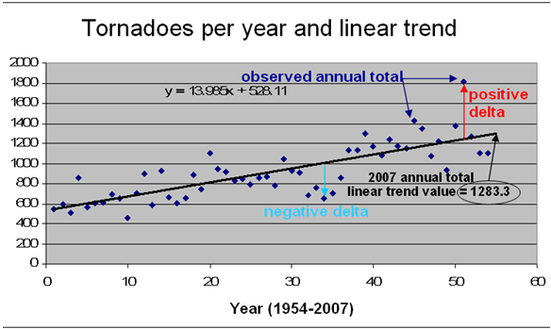
Number of Tornadoes Reported
Source: NOAA Storm Prediction Center: http://www.spc.noaa.gov/wcm/adj.html

Slide 9
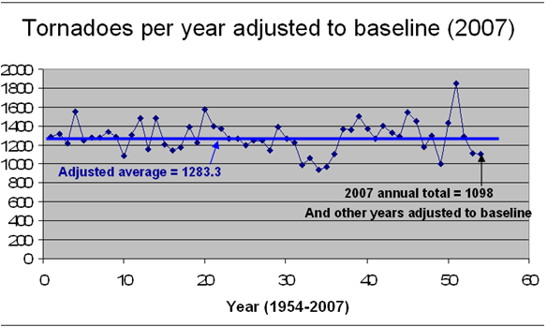
Adjusted Tornadoes Reported
Source: NOAA Storm Prediction Center: http://www.spc.noaa.gov/wcm/adj.html

Slide 10
Significant Tornadoes by Year
Source: NOAA Storm Prediction Center, F3-F5 or EF3-EF5

Slide 11
Significant Tornadoes by Year
Source: NOAA Storm Prediction Center, F3-F5 or EF3-EF5

Slide 12
EF5 or F5 Tornadoes Reported by Year
Source: NOAA Storm Prediction Center

Slide 13
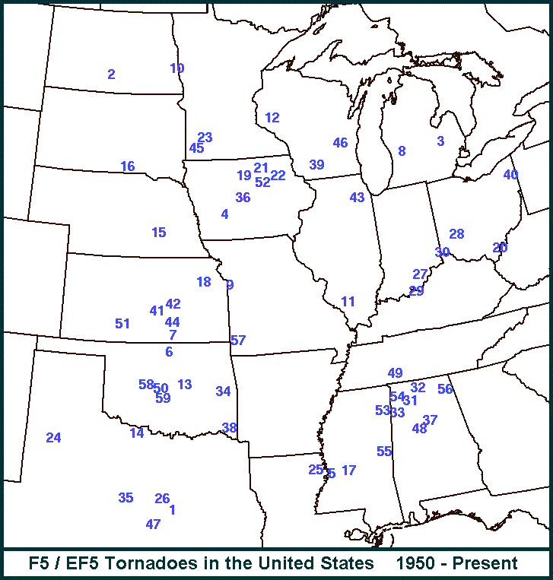
EF5 or F5 Tornadoes since 1950
59 May 20, 2013 Moore OK 58 May 24, 2011 El Reno/Piedmont OK 57 May 22, 2011 Joplin MO 56 April 27, 2011 Rainsville/Sylvania AL 55 April 27, 2011 Preston MS 54 April 27, 2011 Hackleburg/Phil Campbell AL 53 April 27, 2011 Smithville MS 52 May 25, 2008 Parkersburg IA 51 May 4, 2007 Greensburg KS 50 May 3, 1999 Bridge Creek/Moore OK 49 April 16, 1998 Waynesboro TN 48 April 8, 1998 Pleasant Grove AL 47 May 27, 1997 Jarrell TX 46 July 18, 1996 Oakfield WI 45 June 16, 1992 Chandler MN 44 April 26, 1991 Andover KS 43 August 28, 1990 Plainfield IL 42 March 13, 1990 Goessel KS 41 March 13, 1990 Hesston KS 40 May 31, 1985 Niles OH 39 June 7, 1984 Barneveld WI 38 April 2, 1982 Broken Bow OK 37 April 4, 1977 Birmingham AL 36 June 13, 1976 Jordan IA 35 April 19, 1976 Brownwood TX 34 March 26, 1976 Spiro OK 33 April 3, 1974 Guin AL 32 April 3, 1974 Tanner AL 31 April 3, 1974 Mt. Hope AL 30 April 3, 1974 Sayler Park OH 29 April 3, 1974 Brandenburg KY 28 April 3, 1974 Xenia OH 27 April 3, 1974 Daisy Hill IN 26 May 6, 1973 Valley Mills TX 25 February 21, 1971 Delhi LA 24 May 11, 1970 Lubbock TX 23 June 13, 1968 Tracy MN 22 May 15, 1968 Maynard IA 21 May 15, 1968 Charles City IA 20 April 23, 1968 Gallipolis OH 19 October 14, 1966 Belmond IA 18 June 8, 1966 Topeka KS 17 March 3, 1966 Jackson MS 16 May 8, 1965 Gregory SD 15 May 5, 1964 Bradshaw NE 14 April 3, 1964 Wichita Falls TX 13 May 5, 1960 Prague OK 12 June 4, 1958 Menomonie WI 11 December 18, 1957 Murphysboro IL 10 June 20, 1957 Fargo ND 9 May 20, 1957 Ruskin Heights MO 8 April 3, 1956 Grand Rapids MI 7 May 25, 1955 Udall KS 6 May 25, 1955 Blackwell OK 5 December 5, 1953 Vicksburg MS 4 June 27, 1953 Adair IA 3 June 8, 1953 Flint MI 2 May 29, 1953 Ft. Rice ND 1 May 11, 1953 Waco TX
Source: NOAA Storm Prediction Center

Slide 14
Top 5 April Tornado Outbreaks
Year | Tornadoes
2011 | 758
1974 | 291
2006 | 258
2009 | 226
1957 | 219

Slide 15
Significant Hail Events by Year
Source: NOAA Storm Prediction Center; Hail >= 3 inches

Slide 16
Significant Wind Events by Year
Source: NOAA Storm Prediction Center; Wind > = 80 knots

Slide 17
Source: NOAA Storm Prediction Center

Slide 18
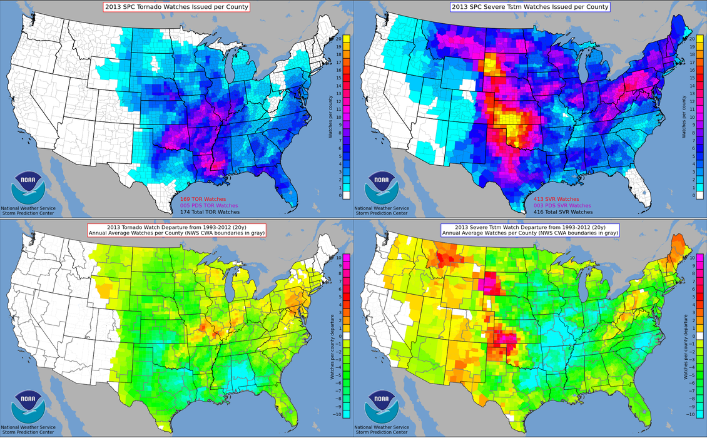
Source: NOAA Storm Prediction Center

Slide 19
Hurricanes

Slide 20
Historical Named Storms
Source: Weather Underground

Slide 21
Historical Hurricanes
Source: Weather Underground

Slide 22
7 Year Moving Averages
Source: Weather Underground

Slide 23
Florida Hurricane Strikes

Slide 24
Major Atlantic Hurricanes
Source: Chris Landsea NOAA @ Aon Benfield Conference and Wikipedia

Slide 25
Why Increases in Insured Losses?
Recent active weather period
Population changes
Economy
Stormchasers
The new norm?

Slide 26
Significant Tornadoes by Year
Source: NOAA Storm Prediction Center, F3-F5 or EF3-EF5

