Slide 1
Reinsurance--Basics and Beyond
September 22, 2014
Elliot Burn
Managing Director, GC Analytics
Presented to: Casualty Actuaries of New England

Slide 2
Agenda
Not Too Much Prior Knowledge Required
Reinsurance Basics
Brokered and Direct Reinsurance
Roles within a Broker
Process Steps in Reinsurance Placement
Reinsurance Pricing
State of the Market

Slide 3
Reinsurance basics

Slide 4
Reinsurance
A Definition
Insurance for Insurance Companies
  An insurance company, called the primary or ceding company, shares portions of its liability with another insurance company, known as a reinsurer
Reinsurance is a transaction between insurance companies only
The heart of reinsurance is utmost good faith

Slide 5
Functions of Reinsurance
Primary Functions
  Capacity
  Stability
  Financing
  Catastrophe
Secondary Functions
  Underwriting Advice
  Entering/Exiting lines of business/states etc.

Slide 6
Types of Reinsurance Agreements
Facultative Reinsurance
  An Agreement between the ceding company and the reinsurance company which applies to one individual risk of the ceding company, i.e., a restaurant, building, tournament, etc.
Treaty Reinsurance
  An Agreement between the ceding company and the reinsurance company which applies to the ceding company’s entire book of a specific type of business, i.e., Property, Casualty, Auto Physical Damage, Workers Compensation, etc.

Slide 7
Forms of Reinsurance
Pro Rata
  Quota share
  Surplus share
Excess of loss
  Per Risk/Per Policy/Per Insured/Per Location
  Per Occurrence (catastrophe)
  Aggregate

Slide 8
Forms of Reinsurance
Pro Rata Reinsurance (Proportional)
Sharing concept - Ceding company and
Reinsurer share premiums and losses in
a determined percentage
Excess of Loss Reinsurance (Non-Proportional)
For a part of the premium, Reinsurers
cover losses above a specified retention up
to a predetermined limit
40%
Quota
Share
60%
Company
Retention
$2,000,000 in excess of $1,000,000
$500,000 in excess of $500,000
Company Retention

Slide 9
Reinsurance Pricing Jargon
Retention = portion of claim amount from ground-up (first dollar) that company keeps
Attachment = beginning or bottom of layer
Co-Participation = sharing the layer (pro-rata)
Exhaustion = top of the layer
Probability of
  Attachment = likelihood of a claim reaching the bottom of the layer
  Exhaustion = likelihood of claim going through the top of the layer
  Function of the severity curve
“Out the Top”
Exhaust
Limit
Co-Par
Size of Claim
Attach
Retention

Slide 10
Reinsurance Pricing Jargon
Annual Aggregate Deductible (AAD) = just what it says
Rate on Line (RoL) = premium / limit
Loss on Line (LoL) = expected layer loss cost / limit
Reinstatement = additional premium to get another limit after exhausting the first one
  Very common in property cat
“Out the Top”
Exhaust
Limit
Co-Par
Size of Claim
Attach
Retention

Slide 11
Conceptual Comprehensive Group-Wide Risk Management Program
“Top and Aggregate”
Section A - $350M xs $425M per Occurrence
Section B - - $350M xs $400M Aggregate subject to a $50M USA per occ. and $10M Non-USA per occ. deductible
Annual aggregate limit = $500M
Estimated cost – 17.5% to 22.5% RoL
$775M
“Top and Aggregate”
“Top and Aggregate”
$425M
“Top and Aggregate”
“Top and Aggregate”
QS
QS
50m
Pillared
50M
Pillared
Back
50m
50m
50m
50m
50m
Back
50M
50M
50M
50M
50m
50M
50m
$150M
50M
50M
up
up
Pillared
Pillared
FL
GU
NE
NA
FL
GU
NE
NA
JP
EU
JP
EU
ROW
ROW
Floater
HU
HU
HU
EQ
Floater
HU
HU
HU
EQ
ANP
ANP
ANP
ANP
Insurance
Reinsurance
August 26, 2014
10

Slide 12
Brokered and direct reinsurance

Slide 13
Brokered and Direct Reinsurance
Brokered
Direct
Dominant in US
Client can dictate that “direct” reinsurers transact on brokered basis
Syndicated among a set of counterparties
Brokers serve as client advocates, manage the reputation and contract enforcement
Dominant in Europe and Life
Single counterparty
Reinsurer provides underwriting expertise
Massive franchise investment
Long-term partnerships
Intent is to be there come what may

Slide 14
Roles within a broker

Slide 15
Roles within a Broker
Brokers – four areas
  Relationship Management
  Executive coverage, decision makers
  Structuring
  Artistry
  Placement
  Augury
  Claims Collections
  Enforcement
Specialist Support
Actuaries
Catastrophe modelers
Contracts Analysts
Counterparty Credit Risk Analysts
Advisors: rating agency, regulatory, accounting

Slide 16
Process steps in reinsurance placement

Slide 17
Comprehensive Approach Ensures the Best Solutions
Contract at Placement
Post-Placement Review
Sign Lines + Issue Contracts
Evaluate Business Profile
Determine Firm Order Terms
Determine Goals + Objectives
Solicit + Analyze Quotes
Analyze Risk Profile
Implement Marketing Strategy
Cat Modeling + Analysis
Develop + Test Alternative Solutions
Develop Marketing Strategy + Submission
Select Optimal Solution
Prepare Contract Wording
MetaRisk® ROLePlay
Market Security Analysis
Reinsurance Decision Tool
GC Preferred Clauses

Slide 18
How We Think About Reinsurance
The Guy Carpenter Client Experience
Client and Advisor:
Aligned Understanding
Actuarial and Analytical Expertise
Market
Knowledge
P
l
a
c
e
m
e
n
t
Product
Expertise
MetaRisk
R
D
T
Benchmarking to Peers
Client Data
Leverage and Relationships
External
Data
Product Line
Models
Reinsurance Economic Optimization
Technical
Broking
Driving value at each end of the reinsurance transaction.

Slide 19
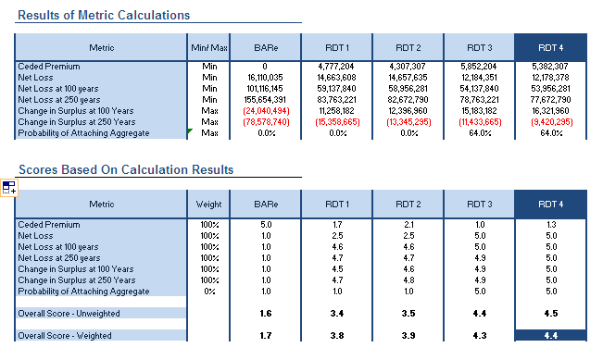
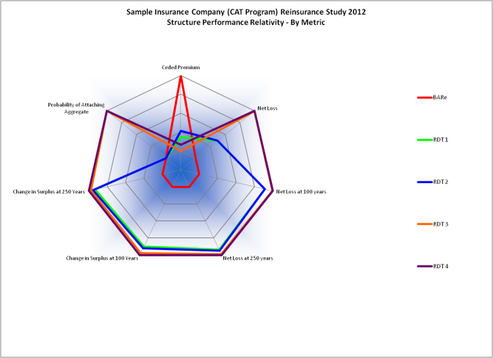
Reinsurance Decision Tool (RDT)
Value-Weighted Metrics
Balanced Scorecard Improves Transparency and Buy-In
18

Slide 20
Reinsurance pricing

Slide 21
Basics of Reinsurance Pricing
Quota Share = expected loss ratio (~insurance planning)
Excess of Loss
  Layer Loss Cost
    Experience Rating = recasting history
    Exposure Rating = theoretical using severity curves
    Catastrophe modeling = high-powered exposure rating
  Capital Cost / Risk Load
    Standalone = using layer standard deviation
    Marginal = based on change in portfolio risk metrics

Slide 22
Reinsurance Price “Discovery”
Submission
Quotes and Authorizations
Firm Order Terms (FOT)
Bindings
Package up your information
Exposure datasets up on FTP site for cat
Quotes leverage vast IP franchise (Underwriters, actuaries, cat modelers, pricing tools)
Authorizations are max limits (indicator of interest) at their quoted price
No reinsurer sees the other quotes
Broker finds the clearing price
Target is 100% placement
A key function of the broker: guidance on the pricing
Heavily driven by constant benchmarking
Price-taking exercise for reinsurers
Remember role #3 of a broker?
A lot of soft factors

Slide 23
STATE OF THE MARKET
JANUARY 1 to July 1, 2014 PROPERTY REVIEW

Slide 24
Executive Summary July 2014: Excess Capacity and Low Loss Experience Continue to Impact Market Conditions
In 2014 risk adjusted price decreases have averaged in the mid to high teens and the impact on the ROL Index was down 17 percent for the full year
Catastrophe bond issuance set a record for the first six months of 2014 at $5.7B
There are signs that markets are still applying underwriting discipline – a few programs re-priced prior to completion and one catastrophe bond deal was pulled from the market as offered terms proved too aggressive to fill the order
Changes in coverage, a growing range of offered products and multi-year options continued to provide opportunities for companies to better tailor solutions to meet their risk management needs
Companies were able to utilize savings on their core purchases to round out their coverage strategy
Excess capacity, alternative market influence and low loss activity drove decreased pricing, tailored terms and a growing number of multi-year placements
23
23
Notes:
23

Slide 25
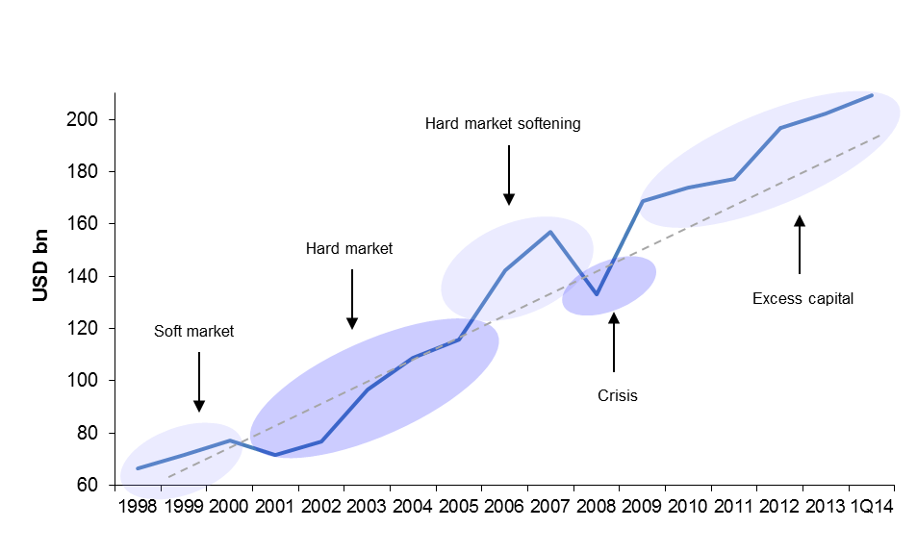
Capital Inflows Continue Unabated
Guy Carpenter Global Reinsurance Composite Capital Position
_{Source: Guy Carpenter}
_{26 August 2014}
₂₄
Notes:
₂₄
₂₄

Slide 26
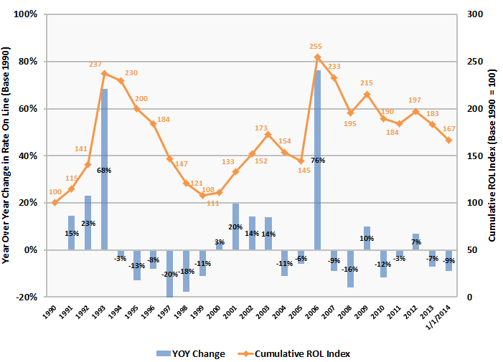
US Rate on Line Index at January 1, 2014
1/1/14 represents a 15% decrease from 1/1/13 and a 9% decrease from the 2013 full year calculation.
Notes:
Please note that price points are representative of conditions at January 1, comparing like for like renewals. For example, while pricing decreased significantly in the United States through July 2013 and the full year index was down 7 percent, pricing at January 1, 2013 was up slightly due primarily to the impact of Superstorm Sandy and a number of Midwest storms. Therefore, the current 2014 price point represents the difference from last year’s January 1 renewals. Also note, the data points in no way reflect pricing relativities between geographies.

Slide 27
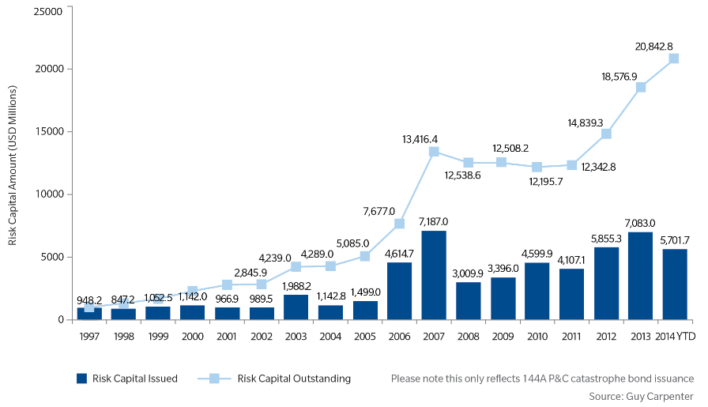
Growth in Utilization of Catastrophe Bonds

Slide 28
Growth in Utilization of Catastrophe Bonds
Continued Innovation in 2014
In addition to record high issuance there have been several “firsts” in 2014 catastrophe bond transactions
Eight first time sponsors contributing to 18 total transactions since January 1
  Includes new offerings from TWIA, the World Bank (to benefit the Caribbean Catastrophe Risk Insurance Facility (CCRIF), Sompo and Generali
First time structure or pricing achievements including:
  Aozora Re (benefitting Sompo Japan Nipponkoa) is the first yen-denominated cat bond to be issued and is the lowest yielding Japan peril cat bond
  Lion I Re Limited (benefitting Generali) is first ever 144A indemnity triggered Europe windstorm cat bond, first Italian sponsored catastrophe bond and first catastrophe bond to benefit Generali
  East Lane VI (benefiting Chubb) is the first US hurricane exposed cat bond to price below 3% ROL

Slide 29
July 1, 2014 Quoting Observations
July 2014 quoting range was down 10% to up 5%
Quoting range has widened from 2012 and 2013 spreads of down 6% to up 6%
  Consistent with June 2014 trend that also saw a widening of the previous year’s range
Greater variability in quoted decreases below 2013 pricing is driving the increased spread
Full year quoting behavior is still slightly tighter than historical norms at down 6% to up 9%
The majority of catastrophe XOL quotes on core purchases still come from traditional reinsurers
  Five alternative markets met the minimum quoting threshold for inclusion in the full year quoting behavior analysis as compared to two in 2013
28
28
Notes:
28

Slide 30
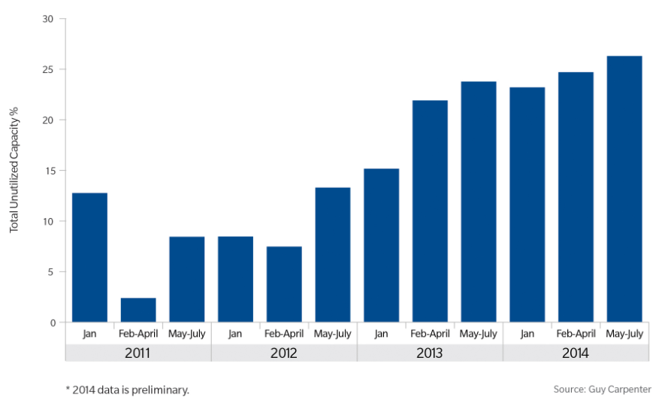
Historical Unutilized Authorization Percentage Highlights Growing Excess Capacity
Even at significantly decreased pricing levels and with several cedants expanding coverage purchased, unused authorized limit continued to increase
August 26, 2014
Notes:
With continued moderate loss experience, growing reinsurer surplus and increasing alternative market capital, the percentage of excess capacity continues to climb. The June 2013 renewals still represent a high point with only approximately 70 percent of authorizations utilized as these renewals were a heavy focus for both alternative and traditional markets. However, based on a preliminary review of total capacity utilized for the May through July 2014 renewals excess capacity has increased to just over 26% from just under 23% for the same period in 2013

Slide 31
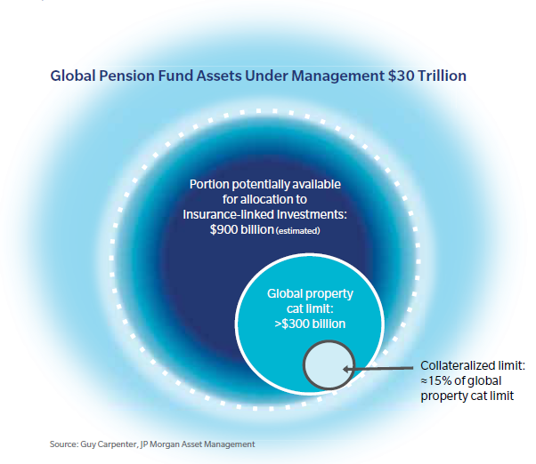
Market Drivers
Alternative Capital

Slide 32
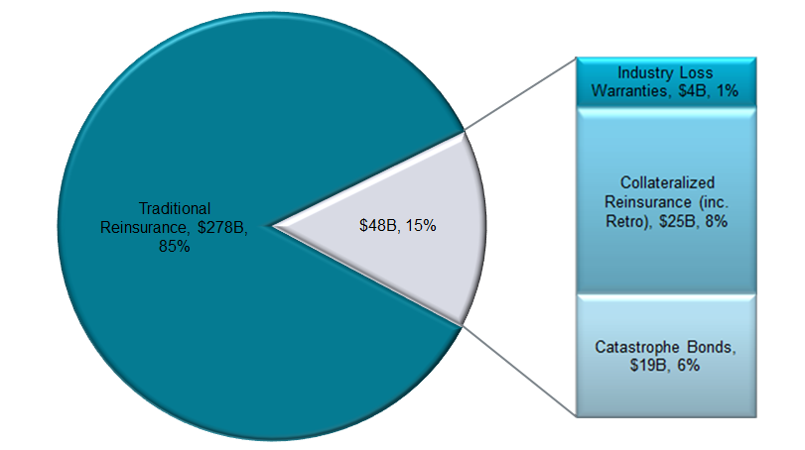
Capital Markets Participation In Reinsurance
Estimate Through January 1, 2014 Renewals
Source: GC Securities Proprietary Database (estimates only), Swiss Re sigma and Standard & Poor’s, Business Insurance.
Notes:
Looking specifically at some of the numbers, alternative capital through various products and access points now accounts for about $44B or roughly 14% of global limit placed. Catastrophe bonds and collateralized placements are the most significant area of current activity and will continue to be the primary focus for much of this capital in the near term. While we look at this activity in the context of global placements, the majority of limit is focused on the US and within that, Florida and cat pools, both areas of growing reinsurance need. So, while we’ve seen the alternative dollars deployed continue to grow, the percentage of overall cat hasn’t necessarily increased at the same rate as the overall pie is expanding as well. The degree of influence alternative capital has had and the traditional market’s reaction extends beyond pricing to coverage as well, bringing about some of the most dynamic and creative market conditions we’ve seen.
31

Slide 33
Pension Funds
New capital coming in
Prices are falling
Why both?
  Quantitative easing → low fixed income returns
  Pension funds heavily peer-focused and benchmark driven, particularly the 5-year track record
    2013 marked five years since 2008 where “insurance risk” (cat bonds) demonstrated (i) low defaults (few cats) and (ii) low beta, especially compared to other fixed income
  Believe it or not, the parameter error in cat models is way less than in credit risk models

Slide 34
Current Landscape
Reinsurer Strategies
Traditional reinsurers are navigating current market conditions by …
Offering broader coverage in an effort to avoid competing with the capital markets on price only
  Extended hours clauses
  Broadened terrorism coverage
  Enhanced reinstatement terms
  Contractual agreement to advance claims payments
Leveraging platforms to deliver more service to clients
  Moving from product focus to client focus
  Offering analytic insights and bespoke projects
  Discrete placements
Authorizing larger line sizes in an effort to grow market share
Coming off business as opposed to following the market down

Slide 35
Current Landscape
Reinsurer Strategies
Identifying areas to “lock in” client relationships
  Multi year pre renewal capacity
  Discounts on “bouquet” of cessions
  Loss Ratio view of participations
  Proportional support
Leveraging inwards vs. retro purchases
  Capitalising on non correlating exposures
  Buying more QS to retain gross portfolios while taking better PCs and commissions
  FL specific retro to improve metrics on the inwards book
Re-allocating capital to the insurance side of the company
Leveraging underwriting expertise by setting up sidecar capacity to write on behalf of new capital
34
Notes:
34

Slide 36
Where are we now?
Influx of new capital into the (re)insurance industry constitutes the largest change to the sector’s capital structure in recent memory
  Much of new capital is patient money that will persist through loss cycles
Over the past 24 months approximately $20 billion of new capital has entered the market through investments in ILS funds and sidecars as well as formation of hedge fund related reinsurance companies and collateralized reinsurance vehicles
Convergence capital continues to grow as a percentage of property catastrophe limit placed and some markets are broadening line of business and product focus
The impact on reinsurance program cost and structure has been substantial and will continue to evolve as (re)insurers leverage new sources of capital to create additional operational efficiency
35
Notes:
35

Slide 37
Looking Ahead to January 1, 2015 Renewals
Some renewal discussions are already underway
  Full evaluation of the range of products available takes additional time
  Placement timelines for catastrophe bonds and collateralized reinsurance may be longer to ensure all documentation is in place
There is significant capacity unsigned after the June/July 1 renewals
  Market conditions are very favorable with a high degree of flexibility on price and coverage
Wide range of risk transfer products should be considered
  Occurrence: Traditional, Collateralized, 144A Cat Bond, Private Cat Bond, CWIL, ILW
  Aggregate: Pure aggregate, Top and Drop, Top and Aggregate, Cascading
  Expansion to multi-year
Possible opportunistic buys for 2014 wind season
  Aggregate, Underlying, Named Storm, Top and aggregate
August 26, 2014
36

Slide 38
STATE OF THE MARKET
PRIMARY AND UMBRELLA/EXCESS LIABILITY
JULY 2014

Slide 39
Primary Casualty
  Improving rate environment for prior few years (~ +5%) helping to improve underlying profitability
    High expense ratios still put pressure on margins for carriers
    Rates flattening out
  Large National carriers generally do not purchase reinsurance on their primary casualty
    Regional carriers will purchase coverage
    Excess of loss structures are more commonplace as a result of expense ratio dynamics
    Clash also commonly purchased

Slide 40
Market Commentary
Noticeable change to reinsurance market since July 1, 2013
  Reinsurer appetite increased and treaty terms much improved
  Average ceding commissions increasing by 2 to 4 points and in some cases more than 4
    Reinsurers increasing desire for business due to favorable underlying insurance rates, loss of property cat premium, and view that historical results have been better than previously thought (2005 – 2011 years)
    Terms are still dependent on underlying loss ratio of a given portfolio
Certain Segments have had particular poor results affecting loss ratios
  Energy: Deepwater, PG&E, Enbridge, Kleen Energy, Wildfires
    Many energy portfolios cannot be included in mainframe treaties and are reinsured separately
    Separate structures tend to be XOL with paid reinstatements
  NY Contractors: Losses have led to changes in limits, attachments and pricing
    Reinsurers not keen to reinsure this business below $5M attachment points
  Rail Losses: Recent losses starting to bring attention to this segment
    Quebec, France, Spain, Metro-North

Slide 41
US Umbrella / Excess Liability Marketplace
Gross vs. Net Capacity (as of 5/1/14)
Carriers are retaining an average of 43% of gross capacity (excl. 4 Net writers)
Notes:
40

Slide 42
US and Bermuda Umbrella / Excess Liability Market Place
Companies with ≥ $10M Capacity (as of 5/1/14)
Reinsurance Structure Comparison
Commentary
Predominant structure is quota share
Most of the XOL structures purchased include other lines of business
The hybrid structures contain a mix of quota share and XOL
Most companies have at least $25M gross capacity
Reinsurers more likely to sell Excess of Loss structures on portfolios that are made up predominately of lead umbrella business
  Constant attachment point versus writing excess on excess
  Portfolio composition dictates overall market appetite
Universe = 48 Companies
Hybrid

Slide 43
US and Bermuda Umbrella / Excess Liability Market Place
Terms Analysis (as of 5/1/14)
Ceding commissions range from 23% to 34%
  Avg. Ceding Commission is 29% in U.S.
  Avg. Ceding Commission is 27.5% in Bermuda with Legacy carriers having the highest
  These averages have trended higher over the last 6 months
Highest ceding commissions are provided to wholesale platforms, those platforms that have been in existence for a long time and show historical profitability, and quota share reinsurance structures.
  Acquisition costs are higher for wholesale-produced business
Reinsurers paying between 10 and 16% over original acquisition costs
  Some treaties have acquisition cost plus structures
Books with a greater percentage of retail produced business have lower cedes (more deals done Net)
  Expense structure and perceived profitability is lower

Slide 44
STATE OF THE MARKET
WORKERS COMPENSATION
JULY 2014

Slide 45
2014 Primary Workers Compensation Recap
GC portfolio’s aggregate Subject Premium base was +12.3% over 2013 due to:
  low-to-mid single digit rate increases
    Over 70% reported rate increases +1% ➔ 30%; plus another 16% flat
  and continued slight payroll expansion
    Marsh 2013: +2.8% (average on all accounts)
Consensus that carriers can no longer rely on investment income or reserve releases to compensate for underwriting deficiencies
  Cat Model-driven results increasingly dictating market appetite
  Increased use of Predictive Modeling for the WC line
    predominantly used for claims administration for 15+ years
    increasingly being used for risk underwriting/pricing pre-selection
    various vendors and options to choose from
Although most employers have focused on the ACA law’s health benefit Δ’s, its expected impact on WC costs remains uncertain and an area of concern
Despite favorable 2013 rate increases, some WC market challenges continue to persist due to core fundamentals

Slide 46
Workers Compensation Market Overview
Workers comp profitability varies significantly by industry and geography
  Manufacturing, construction and transportation tend to have the higher rates and were most susceptible to the economic downturn . Slow but improving outlook
  Individual states manage workers comp rates and enact reforms.
Key issues impacting the current and future state of the WC segment include:
1
Continued headwinds to underwriting profitability driven by various macroeconomic factors including limited GDP and employment growth
2
Challenging insurance cycle marked by excess capital and competition
3
Uncertain impact from ACA healthcare reform, amid continued rising medical claim costs (the medical loss ratio) in excess of CPI
4
Loss reserve trends suggesting further reserve strengthening in the coming years
5
Potential expansion of alternative opt-out systems (i.e. Texas and Oklahoma)
6
Investment income continuing at historical low levels
7
Some positives since last year such as continued Premium increases, Frequency rate declines, and moderate Severity growth
Notes:
Good summary slide from our friends in GC Securities

Slide 47
July 2014 Reinsurance Market
Workers’ Compensation
  WC Cat layers rates averaging down flat to -10%; ROL decreases down flat to -2%
Rate reductions on the multi-claimant Cat layers primarily driven by SP growth
  underlying rate increases and higher exposure from continued payroll increases
  a relatively light overall cat loss year plus new traditional reinsurance market capacity gravitating towards the WC line
Increased interest for WC is likely to be sustained in 2014 due to
    continued pricing increases forecasted
    Increasing payrolls
    improvement in operating results (overall combined ratio was lowest in 5 years)
    improved underwriting discipline and a slight reduction in competition
Potential opportunity in offering reinsurance solutions for leveraged insurance companies looking to address reserve development challenges
Likelihood of additional capacity that may be needed to mitigate continued uncertainty around the TRIPRA reauthorization (due to expire on December 31, 2014)

Slide 48
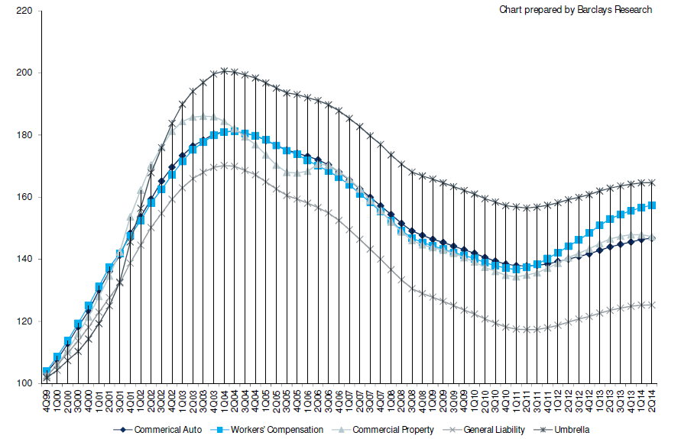
2nd Quarter 2014 Primary Market
Cumulative Quarterly Rate Increases by Line
WC is currently at 3rd Quarter 2007
And 2nd Quarter 2002 levels
Cumulative rate %Δ Since 2000
47

Slide 49
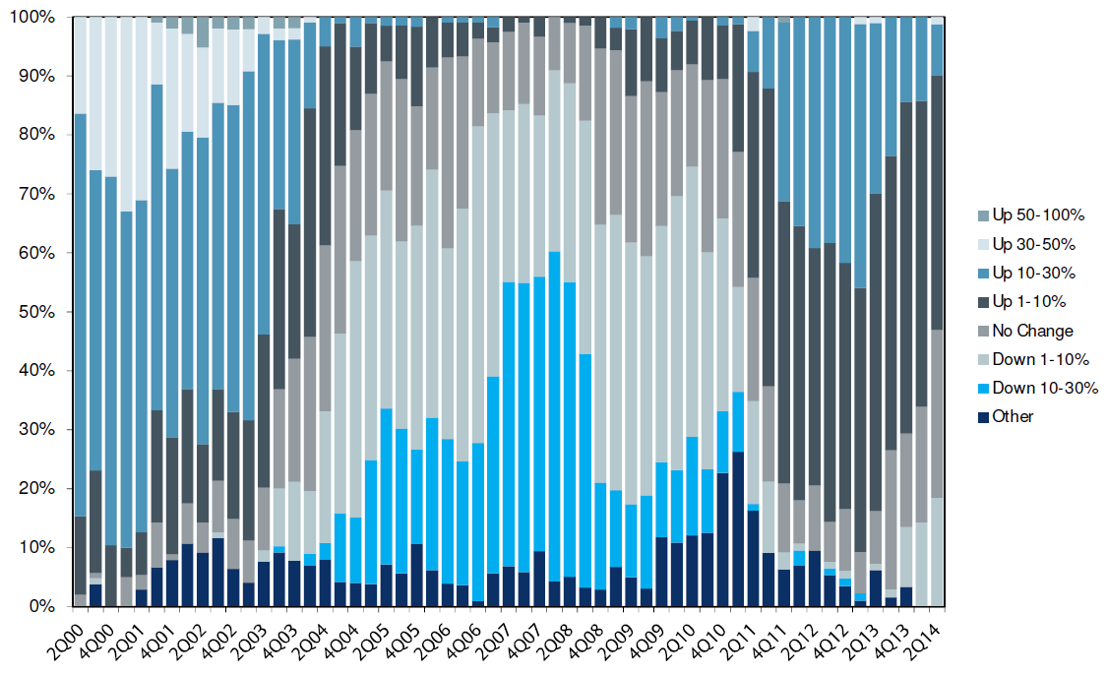
2nd Quarter 2014 Primary Market
WC Rate Increases Reported by Agents & Brokers in CIAB Survey
Over 50% reported rate increases +1% ➔ +30%
% of Survey Responders

Slide 50
July 2014 Reinsurance Market
Workers’ Compensation
Typical Price, Terms and Conditions for multi-claimant excess of loss program have improved in recent years
  Conventional weapon terrorism is included in the standard program
  Maximum Any One Life (MAOL) $10M (quotes for up to $20M bring requested)
  Ten Year Sunset
  Commutation, mutually agreeable
  96 hour “event” coverage for occupational disease
  Limited exclusions: no class exclusions, example “airlines”
Other notable enhancements (structural or otherwise):
  Aggregate Catastrophe Excess of Loss
  Multi-year coverage
  Increased MAOLs > $10M being purchased (or elimination of MAOL for $10M xs $10M)
  Incorporated pandemic coverage for WC compensable losses
  Coordinating facultative reinsurance for exposure spikes
  Flexibility terrorism coverage
    Inclusive of NBCR (or some combination); select locations only with shared limits
    Aggregate terrorism coverage to dovetail with TRIPRA

Slide 51
July 2014 WC Cat Reinsurance Renewal Recap
Subject Premium Income (YOY)
Subject base increases continued predominantly from rate increases with smaller contributions from class shift and new payroll
Many July WC Cat renewals continued to experience notable SPI increases YOY

Slide 52
July 2014 WC Cat Reinsurance Renewal Recap
Rates & Rates on Line (YOY)
Rates ROLs
Reinsurers reduced ROLs & Lower Rates corresponded with higher SPIs

Slide 53
July 2014 WC Single Claimant Exposed Reinsurance Renewal Recap
SPI & Rates (YOY)
Subject Premium Rates
Reinsurers found primary rate and subject premium increases to be adequate, leading to continued moderate reinsurance renewal rate decreases

Slide 54
Thank You
Questions?

