Slide 1
CANE – Liability and Tort Trends
Spring Meeting April 4, 2013

Slide 2
Liability Trends in Reinsurance – Retentions & Limits
Companies retaining more net.
What they are buying has changed over the past decade.
Primary Company use of quantitative analytics (aka. predictive models) for pricing and loss ratio selections is everywhere.
Limits have remained relatively static for years.

Slide 3
Liability Trends in Reinsurance – the Consequences
Severity claim inflection points will be felt by insurers more than reinsurers which is different than in the past.
For the reinsurer, because we are even further out on the tail, we expect our results to be more volatile than they were in the past.
Reinsurers are starting to experiment with the same types of segmentation models you are using.
Low interest rate environment means UW discipline is a must.

Slide 4
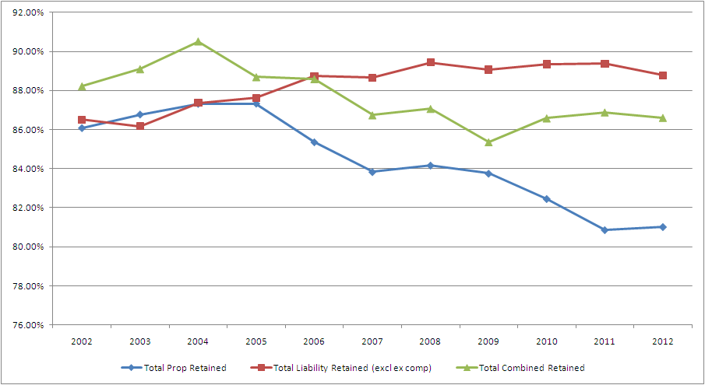
Company Retentions 2002-2012
Source: SNL Financial Annual Statement Data
Net/Direct

Slide 5
Emerging Issues
So Many Issues, So Little Time…
Cyber Attacks
Nanotechnology
3D Printing
Green Construction
Internet Communications– Personal Injury Claims
Internet Interruptions - Property Damage Claims
Fracking
Judicial Reformation of Policy Defenses
GMO’s
Food-borne Illness
BPA
Food Flavorings and Coloring Litigation
Hazardous Imported Products
C8 / PFOA
Secondhand Smoke
Endocrine Disrupters
Counterfeit / Imported Medicines
First Party Coverage for Asbestos Remediation
Legal Highs
Toxins in Personal Care Products
Climate Change
Pandemic
Healthcare Changes

Slide 6
Emerging Issues in Liability
BIG DATA –
Is the use of this data going to effect the litigation environment?
Changing standards of liability?
Will the lawyers keep pace with the change?

Slide 7
Emerging Issues in Liability

Slide 8
Analytics on actual legal expenditures -

Slide 9
Big Data and Unintended Consequences
How will data used for one reason potentially be used against a company for another?
Two examples:
Implementation of the Fair Housing Act by HUD – Final Rule went into effect March 18, 2013.
Medical Malpractice and ICD 9 codes.

Slide 10
Implementation of the Fair Housing Act by HUD
Congress enacted the Fair Housing Act in 1968 to prohibit housing discrimination based on race, religion, gender, familial status or ethnicity.
The law was an attempt to put an end to restrictions on selling homes, refusals to rent apartments, denials of mortgages, or charges of higher interest rates based on the protected classes.
The US Department of Housing and Urban Development (HUD) is tasked with enforcement.
Last summer, HUD filed a Complaint against Allstate Corp. alleging the law applied to their underwriting decision not sell to homeowners’ insurance in and around Wilmington, DE to home with flat roofs.

Slide 11
Implementation of the Fair Housing Act's Discriminatory Effects Standard
The final rule effective March 18, 2013, clarifies that the law applies to homeowners insurance.
Some commented that liability for insurance practices based on a disparate impact is inappropriate because insurance is risk-based and often based on a multivariate analysis.
One commenter wrote that “to avoid creating a disparate impact, an insurer would have to charge everyone the same rate, regardless of risk,” or might be forced to violate state laws that require insurance rates to be actuarially sound estimates of the expected value of all future costs associated with an individual risk transfer.
HUD Response: HUD believes that these concerns are misplaced.
(No Worries) § 100.500 makes clear, the respondent or defendant has a full opportunity to defend the business justifications for its policies. This “burden-shifting framework” distinguishes “unnecessary barriers proscribed by the [Act] from valid policies and practices crafted to advance legitimate interests.” [140]

Slide 12
At Least One Commentator Has Said of the Final Rule…
The practical result of this rule is that insurance companies may now face discrimination lawsuits for any statistical disparities among protected groups regardless of intent to discriminate, which in practice subjects all underwriting factors to the risk of challenge and is contrary to the entire business model for insurance.
Effectively, despite the fact that your company does not consider race, religion, ethnicity or other demographic factors in your underwriting, you could be required to justify any or all of the factors you use to price coverage if a plaintiff’s attorney can show a disparate impact on these groups.
Want to more? Go to: https://www.federalregister.gov/articles/2013/02/15/2013-03375/implementation-of-the-fair-housing-acts-discriminatory-effects-standard#h-25

Slide 13
ICD 9 Codes in Hospital Claim Data
In 2008, study commissioned by the Agency for Healthcare Research and Quality (AHRQ) on Adverse Events (AEs) that are the most significant and common sources of harm to patients.
Virtually all inpatient discharges are assigned an ICD 9 code.
Study looked at 13,695 charts containing 27,815 flagged codes from Utah and Missouri.

Slide 14
ICD 9 Codes in Hospital Claim Data
Codes bucketed into 6 major categories:
Adverse Drug Events,
Surgical Events,
Misadventures,
Device Events,
Infections,
Other Adverse Events

Slide 15
Rand’s Study
The AHRQ hired Rand Coporation and they brought it all together – malpractice liability claims and ICD-9 code data.
May 2010 Rand published the results of its study analyzing the occurrence of clinical events and patient safety.
NORCAL ,TDC, SCIPIE and Cooperative of American Physicians representing more than 50% of the physicians marketplace donated 27,000 malpractice claims.

Slide 16
Rand Study - Findings
“a highly significant correlation between the frequency of adverse events and malpractice claims: On average, a county that shows a decrease of 10 adverse events in a given year would also see a decrease of 3.7 malpractice claims. Likewise, a county that shows an increase of 10 adverse events in a given year would see on average, an increase of 3.7 malpractice claims.”
“According to the statistical analysis, nearly three-fourths of the within-county variation in annual malpractice claims could be accounted for by the changes in patient safety outcomes.”

Slide 17
Hospital Liability
Liability based on corporate negligence does not depend upon a particular relationship between the hospital or managed care entity and the physician. This duty traditionally arose from a hospital's responsibility to the general public to meet a standard of care.
The doctrine imposes a legal duty on hospitals to: (1) select and retain only competent physicians; (2) oversee patient care by all persons who practice medicine within their walls; and (3) formulate, adopt and enforce adequate rules and policies to insure quality care for patients.
Notes:
….

Slide 18
Two Minds about Trends Predictions…
Just as our present is the result of our past, so to our future will be the result of our present. Every minute of every day we are weaving the threads that will make the cloth of the future.’ — Anne Spencer Parry
OR…….
‘It’s tough to make predictions, especially about the future.’ — Yogi Berra
THANK YOU….

