Slide 1
Behavioral Economics
Sharon Tennyson, Ph.D.
Cornell University
CANE 2012 Spring Meeting
Sturbridge, MA April 2

Slide 2
Agenda
Research themes in behavorial economics
Research applications to insurance markets
Practical applications to insurance markets
…not necessarily in this exact order

Slide 3
Are Consumers “Rational”?
Rational economic model of consumer decisions under uncertainty over time:
  Make consumption choices (x_{t}) to maximize the discounted sum of Expected Value of Utility EU(x_{t}) subject to a set of resource constraints (y_{t})
    Max EU(x_{t}) = ∑r_{t}p_{t}U(x_{t})
      Consumers have consistent preferences [U(.)]
      Consumers have rational beliefs about p_{it}
      Consumers expectations are stable or Bayesian-updated
      Consumers discount at a constant rate over time
      Consumers are risk-averse

Slide 4
Behavioral Economics
The use of social, cognitive and emotional factors in understanding the economic decisions of individuals and institutions
Early work focused on identifying anomalies (departures from rational model)
  There is ample and growing evidence that rational decision theory in economics does not capture many important aspects of consumer decision-making
Field has progressed a great deal
  Theoretical modeling (formalization)
  Empirical testing

Slide 5
Areas of Research
  Non-standard discounting
    Myopia and impatience
  Non-standard beliefs or expectations
    Probabilities and forecasts
  Non-standard decision-making
    Cognitive limitations
  Social and psychological mediators

Slide 6
Nonstandard Discounting
A “self-control” problem can lead to short-term or impulsive decisions that you later regret
  Self-control problems can be conceptualized as discounting more steeply in the immediate future
Economically “rational” discounting assumes an exponential discount function
Time-inconsistent discounting incorporates a hyperbolic or quasi-hyperbolic discount function
  Value of consumption in the near future is discounted sharply relative to consumption today
  Value of consumption in the distant future is not discounted sharply relative to consumption in the nearly-distant future

Slide 7
Discounting the future
Exponential discounting
  D_{r} = 1/(1+r)
Quasi-hyperbolic discounting
  D_{h} = b/(1+r) where b lies between 0 and 1
Discounted value
Exponential
(rational)
Hyperbolic
(myopic)
Time

Slide 8
Self Control Problems
Self control problems arise when the immediate payoff from a decision is negative but the long term payoff is positive
  Saving (impulsive credit card use)
  Eating (health, obesity)
  Exercising (health, obesity)
  Financial planning (retirement security)
  Insurance purchase (risk security)

Slide 9
Example
Suppose the immediate payoff from healthy diet is -5 today and the delayed payoff is +10 next period
Consumer’s discount rate r=0.10
Consider a “rational” discounter:
  The consumer’s discount rate is 1/(1.1) = .9091
  Choose the healthy food if -5 + (.9091)(10) > 0
  = 4.09 => Eat healthy food!
Consider a discounter with “impatience constant” = 0.5:
  The consumer’s discount rate is .5/(1.1) = .4545
  Choose the healthy food if -5 + (.4545)(10) > 0
  = -0.45 => Eat what you want today!

Slide 10
Example, cont.
Why is this a “self control” problem?
  Rational economics assumes that consumers make decisions by Max EU(x) = ∑r_{t}p_{it}U(xit)
If the “impatient” consumer could make a choice for himself in a forward-looking manner (e.g. at t=0) to maximize the sum of discounted utility across both periods he would choose the healthy food:
  Deciding at t=0, choose healthy food if
  (0.5/1.1)(-5) + (0.5/1.1)²(10) > 0
  0.4545(-5) + 0.4132(10) = -2.2725 + 4.132 = 1.857

Slide 11
Nonstandard Expectations
Non-Bayesian Updating:
  An earlier literature has shown that consumers tend to overweight priors or overweight new information – depending on emotional context
Projection Bias:
  Consumers expect future preferences or states of the world to be closer to their present ones than they will actually be

Slide 12
Projection Bias
Projection bias can be modeled as a failure to fully update “tastes” in a model in which utility can be written as u(c,s), where c is consumption and s is a “state” that parameterizes tastes
  the person’s prediction of her own future preferences, u˜ (c,s) lies somewhere “in between” her true future tastes u(c,s) and her current tastes u(c,s’)
Projection bias can lead to dynamic inconsistency

Slide 13
Projection Bias Examples
Example: Food choice experiment
Subjects are either given a snack or not given a snack while performing an experimental task
All subjects are offered a choice of a filling snack or fruit, to be delivered in one week
  Subjects who are hungry today are nearly twice as likely (78% to 42%) to choose the filling snack
Example: Catalog orders
Consumers are more likely to order cold weather wear during fall cold snaps than during warmer weather
  Orders of cold weather wear made during cold snaps are more likely to be returned later
Notes:
13

Slide 14
Nonstandard Decision Making
Limited Attention
  Some elements of a decision may not be as easy to observe and will receive less attention
Menu Effects
  Individuals who face a large set of choices face difficulties in choosing optimally
These effects can be modeled as arising from fixed resource limits on attention or mental processing capacity: individuals must choose to allocate

Slide 15
Limited Attention Examples
Inattention to shipping costs (online purchases)
  Studies of consumer purchases online show that consumers make decisions based on quoted price of good, not full price including shipping (which is revealed later)
Inattention to complex information (disclosures)
  Studies of hospital and college rankings reveal that nominal rankings (#1, #2, etc) are important even if the detailed scores suggest little difference between the differently ranked institutions

Slide 16
Menu Effects
Choice Avoidance
  Enrollment in employee retirement savings programs most likely with only 2 fund choices and declines with the number of choices
Status quo bias
  Enrollment rates are much higher when default is that new employees are enrolled than when default is non-enrollment
  Many employees keep their funds invested in the default option chosen by the employer

Slide 17
Other Menu effects
Preference for the familiar
  Brand loyalty
  Familiar looking packaging
Preference for the salient
  Order of listing on a ballot affects vote percentages
  When presented with ordered choices consumers often choose the “middle” one
Stress, delay in choosing

Slide 18
Implications for Markets
Consumers may make systematic and predictable “mistakes” in consumption choices
Firms may profit from learning about common consumer “mistakes”
  Taking advantage
  Improving

Slide 19
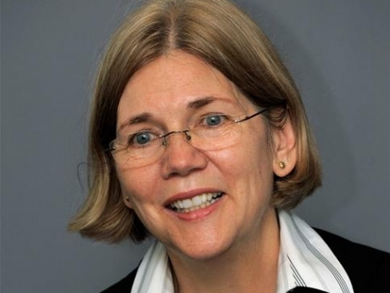

Cautionary Tale
“Today, few of us seriously believe that we have the marketplace that American families deserve … fine print can obscure important information, and complex terms can confuse even the most diligent consumers. The lender that wins a customer’s business in this market isn’t always the one that offers the product that best matches the consumer’s needs and preferences.”

Slide 20
Social and Psychological Mediators
Personality characteristics have predictive effects on some behaviors
  Impatience
  Cognitive limits
Social context has mediating effect on behaviors
  Herding and first-movers
  Social networks and social norms
    Not necessarily efficiency enhancing

Slide 21
Consumer Ethics
  In consumer surveys, a consumer’s attitude toward various forms of dishonesty are strongly related
    Insurance claims fraud; underreport income on taxes; remove a quality towel from a hotel; lie on a resume´
  In experimental settings, even people who view themselves as honest often cheat
    Cheating is usually by small amounts
    Cheating is more likely if no detection method is apparent
    Cheating is less likely if ethical reminders are given

Slide 22
Social Norms
  In experimental settings, people are more likely to choose a cooperative action if others have cooperated in earlier rounds
  In experimental settings, people are more likely to cheat if they observe someone else cheating
    Only if the person is perceived as “in-group”
    “Out-group” cheaters reduce cheating by others

Slide 23
Research on Insurance
Insurance is a natural setting in which to test behavioral economics
Earlier research tended to use experimental methods or aggregated data on insurance ownership or claims
Recent research adds individual-level data on choices and behaviors
  Insurance purchase
  Choice of contract features
  Contract cancellation
  Claiming behavior

Slide 24
Insurance Ownership
Catastrophe insurance
  Analysis of individual data shows more conformity to economic principles than may have been expected
  However, unobserved individual heterogeneity is important
    Personal risk attitudes appear to be an important element in demand variation (Petrolia 2010)
    Risk awareness appears to be important (Knoller 2011)

Slide 25
Deductible Choice
Research deductible choice (across multiple contracts) show that risk preferences are not stable across contexts (Cohen and Einav 2007, Barsyghian et al 2011)
Unobserved individual heterogeneity appears to explain some differences in preference stability (Anderson and Mellor 2009)

Slide 26
Claiming Behavior
Consumer surveys show that the size of deductible reduces perceptions of the fairness of the insurance arrangement and therefore increases the acceptability of claim build-up (Miyazaki 2009)
Estimates using individual data show that in Canadian auto insurance a deductible increase from $250 to $500 increases the average claim by 14.6%-31.8% (Dionne and Gagné 2001)

Slide 27
Claiming Behavior
Experiment: subjects pay an insurance premium to a pool; may report a loss (0, low, high); return = individual + share of pool at end of 5 rounds (Lammers and Schiller 2010)
  If individual payout from pool includes a deductible, over-reporting of loss is significantly more likely than if full payment contract
    Deductibles are perceived as “unfair”
  If individual payout from pool includes a bonus-malus scheme for future claims, reporting of loss in last period is not significantly different than if full payment contract

Slide 28
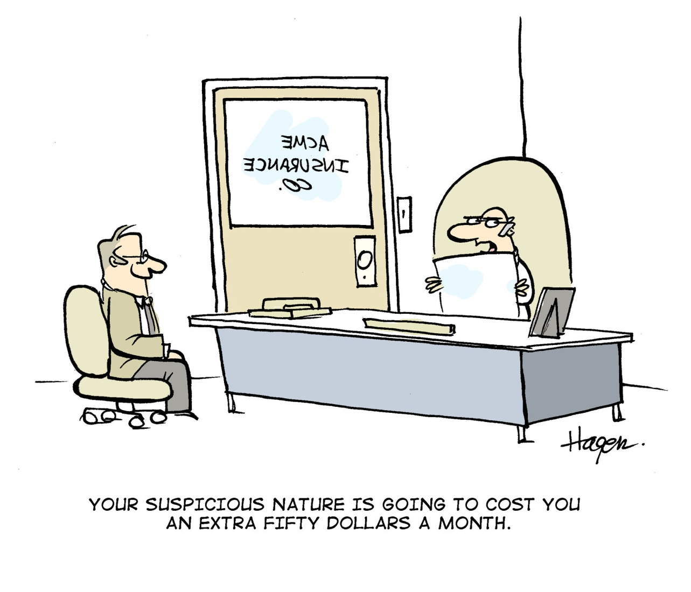
Other Applications
Underwriting cycles
Why are credit scores pertinent?
Pricing models
  Demand elasticity
  Contract form

Slide 29
Further Reading
Andersen, Lisa and Jennifer Mellor, Are risk preferences stable? Comparing an experimental measure with a validated survey-based measure, Journal of Risk and Uncertainty 39, 2009: 137-160
Barseghyan, Levon, Jeffrey Prince, and Joshua C. Teitelbaum, Are Risk Preferences Stable across Contexts? Evidence from Insurance Data, American Economic Review 101, 2011: 591–631
Cohen, Alma, and Liran Einav, Estimating Risk Preferences from Deductible Choice, American Economic Review, 97(3), 2007: 745–88
Lammers, Frauke and Jörg Schiller, Contract design and insurance fraud: an experimental investigation, Discussion paper 19-2010, Universitat Hohenheim, Stuttgart Germany
Petrolia, Daniel P., Craig E. Landry and Keith H. Coble, Risk Preferences, Risk Perceptions, and Demand for Flood Insurance, 2011, http://papers.ssrn.com/sol3/papers.cfm?abstract_id=1843326
Miyazaki, Anthony, Perceived Ethicality of Insurance Claim Fraud: Do Higher Deductibles Lead to Lower Ethical Standards? Journal of Business Ethics, 87(4), 2008: 589-598
Schwarcz, Daniel, Insurance Demand Anomalies and Regulation, Journal of Consumer Affairs 44(3) 2010: 557-575
Shapira, Zur and Itzhak Venezia, On the Preferences for Full-Coverage Policies: Why Do People Buy Too Much Insurance? Journal of Economic Psychology, 29 2010: 747–761
Sydnor, Justin, (Over)insuring Modest Risks, American Economic Journal: Applied Economics, 2(4), 2010: 177–99

