Slide 1
Casualty Actuaries of New England
Meeting of April 2, 2012
Emerging Risks –
Knowns and Unknowns
Alan D. Roth, Ph.D.
Chief Risk Officer,
Advanced Fusion Systems, LLC

Slide 2
ELECTROMAGNETIC
PULSE

Slide 3
Three main sources
The Sun – a certainty (99.9%?)
A nuclear blast – possible (50%?) & devastating
A non-nuclear strike – very likely (75%?) and near-term

Slide 4
Let’s take a look at the sun.
You don’t need to put on sunglasses for this.

Slide 5
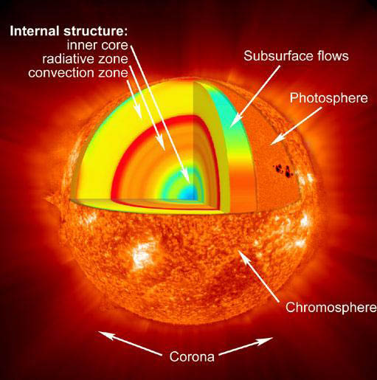
What causes the Sun to behave the way it does?

Slide 6
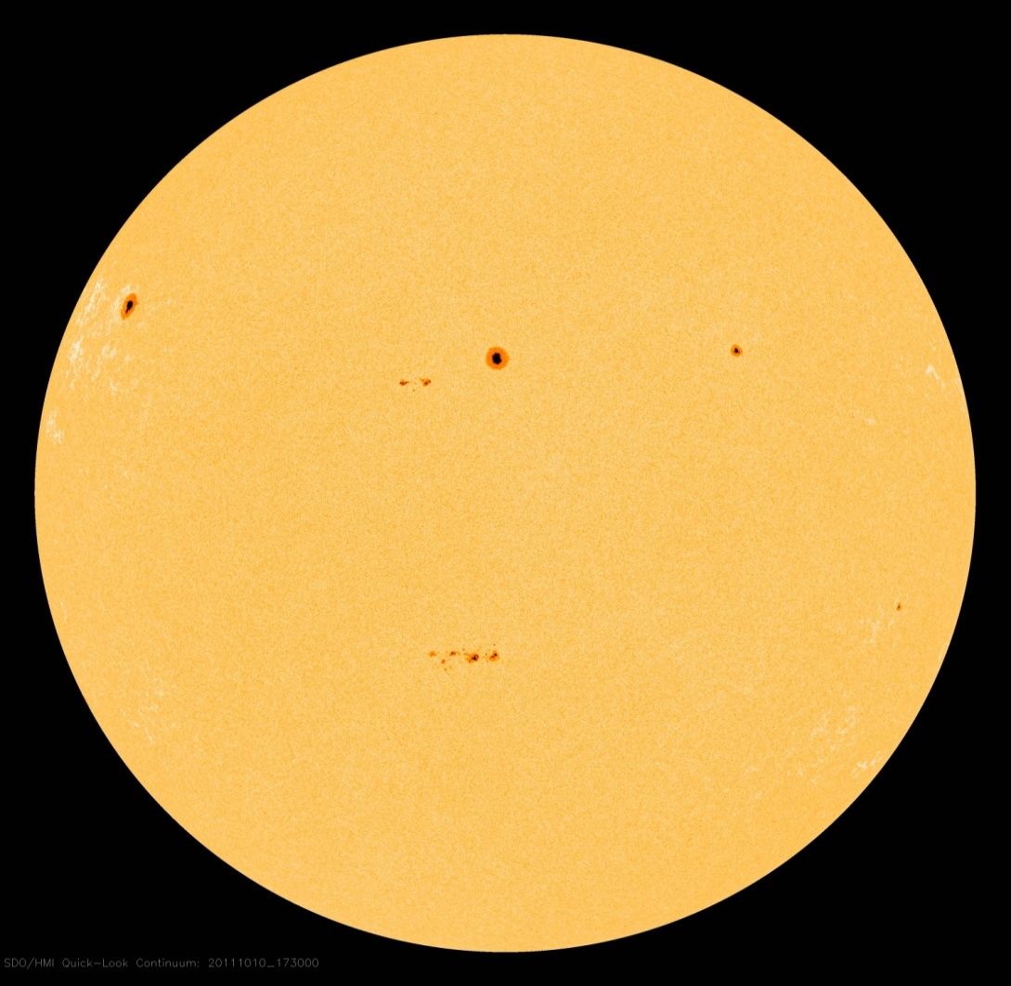
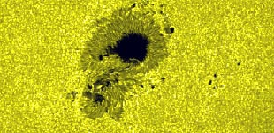
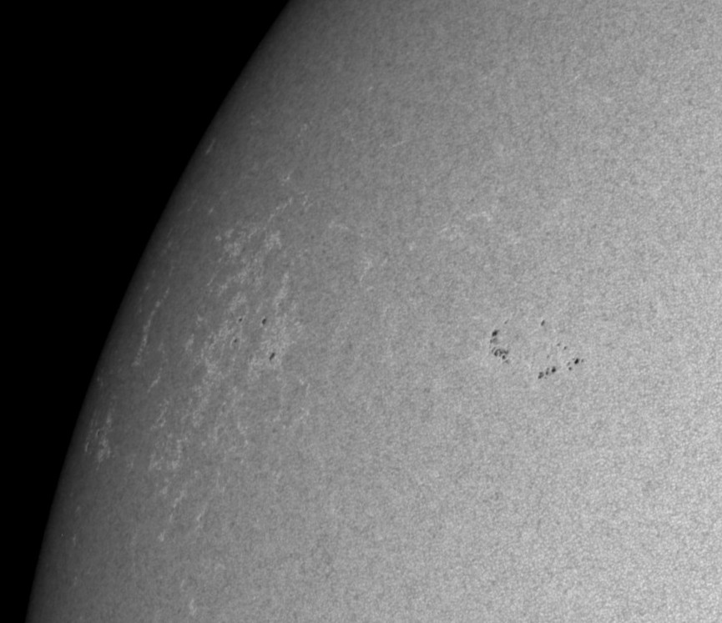
Sunspots

Slide 7
Sunspots
Sun has an 11-year cycle of sunspot activity
Currently it is Cycle 24 which follows a very deep minimum and is expected to peak in 2013.
Sunspots are very active areas on the Sun’s surface where there are often solar flares and the launching of coronal mass ejections (CMEs)

Slide 8
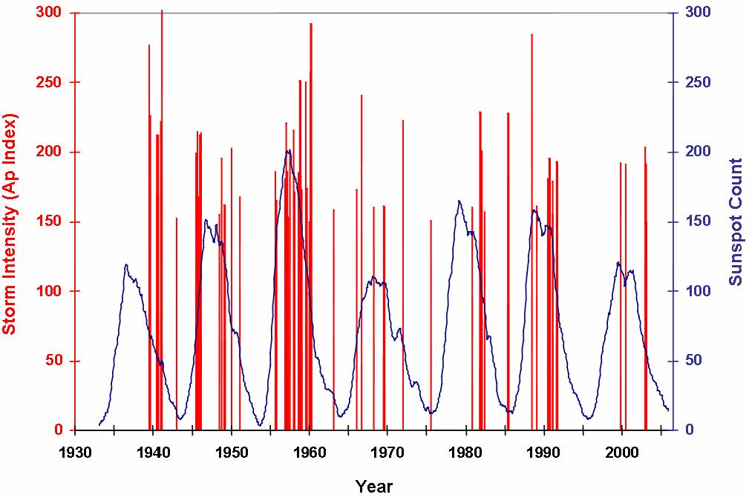
Geomagnetic Storms during solar cycles
Vertical red lines show timing and intensity of storms.
Only occasionally do they coincide with solar maximums.

Slide 9
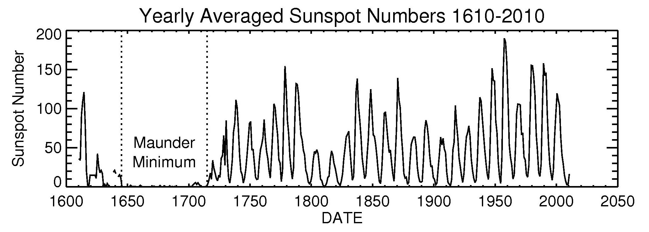

Slide 10
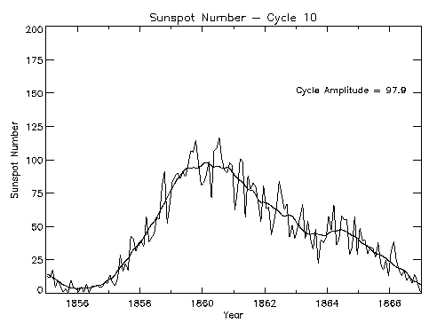
The Carrington Event of 1859 in Cycle 10
Not even 100 sun spots at peak that year
http://www.ips.gov.au/Educational/2/3/1

Slide 11
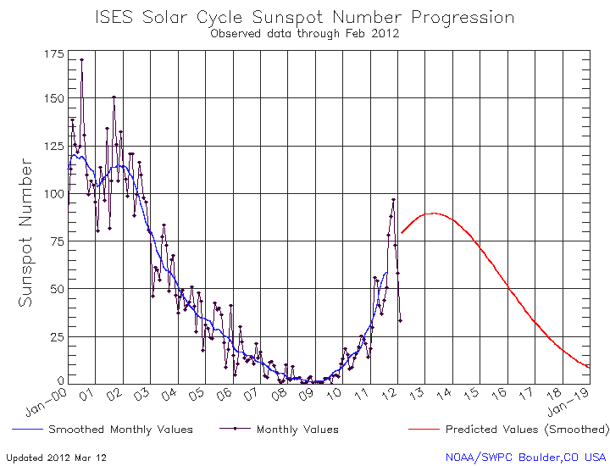
The recent long, deep solar minimum lasted almost two full years 2008-09
This last happened in 1912-14
http://www.swpc.noaa.gov/SolarCycle/

Slide 12
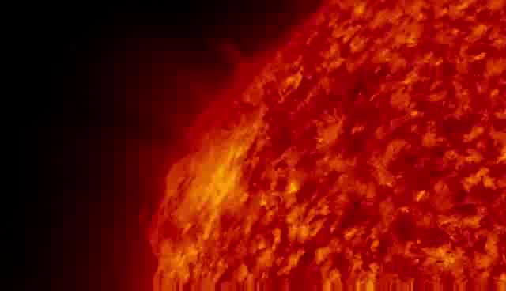
A Solar Flare (video repeated)

Slide 13
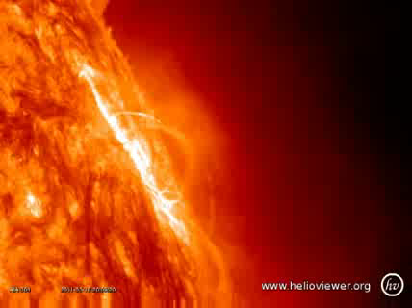

Slide 14
Solar Flares
Solar flares generate radiation storms that affect satellites. They arrive in about 17-19 minutes. This is not well known. Confusion with CMEs.
Because the Sun revolves, the radiation storms come from the left side of the Sun.
NOAA provides radiation storm alerts for major GPS users, managers of communications satellites and airlines.

Slide 15
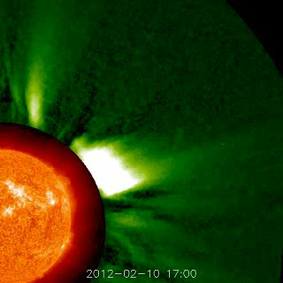
Coronal Mass Ejection (CME)

Slide 16
These CMEs are dangerous events
They reach the earth in 1 to 4 days.
They need to be fired directly at us (with help of the solar wind).
They need to have the correct north/south orientation.
We know if the conditions are right for a major geomagnetic storm only about 17 to 20 minutes ahead of its arrival.

Slide 17
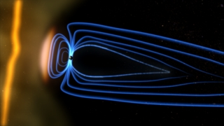
Coronal Mass Ejection meeting the earth’s geomagnetic field
The small dot in the light blue area is the earth. The blue lines represent the earth’s geomagnetic field. http://svs.gsfc.nasa.gov/vis/a010000/a010100/a010104/index.html

Slide 18
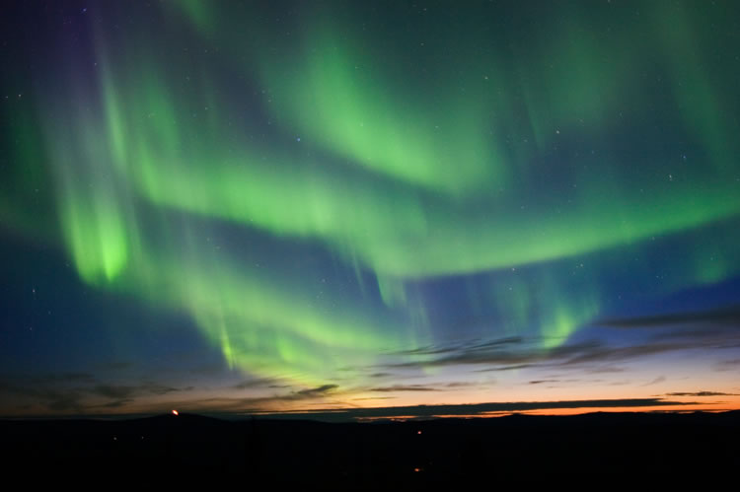
Aurora Borealis – Northern Lights k
Photo: http://geology.com/nasa/aurora-borealis.shtml

Slide 19
There have been many geomagnetic storms
The online Operations Manual of the North American Electric Reliability Corporation (NERC) cites geomagnetic storms of 1957, 1958, 1968, 1970, 1972, 1974, 1979, 1982, and 1989 as causes of major power system disturbances.
The last geomagnetic storm that had serious damaging effects was 2003.

Slide 20
We have become more and more vulnerable to solar activity
As our electric grid technology improves to give us better, more efficient service, the grid becomes more vulnerable to geomagnetic storms.
We depend on electricity for so many things that would no longer be available.
What specifically would not be available?

Slide 21
The Carrington Event of 1859 and the Geomagnetic Storm of 1921 are considered 100-year events.
NASA scientists tell us
the next big one is due.
The question is not “if” but “when”.

Slide 22
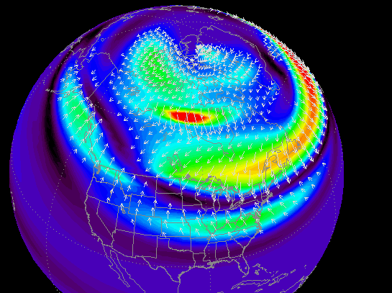
Electrojets of the 1989 Storm

Slide 23
Impact of the 1989 storm
Coronal mass ejection was launched on March 9, 1989. It reached earth 3 ½ days later.
It was manifested by a ground induced current (GIC) that coupled with transmission lines.
The greatest impact was the outage of the Quebec Province electric grid for 9 hours.
One large transformer was destroyed (cooked) at the Salem nuclear plant in New Jersey.

Slide 24
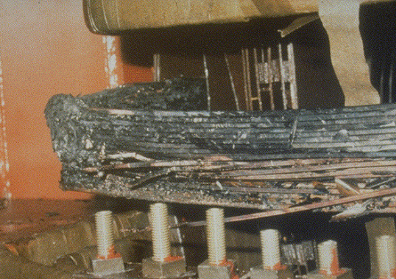
Damage from 1989 storm
Part of the cooked transformer
Kappenman, Geomagnetic Storms and Their Impacts on the U.S. Power Grid
Prepared for Oak Ridge National Laboratory, January 2010, p. 2-29

Slide 25
Damage from 1989 storm cont’d
Within 2 years after the March ’89 exposure, 11 nuclear plants noted failures of large transformers, in addition to the Salem failure.

Slide 26
Power Grids should expect Storms 4 to 10 Times More Intense than the March 1989 Storm and to extend much further south.

Slide 27
But less destruction is more likely
We can recover from a moderate or indirect hit. But we may need to get through some weeks or some months. Those who prepare will be the most likely to regain operations.

Slide 28
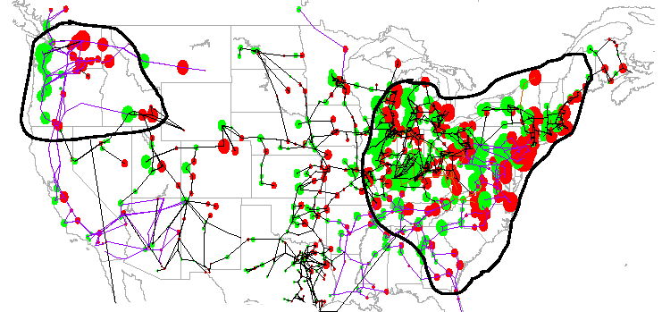
Power System Disturbance and Outage Scenario of Unprecedented Scale
Areas of Probable Power System Collapse
Impacted Regions involve population of >130 Million
John G. Kappenman, Storm Analysis Consultants, October 2010

Slide 29
THE NUCLEAR BLAST

Slide 30
High Altitude
(Nuclear) EMP
= HEMP

Slide 31
First example of HEMP was 9 July 1962 – Starfish Prime
The nuclear pulse reached Honolulu 898 miles from the detonation point. Burned out 300 street lights and triggered many burglar alarms. Some hotels had “Rainbow Parties” watching the aurora.
Today’s nuclear devices can be made to maximize the electromagnetic pulse.

Slide 32
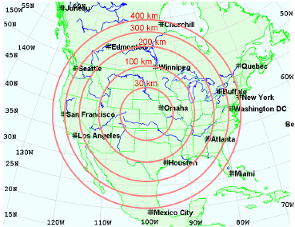
HEMP Exposed Area for Height of Blast

Slide 33
Electric Grid Consequences
The pulse has 3 parts: E1, E2 and E3
E1 will damage electronic gear including protection devices.
E2 will saturate the core of transformers and generators.
E3 will burn up the transformers and generators.
Nuclear cooling systems will not function.
Back-up generators will not function.
Degree of dysfunction will vary for many reasons.

Slide 34
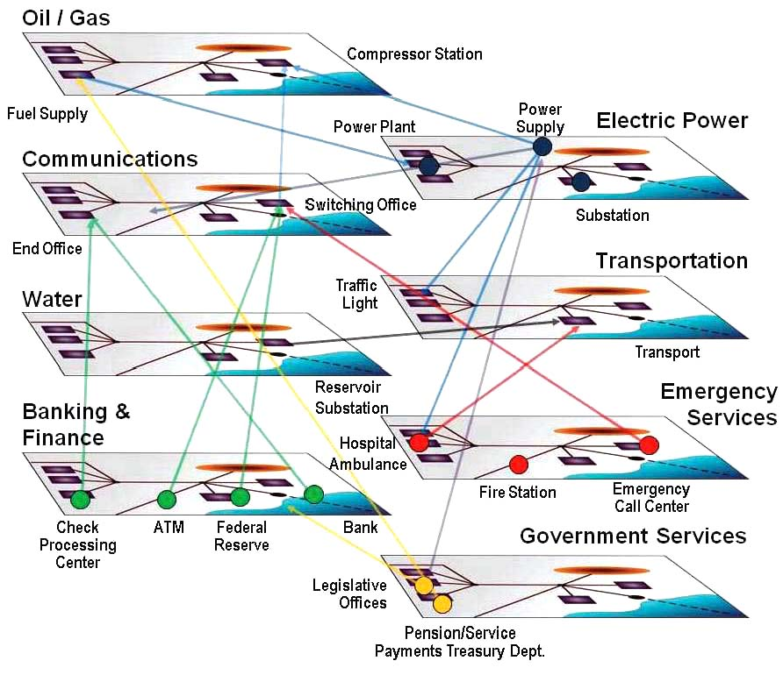
Interconnectedness

Slide 35
NON-NUCLEAR EMP
(NNEMP)

Slide 36
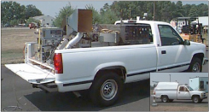

EMP Generators

Slide 37
NNEMP may be the greatest most immediate threat.
An EMP generator can fit inside a van and can destroy an electrical substation from the road.
It is not difficult to get parts for it and make it.
It can be 5 times stronger than a nuclear blast.
The van then drives to other substations unnoticed. We wouldn’t know what hit us.

Slide 38
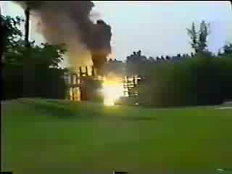
Attack on Transformer
This shows what could happen after an
NNEMP strike (video is not from an NNEMP)
Example is a
3 MVA-rated
Transformer.
It could just as well have been a
200 MVA-rated
Transformer.

Slide 39
Tasks that are needed now
Educate others about this threat and the need for priority attention.
Determine what is needed to manage a week or more and then a month or more without electricity. This is not easy. There are many websites that can help.
Plan what to do when satellite malfunction causes a loss of communications or GPS service.
Water, food, medical supplies, and other basics can be stored. Plan for this and start storing.
Steuben Foods in Elma, NY provides an example.
www.steubenfoods.com

Slide 40
More tasks
Back-up generators and fuel need to be in place.
Speak with your utilities to see what their plans are. Work with them. Encourage them.
Investigate preparations at all of your locations and along your supply chains.
Plan strong protection for storage depots.
Consider renewable energy options.
Insurers need to consider what risks can be transferred. Actuaries will struggle.

Slide 41
Solutions are coming
Devices to counter the EMP pulse at key locations are on the drawing board and may start to be available as early as the end of this year.
Websites of value:
www.empactamerica.org
www.eiscouncil.org
www.empcommission.org

Slide 42
Climate Change: Is it Real?
What do you think?

Slide 43
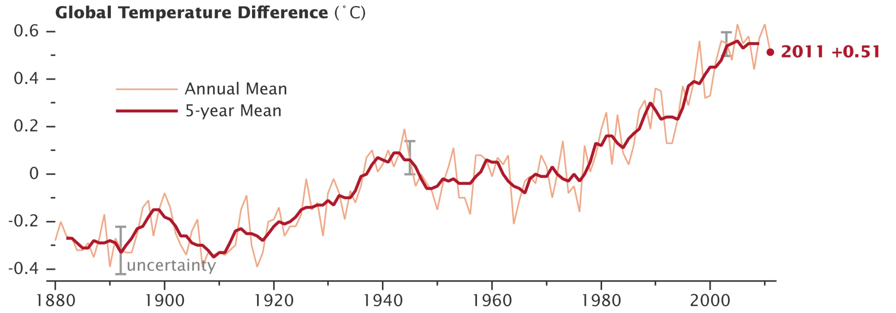
NASA SHOWS IT’S HAPPENING

Slide 44
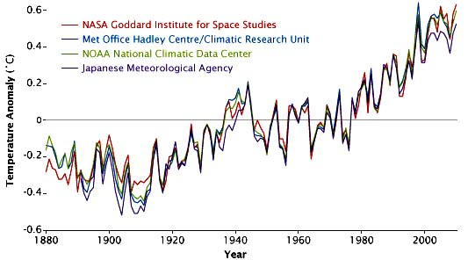
But it’s not so simple!

Slide 45
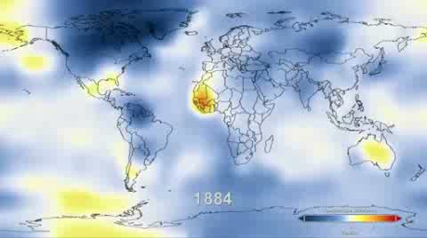
Where? – is also important!
We need to consider:
Pacific Decadal Oscillation
North Atlantic Oscillation
Southern Oscillation: El Niño and La Niña

Slide 46
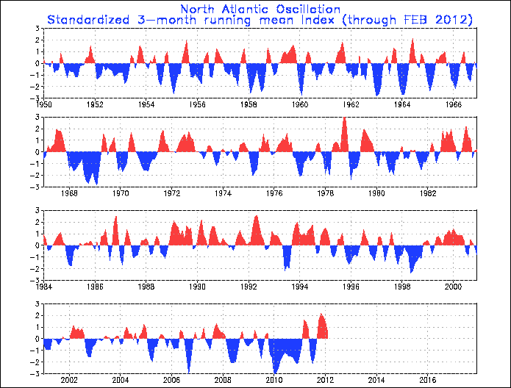
NOAA: North Atlantic Oscillation

Slide 47
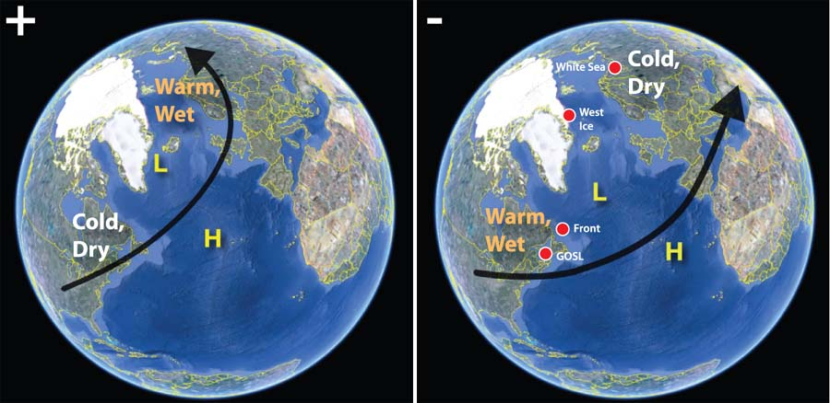
NOAA: North Atlantic Oscillation

Slide 48
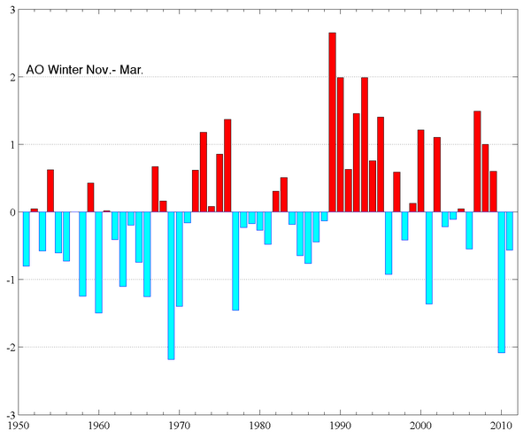
Arctic Oscillation
The state of atmospheric circulation over the Arctic.
Red is low pressure, blue is high pressure.
Influences weather patterns at lower latitudes.

Slide 49
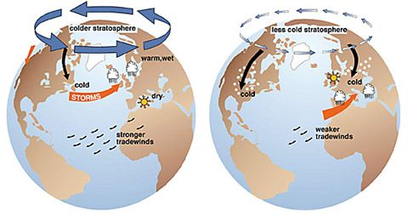
ARCTIC OSCILLATION
Effects of the Positive Phase | Effects of the Negative Phase of the Arctic Oscillation of the Arctic Oscillation

Slide 50
While we know the earth is getting warmer, we don’t understand climate change impact well enough.
Where? When? How much?
How fast could it really change?

Slide 51
Abrupt Climate Change 23 Times!
Courtesy Richard B. Alley
The Two-Mile Time Machine, Princeton University Press, 2000, p. 117

Slide 52
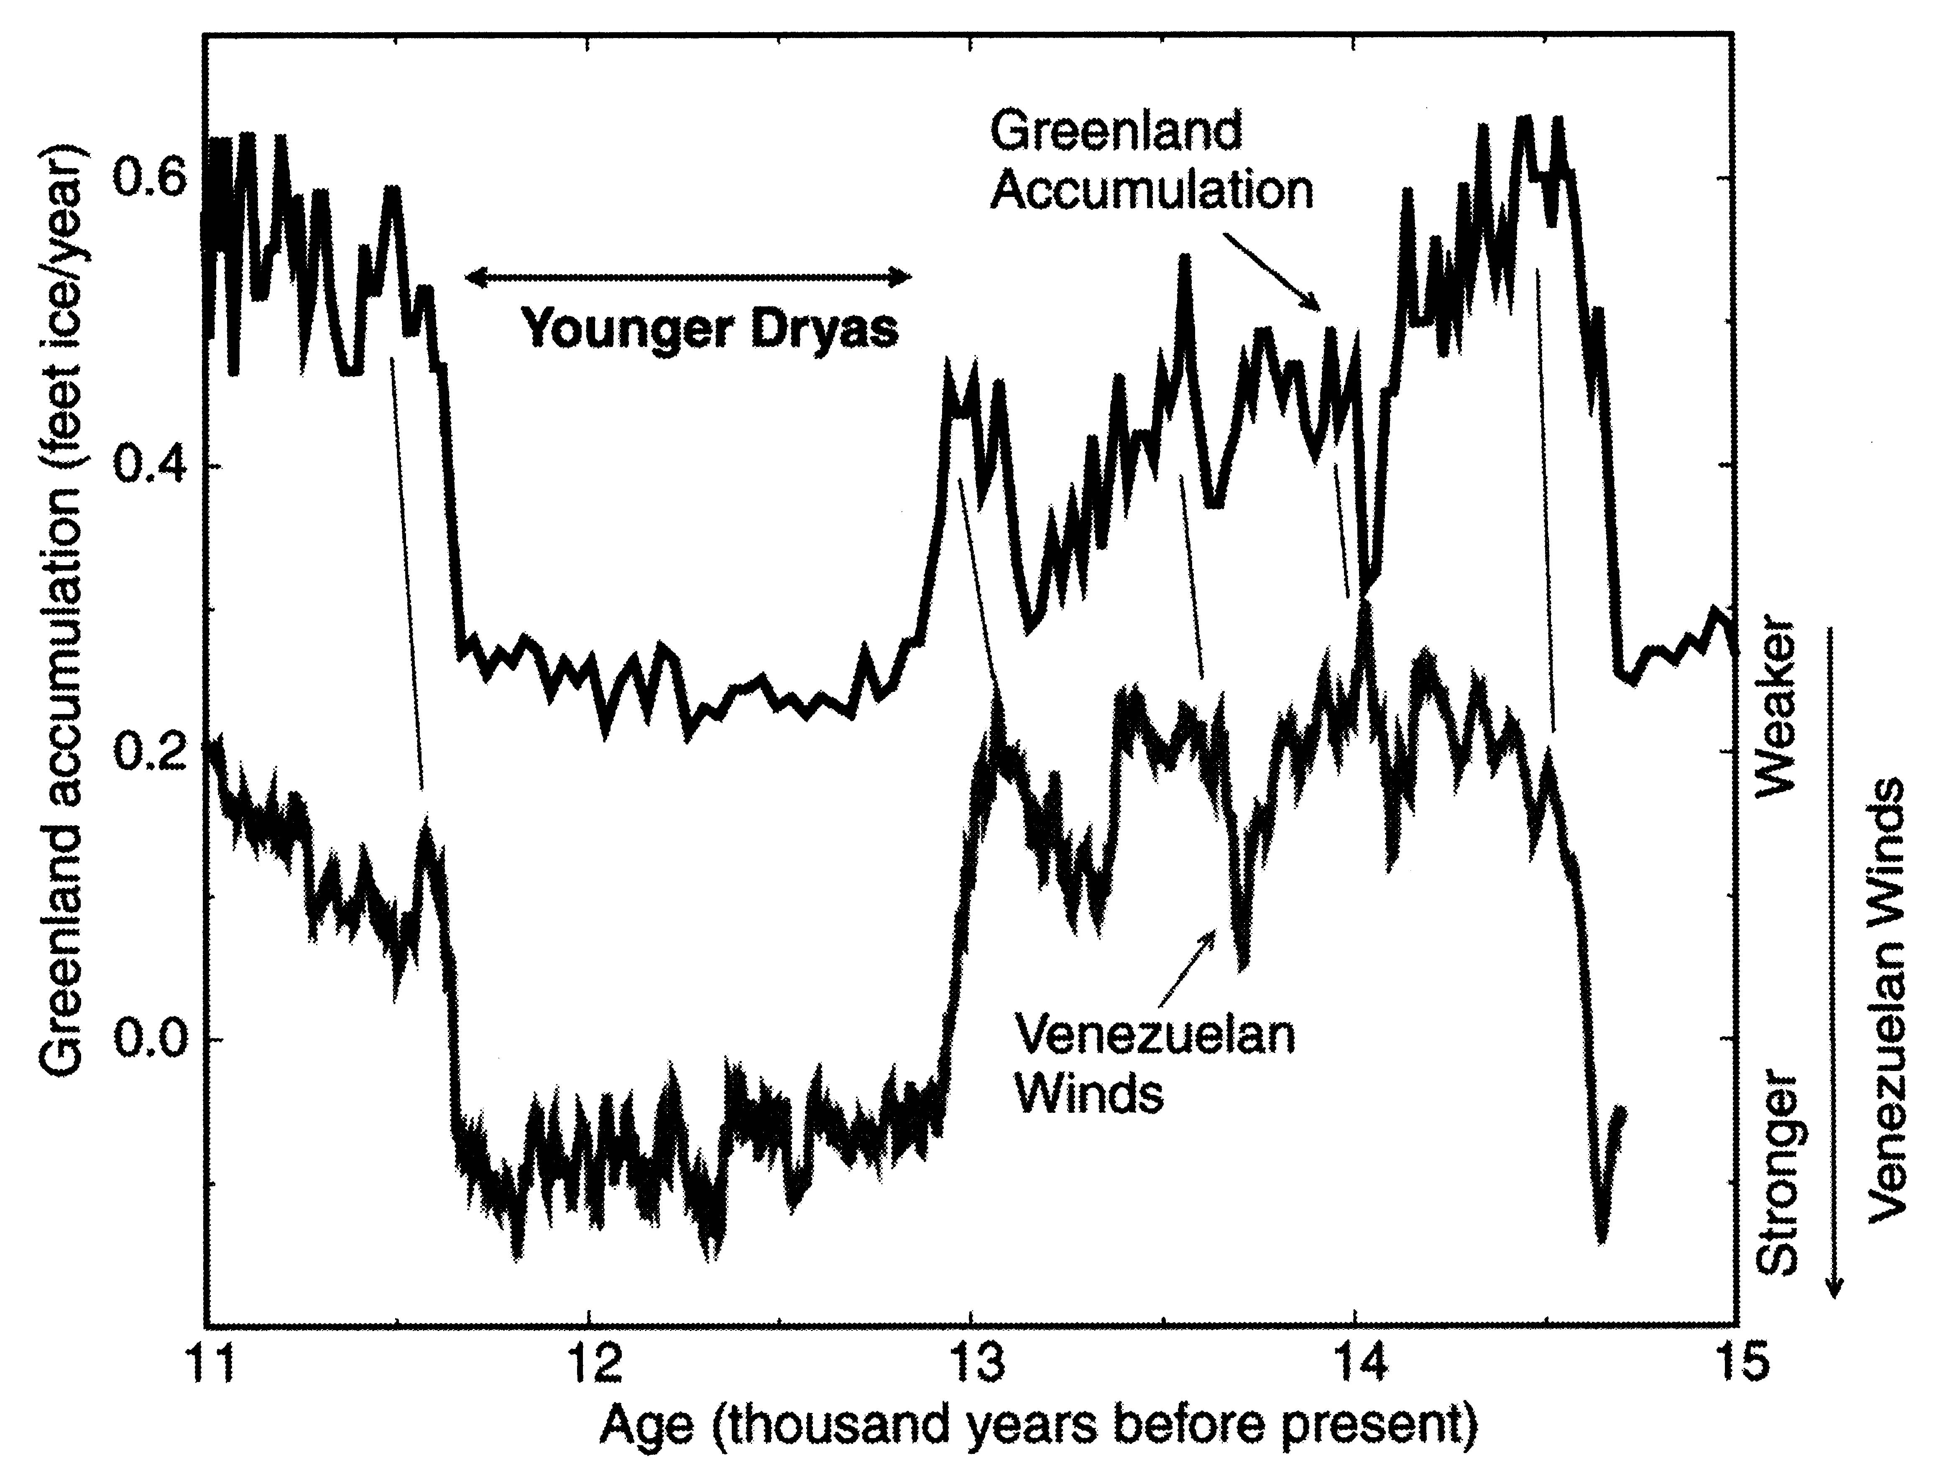
The Same Pattern
Seen in Venezuelan Winds
Courtesy Richard B. Alley
The Two-Mile Time Machine, Princeton University Press, 2000, p. 117

Slide 53
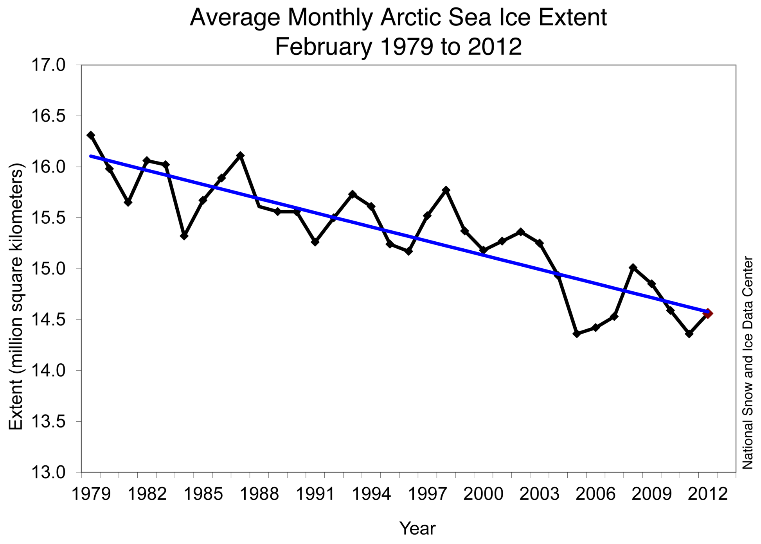

Slide 54
The Threat of the Permafrost
Continuous permafrost covers about 11 million square kilometers.
The top 3 meters contains about 1 trillion tons of carbon.
90% of the continuous permafrost is expected to thaw down to 3 meters by the end of the century.
That will cause the emission into the atmosphere of about 500 billion tons of methane.
Methane is 100 times more powerful than CO₂ when it is first emitted.
This together with the unexpected heat from the Arctic Ocean could be the tipping point to abrupt change.

Slide 55
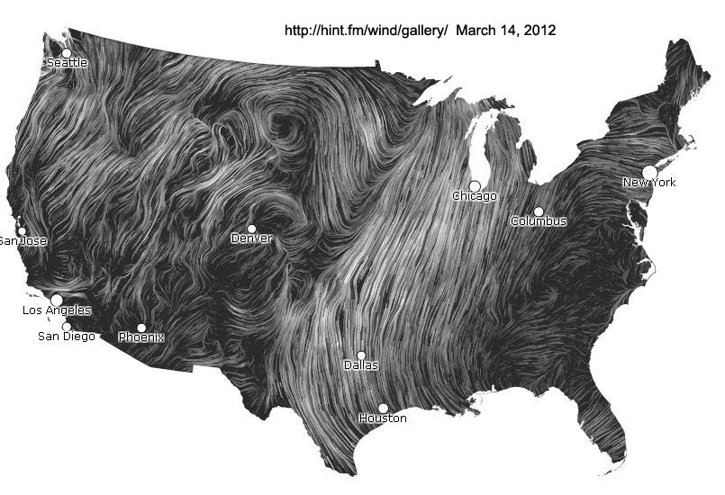
New Tool to See Winds

Slide 56
Water
Scarcity

Slide 57
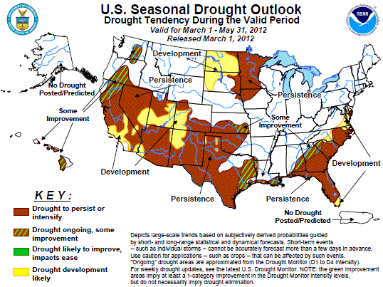

Slide 58
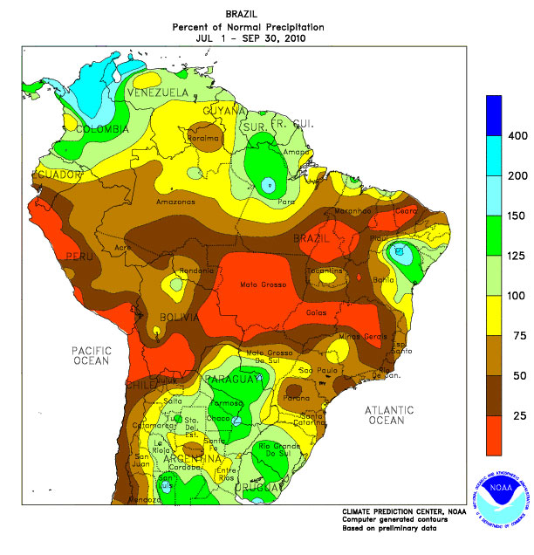
3rd Extreme (100-year) Drought in Brazil in 15 Years

Slide 59
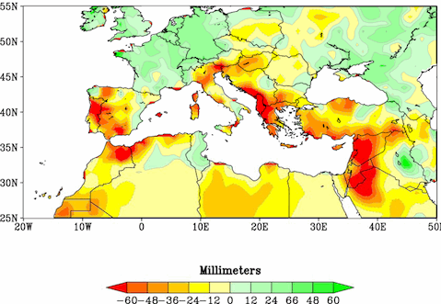
NOAA: Reds and oranges highlight lands around the Mediterranean that experienced significantly drier winters during 1971-2010 than the comparison period of 1902-2010.

Slide 60
Water scarcity problems are widespread
“Danube is at near record lows.”
Parts of UK had driest 12 months since records began in 1910.
Northern China including Beijing is plagued by water shortages.
“Drought turns southern China into arid plain”
“Russia counts the cost of drought and wildfires”
“Severe drought threatens millions in Somalia”
“Yemen’s capital will run out of water by 2025”
“Drought May Threaten Much of Globe Within Decades”
“Land ‘evapotranspiration’ taking unexpected turn: Huge parts of world are drying up”
“80 Percent of Global Water Supplies at Risk”
“Groundwater depletion rate accelerating worldwide”

Slide 61
Water scarcity is a problem in our oceans!
The scarcity of good water.
Water water everywhere and…………….
no oxygen to breathe!
Hypoxic “dead” zones are increasing due mainly to fertilizer runoff. A good map of dead zones: http://www.wri.org/project/eutrophication/map
Warmer oceans and increasing acidity adversely affect the bottom of the food chain.
For many reasons, the future of seafood is bleak.

Slide 62
Two huge dustbowls are forming
One is across NW China, western Mongolia and central Asia.
The other is central Africa.
Each dwarfs the U.S. dustbowl of the 1930s.

Slide 63
Half the world’s population live in countries with falling water tables including India, China and the U.S. (the vast Ogallala aquifer).
A serious example: 175 million Indians are fed with grain produced from irrigation wells that will soon go dry.

Slide 64
The Fouling of Water
This is a worldwide problem of a high order. Many major rivers are heavily polluted.
In the U.S., will hydraulic fracturing poison groundwater? The jury is still out on that.
What are tar sands and what is the problem with the KK Pipeline?

Slide 65
FOOD
SCARCITY

Slide 66
Problems with livestock
High consumption of grains increases demand for scarce crops. ~7 lb. of grain produce 1 lb. of meat.
Cause clearing of forests and natural grasslands for grazing.
Represent 14.5% of total GHGs, more than transportation sector.
Crowded planet with rising middle class increases demand for livestock products.

Slide 67
Biofuels compete with food
In 2009, biofuels used 119 million tons of grain, enough to feed 350 million people.

Slide 68
Climate change affects irrigated rice yield
While higher daytime temperature increases yield, higher night-time temperature decreases yield even more.
Yield has already dropped 10-20% over the past 25 years.
Land is scarce and the population growth is overwhelming.
Corn and soybeans are also at risk with temperature rise.

Slide 69
Extreme weather events destroy crops
Add major flooding to the problem of droughts.
We’ve seen disastrous, historic flooding in many countries in 2010 and 2011 including the U.S. Just in 2011, historic flooding in:
Europe (numerous countries), Australia, Thailand, Pakistan, China, Columbia, Canada, Bolivia, Brazil, Sri Lanka…..heavy flooding in many others.

Slide 70
Climate change affects seasons
The timing of rain is critical for plant growth. Many areas now have experienced changes in the onset of wet and dry seasons, reducing crop yields.

Slide 71
More fertilizer is needed to increase yield!
But fertilizer produces nitrous oxide, a potent greenhouse gas!

Slide 72
Other natural enemies
The phorid fly is killing off honey bees.
Bats are disappearing due to fungus.
Wheat rust Ug99 is moving around the globe.
A microscopic fungus is affecting cattle.
Roundup’s gyphosate could be irreversibly devastating the microbiodiversity of the soil.
Hope for genetically-engineered crops is decreasing.

Slide 73
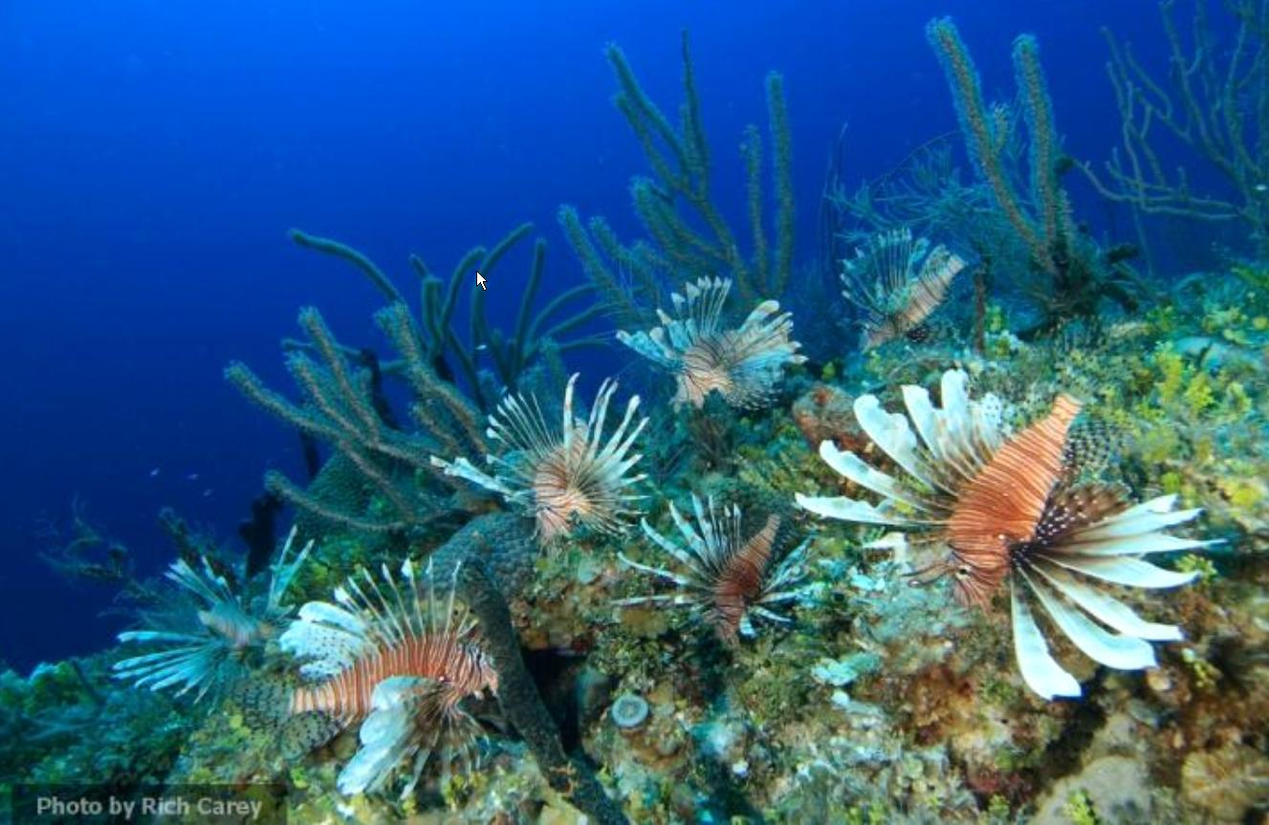
Invasive Species

Slide 74
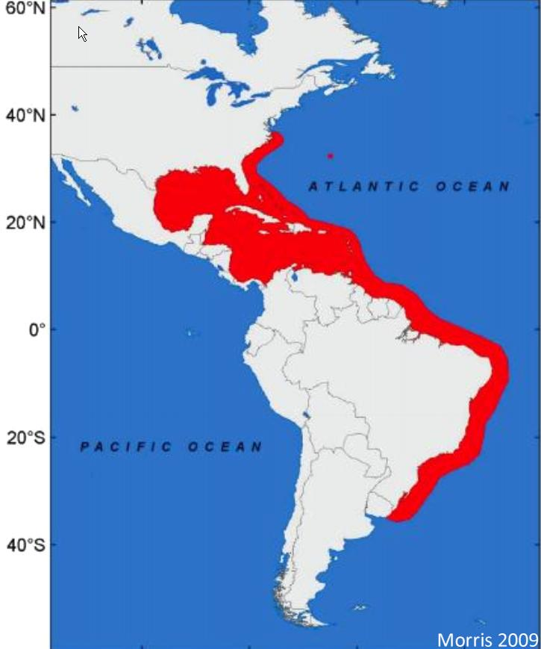
Habitat of the Lion Fish

Slide 75
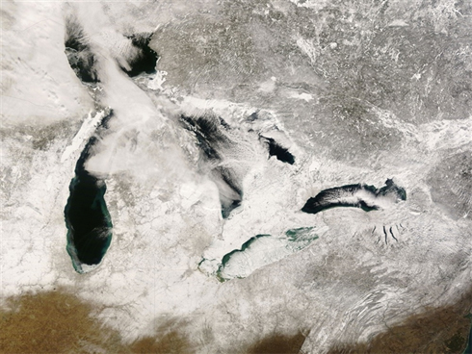
Great Lakes Ice Cover Down 71%
1973 to present
Invasive species of toxic algae among new threats due to warmer water.

Slide 76
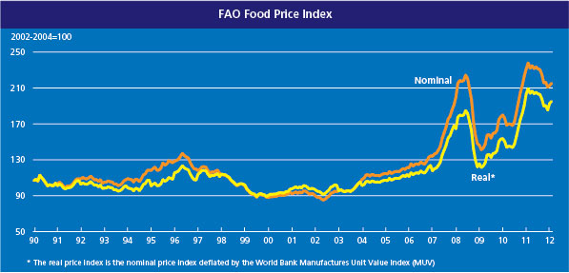
FAO Food Price Index

Slide 77
PANDEMICS

Slide 78
Pandemics
H1N1 virus reached pandemic levels in 2009.
It was less virulent than expected but it infected about 55 million Americans with as many as 16,000 deaths and more than 360,000 hospitalizations, said the CDC.¹
A study by Mercer LLC of 1,000 employers across the U.S., Latin America, Canada, Asia and Europe found that only 25% have integrated contingency plans in the event of an outbreak.²
Reuters, Jan 15, 2010
http://www.businessinsurance.com/apps/pbcs.dll/article?AID=/20091221/NEWS/912219994#.

Slide 79
Pandemics cont’d
Mercer found that 94% of employers with a plan distributed hand sanitizers, 64% started more frequent or intensive office cleaning and 54% started providing more H1N1 educational sessions.*
Only one-third of organizations worldwide have issued guidance to their employees about the message that should be given to clients and suppliers should business be affected by the spread of the virus. (also Mercer)
*http://www.businessinsurance.com/apps/pbcs.dll/article?AID=/20091221/NEWS/912219994#

Slide 80
FLU Vaccines are Controversial
In The Lancet Infectious Diseases, Volume 12, Issue 1, Pages 36 - 44, January 2012
The study identified and qualified 14 observational studies and 17 randomized, controlled studies 1/1/67 to 2/15/11. For ages 18 to 65, the effectiveness rate was 59%. They concluded: Flu vaccines “can provide moderate protection.”
BUT, they added “…such protection is greatly reduced or absent in some seasons.”
They urge that work proceed on developing more effective vaccines.

Slide 81
Pandemic Insurance Coverage
The principal liability exposure will likely be alleged negligence (failing to protect against exposure to the virus).
Business interruption coverage may not cover losses. Check policies and investigate options.
It pays to do small things that have a big payback in employee health.

Slide 82
Some small things for employee health
Sunshine makes a big difference. Facilitate access outdoors during mid-day when there is sun and comfortable temperature. The H1N1 pandemic was seasonal when people were mostly indoors. Sunshine provides needed vitamin D. Many studies support this. Visit www.vitaminDcouncil.org.
Vitamin D3 capsules are small, easy to swallow, very cheap and strongly protective. Adults should be taking at least 5,000 iu per day.

Slide 83
More small things for employee health
Use the Vitamin D Council recommendation for dose, backed by hundreds of scientific studies, not government recommended levels set by committees that have focused only on bone health.
You will be amazed at all of the illnesses that vitamin D can help avoid. Make vitamin D available to employees regularly, not just for pandemics.
Set up hand sanitizer stations throughout the workplace.

Slide 84
“L” Articles on Vitamin D*
Lack of Sunlight Leads to Infertility
Lack of Sunlight May Raise Stroke Risk
Lack of Sunshine Causes One Million Deaths a Year
Lack of Sunshine Vitamin Linked to Cognitive Decline
Lack of Vitamin D; More Evidence Connected to Breast, Colon Cancer
Latitude of residence and position in time zone are predictors of cancer incidence, cancer mortality, and life expectancy at birth
Leukemia patients with insufficient vitamin D levels face earlier mortality risk
Long-term high dose vitamin D well tolerated
Low D Levels in Kids Raises Insulin Woes
Low levels of vitamin D in professional basketball players after wintertime- relationship with dietary intake of vitamin D and calcium
Low Vitamin D- A Contributor to Mental Disorders in Children
Low Vitamin D and Spinal Cord Disease
Low Vitamin D Associated With Poor Prognostic Features in Breast Cancer
Low vitamin D causes problems for acutely ill patients
Low Vitamin D Common in Spine Surgery Patients
Low vitamin D in kids may play a role in anemia
Low vitamin D levels can predict Parkinson's disease
Low Vitamin D Levels Could Cause Liver Disease
Low vitamin D levels linked to allergies in kids
Low vitamin D levels linked to depression in children
Low vitamin D levels may contribute to development of Type 2 diabetes
Low Vitamin D Levels May Promote Severe Asthma
Low vitamin D levels tied to pregnancy complication
Low vitamin D status associated with increased mortality in nursing homes
Lower rheumatoid arthritis rates linked to vitamin D
*These files are in my desktop computer.

Slide 85
“S” Articles on Vitamin D*
Serum 25-Hydroxy Vitamin D and Prostate Cancer Risk in a Large Nested Case–Control Study
Serum 25-hydroxyvitamin D levels are associated with prognosis in hematological malignancies
Simple Way to Reduce Risk of C-Section
Skin cancer patients more likely to be deficient in vitamin D
Sperm switch into top gear with the sun
Staphylococcus aureus nasal carriage is associated with serum 25-hydroxyvitamin D levels, gender and smoking status
Study Confirms Sun Exposure Protects Against Skin Cancer
Study explores link between sunlight, multiple sclerosis
Study links rheumatoid arthritis to vitamin D deficiency
Study released on heart health and vitamin D levels
Study shows vitamin D deficiencies may impact onset of autoimmune lung disease
Study urges vitamin D supplement for infants
Study: UV Vitamin D Reduces Cancer Risk
Subsequent primary cancers after melanoma diagnosis support that low vitamin D level is a risk factor for melanoma
Sunlight Can Lower Your Blood Pressure
Sunshine- The Newest Natural Weapon Against Asthma
Sunshine 'protective' against MS
Sunshine is Nature's Disease Fighter
Systematic review- Vitamin D and cardiometabolic outcomes
*These files are in my desktop computer.

Slide 86
Is Vitamin C IV a Viruscide?
http://www.youtube.com/watch?v=k0GC9Fq8lfg
“Vitamin C, Infectious Diseases, and Toxins: Curing the Incurable” by Thomas E. Levy MD JD
Well documented. Includes many references to peer-reviewed journal articles on Vitamin C IV over many decades
Precipitated action by Government of New Zealand
Liposomal Vitamin C

Slide 87
For the next pandemic
Review plans to operate with diminished personnel and a drop in supplier capability.
Review telecommunications capability for many people to work from home. Smart phones can help.
Review how travel, meetings and conferences will be affected.
Work with public health and other public services.

Slide 88
Resources for Pandemics
http://global.marsh.com/risk/pandemic/index.php#Resources
http://www.pandemicflu.gov/
http://www.flu.gov/
http://www.cdc.gov/flu/tools/fluaid/
http://www.cdc.gov/h1n1flu/
http://www.rims.org/RESOURCES/BUSINESSCONTINUITYANDPANDEMICS/Pages/default.aspx
http://www.osha.gov/Publications/influenza_pandemic.html
http://bioethics.iu.edu/reference-center/pandemic-influenza/
http://nnlm.gov/ep/disaster-plan-templates/pandemic-planning/
http://www.hhs.gov/pandemicflu/plan/appendixj.html
http://www.lrc.fema.gov/path_pandemic.html

Slide 89
CYBER SECURITY

Slide 90
We have become dependent in ways we never anticipated
Much of the commercial/industrial world operates online. Even our military is largely Internet dependent.
We are not prepared to operate offline.
Social media has become pervasive.
How many of you do banking online?
How many of you depend on VOIP for communications?

Slide 91
Probably the greatest concern of organizations is loss of critical data. ID theft, IP theft, e-mail theft……aka “data breaches” are constant threats.
But this is not an “emerging risk.” It’s a current risk that is already happening all around us.
Rather, the emerging risk is the potential loss of the Internet for lengthy periods of time. How many of you have spent time examining strategy for such an occurrence?

Slide 92
We have given our enemies the means to cause us grave harm. We are so dependent on the Internet that its loss would be catastrophic.

Slide 93
Cyber Security cont’d
The Stuxnet worm that damaged Iranian nuclear development operations was just a start.
“A malicious computer attack that appears to target Iran’s nuclear plants can be modified to wreak havoc on industrial control systems around the world, and represents the most dire cyberthreat known to industry, government officials and experts said.”*
*Senate Homeland and Government Affairs Committee, Nov. 17, 2010

Slide 94
Cyber Security cont’d
Deputy Secretary of Defense William Lynn said in a keynote address to the gathering, "The threat is moving up a ladder of escalation, from exploitation to disruption to destruction.“
"Perhaps the greatest concern in our judgment is a terrorist group that gains the level of disruptive and destructive capability currently possessed by nation-states," Lynn said.
Cyber warfare is a real possibility. The Defense Dept. has been developing both defensive and offensive cyber weapons.
While the Internet itself is a potential target, it could also become the vehicle for enemies to disable the electric grid, potable water systems and other such infrastructure.

Slide 95
We can see how vulnerable we are when Anonymous can tell us in advance what it is they are going to attack and when the attack will be launched.
And then they do it.

Slide 96
Cyber Security cont’d
If the Internet goes down for an hour, a day, a week, what will you do? What will you lose?
Clearly, cyber security has improved and cyber security companies sound confident, but Homeland Security and Defense Dept. officials have a different take on it.
Is there a Black Swan waiting in the background?
Risk managers need to ask a lot of questions.

Slide 97
Contact information:
Alan D. Roth, Ph.D.
10849 Bucknell Drive
Wheaton, MD 20902
(301) 928-6314 mobile
aroth@advfusion.com
LinkedIn: search “Alan Roth, Ph.D.” or
www.linkedin.com/pub/alan-roth-ph-d/7/35/284

