Slide 1
Importance of Demographics 2014
Presentation to CANE
Conning March 23, 2015

Slide 2
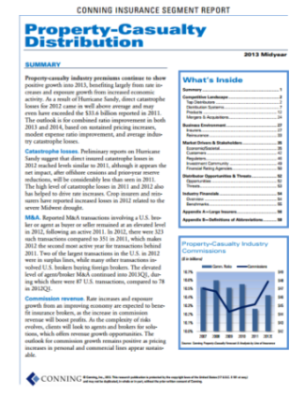
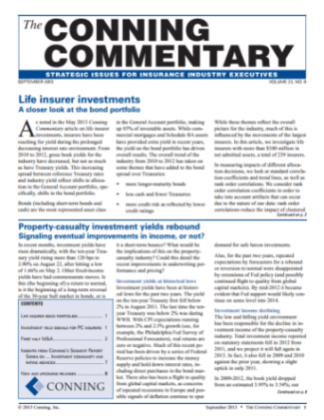
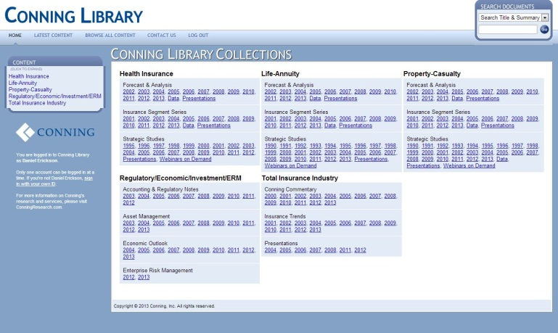
Conning Insurance Research
Publications and Services
Experience/Resources
Strategic
Studies
Forecast &
Analyses
Segment Reports
30 Lines of Business
17 professionals, including marketing
Dedicated property–casualty and life/health-annuity groups
Backgrounds include actuarial, strategic planning, equity research, underwriting, investment banking
Average experience of over 20 years
In-depth insurance expertise supports asset management business and is key differentiator for Conning
Conning Library
Also provide proprietary research: strategic planning, business development, peer analyses
Over 200 publications annually, 2,000+ in archive
Subscription service—Clients include insurers, professional services firms, investor community
2

Slide 3
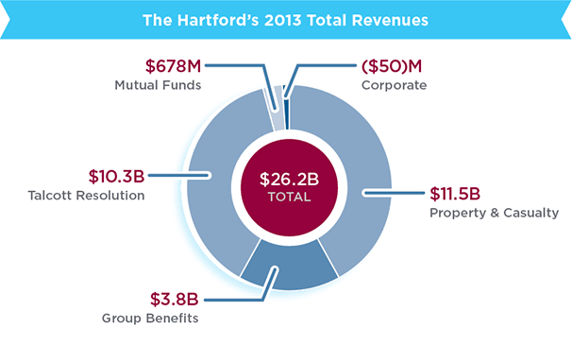
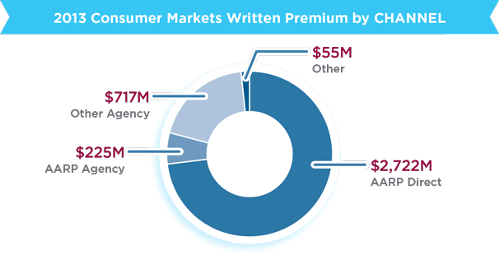
THE HARTFORD AT A GLANCE
COMPANY
Founded: 1810
Employees: Approximately 17,500
Headquarters: Hartford, Conn
2013 Revenues: $26.2B
Shareholder equity: $18.9B
MARKET RANKINGS
No. 4 commercial multi-peril carrier, based on direct written premiums
No. 2 workers’ compensation insurer, based on direct written premiums
No. 7 in P&C commercial insurance
No. 11 in total personal lines (4th largest direct player)
No. 3 in fully insured disability in force
notable:
The Hartford serves more than one million small businesses.
The Hartford is a founding partner of U.S. Paralympics.
The Hartford’s trademark logo echoes the majestic stag depicted in Sir Edwin Landseer’s 1851 painting Monarch of the Glen. A hart fording a stream is a natural symbol for a company named The Hartford.
The Hartford provided insurance for the only home Abraham Lincoln ever owned
Source: www,Hartford.com, IR Section

Slide 4
Why Do Demographics Matter?
The Changing Consumer: Long-Term and Short-Term
Population Growth
Geographic Shifts
Changing Age Profile
Increasing Racial/Ethnic Diversity
Socioeconomic Changes
Current Market Trends: Consumer Behavior
Ownership
Migration
Driving
New Approaches for Market Segments
HNW, NSA, Senior, Hispanic
New Approaches for Customer Contact

Slide 5
The Changing insurance Consumer
Notes:
So first – a look at some of these macro changes to the consumer

Slide 6
Five Critical Trends Reshaping Consumer Markets
Slow population growth
Geographic shift
Age demographics
Increasing diversity
Changing household structure
Notes:
The 2010 U.S. Census provides us a refreshed view of the U.S. consumer and highlights some trends that will be important—providing a look at trends that should provide a useful baseline to begin thinking about tomorrow’s consumer.
There are 5 major areas underlying the changing consumer market—population growth, age profile, shifts in the geographic balance of the population, ethnic/racial diversity, and some important social changes – changes to household structures and behaviors.

Slide 7
Tomorrow’s Consumer Market Will Not Look Like Today’s
U.S. Population Characteristics
 | 1970 | 2000 | 2014 | 2030
Resident Population (in millions) | 203 | 281 | 313 | 350
% over 65 | 10% | 12% | 15% | 20%
% White (non-Hispanic) | 79.9% | 69.1% | 62.2% | 55.4%
% households married w/children | 40% | 24% | ?? | ??
Women in workforce % | 41% | 58% | ?? | ??
Source: U.S. Census Bureau, Harvard University Joint Center for Housing Studies, Bureau of Labor Statistics
Notes:
Tomorrow’s consumer base is going to look quite different from the way it appears today – and more distinct from the way it appeared when today’s leadership was in their formative years.
This is probably a gross generalization – but -- the bulk of the industry leaders in today’s personal lines market were probably growing up in the 1970s. The U.S. population was lighter at that time by about 100 million people, it was skewed heavily toward the youth segment, largely white, and the traditional married w/ children household was the norm. Flash forward 30 years – when the emerging group of insurance leaders was entering the workforce – in 2000
Tremendous population growth
A racial and ethnic profile that was starting to look much more diverse.
And the concept of the nuclear family as the typical household was fading quickly
In another 30 years – what we’re likely to see is a bigger population – but growing much more slowly
The over 65 segment will have gone from 1 in 10 to 1 in every 5 individuals.
As an aside – by 2030 in Japan that number will be like 1 in 2.
And we’ll be getting close to the point where the white population is acquiring minority status.

Slide 8
Population Growth Has Been an Important Growth Driver
U.S. Population by Decade (Ending)
(in millions)
U.S. Population Growth by Decade (Ending)
Source: U.S. Census Bureau
Notes:
Let’s look at some of these factors in more detail.
Population growth has been a driver of U.S. business growth and insurers have benefitted from this. A growing population means an expanding market, optimism, and a growing workforce. Continued growth should not be taken for granted, however, and is not a worldwide phenomenon. Population change can be much slower or even negative, as it is in many of the developed nations. The outlook for the U.S. is for continued population growth, but it is critical for planning purposes to understand the changing character of this growth.
The most important distinction between prior decades and those that are unfolding is that the pace of growth will be slower.
The second graph shows U.S. population growth by decade from 1800 through a forecast for 2030.
The decade that ended in 2010 saw the slowest rate of total population growth (9.7%) since the Great Depression, and projections for the current decade are for even slower growth (7.9%). Fewer Americans are in their child-bearing years, and the recession has slowed the pace of immigration. Slower overall growth dampens growth of the consumer base and constrains the availability of the talent pool.
Behind this projected slowdown are assumptions about the three key determinants of population growth: fertility, mortality, and immigration.
While fertility rates are close to the population replacement level in the U.S. (2.1 births per woman), population projections assume a slow-but-steady erosion in this figure as the fertility rates of higher fertility racial/ethnic groups begin to converge on the average fertility rates of non-Hispanic whites over time. For the first time in history – the death rate exceeds the birth rate.
Advances in medical technology and improved living conditions provided improvements in mortality rates, but an increasing age profile for the U.S. population is expected to begin to push mortality rates back up in the coming decades.
Helping to offset these negatives somewhat is the beneficial impact of immigration. The U.S. remains a target for immigrants and population projections assume an ever greater contribution of immigration to the overall growth figure, with particularly strong growth over the next 20 years.
These trends are expected to translate into slower exposure growth with a potential impact on competitive dynamics in the personal lines market. An expanding population has fueled growth in exposure units in both personal auto and homeowners, but longer-term planning will need to reflect slower growth. The slowing growth in population is also expected to have a dampening effect on growth in insured values. All other things being equal, slower population growth is expected to slow demand, which will, in turn, exert downward pressure on asset values—personal property and vehicle. Finally, reduced population growth rates are expected to promote increased competition, which will have a downward impact on rates. The personal auto line has already seen a flattening in average premium growth over the better part of the last decade.

Slide 9
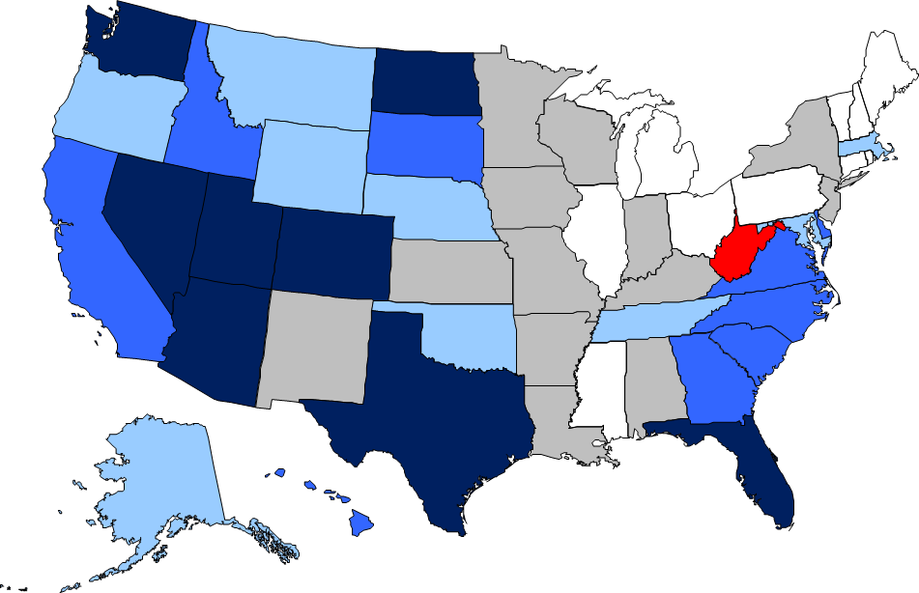
Population Growth Will Not Be Uniform Across the States
State Population Growth 2010-2014
<0%
0%-1%
1%-3%
3%-4%
4%-5%
>5%
Source: U.S. Census Bureau
Notes:
Our next trend is the rather remarkable geographic growth pattern developing.
Total population will be growing more slowly relative to historical norms, but it will not be growing uniformly. The map shows population growth in each of the 50 states since 2000 – the darker the shading -- the stronger the growth. Growth is much stronger in the South and the West. The Northeast is barely growing and the Midwest is only a little better. Between 2000 and 2013, the United States population increased by an estimated 34 million. More than half (53%) of total population growth came from the southern states.
Texas alone added 5.5 m and Florida another 3.5 million.
Meanwhile, MI lost population and Rhode Island was basically flat – not growth over the 13 year period.

Slide 10
Recent Migration Patterns Support Longer-Term Trends
Migration Magnets, 2011-2012
<= -0.4%
-0.1% to -0.3%
0.0% to 0.1%
0.2%
0.3% to 0.4%
>= 0.5%
Source: U.S. Census Bureau
Notes:
A look at migration trends over the last few years finds ongoing state population growth patterns consistent with longer-term trends. States benefiting from large population gains tend to be Western and Southern states …
… while those struggling with dwindling populations tend to be in the Northeast and Midwest.
The map provides a graphic summary of state to state migration flows from data collected in the most recent (2012) American Community Survey of the U.S. Census. States with the greatest net inflow rate of interstate migrants from 2011 to 2012 are shown in progressively darker shades of blue. Between 2011 and 2012 North Dakota experienced a net migration gain equal to 2.1% of state population, while Alaska and New Jersey experienced a loss of one percent or more of state population.
Florida and Texas continue to attract the largest number of domestic migrants (as opposed to the highest migration rate). These two states have been the domestic migration leaders in the nation every year since 2000.
New York experienced the greatest volume loss due to state-to-state movements between 2011 and 2012.

Slide 11
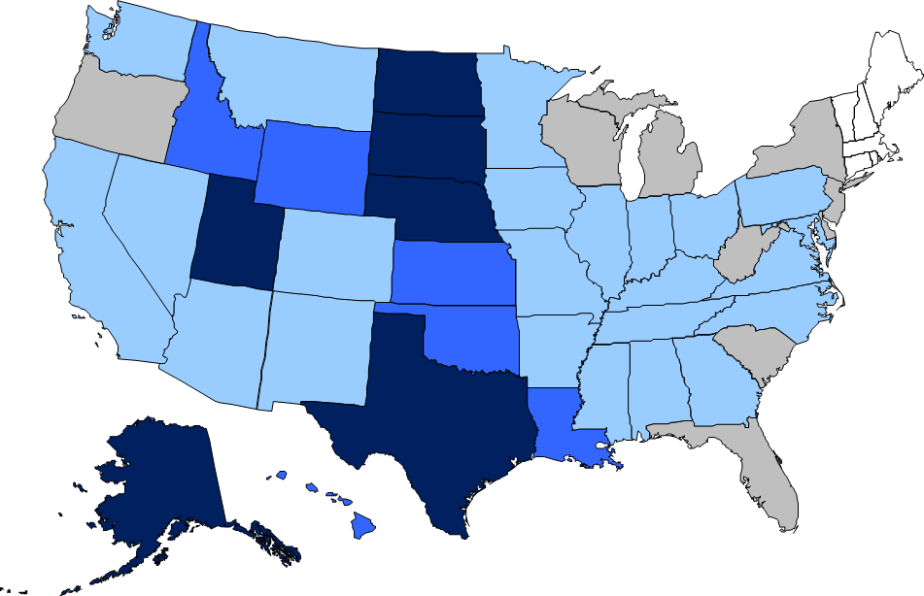
Birth Rates Are Also Highly Variable Across the States
State Birth Rate, 2013
<11
11-12
12-13
13-14
14+
Births per 1,000 women
Source: National Center for Health Statistics
Notes:
In order to maintain population stability, the birthrate must remain at 2.1 births per woman. Above that, the population rises; below that, it falls. In the advanced industrial world, the birthrate is already substantially below 2.1.

Slide 12
Differing Growth Rates Create Different Opportunities
Population Growth 2000-10 |  |  |  | Growth in Housing Units 2000-10
Rank | State | Growth % |  | Rank | State | Growth %
1 | Nevada | 35.1% |  | 1 | Nevada | 41%
2 | Arizona | 24.6% |  | 2 | Arizona | 29%
3 | Utah | 23.8% |  | 3 | Utah | 27%
4 | Idaho | 21.1% |  | 4 | Idaho | 26%
5 | Texas | 20.6% |  | 5 | Georgia | 24%
6 | N. Carolina | 18.5% |  | 6 | Florida | 23%
7 | Georgia | 18.3% |  | 7 | N. Carolina | 22%
8 | Florida | 17.6% |  | 8 | Texas | 22%
9 | Colorado | 16.9% |  | 9 | Colorado | 22%
10 | S. Carolina | 15.3% |  | 10 | S. Carolina | 22%
11 | Delaware | 14.6% |  | 11 | Delaware | 18%
12 | Wyoming | 14.1% |  | 12 | Alaska | 18%
13 | Washington | 14.1% |  | 13 | Washington | 17%
14 | Alaska | 13.3% |  | 14 | Montana | 17%
15 | New Mexico | 13.2% |  | 15 | Wyoming | 17%
Source: U.S. Census Bureau
Notes:
The differing growth rates and the emergence of high growth and slow growth states present insurers with very different marketing opportunities on a state-by-state basis
Those states that are growing generate growth opportunities due to both the increased population and usually more favorable economic landscapes (more favorable employment opportunities relate to stronger growth in income).
Strong population growth contributes to strong growth in exposure units in both auto and home. The tables displayed show the top population growth states on the left and the leading states for growth in housing units (a driver of homeowner exposure growth) on the right. As you can see – the correlation is close to 1:1 for growth in homeowner exposure units.
. Insurers with a regional focus in the northeast and Midwest states will be particularly challenged.

Slide 13
Expansion States May Differ Markedly from Existing States
Largest Minority Population, 2009 |  |  | Smallest Minority Population, 2009
State | Non-Hispanic White Population as a % of Total State Population |  | State | Non-Hispanic White Population as a % of Total State Population
Hawaii | 25.1% |  | Iowa | 89.8%
District of Columbia | 33.5% |  | New Hampshire | 92.8%
New Mexico | 40.9% |  | West Virginia | 93.3%
California | 41.7% |  | Vermont | 94.9%
Texas | 46.7% |  | Maine | 94.9%
Median Age by Region
 | median age |  |  | change
 | 1990 | 2000 | 2010 | 1990-2010 (in years)
U.S. Total | 32.6 | 35.3 | 37.2 | 4.6
Northeast | 34.0 | 36.8 | 39.2 | 5.2
Midwest | 32.9 | 35.6 | 37.7 | 4.8
South | 32.7 | 35.3 | 37.0 | 4.3
West | 31.7 | 33.8 | 35.6 | 3.9
Source: U.S. Census Bureau
Notes:
If you’re an insurer that seeks to respond to this message and pursue opportunities in some of these high growth states, it will be important to recognize that some of these growing states differ markedly from the slower growth states – in more than just growth rate.
Immigration fueled much of the growth over the past decade, and the states with the most rapid growth tend also to be among the more diverse.
As the hard to read table shows – 4 states + DC are now majority minority – with the non-Hispanic white population making up less than half of the state population. 7 more states are at the “tipping point” of possibly attaining this status within the next decade.
In contrast, 4 states have a minority population that is less than 1 tenth of the total state population.
The bottom table shows another point of variance– The Northeast is getting a lot older than the rest of the country.
Insurer growth/expansion plans in the individual states will need to reflect these changes. Different channel, message, and product plans will need to reach these differing market segments.

Slide 14
Baby Boomers and Immigrants Are Reshaping the Age Profile
Population Age Structure, U.S., 2013
Source: U.S. Census Bureau
Notes:
Over the next three decades, the senior segment of society will be the most rapidly growing demographic group. What’s driving this?
Changes in longevity – individuals are living longer today than at any time in the past
Changes in fertility – we already showed you how fertility rates are going down. When you’re providing fewer young members of the population – and you’re hanging on longer to the older members -- the population ages.
3. And then there’s the boomer cohort. Those of us born between 1946 and 1964 – that bulge in the middle (show the box) – the pig in the python. That group if turnign 65 now at a pace of 10,000 people/day.
In the decade ending in 2020, the 45-54 age cohort is projected to decline by 10%, while the over-65 population is forecast to expand by almost 40%.
Insurers that respond to the needs of a growing senior population will be poised for growth, but the risk characteristics of this group will be different from those of prior experience.
While this segment is appealing due to its growth prospects, its insurance needs, and its ability to pay for risk management products and services.

Slide 15
U.S. Population Is Approaching “Majority Minority”
US. Population Estimates and Projections, 1990-2050
2012 Projections
Source: U.S. Census Bureau
Notes:
If growth patterns continue—from both immigration and natural increase—the population of Hispanic or Latino origin is projected to grow steadily as a percentage of the total U.S. population, reaching 30% by 2050—almost 20% by 2020. By 2020, the Asian population is expected to reach 5.4%—up from 3.6% in 2000.
The graph on this page provides a good visual of the dramatic changes underway. If you look closely at that dark blue data series (the bottom of the stacked bars) – you’ll see that the white, non-hispanic portion of the populatoin drops below 50% of the total somewhere between 2040 and 2045. At tha tpoint, -- 2042 by the latest estimate – the U.S. will be what is being termed “majority minority”.
The value of this information lies in understanding how these different groups behave as customers. The increasing diversity will bring with it different financial needs, channel preferences, and attitudes toward insurance. Insurers and distributors will have to adjust marketing plans to design, produce, and promote insurance products and services that cater to the needs and buying behaviors of an increasingly diverse consumer base.

Slide 16
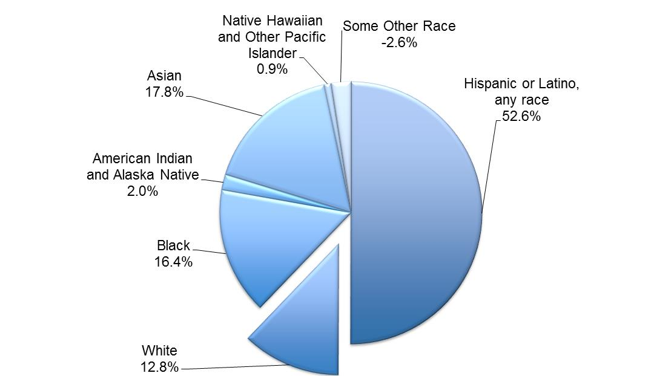
Ethnic Composition of the U.S. Is Changing Rapidly
Share of Population Growth, 2000-2010
Source: U.S. Census Bureau
Notes:
This pie chart shows the share of population growth over the last decade attributed to different racial and ethnic groups. – You can see that only 13% came from the non-Hispanic white population.
Immigration was responsible for roughly 1/3 of U.S. population growth.

Slide 17
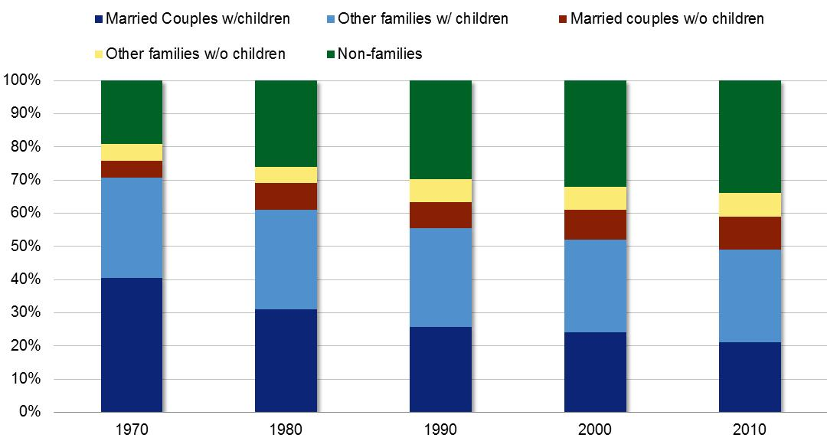
Structure of the U.S. Household Undergoing Notable Change
Share of Households by Type, U.S.
Source: Brookings Institute
Notes:
The structure of the U.S. household is another area undergoing dramatic change, with implications for insurer marketing and risk selection. This graph shows the changes to a number of different household structures over time. The married w/ children household is the shrinking navy blue bar at the bottom.
There are a number of interesting trends buried within these stats. The “Other Families” with children category (the pale blue) – 4 out of 5 of these are headed by women. 40% of ALL births are now to unmarried women. And you can see from that growing dark green band across the top that non-families now account for more than 30% of total households. – 80% of these are single persons living alone. As the proportion of non-families continues to rise, the share of family-centered households is on the decline.– A very different social structure than we had 20-30 years ago.

Slide 18
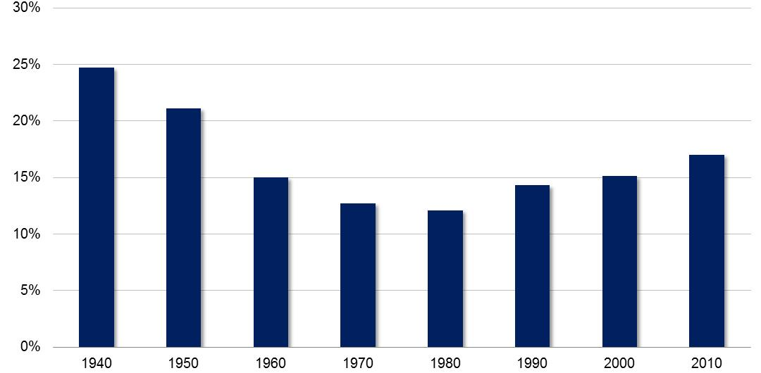
Multi-Generational Households Are Re-Emerging
Share of U.S. Population in Multi-Generational Family Households
Source: U.S. Census Bureau, Pew Research
Notes:
Within the family households, there is strong growth in multi-generational households and young adults living with their parents longer.
Along with these changes is a related trend: the re-emergence of the grandparent –headed household. Multi-generational households are family households consisting of three or more generations of relatives (e.g., family with children and grandparents). In 1940, the multi-generational household was common, representing nearly a quarter of all households. This approach declined sharply over the next 40 years, bottoming out in 1980 at 12% of all U.S. households.
In 2000, there were 3.9 million multi-generational households. That number increased to 5.1 million by 2010—a 30% increase. This has three trends feeding it: (1) the aging population with older parents moving in with their children and (2) immigration, bringing ethnic groups where multi-generational households are more common, and (3) economic hardship (e.g., foreclosures, job loss), forcing families to adopt new strategies to make ends meet.
Along with this change is an increase in the role of grandparents as caregivers. 1 in 10 (7.7 million) children in the U.S. now live with a grandparent, and approximately 3 million of these children are also relying on that grandparent as a primary caregiver

Slide 19
Changing Consumer Behavior
Notes:
So those are some of the big, slow moving trends – with the potential to have a huge impact on the market
Let’s look now at a couple of near-term, more rapidly developing trends helping to shape the market.

Slide 20
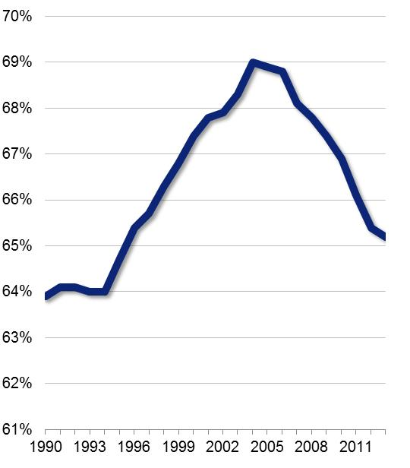
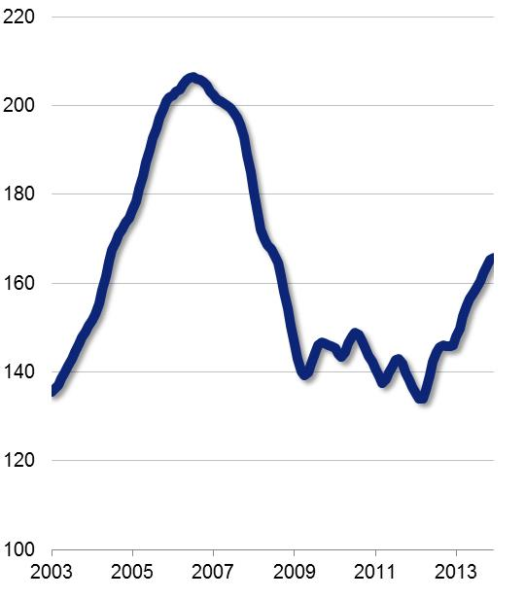
Decrease in Homeownership Affecting Exposure Growth …
Home Ownership Rate
Case-Shiller Home Price Index
Source: U.S. Census Bureau, CoreLogic
Notes:
Home ownership is an important one to consider – given its ability to directly impact exposure growth.
Home ownership rose from an average of 64.5% in the 1990s to 69% and above between 2004 and 2006. This surge was fueled by changes in demographics, innovations in mortgage lending, and strong government-driven incentives directed at both lending institutions and at homeowners. As you can see, home ownership rates have suffered a rather steep decline since late 2006.
Declining home values and the resulting personal and financial turmoil may have changed the incentives for home ownership for a large segment of the population.
As indicated in the graph on the right, we are edging further away from the recession that was a factor in much of this, but – as indicated in the homeownership graph on the left -- the trend is not reversing – perhaps it’s slowing, but too soon to tell. There are more factors behind this than simply recessioin-affected incomes and employment concenrns.

Slide 21
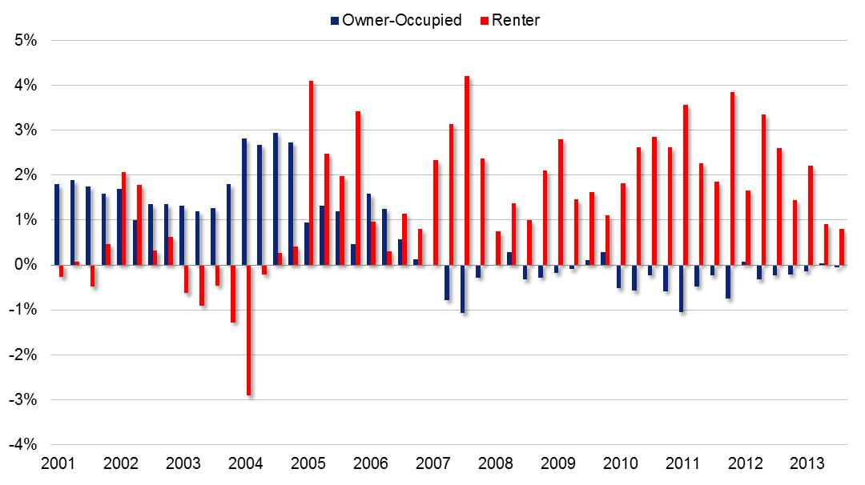
… and Correlated with Strong Growth in Rentals
% Change in Owner vs. Renter Housing
Source: U.S. Census Bureau
Notes:
One of the immediate impacts of this is the big pick up in rentals. The graph shows growth (as percent change) in owner-occupied housing units in blue alongside the growth in rental-occupied units in red. This shows a complete reversal of trend following the housing crisis. Prior to 2007 average annual growthin in owner occupied housing was 1.6% per year. From 2007 forward the average annual growth rate has been -0.3%. For rentals, prior to the collapse the average growht rate was a meager 0.6%, but after the crisis –- 2.1%.
An important associated trend that is worth noting here -- Large institutional investors such like Blackstone have surged into the market over the past three years, buying up distressed properties, remodeling and putting them up for rent. The share of single family homes purchased by business investors increased from less than one percent in 2004 to nearly 6.5% at the end of 2012. This is driven by the availability of foreclosed homes – allowing investors to buy properties at distressed prices.
It is possible that some of these institutional investors will sell when home values make it appealing to do so. But – a number of these large investors have stated plans to sell these portfolios to entities than will continue to manage them as rental properties. Thus, removing what were once personal property exposure units from the homeowners market for an extended period.

Slide 22
Is the Decline Part of a Broader Trend?
The Sharing Economy
Notes:
Another factor to consider is more of a generational trend – and that is the longer-term trend away from ownership—part of the rentership or sharing economy.
There is a growing segment of the population for whom ownership is not so appealing, and renting/sharing seems natural. Home ownership creates friction in a job market where people want to be quick to seize opportunities – sometimes a portfolio of opportunities.. Homeowners, while not stuck in a location, face a significant obstacle to moving rapidly. There is a generation ready to rent an apartment using Craigslist, join Zipcar to facilitate travel needs– or ride share using the Lyft app, and vacation in someone else’s home using Airbnb. There is a whole sharing economy developing in which asset owners use online clearinghouses to capitalize the unused capacity of their hard assets (home, car, even things like lawnmowers).
This trend indicating changing attitudes toward ownership clearly has implications for personal lines exposure growth – particularly for those who will make up tomorrows target markets.
Alix Partners, a MI-based consulting firm serving the car industries, estimates that car sharing has cost car makers 500,000 vehicle purchases so far – with estimates that 4 million Americans will car share by 2020 – a 400% increase.

Slide 23
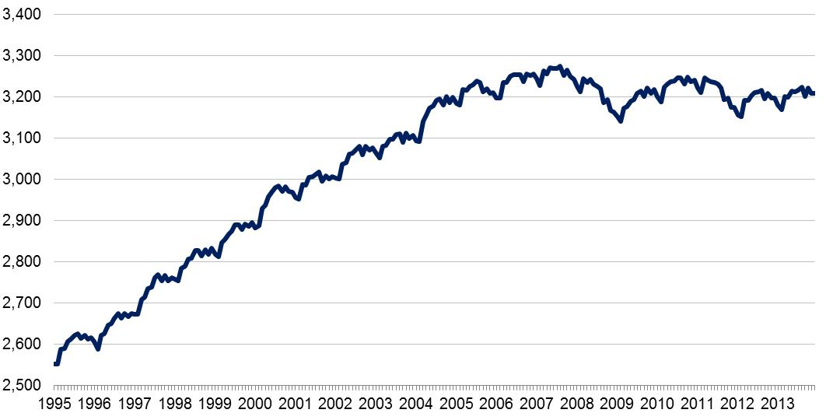
Vehicle Miles Traveled, Rolling 12-Month Total
Vehicle Miles Traveled, Rolling 12-Month Total
(in billions)
Source: Federal Highway Administration
Notes:
Another important consumer behavioral trend affecting the personal auto line is the plateauing in vehicle miles travelled.
Vehicle miles traveled were up slightly for 2013—climbing 0.6% relative to a year earlier.
Part of this is related to gas prices. Ten years ago, the price of a gallon of gas averaged $1.37 and the median household income was $42,000 per year. In the intervening years – gas prices have gone up more than 150%—while household income has risen only 18%. Where gas used to represent perhaps 3% of annual income in 2000 it is now is 8%-10%.
But there is more going on here also. Teenagers are much less interested in driving than a generation ago. They way people interact has changed – and made physical co-location less important
Reduced driving has a beneficial effect of reduced claim frequency, which is certainly a positive for insurer loss ratios and for improved underwriting profitability. As pointed out by Brian Sullivan of the Auto Insurance Report, however, the longer-term implication of decreasing losses is decreasing premiums, which is an unsettling trend for a company that is looking to grow.

Slide 24
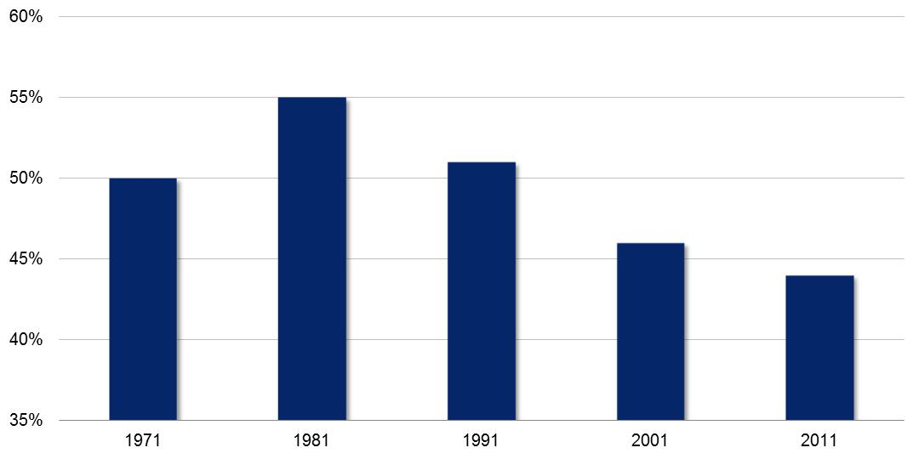
This May Reflect Generational Changes in Attitude Toward Cars
Share of Potential Drivers 15-19 with Drivers’ License
Source U.S. Census Bureau, Federal Highway Administration

Slide 25
New Approaches for New Markets
Market Segments
Notes:
The last section then is a look at what to make of all these observations. How are companies reacting to theses trends? We have carved out a few examples of new approaches to the market by companies -- yours among them – that have responded to the opportunities presented by a changing market. We’ll look at how the market is being segmented around the new consumer base and then at how this affects how insurers engage the customer.

Slide 26
Undifferentiated Personal Lines Market Dissolving
Personal Lines Consumer
High Net Worth
Non-Standard Auto
Senior Segment
Young Adults
Hispanic Market
Notes:
An important theme that emerges from an analysis of the evolving customer base is the increasing diversity of the market—by age profile, socioeconomic structure, ethnicity, and household structure. This, in turn, is creating changes in consumer needs and preferences.
The sea of data becoming available about consumers is making marketers less interested in the market as a whole and more focused on segments that are being bubbling out of the larger undifferentiated market. Social, digital, and mobile technologies are changing the way consumers buy things and providing insurers with new data about preferences and purchase patterns. Forces affecting insurance are the same as those driving market share away from network television (mass market) and toward the hundreds of focused cable outlets (micro-markets).
The segments reviewed in this study include the high net worth segment, nonstandard auto insurance risks, seniors, the youth market, and the rapidly growing Hispanic market.

Slide 27
HNW Concerns Extend Beyond Typical Mass Market
Homeowners
Automobile
Excess liability
Valuables (jewelry, art, and other collectibles)
Watercraft (from small boats to large yachts)
Family protection (kidnap and ransom)
Workers’ compensation and personal liability
Notes:
The high net worth segment is on that fascinates many insurers – but remains difficult to penetrate.
Most insurers competing in this market identify their market in terms of home value – or more specifically, home replacement value. While there is variability across the HNW specialists, the most common threshold is households with a primary residence replacement cost in excess of $1 million.
According to data from the Census, there are an estimated 1.5 million households with home valued at $1m or more. Based on estimated asset values for this group, we can get an estimated premium potential between $50b and 80b for this group.
These figures represent a market potential that may be only partly penetrated by insurance sales, as some wealthy individuals may choose to self-insure their property and some of their liability exposure.
And actually, Market participants believe that as much as 70%-80% of the potential market is insured outside of the high net worth specialists – insuring with mass market or middle market insurance programs.
The HNW individual has risk managemet concerns that extend beyond the lmits of the typical mass market policy.
A clever advertisement of U.K.-based insurer, Hiscox, states that one-third of the claims it pays would not even have been covered under a standard home insurance policy. The HNW policies often provide protection for kidnap and ransom, carjacking, training for traveling abroad, and increased limits for fine art and jewelry – as well as enhance liability for coverage associated with employment in the home.

Slide 28
HNW Concerns Extend Beyond Typical Mass Market
U.S. Households by Net Worth: 2013
Source: U.S. Census Bureau, Conning analysis
Notes:
Using Census data, we find that Affluent Investors represent approximately 52 million households, or 44% of all U.S. households. According to the IRS, individuals with gross assets of $2 million or more had a total net worth of $12 trillion in 2007 (the latest data available).
We define an affluent investor as someone with a minimum of $100,000 of financial assets. We use financial assets because those assets are available to invest in products or services sold by insurers.

Slide 29
U.S. HNW Market Is Served by a Small Number of Insurers
Insurers Serving the U.S. HNW/UHNW Market
HNW Market
Chubb
AIG
ACE (now including FFC)
PURE
Crestbrook
Cincinnati Financial
Notes:
Serving this segment are a small number of insurers. In the United States, Chubb is widely recognized as the strongest brand, followed by AIG and Fireman’s Fund. More recent entrants include ACE and reciprocal insurer, PURE. And NW (Nationwide) has just announced entry into this market with its Crestbrook subsidiary.
The challenge to date has been in developing an effective distribution channel to access a larger percentage of the HNW market. Most of this business is written through the broker market, and standard compensation structures in insurance brokerage do not support significant customization or personal services.
The commission levels a broker may realize on a per client basis require that each broker would need hundreds of clients to cover costs and to provide good income. This works against customized and personalized service and instead fosters a more generic product and service approach consistent with that delivered to the mass market.

Slide 30
Interest in the Nonstandard Market Is Changing
Common Characteristics of a Nonstandard Risk
Lack of prior insurance
Failure to maintain continuous coverage
Driver age (Both youthful drivers and elderly drivers tend to exhibit greater claim frequencies)
Prior accidents
Driving violations
Type of vehicle driven (Expensive or high-performance vehicles cost more to repair or replace and may create an appealing target for vandals or thieves)
A demonstrated history of financial difficulties or carelessness (linked to poor credit scores)
Need for flexible payment plans and installment billing options
Occupation (Certain occupations are statistically correlated with higher loss frequencies)
Notes:
At the other end of the personal lines consumer base is the non-standard auto market
This is not a new market – but the way it’s being served is perhaps changing.
Conning estimates a market size of $33 billion to $40 billion for the nonstandard auto segment, based on a 2013 total personal auto market of $175 billion.
The nonstandard auto market tends to be highly price-sensitive, and the lower-cost operations of the direct channel offer a potential competitive advantage. The high policy turnover in this market, however, is not conducive to direct channel economics that thrives on renewal retention.

Slide 31
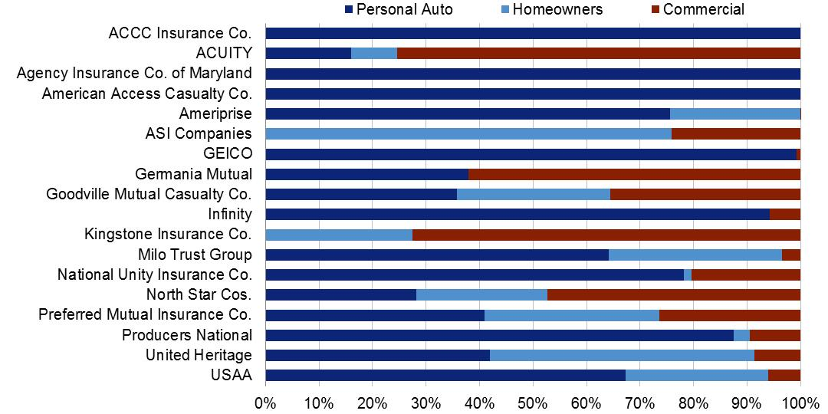
Specialization Common Among Market Leaders
Personal Lines Growth and Profit Leaders: Line-of-Business Distribution
Data source: ©A.M. Best Company—used by permission, Conning analysis
Notes:
Our most recent study that touched on this topic was one focused on Growth and Profit leaders in personal ines insurance.
The study looked at what we identify as “successful personal lines insurers”. That is, those personal lines insurers that have led the industry in both growth and profitability over the last decade.
What we came up with were 18 insurers participating in the personal lines market in a meaningful way – who are consistent leaders in terms of DWP growth and combined ratio. The members of this group are listed. Some are familiar, some less so.
The bar graph plots the line of business breakdown for the insurers in our group (perosnao auto in navy, homeowners in light blue and commercial in royal).
Specialization appears to be a common characteristic among insurers in this group. Seven members of the group are pure and nearly pure specialists in a line of business or product type—and ten of the 18 could be considered essentially personal lines specialists, effectively writing no commercial business.
You see pure LOB specialists – but beyond that other areas of specialization

Slide 32
5 of the Leaders Are NSA Specialists
Nonstandard auto
Line-of-Business Distribution
Data source: ©A.M. Best Company—used by permission, Conning analysis
Notes:
Five of these companies are non-standard auto specialists
<<Name them>>
So while a number of insurers are scaling back their involvement in this market – a few insurers are figruing out ways to grow profitably in this segment.

Slide 33
Traditional/“Defined” Nonstandard Market Under Pressure
Largest Insurance Groups Writing Nonstandard Auto, 2006
Group | 2006 Direct NSA Premiums Written | Market Share | 2013 Direct NSA Premiums Written (Est.) | % Change
Progressive Insurance Group | $11,990,527 | 32.5% | NA
Allstate Insurance Group | 3,437,192 | 9.3% | $637,000 | (81%)
Berkshire Hathaway Insurance Group | 3,198,641 | 8.7% | NA
State Farm Group | 2,126,082 | 5.8% | NA
Farmers Insurance Group | 2,090,933 | 5.7% | 1,800,896 | (14%)
American International Group | 1,238,555 | 3.4% | NA
Infinity Property & Casualty Group | 939,376 | 2.5% | 1,254,501 | 34%
Sentry Insurance Group | 868,954 | 2.4% | 447,972 | (48%)
Nationwide Group | 853,445 | 2.3% | NA
Mercury General Group | 716,715 | 1.9% | 609,921 | (15%)
GMAC Insurance Group (National General) | 687,153 | 1.9% | 612,118 | (11%)
Bristol West Insurance Group | 570,428 | 1.5% | 261,563 | (54%)
American Family Insurance Group | 568,424 | 1.5% | 593,849 | 4%
Old American County Mutual Fire Insurance Co. | 423,608 | 1.1% | 457,357 | 8%
Total Above | $29,710,033 | 80.5%
$ in thousands
Data source: ©A.M. Best Company—used by permission; Allstate supplemental financial information; Conning analysis
Notes:
The left hand column of data on this page is drawn from Best’s A4 report in 2006 – and shows a market of better than $30b . This is only the Top 14 groups that at the time comprised 80% of the market.
Now, of course, what’s happened, is that insurers do not have companies set up as non-standard companies. The have companies with multi-tiered rating plans that can go all the way from preferred to non-standard. So the Best’s lists, which still exist – don’t’ accommodate that kind of rating flexibility – and can’t be relied on in the same way.
But the A4 lists do provide some information for us that is useful – and the column at the right contains data from their current database for the companies that do still report non-standard auto in a particular underwriting company.
And what you see is, by and large, a reduction in the volume of non-standard auto written by many of these companies. Infinity is growing – American Family – and also Old American. But a lot of negative numbers in the far right column .
Some of this is just what we talked about – Insurers like Progressive – with different rating plans – now writing the non-standard auto as part of a range of classes of business.
But there’s more going on here.

Slide 34
Market Growth Concern—Auto and NSA
NSA = 3% of Total Auto Premium in 2013
Between 2006 and 2013, Allstate’s nonstandard auto portfolio declined by 11% per year on average.
Allstate Personal Auto Net Premiums Written
NSA = 23% of Total Auto Premium in 1997
$ in millions
Source: Allstate Quarterly Investor Supplements, 199802913
Notes:
This is a look at Allstate’s self-reported non-standard writings over the last decade and a half. This is just one company – but what they’re going through might resemble trends and pressures that the other large standard market companies are going through, as well. Companies like State Farm, Geico, Farmers
You can see that for Allstate -- nonstandard used to be almost a quarter of their business. From the late 90s forward – that share has contracted to the point where now they only classify 3% of the portfolio as non-standard auto.
That’s really a function of two things –may be more – but two big things. The first is bad experience with the business – and the resulting desire to pull back a little. And the other is more related to the enhanced analytics that we’ve talked about.
Whereas there used to be some rather coarse indicators of what pushed a driver into non-standard, a belter understanding of – a deeper look into certain characteristics, indicated that there were some attractive risks – or potential preferred risks – lurking down in the ill-defined pool of nonstandard drivers.
So -- with better analytics - companies are able to mine the gems from this group – and also look beyond the traditional indicators – non-standard auto – coverage gaps, accidents, etc. – and see that there are some potentially high-lifetime value customers in this group.

Slide 35
NSA Specialist Growth Not Absorbing Traditional Market Migration
NSA Specialist Peer Group
Infinity
National General
Home State
Affirmative
Safe Auto
Agency Ins. Co. of MD
Producers National
ACCC
American Access
United Automobile
MGA Insurance
Loya
Hallmark Insurance
Direct General
Permanent General
$ in millions
Data source: ©A.M. Best Company—used by permission, Conning analysis
Notes:
If it were simply that the traditional market leaders were losing interest in this business – you’d expect to see the non-standard specialists growing rapidly as the non-standard business – discarded by the likes of Allstate – flowed to them. And we do see good growth with this group . But ALL was losing non-standard designated business at ~11% per year clip - while the non-standard specialists were only growing 4% per year.
So – challenge #1, is the sort of porous boundaries of this segment – leaking premium volume.

Slide 36
Growth Pressures Pushing Market Leaders Down Market
Personal Auto Premium Growth
Behavior Changes
Economic Pressure
Individual Retention Levels
Vehicle Safety Technology
V2V Technology
Sharing Economy
Growth of Low-Cost Providers
Notes:
We talked earlier about the array of pressures facing the personal auto market.
Vehicle safety technology and emerging vehicle to vehicle technology – working against premium growth
We’ve got what may be long-term behavioral trends – in terms of a youth segment less interested in driving -- and swept up in a growing fascination with the sharing economy.
The rising influence of low costs providers and price transparency – pressuring rate growth
All of this leavers market participants looking for opportunities to grow.

Slide 37
With Improving Data NSA Could Dissolve into Micro-Segments
Non-Standard Auto
Thin File
Good Credit/ Bad Record
Quick Card/ Quick Lapse
Coverage Gap
Youthful Drivers
Notes:
The non-standard market is pretty diverse. Probably more diverse than the standard/preferred market in terms of the risk they present.
You’ve got
Youthful drivers
What we’ll call thin file – people without much of a documented record of financial responsibility
Within that you’ve got recent immigrants – someone coming out of a long-term marriage perhaps -- w/o a track record of making financial decisions on their own
People with gaps in coverage
The classic segment of people who are in and out of the market – just meeting their ID requirements on a need-to-have basis.
And I’ve noted earlier – the part of the market that a lot of market leaders are going after – the good credit/bad record crowd – or maybe the good credit, coverage gap crowd
It’s a very diverse group – probably representing diverse needs and diverse opportunities for service. With emerging analytical tools – this is as chance to really segment the market.
Developing a better understanding of the risks in the portfolio.

Slide 38
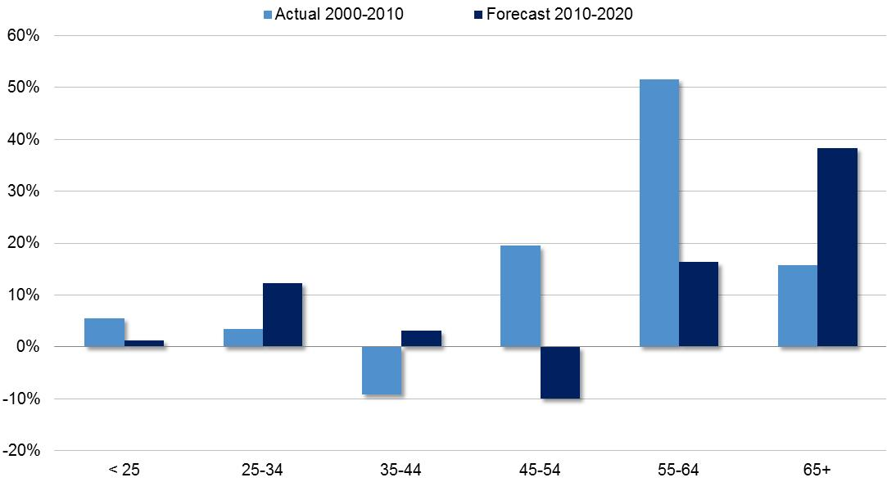
Senior Segment Is the Fastest-Growing Age Cohort
U.S. Population Growth by Age Cohort
Source: U.S. Census Bureau
Notes:
The Senior segment is directly tied to one of our big macro trends.
The senior segment (65+), or the “mature market,” is the fastest-growing age cohort in the U.S. The bulge working its way through the population will produce, on average, an estimated 10,000 individuals entering this segment every day for the next 20 years.
Conning estimates the size of this market at $43 billion as of 2013. As noted, this is a market that is projected to grow at a pace in excess of 10% per year.
The graph shows the growth for the decade just passed and projections for the decade we’re in now (the darker blue bars) – and
You can see how much more strongly the 65+ crowd is expected to grow than any other age group – particularly when compared to the declining 45-54 cohort.

Slide 39
Only a Few Companies Identify Seniors as a Target
Source: The Hartford
Notes:
Only a few companies explicitly target this marekt segment – Your exclusive agreement with AARP is a significant competitive advantage in this market
By the time the Hartford’s AARP arrangement is up for renegotiation in 2020, over one-third of all Americans will be eligible for the AARP membership

Slide 40
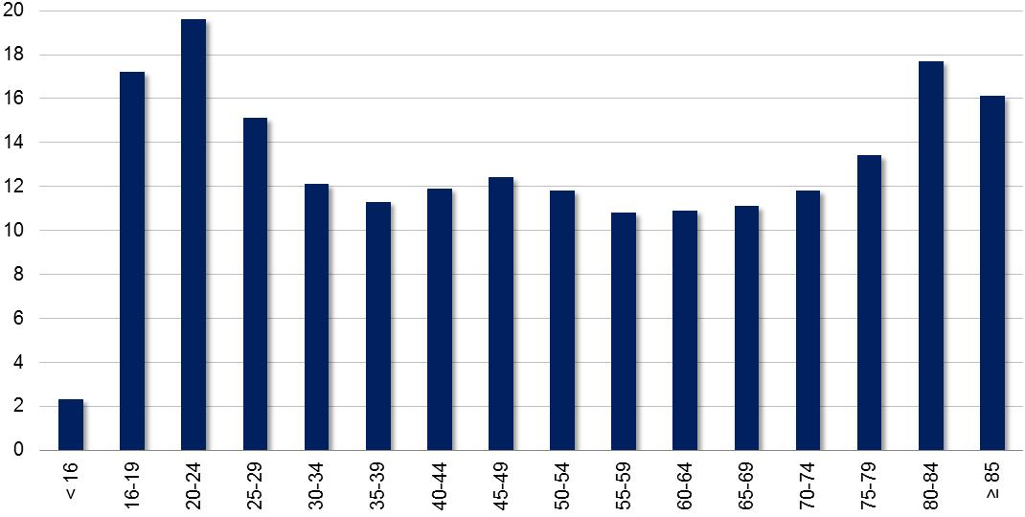
Senior Segment Presents Challenging Risk Characteristics
Motor Vehicle Crash Deaths per 100,000 People by Age, 2009
Source: Insurance Institute for Highway Safety
Notes:
Liberty Mutual and GEICO also offer products and services that address the needs of this growing market.
<<as we saw in an earlier slide >> the senior segment has some challending characteristics. The graph provides a proxy for personal auto loss costs by age band – showing vehicle crash deaths per capita – showing the stark contrast between the groups at either end of the driving population –
Seniors 75 and over have the second-highest probability of dying in car accidents, after young people aged 15-24.
In addition, The emerging cohort of seniors will be working longer (combined effects of better medicine, better nutrition, and lack of retirement savings), which means they will be driving more than historical experience would lead one to expect. Reduced mileage has been characteristic of this segment, but that is expected to change.

Slide 41
Annual Mileage an Important Factor for Seniors
Average Mileage per Age Cohort, 2009
Source: Federal Highway Administration National Household Travel Survey
Notes:
Reduced mileage has been characteristic of this segment, but that is expected to change. But the change may be slow, and in the meantime it can be a major differentiating factor in rating senior drivers in contrast to the rest of the population.

Slide 42
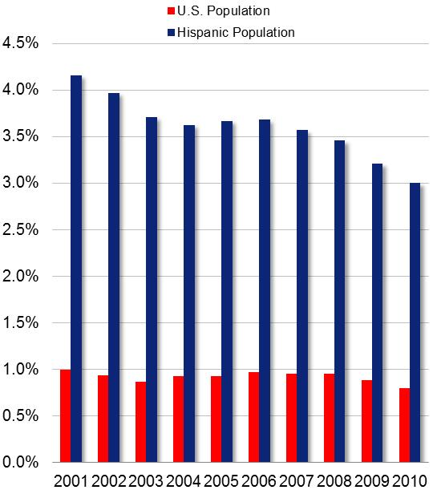
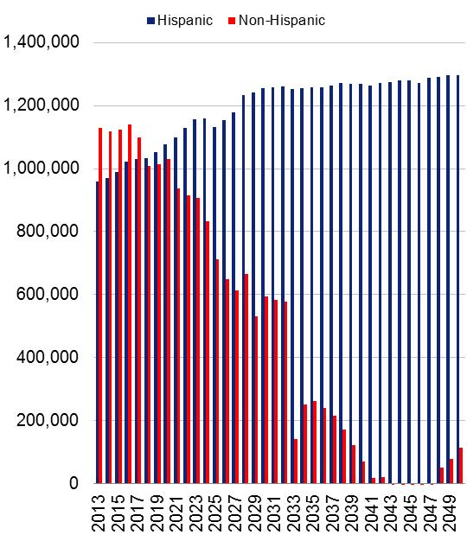
Hispanic Market Is of Growing Importance for Insurers
Annual Population Growth Rate, Total U.S. vs. Hispanic Population
Annual Increase in Driving Age Population
Source: U.S. Census Bureau
Notes:
Finally – the Hispanic market - The Hispanic market consists of individuals of Hispanic origin by heritage or nationality group. Between 2000 and 2010, Hispanics accounted for more than half (55.5%) of the nation’s growth. The Hispanic growth rate in that period of 43% was more than four times the growth rate of the total population (9.7%).
With a high proportion of today’s youth in this demographic segment, the Hispanic market is clearly of growing importance for insurers—forming a critical piece of tomorrow’s market. The Hispanic population is projected to rise from 16% of the U.S. population in 2010 to about 20% by 2020.
Conning estimates a Hispanic personal auto market size of $18 billion to $21 billion – and -- a potential Hispanic homeowners insurance market segment of $6.4 billion. Applying the Census growth projections to these market size estimates drivers you to a %41b market by 2020.

Slide 43
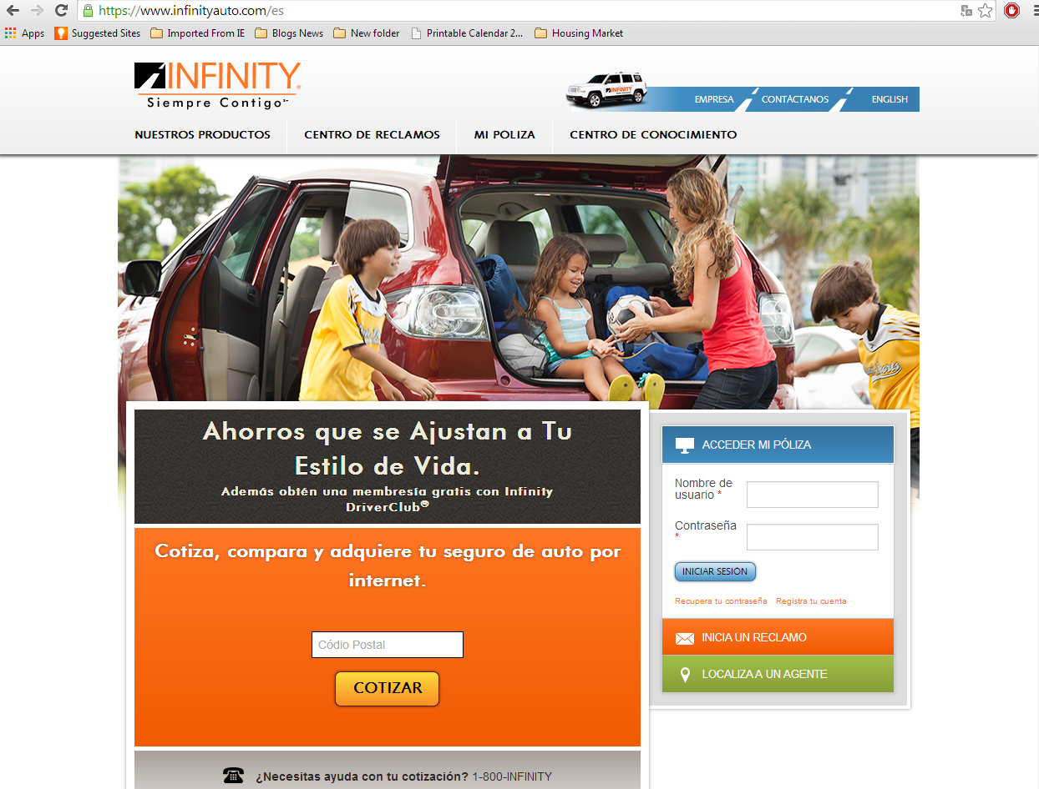
Insurers Devoting More Resources to This Segment
Source: www.Infinityauto.com/es
Notes:
The opportunity presented by this growing segment has not escaped notice of the leading personal lines insurers. Allstate, Nationwide, and State Farm all devote significant resources to account acquisition and client servicing in this segment.
This shows Allstate’s efforts to reach this segment – but they are not alone. Most of the larger national carriers have mesaging geared toward this important segment.
The Hispanic consumer market is not homogenous and includes individuals from several different countries. More importantly, there are important differences between first, second, and third generation immigrants. Understanding the needs of these different elements of the Hispanic market is critical to success in developing a competitive advantage in this market.

Slide 44
Select Brokers/Agencies Are Also Finding Opportunity
Notes:
Insurers are not the only ones positioning to take advantage of this market. There are significant opportunities for agencies, as well. Both Protector Holdings and Confie Seguros were formed to consolidate retail brokerages operating in the Hispanic market.
Protector Holdings. “Protector Holdings was formed in 2013 by Dowling Capital Partners and Edgewood Partners Insurance Center (“EPIC”) to pursue a roll-up strategy of acquiring retail insurance brokerages serving the Hispanic market in the West and Southwest regions of the United States. Protector Holdings closed on the acquisition of its platform agency Premier Insurance Services, in May 2013.
Confie Seguros. Private equity-backed insurance broker Confie Seguros purchased the retail auto insurance unit of Affirmative Insurance Holdings in 2013 as part of a series of acquisitions to build its reach in the U.S. Hispanic market. Confie has acquired over sixty companies to work toward its objective of being the first national personal lines broker with a focus on the Hispanic market.

Slide 45
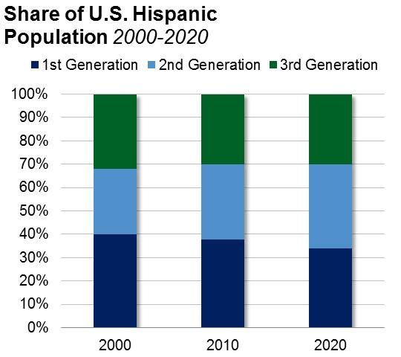
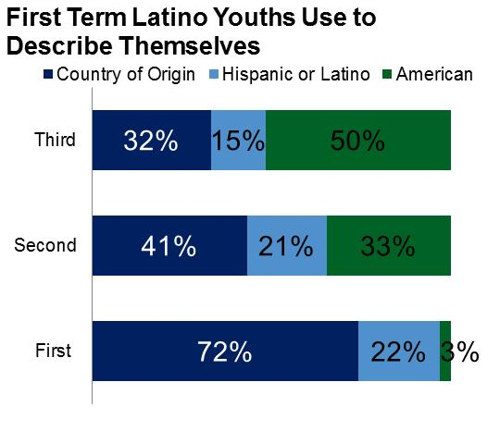
Generational Differences Create Different Markets
First: Foreign-born or immigrant.
Second: U.S. native (born in the United States or territories), with at least one first-generation parent.
Third-and-higher: U.S. native (born in the United States or territories), with both parents native-born.
Source: http://www.pewhispanic.org/2014/04/29/statistical-portrait-of-hispanics-in-the-united-states-2012/

Slide 46
Finally: Micro-Segmentation from Personalized Data
Auto Rating Data Sophistication Transforming with “Real Time” Access
Internet of Things (IoT)
Social Media
Telematics
Dynamic, updatable data
Specificity of Content
50 2000 750,000
Predictive analytics
Traditional application-based information
Annual Monthly Daily Instant
Speed of Information
Telematics … vehicles … trucks … what about appliances? Factories?
Source: Consumer Trends in Personal Lines Insurance, Conning, 2012
46

Slide 47
New Approaches for New Markets
Customer Contact

Slide 48
Increasing Complexity of Customer Retention
Auto Insurance Shopping and Switching Percentages vs. Pricing
Source: J.D. Power U.S. Insurance Shopping Studies, 2010-2014, Bureau of Labor Statistics, Conning analysis
Notes:
Tied in with this, too, is a rate environment that is likely to discourage shopping, which makes growth perhaps more challenging. The slide shows a little evidence of the correlation between the tendency to shop and the prevailing rate environment. As rates soften – shopping diminishes.
So -- again – more pressures on growth – greater tendency for market leaders to look for new places to grow. – Pushing into traditionally overlooked parts of the market.

Slide 49
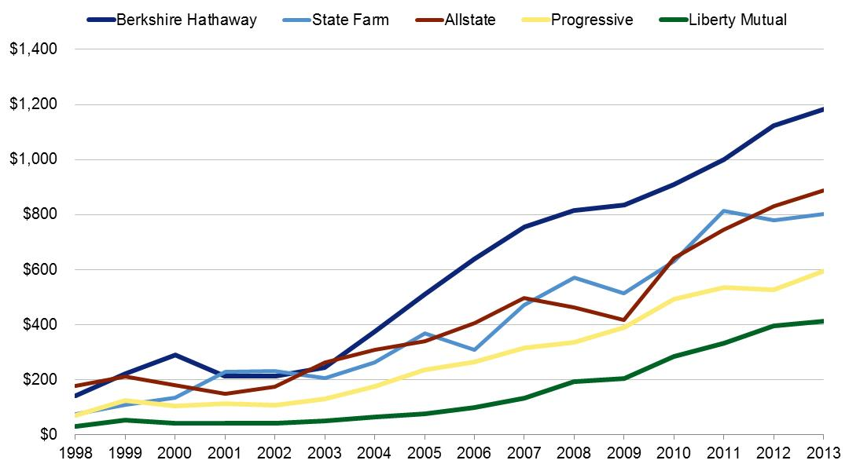
Spending More to Establish an Unstable Relationship
Advertising Expense, Five Largest Spenders
($ in millions)
Data source: ©A.M. Best Company—used by permission, Conning analysis
Notes:
We’ve already noted a few key observations
Consumer interest in gathering information online
Rising trust in the online transaction
Varying shopping preferences by demographic group
A preference for the freedom to use multiple channels
And one of the most critical trends within distriubtion is this massive increase in ad spending.
This certainly works to get customers shopping – about ¼ of auto insurance customers shopped for a new policy last year – according to statisitics from JD Power. The problem is that customers who shop and switch – tend to post pretty low retention metrics with their new carrier. So insurers are spending more money to get new business -- much of which won’t return the next year. The value of the acquired policies declines as retention erodes.
For the direct response model with high up front costs – account profitability centers on recoupment of these big up front costs over an extended renewal period – the longer an account stays on the books – the more profitable it becomes.
Messaging that encourges shopping – really fights against the direct response company’s interests.
So what shakes out of these channel observations?
We think that two interim takeaways from these observations are that 1) consumers right now appear to want to connect with their insurers through a variety fo channels; and 2) attempting to zone in on one likely future model of what a successful distribution format will look like is not very realistic. Projecting the future based on a linear extrapolation of current trends ignores the complexity of a system like the market for personal lines insurance.
But that doesn’t mean that companies can’t take strategic steps in response to these trends. – and they are.

Slide 50
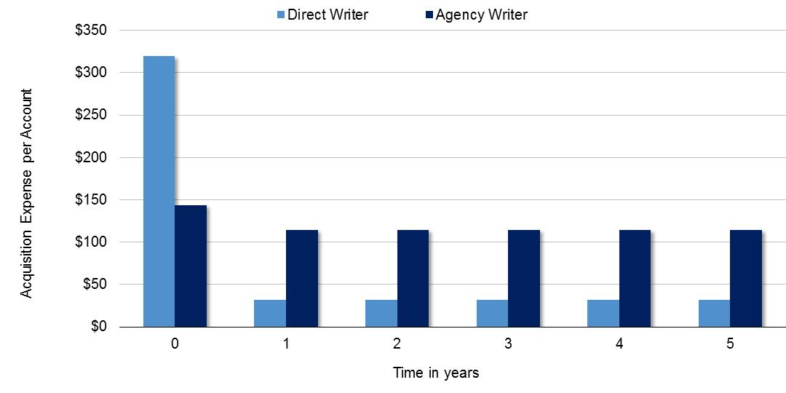
Economics of Acquisition Costs: Direct Response and Agency
Direct vs. Agency Acquisition Costs
5-Year Account Lifecycle
The example assumes that underwriting and policy issuance expenses are similar for each insurer.

Slide 51
Increasing Competition: Rise of Aggregators
51
Notes:
Add GEICO

Slide 52
Buying Behavior Is Shifting Too
What Is Driving Channel Evolution?
Gathering information online is the most popular auto insurance shopping method
Increasing sophistication of pricing models reduces the need for front-line underwriting (McKinsey)
Trust in online financial transactions is high (88% of customers bank online)
Insurance customer satisfaction is highest among those who interact with their insurer through the agent and emerging channels (JDPower)
Customer expectations of insurance is influenced by interactions with other retailers
Shopping and buying habits vary by demographic group
Notes:
Understanding the insurance buying behavior of the evolving consumer market is another critical piece of the consumer profile.
We can follow some of the key trends affecting channel choices and get a sense from where things are headed
Increasing sophistication of pricing models reduces the need for front-line underwriting. This reduces the value added of the traditional agent.
Trust in online financial transactions is high (88% of customers bank online)
But - - -customer satisfaction is highest when consumers are allowed to combine channels.
As the last bullet notes, shopping and buying habits vary by demographic group. If I am reading your comments correctly, a majority of AARP members prefer to buy from a local agent.
So those are some of the key trends that have emerged recently.

Slide 53
Allstate Addressing Array of Consumer Preferences
Brand Neutral
Encompass
Answer Financial
Allstate Agencies
esurance
Local Advice
Self-Service
Brand Sensitive
Source: Allstate 2012 Annual Report
Notes:
This slide shows Allstate’s framework for personal lines distribution – recognizing some of these trends we’ve talked about. They aren’t placing bets on a channel – but positioning themselves to meet the evolving consumer preferences of a diverse market. They new the market as a functio nof two variable – brand sensivity and the need for advice and/or service. And they are developing offerings for each of these quadrants.

Slide 54
Other Insurers Are Pursuing Multichannel
Brand Neutral
Independent Agency
Online Agency/ Aggregator
Exclusive Agency
Direct Response
Local Advice
Self-Service
Brand Sensitive
Notes:
Viewing this more generically – it is a useful model for addressig the market
Indepdent agency
Online agency
Direct response
And exclusive agency
And when you view it this way – you see that Allstate isnt’ alone in positioniing themselves to address the needs of the evolving consumer market.

Slide 55
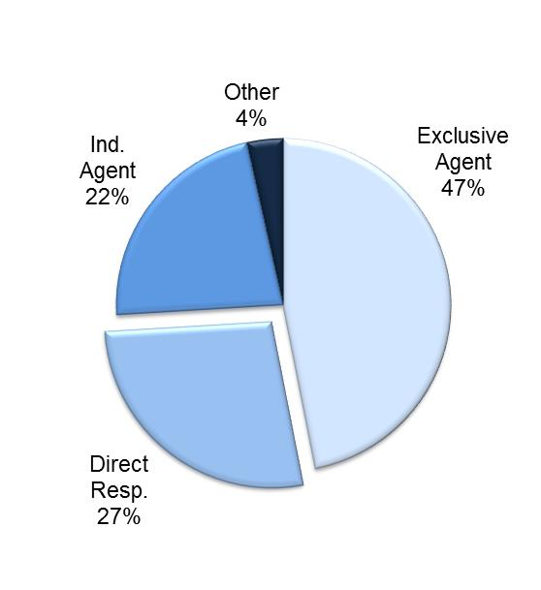
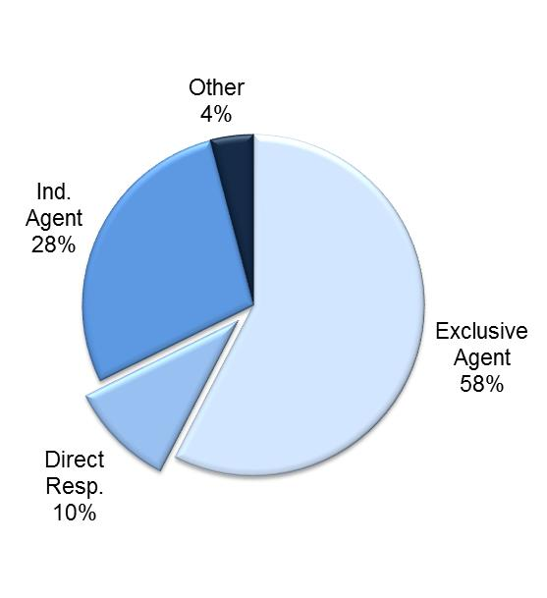
Direct Response Still More Prominent in Auto
Personal Auto Premium Distribution by Channel
Homeowners Premium Distribution by Channel
Data source: ©A.M. Best Company—used by permission; Company GAAP filings; Investor presentations; Company news releases; Conning analysis
Notes:
The distribution landscape already looks quite a bit different than it did a decade ago – although these differences vary by channel. This provides a view of where we think things are from a a channel standpoint for the two lines of business – auto clearly much more affected by developments in the direct response channel. In the mid-90s, that direct percentage for auto was, perhaps, 15% -- now it’s pushing close to 30%.
The complexity of the home product relative to its auto counterpart is a principle driver of these differences. It’s a more complex product with more decisions to be made (coverage, perils, exclusions, limits) and the potential for a huge mistake is greater with homeowners than with auto. There is, therefore, a reluctance on the part of the consumer to trust the protection of their largest asset to the risks of an online transaction.
But we’re curious about where the market might be headed.

Slide 56
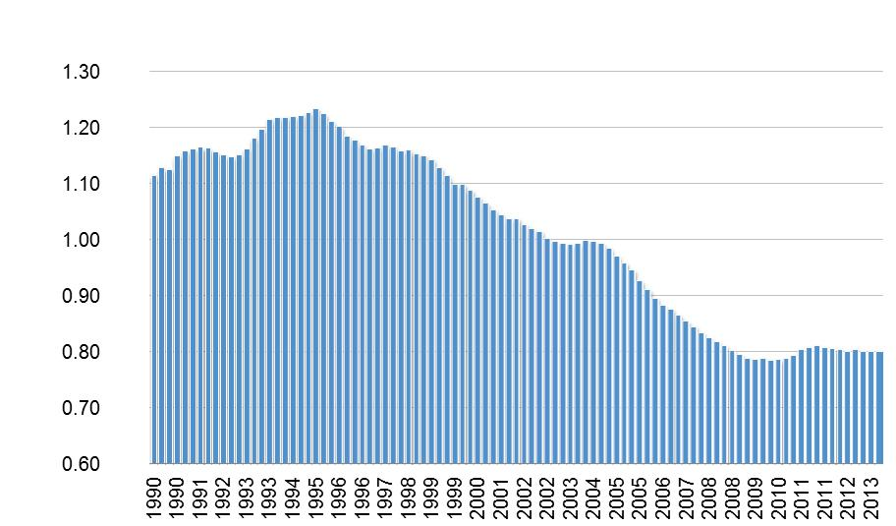
Auto Frequency Improvements … Challenge to the Auto Market?
Contributors to Frequency Trends
Graduated driver laws
DUI enforcement
Safer roads
Anti-lock brakes
Reduced miles traveled
Driver monitoring
Event recorders
Location tracking
Back-up cameras
Paid Claim Frequency: Personal Auto Bodily Injury
Source: ISO Fast Track; Conning analysis
56

Slide 57
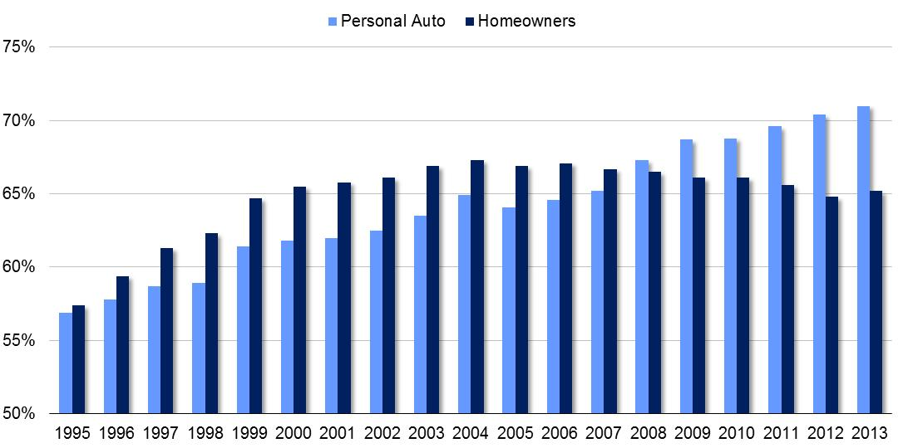
Consolidation in Auto, What About Homeowners?
Market Share of Top 10 Personal Auto and Homeowners Insurers
The homeowners line followed a path similar to personal auto until catastrophe events in 2004-2005 led many large national insurers to de-risk the homeowners portfolio. Is that ending?
Data source: ©A.M. Best Company—used by permission, Conning analysis

Slide 58
Insurers Continue to Advance Service with Mobile Technology Apps
Keeping Mobile Fresh and Active
To Drive Customer Retention
58

Slide 59
About Conning
Conning is a leading investment management company for the global insurance industry. Conning is focused on the future, supporting the insurance industry with innovative financial solutions, investment experience, and proprietary research. Conning’s unique combination of asset management, risk and capital management software and advisory solutions, as well as insurance research, helps clients achieve their financial goals through customized business and investment strategies. Founded in 1912, Conning is headquartered in Hartford, Connecticut, and serves its global client base from additional offices in New York, London, Cologne, and Hong Kong.
Insurance Research Conning publishes a number of insurance industry research services, including its Insurance Segment Reports semiannual line-of-business reviews; its Forecast & Analysis service, which offers a forward look at the industry; and its well-known Strategic Study series of executive reports on key products and trends and issues of critical industry importance. All are available in print and online through our web-based insurance research portal Conning Library (www.conninglibrary.com).
In addition to its published research, Conning offers proprietary research services to the insurance industry.
For more information on our insurance research services, please call 888-707-1177 or visit www.conningresearch.com.
This presentation has been prepared for and distributed exclusively to specific clients of Conning. Further distribution, sale, or reproduction, in whole or in part, and by any means, is prohibited. Statements and information in this report were compiled from sources that we consider to be reliable or are expressions of our opinion. The presentation is not intended to be complete, and we do not guarantee its accuracy. It does not constitute and must not be considered investment advice. With offices in Hartford, New York, London, Cologne, and Hong Kong, Conning is a portfolio company of the funds managed by Aquiline Capital Partners LLC (“Aquiline”), a New York-based private equity firm.
The names of certain companies, products, and product brands, and the logos and images related thereto, are trademarks of their third-party owners. They are used herein for illustrative and informational purposes only. Nothing herein implies sponsorship or endorsement of those companies or products by Conning, or an endorsement by such trademark owners of Conning or its products and services.

