Slide 1
Risk Classification Application:
Comm. Auto Optional Class Plan
© Insurance Services Office, Inc., 2015

Slide 2
This Presentation’s Topic
ISO is about to enhance its Commercial Lines Manual with an Optional Classification Plan for certain Commercial Auto risks.
© Insurance Services Office, Inc., 2015

Slide 3
Scope
The Optional Class Plan changes the following prospective loss costs:
Vehicles:
  Trucks, Tractors, and Trailers (but not zone-rated)
  Private Passenger Types
Coverages:
  CSL Liability
  Collision
  Comprehensive (also: Specified Causes of Loss coverage)
© Insurance Services Office, Inc., 2015

Slide 4
Timing
Filing began in October 2015
Companies opting in will determine their own effective date.
ISO Staff’s long term goal: Replace the current rating structure. (Not before 2019.)
Rules & Modeling support are in ISO Circular LI-CA-2015-152.
© Insurance Services Office, Inc., 2015

Slide 5
Manual Mechanics
The Optional Class Plan will be accessible as a supplement to the State Insurance Manual (SIM).
Two sets of loss costs will be maintained.
The existing rules in the current manual won’t change.
For companies opting in, the new optional rules will replace parts of the manual, the same way the state exceptions replace the multistate today.
© Insurance Services Office, Inc., 2015

Slide 6
Marketplace Simulation
Simplifying Assumptions:
TTT Liability only
Several companies start with the current ISO manual, pricing for a 70% loss ratio.
Company A has a (randomly selected) 20% of the insured risks.
Customers won’t switch insurers unless there is a 10% price advantage to switching.
© Insurance Services Office, Inc., 2015

Slide 7
Marketplace Simulation
Company A changes rating plans.
(revenue neutral)
Customers react by switching insurers.
Competitors increase rates to improve loss ratio.
Customers react again! … and so on.
Company A switches to the new rating plan.
Customers react by switching insurers if there is a 10% difference.
Competitors increase their rates due to higher losses.
Customers react again!
© Insurance Services Office, Inc., 2015

Slide 8
Marketplace Simulation
Company A changes rating plans.
(revenue neutral)
Customers react by switching insurers.
Competitors increase rates to improve loss ratio.
Customers react again! … and so on.
Company A switches to the new rating plan.
Customers react by switching insurers if there is a 10% difference.
Competitors increase their rates due to higher losses.
Customers react again!
© Insurance Services Office, Inc., 2015

Slide 9
Marketplace Simulation
!
!
Company A changes rating plans.
(revenue neutral)
Some customers react by switching insurers.
Competitors increase rates to improve loss ratio.
Customers react again! … and so on.
Company A switches to the new rating plan.
Customers react by switching insurers if there is a 10% difference.
Competitors increase their rates due to higher losses.
Customers react again!
© Insurance Services Office, Inc., 2015

Slide 10
Marketplace Simulation
!
!
Company A changes rating plans.
(revenue neutral)
Some customers react by switching insurers.
Competitors increase rates to improve loss ratio.
Customers react again! … and so on.
Tangent: How can both loss ratios be increasing?...
Company A switches to the new rating plan.
Customers react by switching insurers if there is a 10% difference.
Competitors increase their rates due to higher losses.
Customers react again!
© Insurance Services Office, Inc., 2015

Slide 11
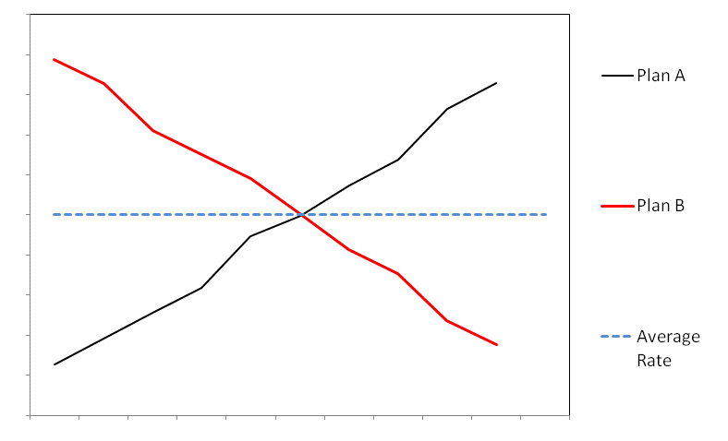
Marketplace Simulation
Company A switches to the new rating plan.
Customers react by switching insurers if there is a 10% difference.
Competitors increase their rates due to higher losses.
Customers react again!
© Insurance Services Office, Inc., 2015

Slide 12
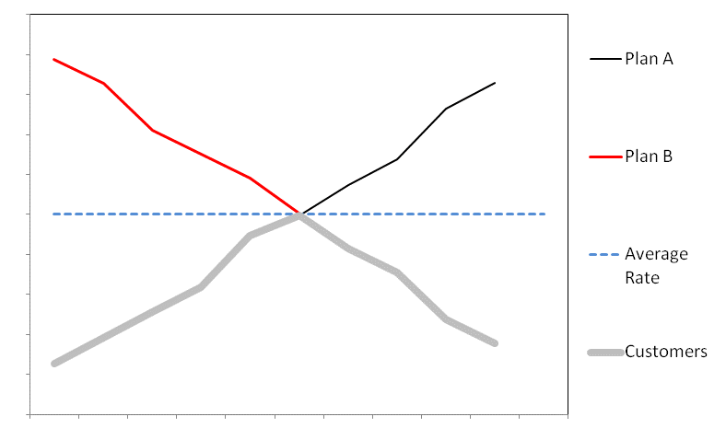
Marketplace Simulation
Company A switches to the new rating plan.
Customers react by switching insurers if there is a 10% difference.
Competitors increase their rates due to higher losses.
Customers react again!
© Insurance Services Office, Inc., 2015

Slide 13
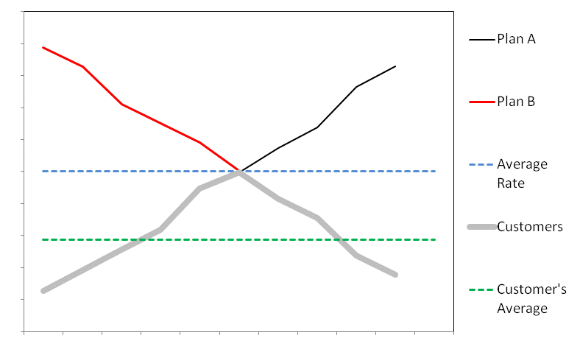
Marketplace Simulation
Company A switches to the new rating plan.
Customers react by switching insurers if there is a 10% difference.
Competitors increase their rates due to higher losses.
Customers react again!
© Insurance Services Office, Inc., 2015

Slide 14
Marketplace Simulation
Company A changes rating plans.
(revenue neutral)
Some customers react by switching insurers.
Competitors increase rates to improve loss ratio.
Customers react again! … and so on.
Company A switches to the new rating plan.
Customers react by switching insurers if there is a 10% difference.
Competitors increase their rates due to higher losses.
Customers react again!
© Insurance Services Office, Inc., 2015

Slide 15
Marketplace Simulation
Company A changes rating plans.
(revenue neutral)
Some customers react by switching insurers.
The other companies increase rates to improve loss ratios.
Customers react again! … and so on.
Company A switches to the new rating plan.
Customers react by switching insurers if there is a 10% difference.
Competitors increase their rates due to higher losses.
Customers react again!
© Insurance Services Office, Inc., 2015

Slide 16
Marketplace Simulation
!
Company A changes rating plans.
(revenue neutral)
Some customers react by switching insurers.
The other companies increase rates to improve loss ratios.
Customers react again! … and so on.
Company A switches to the new rating plan.
Customers react by switching insurers if there is a 10% difference.
Competitors increase their rates due to higher losses.
Customers react again!
© Insurance Services Office, Inc., 2015

Slide 17
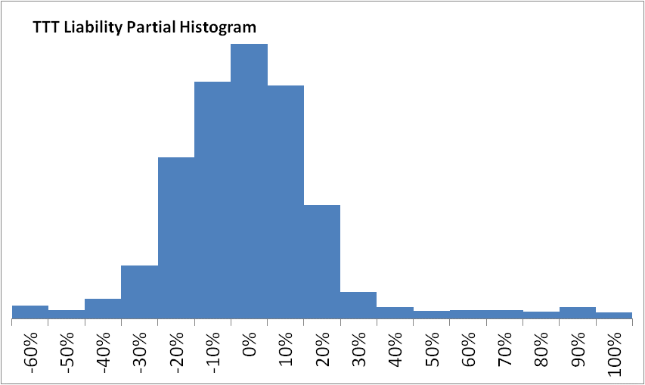
Swings
© Insurance Services Office, Inc., 2015

Slide 18
Swings
Over 80% of risks are within +/- 25%
Over 90% of risks are within +/- 45%
Most extreme % changes are for Trailers.
© Insurance Services Office, Inc., 2015

Slide 19
Swings
Over 80% of risks are within +/- 25%
Over 90% of risks are within +/- 45%
Most extreme % changes are for Trailers.
© Insurance Services Office, Inc., 2015

Slide 20
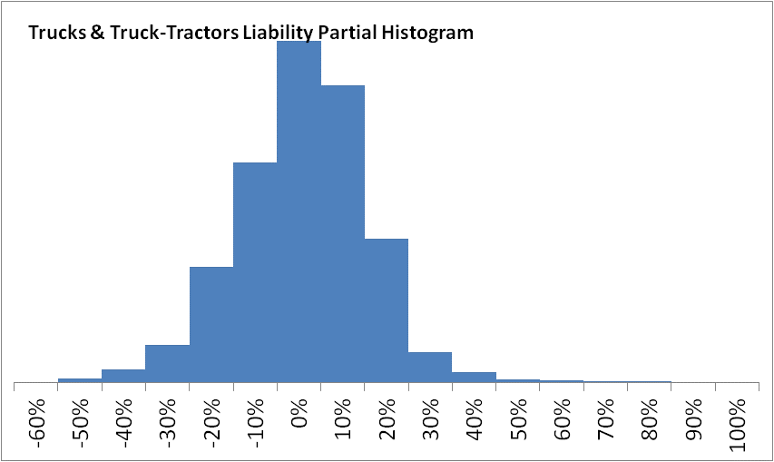
Swings
What if we exclude trailers?
Over 90% of risks are within +/- 25%
Almost 99% are within +/- 45%
© Insurance Services Office, Inc., 2015

Slide 21
Swings
Q: What kind of Trucks are getting the biggest Liability increases?
A: The ones with the highest factors for these new variables:
Moderate Vehicle Age (3-5)
Unusually high Original Cost New (OCN)
© Insurance Services Office, Inc., 2015

Slide 22
Swings
Q: What kind of Trucks are getting the biggest Liability increases?
A: Vehicles that share these 3 characteristics:
Secondary Classes: Garbage Disposal, Tow Truck for Hire, Sand & Gravel
Moderate Vehicle Age (3-5)
High Original Cost New (OCN)
© Insurance Services Office, Inc., 2015

Slide 23
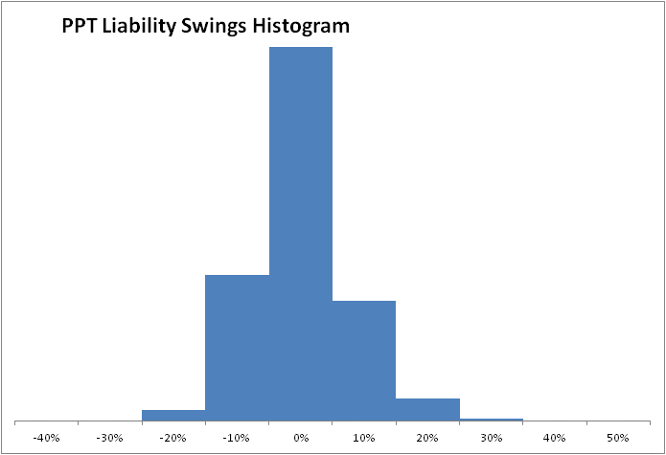
Swings
© Insurance Services Office, Inc., 2015

Slide 24
Swings
Over 99% are within +/- 25%
Characteristics of increases:
  1 or 2 vehicles on policy
  Moderate Vehicle Age
  High OCN
  No youthful operator & no commute. (Discount reduced)
© Insurance Services Office, Inc., 2015

Slide 25
Swings
Over 99% are within +/- 25%
Characteristics of increases:
  1 to 2 vehicles on policy
  Moderate Vehicle Age
  Low OCN
  No youthful operator & no commute. (Discount reduced)
© Insurance Services Office, Inc., 2015

Slide 26
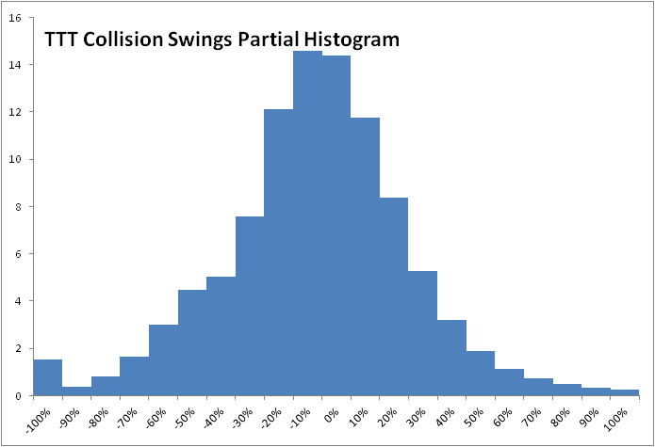
Swings
© Insurance Services Office, Inc., 2015

Slide 27
Swings
Only 61% are within +/- 25%
Biggest Increases:
Trucker-classified Trailers
Medium Weight Farming Trucks
© Insurance Services Office, Inc., 2015

Slide 28
Swings
Only 61% are within +/- 25%
Biggest Increases:
Trucker-classified Trailers
Medium Weight Farming Trucks
© Insurance Services Office, Inc., 2015

Slide 29
Swings
Only 61% are within +/- 25%
Biggest Increases:
Trucker-classified Trailers
Medium-weight Farming Trucks
© Insurance Services Office, Inc., 2015

Slide 30
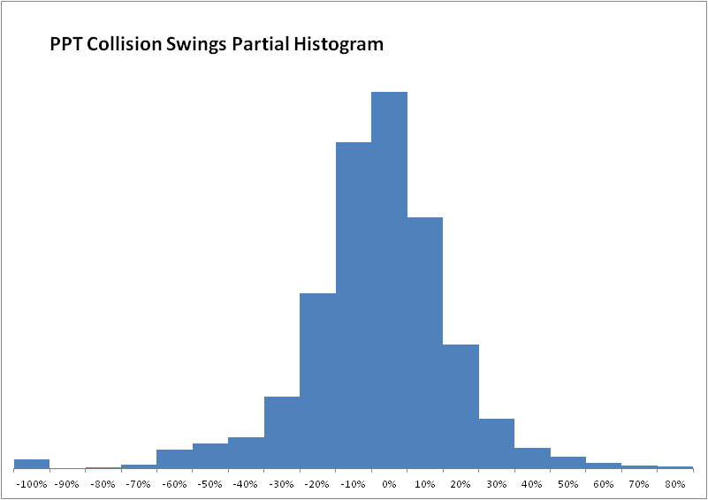
Swings
© Insurance Services Office, Inc., 2015

Slide 31
Swings
Over 80% within +/- 25%
Biggest Increases:
Old vehicles with very high OCNs. (Restored?)
© Insurance Services Office, Inc., 2015

Slide 32
Swings
Over 80% within +/- 25%
Biggest Increases:
Old vehicles with very high OCNs. (Restored?)
© Insurance Services Office, Inc., 2015

Slide 33
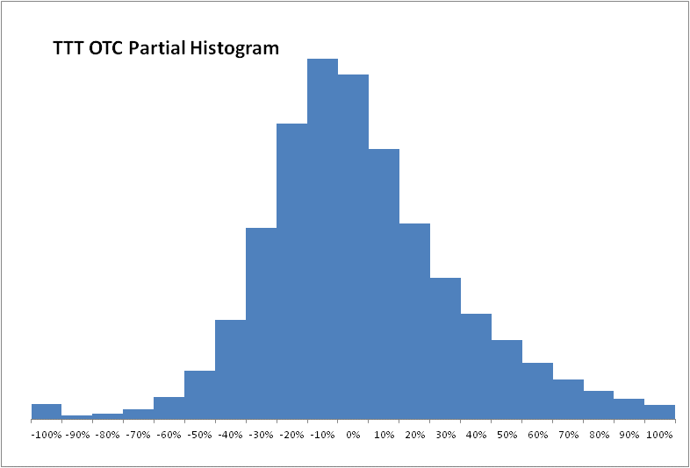
Swings
© Insurance Services Office, Inc., 2015

Slide 34
Swings
63% within +/- 25%
Biggest Increases:
Trucker-classified Trailers (again)
Medium-weight Farming Trucks (again)
© Insurance Services Office, Inc., 2015

Slide 35
Swings
63% within +/- 25%
Biggest Increases:
Trucker-classified Trailers (again)
Medium-weight Farming Trucks (again)
© Insurance Services Office, Inc., 2015

Slide 36
Swings
63% within +/- 25%
Biggest Increases:
Trucker-classified Trailers (again)
Medium-weight Farming Trucks (again)
© Insurance Services Office, Inc., 2015

Slide 37
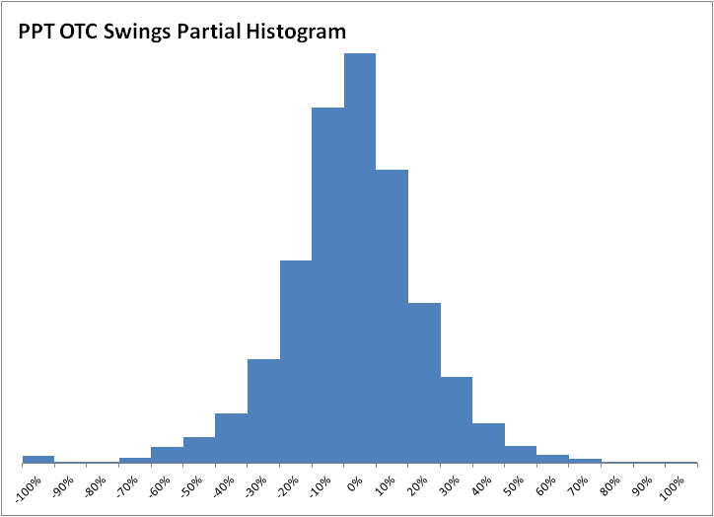
Swings
© Insurance Services Office, Inc., 2015

Slide 38
Swings
80% within +/- 25%
Biggest Increases:
No youthful operator & no commute.
Few vehicles on the policy.
© Insurance Services Office, Inc., 2015

Slide 39
Introduction of New Variables
© Insurance Services Office, Inc., 2015

Slide 40
Introduction of New Variables
NAICS
  Industrial Classification
  Replaces SIC
  Hierarchical six-digit structure, but:
  Initially rating will differ by first 3 digits.
© Insurance Services Office, Inc., 2015

Slide 41
Introduction of New Variables
NAICS Difficulties:
  We collect SIC, not NAICS
  We only get SIC reporting on a minority of records.
  For some categories, all/most of the reporting comes from one company.
© Insurance Services Office, Inc., 2015

Slide 42
Introduction of New Variables
NAICS Modeling Approach:
  Top-down iterative GLMs:
    “Company concentration” 85% cut-off
    P-value
    Consistency from year to year.
    Consistency with indications from other modeling approaches (GLMC).
  Very conservative
  selections:
© Insurance Services Office, Inc., 2015

Slide 43
DRAFT Manual Table
[ Draft tables are populated with 1.00’s for illustrative purposes only. ]
© Insurance Services Office, Inc., 2014

Slide 44
Introduction of New Variables
Original Cost New (OCN) and Vehicle Age
Current:
Physical Damage
only
Optional Plan:
Physical Damage and Liability
© Insurance Services Office, Inc., 2015

Slide 45
More Variation For Existing Factors
© Insurance Services Office, Inc., 2015

Slide 46
More Variation For Existing Factors
Primary Classification Factor
(TTT: Vehicle Weight, Business Use, Radius of Operations)
(PPT: Commute Distance, Youthful Operator, Business v Personal)
Current:
Liability
Physical Damage
(One set for PPT)
Optional Plan:
Liability
Comprehensive
Collision
© Insurance Services Office, Inc., 2015

Slide 47
More Variation For Existing Factors
TTT Secondary Classification Factor
Current:
One set
(Does not apply to Trailers.)
Optional Plan:
Liability
Comprehensive
Collision Trucks
Collision Trailers
Also: Differentiation on the second digit.
© Insurance Services Office, Inc., 2015

Slide 48
More Variation For Existing Factors
Fleet Factor becomes Fleet Size Factor
Current:
Two Categories:
Fleet and Non-Fleet
Optional Plan:
Twenty Fleet Size categories
PPT Factors
© Insurance Services Office, Inc., 2015

Slide 49
More Variation For Existing Factors
Original Cost New (OCN) Ranges
Current:
11 ranges.
Linear increase over
$90k
Optional Plan:
41 ranges up to $1 Million
© Insurance Services Office, Inc., 2015

Slide 50
More Variation For Existing Factors
Vehicle Age Factors
Current:
12 Age Ranges
Optional Plan:
28 Age Ranges
Decline differs by OCN for Collision.
© Insurance Services Office, Inc., 2015

Slide 51
More Variation For Existing Factors
Other enhancements:
All:
Unique Stated Amount Age Factor
TTT Collision:
Heavy Farming Vehicle Discount
Heavy Dumping Vehicle Surcharge replaces current Dumping factor
© Insurance Services Office, Inc., 2015

Slide 52
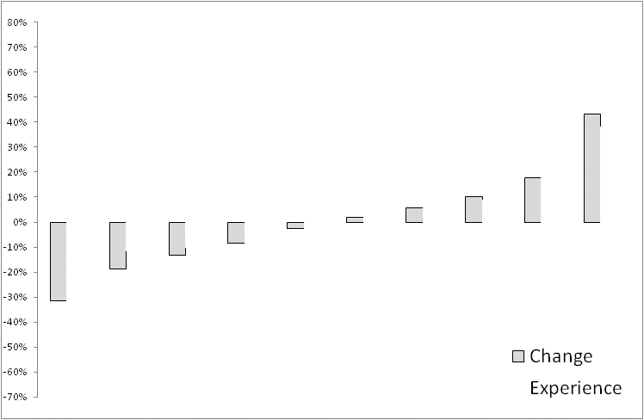
Lift: TTT Liability
© Insurance Services Office, Inc., 2015

Slide 53
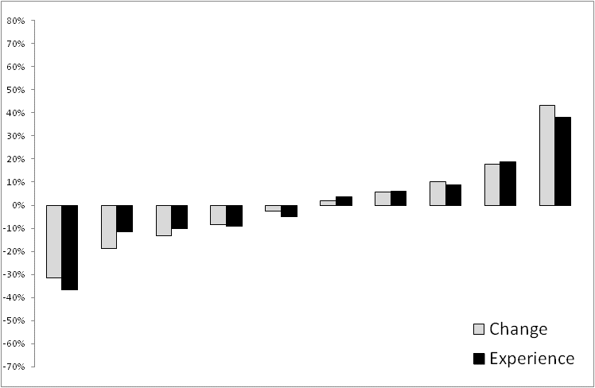
Lift: TTT Liability
© Insurance Services Office, Inc., 2015

Slide 54
Lift: TTT Liability
Since appearances can be deceiving, how can we measure the success of the model in matching loss experience?
In particular, can we summarize it in a single number that is accessible to a non-actuarial audience?
One possibility: Computing R² on the lift chart itself.
© Insurance Services Office, Inc., 2015

Slide 55
Lift: TTT Liability
By-Decile R² Value: 97%
© Insurance Services Office, Inc., 2015

Slide 56
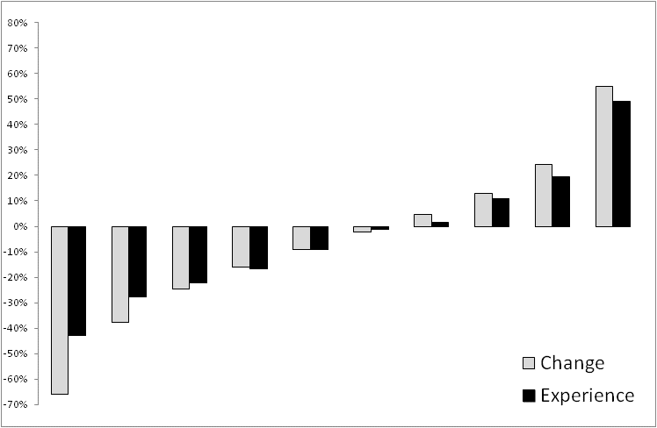
Lift: TTT Collision
By-Decile R² Value: 89%
© Insurance Services Office, Inc., 2015

Slide 57
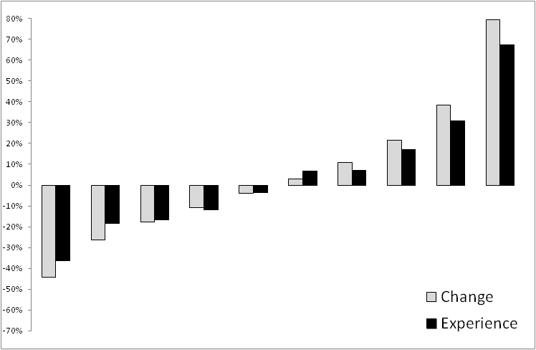
Lift: TTT OTC
By-Decile R² Value: 95%
© Insurance Services Office, Inc., 2015

Slide 58
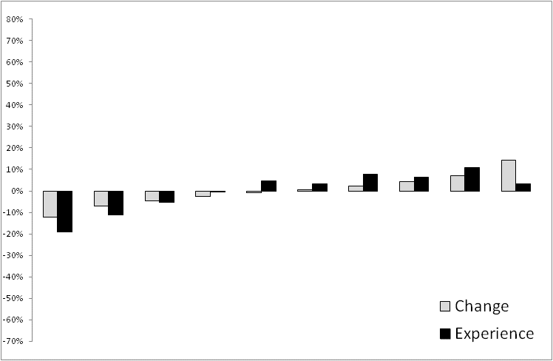
Lift: PPT Liability
By-Decile R² Value: 65%
© Insurance Services Office, Inc., 2015

Slide 59
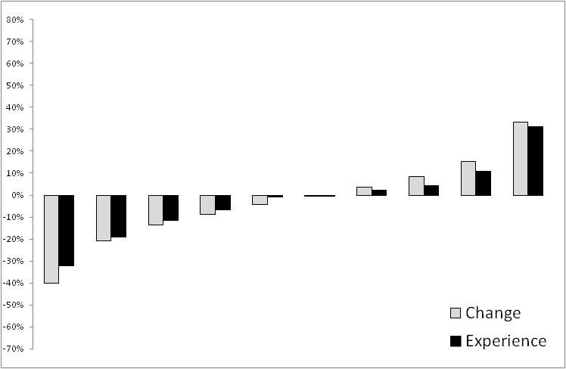
Lift: PPT Collision
By-Decile R² Value: 95%
© Insurance Services Office, Inc., 2015

Slide 60
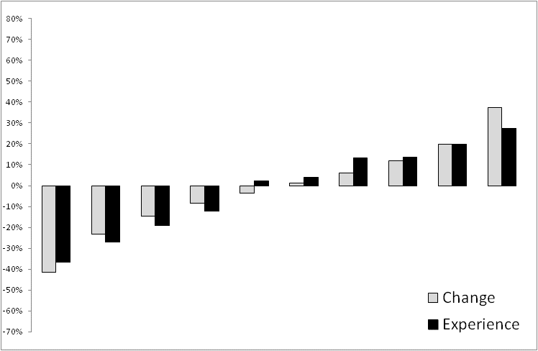
Lift: PPT OTC
By-Decile R² Value: 94%
© Insurance Services Office, Inc., 2015

Slide 61
Case Study
PPT Liability Mystery:
A lift chart looks good when modeling, but terrible after making factor selections.
Much of the lift was being provided by control variables.
This combination of variables was predicting poor experience:
  One vehicle on the policy.
  Vehicle Age and OCN not known.
© Insurance Services Office, Inc., 2015

Slide 62
Case Study
PPT Liability Mystery:
Lift chart looks right when modeling, but terrible after making factor selections.
A discount for single-vehicle policies was offsetting a surcharge on a control variable.
This combination of variables was predicting poor experience:
  One vehicle on the policy.
  Vehicle Age and OCN not known.
© Insurance Services Office, Inc., 2015

Slide 63
Case Study
PPT Liability Mystery:
Lift chart looks right when modeling, but terrible after making factor selections.
A discount for single-vehicle policies was offsetting a surcharge on a control variable.
This combination of variables identified a group with poor experience:
  One vehicle on the policy.
  Vehicle Age and OCN not known.
© Insurance Services Office, Inc., 2015

Slide 64
Case Study
PPT Liability Mystery: The explanation.
We were actually modeling a correlation between risky insureds and the decision not to buy physical damage insurance.
© Insurance Services Office, Inc., 2015

Slide 65
Case Study
PPT Liability Mystery: 1st moral.
When using a variable to control for missing data, the indication should appear to be a plausible average for the variable that is missing.
© Insurance Services Office, Inc., 2015

Slide 66
Case Study
PPT Liability Mystery: 2nd Moral
No amount of fancy modeling can replace old-fashioned data investigation and critical thinking.
© Insurance Services Office, Inc., 2015

Slide 67
Contact Info
Kevin Hughes, FCAS, CPCU
Commercial Auto Product Specialist
(201) 469-2617
khughes@iso.com
© Insurance Services Office, Inc., 2015

