Slide 1
Property & Casualty Insurance Market Update
Trends, Challenges & Opportunities for 2016 and Beyond
Casualty Actuaries of Greater New York
New York, NY
December 3, 2015
Download at www.iii.org/presentations
Robert P. Hartwig, Ph.D., CPCU, President & Economist
Insurance Information Institute ♦ 110 William Street ♦ New York, NY 10038
Tel: 212.346.5520 ♦ Cell: 917.453.1885 ♦ bobh@iii.org ♦ www.iii.org

Slide 2
Insurance Industry Financial Performance
2014 Was a Reasonably Good Year
2015: A Repeat of 2014?
2

Slide 3
P/C Industry Net Income After Taxes
1991–2015:Q3 (Est.)
$ Millions
2005 ROE*= 9.6%
2006 ROE = 12.7%
2007 ROE = 10.9%
2008 ROE = 0.1%
2009 ROE = 5.0%
2010 ROE = 6.6%
2011 ROAS¹ = 3.5%
2012 ROAS¹ = 5.9%
2013 ROAS¹ = 10.2%
2014 ROAS¹ = 8.4%
2015:H1 ROAS = 9.2%
Net income fell modestly (-12.5%) in 2014 vs. 2013
ROE figures are GAAP; ¹Return on avg. surplus. Excluding Mortgage & Financial Guaranty insurers yields a 8.2% ROAS in 2014, 9.8% ROAS in 2013, 6.2% ROAS in 2012, 4.7% ROAS for 2011, 7.6% for 2010 and 7.4% for 2009.
Sources: A.M. Best, ISO; Insurance Information Institute

Slide 4
ROE: Property/Casualty Insurance by Major Event, 1987–2015E
(Percent)
P/C Profitability Is Both by
Cyclicality and Ordinary Volatility
Modestly higher CATs
Katrina, Rita, Wilma
Low CATs
Sept. 11
Hugo
Lowest CAT Losses in
15 Years
4 Hurricanes
Sandy
Andrew
Record Tornado Losses
Northridge
Financial Crisis*
* Excludes Mortgage & Financial Guarantee in 2008 – 2014.
Sources: ISO, Fortune; Insurance Information Institute.

Slide 5
P/C Insurance Industry
Combined Ratio, 2001–2015:Q3 (Est.)*
Heavy Use of Reinsurance Lowered Net Losses
Relatively Low CAT Losses, Reserve Releases
Higher CAT Losses, Shrinking Reserve Releases, Toll of Soft Market
As Recently as 2001, Insurers Paid Out Nearly $1.16 for Every $1 in Earned Premiums
Relatively Low CAT Losses, Reserve Releases
Avg. CAT Losses, More Reserve Releases
Sandy Impacts
Best Combined Ratio Since 1949 (87.6)
Cyclical Deterioration
Lower CAT Losses
* Excludes Mortgage & Financial Guaranty insurers 2008--2014. Including M&FG, 2008=105.1, 2009=100.7, 2010=102.4, 2011=108.1; 2012:=103.2; 2013: = 96.1; 2014: = 97.0.
Sources: A.M. Best, ISO.

Slide 6
Auto & Home vs. All Lines, Net Written
Premium Growth, 2000–2018F
While homeowners insurance has grown faster than auto for many years, auto is generally more profitable, though not recently
Average 2000-2014
Auto = 3.0%
Home = 6.4%
All Lines = 3.8%
Sources: A.M. Best (2000-2014); Conning/Insurance Information Institute (2015F-2018F); Insurance Information Institute.

Slide 7
Distribution of Direct Premiums Written by Segment/Line, 2013
Personal/Commercial lines split has been about 50/50 for many years
Pvt. Passenger Auto is by far the largest line of insurance and is currently the most important source of industry profits
Billions of additional dollars in homeowners insurance premiums are written by state-run residual market plans
Distribution Facts
2013
Commercial Lines
$269.2B/51%
Homeowners
$80.7B/15%
Pvt. Pass Auto
$180.8B/34%
Sources: A.M. Best; Insurance Information Institute research.

Slide 8
RNW All Lines by State, 2004-2013 Average:
Highest 25 States
The most profitable states over the past decade are widely distributed geographically, though none are in the Gulf region
Profitability Benchmark: All P/C
US: 7.9%
Source: NAIC; Insurance Information Institute.

Slide 9
RNW All Lines by State, 2004-2013 Average:
Lowest 25 States
Some of the least profitable states over the past decade were hit hard by catastrophes
Source: NAIC; Insurance Information Institute.

Slide 10
Return on Net Worth: Pvt. Passenger Auto,
10-Year Average (2004-2013*)
Top 25 States
(Percent)
Hawaii was the most profitable state for auto insurers from 2004-2013
*Latest available.
Sources: NAIC.

Slide 11
Top Ten Most Expensive And Least Expensive States For Automobile Insurance, 2012 (1)
Rank | Most expensive states | Average expenditure | Rank | Least expensive states | Average expenditure
1 | New Jersey | $1,219.93 | 1 | Idaho | $534.56
2 | D.C. | 1,154.91 | 2 | South Dakota | 556.51
3 | New York | 1,152.45 | 3 | Iowa | 561.26
4 | Florida | 1,127.93 | 4 | North Dakota | 576.08
5 | Louisiana | 1,112.53 | 5 | Maine | 582.43
6 | Delaware | 1,065.37 | 6 | Wisconsin | 598.84
7 | Michigan | 1,048.87 | 7 | North Carolina | 611.48
8 | Rhode Island | 1,034.50 | 8 | Nebraska | 616.78
9 | Connecticut | 986.73 | 9 | Wyoming | 618.81
10 | Massachusetts | 976.65 | 10 | Kansas | 632.07
Florida ranked 4th as the most expensive state in 2012, with an average expenditure for auto insurance of $1,127.93.
Based on average automobile insurance expenditures.
Source: © 2014 National Association of Insurance Commissioners.

Slide 12
Return on Net Worth: Pvt. Passenger Auto,
10-Year Average (2004-2013*)
(Percent)
Bottom 25 States
Michigan was the least profitable state for auto insurers from 2004-2013
*Latest available.
Sources: NAIC

Slide 13
Return on Net Worth: Homeowners Insurance,
10-Year Average (2004-2013*)
Top 25 States
(Percent)
Hawaii was the most profitable state for home insurers from 2004-2013 due to the absence of hurricanes during this period
*Latest available.
Sources: NAIC.

Slide 14
Return on Net Worth: Homeowners Insurance,
10-Year Average (2004-2013*)
Bottom 25 States
(Percent)
Hurricanes Katrina and Rita made Louisiana and Mississippi the least profitable states for home insurers from 2004-2013
*Latest available.
Sources: NAIC

Slide 15
Top Ten Most Expensive And Least Expensive States For Homeowners Insurance, 2012 (1)
Florida ranked as the most expensive state for homeowners insurance in 2012, with an average expenditure of $2,084.
Rank | Most expensive states | HO average premium | Rank | Least expensive states | HO average premium
1 | Florida | $2,084 | 1 | Idaho | $538
2 | Louisiana | 1,742 | 2 | Oregon | 567
3 | Texas | 1,661 | 3 | Utah | 580
4 | Oklahoma | 1,501 | 4 | Wisconsin | 631
5 | Mississippi | 1,314 | 5 | Washington | 648
6 | Alabama | 1,248 | 6 | Nevada | 674
7 | Rhode Island | 1,233 | 7 | Delaware | 678
8 | Kansas | 1,213 | 8 | Arizona | 691
9 | Connecticut | 1,160 | 9 | Ohio | 721
10 | New York | 1,158 | 10 | Maine | 741
Includes policies written by Citizens Property Insurance Corp. (Florida) and Citizens Property Insurance Corp. (Louisiana), Alabama Insurance Underwriting Association, Mississippi Windstorm Underwriting Association, North Carolina Joint Underwriting Association and South Carolina Wind and Hail Underwriting Association. Other southeastern states have wind pools in operation and their data may not be included in this chart. Based on the HO-3 homeowner package policy for owner-occupied dwellings, 1 to 4 family units. Provides “all risks” coverage (except those specifically excluded in the policy) on buildings and broad named-peril coverage on personal property, and is the most common package written.
The Texas Department of Insurance developed home insurance policy forms that are similar but not identical to the standard forms. In addition, due to the Texas Windstorm Association (which writes wind-only policies) classifying HO-1, 2 and 5 premiums as HO-3, the average premium for homeowners insurance is artificially high.
Note: Average premium=Premiums/exposure per house years. A house year is equal to 365 days of insured coverage for a single dwelling. The NAIC does not rank state average expenditures and does not endorse any conclusions drawn from this data.
Source: ©2014 National Association of Insurance Commissioners (NAIC). Reprinted with permission. Further reprint or distribution strictly prohibited without written permission of NAIC.

Slide 16
P/C Insurance Loss Reserve Development, 1992 – 2017E*
Reserve releases are expected to gradually taper off slowly, but will continue to benefit the bottom line and combined ratio through at least 2017
Reserve Change
Source: A.M. Best; Barclays research for estimates.

Slide 17
Profitability & Politics
How Is Profitability Affected by the President’s Political Party?
17

Slide 18
P/C Insurance Industry ROE by Presidential Administration, 1950-2014*
OVERALL RECORD: 1950-2014*
Democrats 7.72%
Republicans 7.85%
Party of President has marginal bearing on profitability of P/C insurance industry
*Truman administration ROE of 6.97% based on 3 years only, 1950-52;.
Source: Insurance Information Institute

Slide 19
P/C insurance Industry ROE by Presidential Party Affiliation, 1950- 2014
BLUE = Democratic President RED = Republican President
Nixon/Ford
Carter
Reagan/Bush I
Clinton
Bush II
Obama
Truman
Eisenhower
Kennedy/ Johnson
.
Source: Insurance Information Institute

Slide 20
2015 Property and Casualty Insurance
Regulatory Report Card
C
AK
AL
A
WA
ME
C
MT
B
ND
C
VT
D
MN
D
NH
B
OR
ID
C+
C
NY
MA
= A
= B
= C
= D
= F
= NG
B
SD
B+
WI
MI
CT
RI C+
B
B
NJ
WY
PA
C
B
B+
IA
B
C-
A
C+
OH
MD
NV
NE
A-
IL
IN
DE
B+
WV
B
UT
B
C
VA
CO
C+
A
B
A
B
KS
MO
KY
CA
B
A
F
D
A-
TN
NC
C
AZ
NM
OK
C
AR
C
SC
Source: James Madison Institute, February 2008.
A-
D
HI
B
B
AL
B
MS
C
GA
LA
D+
TX
D
Not Graded: District of Columbia
FL
D
D
Source: R Street Insurance Regulation Report Card, December 2015

Slide 21
CURRENT ISSUES IN AUTO INSURANCE
Price Optimization
Attacks on Underwriting Criteria
21

Slide 22
Price Optimization: The Latest
Significant Discussion of Price Optimization Issue in Recent Months
15 States Have Issued Bulletins Addressing Its Use (as of 12/1/15)
  Requests for information in several other states
Each State Defines Price Optimization Differently
  At least 10 definitions from states; NAIC, vendors and others
States’ Concerns Come Despite Absence of Any Discernable or Detectable Market Disruptions
  Competition in auto insurance markets is intense, healthy and vigorous
  More than 99% of drivers are insured through the voluntary market
  Absence of consumer complaints
  High degree of consumer satisfaction with auto insurers
  Empowered Consumers: Have more tools available today than ever before to help them shop, collect and compare prices
  Rates are not inadequate, excessive or unfairly discriminatory
22
12/01/09 - 9pm
eSlide – P6466 – The Financial Crisis and the Future of the P/C
Notes:
22

Slide 23
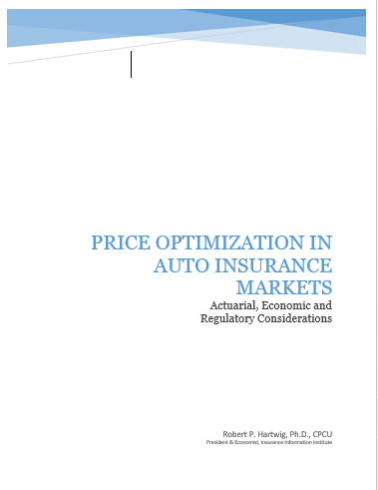
I.I.I. Actions: NCOIL Hearing Testimony
Testified as industry’s witness at July 17 National Conference of Insurance Legislators’ hearing on Price Optimization;
Worked very closely with PCI, AIA, NAMIC and independent companies.

Slide 24
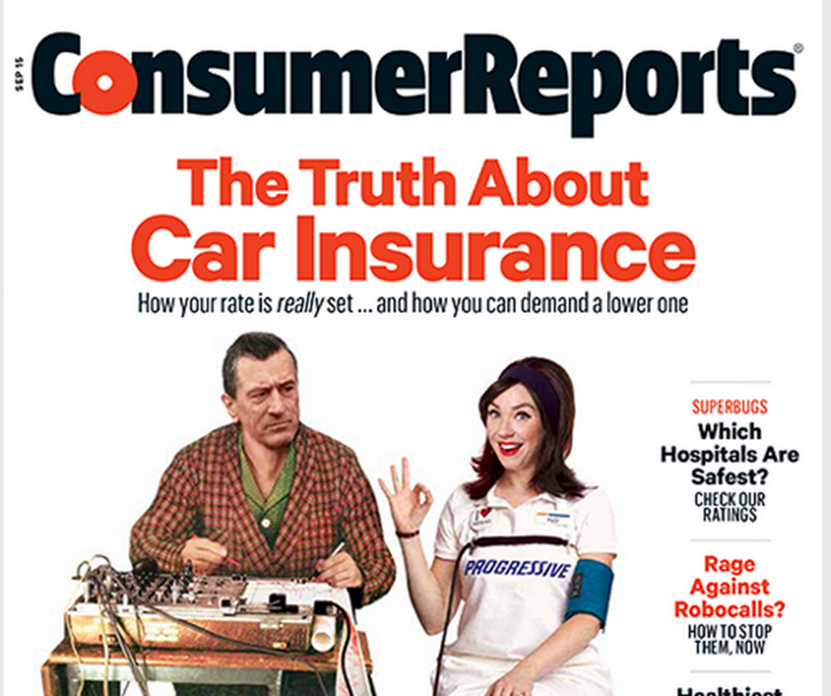
Consumer Reports - #fixcarinsurance
CR’s complaint
  Analyzed 2 billion quotes
  Price-setting is “shrouded in secrecy and rife with inequities”
    Credit Scoring
    Price Optimization
  “Little transparency and not enough fairness”
September Consumer Reports, Released July 30.

Slide 25
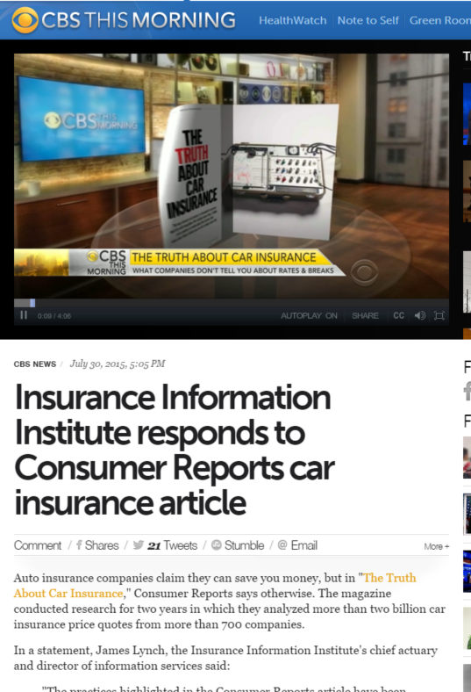
Consumer Reports: I.I.I Response
Non-Driving Factors Proved Effective, Have Been Used for Decades
    Gender
    Territory
    Age
    Grades
Hundreds of Class Plan Filings Annually Reconfirm Their Value

Slide 26
Recent Attacks on the Insurance Industry
Why Are Critics Suddenly More Aggressive?
26

Slide 27
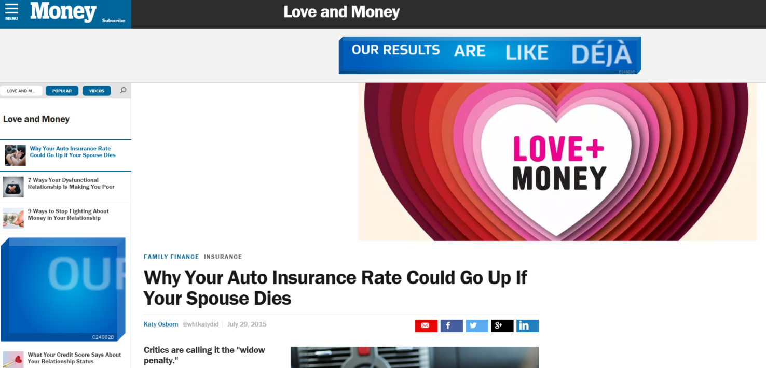
CFA’s Conclusion: The ‘Widow Penalty’
“a change in marital status from married to unmarried (through divorce or the death of a spouse) can cause a woman’s auto insurance premiums to rise as much as 226%—suggesting a ‘widow penalty’ that CFA director of insurance Bob Hunter said in a press teleconference Monday with executive director Stephen Brobeck is ‘immoral and should be stopped at once.’”

Slide 28
What’s Driving Attacks on the Insurance Industry?
Recent Surge in Attacks is Associated with Income Inequality Debate in the United States
  Attacks not confined to auto insurance (e.g., Workers Comp, Health)
  Not confined to insurance (banks, lending in general, student loans)
Politics, Economics, Regulation & Demographics Are Principal Drivers
  CFA/CR and others (ProPublica) emboldened in current environment
  Dodd-Frank Act stuffed with income inequality mandates and studies
  FIO now studying auto insurance affordability; Wants to create index.
  Definition of “fairness” is shifting
CFA Has Been Able to Attack Certain Rating Factors Based on New Perception of Fairness (which is independent of actual risk)
  Education Occupation Marital Status Gender
  Age Credit Profile Location “Price Optimization”
All of These Are Vulnerable to Attack in the Current Environment
Infinite Number of Quotes Online→CFA Uses to Highlight Perceived Inequities

Slide 29
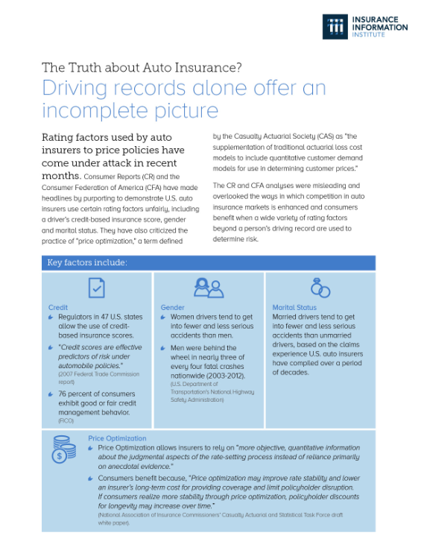
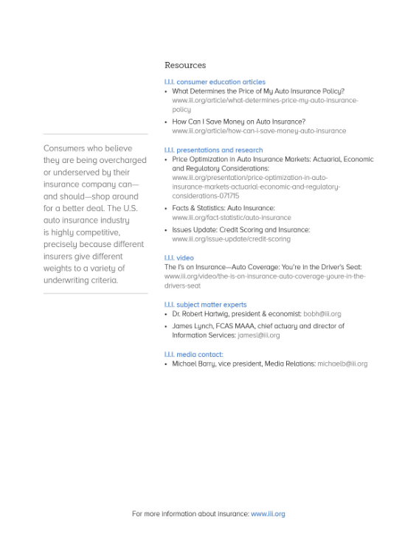
Handout for Government Affairs Staff Attending NAIC Meeting

Slide 30
INVESTMENTS:
THE NEW REALITY
Investment Performance is a Key Driver of Profitability
Depressed Yields Will Necessarily Influence Underwriting & Pricing
30

Slide 31
Property/Casualty Insurance Industry Investment Income: 2000–2015E¹
Investment earnings are still below their 2007 pre-crisis peak
($ Billions)
Due to persistently low interest rates,
investment income fell in 2012, 2013 and 2014.
¹ Investment gains consist primarily of interest and stock dividends. *2015 figure is estimated based on annualized data through Q3.
Sources: ISO; Insurance Information Institute.

Slide 32
Distribution of Invested Assets: P/C Insurance Industry, 2013
$ Billions
Total Invested Assets = $1.5 Trillion
Source: Insurance Information Institute Fact Book 2015, A.M. Best.

Slide 33
U.S. Treasury Security Yields:
A Long Downward Trend, 1990–2015*
Yields on 10-Year U.S. Treasury Notes have been essentially below 5% for a full decade.
U.S. Treasury yields plunged to historic lows in 2013. Longer-term yields rebounded then sank fell again.
Since roughly 80% of P/C bond/cash investments are in 10-year or shorter durations, most P/C insurer portfolios will have low-yielding bonds for years to come.
*Monthly, constant maturity, nominal rates, through October 2015.
Sources: Federal Reserve Bank at http://www.federalreserve.gov/releases/h15/data.htm. National Bureau of Economic Research (recession dates); Insurance Information Institute.
33
12/01/09 - 9pm
eSlide – P6466 – The Financial Crisis and the Future of the P/C
Notes:
33

Slide 34
Treasury Yield Curves:
Pre-Crisis (July 2007) vs. June 2015
Treasury yield curve remains near its most depressed level in at least 45 years. Investment income is falling as a result. Even when the Fed begins to raise rates, yields unlikely to return to pre-crisis levels anytime soon
The Fed Is Actively is Signaling that it Is Likely to Begin Raising Rates Later in 2015 but Only Very Gradually
Source: Federal Reserve Board of Governors; Insurance Information Institute.

Slide 35
Net Yield on Property/Casualty Insurance Invested Assets, 2007–2015*
(Percent)
Book yield in 2015 is down 77 BP from pre-crisis levels
The yield on invested assets remains low relative to pre-crisis yields. The Fed’s plan to raise interest rates in late 2015 has already pushed up some yields, albeit quite modestly.
*2015 figure is the average of the four quarters ending in 2015:Q2.
Sources: SNL Financial; Insurance Information Institute

Slide 36
Interest Rate Forecasts: 2015 – 2021
Yield (%)
3-Month Treasury
10-Year Treasury
The end of the Fed’s QE program in 2014 and a stronger economy have yet to push longer-term yields much higher
A full normalization of interest rates is unlikely until the 2020s, more than a decade after the onset of the financial crisis.
Sources: Blue Chip Economic Indicators (11/15 for 2015 and 2016; for 2017-2021 10/15 issue); Insurance Info. Institute.

Slide 37
Annual Inflation Rates, (CPI-U, %),
1990–2016F
Annual Inflation Rates (%)
Inflation peaked at 5.6% in August 2008 on high energy and commodity crisis. The recession and the collapse of the commodity bubble reduced inflationary pressures in 2009/10
Inflationary expectations have slipped (due in part to falling energy costs) allowing the Fed to maintain low interest rates
Slack in the U.S. economy and falling energy prices suggests that inflationary pressures should remain subdued for an extended period of times
Sources: US Bureau of Labor Statistics; Blue Chip Economic Indicators, 11/15 (forecasts).

Slide 38
P/C Insurer Net Realized
Capital Gains/Losses, 1990-2015:Q3*
Realized capital gains rose sharply as equity markets rallied in 2013-14
($ Billions)
Insurers Posted Net Realized Capital Gains in 2010 - 2014 Following Two Years of Realized Losses During the Financial Crisis. Realized Capital Losses Were a Primary Cause of 2008/2009’s Large Drop in Profits and ROE.
*Through Q3 2015 (preliminary)
Sources: A.M. Best, ISO, SNL, Insurance Information Institute.
38
12/01/09 - 9pm
eSlide – P6466 – The Financial Crisis and the Future of the P/C
Notes:
38

Slide 39
Property/Casualty Insurance Industry Investment Gain: 1994–2015:Q2¹
($ Billions)
Investment gains in 2014 will rival the post-crisis high reached in 2013
Total Investment Gains Were Down Slightly in 2014 as Low Interest Rates Pressured Investment Income but Realized Capital Gains Remained Robust
¹ Investment gains consist primarily of interest, stock dividends and realized capital gains and losses.
* 2005 figure includes special one-time dividend of $3.2B; 2015 figure is through Q2 2015.
Sources: ISO, SNL; Insurance Information Institute.

Slide 40
S&P 500 Index Returns, 1950 – 2015*
Annual Return
Volatility is endemic to stock markets—and may be increasing—but there is no persistent downward trend over long periods of time
Fed Raises Rate
Tech Bubble Implosion
2015*:
+2.1%
Energy Crisis
Financial Crisis
*Through Dec. 1, 2015.
Source: NYU Stern School of Business: http://pages.stern.nyu.edu/~adamodar/New_Home_Page/datafile/histretSP.html Ins. Info. Inst.

Slide 41
Reduction in Combined Ratio Necessary to Offset 1% Decline in Investment Yield to Maintain Constant ROE, by Line*
Lower Investment Earnings Place a Greater Burden on Underwriting and Pricing Discipline
*Based on 2008 Invested Assets and Earned Premiums
**US domestic reinsurance only
Source: A.M. Best; Insurance Information Institute.
41
12/01/09 - 9pm
eSlide – P6466 – The Financial Crisis and the Future of the P/C
Notes:
41
This shows the drop in Combined Ratio for each line of business that would be needed to maintain a constant ROE, given a 1-percentage-point drop in investment yield

Slide 42
Distribution of Bond Maturities,
P/C Insurance Industry, 2003-2013
The main shift over these years has been from bonds with longer maturities to bonds with shorter maturities. The industry first trimmed its holdings of over-10-year bonds (from 24.6% in 2003 to 15.5% in 2012) and then trimmed bonds in the 5-10-year category (from 31.3% in 2003 to 27.6% in 2012) . Falling average maturity of the P/C industry’s bond portfolio is contributing to a drop in investment income along with lower yields.
Sources: SNL Financial; Insurance Information Institute.

Slide 43
CAPITAL/CAPACITY
Capital Accumulation Has Multiple Impacts
Alternative Capital Impacts?
43

Slide 44
Policyholder Surplus,
2006:Q4–2015:Q2
($ Billions)
2007:Q3
Pre-Crisis Peak
Drop due to near-record 2011 CAT losses
Surplus as of 6/30/15 stood at a near-record high $672.4B
The industry now has $1 of surplus for every $0.73 of NPW,
close to the strongest claims-paying status in its history.
2010:Q1 data includes $22.5B of paid-in capital from a holding company parent for one insurer’s investment in a non-insurance business .
The P/C insurance industry entered 2015
in very strong financial condition.
Sources: ISO, A.M .Best.
44
12/01/09 - 9pm
eSlide – P6466 – The Financial Crisis and the Future of the P/C
Notes:
44

Slide 45
Alternative Capital
New Investors Continue to Change the Reinsurance Landscape
First I.I.I. White Paper on Issue Was Released in March 2015
45

Slide 46
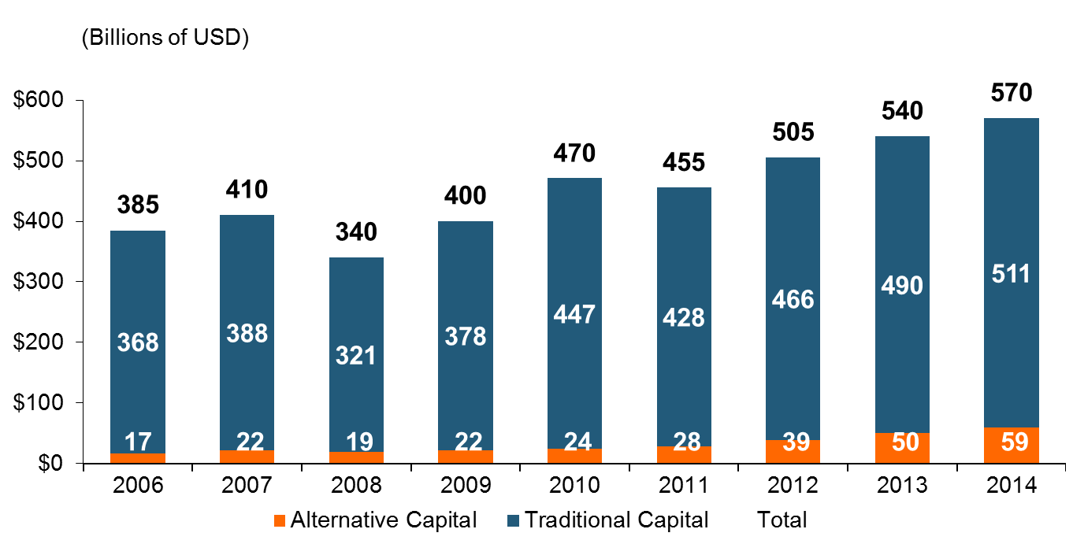
Global Reinsurance Capital (Traditional and Alternative), 2006 - 2014
Total reinsurance capital reached a record $570B in 2013, up 68% from 2008.
But alternative capacity has grown 210% since 2008, to $50B. It has more than doubled in the past three years.
2014 data is as of June 30, 2014.
Source: Aon Benfield Analytics; Insurance Information Institute.

Slide 47
Alternative Capital as a Percentage of Traditional Global Reinsurance Capital
Alternative Capital’s Share of Global Reinsurance Capital Has More Than Doubled Since 2010.
2014 data is as of June 30, 2014.
Source: Aon Benfield Analytics; Insurance Information Institute.

Slide 48
Catastrophe Bond Issuance and Outstanding: 1997-2015:Q2
Risk Capital Amount ($ Millions)
Cat Bond Issuance Appears to Be Slowing Down in 2015 from 2014’s Record Pace. Lower Yields on Bonds Explain Some of the Contraction.
Source: Guy Carpenter.

Slide 49
US Property CAT Rate on Line Index & Global Reinsurance ROE
US Property CAT ROL
Global Reinsurance ROE
Record traditional capacity, alternative capital and low CAT activity have pressured reinsurance prices; ROEs are own only very modestly
Source: Barclays PLC from Guy Carpenter; Insurance Information Institute.

Slide 50
M&A UPDATE:
A PATH TO GROWTH?
Are Capital Accumulation, Drive for Growth and Scale Stimulating M&A Activity?
50

Slide 51
U.S. INSURANCE MERGERS AND ACQUISITIONS,
P/C SECTOR, 1994-2014 (1)
M&A activity in 2015 will likely reach its highest level since 1998
M&A activity in the P/C sector was up sharply in 2014 but remains well below pre-crisis or late 1990s levels.
($ Millions)
(1) Includes transactions where a U.S. company was the acquirer and/or the target.
Source: Conning proprietary database.

Slide 52
Growth
Premium Growth Rates Vary Tremendously by State and Over Time, But…
52

Slide 53
Net Premium Growth (All P/C Lines): Annual Change, 1971—2015:Q3P
(Percent)
1975-78
1984-87
2000-03
Net Written Premiums Fell 0.7% in 2007 (First Decline Since 1943) by 2.0% in 2008, and 4.2% in 2009, the First 3-Year Decline Since 1930-33.
Outlook
2016F: 4.0%
2017F: 3.8%
2015:Q3: 3.1%
2014: 4.1%
2013: 4.4%
2012: +4.2%
Shaded areas denote “hard market” periods
Sources: A.M. Best (1971-2013), ISO (2014-15).

Slide 54
NPW Premium Growth: Peaks & Troughs in the P/C Insurance Industry, 1926 – 2015E
ROE
Post WW II Peak:
1947: 26.2%
1970-90: Peak premium growth was much higher in this period while troughs were comparable. Rapid inflation, economic volatility, high interest rates, tort environment all played roles
Start of WW II
1941: 15.8%
Economic Shocks, Inflation:
1976: 22.0%
Tort Crisis
1985/86: 22.2%
Post-9/11
2002:15.3%
1988-2000: Period of inter-cycle stability
2015E 4.1%
1950-70: Extended period of stability in growth and profitability. Low interest rates, low inflation, “Bureau” rate regulation all played a role
2010-20XX? Post-recession period of stable growth?
Twin Recessions; Interest Rate Hikes
1987: 3.7%
Great Recession:2010: -4.9%
Great Depression
1932: -15.9% max drop
Note: Data through 1934 are based on stock companies only. Data include state funds beginning in 1998.
Source: A.M. Best; Insurance Information Institute.

Slide 55
Direct Premiums Written: Total P/C
Percent Change by State, 2007-2014
Top 25 States
North Dakota was the country’s growth leader over the past 7 years with premiums written expanding by 70.7%, fueled by the state’s energy boom
Growth Benchmarks: Total P/C
US: 13.0%
Sources: SNL Financial LC.; Insurance Information Institute.

Slide 56
Direct Premiums Written: Total P/C
Percent Change by State, 2007-2014
Bottom 25 States
Growth was negative in 4 states and DC between 2007 and 2014
Sources: SNL Financial LC.; Insurance Information Institute.

Slide 57
Direct Premiums Written: Comm. Lines
Percent Change by State, 2007-2014
Top 25 States
43 states showed commercial lines growth from 2007 through 2014
Growth Benchmarks: Commercial
US: 5.9%
Sources: SNL Financial LLC.; Insurance Information Institute.

Slide 58
Direct Premiums Written: Comm. Lines
Percent Change by State, 2007-2014
Bottom 25 States
Nearly half the states have yet to see commercial lines premium volume return to pre-crisis levels
Sources: SNL Financial LLC.; Insurance Information Institute.

Slide 59
Pricing Trends
Personal Lines Pricing Is Up
Survey Results Suggest Commercial Pricing Has Flattened Out
59

Slide 60
Monthly Change in Auto Insurance Prices, 1991–2015*
Cyclical peaks in PP Auto tend to occur roughly every 10 years (early 1990s, early 2000s and likely the early 2010s)
Pricing peak occurred in late 2010 at 5.3%, falling to 2.8% by Mar. 2012
“Hard” markets tend to occur during recessionary periods
Sept. 2015 reading of 5.5% is up from 4.2%
a year earlier
*Percentage change from same month in prior year; through Sept. 2015; seasonally adjusted
Note: Recessions indicated by gray shaded columns.
Sources: US Bureau of Labor Statistics; National Bureau of Economic Research (recession dates); Insurance Information Institutes.
60
12/01/09 - 9pm
eSlide – P6466 – The Financial Crisis and the Future of the P/C
Notes:
60

Slide 61
Commercial Lines Rate Change by Month (vs. Year Earlier), July 2001 – Oct. 2015
Not Much of A Hard Market, By Historic Standards
Oct. 2015: -2.0%
Commercial Insurance Rate Changes Are Flat to Slightly Down
SOURCE: MarketScout, Insurance Information Institute.

Slide 62
Change in Commercial Rate Renewals, by Line: 2015:Q3
Commercial Auto rate increases are larger than any other line, followed by EPL and D&O
Percentage Change (%)
Major Commercial Lines Renewals Were Mixed to Down in Q3:2015; EPL, D&O and Commercial Saw Gains
Note: CIAB data cited here are based on a survey. Rate changes earned by individual insurers can and do vary, potentially substantially.
Source: Council of Insurance Agents and Brokers; Insurance Information Institute.

Slide 63
How the Risk Dollar is Spent
(U.S. Firms with Revenues Under $1 Bill)
Source: 2015 RIMS Benchmark Survey; Insurance Information Institute.
63
Notes:
63

Slide 64
Underwriting Performance
64
Notes:
64

Slide 65
Homeowners Insurance Combined Ratio: 1990–2017F
Hurricane Andrew
Record tornado activity
Hurricane Sandy
Hurricane Ike
Homeowners Performance in 2011/12 Impacted by Large Cat Losses. Extreme Regional Variation Can Be Expected Due to Local Catastrophe Loss Activity
Sources: A.M. Best (1990-2014);Conning (2015F-2017F).

Slide 66
Homeowners Multi-Peril Loss & ALAE Ratio, 2014:
Highest 25 States
MT had the worst loss ratio in 2014, followed by NE and SD…
Sources: SNL Financial; Insurance Information Institute.

Slide 67
Homeowners Multi-Peril Loss & ALAE Ratio, 2014:
Lowest 25 States and DC
OK and FL had the best performances in 2014. Traditionally high cat-loss states did well last year due to unusually low cat activity
Sources: SNL Financial; Insurance Information Institute.

Slide 68
Florida Citizens Policy Count, 2003 – 2015* (Thousands)
Florida Citizen’s policy count is down by nearly 900,000 (61%) from its 2011 peak
A lack of major hurricanes, ample private sector/reinsurer capital and capital market interest—combined with structural changes to Citizens—have combined to take Citizens policy count and exposure to their lowest levels in many years
*As of October 6, 2015. All other figures are as of Dec. 31.
Source: Florida Citizens https://www.citizensfla.com/about/bookofbusiness/; Insurance Information Institute (I.I.I.).
Notes:
68

Slide 69
Private Passenger Auto Combined Ratio: 1993–2017F
Private Passenger Auto Underwriitng Performance Is Exhibiting Remarkable Stability
Sources: A.M. Best (1990-2014); Conning (2015F – 2017F); Insurance Information Institute.

Slide 70
Collision Coverage: Severity & Frequency Trends Are Both Higher in 2015*
Annual Change, 2005 through 2015*
The Recession, High Fuel Prices Helped Temper Frequency and Severity, But this Trend Will Likely Be Reversed Based on Evidence from Past Recoveries
*2015 figure is for the 4 quarters ending with 2015:Q2.
Source: ISO/PCI Fast Track data; Insurance Information Institute

Slide 71
Commercial Lines Combined Ratio, 1990-2016F*
Commercial lines underwriting performance improved in 2013/14 but higher cats, diminishing prior year reserves and rising loss cost trends in some lines could push combined ratios higher
*2007-2012 figures exclude mortgage and financial guaranty segments.
Source: A.M. Best (1990-2014); Conning (2015-16F) Insurance Information Institute.

Slide 72
Commercial Auto Combined Ratio: 1993–2017F
Commercial Auto is Expected to Improve Only Slowly as Rate Gains Barely Offset Adverse Frequency and Severity Trends
Sources: A.M. Best (1990-2014);Conning (2015F-2017F); Insurance Information Institute.

Slide 73
Commercial Property Combined Ratio:
2007–2017F
Commercial Property Underwriting Performance Has Been Volatile in Recent Years, Largely Due to Fluctuations in CAT Activity
Source: Conning Research and Consulting.

Slide 74
General Liability Combined Ratio:
2005–2017F
Commercial General Liability Underwriting Performance Has Been Volatile in Recent Years
Source: Conning Research and Consulting.

Slide 75
Commercial Multi-Peril Combined Ratio: 1995–2016F
Commercial Multi-Peril Underwriting Performance is Expected to Remains Stable in 2015 Assuming Normal Catastrophe Loss Activity
*2015F-2016F figures are Conning figures for the combined liability and non-liability components.
Sources: A.M. Best; Conning; Insurance Information Institute.

Slide 76
Inland Marine Combined Ratio:
2004–2017F
Inland Marine Underwriting Performance Has Been Consistently Strong for Many Years
Source: A.M. Best (2004-2014); Conning Research and Consulting (2015F-2017F).

Slide 77
Workers Compensation Combined Ratio: 1994–2015F
WC results have improved markedly since 2011
Workers Comp Results Began to Improve in 2012. Underwriting Results Deteriorated Markedly from 2007-2010/11 and Were the Worst They Had Been in a Decade.
Sources: A.M. Best (1994-2009); NCCI (2010-2014P) and are for private carriers only; Insurance Information Institute (2015F).

Slide 78
Workers Compensation Operating Environment
Workers Comp Results Have Improved Substantially in Recent Years
78

Slide 79
Workers Compensation Combined Ratio: 1994–2015F
WC results have improved markedly since 2011
Workers Comp Results Began to Improve in 2012. Underwriting Results Deteriorated Markedly from 2007-2010/11 and Were the Worst They Had Been in a Decade.
Sources: A.M. Best (1994-2009); NCCI (2010-2014P) and are for private carriers only; Insurance Information Institute (2015F).

Slide 80
Nonfarm Payroll (Wages and Salaries):
Quarterly, 2005–2015:Q1
Billions
Latest (2015:Q1) was $7.66 trillion, a new peak--$1.34 trillion above 2009 trough
Prior Peak was 2008:Q3 at $6.54 trillion
Growth rates
2011:Q1 over 2010:Q1: 5.5%
2012:Q1 over 2011:Q1: 4.2%
2013:Q1 over 2012:Q1: 2.5%
2014:Q1 over 2013:Q1: 4.3%
2015:Q1 over 2014:Q1: 4.4%
Recent trough (2009:Q1) was $6.23 trillion, down 5.3% from prior peak
Note: Recession indicated by gray shaded column. Data are seasonally adjusted annual rates.
Sources: http://research.stlouisfed.org/fred2/series/WASCUR; National Bureau of Economic Research (recession dates); Insurance Information Institute.
80
12/01/09 - 9pm
eSlide – P6466 – The Financial Crisis and the Future of the P/C
Notes:
80

Slide 81
Payroll vs. Workers Comp Net Written Premiums, 1990-2014P
Payroll Base* WC NWP
$Billions $Billions
7/90-3/91
3/01-11/01
12/07-6/09
WC premium volume dropped two years before the recession began
WC net premiums written were down $14B or 29.3% to $33.8B in 2010 after peaking at $47.8B in 2005
Continued Payroll Growth and Rate Gains Suggest WC NWP Will Grow Again in 2015
*Private employment; Shaded areas indicate recessions. WC premiums for 2014 are from NCCI.
Sources: NBER (recessions); Federal Reserve Bank of St. Louis at http://research.stlouisfed.org/fred2/series/WASCUR ; NCCI; I.I.I.

Slide 82
Workers Compensation Premium:
Fourth Consecutive Year of Increase
Net Written Premium
$ Billions
p Preliminary
Source: NCCI from Annual Statement Data.
Includes state insurance fund data for the following states: AZ, CA, CO, HI, ID, KY, LA, MD, MO, MT, NM, OK, OR, RI, TX, UT.
Each calendar year total for State Funds includes all funds operating as a state fund that year.
Calendar Year

Slide 83
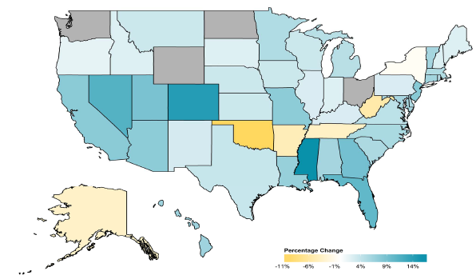
2014 Workers Compensation Direct Written Premium Growth, by State*
PRIVATE CARRIERS: Overall 2014 Growth = +4.6%
While growth rates varied widely, most states experienced positive growth in 2014
*Excludes monopolistic fund states (in gray): OH, ND, WA and WY.
Source: NCCI.

Slide 84
2013 Workers Compensation Direct Written Premium Growth, by State*
PRIVATE CARRIERS: Overall 2013 Growth = +5.4%
While growth rates varied widely, all states experienced positive growth in 2013
*Excludes monopolistic fund states (in white): OH, ND, WA and WY.
Source: NCCI.

Slide 85
Workers Compensation Components of Written Premium Change, 2013 to 2014
Written Premium Change from 2013 to 2014
Net Written Premium—Countrywide | +4.6%
Direct Written Premium—Countrywide | +4.6%
Direct Written Premium—NCCI States | +4.5%
Components of DWP Change for NCCI States
Change in Carrier Estimated Payroll | +4.7%
Change in Bureau Loss Costs and Mix | -1.4%
Change in Carrier Discounting | +0.4%
Change in Other Factors | +0.8%
Combined Effect | +4.5%
Growth is now almost entirely payroll driven
Sources: Countrywide: Annual Statement data.
NCCI States: Annual Statement Statutory Page 14 for all states where NCCI provides ratemaking services.
Components: NCCI Policy data.

Slide 86
WC Approved Changes in Bureau Premium Level (Rates/Loss Costs)
Percent
By Effective Date for Total Market
Cumulative 2000–2003
+17.1%
Cumulative 2011–2014
+11.8%
Cumulative 1994–1999
-27.8%
Cumulative 2004–2011
-30.8%
Cumulative
1990–1993
+36.3%
Approved rates/loss costs are down for the first time since 2010
Calendar Year
*States approved through 4/24/15.
Note: Bureau premium level changes are countrywide approved changes in advisory rates, loss costs and assigned risk rates as filed by applicable rating organization, relative to those previously approved.
Source: NCCI.

Slide 87
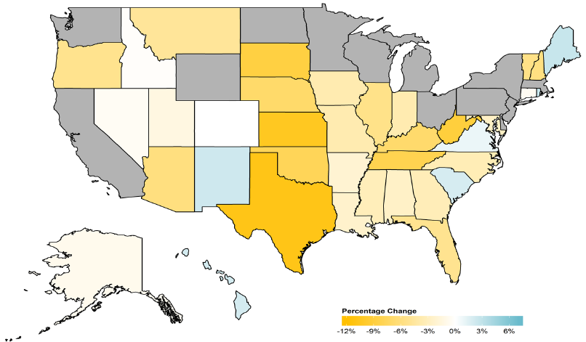
WC Approved or Filed and Pending Change in NCCI Premium Level by State
Latest Change for Voluntary Market
While growth rates varied widely, most states experienced positive growth in 2014
*Excludes monopolistic fund states (in gray): OH, ND, WA and WY.
Source: NCCI.

Slide 88
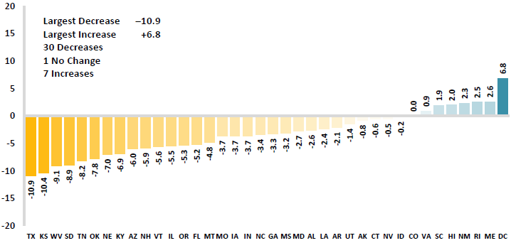
WC Approved or Filed and Pending Change in NCCI Premium Level by State
Latest Change for Voluntary Market
Excludes Law-Only Filings
The majority of states experienced decreases in rates/loss costs over
Note: Premium level changes are approved changes are approved or filed and pending changes in advisory rates, loss costs and rating values as of 4/24/15 as filed by applicable rating organization, relative to those previously approved. SC is filed and pending. IN and NC are in cooperation with state rating bureaus.
Source: NCCI.

Slide 89
Workers Compensation Lost-Time
Claim Frequency Declined in 2014
Percent
Cumulative Change of –51.1%
(1994–2013 adj.)
*Adjustments primarily due to significant audit activity.
2014p: Preliminary based on data valued as of 12/31/2014.
Source: NCCI Financial Call data, developed to ultimate and adjusted to current wage an voluntary loss cost level; Excludes high deductible policies; 1994-2013: Based on data through 12/31/13. Data for all states where NCCI provides ratemaking services, excluding WV.
Frequency is the number of lost-time claims per $1M pure premium at current wage and voluntary loss cost level
Accident Year

Slide 90
Workers Comp Indemnity Claim Costs: Modest Increase in 2014
Average Indemnity Cost per Lost-Time Claim
Indemnity
Claim Cost ($ 000s)
Average indemnity costs per claim were up 4% in 2014 to $23,600, the largest increase since 2008
+1.9%
+4%
Cumulative Change = 141%
(1991-2014p)
Accident Year
2014p: Preliminary based on data valued as of 12/31/2014.
1991-2013: Based on data through 12/31/2013, developed to ultimate
Based on the states where NCCI provides ratemaking services including state funds, excluding WV; Excludes high deductible policies.
Notes:
90
Exhibit 11 of Article

Slide 91
WC Indemnity Severity vs. Wage Inflation, 1995 -2014p
Indemnity severities usually outpace wage gains
Annual Change 1994–2014
Indemnity Claim Sev.: +4.6
US Avg. Weekly Wage: +3.4%
WC indemnity severity turned positive again in 2011
2014p: Preliminary based on data valued as of 12/31/2014; 1991-2010: Based on data through 12/31/2010, developed to ultimate. Based on the states where NCCI provides ratemaking services. Excludes the effects of deductible policies. CPS = Current Population Survey.
Source: NCCI

Slide 92
Workers Compensation Medical Severity:
Moderate Increase in 2014
Medical
Claim Cost ($000s)
Average Medical Cost per Lost-Time Claim
Medical severity for lost time claims was up 4% in 2014, the largest increase since 2009
Annual Change 1991–1993: +1.9%
Annual Change 1994–2001: +8.9%
Annual Change 2002–2010: +6.0%
Cumulative Change = 263%
(1991-2014p)
Accident Year
Accident Year
2014p: Preliminary based on data valued as of 12/31/2014.
1991-2013: Based on data through 12/31/2013, developed to ultimate
Based on the states where NCCI provides ratemaking services including state funds, excluding WV; Excludes high deductible policies.

Slide 93
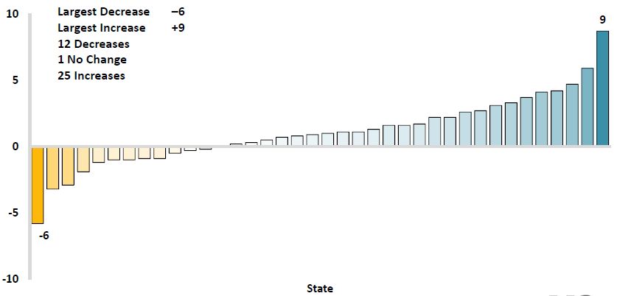
Workers Comp Change in Medical Severity by State, Avg. Annual Change, 2009-2013
Percent
The change in lost-time medical severities from 2009-2013 ranged from a low of -6% to a high of 9%
While growth rates varied widely, most states experienced positive growth in 2014
Source: NCCI’s Analysis of Frequency and Severity of Claims Across the Country as of 12/31/13 on ncci.com.
Values reflect methodology and state data underlying the most recent rate/lost cost filing.
TX changes are for the years 2010-2013.

Slide 94
Annual Inflation Rates, (CPI-U, %),
1990–2016F
Annual Inflation Rates (%)
Inflation peaked at 5.6% in August 2008 on high energy and commodity crisis. The recession and the collapse of the commodity bubble reduced inflationary pressures in 2009/10
Inflationary expectations have slipped (due in part to falling energy costs) allowing the Fed to maintain low interest rates
Slack in the U.S. economy and falling energy prices suggests that inflationary pressures should remain subdued for an extended period of times
Sources: US Bureau of Labor Statistics; Blue Chip Economic Indicators, 5/15 (forecasts).

Slide 95
Workers Compensation
Change in Medical Severity
Comparison to Change in Medical Consumer Price Index (CPI)
Percent Change
Average Annual Change: 1994—2014
Lost-Time Medical Severity: +6.4%
US Medical CPI: +3.7%
Year
2014p: Preliminary based on data valued as of 12/31/2014.
Sources: Severity: 995-2013: Based on data through 12/31/2013, developed to ultimate
Based on the states where NCCI provides ratemaking services including state funds, excluding WV; Excludes high deductible policies.
US Medical CPI: US Bureau of Labor Statistics.

Slide 96
WC Medical Severity Generally Outpaces the Medical CPI Rate
Average annual increase in WC medical severity from 1995 through 2014 was well above the medical CPI (6.4% vs. 3.7%), but the gap has narrowing. Lost-time medical severities appear to on the rise again.
Sources: Med CPI from US Bureau of Labor Statistics, WC med severity from NCCI based on NCCI states.

Slide 97
Medical Cost Inflation vs. Overall CPI, 1995 – 2014*
Though moderating, medical inflation will continue to exceed inflation in the overall economy
Average Annual Growth Average 1995 – 2013
Healthcare: 3.8%
Total Nonfarm: 2.4%
*July 2014 compared to July 2013.
Sources: Med CPI from US Bureau of Labor Statistics, WC med severity from NCCI based on NCCI states.

Slide 98
U.S. Health Care Expenditures,
1965–2022F
$ Billions
From 1965 through 2013, US health care expenditures had increased by 69 fold. Population growth over the same period increased by a factor of just 1.6. By 2022, health spending will have increased 119 fold.
U.S. health care expenditures have been on a relentless climb for most of the past half century, far outstripping population growth, inflation of GDP growth
Sources: Centers for Medicare & Medicaid Services, Office of the Actuary at http://www.cms.gov/Research-Statistics-Data-and-Systems/Statistics-Trends-and-Reports/NationalHealthExpendData/NationalHealthAccountsProjected.html accessed 3/14/14; Insurance Information Institute.

Slide 99
National Health Care Expenditures as a Share of GDP, 1965 – 2022F*
% of GDP
Health care expenditures as a share of GDP rose from 5.8% in 1965 to 18.0% in 2013 and are expected to reach 19.9% of GDP by 2022
2022 19.9%
2010: 17.9%
2000: 13.8%
1990: 12.5%
Since 2009, heath expenditures as a % of GDP have flattened out at about 18%--the question is why and will it last?
1980: 9.2%
1965 5.8%
Sources: Centers for Medicare & Medicaid Services, Office of the Actuary at http://www.cms.gov/Research-Statistics-Data-and-Systems/Statistics-Trends-and-Reports/NationalHealthExpendData/NationalHealthAccountsProjected.html accessed 3/14/14; Insurance Information Institute.

Slide 100
Insured Catastrophe Losses
2013/14 and YTD 2015 Experienced Below Average CAT Activity After Very High CAT Losses in 2011/12
Winter Storm Losses Far Above Average in 2014 and 2015
100

Slide 101
U.S. Insured Catastrophe Losses
($ Billions, $ 2014)
2012 was the 3rd most expensive year ever for insured CAT losses
2013/14 Were Welcome Respites from 2011/12, among the Costliest Years for Insured Disaster Losses in US History. Longer-term Trend is for more—not fewer—Costly Events
$11.0B in insured CAT losses though 9/30/15
*Through 9/30/15 in 2015 dollars.
Note: 2001 figure includes $20.3B for 9/11 losses reported through 12/31/01 ($25.9B 2011 dollars). Includes only business and personal property claims, business interruption and auto claims. Non-prop/BI losses = $12.2B ($15.6B in 2011 dollars.)
Sources: Property Claims Service/ISO; Insurance Information Institute.
101
12/01/09 - 9pm
eSlide – P6466 – The Financial Crisis and the Future of the P/C
Notes:
101

Slide 102
Combined Ratio Points Associated with Catastrophe Losses: 1960 – 2015F*
Avg. CAT Loss Component of the Combined Ratio by Decade
1960s: 1.04 1970s: 0.85 1980s: 1.31 1990s: 3.39 2000s: 3.52 2010s: 5.82*
Catastrophe losses as a share of all losses reached a record high in 2011
Combined Ratio Points
The Catastrophe Loss Component of Private Insurer Losses Has Increased Sharply in Recent Decades
*2010s represent 2010-2014.
Notes: Private carrier losses only. Excludes loss adjustment expenses and reinsurance reinstatement premiums. Figures are adjusted for losses ultimately paid by foreign insurers and reinsurers.
Source: ISO (1960-2010); A.M. Best (2011-15E) Insurance Information Institute.

Slide 103
Top 16 Most Costly Disasters in U.S. History—Katrina Still Ranks #1
(Insured Losses, 2014 Dollars, $ Billions)
Storm Sandy in 2012 was the last mega-CAT to hit the US
Includes Tuscaloosa, AL, tornado
Includes Joplin, MO, tornado
12 of the 16 Most Expensive Events in US History Have Occurred Since 2004
Sources: PCS; Insurance Information Institute inflation adjustments to 2014 dollars using the CPI.

Slide 104
Inflation Adjusted U.S. Catastrophe Losses by Cause of Loss, 1995–2014¹
Wind/Hail/Flood (3), $21.4
Fires (4), $6.0
Winter storm losses were much above average in 2014/15 are will push this share up
Other (5), $0.2
Insured cat losses from 1995-2014 totaled $395.6B, an average of $19.8B per year or $1.65B per month
Geological Events, $0.5
Terrorism, $24.5
Winter Storms, $26.9
Hurricanes & Tropical Storms, $161.2
Tornado share of CAT losses is rising
Wind losses are by far cause the most catastrophe losses, even if hurricanes/TS are excluded.
Events Involving Tornadoes (2), $154.9
Catastrophes are defined as events causing direct insured losses to property of $25 million or more in 2014 dollars.
Excludes snow.
Does not include NFIP flood losses
Includes wildland fires
Includes civil disorders, water damage, utility disruptions and non-property losses such as those covered by workers compensation.
Source: ISO’s Property Claim Services Unit.

Slide 105
Winter Storm and Winter Damage Events in the US, 1980-2015 (2014 US$)
Three of the four most costly years ever for insured losses from winter storms and damage occurred in the 1990s, led by the “Storm of the Century” in 1993.
2015 insured winter storm losses totaled $2.3B, similar to 2014 and about double the long-run average
$ Billions, in 2014 Dollars
5-year running average
*Winter storms include winter damage, blizzard, snow storm and cold wave
**Losses adjusted to inflation based on country CPI
Source: Property Claim Services, MR NatCatSERVICE.
105

Slide 106
Loss Events in the US, 1980 – 2014
Overall and Insured Losses
Overall losses totaled $25bn; Insured losses totaled $15.3bn
$ Billions
2015 First Half:
$8.2 Billion Insured Losses
$12.0 Overall Losses
Overall losses
(in 2013 values)*
Insured losses
(in 2013 values)*
*Losses adjusted to inflation based on CPI.
Source: Property Claim Services, MR NatCatSERVICE.
106

Slide 107
Number of National Flood Insurance Program Policies in Force at Year-End, 1980-2015*
(millions)
The number of NFIP policies in force has plunged by 549,000 or 9.6% since 2009, even as coastal development surges and sea levels rise
Source: National Flood Insurance Program.
* As of July, 2015

Slide 108
Take-Up Rates for Various Types of Insurance in the U.S.
Take-Up Rate
Take-up rates vary widely by type of coverage
Sources: CA Earthquake (WSJ, http://www.wsj.com/articles/california-pushes-homeowners-to-insure-against-earthquakes-1440980138 ); Flood and Renters (I.I.I. June 2015 Pulse Survey); Cyber (Advisen, 2015); Terrorism (Marsh Global Analytics, 2014 Terrorism Risk Insurance Report, April 2014; data for 2013); Pvt. Passenger Auto (Insurance Research Council, Uninsured Motorists, 2014 Edition, data for 2012); Home and Workers Comp (I.I.I. estimates); Insurance Information Institute research.

Slide 109
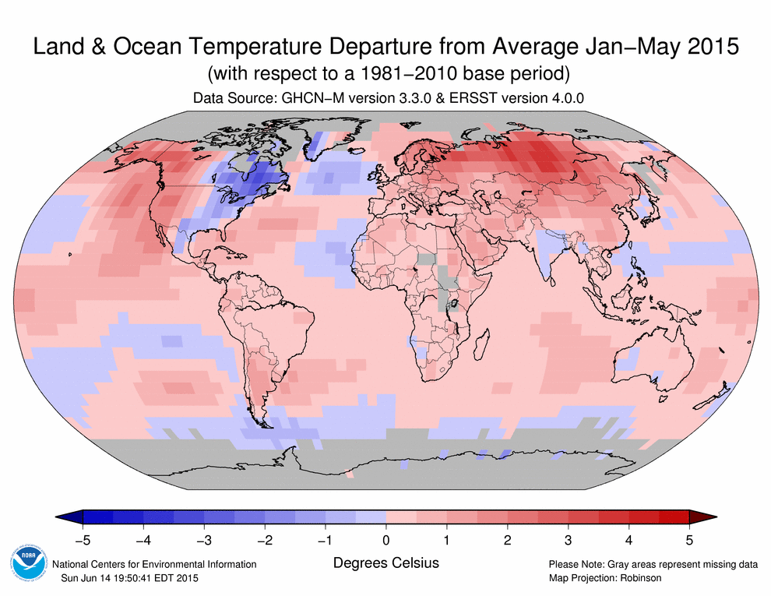
The World is Warmer...With One Big Exception!
HIGHLIGHTS
2014 was the warmest year across global land and ocean surfaces since records began in 1880.
9 of the 10 warmest years in the 135-year period of record have occurred in the 21st century. 1998 currently ranks as the fourth warmest year on record.
2015 will likely also be one of the warmest years on record as well
Source: NOAA; Munich Re.

Slide 110
THE ECONOMY
The Strength of the Economy Will Greatly Influence Insurer Exposure Base Across Most Lines
110

Slide 111
US Real GDP Growth*
The Q4:2008 decline was the steepest since the Q1:1982 drop of 6.8%
Real GDP Growth (%)
Recession began in in June 2009
Q1 2014/15 GDP data were hit hard by this year’s “Polar Vortex” and harsh winter
Demand for Insurance Should Increase in 2016 as GDP Growth Continues at a Steady, Albeit Moderate Pace and Gradually Benefits the Economy Broadly
* Estimates/Forecasts from Blue Chip Economic Indicators.
Source: US Department of Commerce, Blue Economic Indicators 11/15; Insurance Information Institute.

Slide 112
Real GDP by State Percent Change, 2014*:
Highest 25 States
North Dakota was the economic growth juggernaut of the US in 2014—by far
Only 7 states experienced growth in excess of 3% in 2014, which is a growth rate we would see nationally in a more typical recovery
Growth Benchmarks: Real GDP
US: 2.2%
*Advance statistics
Sources: U.S. Bureau of Economic Analysis; Insurance Information Institute.

Slide 113
Real GDP by State Percent Change, 2014*:
Lowest 25 States
Growth rates in 16 states were still below 1% in 2014
Mississippi and Alaska were the only states to shrink in 2014
*Advance statistics
Sources: US Bureau of Economic Analysis; Insurance Information Institute.

Slide 114
US Unemployment Rate Forecast
Rising unemployment
eroded payrolls
and WC’s
exposure base.
Unemployment peaked at 10% in late 2009.
2007:Q1 to 2016:Q4F*
Jobless figures have been revised downwards for 2015/16
Unemployment forecasts have been revised modestly downwards. Optimistic scenarios put the unemployment as low as 5.0% by Q4 of 2015.
* = actual; = forecasts
Sources: US Bureau of Labor Statistics; Blue Chip Economic Indicators (11/15 edition); Insurance Information Institute.

Slide 115
GDP Growth: Advanced & Emerging Economies vs. World, 1970-2016F
Emerging economy growth rates are expected to ease to 4.0% in 2015 and 4.5% in 2016
GDP Growth (%)
World output is forecast to grow by 3.1% in 2015 and 3.6% in 2016. The world economy shrank by 0.6% in 2009 amid the global financial crisis
Advanced economies are expected to grow at a modest pace of 2.0% in 2015 and to 2.2% in 2016.
Source: International Monetary Fund, World Economic Outlook, Oct. 2015; Insurance Information Institute.

Slide 116
Non-Life Insurance: Global Real (Inflation Adjusted) Premium Growth, 2014
Real nonlife premium growth was stronger in the US in 2014 than in most of Europe
Market | Life | Non-Life | Total
Advanced | 3.8 | 1.8 | 2.9
Emerging | 6.9 | 8.0 | 7.4
World | 4.3 | 2.9 | 3.7
Source: Swiss Re, sigma, No. 4/2015.
116
12/01/09 - 9pm
eSlide – P6466 – The Financial Crisis and the Future of the P/C
Notes:
116

Slide 117
CONSTRUCTION INDUSTRY OVERVIEW & OUTLOOK
The Construction Sector Is Critical to the Economy and the P/C Insurance Industry
117

Slide 118
Value of New Private Construction: Residential & Nonresidential, 2003-2015*
2015: Value of new pvt. construction hits $788.0B as of Aug. 2015, up 57.5% from the 2010 trough but still 13.5% below 2006 peak
New Construction peaks at $911.8. in 2006
Billions of Dollars
Trough in 2010 at $500.6B, after plunging 55.1% ($411.2B)
$15.0
$613.7
$404.7
$298.1
$261.8
$383.3
$238.8
Private Construction Activity Is Moving in a Positive Direction though Remains Well Below Pre-Crisis Peak; Residential Dominates
*2015 figure is a seasonally adjusted annual rate as of August.
Sources: US Department of Commerce http://www.census.gov/construction/c30/c30index.html ; Insurance Information Institute.
118
12/01/09 - 9pm
eSlide – P6466 – The Financial Crisis and the Future of the P/C
Notes:
118

Slide 119
Value of Construction Put in Place, August 2015 vs. August 2014*
Growth (%)
Private: +16.5%
Public: +7.0%
Private sector construction activity is up in both the residential and nonresidential segments
Public sector construction activity is finally beginning to create less drag up after years of decline
Overall Construction Activity is Up Again After Languishing in Early 2015; State/Local Sector Government Sector May Be Recovering as Budget Woes Ease in Some Jurisdictions
*seasonally adjusted
Source: U.S. Census Bureau, http://www.census.gov/construction/c30/c30index.html ; Insurance Information Institute.

Slide 120
New Private Housing Starts, 1990-2021F
Job growth, low inventories of existing homes, low mortgage rates and demographics should continue to stimulate new home construction for several more years
(Millions of Units)
New home starts plunged 72% from 2005-2009; A net annual decline of 1.49 million units, lowest since records began in 1959
Insurers Are Continue to See Meaningful Exposure Growth in the Wake of the “Great Recession” Associated with Home Construction: Construction Risk Exposure, Surety, Commercial Auto; Potent Driver of Workers Comp Exposure
Source: U.S. Department of Commerce; Blue Chip Economic Indicators (10/15); Insurance Information Institute.

Slide 121
Rental-Occupied Housing Units as % of Total Occupied Units, Quarterly, 1990:Q1-2015:Q1
Trend down began in 1994:Q3 from 36.2% in Q2
Increasing percent of renters
Increasing percent of owners
Latest was 36.3% in 2015:Q1
Trough in 2004:Q2 and Q4 at 30.8%
Since the Great Recession ended in June 2009, renters occupied 5.7 million more units (+15.6%).
Sources: US Census Bureau, Residential Vacancies & Home Ownership in the First Quarter of 2015 (released April 28, 2015) and earlier issues; Insurance Information Institute. Next Census Bureau report to be released on July 28, 2015.
121
12/01/09 - 9pm
eSlide – P6466 – The Financial Crisis and the Future of the P/C
Notes:
121

Slide 122
I.I.I. Poll: Renter’s Insurance
Q. Do you have renters insurance? ¹
Americans are increasingly choosing to rent, but are slow to understand the need to insure, exacerbating the underinsurance gap
The Percentage of Renters Who Have Renters Insurance Has Been Rising Since 2011.
¹Asked of those who rent their home.
Source: Insurance Information Institute Annual Pulse Survey.

Slide 123
CYBER RISK & CYBER INSURANCE
Cyber Risk is a Rapidly Emerging Exposure for Businesses Large and Small in Every Industry
123

Slide 124






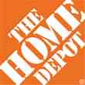

Data Breaches 2005-2015, by Number of Breaches and Records Exposed
# Data Breaches/Millions of Records Exposed
Millions
The total number of data breaches (+27.5%) hit a record high of 783 in 2014, exposing 85.6 million records. Through June 30, this year has seen 117.6 million records exposed in 400 breaches.*
*Figures as of June 30, 2015, from the Identity Theft Resource Center,
http://www.idtheftcenter.org/images/breach/ITRCBreachReport2015.pdf

Slide 125
Estimated Cyber Insurance Premiums Written, 2014 – 2020F
$ Billions
Cyber insurance premiums written could more than triple to $7 billion by 2020
Source: Advisen (2014 est.); PwC (2015, 2020); Insurance Information Institute.

Slide 126
US: External Cyber Crime Costs: Fiscal Year 2014
Information theft (40%) and business disruption or lost productivity (38%) account for the majority of external costs due to cyber crime.
Equipment damages
Other costs*
Information theft
Revenue loss
Business disruption
* Other costs include direct and indirect costs that could not be allocated to a main external cost category
Source: 2014 Cost of Cyber Crime: United States, Ponemon Institute.

Slide 127
Data/Privacy Breach:
Many Potential Costs Can Be Insured
Data Breach Event
Costs of notifying affecting individuals
Defense and settlement costs
Lost customers and damaged reputation
Cyber extortion payments
Costs of notifying regulatory authorities
Regulatory fines at home & abroad
Business Income Loss
Forensic costs to discover cause
Source: Zurich Insurance; Insurance Information Institute
127

Slide 128
The Three Basic Elements of Cyber Coverage: Prevention, Transfer, Response
Loss Prevention
Post-Breach Response
(Insurable)
Loss Transfer (Insurance)
Cyber risk management today involves three essential components, each designed to reduce, mitigate or avoid loss. An increasing number of cyber risk products offered by insurers today provide all three.
Source: Insurance Information Institute research.
128

Slide 129
I.I.I.’s New Cyber Risk Report (Oct. 2015): Cyber Risks Threat and Opportunity
I.I.I.’s 3rd report on cyber risk: Cyber Risk: Threat and Opportunity
Provides information on cyber threats and insurance market solutions
Global cyber risk overview
  Quantification of threats by type and industry
Cyber security and cost of attacks
Cyber terrorism
Cyber liability
Insurance market for cyber risk
http://www.iii.org/white-paper/cyber-risks-threat-and-opportunities-100715

Slide 130
Marsh: Percentage of U.S. Companies Purchasing Cyber Insurance Increased in 2014
Ever larger numbers of insureds seek financial protection via cyber insurance. The percentage of U.S. companies buying cyber insurance rose to 16 percent in 2014.
*Take-up rate refers to the overall percentage of clients that purchased standalone cyber insurance.
Source: Benchmarking Trends: As Cyber Concerns Broaden, Insurance Purchases Rise, Marsh Risk Management Research Briefing, March 2015
130
Notes:
130

Slide 131
Marsh: Total Limits Purchased, By Industry – Cyber Liability, All Revenue Size
Average limits purchased for cyber risk rose to $12.8 million for all industries and all company sizes in 2014. Power and utility companies witnessed the sharpest percentage increase in average limits, at 59 percent.
($ Millions)
Source: Benchmarking Trends: As Cyber Concerns Broaden, Insurance Purchases Rise, Marsh Risk Management Research Briefing, March 2015
131
Notes:
131

Slide 132
Marsh: Total Limits Purchased, By Industry – Cyber Liability, Revenue $1 Billion+
Among larger companies, average cyber insurance limits purchased increased by 22 percent to $34.1 million in 2014, from $27.8 million in 2013.
($ Millions)
Source: Benchmarking Trends: As Cyber Concerns Broaden, Insurance Purchases Rise, Marsh Risk Management Research Briefing, March 2015
132
Notes:
132

Slide 133
Cyber Liability: Historical Rate (price per million) Changes
Cyber insurance premiums were generally volatile in 2014 due to increased frequency and severity of losses. Average rate increases at renewal for both primary layers and total programs were lower in Q4 2014 than in Q1.
Source: Benchmarking Trends: As Cyber Concerns Broaden, Insurance Purchases Rise, Marsh Risk Management Research Briefing, March 2015

Slide 134
INDUSTRY DISRUPTORS
Technology, Society and the Economy Are All Changing at a Rapid Pace
Will Insurers Keep Pace?
134

Slide 135
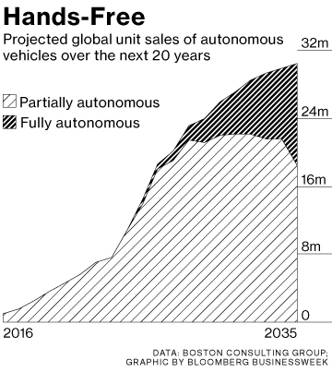
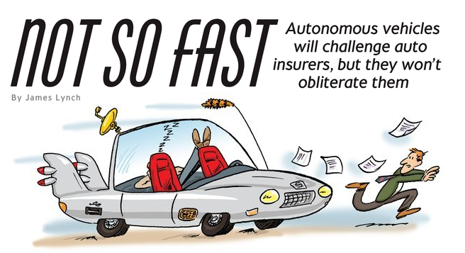
Media is Obsessed with Driverless Vehicles: Often Predicting the Demise of Auto Insurance
By 2035, it is estimated that 25% of new vehicle sales could be fully autonomous models
Questions
Are auto insurers monitoring these trends?
How are they reacting?
Will Google take over the industry?
Will the number of auto insurers shrink?
How will liability shift?
Source: Boston Consulting Group.

Slide 136
Personal Lines Distribution Channels, Direct vs. Independent Agents, 1972-2014
Independent agents have lost significant personal lines market share since the early 1970s. Although the trend slowed from 2000-2007, it may be accelerating again.
Source: Insurance Information Institute; based on data from Conning and A.M. Best.

Slide 137




On-Demand/Sharing/Peer-to-Peer Economy Impacts Many Lines of Insurance
The “On-Demand” Economy is or will impact many segments of the economy important to P/C insurers
  Auto (personal and commercial)
  Homeowners/Renters
  Many Liability Coverages
  Professional Liability
  Workers Comp
Many unanswered insurance questions
Insurance solutions are increasingly available to fill the many insurance gaps that arise
137
12/01/09 - 9pm
eSlide – P6466 – The Financial Crisis and the Future of the P/C
Notes:
137

Slide 138



Labor on Demand: Huge Implications for the US Economy, Workers & Insurers
Will YOUR job be reduced to an app?

Slide 139
TNC Ridesharing Arrangements: Insurance Applicability
The concern was that TNCs were seeking to offload risk on to personal auto insurers. An increasing number of personal auto insurers have developed solutions to ensure that coverage gaps are minimized
*From publically available sources as of June 2, 2015.
Source: ISO/Verisk.
139

Slide 140
Ridesharing Regulation/Legislation and Status of ISO Filings as of 9/30/15
Status Ride Sharing Legislation/Regulation
Status of ISO Filings
140
Source: ISO.

Slide 141
Homesharing: ISO’s Proposed Changes*
.
*As of Oct. 6, 2015.
Source: ISO/Verisk.
141

Slide 142
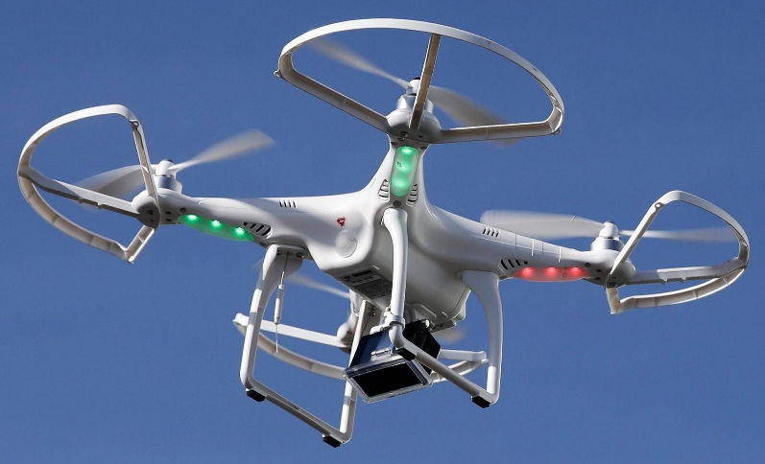

Send in the Drones: Potential Rapid
Adoption in Industry; Media Loves It
Drones or Unmanned Aerial Vehicle (UAV) technology is seeing rapid adoption rate in many industries, including insurance
~700,000 drones in US by year-end
FAA granting Section 333 exemptions for commercial use and testing of UAS
FAA will require most drones to be registered by year-end 2015.
At least 5 insurers have received permission to test
Wide variety of applications: claims, pre-event property inspections…
Insurers partnering with construction industry to guide R&D and regulation of UAV use via Property Drone Consortium: www.propertydrone.org

Slide 143


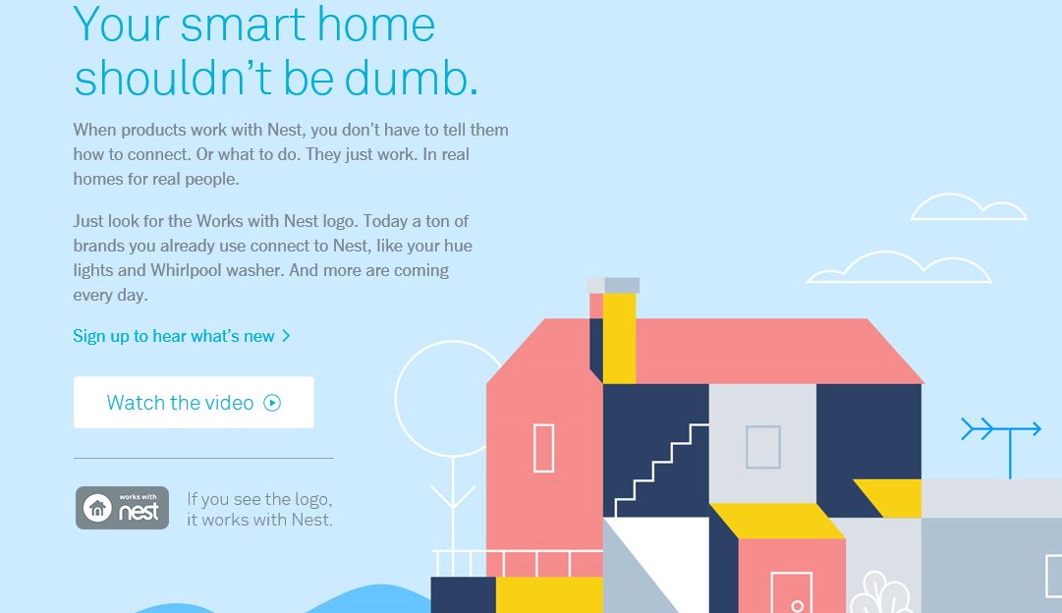
Telematics for Your Home:
The Internet of Things
The home is the next frontier for telematics
Rapidly becoming a crowded space
How and with whom will insurers partner?
Can control increasing array of household systems remotely
  Heat, A/C
  Fire, CO detection
  Security Systems
  Cameras/Monitors
  Appliances
  Lighting
Technology is adaptive
  Uses sensors and algorithms to learn about you
143
12/01/09 - 9pm
eSlide – P6466 – The Financial Crisis and the Future of the P/C
Notes:
143

Slide 144
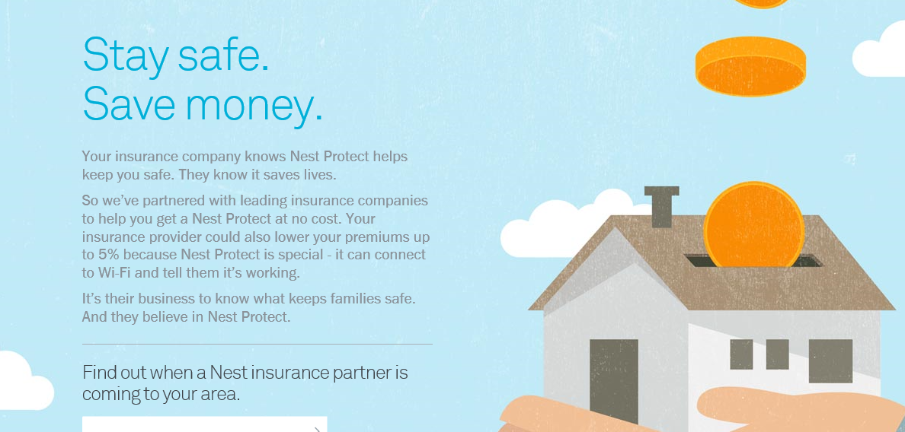
Partnerships with Insurers: Selling Safety and Savings Simultaneously
Nest is actively seeking to partner with insurers. As of Nov. 1, 2015, Nest listed 2 insurance partners offering discounts in a number of states: American Family (MN) and Liberty Mutual (AL, CO, DE, IL, KY, ME, MN, PA, UT and WI)
Source: https://nest.com/insurance-partners/ accessed 11/1/15; Insurance Information Institute research.
144
12/01/09 - 9pm
eSlide – P6466 – The Financial Crisis and the Future of the P/C
Notes:
144

Slide 145
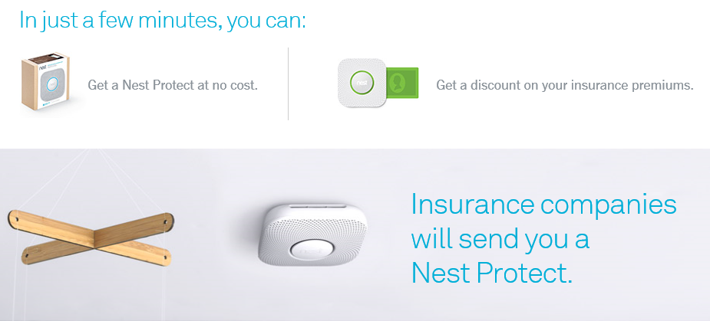
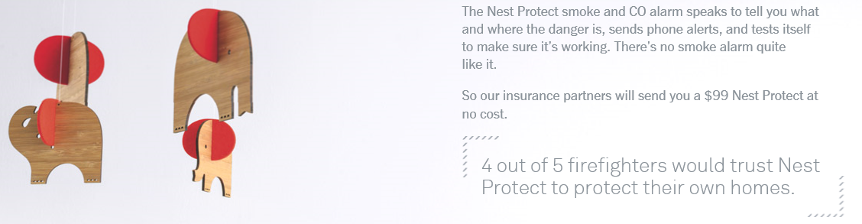
Partnerships with Insurers
Nest is selling its products via insurance partners
Source: https://nest.com/insurance-partners/ accessed 11/1/15; Insurance Information Institute research.
145
12/01/09 - 9pm
eSlide – P6466 – The Financial Crisis and the Future of the P/C
Notes:
145

Slide 146
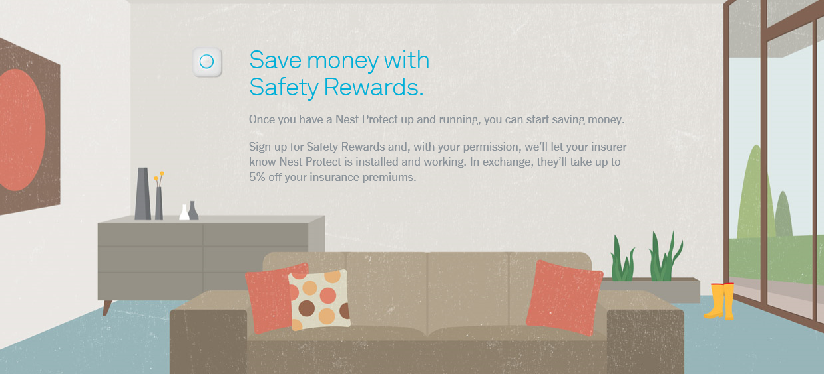
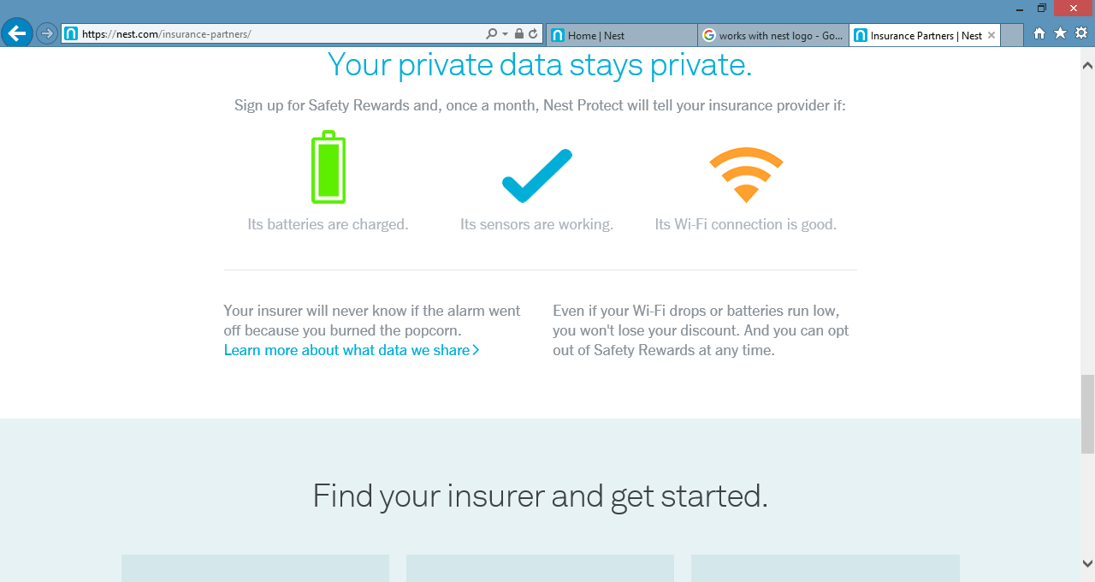
Partnerships with Insurers
Nest is selling its products via insurance partners
Source: https://nest.com/insurance-partners/ accessed 11/1/15; Insurance Information Institute research.
146
12/01/09 - 9pm
eSlide – P6466 – The Financial Crisis and the Future of the P/C
Notes:
146

Slide 147
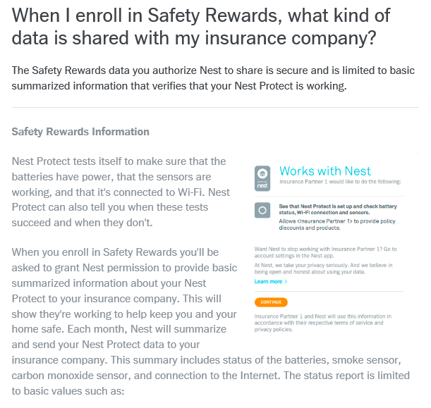
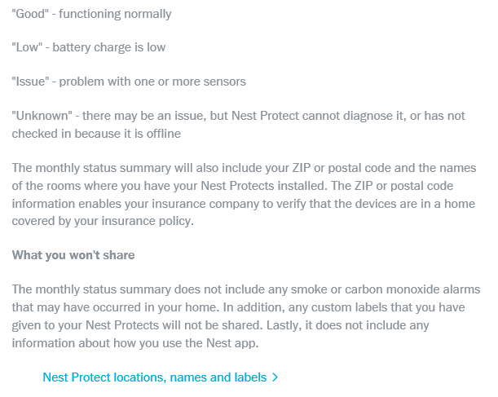
Partnerships with Insurers: Information Collected, Addressing Privacy Concerns
Privacy, control of data concerns get significant attention
Source: https://nest.com/support/article/When-I-enroll-in-Safety-Rewards-what-kind-of-data-is-shared-with-my-insurance-company accessed 11/1/15; Insurance Information Institute research.
147
12/01/09 - 9pm
eSlide – P6466 – The Financial Crisis and the Future of the P/C
Notes:
147

Slide 148
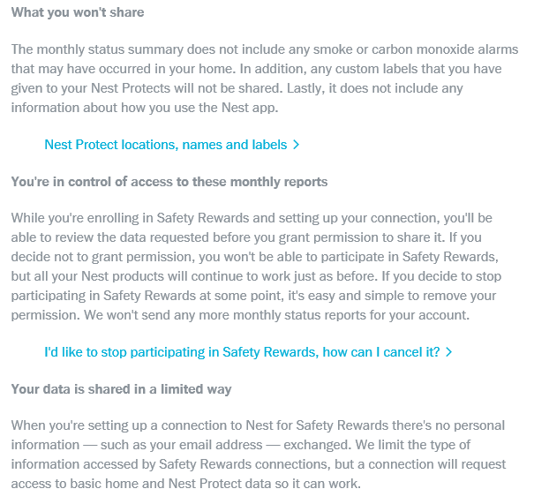
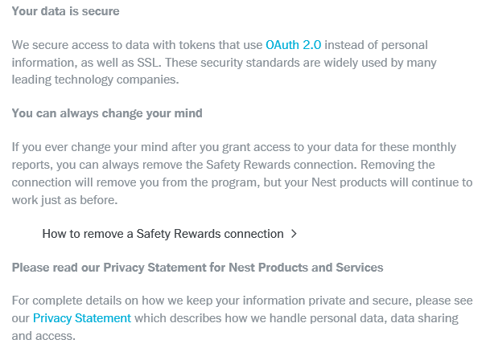
Partnerships with Insurers: Information Collected, Addressing Privacy Concerns
Privacy, control and security of data get significant attention
Source: https://nest.com/support/article/When-I-enroll-in-Safety-Rewards-what-kind-of-data-is-shared-with-my-insurance-company accessed 11/1/15; Insurance Information Institute research.
148
12/01/09 - 9pm
eSlide – P6466 – The Financial Crisis and the Future of the P/C
Notes:
148

Slide 149
Shifting Legal Liability &
Tort Environment
Will the Tort Pendulum
Swing Against Insurers?
149

Slide 150
Average Personal Injury Jury Award,
2009 – 2013
Average awards in Personal Injury cases have increased by more than 1/3 in recent years
Source: Current Award Trends in Personal Injury, 54th Edition; Insurance Information Institute.

Slide 151
Business Leaders Ranking of Liability Systems in 2015
Best States
Delaware
Vermont
Nebraska
Iowa
New Hampshire
Idaho
North Carolina
Wyoming
South Dakota
Utah
Worst States
Arkansas
Missouri
Mississippi
Florida
New Mexico
Alabama
California
Illinois
Louisiana
West Virginia
New in 2015
Vermont
New Hampshire
North Carolina
South Dakota
Newly Notorious
Arkansas
Missouri
Drop-offs
Rising Above
Minnesota
Kansas
Virginia
North Dakota
Oklahoma
Montana
Source: US Chamber of Commerce 2015 State Liability Systems Ranking Study; Insurance Info. Institute.

Slide 152
The Nation’s Judicial “Hellholes”: 2014/2015
Watch List
Illinois
Madison County
West Virginia
Atlantic County, New Jersey
Mississippi Delta
Montana
Nevada
Newport News, Virginia
Philadelphia, Pennsylvania
California
Dishonorable Mention
Assignment of Benefits issue looms large in FL
New York City Asbestos Litigation
AL Supreme Court
PA Supreme Court
Volkswagen: Massive tort actions, fines, penalties certain. Are others vulnerable? Issue of cheating on environmental standards and liability looms large.
Florida
Source: American Tort Reform Association; Insurance Information Institute

Slide 153
Insurance Information Institute Online:
www.iii.org
Thank you for your time
and your attention!
Twitter: twitter.com/bob_Hartwig
Download at www.iii.org/presentations

