Slide 1
Professionalism in the Evolving World of UBI
Casualty Actuaries of Greater New York (CAGNY)
Spring Meeting -- June 11th, 2014

Slide 2
CAS Antitrust Notice
The Casualty Actuarial Society is committed to adhering strictly to the letter and spirit of the antitrust laws. Seminars conducted under the auspices of the CAS are designed solely to provide a forum for the expression of various points of view on topics described in the programs or agendas for such meetings.
Under no circumstances shall CAS seminars be used as a means for competing companies or firms to reach any understanding – expressed or implied – that restricts competition or in any way impairs the ability of members to exercise independent business judgment regarding matters affecting competition.
It is the responsibility of all seminar participants to be aware of antitrust regulations, to prevent any written or verbal discussions that appear to violate these laws, and to adhere in every respect to the CAS antitrust compliance policy.

Slide 3
Background

Slide 4
UBI and the connected car
Sources: http://www.gsma.com/connectedliving/wp-content/uploads/2012/03/gsma2025everycarconnected.pdf
http://www.insurance.com/auto-insurance/auto-insurance-basics/three-in-four-insurers-moving-forward-with-pay-as-you-go.html

Slide 5
Potential applications in pricing
Mileage authentication
Behavioral scoring
Forgiveness
Location-based discounts

Slide 6
Recipe for confusion
Technology and Cost Intensive
Risk Classification
Data Quality
Complexity and Domain Expertise
Credibility
Data Volumes
and Integrity
Expense Provisions
Outside Expertise
Business Practices and Constraints
Communications
Flexibility and Judgment
Ratemaking (SOP)
Modeling (Draft)
Disclosure and Recordkeeping
Code of Conduct
Notes:
Cred effective 5/2014

Slide 7
“End-to-end” case study
Technology platform
Model build or buy
Initial pricing
Rating plan
Implementation
Disclosures
Monitor operating results

Slide 8
Technology selection

Slide 9
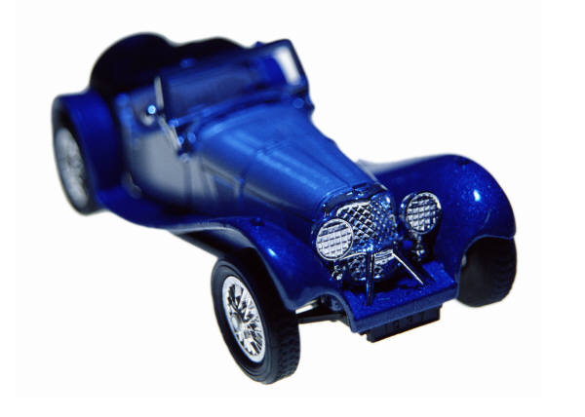
Driving behavior data
3.27 Gal / fuel
256.6°F
4200 RPM
72,852 Miles
Dr. Seatbelt: Y
101°F
25 Mil Vis
Wind: 2mph NW
Sunny
2013/08/18
22:47:53.07 UTC
34° 59’ 20”
-106 ° 36’ 52”
-9.8 m /s²
Interstate 40
(Freeway)
Speed Limit 65 MPH
Albuquerque, New Mexico
Avg. Traffic Flow 82 mph
86 mph
6.23 m / s²

Slide 10
Data selection
appropriateness for intended purpose…;
reasonableness and comprehensiveness…;
… known, material limitations…;
the cost and feasibility of obtaining alternative data…;
the benefit… balanced against its availability and the time and cost to collect and compile…;
sampling methods…
Source: ASOP 23 (Data Quality), Section 3.2.b

Slide 11
Discussion
Dongle
Dedicated technology
One size fits most
Powered by vehicle
Send data
Installation and logistics
Smartphone
Repurposed
Support multiple OS
Charger needed
Send/receive
Simple download

Slide 12
Initial pricing

Slide 13
Types of expenses
2.3 General administrative
2.5 Other acquisition
2.7 Premium-related
3.3 “Start-up costs” (may be amortized)
Source: ASOP 29 (Expense Provisions in P&C Insurance Ratemaking), Sections 2 and 3

Slide 14
Debating discount-only UBI
Approach A
Approach B
All pure premiums and cost assumptions above are hypothetical.

Slide 15
“Actuarially sound”
Estimate of the expected value of future costs
Provides for all costs associated with the transfer of risk
Provides for the costs associated with an individual risk transfer
Source: Ratemaking Statement of Principles, Section IV.E

Slide 16
“Actuarially sound” (cont’d)
Such rates comply with four criteria commonly used by actuaries:
Reasonable
Not excessive
Not inadequate
Not unfairly discriminatory
Source: Ratemaking Statement of Principles, Section IV.E

Slide 17
Discussion
Hypothetical scenarios:
Spread device costs over all policyholders
Enrollment discount (before telematics observation)
Eligibility limited to specific market segment
Source: Ratemaking Statement of Principles, Section IV.E

Slide 18
Model selection

Slide 19
UBI predictive models
Fleet
Judgmental
Behavior only
“Insurance TSP”
Full pricing

Slide 20
External models
For specialized knowledge outside actuary’s own area of expertise:
Determine appropriate reliance on experts
Obtain basic understanding of model
Evaluate whether appropriate for intended application
Determine appropriate validation has occurred
Determine appropriate use
Source: ASOP 38 (Using Models Outside the Actuary’s Area of Expertise), Section 3.1

Slide 21
Model development
Fitness for intended purpose:
Capability
Granularity of inputs
Causal relationships recognized
Ability to perform stochastic/stress testing
Ability to identify volatility around predictions
Source: ASOP on Modeling (Exposure Draft), Section 3.2.1

Slide 22
Discussion
Proprietary
New data stream
Control assumptions
Low data volumes
Industry/company specific
Vendor
Domain expertise
“Black box”
Data across clients
Possibly developed for fleets

Slide 23
Selections

Slide 24
Common issues
Unique or exacerbated in UBI setting:
Small data sample
Highly correlated dependent variables
Low statistical significance
Control variables present problems
Severe sample bias
Device disharmony

Slide 25
Actuarial judgment
One way to estimate a price is to rely exclusively on wisdom, insight, and good judgment ... This usually is not the best method…
Informed actuarial judgments can be used effectively in ratemaking… and should be documented and available for disclosure.
If the actuary judges that the use of the data… may cause the results to be highly uncertain or contain a material bias, the actuary may choose to complete the assignment, but should disclose …
Sources: SoP Regarding P&C Insurance Ratemaking, Section III; SoP Regarding Risk Classification, Section III.A; ASOP No. 23 (Data Quality)

Slide 26
Discussion
Hypothetical scenarios:
Use “near accidents” as proxy for claims
Assume driving independent of traditional variables
Accept high p-value estimates
PCA to reduce number of input variables
Scale accelerometer readings by device

Slide 27
Classification

Slide 28
Risk classification system
Reflect expected cost differences
Distinguish among risks on basis of cost-related factors
Apply objectively
Practical and cost-effective
Acceptable to the public
Source: Risk Classification Statement of Principles, Section I

Slide 29
Imperfect proxy
Source: ISO fleet data, operators aged 40 - 60

Slide 30
Risk characteristics
Relationship [with] expected outcomes (“fairness”)
Causality (not strictly required)
Objectivity
Practicality
Applicable Law
Industry Practices
Business Practices
Source: ASOP 12 (Risk Classification), Section 3.2

Slide 31
Discussion
Hypothetical risk characteristics considered:
Maximum speed over six month period
Standard deviation of speed
Trips on Sundays between 8AM and 12PM
Miles in areas with lower accident rate than garage
Braking in icy conditions

Slide 32
Program design

Slide 33
Credibility
Credibility -- A measure of the predictive value in a given application that the actuary attaches to a particular set of data
Full Credibility -- The level at which the subject experience is assigned full predictive value based on a selected confidence interval.
ASOP No. 25 (Credibility Procedures), Section 2

Slide 34
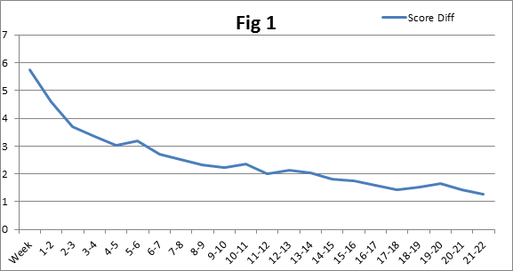
Teaching effect
Score Range
Time period of observation
Source: participating carrier data
Notes:
Draw a contrast to Defensive Driver discount
(Do habits become ingrained to point where device can be removed?)
How do we teach people to drive more safely (transition to science)

Slide 35
Operational considerations
Expense
Constancy
Availability of coverage
Avoidance of extreme discontinuities
Absence of ambiguity
Manipulation
Measurability
Source: Risk Classification Statement of Principles, Section IV.E

Slide 36
Possible implementations
Five Years |  |  | A
Three Years | B | C
One Year | D |  |  | E
 | 90 Days | Six Months | One Year | Continuous
Discount Period
Observation Period
Notes:
Miles?

Slide 37
Hypothetical distribution

Slide 38
Discussion

Slide 39
Communications

Slide 40
Stakeholder examples
Clients
Employers
Regulators
Policyholders
Plan participants
Investors
General public
Source: ASOP 41 (Actuarial Communications), Appendix

Slide 41
Features of UBI consent
To policyholders:
Pricing methodology (overview)
Data collected
Use cases
Sharing
Retention

Slide 42
Actuarial disclosures
Uncertainty or risk
Conflict of interest
Reliance on other sources for data or other information
Responsibility for assumptions and methods
Information date
Subsequent events
Source: ASOP 41 (Actuarial Communications), Section 3.4

Slide 43
Report recipients
Intended User – any person who the actuary identifies as able to rely on the actuarial findings.
Other User – any recipient of an actuarial communication who is not an intended user.
The actuary should recognize the risks of misquotation, misinterpretation, or other misuse of such a document and should take reasonable steps to ensure that the actuarial document is clear and presented fairly.
Source: ASOP 41 (Actuarial Communications), Section 2 and 3.5.1

Slide 44
Discussion
Hypothetical scenarios:
Regulator requests model formula
Policyholder requests rationale for discount
Regulator requests variable be removed from model
Actuary participates in marketing strategy
Actuary presents modeling approach at conference

Slide 45
Questions and comments
Contact jweiss@iso.com or 201.469.2216.
www.verisk.com/telematics
No part of this presentation may be copied or redistributed without the prior written consent of ISO. This material was used exclusively as an exhibit to an oral presentation. It may not be, nor should it be relied upon as reflecting, a complete record of the discussion.

