Slide 1
Emerging Risks
Nick Beecroft
Manager, Emerging Risks & Research

Slide 2
Scope
What is an emerging risk?
Quantification: ‘plausible but extreme’
Assessment: connected risk in a globalised world
Case studies:
  Cyber attack on the US power grid
  Food system shock
Emerging risk research projects:
  Space weather
  Autonomous technology and the ‘digital revolution’

Slide 3
What is an ‘Emerging Risk’?
Lloyd’s defines an emerging risk as: an issue that is perceived to be potentially significant but which may not be fully understood or allowed for in insurance terms and conditions, pricing, reserving or capital setting.
In practical terms, the defining feature of an emerging risk is high uncertainty concerning the essential features of the risk (likelihood and impact)
The aim of emerging risk management at Lloyd’s is to reduce uncertainty through research and scenario development.
Exposure management
Research (thought leadership)
Scenario development
Innovation
Notes:
The Lloyd’s emerging risks team has responsibility for research, scenario development and informing innovation strategy.
The strategic aim is to anticipate risks in order that the Lloyd’s market can be prepared for new sources of claims, and can develop products that clients will need.
The operational focus is on reducing uncertainty – not predicting the future!

Slide 4
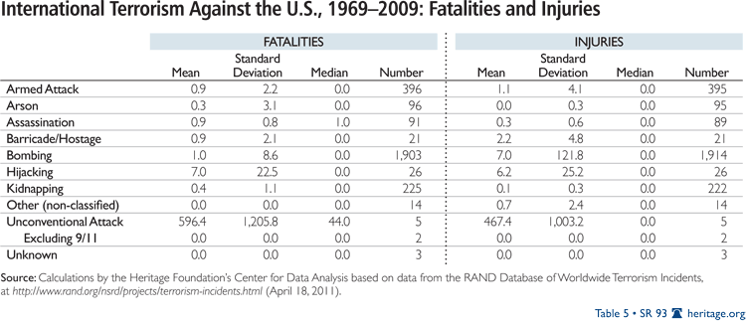
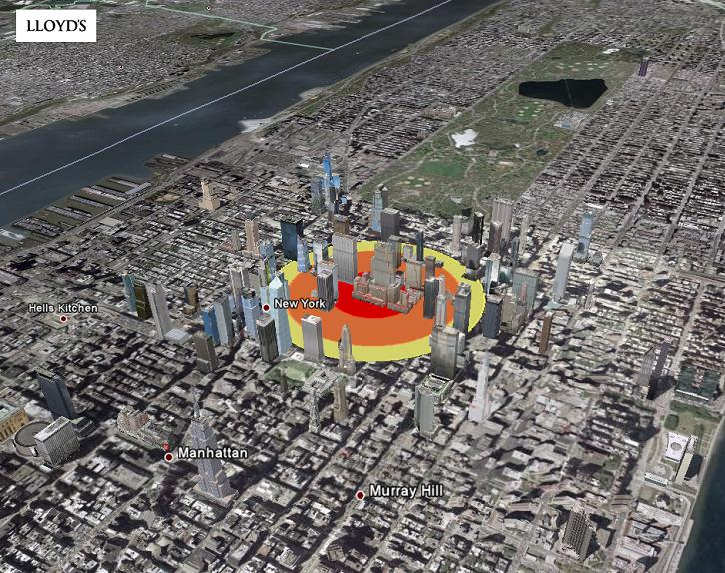
Quantification: plausible but extreme
Scenarios are a valuable tool to explore uncertainty and test assumptions
For emerging risks, proxy data can be used to frame analysis
Qualitative assessment is essential
Beware behavioural bias!
Lloyd’s Realistic Disaster Scenario
2-tonne bomb blast, Rockefeller Centre, New York City

Slide 5

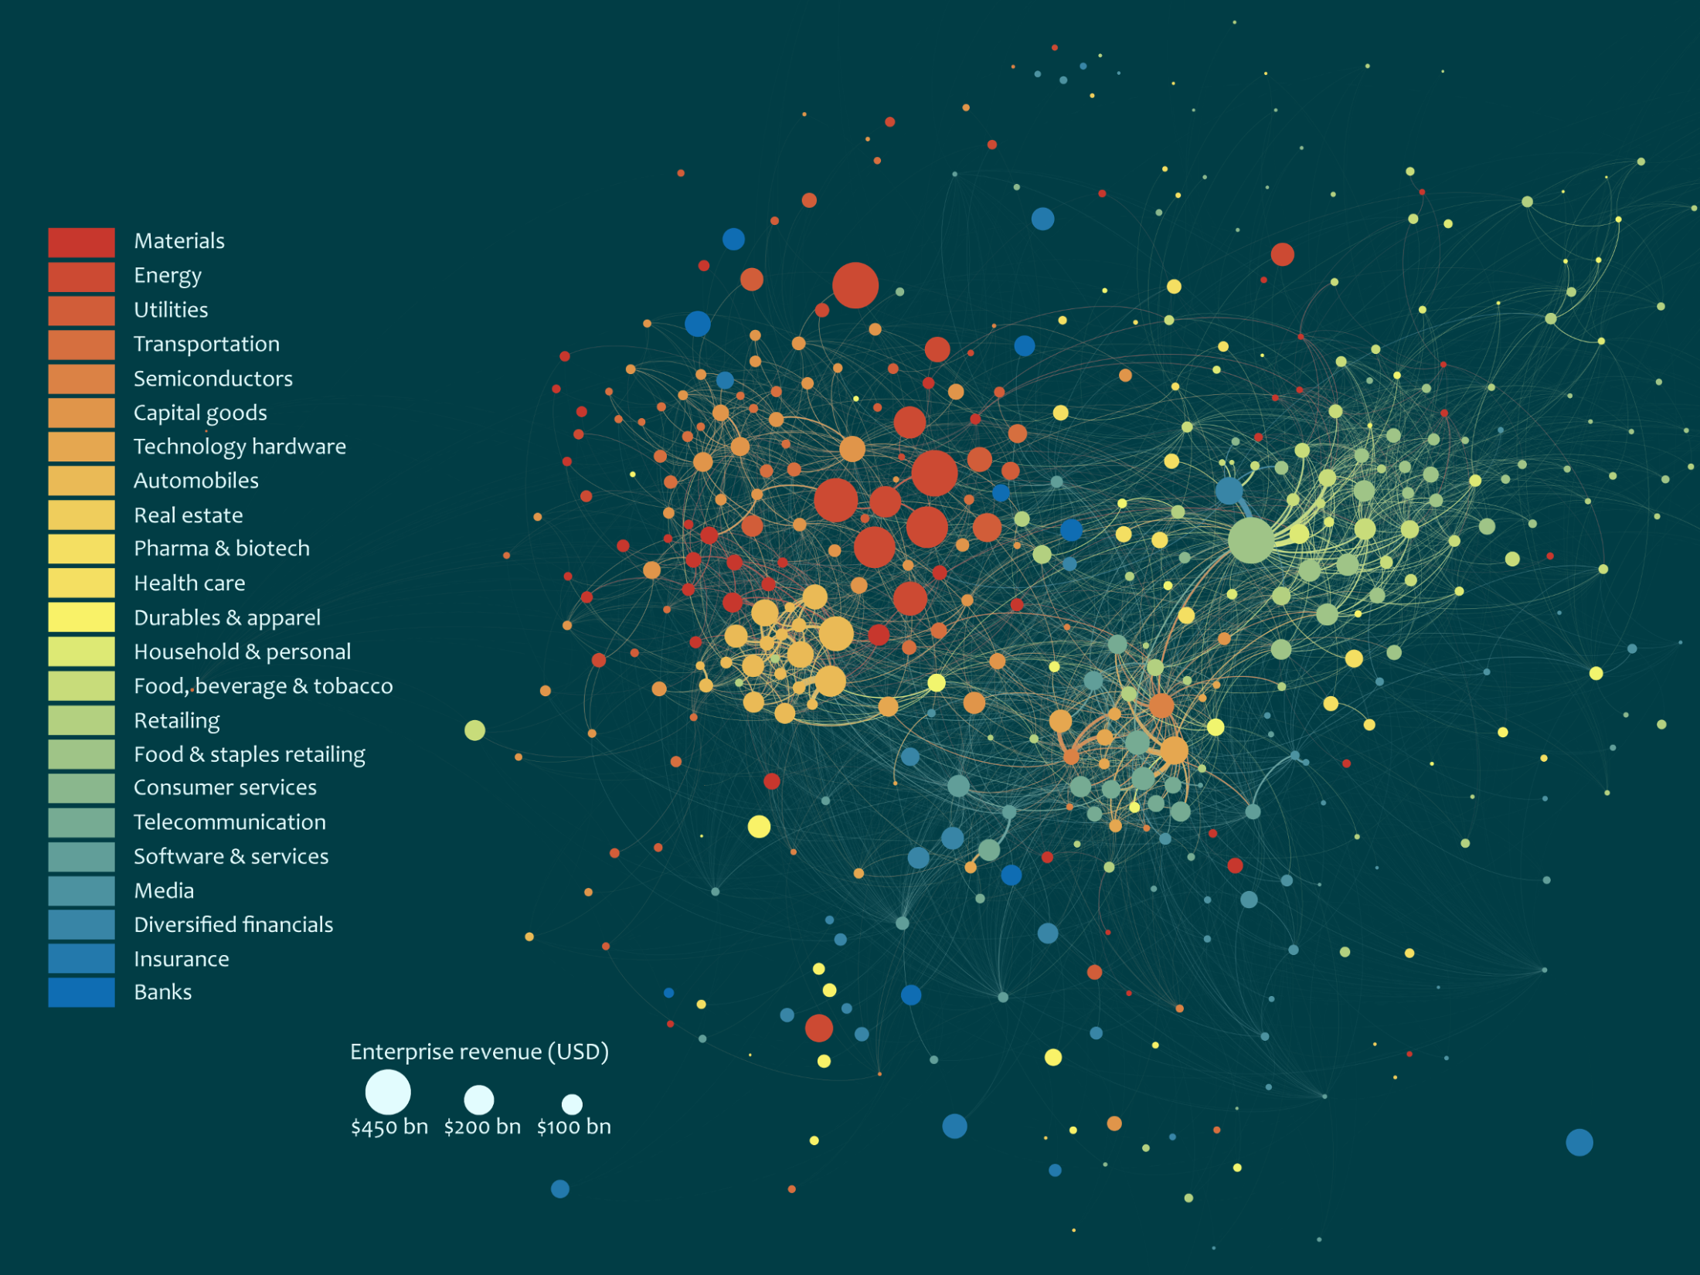
Assessment: connected risk in a globalised world
Enterprises driving the global economy
PetroChina
Roche
Biotech
Gazprom
GlaxoSmithKline
Energy
Johnson & Johnson
Aerospace
Pfizer
Shell
Berkshire Hathaway
BP
Chevron
ExxonMobil
Wal-Mart
Consumer
General
Motors
Sinopec
Volkswagen
Tesco
Nestlé
Toyota
Apple
Auto
Amazon
AT&T
Allianz
Technology
Financial
AXA
Oracle
Notes:
This force-directed graph produced by the Cambridge University Centre for Risk Studies depicts the trading relationships of the 300 largest enterprises in the global economy. Bloomberg trading data has been combined with an algorithm that draws the enterprises together according to their volume of trade with each other. It shows how the global economy is a connected system, formed of many smaller systems based on sectors of economic activity.
In terms of risk management, this means that any given shock event can cascade throughout a sub-system, and the system as a whole, in ways that are difficult to predict. Thanks to modern communications and travel, effects can be magnified and distributed at high speed.
Risk is increasingly connected, and when assessing emerging risks we often need to think of them as shocks to connected systems that can simultaneously impact multiple classes of insurance and insured clients around the world.
This applies to business interruption, cyber risk, liability and reputation to name a few.

Slide 6


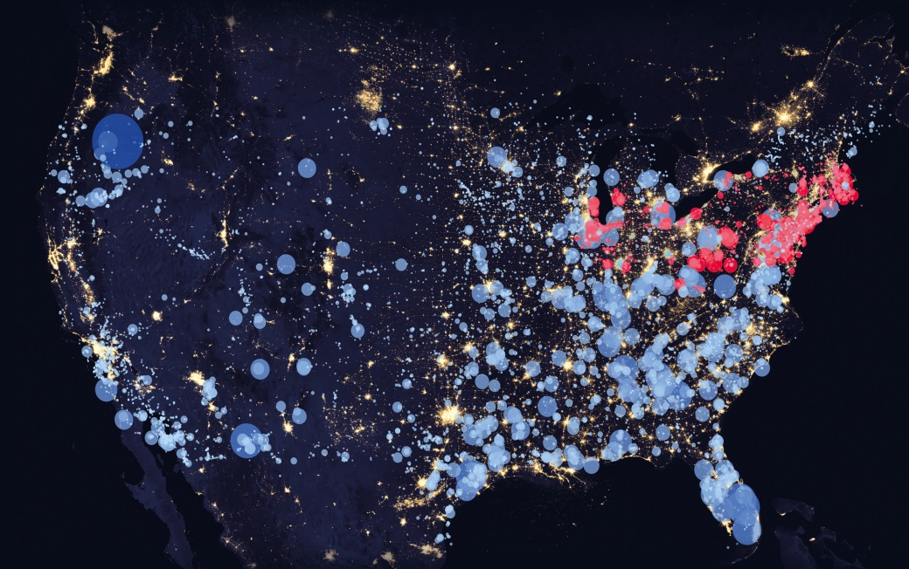
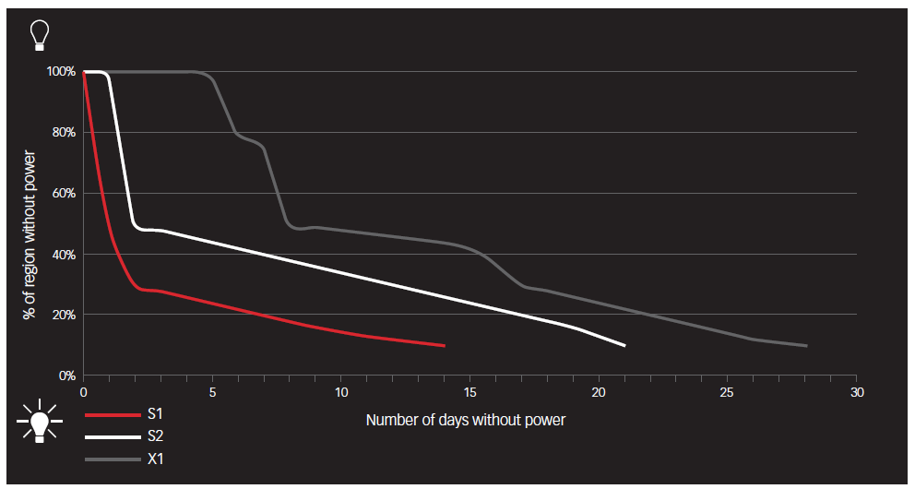
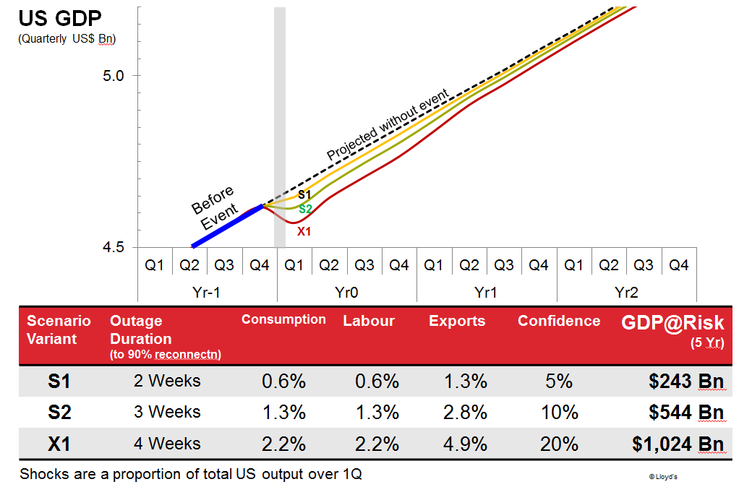
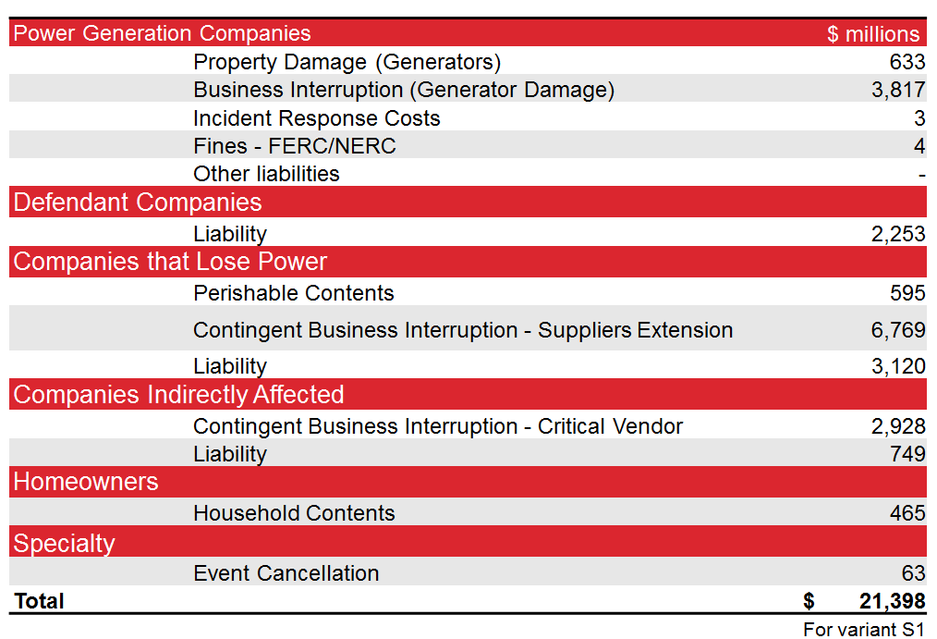
Cyber attack against the US power grid
www.lloyds.com/businessblackout
Duration and extent of power outage
Insurance claims

Slide 7
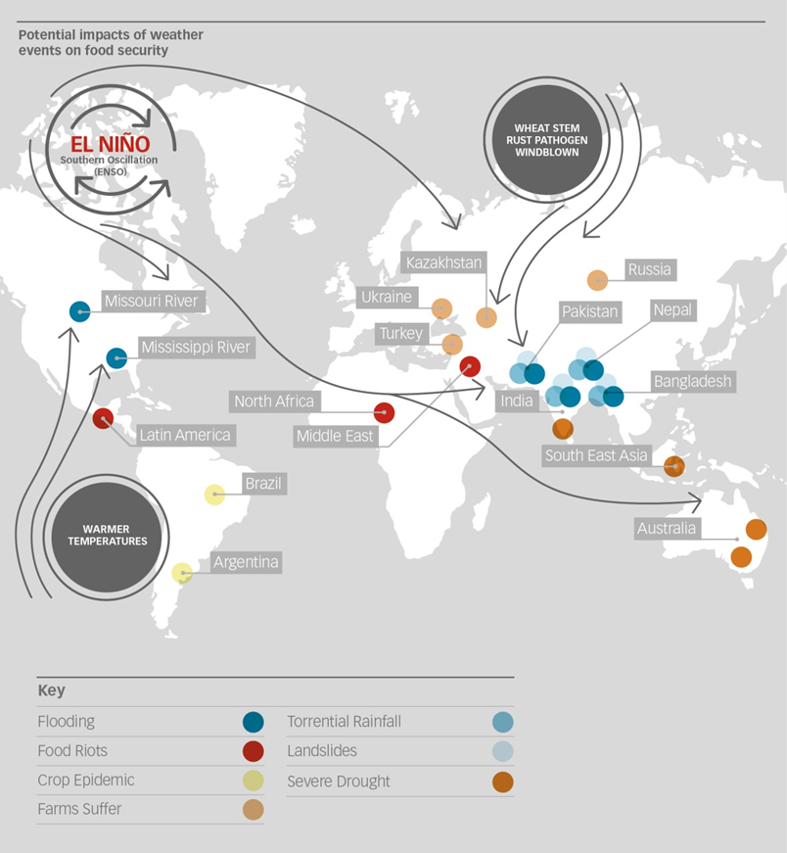
Food system shock
Insurance impacts
Terrorism and Political Violence
Political Risk
Business Interruption
Marine and Aviation
Agriculture
Product Liability and Recall
Environmental Liability
Compounding factors
Potential to span multiple years
Impacts on investment income
Impacts on regulatory and business environment

Slide 8
Emerging risks research

Slide 9
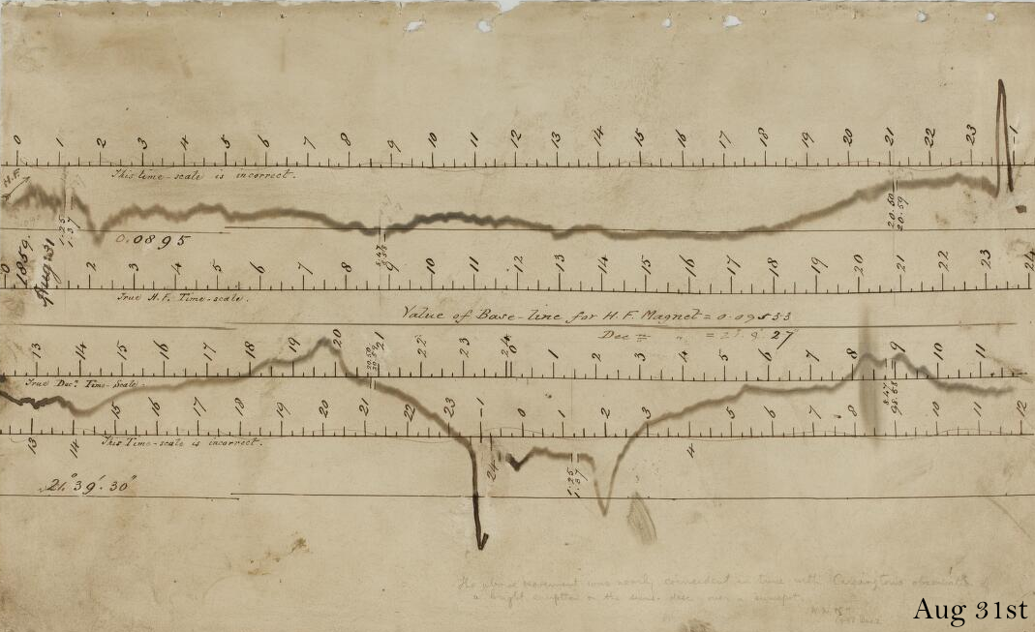
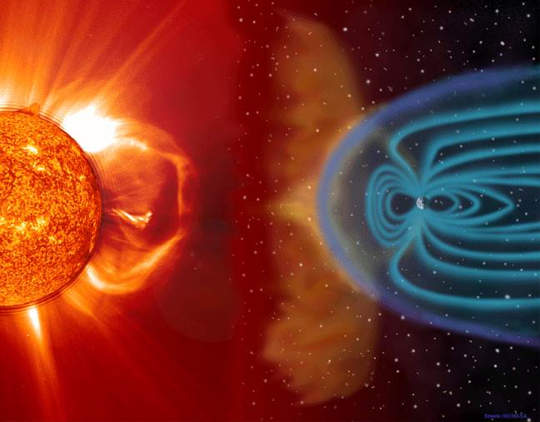
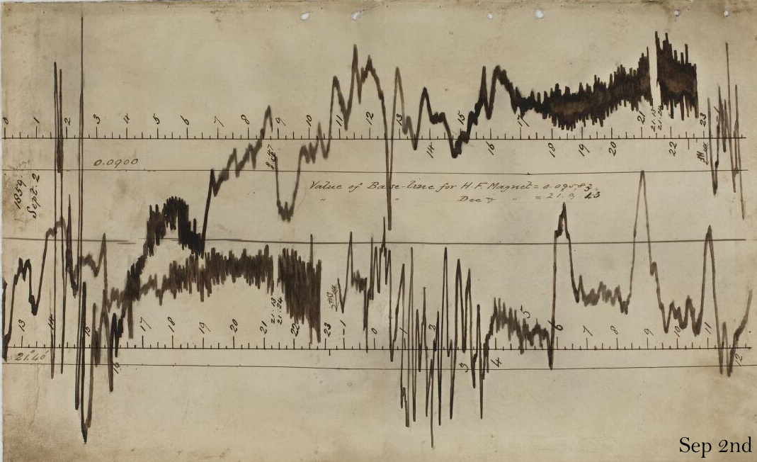
Research: severe space weather
Coronal mass ejection and the earth’s magnetic field (source: European Space Agency)
Magnetogram recordings of the ‘Carrington event’
Recorded at the Greenwich Observatory, 1859
(source: British Geological Survey)

Slide 10
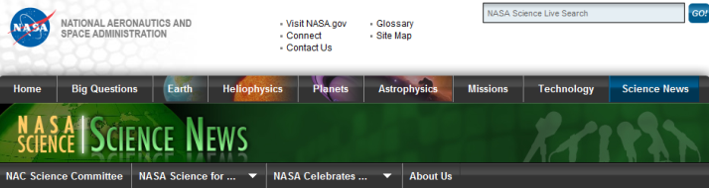

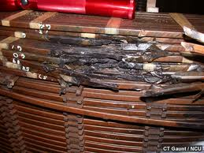
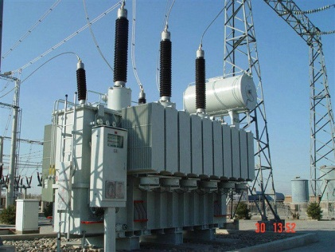
Research: severe space weather
Lloyd’s commissioned research on the risk to the North American electric grid which showed that an extreme geomagnetic storm is almost inevitable in the future, with a return period of 150 years
A severe event could generate a power outage in North America of between 16 days and 2 years, affecting a population of 20-40 million.
Lloyd’s is now developing a model that will enable syndicates to estimate aggregate exposure to a severe space weather event
Damage to high voltage transformer following geomagnetic storm
Notes:
Sources:
http://www.lloyds.com/news-and-insight/risk-insight/library/natural-environment/solar-storm
http://www.raeng.org.uk/publications/reports/space-weather-full-report
March 2015 space weather event: http://www.space.com/28845-solar-storm-auroras-st-patricks-day.html
July 2012 severe event ‘near miss’: http://science.nasa.gov/science-news/science-at-nasa/2014/23jul_superstorm/
October 2003 event (damage to S African power transformers): http://www.space.com/23396-scary-halloween-solar-storm-2003-anniversary.html

Slide 11
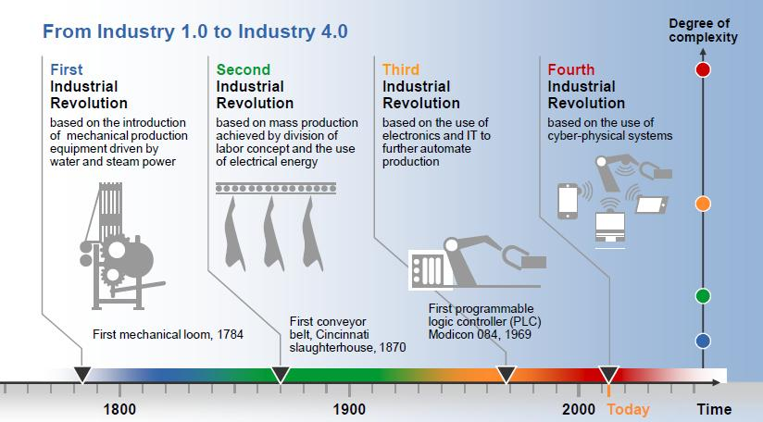
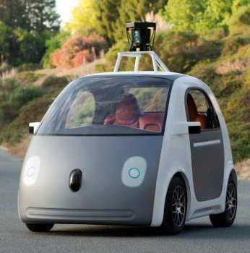
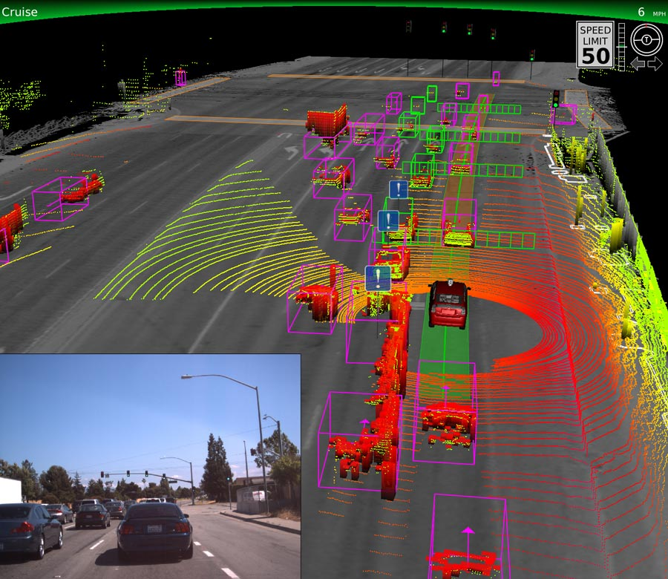

Research: autonomous machines and the ‘digital revolution’
Big data combined with artificial intelligence
Risk does not disappear
  Decision-making by machines
  Personal liability transformed in to product liability?
Connected economy may be more vulnerable to system-wide disruption
www.engineersjournal.ie

Slide 12
www.lloyds.com/emergingrisks

