Slide 1
SERFF:
Tips & Tricks
SHOENFELT CONSULTING, INC.
3717 Latimore Road, Shaker Heights, OH 44122
(216) 244-4295
Jim@ShoenfeltConsulting.com

Slide 2
Login

Slide 3
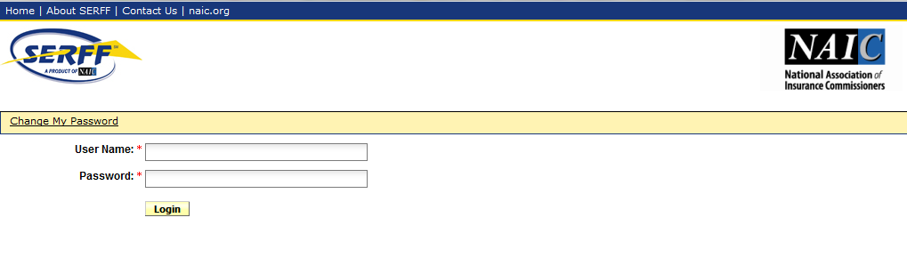
Notes:
This is the login screen. If you are a consultant that it is possible you may have multiple logins. (For example – one for your own company where you file as a Third Party for other companies – and possibly others for when the company adds you as a user in their own SERFF instance.)

Slide 4
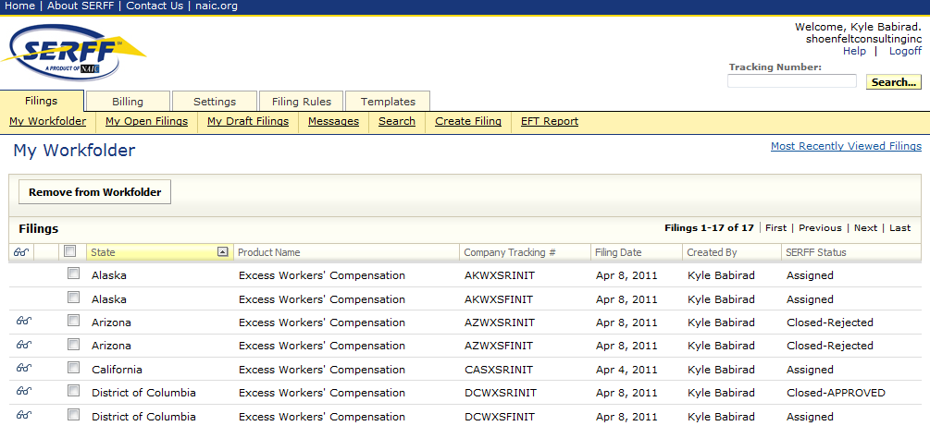
Workfolder
Notes:
When you log in, you’ll see five tabs. The first tab is “Filings”. Selecting a tab presents various options. For example, if you select the “Filings” tab, you may then choose from “My workfolder”, “My open filings”, “My Draft filings”, “Messages”, “Search”, “Create filing”, and “EFT report”. This screen shot shows “my Workfolder”. Only filings which you specifically choose to move here appear here. Filings stay in your workfolder until you remove them, even if the filings are closed. So it is possible that you can see open, closed, and draft filings here. It’s a good way to group similar filings together if you are working on a countrywide project, so that you can see the current status of all the states.

Slide 5
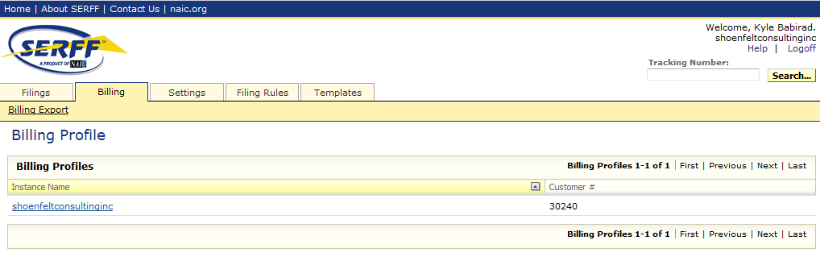
Billings
Notes:
The Second tab is “Billing”. This is the billing profile. If you click on your instance name you can see how much filings are left in your “block” if you have purchased one.

Slide 6
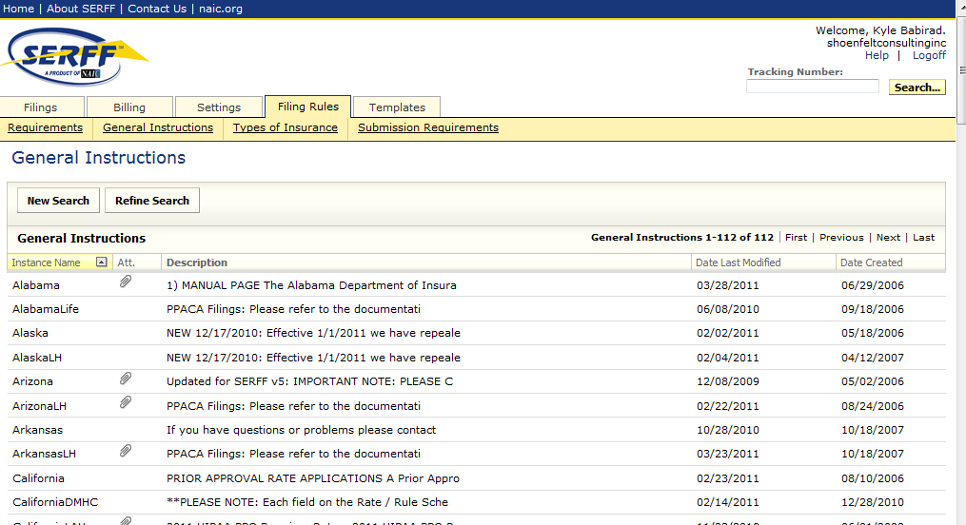
Filing Rules
Notes:
The fourth tab is “Filing Rules”. Under “Filing Rules”, you may select “requirements”, “General Instructions”, “types of Insurance’, and “Submission requirements”. This screen shows the “general instructions’ selection. If you want to check the general filing instructions for a specific state and you don’t want to actually make a filing, you can click Filing Rules → General Instructions and click the state you want to view the instructions for.

Slide 7
Filings

Slide 8
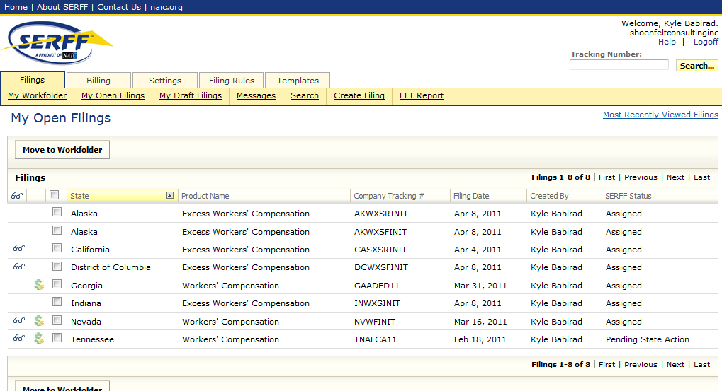
Filings
Open Filings
Notes:
Moving back to the “Filings Tab”. This screen shows the “My open filings” selection. “My open filings” selection shows all filings that have been submitted to the state and are currently open (i.e. not approved and not rejected). Once a filing has been approved, the filing disappears from the “My Open Filings” – so the only way you’ll be able to see it is if:
You’ve previously moved the filing to your Workfolder
You search for the filing under the Search tab
You click on the filing through the message in your message box that explains that the filing has been closed (this is how I usually look at closed filings.)

Slide 9
Filing status on…
Open Filings
Notes:
Filing status on open filings. After you submit the filing the status will be “Submitted”. This is usually the earliest stage of the filing. Once the filing has been assigned to a reviewer it will be marked “Assigned” (usually shortly after you submit the filing). On open filings, you will also see “Pending State Action” and “Pending Industry Response”. “Pending Industry Response” means there is an objection on the filing that the company needs to submit a response to. “Pending State Action” means that there was an objection on the filing, and the company has responded so the ball is in the DOI’s court now.

Slide 10
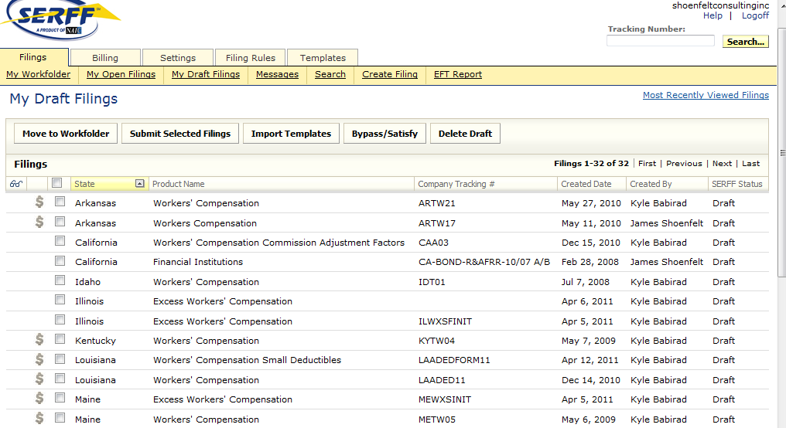
Filings
Open Filings
Draft Filings
Notes:
The third selection under the “Filings” tab is “My draft filings”. These are your draft filings. The state cannot see any of these. Note that only users who have been designated as an author on a filing can see the filing, whether it is open, closed or in draft status.

Slide 11
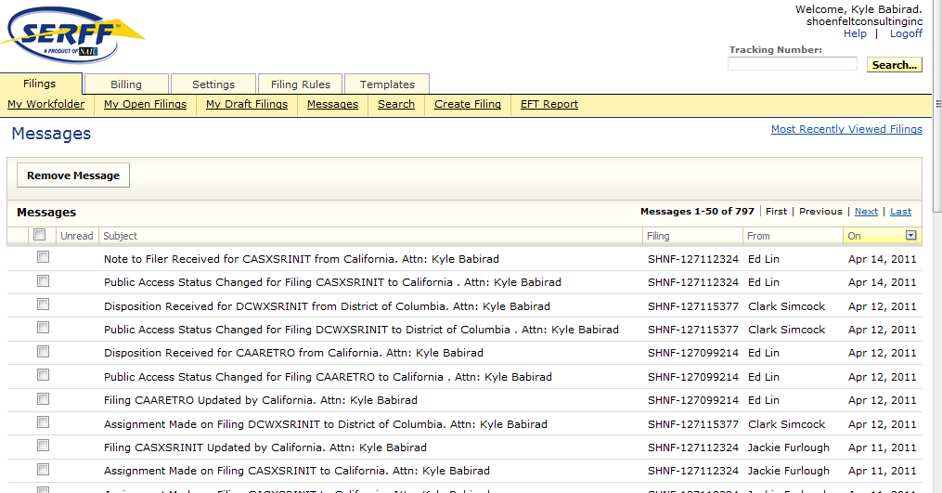
Filings
Open Filings
Draft Filings
Messages
Notes:
The fourth selection of the “Filings” tab is “Messages”. The “Messsages” sub-tab shows your Messages. Usually the messages you want to look out for are “Disposition Received” and “Note to Filer Received”.

Slide 12
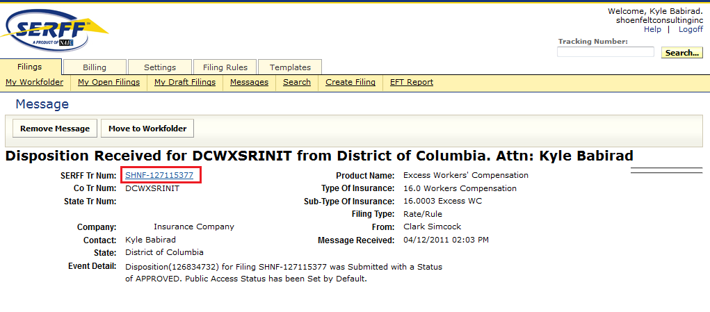
Filings
Open Filings
Draft Filings
Messages
Notes:
If you click on the message, you can see a link to the actual filing. Since filings that are Approved won’t appear in Open Filings anymore, clicking on the Disposition message is a convenient way to look at your filing (and print to PDF using the PDF Pipeline) after it has been closed.

Slide 13
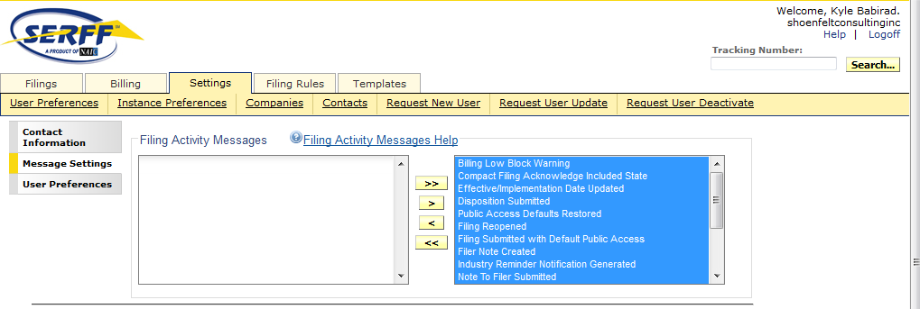
Filings
Open Filings
Draft Filings
Messages
Settings View
> Message Settings
Notes:
Sometimes it is useful if there are some types of messages in your Message Box that you just don’t care about. This is kind of like a “SPAM filter”. You may handle this in the third tab “Settings” by Selecting Settings → User Preferences → Message Settings. For example, you may want to remove “billing low block warnings”.
If you want to remove a specific message, you may do that from Filings -> Messages.

Slide 14
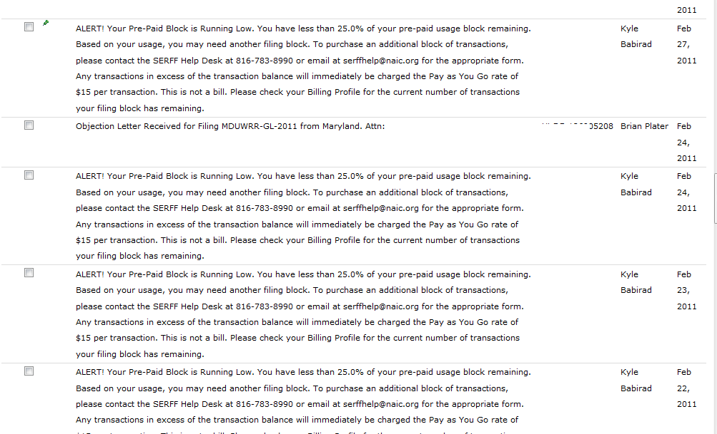
Filings
Open Filings
Draft Filings
Messages
Settings View
> Message Settings
Notes:
One message in particular that can be annoying is the “Billing Low Block Warning” message. Currently, SERFF generates a “Billing Low Block Warning” in your message box whenever a filing is made and you only have 25% of your “Block” left. This means if you have a block of 1000 filings, you are going to see the “Low Block” warning 250 times in a row (for your last 250 filings in your block) unless you disable the message. As you can see in the screenshot in 4.1, the billing low warnings can sometimes flood out actual important messages.

Slide 15
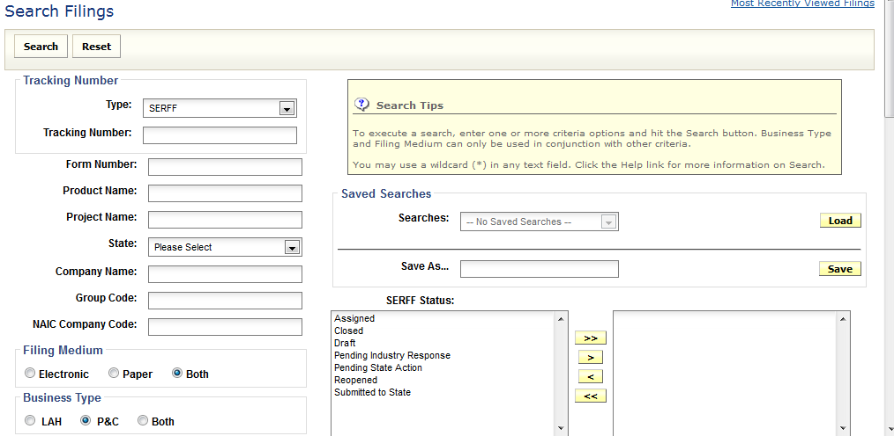
Filings
Open Filings
Draft Filings
Messages
Search
Notes:
This is the filing search. Most of the search terms are self explanatory.

Slide 16
Create Filing

Slide 17
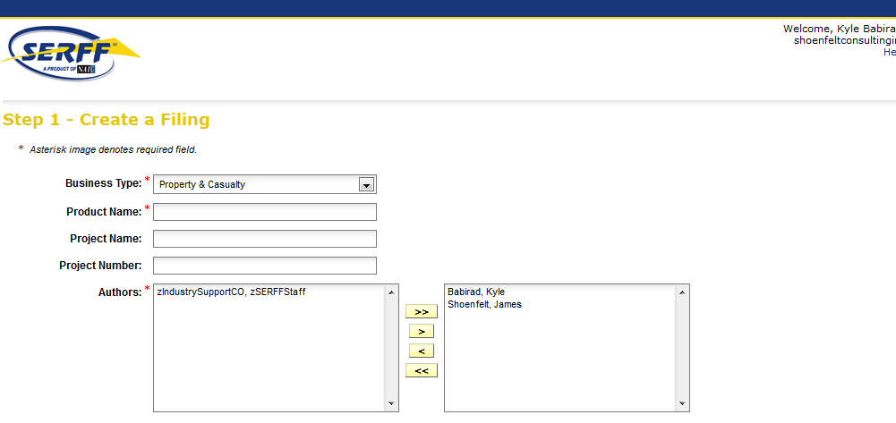
Create Filing
Step 1
Notes:
Step 1 of creating a filing. The business type will already be filled if you had the default set in settings. Add as an author every user you want to be able to see the filing. Sometimes you will see “zIndustrySupportCO, zSERFFStaff” if you’ve previously called the SERFF help desk for a technical issue and the issue is still outstanding.

Slide 18
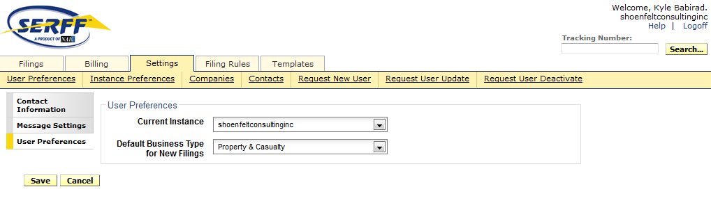
Create Filing
Step 1
Settings View
> User Preferences
Notes:
You can see this second menu under Settings → User Preferences → User Preferences. If you only file for P&C, it can be useful to set the “Default Business Type for New Filings” to “Property & Casualty”. Otherwise you have to select “Property & Casualty” from a drop-down box every time you make a filing.

Slide 19
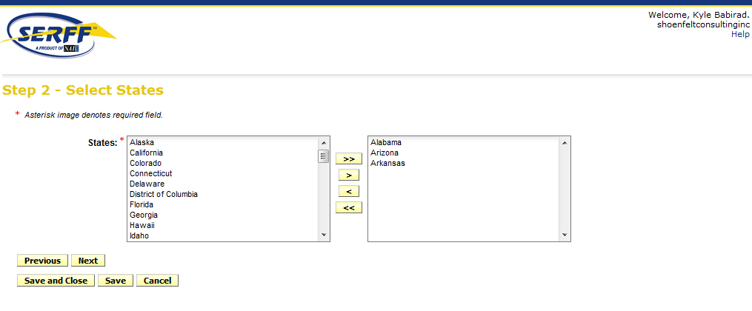
Create Filing
Step 2
Notes:
Choose which states you want to submit filings to. If you are doing the same filing in multiple states sometimes you can save time by adding multiple states here.

Slide 20
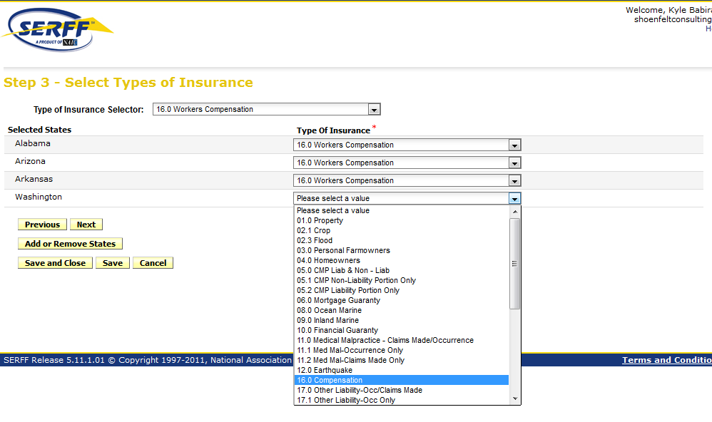
Create Filing
Step 3
Notes:
Select the Line of Insurance for your state. There is a drop down box at the top that will select the same line for all of the states. However some states (like Washington in the pic) don’t define the line the same, so you have to pick the line in that state individualy (e.g. Compensation instead of Workers’ Compensation.)

Slide 21
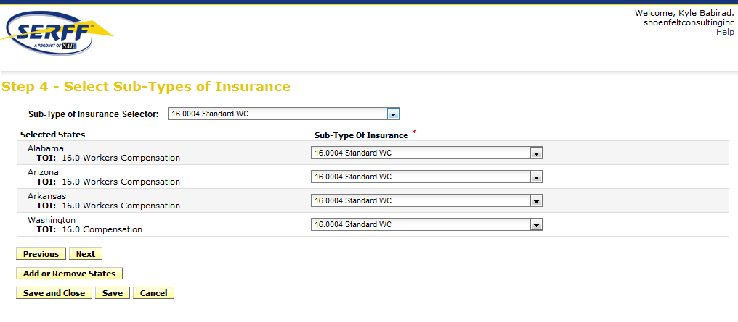
Create Filing
Step 4
Notes:
Step 4. Select the subline

Slide 22
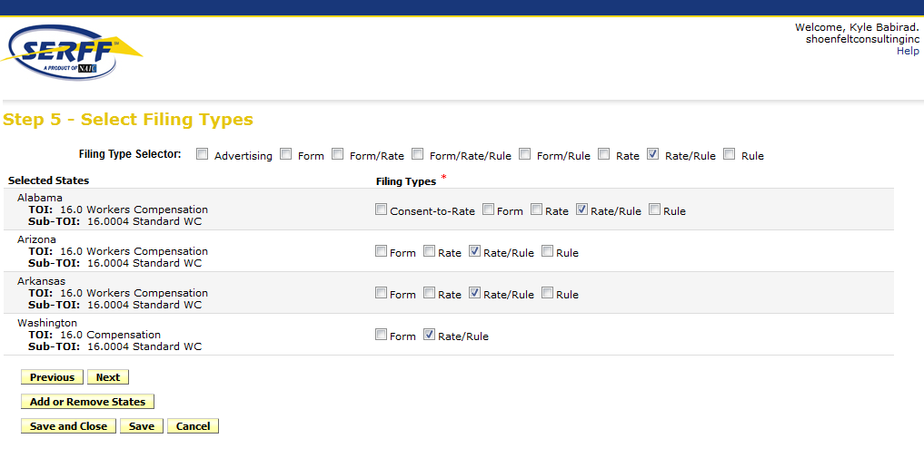
Create Filing
Step 5
Notes:
Select the type of filing. Some states let you do Rate/Rule/Form filings, some require Rate/Rule and Form filings to be made separately. This is a reliable way to learn if the state allows you to make rate/rule/forms in one filing. If you would like to make a rate/rule/forms filing, and the state only permits rate/rule or form, then you must choose one (e.g. rate/rule) here… and then create another filing for all of the states that prohibit you from making rate/rule/forms filings in a single filing.

Slide 23
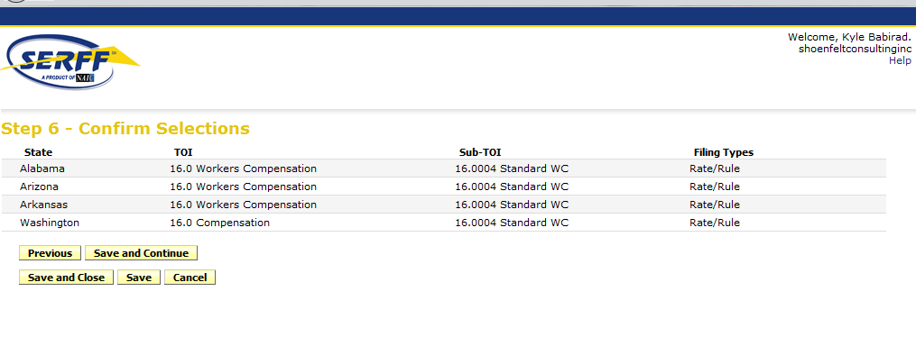
Create Filing
Step 6
Notes:
Straightforward

Slide 24
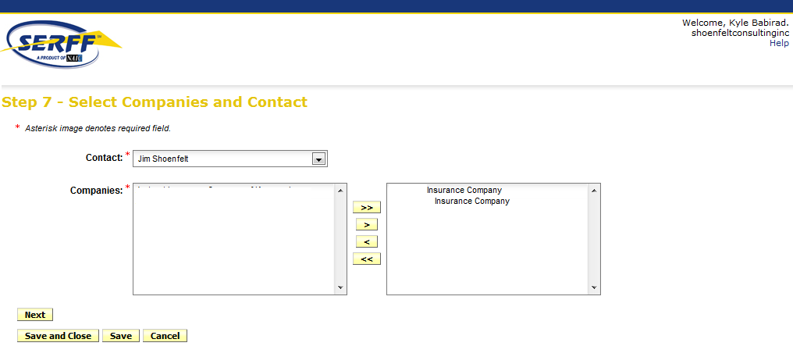
Create Filing
Step 7
Notes:
Select which companies will be in the filings. In this step, you aren’t saying that these companies go in ALL of the states, they are just the companies you can pick from in the next step. (I’ve blocked the names of the companies from this screen, but you get the idea.)

Slide 25
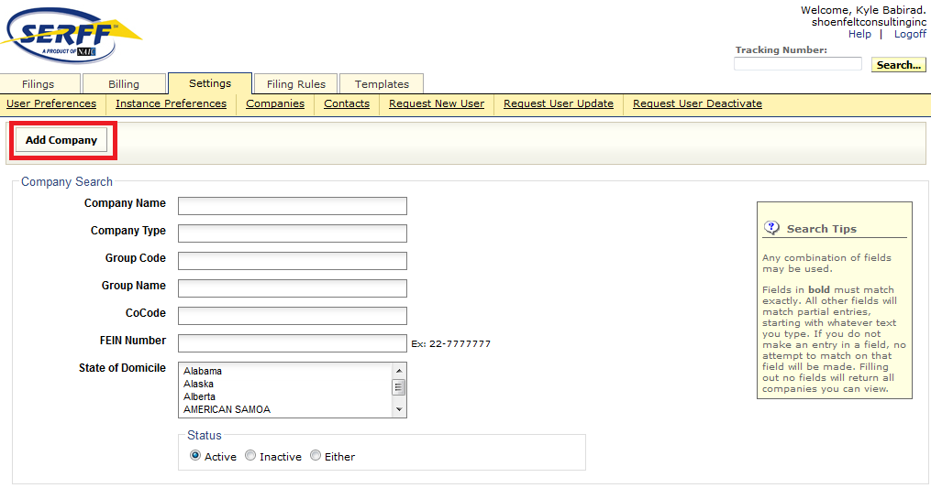
Create Filing
Step 7
Settings View
> Add Company
Notes:
If you need to add another company to your instance, you go to settings → Companies and click the Add Company button. (For some reason I always have a hard time finding this button even though it seems obvious.)
One might think that you need to more formally contact NAIC in order to add a company here. However, as long as you have the company’s information, you may add a company here and make a filing. (SERFF may require you to add a Third-Party authorization form, however, if you are filing on behalf of a company.)

Slide 26
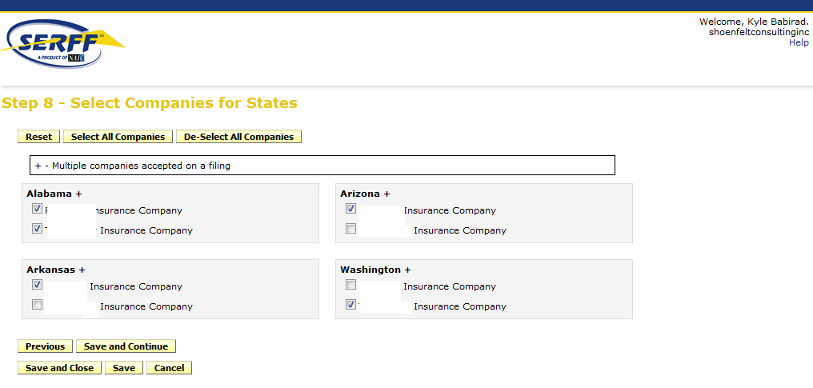
Create Filing
Step 8
Notes:
Select which companies (from the previous step) will go in each of the state filings.

Slide 27
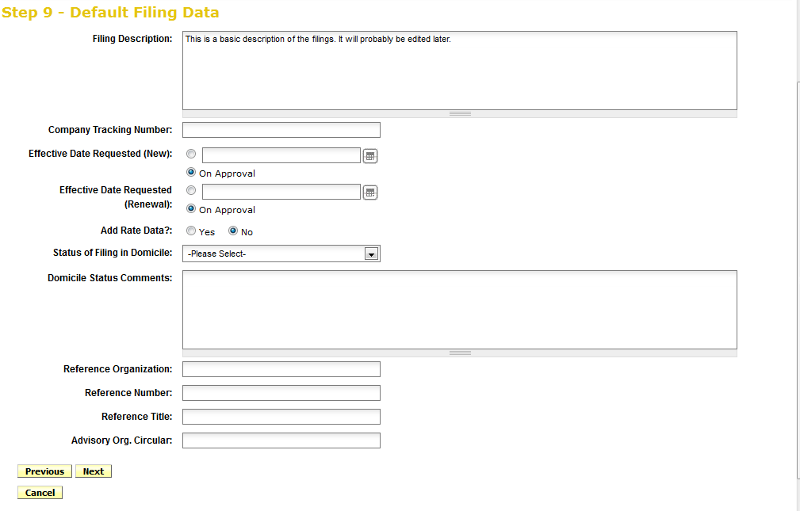
Create Filing
Step 9
Notes:
If the filings all have something in common you can fill out some info here to save time. Otherwise, leave it blank for now. For example, if you’re createing filings for 4 states, you’ll leave the “company tracking number” blank here – assuming that you use a different company tracking number for each filing.

Slide 28
Inside a Filing

Slide 29
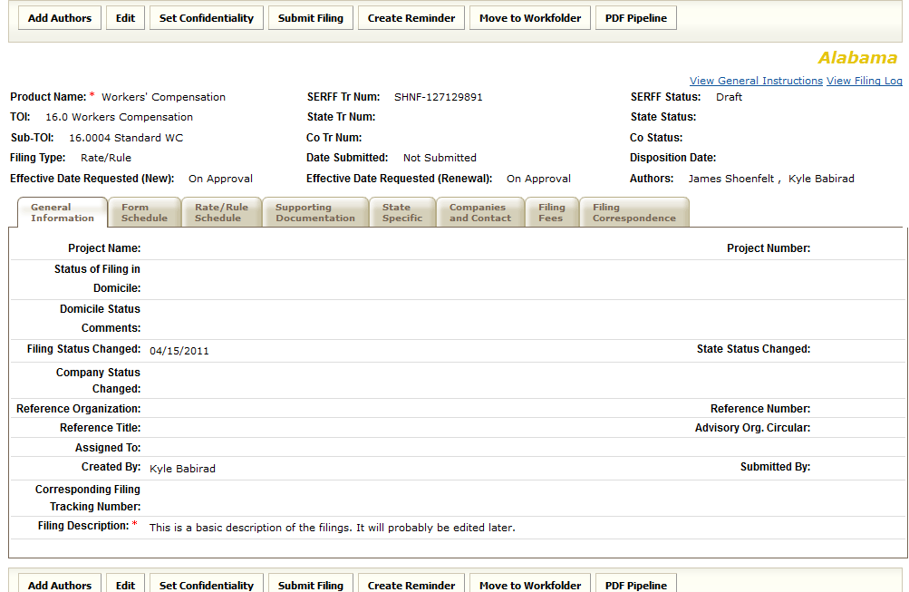
General
Information
Form Schedule
Rate Rule/Schedule
Supporting Documentation
State Specific
Filing Fees
Filing Correspondence
Notes:
By clcikcin on a filing that you’ve created (e.g. Filings -> my workfolder or filings-> open filings or Filings -> draft filings, etc.) you will then see a screen that looks like this. If you select the “General Information tab”. The “Filing Description” is a cover letter of sorts. Most states don’t require an entry in the other fields, but you should check the General Instructions for the state to be sure.

Slide 30
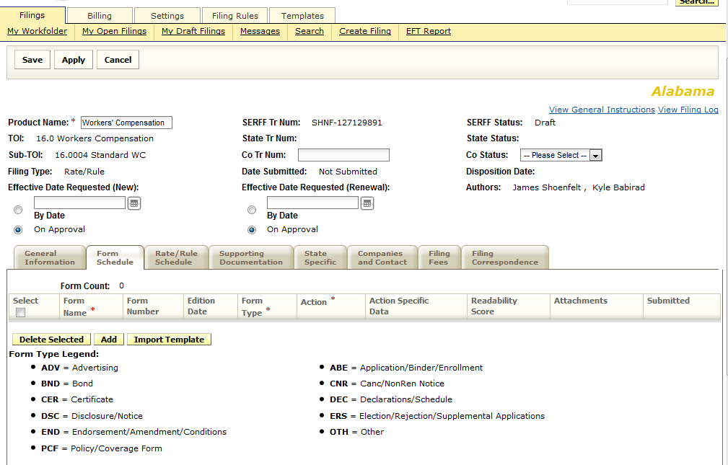
General
Information
Form Schedule
Rate Rule/Schedule
Supporting Documentation
State Specific
Filing Fees
Filing Correspondence
Notes:
Form Schedule.

Slide 31
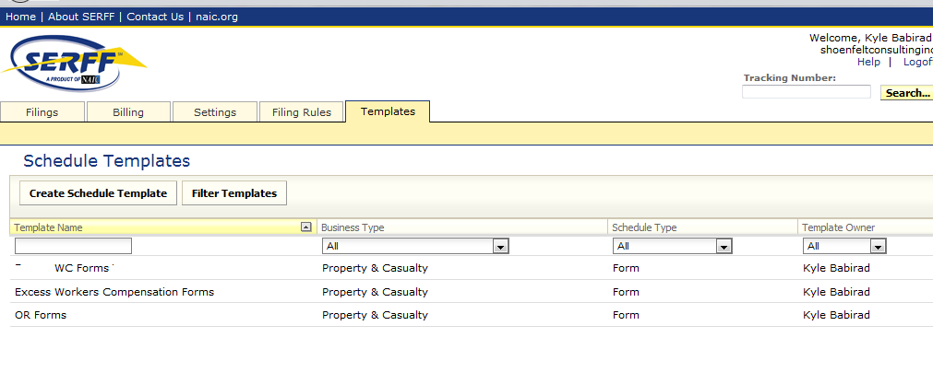
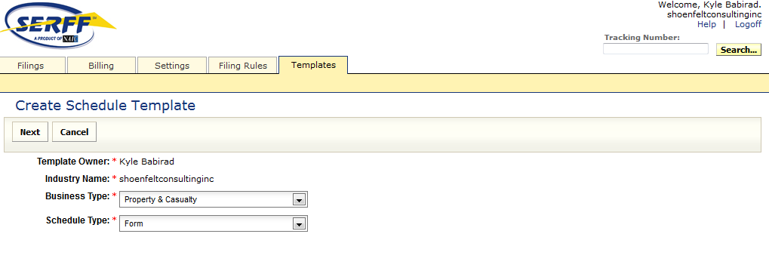
General
Information
Form Schedule
Rate Rule/Schedule
Supporting Documentation
State Specific
Filing Fees
Filing Correspondence
Templates
> Create Schedule Template
Notes:
Even if you plan on only making the filing once – if you are filing many forms it is usually a good idea to make a Form Template first, THEN import the template into the forms schedule. This way, if the state rejects your filing, you don’t have to attach and label the forms all over again.

Slide 32
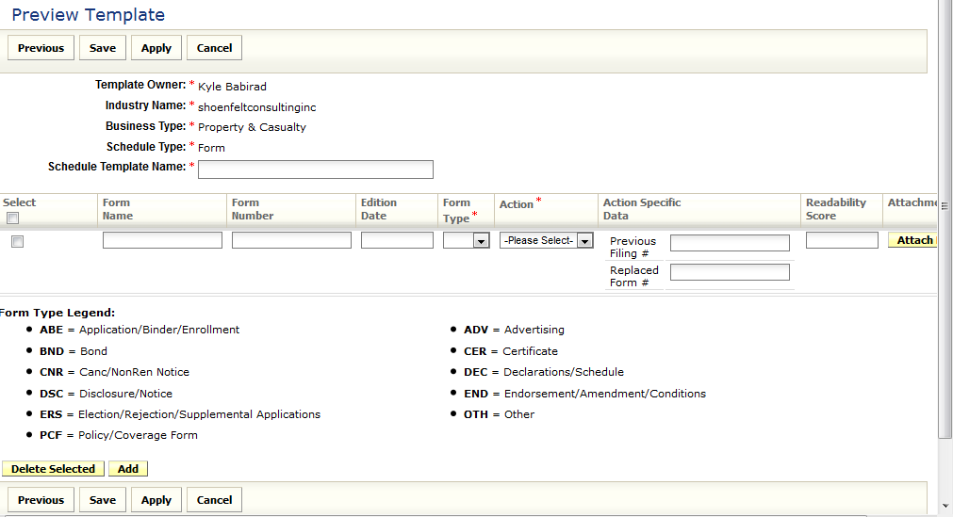
General
Information
Form Schedule
Rate Rule/Schedule
Supporting Documentation
State Specific
Filing Fees
Filing Correspondence
Templates
> Create Schedule Template
Notes:
As you can see in the screenshot – creating a Form Template is exactly like attaching forms to the form schedule.

Slide 33
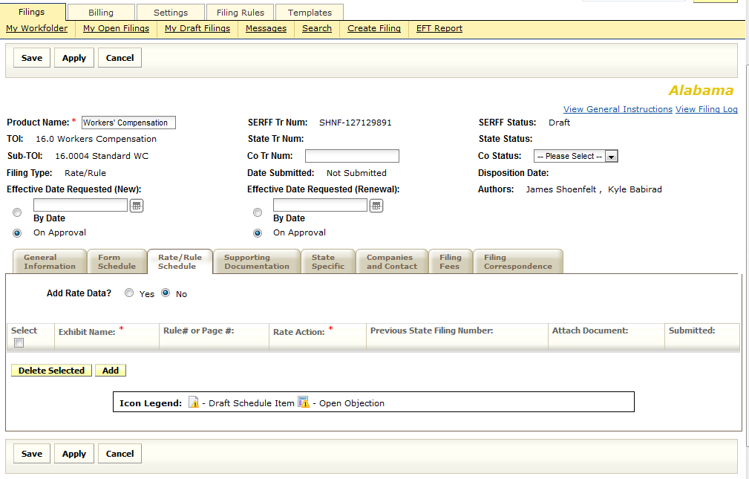
General
Information
Form Schedule
Rate Rule/Schedule
Supporting Documentation
State Specific
Filing Fees
Filing Correspondence
Notes:
Rate Rule Schedule Tab. Attach any rate/rule pages here. Again if you are filing many rate/rule pages then its usually a good idea to make a Rate/Rule Template first, then import the template. If there is a rate impact as a result of the filing then nearly all states will require that you check “Yes” for Add Rate Data. Most states require you “Add Rate Data” even if there is no impact. If you are just introducing a new rule then many states will not require you to check “Yes” for “add rate data”.

Slide 34
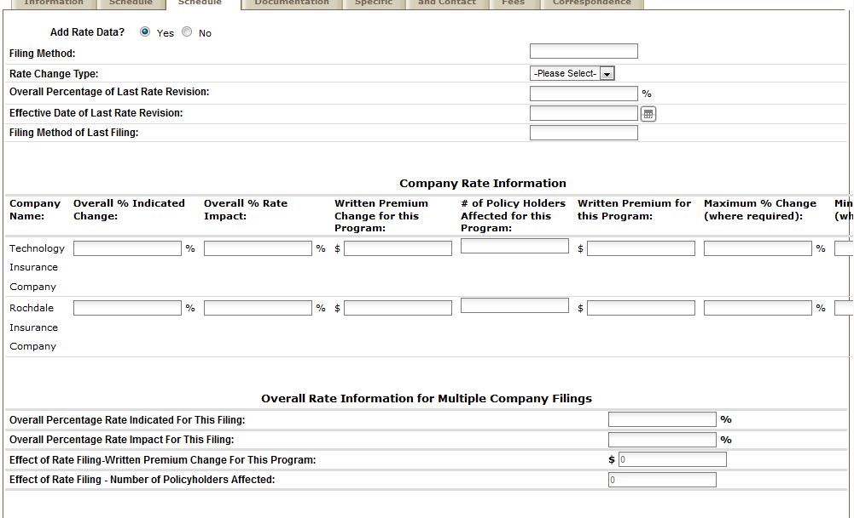
General
Information
Form Schedule
Rate Rule/Schedule
Supporting Documentation
State Specific
Filing Fees
Filing Correspondence
Notes:
This slide shows the fields that appear when you select “Yes” for “Add Rate Data”.

Slide 35
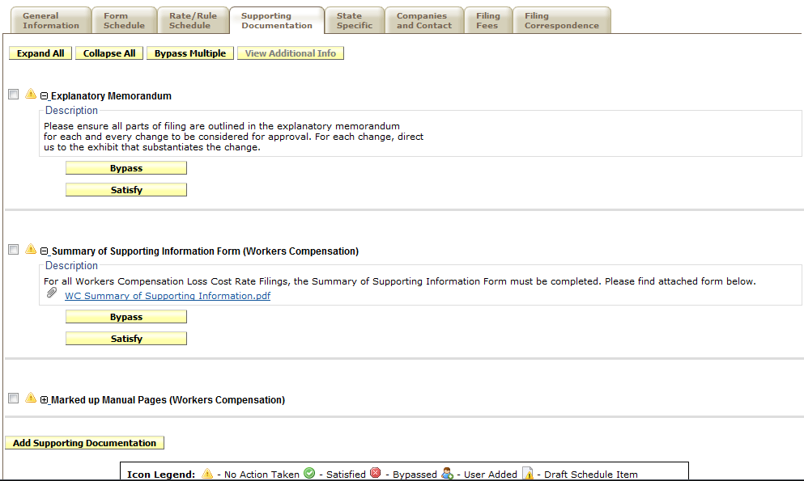
General
Information
Form Schedule
Rate Rule/Schedule
Supporting Documentation
State Specific
Filing Fees
Filing Correspondence
Notes:
Supporting Documentation tab. The categories here vary by state. If you have Supporting Documents that do not fit into any of the categories, then you can click the small “Add Supporting Documentation” button at the bottom to create name your own category. If you are a third party filer, many states do not have a supporting documentation item for Third Party Authorization letters, so you need to create your own category for that, for example.

Slide 36
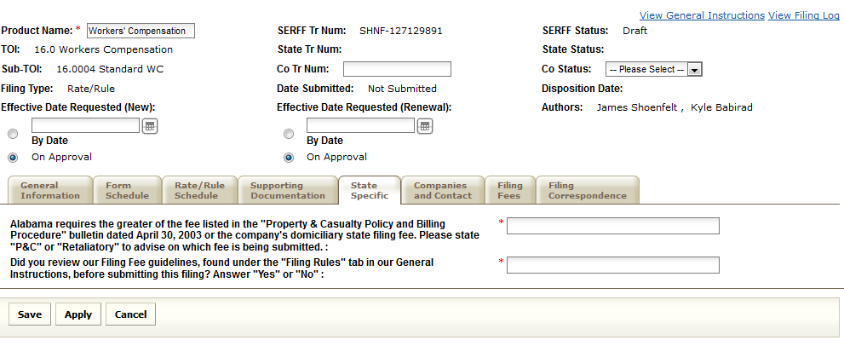
General
Information
Form Schedule
Rate Rule/Schedule
Supporting Documentation
State Specific
Filing Fees
Filing Correspondence
Notes:
State Specific tab. Also varies by state. Usually asks questions like “Did you review the General Instructions?”. Sometimes also asks questions about the rate impact in the filing. Be sure you read the questions carefully and write the response they require, if they are specific. (Some states may automatically reject your filing if you write “Acknowledged” instead of “Yes”, for example) Many states do not even have a State Specific tab.

Slide 37
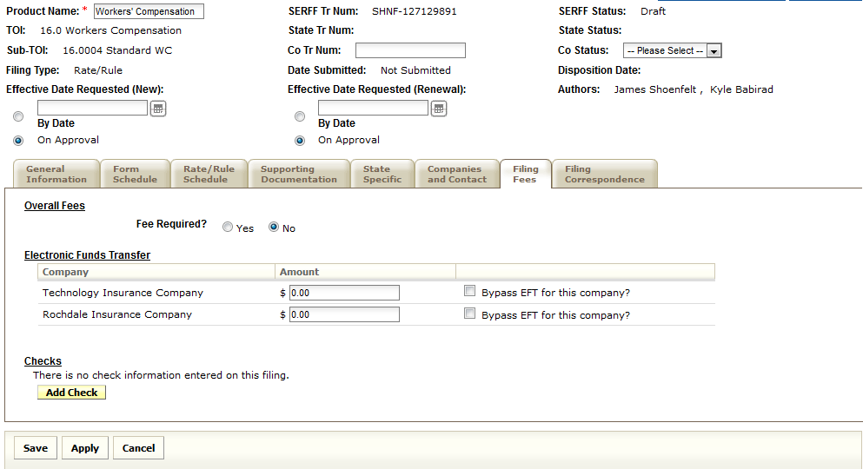
General
Information
Form Schedule
Rate Rule/Schedule
Supporting Documentation
State Specific
Filing Fees
Filing Correspondence
Notes:
Filing fees. If the state only charge one flat fee per filing, (i.e. does not charge extra for extra companies) it is usually OK to put the flat fee next to one of the companies, and bypass the other. Call the DOI reviewer to be sure.

Slide 38
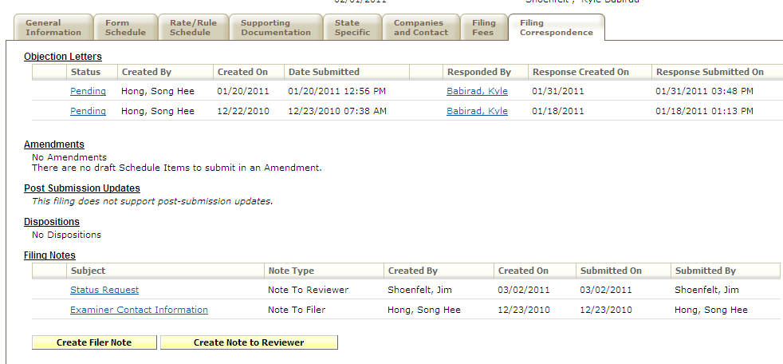
General
Information
Form Schedule
Rate Rule/Schedule
Supporting Documentation
State Specific
Filing Fees
Filing Correspondence
Notes:
1) Objection Letter status field. Where it says “PENDING” in the “status” field does NOT mean that the status of this filing is ‘pending”. Even after the objection letters have been addressed to the Department Of Insurance’s satisfaction, this field may still say “PENDING”. This is just a text field that might say “Pending industry response”.
Consider the following filing which has been “Closed”. (Not shown on this page – but it *is* closed!) Note that the “objection letter” status appears to be “Pending”.
2) Create filer note vs. Create note to reviewer. The following is actually is pretty self-explanatory, but it was confusing to me (for unknown reasons). If you want to tell the reviewer something, click “Create note to Reviewer”. If you want to “create filer note” – this is for internal purposes – a way for you to add information to the filing. We’ve never used this feature, but the instructions say that the Department Of Insurance will not see “create filer notes”.

Slide 39
Amending Filings

Slide 40
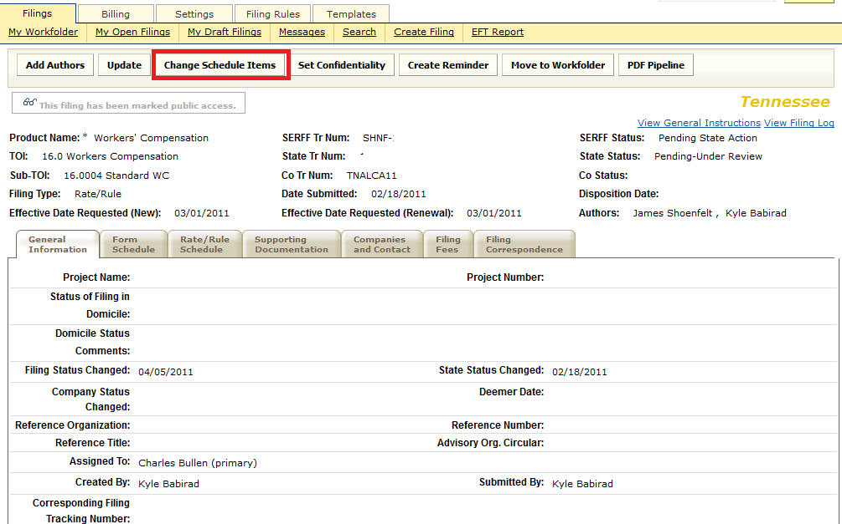
Amending a Filing
Step 1
Notes:
If you want to respond to an objection letter by adding/modifying any Schedule items or Supporting Documentation items, OR if you just want to amend the filing and there is no outstanding objection letter, you need to FIRST click the “Change Schedule Items” button. This will put you in “Revise Mode”. (You can tell if you are in revise mode by the big red box that says Revise Mode at the top.)

Slide 41
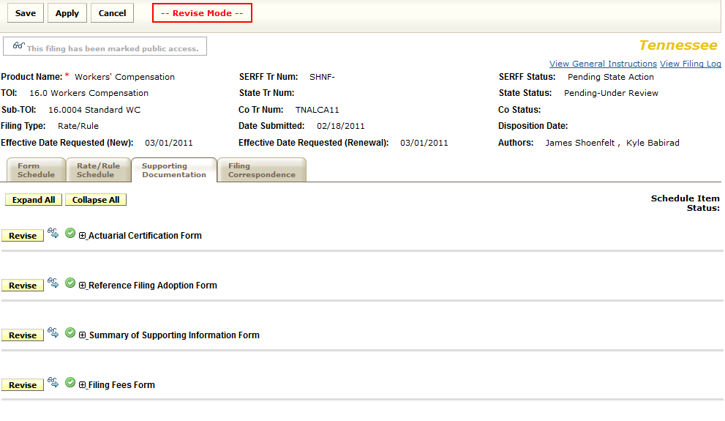
Amending a Filing
Step 2
Notes:
Then you can go to the appropriate tab, and click “Revise” where you want to change an item. If you are adding a new item, there is still an “Add Supporting Documentation” or “Add Schedule Item” button at the bottom.
(You can’t see them on this slide (it was cropped out), but it’s there. You can see it at the bottom of slide 35.
“Add schedule item” appear on the rate/rule schedule tab and the “form schedule tab” in the same place as “add supporting documentation’ appears on the “supporting documentation” tab. Their function is the same too – to add an attachment to the state filing.

Slide 42
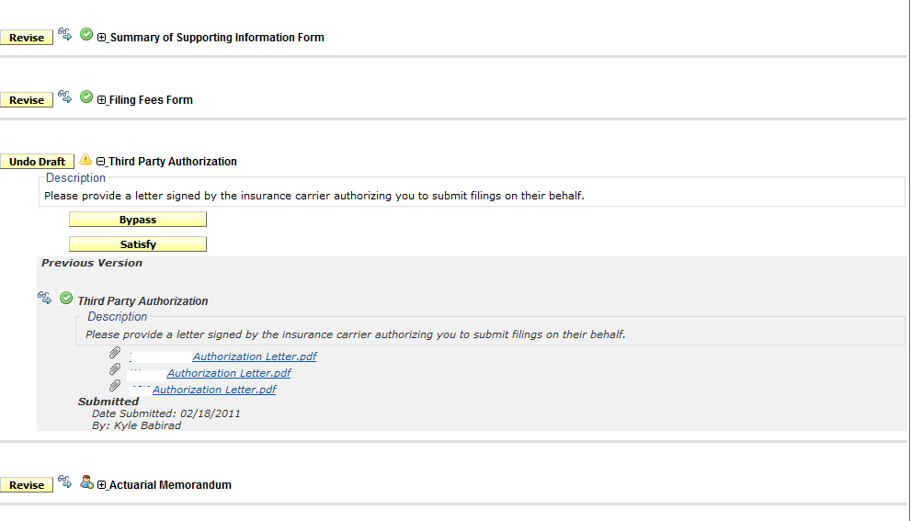
Amending a Filing
Step 3
Notes:
When you click “revise”, the “revise” button changes to an “undo draft” button as seen here. Also, SERFF will then present you with more information below. Specifically, It will show you your previous attachments (ie. the ones you want to replace) in grey background below your new attachments. Your original attachments can always be viewed later, and will always be a part of the filing.
Once you press “satisfy” you will then be prompted with an option to upload replacement support documents – and a button to click “save”.

Slide 43
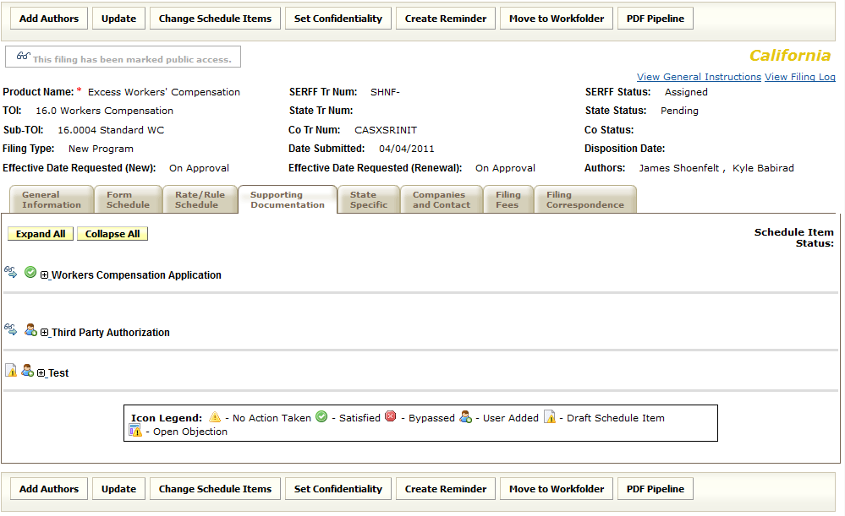
Amending a Filing
Step 4
Notes:
After you click “save” while in revise mode, any items you have added or revised will have this icon next to it.

Slide 44
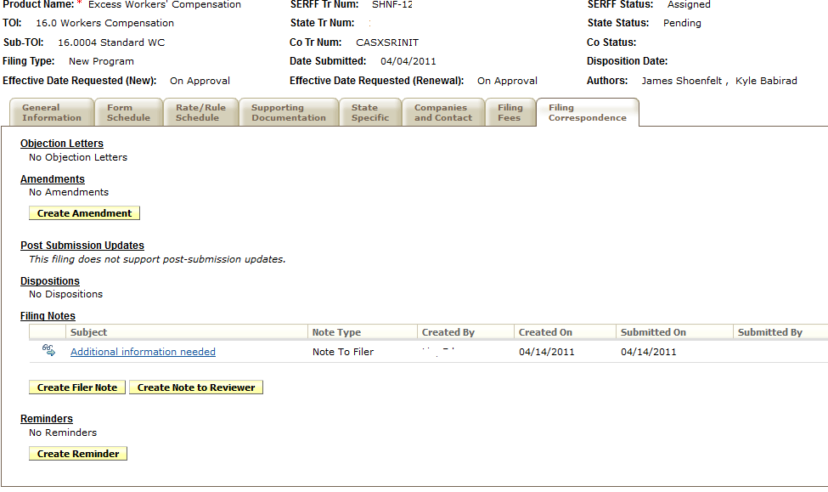
Amending a Filing
Step 5
Notes:
AFTER you have made your changes (e.g. uploaded your revised pages), you THEN go to the “Filing Correspondence” tab and click “Respond” next to the objection letter you are responding to, or click “Create Amendment” if you are amending the filing. (In this slide there is no objection letter, but there is an option to create amendments).
You amend a filing when you want to change something (such as a typo on a rate page) when there is no objection currently on the filing. Sometimes, however, the state will request that you make changes to the filing, but they won’t put the request in an Objection Letter. (See screenshot.) They might put the request in a Note to Filer, or they might send you an email (if they do make any correspondence outside of SERFF its usually good to ask the reviewer to document their request in the SERFF filing via an objection or Note to Filer.) In this case, there is no objection letter to respond to, so you need to amend the filing to make the requested changes.
What is a “Create Filer Note?” This is a way for filers to create note to themselves. The note is not seen by the state.
“Objection letters” are typically used for pages that need to be amended, deleted and changed. “Note to filer” are typically used for requests for information that have no impact on manual pages, forms and/or supporting documentation.

Slide 45
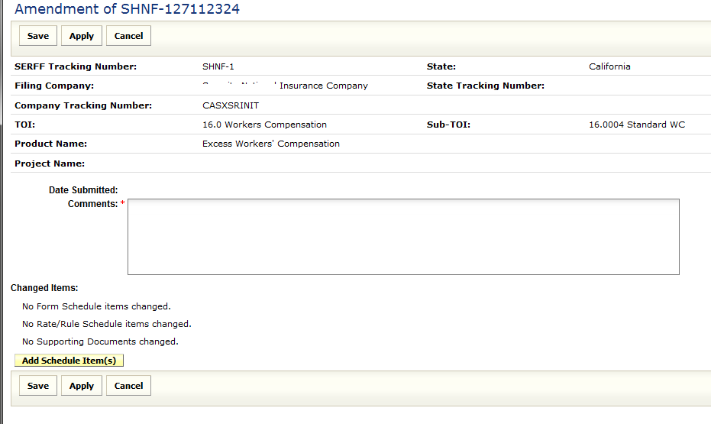
Amending a filing
Step 6
Notes:
This is the screen you see after you click “create amendment”. It is very similar to the screen you see when you click “Respond” next to an objection letter.

Slide 46
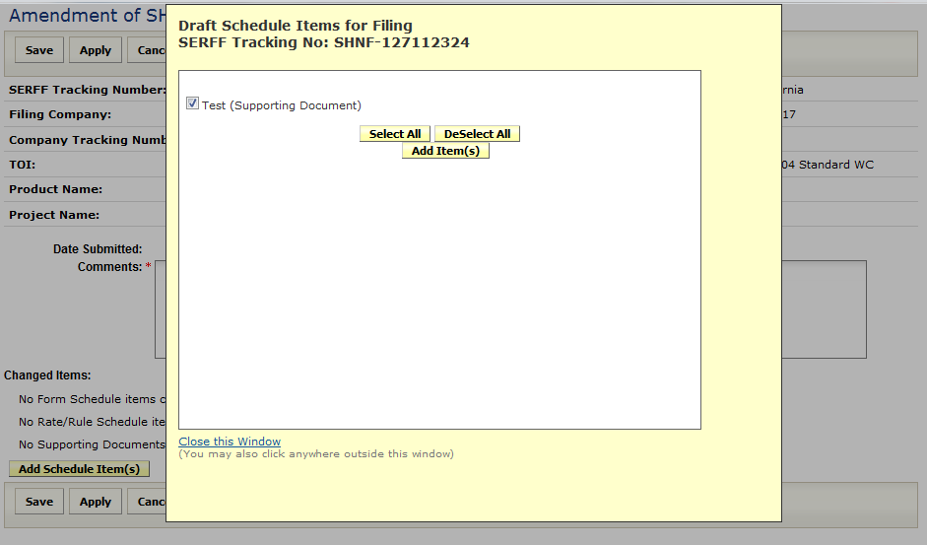
Amending a Filing
Step 7
Notes:
For the changes you made in “revise mode” to appear in your amendment, you need to click “Add Schedule Items”. This slide shows the window that pops up after clicking “Add schedule items”.
Then all of the items you changed (when you went into REVISE mode) will appear on the screen, and you must then check the box next to each change you want the State to see in this amendment or Objection Letter Response. The state will NOT see any change you made unless you check them off here.
After you’ve checked all of the items, click “add item(s)” button. You will then return to the screen shown below. Then you need to type a description of the change in the “Comments” field in the screen that was below it. You then click the “Save” button.

Slide 47
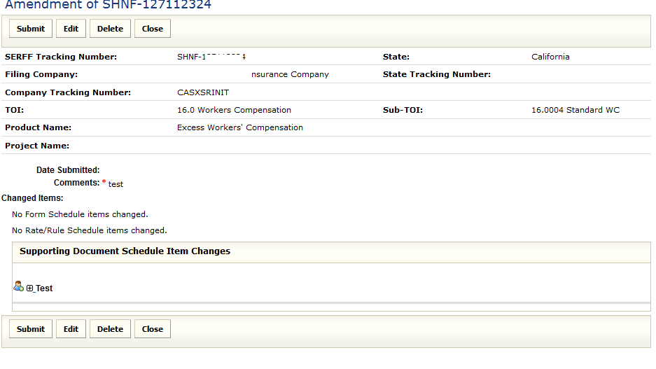
Amending a Filing
Step 8
Notes:
After you click “Save”, you’ll be presented with an option to “Submit” those changes. Click “submit”. The state will only see the changes you’ve made after you click “Submit”.

Slide 48
PDF Pipeline

Slide 49
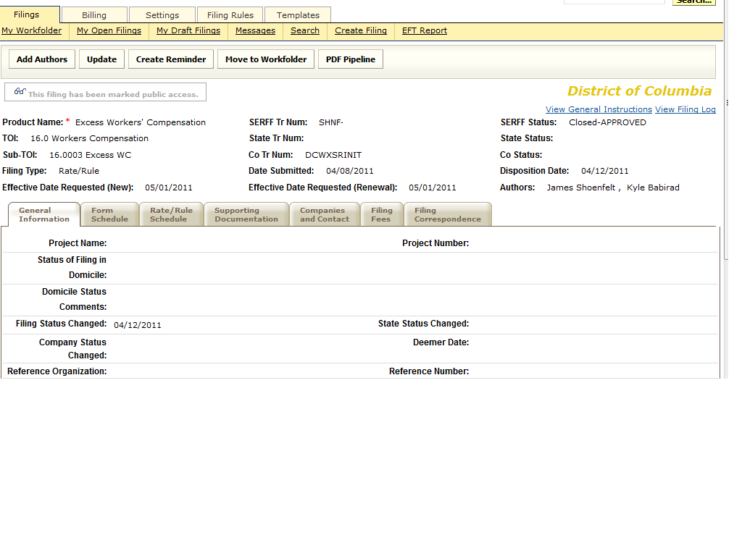
PDF Pipeline
Step 1

Slide 50
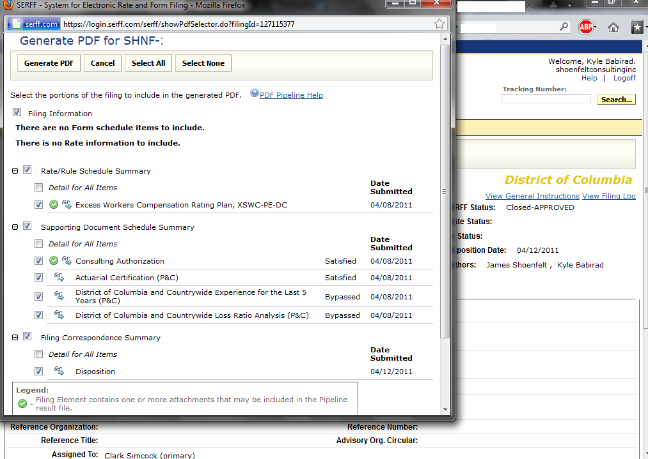
PDF Pipeline
Step 2

Slide 51
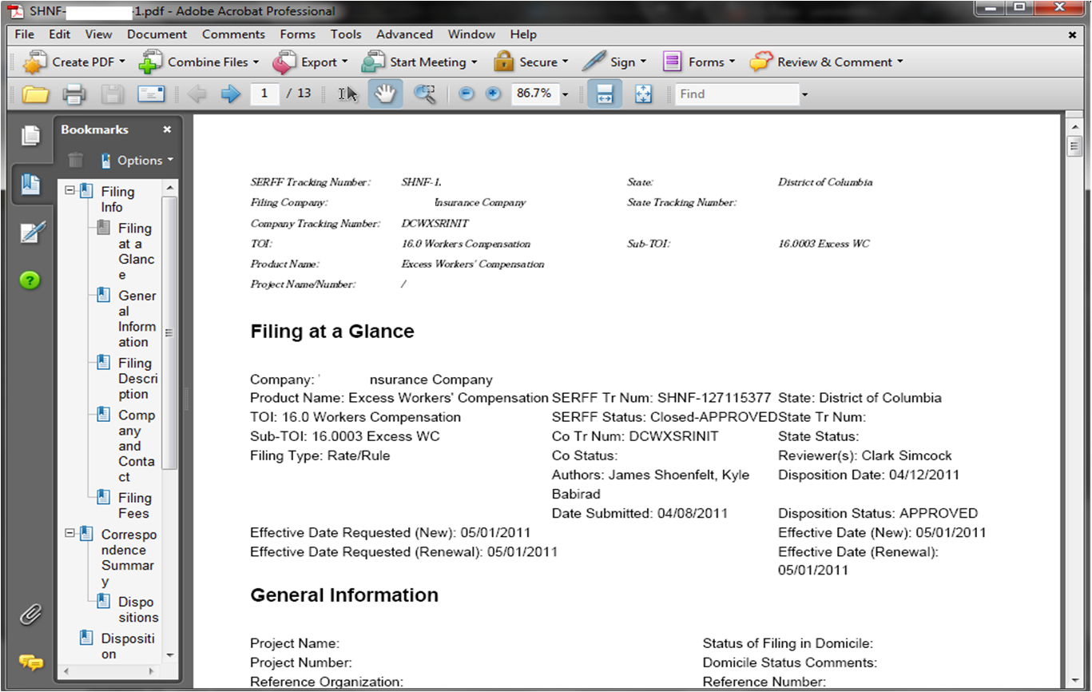
PDF Pipeline
Step 3
Notes:
Sometimes the department makes slick (i.e the kind where users type directly into fields e.g. company name, company address, National Association of Insurance Commissioners number etc.) PDF-type forms for users to fill out. The entries in these fields on these “user-friendly” PDF form/documents rarely, but sometimes, show up as blank on the PDF pipeline printout. Some reviewers have objected to these completed forms being blank because they are looking at printouts of the PDF pipeline rather than looking online on SERFF directly.
Workaround: open up the user-friendly PDF form. Print it to PDF (so that it’s no longer a special form), just as you would any other document -- and then attach this copy of the pdf to the filing. (This copy no longer allows you to change entries in the fields.)
Note: the copy on SERFF is always ok.

Slide 52
SHOENFELT CONSULTING, INC.
James Shoenfelt | 216.561.6267 | jim@shoenfeltconsulting.com
Notes:
The SERFF manual can be found at https://login.serff.com/complete industry manual.pdf. This is a 345 page document that explains everything in details… and is perhaps the best resource for your SERFF questions.

