Slide 1

Health Insurance Affects Us All
Thomas Holzberger, Appointed Actuary
thomas.holzberger@helsana.ch
08.05.2026

Slide 2
Content
Give insights into the political nature of the Mandatory Health Insurance (OKP) system.
Overview of how premiums are calculated and approved by the Federal Office of Public Health (FOPH).
Consideration of the effects of exogenous inflation, shifts in the composition of the insured population, as well as the impact of risk equalization.
Recent impacts of TARDOC and the introduction of outpatient flat rates.
Outlook on EFAS (uniform financing of outpatient and inpatient care), including key issues and challenges.
Overview of Supplemental Health Insurance (VVG), including regulatory restrictions and the link to the Mandatory Health Insurance.

Slide 3
Mandatory Health Insurance (OKP) as of today
Insurance
It is a mandatory social insurance.
It has to be a non-profit business, with Expense Ratio below 5% and Loss Ratio at least 95%.
Often owned by Foundations, therefore not quoted on the stock market.
Services are defined, but the claims-handling can be different between the companies.
Universe is defined by 26 Cantons
26 cantons, each with a health department that decides on hospital-planning.
Majority of hospitals are owned by the cantons.
Currently 55% of inpatient hospital costs are paid by the canton, therefore the financial department of each canton is involved. 45% of the inpatient hospital costs are paid by the health insurance company.
Federal Office of Public Health (FOPH)
Every health insurance company gets approval of premium for each canton individually.
Client
Has the option to each year change their insurance, service model or deductible without a health declaration.

Slide 4
Supplemental Health Insurance (VVG)
Insurance
Voluntary, additional to the mandatory health insurance coverage.
Outpatient treatment: enhanced services, special drugs, etc.
Inpatient treatment: enhanced services, free selection of specialist doctors, hospital rooming, etc.
Universe is defined by 26 Cantons
26 Cantons, each with a health department that decides on hospital-planning.
Majority of hospitals are owned by the cantons, or they are recognized as listed hospitals.
FINMA (Regulator)
Every health insurance company gets individual approval of premium for each product per year.
Profit limitation by law is 10% - 15% of premium.
If a product is loss-making, the premium can only be increased in the defined range (close to 0% for impatient products).
Client
Has the option to each year change their insurance, but they have to pass a health check.
Health insurance companies waive their right to terminate policies.

Slide 5
Mandatory Health Insurance (OKP)

Slide 6

Premium Process Timeline of Mandatory Health Insurance
Jan | Feb | Mar | Apr | May | Jun | Jul | Aug | Sep | Oct | Nov | Dec
Premium iteration and executive board approval
Premium communication FOPH
Midterm -
planning
Determination of exogenous inflation
Approval by FOPH
Portfolio analysis
according closing
Premium assumptions
Risk equalization prior year
1. Premium –
submission FOPH
2. Premium –submission FOPH
Preparation for next year’s process
Estimation of ultimate by region

Slide 7

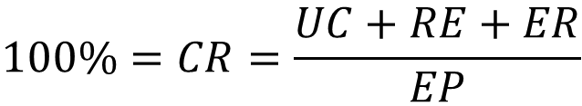
Objective to be achieved
Basics for calculating the premium
$$100\%=CR=\frac{UC+RE+ER}{EP}$$
Equilibrium between premium and net-incurred losses plus expenses
CR: Combined Ratio
UC: Ultimate Claim
RE: Risk Equalization
ER: Expense Ratio
EP: Earned Premium
It is required to include the insurance’s own 10-year- average of capital returns.
Notes:
Die Prämien sind so festzulegen, dass die kantonalen Combined Ratios gleich hoch sind, so dass alle Kantone gleichmässig zum Ergebnis beitragen. Das BAG stützt sich zur Prüfung der Kostendeckung auf die Combined Ratio, deren Berechnung im Kapitel 6 beschrieben wird. Nicht

Slide 8
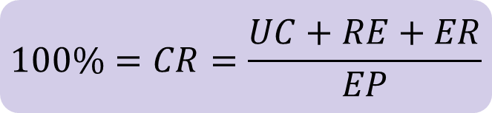
Regulatory Requirements for Premium calculation
Mandatory health insurance has a unified premium, independent of age, sex and health status.
The premium has to be cost covering in each canton.
Differences in premium are due to the following segregations:
Premium regions (42 regions, cantons consists of 1 to 3 regions)
Age groups (kids 0-18, young adults 19-25, adults 26+)
Deductible (0 for kids, 300, 500, 1000, 1500, 2000, 2500)
Limitation in selection of service provider (Alternative Insurance Model - AIM)
Exclusion of accident coverage

Slide 9
Illustration of the Level of Details
42 premium regions, 7 major AIM, 6 deductibles: for adults, young adults, kids

Slide 10
Insurance Payments
Drivers for the inflation
These factors drive the estimation of the expected insurance benefits
Portfolio composition effect | Exogenous cost trend
Change in average cost of claims is driven by the change of the portfolio composition | Change in average cost of claims is due to exogenous effects
Origin Average age Composition of the deductible Etc. | Origin Movement in consumption Adjustment of tax points Etc.
Notes:
Tonspur:
Teuerung: Leistungen Analytik
Bestand: Kunde & Markt

Slide 11
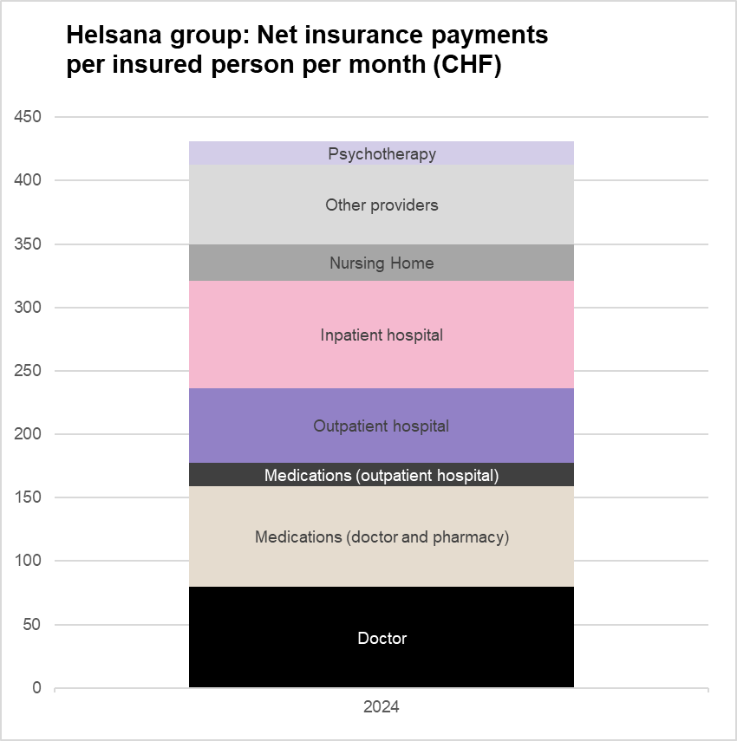

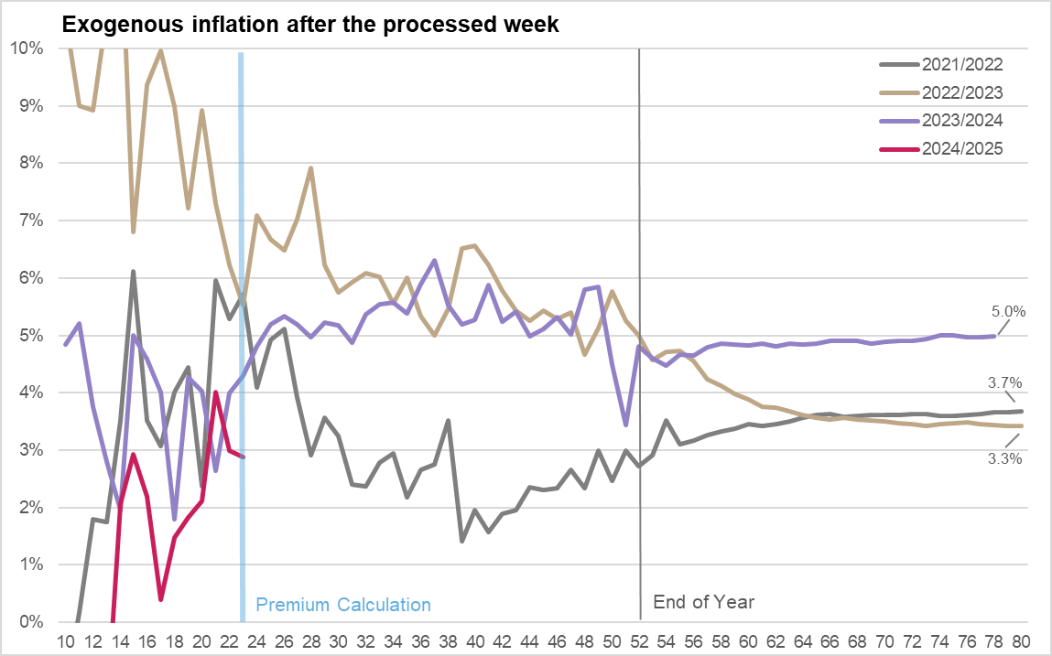
Insurance Payments
Exogenous Inflation
The observed exogenous inflation is very volatile at the time of estimation (after 20 weeks). Therefore we estimate a historic base inflation rate and add special effects for the current and next year on top.

Slide 12
Risk Equalization
Mechanism
Risk equalization creates financial balance between health insurers with different risk structures. It is intended to counteract the incentive for risk selection.
It is structured prospectively, therefore it equalizes risks rather than cost differences.
Across Switzerland as a whole, the total amount paid into risk equalization corresponds to the total amount received from risk equalization.
Indicators: age, sex, hospital stays, pharmaceutical cost groups (PCG)
Insurer 1
Insurer 2
Insurer 1
Insurer 2
Risk
A
B
Risk
A
B
RE
Risk
A
B
Risk
A
B
¼
¾
¼
¾
¼
¾
¼
¾

Slide 13
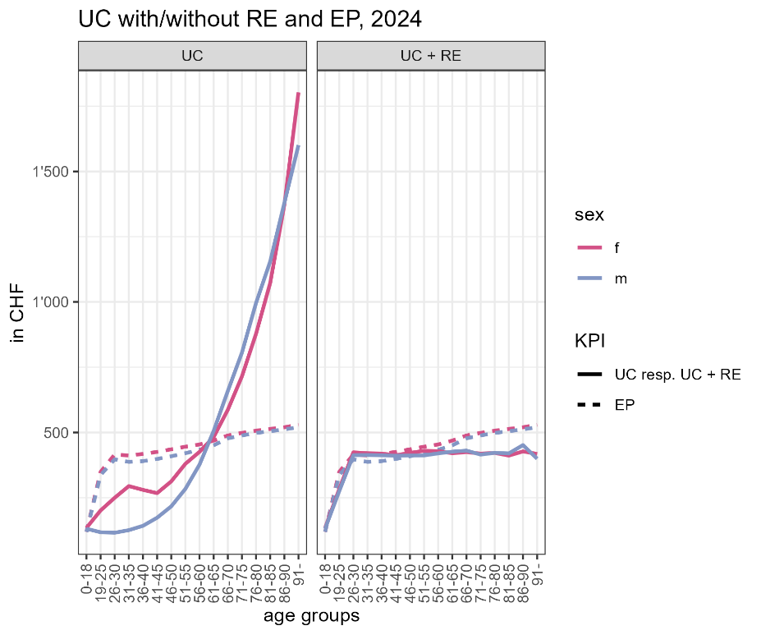
Risk Equalization
Impact
Average Ultimate Claim (UC) differs between different groups of insured persons, for example age groups.
The left-hand graph shows that the UC increases with age.
The right-hand graph shows the effect of risk equalization.
The expenditure (UC + RE) is balanced across age groups.
For example: young people with UC=0 have UC + RE > 0 after risk equalization.

Slide 14
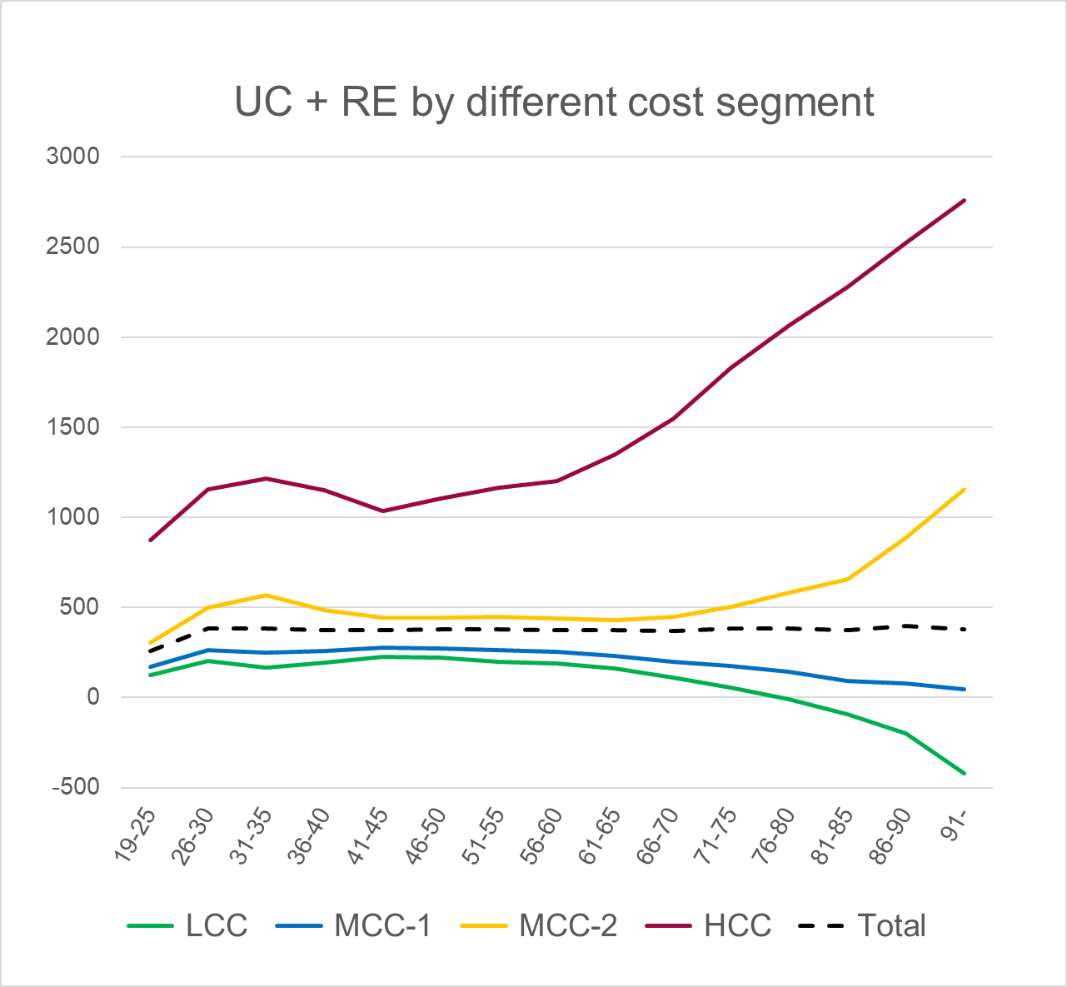
Risk Equalization
Issues still to be resolved
Due to the introduction of EFAS, a refinement of the risk indicator for inpatient hospital stays is necessary.
Swiss risk equalization undercompensates high-cost cases and overcompensates low-cost cases.
  undercompensation for high-cost cases (HCC)
  nearly normal compensation for medium-cost cases (MCC)
  overcompensation for low-cost cases (LCC)

Slide 15
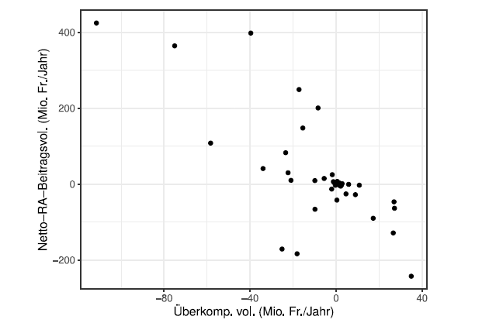
Risk Equalization
Issues still to be resolved
The relationship between under-/overcompensation and status in the RE system (receiver/payer) by insurer
Insurers which are RE receivers are mainly undercompensated
Insurers which are RE payers are mainly overcompensated

Slide 16
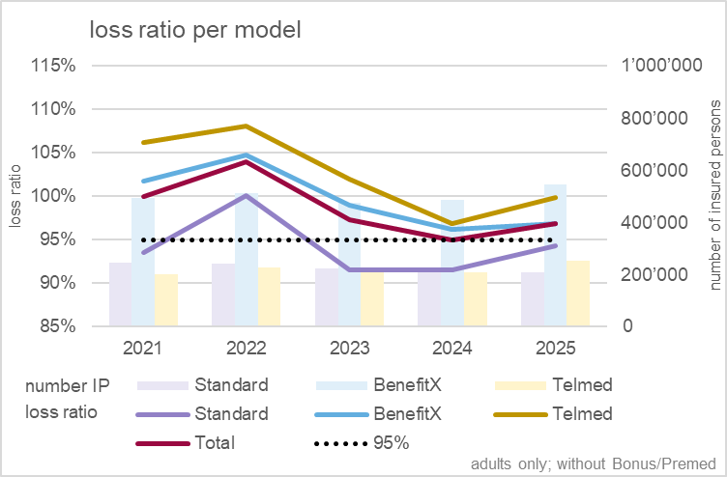
Loss Ratios
Alternative insurance models including risk equalization
The chart on the left-hand side describes the claims expenses (benefit costs plus risk equalization) for the different alternative insurance models.
In 2021 and 2022 most of the models were loss making, driven by a post corona compensation of consumption.
After 2023 the situation returned to equilibrium.
Notes:
6.7% ex. Teuerung auf 2021, wesentlich mehr als erwartet
Prämien 2021 zu tief, wodurch auch die Berechnungsbasis für 2022 zu tief war
folglich waren die Prämien 2022 zu tief
Notwendige Korrektur konnte erst auf 2023 erfolgen

Slide 17
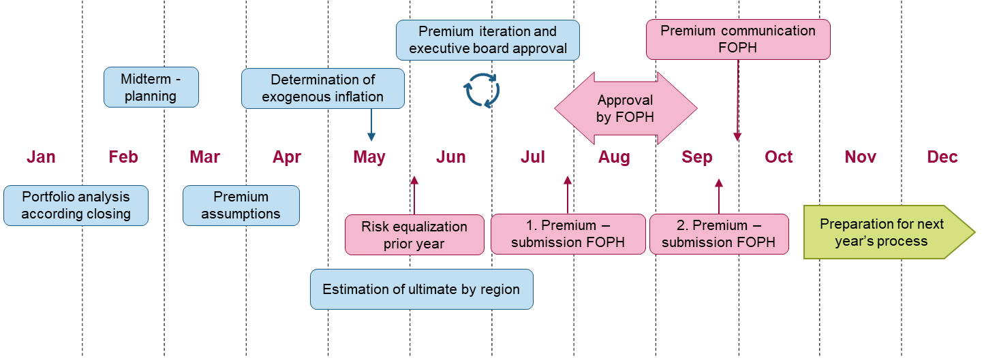
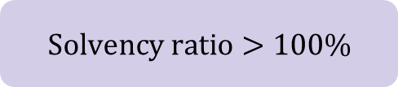
Criteria for Premium approval by FOPH
  1. Non-Profit assumption needs to be proved
  2. Solvency ratio has to be above 100%, also in a pessimistic scenario
  If both criteria are met, and if political requirements are fulfilled, the premium gets approved by FOPH.
$$Solvency ratio>100\%$$
Notes:
https://www.priminfo.admin.ch/de/zahlen-und-fakten/solvabilitaet#:~:text=Eine%20Solvenzquote%20von%20100%25%20bedeutet,die%20Leistungen%20der%20Versicherten%20bezahlen.

Slide 18
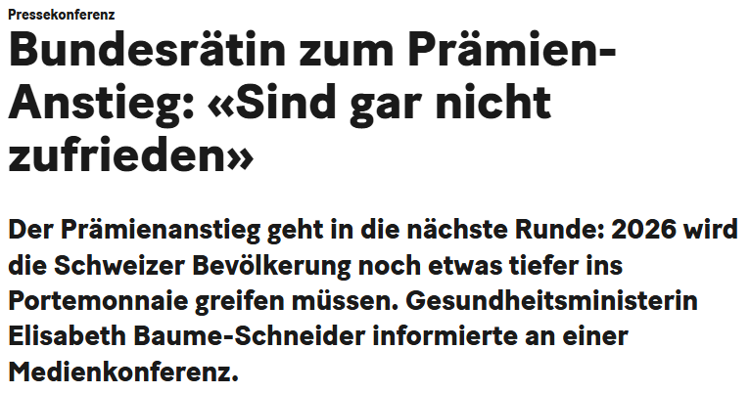
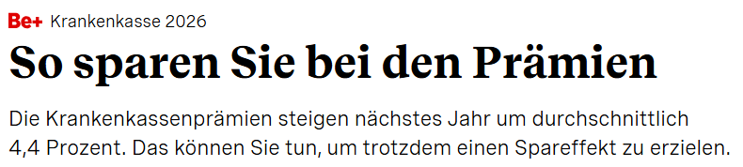
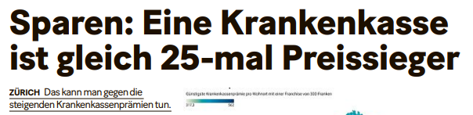
Uncertainty of the Premium position
Inflation
Competition
Premium position
Regulatory/Politics
Our Premium
Notes:
1. Ausgangslage:
Teuerung: intrinsisch schwierige Einschätzung der Teuerung auf Grund der kurzen Beobachtungsperiode, unterschiedliche Einschätzungen von diversen Playern (vgl. Medienberichte Santé Suisse)
Konkurrenz: Ausgangslage der Konkurrenten uneinheitlich hinsichtlich Solvenz, Nachholeffekten und Reserven
Politik: unklar welche kurzfristigen Massnahmen für Kostendämpfung umgesetzt werden, Meinung zu Reserven wechselhaft
Fazit: grosse Unsicherheiten in der Ausgangslage
2. Prämien Helsana: Festsetzung auf Grund von Einschätzungen dieser Unsicherheiten nach aktuellsten Stand des Wissens
3. Prämienposition: Ergebnis unsere eignen Einschätzung mit den Einschätzungen der Konkurrenten ist erst mit der Prämienkommunikation am 1.Oktober möglich (hipp hipp hurra oder zu Tode betrübt…)
Fazit:
Die Prämienposition hängt nicht nur von den eigenen Einschätzungen sondern auch von den Einschätzungen der Konkurrenten ab.
Sowohl wir als auch die Konkurrenten können richtig oder falsch liegen.
Für uns zählt aber letztlich unsere finanzielle Stabilität.
Das Endergebnis, d.h. ob die Prämien für die Leistungen ausreichend waren, ist erst ein Jahr später beurteilbar.

Slide 19
Development & Political Engagement
2026
2027
2028
2031
2032
Tardoc &
Flat Rate
FOPH requires stable cost development
Tax points are required to stay stable
Level of DRG (Diagnosis Related Groups) Flat Rate volume to increase from 10% → 34%
EFAS
Inpatient cantonal contribution 55% of costs
Cantonal contribution for all services minimum 24.5%
Cantonal contribution minimum 26.9%
Without nursing services
With nursing services
Planned measures
for RE
RE: PCG’s optimization, age dependent on inflation
RE for foreign commuters
Increased uncertainty due to data lag and unpredictable governmental influence. FOPH requirements are not mandatory for cantonal health departments.

Slide 20
Development & Political Engagement
Inpatient: pre and post EFAS implementation
Total costs
Health Insurer
Canton
Health Insurer
Canton
6’000
6’000
Free choice of specialist doctors
Hospital rooming
VVG
6’000
4’500
7’500
Base rate CHF [9’500, 11’500]
depending on the hospital
Cost weight [0.2, 63.7]
according to the DRG
(Diagnosis Related Groups)
OKP
10’000
5’500
2’500
Until end of 2027
From 2028

Slide 21
Development & Political Engagement
Outpatient: pre and post EFAS implementation
Health insurer
Health insurer
Canton
Special drugs not on specialty list (SL)
Outpatient hospital treatment
Ambulance transport
Health prevention
Etc.
VVG
160
160
Drugs
Doctor treatment
Outpatient hospital treatment
Physiotherapy
Podology
Etc.
220
165
OKP
55
Until end of 2027
no canton participation
From 2028
canton participation

Slide 22
Supplemental insurance cover (VVG)

Slide 23
Supplemental Health Insurance Coverage
Outpatient products
  Alternative services (TCM, etc.)
  Special drugs
  Prevention (gym, etc.)
  Rescue and recovery
Inpatient products
  Free choice of specialist doctors
  Faster access to surgery
  Private or semiprivate hospital rooming
Premium features
Age
Regions
Sex
Maximum inflation rate is set by FINMA at the product group and market inflation level.

Slide 24
Premium Process Timeline of Supplemental Health Insurance
Jan | Feb | Mar | Apr | May | Jun | Jul | Aug | Sep | Oct | Nov | Dec
Premium iteration and executive board approval
Midterm -
planning
Exogenous inflation determined by FINMA
Approval by FINMA
Portfolio analysis
according closing
Premium assumptions
1. Premium –
submission FINMA
2. Premium –submission FINMA
Preparation for next year’s process
Estimation of ultimate

Slide 25

Regulatory Objective
Basics for Premium Approval
If CR 3 Years average < 85% the Premium has to be reduced to achieve CR > 90%
$85\%<CR$3-Years average
Notes:
Die Prämien sind so festzulegen, dass die kantonalen Combined Ratios gleich hoch sind, so dass alle Kantone gleichmässig zum Ergebnis beitragen. Das BAG stützt sich zur Prüfung der Kostendeckung auf die Combined Ratio, deren Berechnung im Kapitel 6 beschrieben wird. Nicht

Slide 26
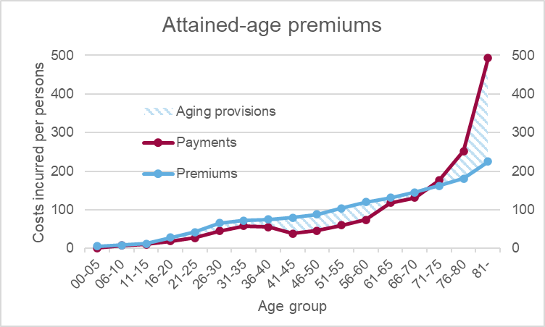
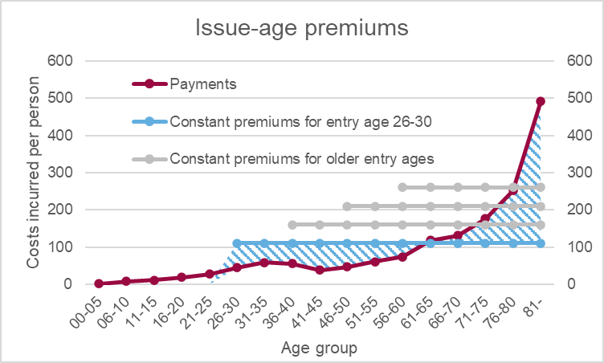
Premium, Ultimate claims and Ageing reserves
Attained-age premiums
Premiums increase with advancing age. However, benefits increase even more than premiums, which is why ageing reserves must be built up. The premiums are partially risk‑adjusted with respect to age.
Issue-age premiums
In younger years, one pays an excessively high premium in order to be protected against an increase in premiums at an advanced age. If you take out an insurance policy at age 30, you pay a lower premium than if you take it out at age 40.

Slide 27
Thank you!
Questions & Discussion
Thomas Holzberger, Appointed Actuary
thomas.holzberger@helsana.ch
08.05.2026

