Slide 1
Social Inflation
CAMAR
May 10, 2021

Slide 2
One Definition of “Social Inflation”
“Social Inflation”
  Larger Jury Verdicts
  Changing Judicial Decisions
  Greater Propensity to Sue

Slide 3
Trends in Jury Awards
Societal trends may reportedly affect how juries decide.
For example, a 2019 Law.com article discusses, in part, how a jury's attitude towards large corporations may be the reason for the increase in awards in civil cases against corporations. Per the article, it may be that "jurors are increasingly familiar with corporate wrongdoing. When it comes to punitive damages, the idea is to punish a corporation and deter it from future wrongdoing…"
A 2019 article in the Wall Street Journal reported "a more than 300% rise in the frequency of verdicts $20 million or over in 2019 from the annual average from 2001 to 2010."
A 2019 article in the Financial Times reported the "median cost of the top 50 [single plaintiff] bodily injury [verdicts] in the US rose from around $28m in 2014 to just over $54m [in 2018]."
Growing distrust in large corporations
Use of So –called “Reptile Theory” By Plaintiff’s Counsel
https://www.law.com/2019/10/17/jurors-want-to-punish-why-a-jury-verdict-goes-nuclear/
https://www.wsj.com/articles/the-specter-of-social-inflation-haunts-insurers-11577442780
https://www.ft.com/content/5fb9aef8-07fb-11ea-a984-fbbacad9e7dd
“The Age of Reptiles“ https://www.lexology.com/library/detail.aspx?g=b640404b-c8b7-4ef8-852e-9c693ec70431

Slide 4

Hypothesized Causes for Changing Loss Experience
“Social Inflation”
Inflation
  Medical Costs
  Legal Costs
Evolving Loss Types
  Traumatic Brain Injuries for example
Law Changes
  Tort Reform
Litigation Funding/Greater Use of Analytics
by Plaintiffs

Slide 5
State Regulatory Environments
Erosion of Some Tort Reform in Some States
State court decisions strike down, in part, noneconomic damage caps (e.g. pain and suffering) for medical malpractice cases in some states, for example:*
  Georgia (2010), Florida (2017)
State court decisions strike down, in part, punitive damages reforms in some states, for example: **
  Georgia (1990), Virginia (1992), Oregon (1998), Utah (2005), Missouri (2014)
States Following Champertous Doctrines May Hinder Some Litigation Funding Arrangements
Some states that may follow champertous doctrines include: Alabama, Delaware, Georgia, Minnesota, Mississippi, New York and Pennsylvania ***
*https://www.law.com/dailyreportonline/2020/05/11/tort-reform-capping-nuclear-insurance-verdicts-stymied-by-covid-19/
** https://www.atra.org/issue/punitive-damages/
*** https://www.mondaq.com/unitedstates/patent/774162/a-strategic-look-at-champerty-and-third-party-litigation-financing?

Slide 6
What is Litigation Financing?
Non-Recourse Loans
According to an American Bar Association guide, litigation financing generally means a transaction in which a third party who is not party to a legal claim chooses to provide capital to a party in a legal claim or its counsel in exchange for a financial interest in the outcome of the legal claim if it is successful. Both defendant and plaintiff sides can reportedly be funded in this manner.
Loans to Plaintiff Firms
Investment Type
https://www.americanbar.org/content/dam/aba/administrative/litigation/materials/2015_spring_leadership_meeting/guide_to_litigation_financing_may_2014_charles_agee.authcheckdam.pdf

Slide 7
Annual Statement LOBs Including General Liability
Commercial Multi-Peril Liability (052)
Other Liability (170)
Products Liability (180)

Slide 8
Types of Insurance included in Annual Statement LOB “Other Liability”
Premises/Operations
Liquor Liability
Directors and Officers
Cyber Liability
Professional E&O
  Excluding Medical Professional
Commercial Umbrella/Excess (Including Commercial Auto)
Personal Umbrella
Personal Liability
Plus More……
Source: https://www.naic.org/documents/industry_pcm_p_c_2017.pdf

Slide 9
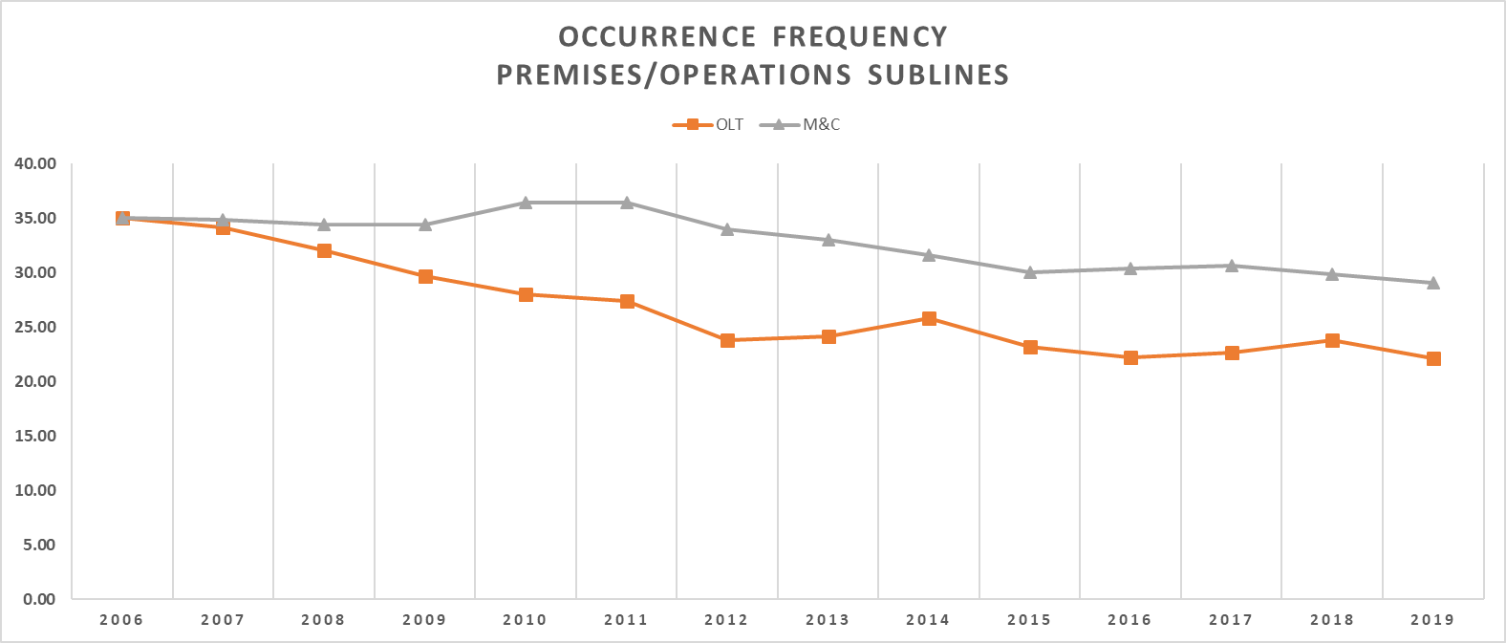
General Liability – Premises/Operations Accident Year Occ. Frequency
Bodily Injury, Property Damage and Fringe Combined. (# of occurrences per $1M of ALCCL) Accident Years Ending 6/30 evaluated as of 9/30/2019 Source: ISO General Liability Experience Reviews – 2020 Groups 3 and 4 General Liability Experience Reviews – 2020 Groups 3 and 4AccA

Slide 10
General Liability Overall vs. Commercial Umbrella/Excess
Bulk reserves are not included and a consistent number of accident years are included in each calendar year. This includes Premises/Operations, Products/Completed Operations, Composite Rated Risks, and Commercial Umbrella/Excess. Source: ISO data

Slide 11
Commercial Umbrella & Excess Liability – Attachment Point Distribution (PY)
Attachment Point Size Groups - High, Medium, and Low
High: Attachment Point > $1.5M
Medium: $500k < Attachment Point <=$1.5M
Low: Attachment Point <= $500k
Source: ISO Data

Slide 12
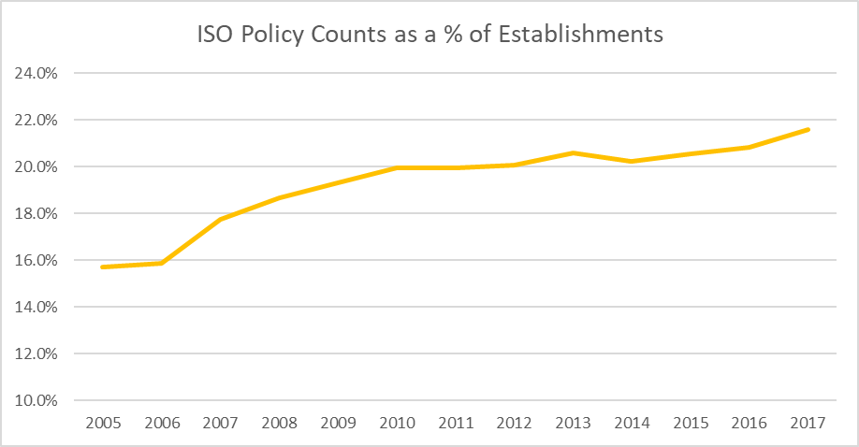
Commercial Umbrella & Excess Liability – Policy Counts
Sources: US Census Bureau - Statistics of US Business Survey (SUSB) Annual Data Tables by Establishment Industry Total Employment Size Category for years 2005-2017. Number of policies is based on ISO reported information

Slide 13
Commercial Umbrella & Excess – Loss Development
  Calendar year perspective: 9 out of the last 10 years have developed adversely
  Accident year perspective: 8 out of the last 10 years have cumulatively developed adversely.
Source: Size of Loss Matrix 2020 V1.
19 year ex-ante analysis using 7-year loss weighted average for LDFs for Incurred Indemnity and ALAE (included)

Slide 14
Historical Reference to General Liability and Social Inflation
        “…..the presence of persistent economic and social inflation coupled with increasing opposition to rate increases from regulators and consumer groups have led insurance companies to view inflation sensitive exposure bases as a great boon.”
                Richard Biondi/Kevin Thompson – CAS Proceedings 1981

Slide 15

Inflation
Higher Inflation
  Fooled Once (Twice…..Ten Times)
Severity Trend vs. General Inflation
Savings Rate
Supply Chain
  COVID
  Weather
  Geopolitical Relations
Unemployment
  Vaccine

Slide 16

Uncertain Future
COVID
  Court System
  Recession
  Claim Settlement Patterns
  Medical Providers
Societal Division
Statue of Limitations

Slide 17
Contact Information
Tim McCarthy
Actuarial Director – Commercial Liability
Commercial Lines Actuarial
ISO
(201) 469-2743
timothy.mccarthy@verisk.com
No part of this presentation may be copied or redistributed without the prior written consent of Insurance Services Office, Inc. This material was used exclusively as an exhibit to an oral presentation. It may not be, nor should it be relied upon as reflecting, a complete record of the discussion.

