Slide 1
Data Munging And Data Pre-Processing in R
SPRING 2021 CAMAR MEETING
Louise Francis, FCAS, CSPA, MAAA
Francis Analytics and Actuarial Data Mining, Inc
Louise_francis@msn.com

Slide 2
Poll: Time Spent on Data Munging Tasks
How Much Time do you spend on data as a percentage of your time on your projects?
  0 – 10%
  11 - 25%
  25 - 50%
  50 - 75%
  > 75%

Slide 3
Follow-up : What type of projects do you do?
What type of work do you do?
  Traditional Actuarial
  Predictive Modeling
  Both
  Other

Slide 4
Data component of actuarial work
Data Tasks are a key part of Actuarial Work
According to a survey about 1/3 of actuarial time is spent on data
  From “Dirty Data on Both Sides of the Pond”, CAS 2008 winter e-forum
The percentage of time for data scientists is more like 80%

Slide 5
Data Wrangling
FromWikipedia
“Data wrangling, sometimes referred to as data munging, is the process of transforming and mapping data from one "raw" data form into another format with the intent of making it more appropriate and valuable for a variety of downstream purposes such as analytics. The goal of data wrangling is to assure quality and useful data. Data analysts typically spend the majority of their time in the process of data wrangling compared to the actual analysis of the data. “
-https://en.wikipedia.org/wiki/Data_wrangling

Slide 6
Overview
Where data is in the predictive modeling cycle
  CRISP-DM
What is tidy data?
What R tools help tidy data?
Introduce the tidyverse packages
Introduce Other Packages useful for data wrangling

Slide 7
CRISP DM
Describes life cycle for data mining
See: https://www.ibm.com/support/knowledgecenter/en/SS3RA7_15.0.0/com.ibm.spss.crispdm.help/crisp_overview.htm
Has six phases with feedback loop

Slide 8
6 Phases of CRISP DM
Business understanding
Data Understanding
Data Preprocessing
Modeling
Evaluation
Deployment

Slide 9
CRISP DM
Describes life cycle for data mining
See: https://www.ibm.com/support/knowledgecenter/en/SS3RA7_15.0.0/com.ibm.spss.crispdm.help/crisp_overview.htm
Has six phases with feedback loop

Slide 10
6 Phases of CRISP DM
Business understanding
Data Understanding
Data Preprocessing
Modeling
Evaluation
Deployment

Slide 11
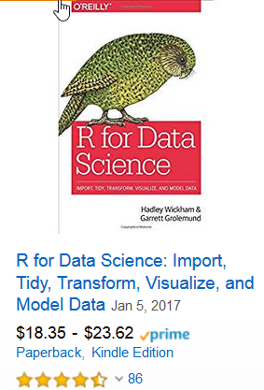
Hadley Wickham
Hadley Wickham: http://hadley.nz/
  Well known R programmer of R libraries
  Chief scientist at Rstudio
  One of his first packages was reshape package for aggregating and organizing data

Slide 12

Another Resource: R for Actuaries
Recommended: Chapter on Data Wrangling in R for Actuaries by Brian Fannin

Slide 13
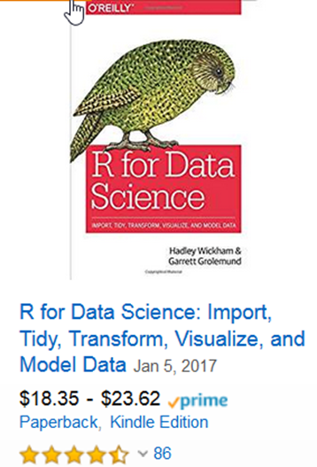
Hadley Wickham
  Developed ggplot2 package
  Developed dplyr package
  Books include R for Data Science and ggplot2
  Proposed tidy data framework
    Described in paper “Tidy Data” in Journal of Statistical Software

Slide 14
Hadley Wickham
Hadley Wickham: http://hadley.nz/
  Well known R programmer of R libraries
  Chief scientist at Rstudio
  One of his first packages was reshape package for aggregating and organizing data

Slide 15
Reading data – readr library
read.csv
read_csv
Both read comma delimited files
read_csv has some capabilities read.csv does not have
  Creates tibble
  Reads larger data sets
  Faster
readr also has read.xls

Slide 16
Example: Ozone Data
From EPA
Download from https://aqs.epa.gov/aqsweb/airdata/download_files.html
Over 5,000,000 records

Slide 17
Code to run both and time them

Slide 18
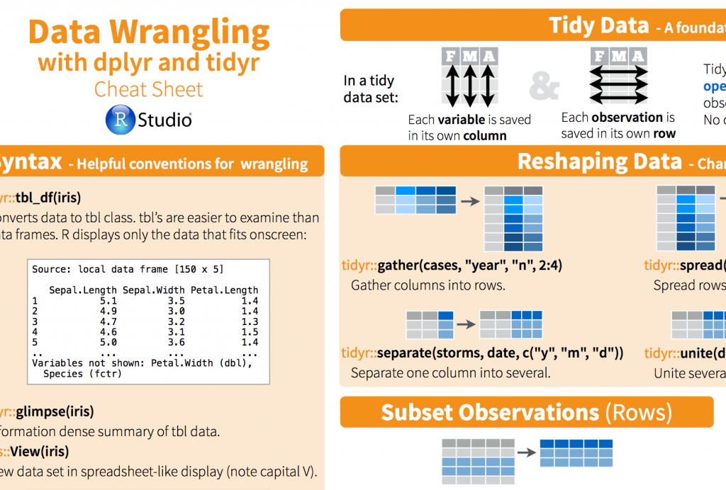
Dplyr and tidyr libraries

Slide 19
Tidy Data Principles
Provides principles on how to organize data
To make data cleaning easier
Which led to tools to make the process easier and more efficient

Slide 20
Wickham’s Definitions
A data set is a collection of values
  quantitative
  qualitative
A variable contains all values that measure the same attribute (such as paid losses)
An observation contains all values measured on the same unit (such as accident year)

Slide 21
Multiple ways to organize data
Two views of data
  Database form
  Spread out form – columns names could represent data
Both can be tidy depending on the application

Slide 22
Triangle data
The spread out form
https://www.casact.org/publications-research/research/research-resources/loss-reserving-data-pulled-naic-schedule-p

Slide 23
Triangle data -snapshot
Values spread across development month

Slide 24
Long Database Format
All paid values in one column, one variable

Slide 25
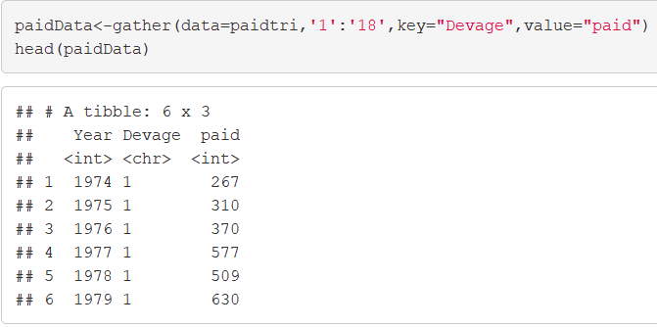

Slide 26
tidyverse
Set of related libraries that
  Read data efficiently (readr)
  Tidy the data through reorganization (tidyr)
  Perform database management functions (diplyr)
  Perform string functions stringr()
  Perform EDA (ggplot2)
  Use code:
  >library(tidyverse)
  Make sure you have installed tidyverse

Slide 27
Claim Data used for illustrations
WC Claim dataset
From Crowd Analytics competition

Slide 28
tidyverse
Set of related libraries that
  Read data efficiently (readr)
  Create tibble data (tibble)
  Tidy the data through reorganization (tidyr)
  Perform database management functions (diplyr)
  Perform string functions stringr()
  Perform EDA (ggplot2)
  Use code:
  >library(tidyverse)
  Make sure you have installed tidyverse

Slide 29
More on readr: Spaces in Variable Names

Slide 30
Make.names
The make.names function can be used to eliminate the spaces
This makes the variables easier to work with in R
myfile="D:/RPM Data/CompClaimsTrain.csv“
wcdata<-read_csv(myfile)
names(wcdata)
names(wcdata)=make.names(names(wcdata),unique=TRUE)

Slide 31
BASE R - Basic Descriptive Statistics: summary()
Use summary function
summary(wcdata)

Slide 32
Get metadata: str()

Slide 33
dplyr used for data management
Optimized version of plyr package
Use to subset, summarize, filter and join data
R has functions such as subset and operators such as [ ] that can perform data management functions but they can be difficult to use
We will use dplyr on Schedule P data downloaded from CAS web site
First read in the data
Note that read_csv provides some metadata

Slide 34
dplyr grammar
select() selects variables/columns from data frame
filter() subsets rows of data frame based on logical conditions
arrange() reorders rows of data frame
rename() renames variables in data frame
mutate() performs variable transformations and adds variables
summarize() summarizes/aggregates data from a data frame
%>% pipe operators used to link multiple verb actions together

Slide 35
dplyr functions
First argument is a data frame
Subsequent arguments describe what is to be done
You can refer to columns without using dollar operator
Return result is a new data frame
The dataframe needs to be tidy

Slide 36
We do not need all the columns

Slide 37
select()
We do not need all the columns
Only keep those relevant to analysis
Use select() to extract only needed columns
Let’s take the first 10 columns
wcdata2<-select(wcdata, 1:10)
names(wcdata2)

Slide 38
Select by Elimination
Leave out variables we don’t want by using a “-” within select function
In this example, we eliminate variables that are duplicates of other variables, such as Jurisdiction and Jurisdiction.Code
We will keep the “Code” variable
wcdata2<-select(wcdata, -Body.Part,-Cause,
-Claimant.Hire.Date,-Detail.Cause,-Injury.Illness.State,
-Jurisdiction, -Nature.of.Injury.Illness,
-OSHA.Injury.Type,-Type.of.Loss)

Slide 39
select()
Can select columns based on patterns in name
  starts_with
  ends_with
  contains
  matches

Slide 40
filter()
Selects rows based on filter applied to values in rows
Similar to subset but faster
Can be used to eliminate records with clearly erroneous values
Such as selecting either lost time or medical only claims for modeling
wcdata3<-filter(wcdata2, Lost.Time.or.Medical.Only..Code=="MO")
Can have multiple conditions (using &, ||)

Slide 41
arrange()
Use arrange() for sorting
  wcdata2<-arrange(subset,desc(Dependent))
wcdata4<-arrange(wcdata3, desc(Dependent))
wcdata4[1:5,1:4]
It is easier to use than sort()
Use desc(varname) to sort descending
Can use .by_group to sort by a group

Slide 42
Sorted Data

Slide 43
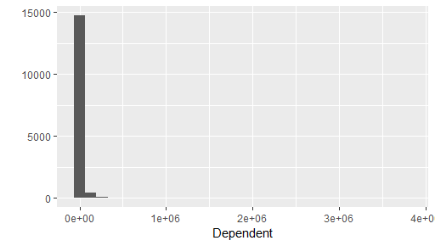
mutate()
Used to perform variable transformations
Most Predictive Modeling projects need a variety of transformations:
For instance, we may want to log highly skewed variables

Slide 44
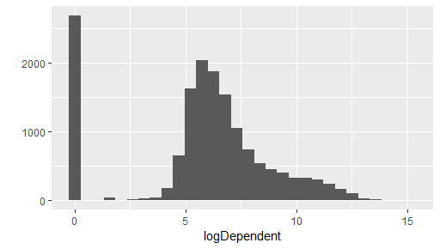
Mutate dependent variable
wcdata4<-mutate(wcdata4,logDependent=log(Dependent+1))
qplot(logDependent,data=wcdata4)

Slide 45
Other transformations
Indicator variables to Identify missing's in variables
Compute time lag variables (Report lag to employer, report lag to carrier)

Slide 46
group_by(), summarize()
Can be used to group data by a variable or variables and then summarize
Lets compute some state level statistics using claimant state:
  Get size in database by counting the number of records for each state
  Use result to reduce cardinality by grouping all low count states into one “small” category
byState=group_by(wcdata4,Claimant.State)
StateSize=summarize(byState,count=n())
StateSize=mutate(StateSize,rankState=min_rank(desc(count)))
head(StateSize)

Slide 47
Using the pipe operator
A different way of organizing code
The logical sequence of the code is more natural
A way of executing steps or nested code/ functions
The pipe operator is %>%

Slide 48
Redo Group_by and Summarize with pipe operator
StateSize<- wcdata3 %>% group_by(Claimant.State.Code) %>%
summarize(count=n()) %>%
mutate(r=min_rank(desc(count)))
The pipe operator is denoted with “%>%”
It moves from left to right
The database comes first
Then the procedures performed on it in chronological order

Slide 49
Joining data
Used to merge datasets
Certain joins are like a VLOOKUP in Excel
inner_join()
left_join()
right_join()
full_join()
We can use a join to join the StateSize data into the data file

Slide 50
JoiNing the grouped data back into original data
wcdata5 =inner_join(wcdata4,StateSize,by="Claimant.State.Code")
names(wcdata5)
Or
wcdata5 =right_join(wcdata4,StateSize,by="Claimant.State.Code")
names(wcdata5)

Slide 51
String Functions
Nearly all languages used by actuaries contain string functions
Some simple string functions can help with data preprocessing in actuarial analyses
Example – Identification of multiple occurrence claims

Slide 52
Simple String Functions Let Us:
Tabulate how many claims there are for each occurrence
Compute the occurrence number, so data can be aggregated to the occurrence level
=right(A2,2)
=left(A2,15)

Slide 53
Regular Expressions
There are various shorthand characters to denote types of strings including:
  0-9 a digit
  \d for digit
  \b for border (blank or punctuation before or after a word
  a-z lowercase letters and A-Z uppercase letters. Also :alpha: for letters
  \w for an alphanumeric character
  \n end of line
  ^ at beginning denotes beginning of string, $ at the end denotes the end of a string
  + one or more of the previous pattern
  * zero or more of the pattern

Slide 54
stringr library
stringr is an R library for processing strings
Functions include
  str_locate – locates the position of a pattern
  str_detect – used to detect a pattern
  str_extract – extracts string matching a pattern
  str_count – counts number of matches to a pattern
  str_sub – subsets a string using start and end position
  str_subset – subsets a string using a regular expression pattern
  str_replace – replaces a string with another string
  str_c – combines strings

Slide 55
stringr library
stringr is an R library for processing strings
Functions include
  str_locate – locates the position of a pattern
  str_detect – used to detect a pattern
  str_extract – extracts string matching a pattern
  str_count – counts number of matches to a pattern
  str_sub – subsets a string using start and end position
  str_subset – subsets a string using a regular expression pattern
  str_replace – replaces a string with another string
  str_c – combines strings

Slide 56
Use regular expression to get claimant number
At end of string
pattern="([\\d]{2})$“
Use str_extract to extract last 2 digits
ClaimantNo=str_extract(ClaimData$Claim_Number,pattern)
head(ClaimantNo)
[1] "01" "02" "01" "02" "03" "04"
Escape symbol
2 digits
Must be character, not factor

Slide 57
Use Regular Expression to get LOB
pattern="([:alpha:]{2})“ or pattern="([A-Z]{2})"
LOB=str_extract(Claim_Number,pattern)
head(LOB)
[1] "WC" "WC" "WC" "WC" "WC" "WC"
2 alphas – (the first 2)

Slide 58
Subset claim number for Occurrence Number
OccurrenceNo=str_sub(Claim_Number,1,16)
[1] "112375-119959-WC" "112375-119959-WC"
[3] "112375-128321-WC" "112375-128321-WC"
[5] "112375-128321-WC" "112375-128321-WC"
Start and end position

Slide 59
str_remove to remove the LOB
All records end with the same LOB so remove it
pattern="-WC"
OccurrenceNo=str_remove(OccurrenceNo,pattern)
head(OccurrenceNo)
[1] "112375-119959" "112375-119959"
[3] "112375-128321" "112375-128321"
[5] "112375-128321" "112375-128321"

Slide 60
Wrangling Date data: Parsing variables
When the data was read in the wrong data type was assigned to some variables
  Date variables read in as character
Use one of readr’s parsing functions to transform to correct data type
  parse_date(), parse_number(),parse_factor(), parse_logical()
  Require a string vector
Example:
wcdata$Dt.Reported.to.Carrier.TPA=parse_date(wcdata$Dt.Reported.to.Carrier.TPA,"%m/%d/%Y")

Slide 61
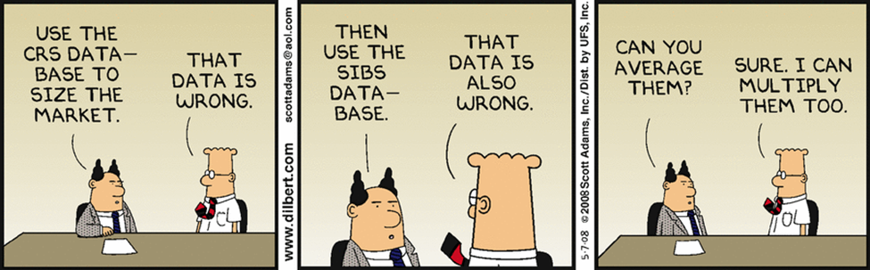
Any Questions?

