Slide 1
Scenario Testing COVID-19 Assumptions with Predictive Models
CAMAR 2021 Spring Meeting

Slide 2
ISO Risk Analyzer Environmental
Geographic risk landscape
  Location-specific data to help you
  classify, segment, and price
  risk with laser precision

Slide 3

ISO Risk Analyzer Personal Auto and Commercial Auto
Environmental Module
Examine the “environment” around a risk. For each risk’s garaging location, the Environmental module analyzes the interactive effects of hundreds of variables, such as:
Traffic generators
Traffic composition
Traffic density and driving patterns
Weather and terrain
Experience and Trend

Slide 4
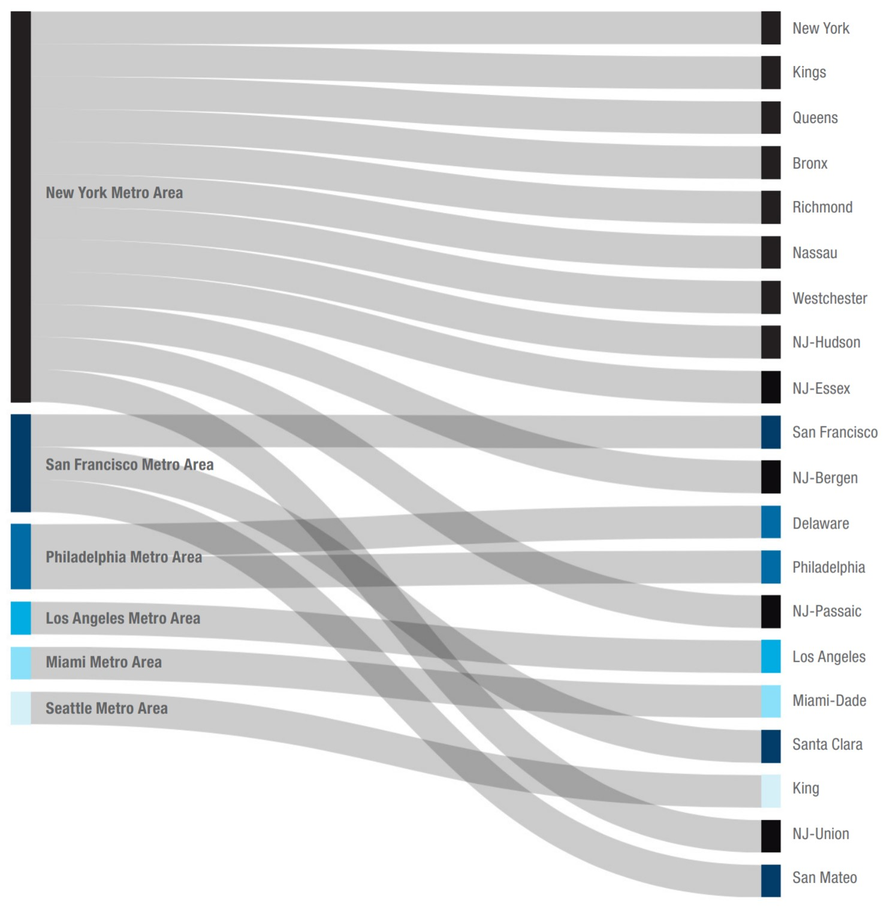
Counties with highest average traffic scores, by metro area
Commercial Auto TTT PD

Slide 5
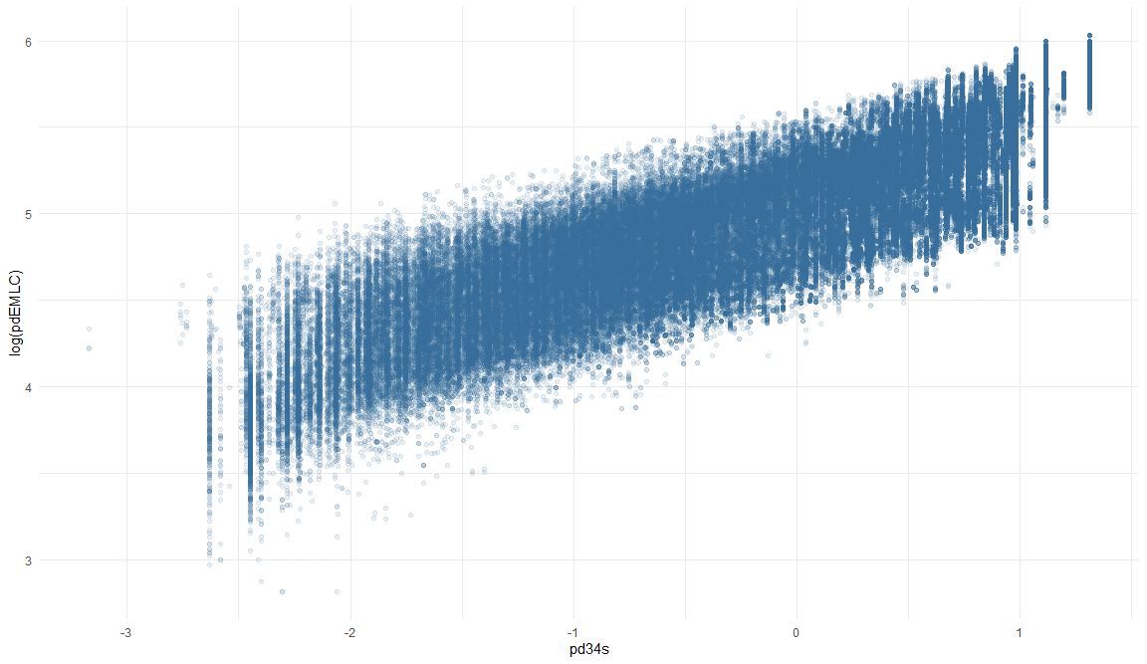
Risk Analyzer Estimated Loss Cost vs. Traffic Score
Commercial Auto TTT Property Damage

Slide 6
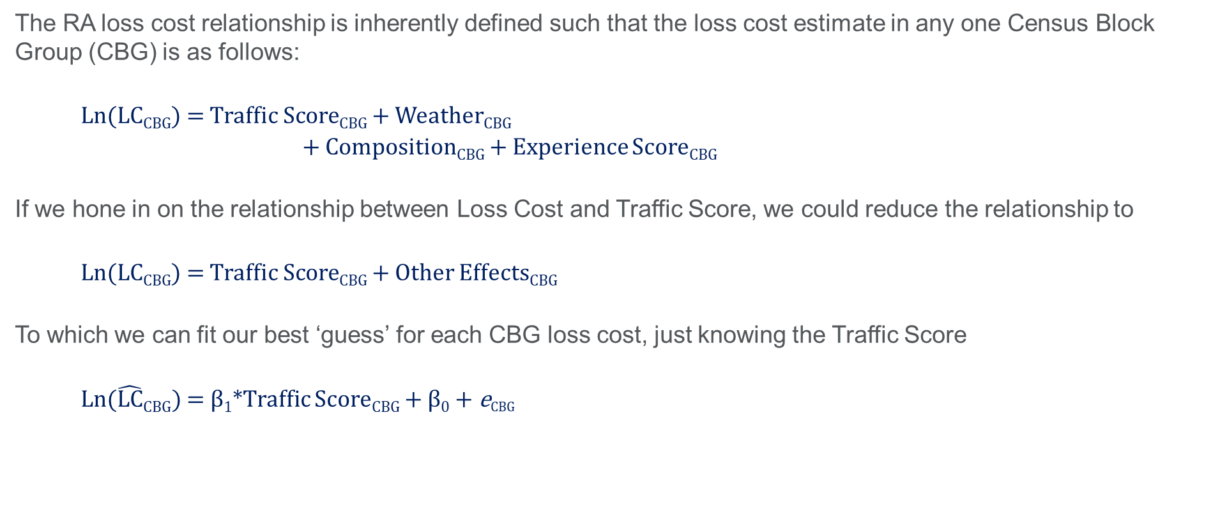
Relationship between RA Traffic Score and RA loss costs
The RA loss cost relationship is inherently defined such that the loss cost estimate in any one Census Block Group (CBG) is as follows:
      Ln(LC_{CBG}) = Traffic Score_{CBG} + Weather_{CBG}
      + Composition_{CBG} + Experience Score_{CBG}
If we hone in on the relationship between Loss Cost and Traffic Score, we could reduce the relationship to
      Ln(LC_{CBG}) = Traffic Score_{CBG} + Other Effects_{CBG}
To which we can fit our best ‘guess’ for each CBG loss cost, just knowing the Traffic Score
      Ln($\hat{LC}CBG$) = β₁*Traffic Score_{CBG} + β₀ + e_{CBG}

Slide 7
Leveraging an economic indicator for more intuitive scenario testing

Slide 8
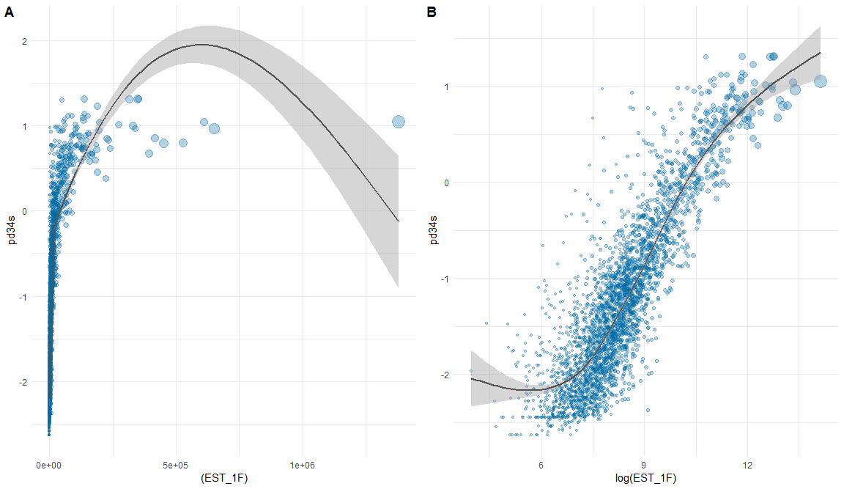
Traffic Score and ISO MarketStance Commercial Insight Data
A. Traffic Score vs. Num of Operating Locations
B. Traffic Score vs. Ln(Num. of Operating Locations)
Commercial Auto TTT PD

Slide 9
Scenario Testing
Fit a relationship between the Traffic Score and the MarketStance operating location data
Then scenario test different forecasts of number of operating locations
The operating location forecast can be translated into an effect on traffic score, and cascade into an effect on loss cost using our established fits

Slide 10
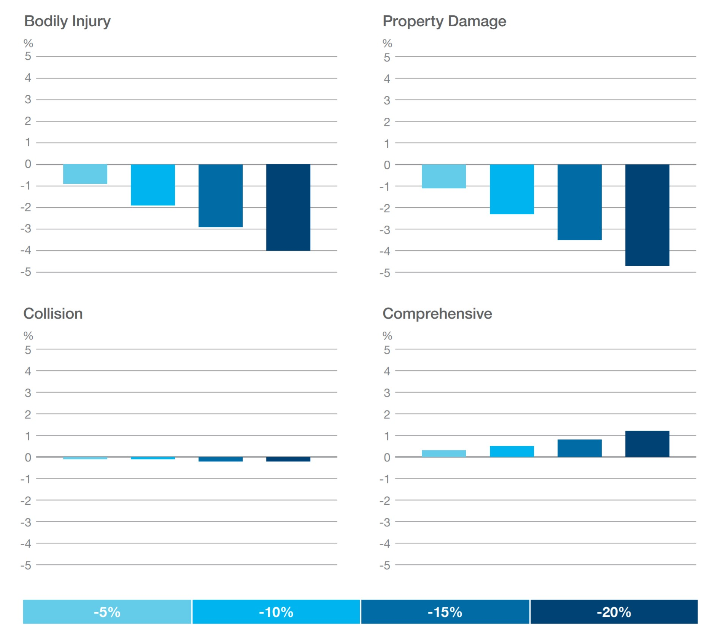
Scenario Testing
Commercial Auto TTT
Scenario:

Slide 11
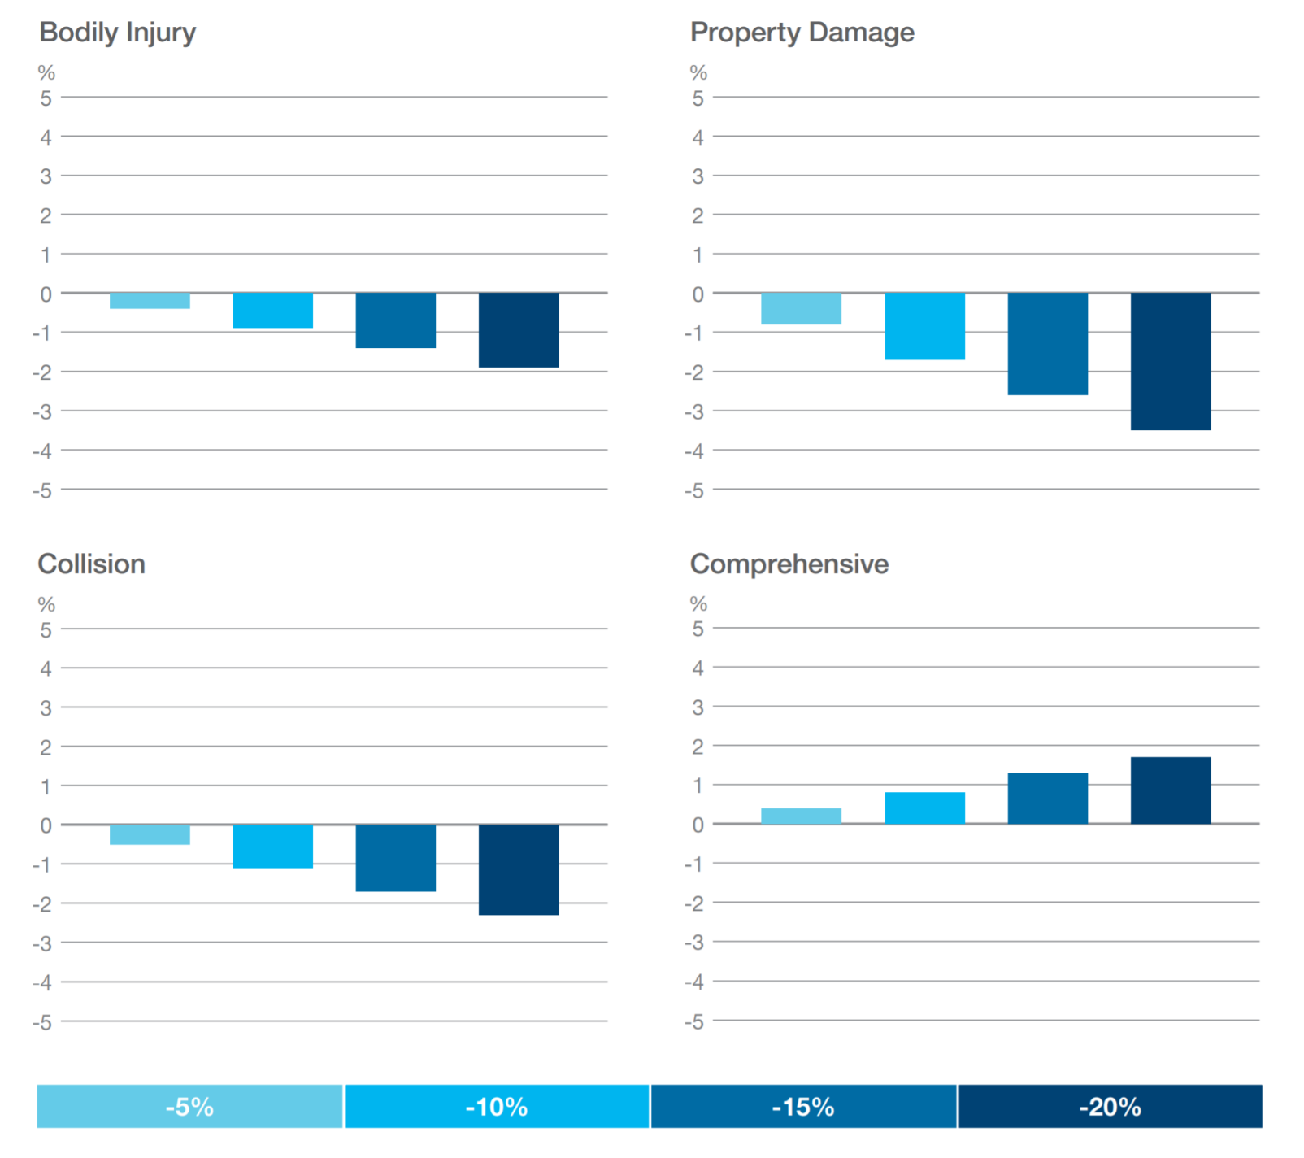
Scenario Testing
Commercial Auto PPT
Scenario:

Slide 12
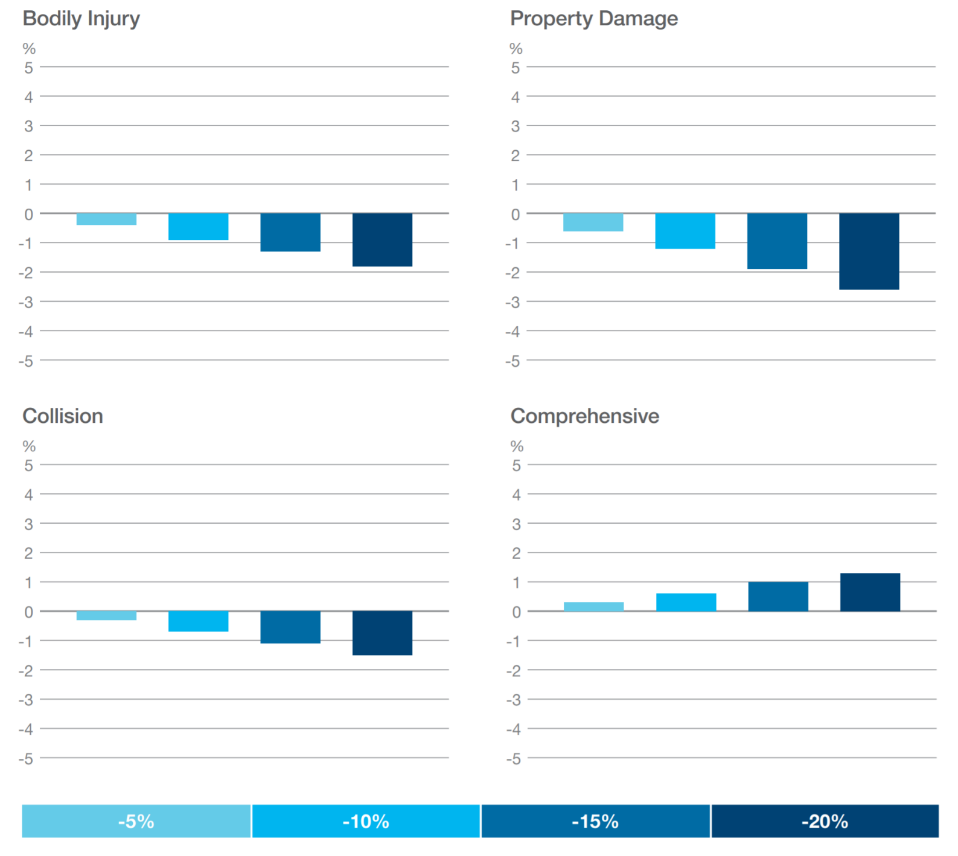
Scenario Testing
Personal Auto
Scenario:

Slide 13
Questions?
Ralph Dweck, FCAS, MAAA
ISO Risk Analyzer
ralph.dweck@verisk.com
t. 201.469.2559
No part of this presentation may be copied or redistributed without the prior written consent of ISO. This material was used exclusively as an exhibit to an oral presentation. It may not be, nor should it be relied upon as reflecting, a complete record of the discussion.

