Slide 1

2021 CAGNY Annual Meeting
May 12, 2021

Slide 2
Schedule
Start | End | Topic
9:00a | 9:05a | Welcoming Remarks, Jason Pessel
9:05a | 9:55a | Machine Learning on Estimation of Claim Liabilities, Marco De Virgilis
9:55a | 10:45a | When is Premium Riskier Than Loss?, Stephen Mildenhall
10:45a | 10:55a | 10-minute break
10:55a | 11:55a | Cyber Risk Insurance, Norman Niami
11:55a | 12:15p | CAGNY Business Session, CAGNY Board
12:15p | 1:15p | Lunch
1:15p | 2:15p | Fraud, Ben Turner
2:15p | 3:05p | Telematics in Ratemaking, Roxanne Turcotte & Francis Duval
3:05p | 3:15p | 10-minute break
3:15p | 4:05p | Human Values in the Loop: Thinking Through the Ethics of AI, Jim Guszcza
4:05p | 4:55p | Professionalism and Modeling, a look at ASOP 56 and ASOP 38, Ken Williams

Slide 3
CAS Antitrust Notice
The Casualty Actuarial Society is committed to adhering strictly to the letter and spirit of the antitrust laws. Seminars conducted under the auspices of the CAS are designed solely to provide a forum for the expression of various points of view on topics described in the programs or agendas for such meetings.
Under no circumstances shall CAS seminars be used as a means for competing companies or firms to reach any understanding – expressed or implied – that restricts competition or in any way impairs the ability of members to exercise independent business judgment regarding matters affecting competition.
It is the responsibility of all seminar participants to be aware of antitrust regulations, to prevent any written or verbal discussions that appear to violate these laws, and to adhere in every respect to the CAS antitrust compliance policy.

Slide 4
Welcoming Remarks
Jason Pessel, CAGNY President

Slide 5
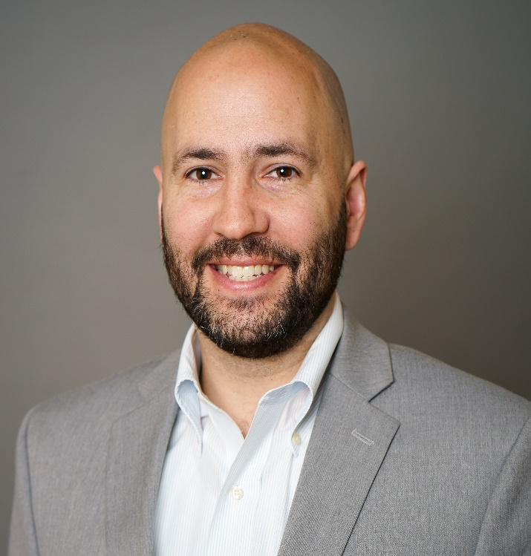
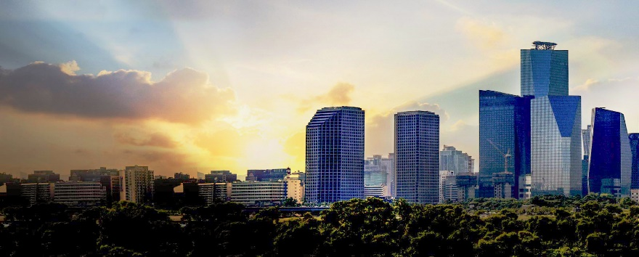
2021 CAGNY Annual Meeting
Welcoming remarks
Jason Pessel
CAGNY President

Slide 6
Machine Learning on Estimation of Claim Liabilities
Marco De Virgilis, Allstate

Slide 7
When is Premium Riskier Than Loss?
Stephen Mildenhall, Convex Risk

Slide 8
Break

Slide 9
Cyber Risk Insurance
Norman Niami, Chairperson, Academy Cyber Risk Task Force (CRTF)

Slide 10
CAGNY Business Session
CAGNY Board

Slide 11
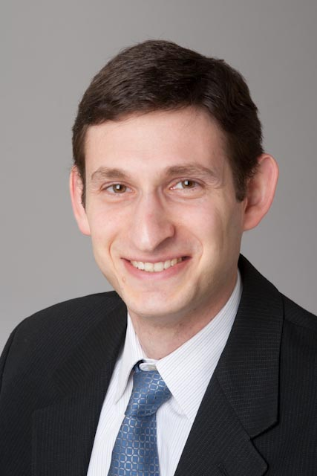
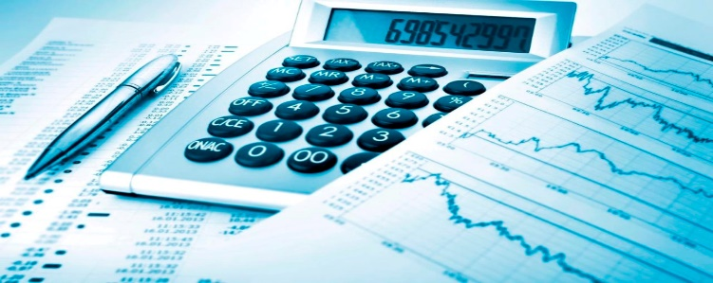
2021 CAGNY Annual Meeting
Financials
Jared Smollik
Treasurer

Slide 12
CAGNY Financials
Total revenues in 2020 were $12,510
The revenue was $24,085 including CAGNY Fall Meeting registration fees, which were not wired from the CAS account until just after the end of the year. For tax purposes, we used this since we account on an accrual basis like most organizations do, rather than a cash basis.
Total expenses in 2019 were $6,145
The December 31, 2020 surplus is $116,752, up from $110,387 on December 31, 2019
The surplus including Fall Meeting registration fees was $128,327. ($17,940 net income)
We feel we are in a good position to resume in-person events when appropriate, potentially as soon as the 2021 Fall meeting.
Negotiated with New Yorker to return deposit premium in 2020. Will host next meeting at the New Yorker.
Virtual webinars provided sufficient income for continued scholarships and strengthening of the surplus in anticipation of increased venue costs for in-person meetings.
Prior to the lockdown, the board compared costs of various venues and determined at the time that The New Yorker still provided the best value for CAGNY’s needs.
Meetings had been growing in attendance and we will need to assess whether that will continue.

Slide 13
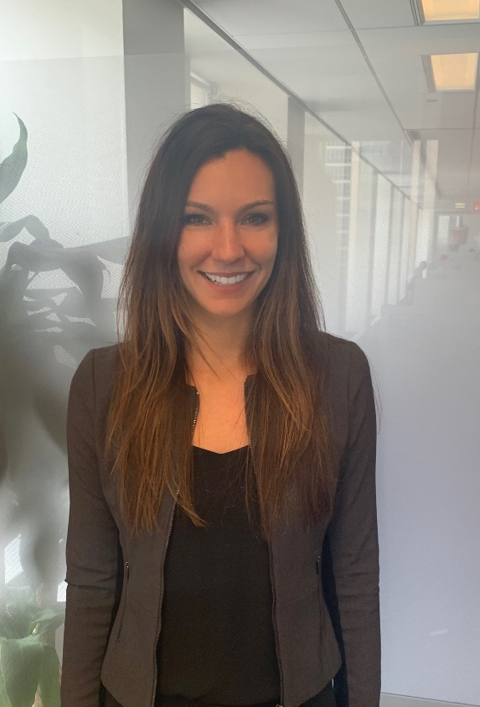


2021 CAGNY Annual Meeting
Scholarships
Victoria Marciano
Education Chair
Sponsored by

Slide 14
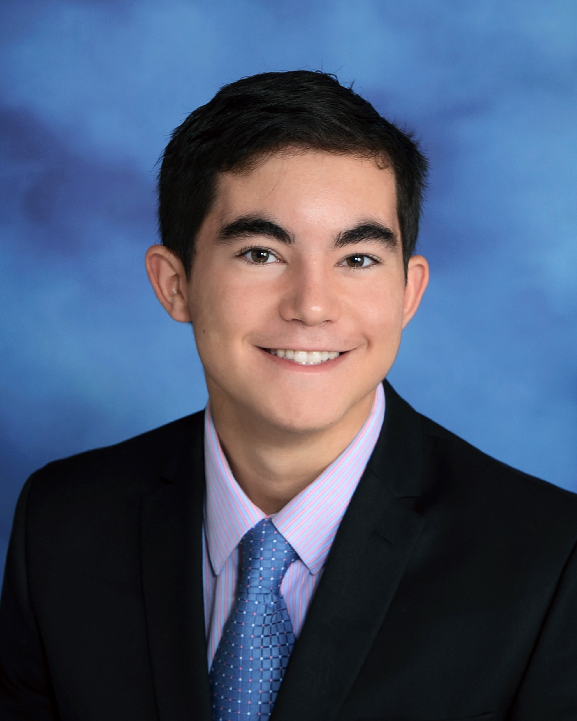
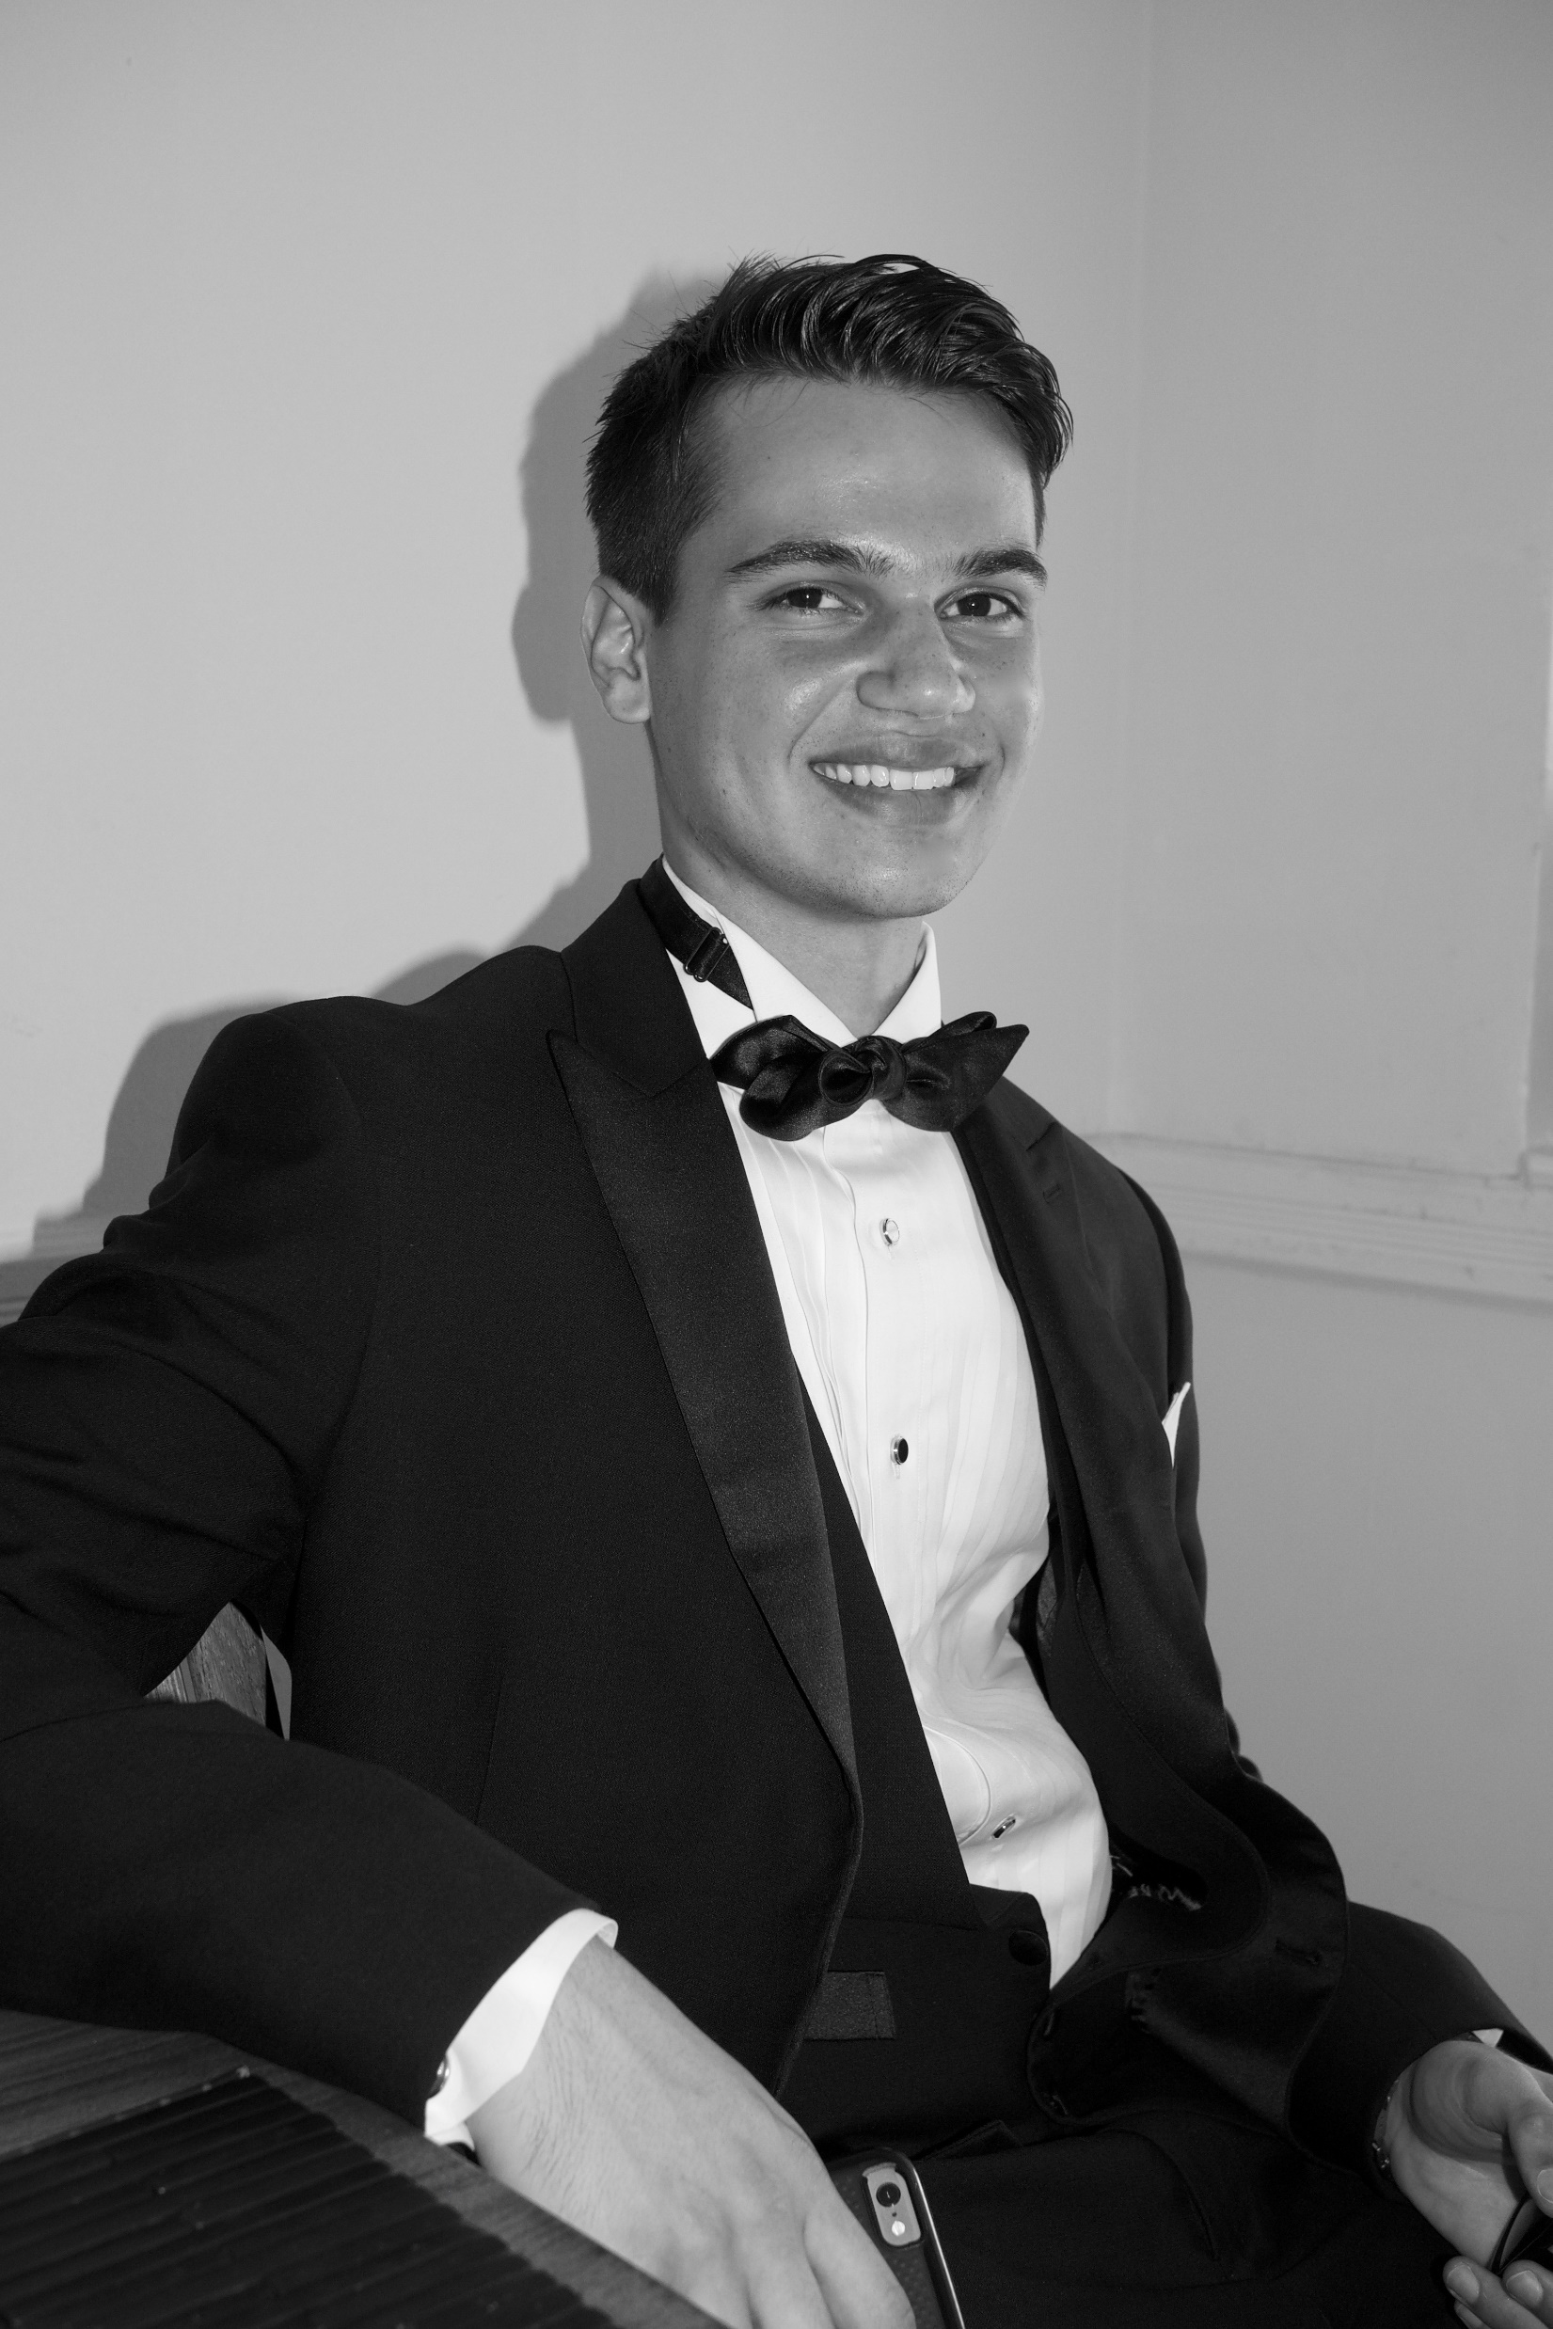
2021 CAGNY Scholarship
Congratulations to the 2021 CAGNY scholarship recipients!
Reiner Atstathi
St. John’s University
Allon Pevzner
St. John’s University

Slide 15
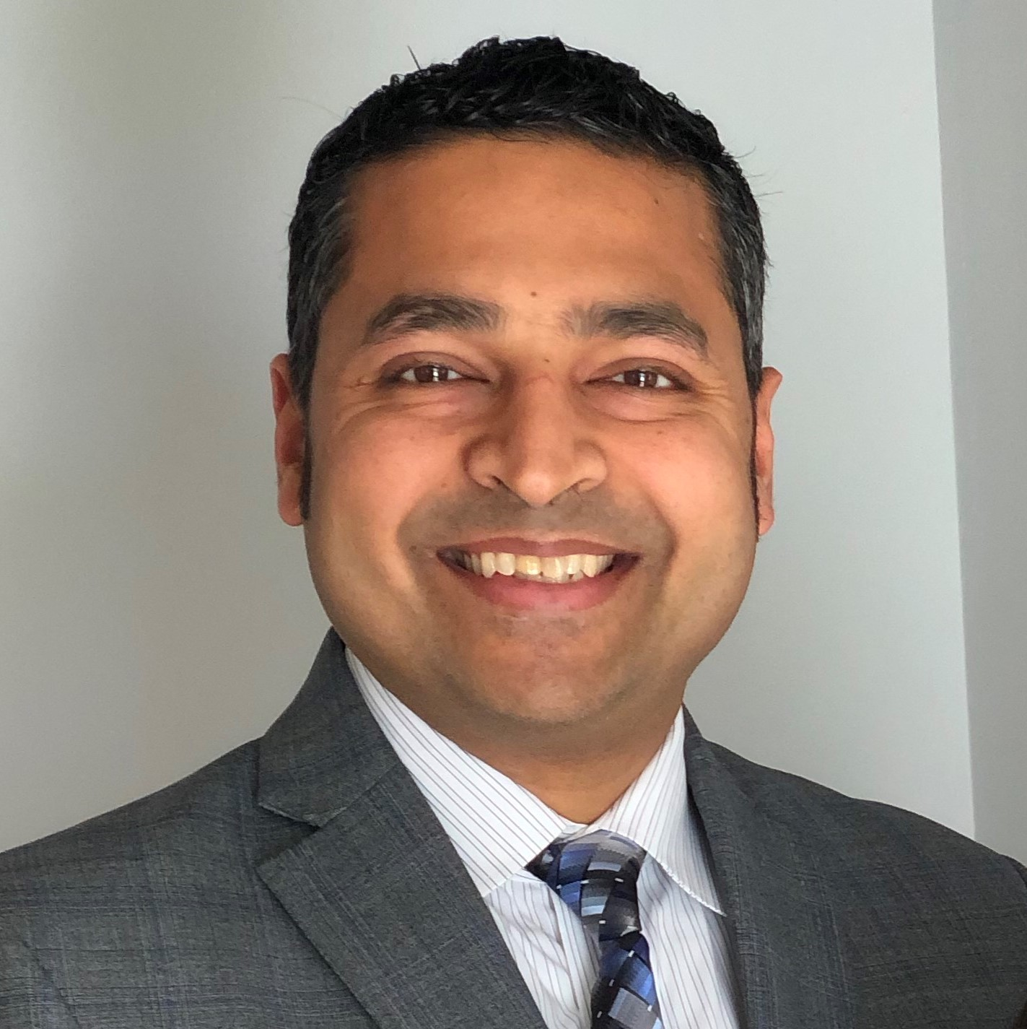
2021 CAGNY Annual Meeting
2021 Board Nomination
Somil Jain
Prospective Treasurer

Slide 16
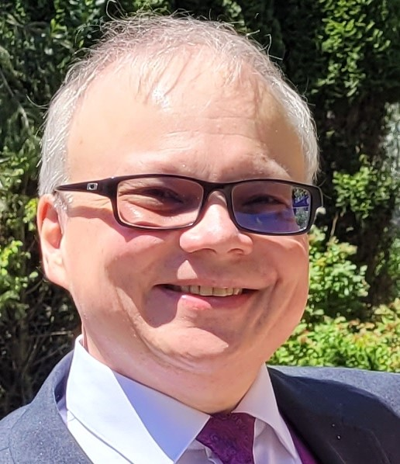
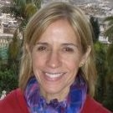
2021 CAGNY Annual Meeting
Transitions for 2021-2022
Jason Pessel, Immediate Past President
John Celidonio, President and filling the remainder of a vacant term
Halina Smosna, President-Elect
Jared Smollik, Vice President

Slide 17
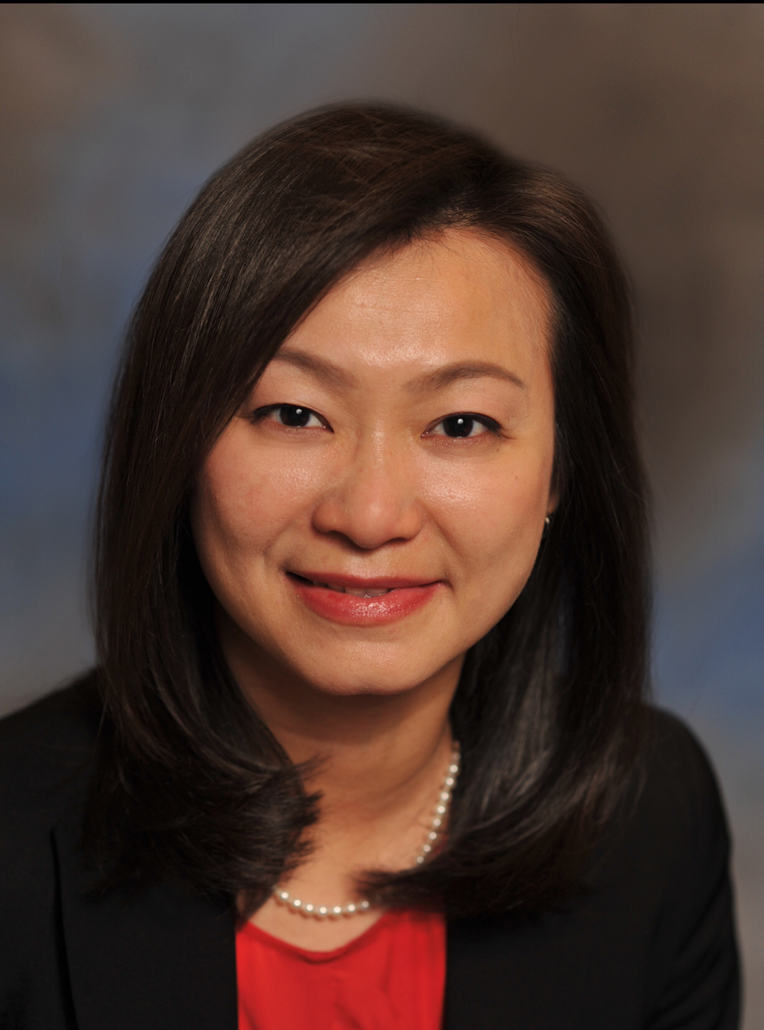
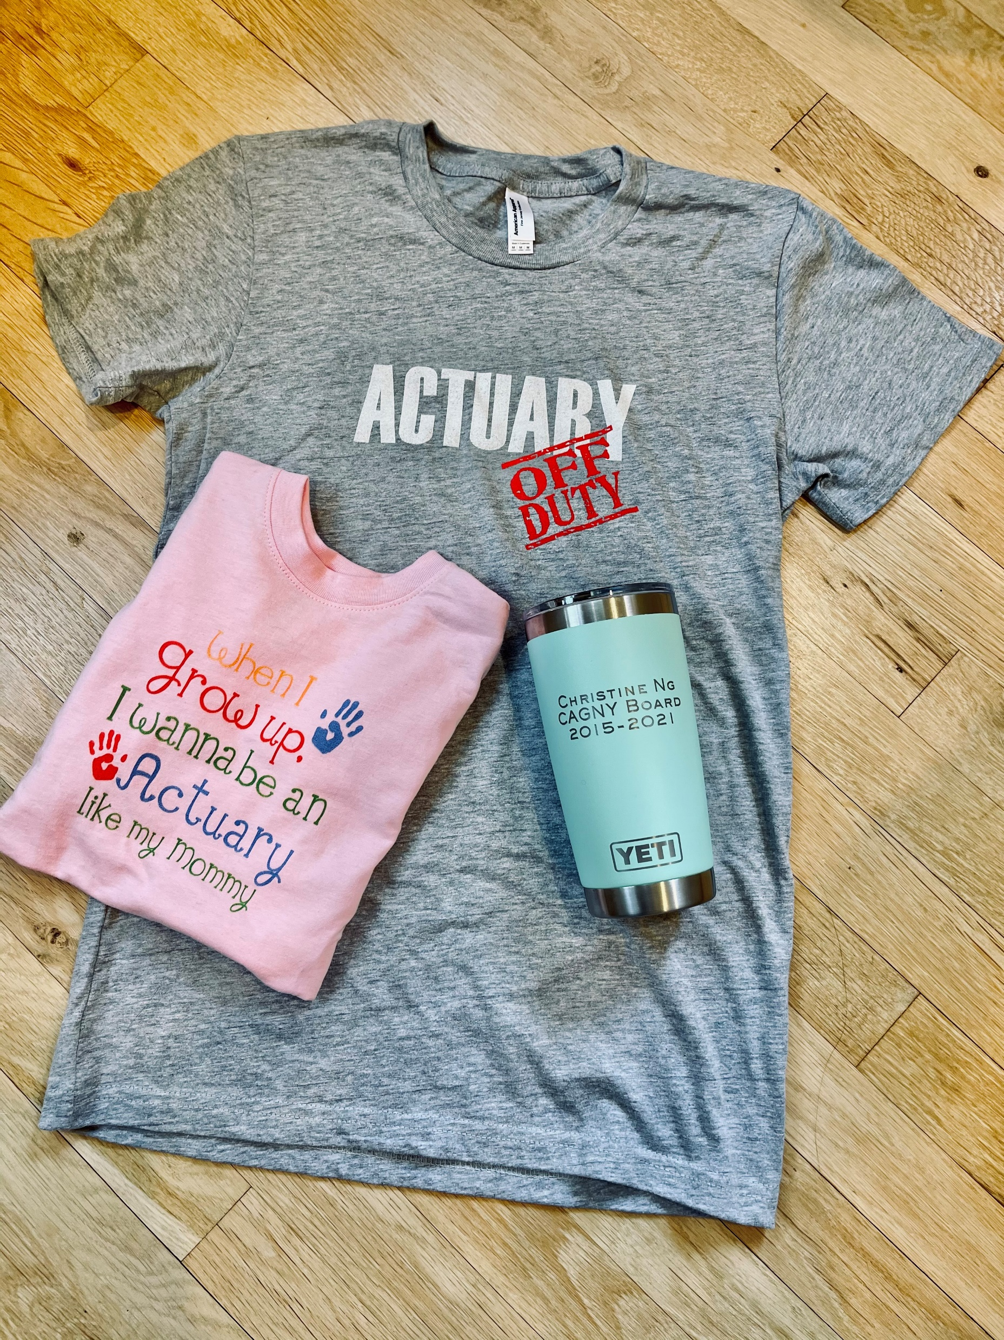
2021 CAGNY Annual Meeting
Outgoing board member
Christine Ng
Served 2015-2021
President 2019-2020

Slide 18
Lunch

Slide 19
Fraud
Ben Turner, FraudSpotters

Slide 20
Telematics in Ratemaking
Roxanne Turcotte, Université du Québec à Montréal
Francis Duval, Université du Québec à Montréal

Slide 21
Break

Slide 22
Human Values in the Loop: Thinking Through the Ethics of AI
Jim Guszcza, Deloitte Consulting

Slide 23
Professionalism and Modeling, a look at ASOP 56 and ASOP 38
Ken Williams, Casualty Actuarial Society

Slide 24
Closing Remarks
CAGNY Vice President Halina Smosna

