Slide 1
CYBER RISK INSURANCE Norman Niami Chairperson, Academy Cyber Risk Task Force (CRTF)
Casualty Actuaries of Greater New York (CAGNY)—12 May 2021

Slide 2
Housekeeping
The statements and opinions expressed by moderators/presenters do not necessarily represent the statements or opinions of the American Academy of Actuaries, the Actuarial Standards Board, the Actuarial Board for Counseling and Discipline, or any Academy boards, councils, or committees.
The Academy operates in compliance with the requirements of applicable law, including federal antitrust laws. The Academy’s antitrust policy is available online at https://www.actuary.org/content/academy-antitrust-policy.

Slide 3
Today’s Program
The Threat & Damage
Market Overview
Data
Silent Cyber
Breach Reporting Requirements
Upcoming Academy Papers

Slide 4
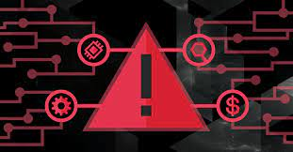
THE THREAT & DAMAGE THREAT

Slide 5
Everyday News Now
533 million Facebook users' phone numbers and personal data have been leaked online
Aaron Holmes
Apr 3, 2021, 10:41
The personal data of over 500 million Facebook users has been posted online in a low-level hacking forum.
The data includes phone numbers, full names, location, email address, and biographical information.
Security researchers warn that the data could be used by hackers to impersonate people and commit fraud.

Slide 6
Many Risks
Today’s connected word increases risk to critical network infrastructure and businesses:
Business Interruption
Loss of proprietary business information
Liability risk from loss of personal data
Direct costs (investigation, ransom, regulatory fines or penalties, restoration or replacement of digital assets, legal, …)

Slide 7
Bad Actors and Motives
Many bad actors: foreign governments, competitors, criminal syndicates, disaffected employees/contractors…
Hacking and malware software can be bought easily; hacking contractors are available for hire; ransomware has been growing significantly.
Large majority of attacks have had financial motives—bundles of personal identifiable information and protected health information are available for sale with somewhat set market prices.
Numerous attacks without financial motive: Sony, NotPetya.

Slide 8
Many Threat Vectors
Phishing has been the largest portion of methods for successful attacks.
Disgruntled/disaffected employee or contractor.
Delayed software patch installation.
Zero-day vulnerability, exploiting software vulnerability before developers know about and/or can fix the issue.

Slide 9
Examples of Many Vulnerabilities
More than 90% of cyber attacks start with an email; more than 90% of breaches due to human error.
Almost 90% of organizations globally experienced Spear Phishing in 2019 (email to a well-researched target).
Most companies have many accounts with non-expiring passwords.
About three-fourths of organizations do not have an incident response plan.

Slide 10
Challenges
Globally the U.S. ranks the highest for ransomware attacks with 18.2% of ransomware attacks.
Pandemic created increase in vulnerabilities and attacks:
Google blocked 18 million daily malware and phishing emails related to coronavirus in April 2020
Cloud-based cyber attacks increased 630% from January to April 2020
Average time to identify a breach in 2020 was 207 days.

Slide 11
Costs
Average cost of a data breach in 2020 was $3.86m.
Average ransomware payment in 2020 was $111k+ (33% above 2019).
Globally U.S. has the highest data breach average cost at almost $9m.
2021 global cost of cybercrime is estimated at $6 trillion.
Estimates are that by 2025 the annual cost could be as high as $10.5 trillion (only U.S. & China have GDPs above that figure).

Slide 12
NotPetya -- 2017
Spread quickly
$10 billion total damages
Act of war?
Merck - $870M
TNT Express - $400M
Saint-Gobain - $384M
Maersk - $300M
Mondeléz - $188M
Reckitt Benckiser - $129M

Slide 13
Scales of Some Recent Incidents
2020 SolarWinds—estimates of at least around 20,000 customers vulnerable including 250 government agencies; Insured for $15m.
2021 Microsoft Exchange Server—at least 30k businesses and government agencies targeted just in the U.S.
2021 Facebook user details leaked online.

Slide 14
MARKET OVERVIEW

Slide 15
Cybersecurity Written Premium (000s)
The figures shown in the graph are limited to information reported to the NAIC by insurance carriers.

Slide 16
Companies Writing Cybersecurity Policies
The figures shown in the graphs are limited to information reported to the NAIC by insurance carriers.

Slide 17
Direct Incurred Loss Ratios
The figures shown in the graphs are limited to information reported to the NAIC by insurance carriers.

Slide 18
Experience & Prices
Aon (March 2021):
Severity rose significantly in 2020
Aon typically saw 3 new E&O/Cyber claims each day (100% increase over 2019)
Ransomware up almost 500% between Q1 2018 & Q4 2020; 150% increase between 2019 & 2021
Data breach & privacy events decreased by 60% in 2020 (first time in 5 years)
At end of 2020 primary layers saw an average price increase of 15.8%
Aon predicted price increases of 20%-50% for the rest of 2021
Excess hit with higher prices

Slide 19
DATA

Slide 20
Challenges
Yesterday’s risks may not be tomorrow’s risks:
Types of bad actors and criminals keep growing
Types of targets and types of attacks keep changing.
More work from home brings additional risks and vulnerabilities

Slide 21
Challenges …
Historical events are likely not to be indicative of the future.
Limited data.
Continuously changing landscape.
Data privacy laws add a new layer of costs.

Slide 22
Challenges …
Other issues:
Insurers’ legacy systems may not be sufficient for cyber risks and required data.
Many vendors to choose from -- Vendor models improving, however, still in their infancy.
Not all losses may be reflected in data (for instance ransomware attack victims may be concerned about reputational damage).
Assessing accumulation.

Slide 23
Market Data
Some high-level data available from NAIC and other public entities.
Many different types of vendors (loss and accumulation models; security firms) with market data.

Slide 24
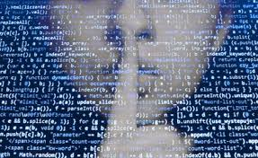
SILENT CYBER

Slide 25
What Is ‘Silent Cyber’?
A cyber event could trigger unexpected payouts under existing policies where the risk was not considered/priced.
Policy wording has not evolved at the rapid pace of technology: unintentional, non-affirmative coverage of losses caused by cyber perils.
There are two major aspects of silent cyber risk: unintentional coverage and unpriced coverage.

Slide 26
Example
A cyber attack that hacks the industrial control system of a dam could result in significant property and flood damage; losses may be covered if the policy’s language on cause of loss is not very clear.
Many lines of business covering the dam and its operator could have potential exposure to silent cyber losses due to unintentional coverage that was not priced.

Slide 27
Managing Silent Cyber Exposure
Determining exposure is complicated: Cyber risks expand and evolve at a rapid pace; it is difficult to expect or predict where the next accident will come from.
Risk assessment requires data that is not typically collected in traditional property and casualty exposure datasets.
Sufficient historical data is often not available to accurately forecast future silent cyber risk exposures and price appropriately.
The global insurance market has been addressing “affirmation” process of cyber risk.

Slide 28
Ending the Silence
Initiatives have begun in the market:
Lloyd’s of London syndicates were required to explicitly affirm or exclude cyber coverage to avoid any silent cyber complications in phases for various lines of business starting January 1, 2020.
In January 2018, Insurance Services Office (ISO) introduced standardized cyber insurance forms.
Many companies have started to manage cyber risks by affirmatively covering or excluding cyber risk in their policies.

Slide 29
Ending the Silence …
NY DFS issued a cybersecurity risk framework in February 2021. It encourages insurers to follow best practices in risk strategy:
Manage and eliminate exposure to “silent” cyber
Evaluate systematic risk
Measure insured risk
Educate insureds and producers
Obtain cybersecurity expertise
Require notice of cyber attack notification to law enforcement

Slide 30
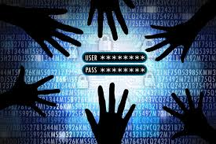
Breach Reporting Requirements: An Analysis of Laws Across the US

Slide 31
Background
Reducing and managing risk efficiently requires information, including that drawn from compliance with laws regulating reporting of cyber breaches.
No uniform national standards exist for notifying consumers and authorities of data breaches.
Each state and territory has its own statute(s) with notification requirements.

Slide 32
Background …
In 2017 NAIC adopted the Insurance Data Security Model Law
To establish common data security and breach notification standards
States encouraged to adopt by the NAIC and U.S. Department of the Treasury
In 2018, a U.S. Department of the Treasury report concluded:
Differences in state laws can make compliance overly burdensome for companies doing business in more than one state
U.S. Congress should enact data security and breach notification legislation that supersedes state law and applies uniform standards across the states

Slide 33
Academy Paper
Academy Cyber Risk Task Force examined the current status of state reporting requirements (Cyber Breach Reporting Requirements: An Analysis of Laws Across the United States; November 2020):
Summarize essential aspects of each jurisdiction’s relevant statute(s) in a consistent manner for comparison
Compare statutes across jurisdictions and report key metrics
Contrast current statutes with NAIC Model Law

Slide 34
Key Takeaways
Typical statute creates issues due to arbitrary threshold and vague language.
Variability creates uncertainty for pricing and designing cyber coverage and may require higher margin components in premiums.
Variability may also make mitigation and prevention more difficult, raising losses due to cyber risk.
Actuaries, insurers, regulators, and public may benefit from increased harmonization.

Slide 35
^{UPCOMING ACADEMY PAPERS}

Slide 36
In Review Process
Intro to Cyber Risk
Silent Cyber
Threat Landscape
Cyber Data
Accumulation
Reinsurance
Ransomware

Slide 37
Papers Currently in the Pipeline
Autonomous Vehicles
Update to Resource Guide
“War” and Cyber Attacks
Vendor Model Comparison

Slide 38
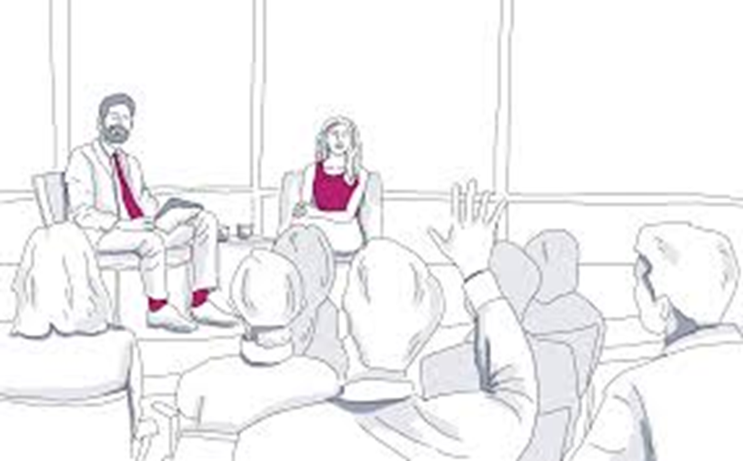
Questions, comments?

