Slide 1
Estimation of Individual Claim Liabilities A comparison of Traditional and Machine Learning Methodologies
CAGNY SPRING MEETING
May 12, 2021
Marco De Virgilis

Slide 2
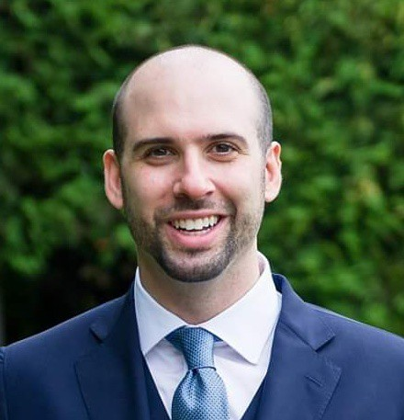
Presenters
Marco De Virgilis,
Senior Actuarial Data Scientist, Allstate

Slide 3
Agenda
Traditional Claim Reserving
Machine Learning in Claim Reserving
Model Comparison

Slide 4
Traditional Claim Reserving

Slide 5
Run-Off Triangles: An Overview
 | 0 | 1 | 2 | 3 | 4 | 5 | 6 | 7 | 8 | 9
1981 | 5,012 | 8,269 | 10,907 | 11,805 | 13,539 | 16,181 | 18,009 | 18,608 | 18,662 | 18,834
1982 | 106 | 4,285 | 5,396 | 10,666 | 13,782 | 15,599 | 15,496 | 16,169 | 16,704
1983 | 3,410 | 8,992 | 13,873 | 16,141 | 18,735 | 22,214 | 22,863 | 23,466
1984 | 5,655 | 11,555 | 15,766 | 21,266 | 23,425 | 26,083 | 27,067
1985 | 1,092 | 9,565 | 15,836 | 22,169 | 25,955 | 26,180
1986 | 1,513 | 6,445 | 11,702 | 12,935 | 15,852
1987 | 557 | 4,020 | 10,946 | 12,314
1988 | 1,351 | 6,947 | 13,112
1989 | 3,133 | 5,395
1990 | 2,063
LDF | 2.999 | 1.624 | 1.271 | 1.172 | 1.113 | 1.042 | 1.033 | 1.017 | 1.009 | 1.000

Slide 6
Run-Off Triangles: An Overview
AY | Latest | Ultimate | IBNR | Mack.S.E | CV(IBNR)
1981 | 18,834 | 18,834 | 0 | 0
1982 | 16,704 | 16,858 | 154 | 143 | 0.928
1983 | 23,466 | 24,083 | 617 | 592 | 0.959
1984 | 27,067 | 28,703 | 1,636 | 713 | 0.436
1985 | 26,180 | 28,927 | 2,747 | 1,452 | 0.529
1986 | 15,852 | 19,501 | 3,649 | 1,995 | 0.547
1987 | 12,314 | 17,749 | 5,435 | 2,204 | 0.405
1988 | 13,112 | 24,019 | 10,907 | 5,354 | 0.491
1989 | 5,395 | 16,045 | 10,650 | 6,332 | 0.595
1990 | 2,063 | 18,402 | 16,339 | 24,566 | 1.503

Slide 7
Run-Off Triangles: Advantages and Disadvantages
Advantages:
Easy Implementation
Stabilizes Experience
Intuitive and Interpretable
Disadvantages:
Information compression, e.g. 10 years worth of data to 55 data points
Unreliable recent results
Loss of information

Slide 8
Machine Learning in Claim Reserving

Slide 9
Individual Claim Reserving
Looking at claim data at the individual level can overcome the main drawback of standard triangle techniques, bringing these advantages:
Timely Estimates:
There is no need to wait for each AY year to sufficiently develop
Extensive Use of Data:
Data is usually recorded anyway, it would be clever to actually use it.

Slide 10
Predicting Ultimate Cost
Target: To predict the ultimate cost of the claims when they are initially reported.
At this stage, there is no paid amount and an initial case reserve is established.
In one case they will be settled and paid. This is the amount that needs to be estimated.
On the other hand, claims could be closed with no payment (CNP), and therefore there will not be any payment.

Slide 11
Predicting Ultimate Costs
We will have three stacked models:
First, each claim will be classified if it will be paid or closed with no payment.
If the claim will be paid, a second model will estimate the final claim amount, ie. ultimate cost.
A third model will also estimate the timing of such payment.

Slide 12
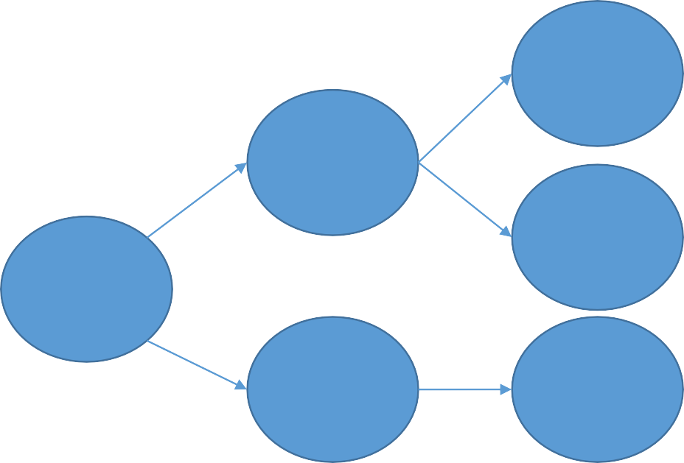
Modeling Framework
The framework is built on one classifier and two regressors.
Amount
Regression
Paid
Lag
Regression
Claim
Classification
CNP
Amount
= 0

Slide 13
Data example
Acc_Date | Rep_Date | Car_Man | Lat | Long | Acc_Time | DUI | BAC | ... | Case Res
Ultimate Cost | Time Lag

Slide 14
Model Comparison

Slide 15
Models Implemented
The following models have been implemented:
General Additive Models, GAM
Multivariate Regression Splines, MARS
K Nearest Neighbor, KNN
Gradient Boosting, GB
Neural Networks, NN
Each different model has been used to classify claims and to predict both ultimate cost and lags.
Then, the performance have been compared and the best performing models have been chosen.

Slide 16
RBNS Results (Reported + IBNER)
Classification Performance:

Slide 17
RBNS Results (Reported + IBNER)
Regression Performance:

Slide 18
RBNS Results (Reported + IBNER)
Regression Performance:

Slide 19
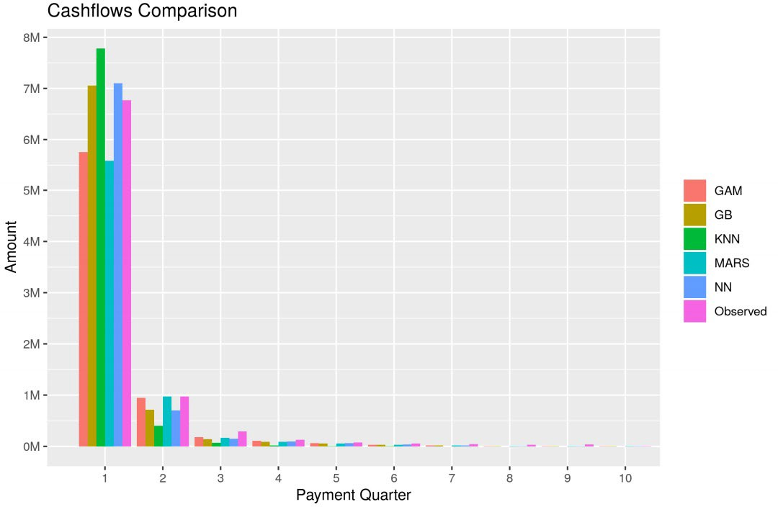
RBNS Results (Reported + IBNER)

Slide 20
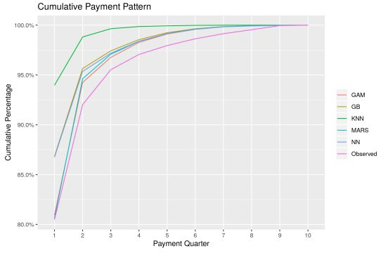
RBNS Results (Reported + IBNER)

Slide 21
IBNYR Estimates
At this point we have obtained estimates for claims that have been reported to the company.
This includes RBNS (Reported but not settled) and IBNER (Incurred but not enough reported).
We still have to produce estimates for IBNYR, (Incurred but not yet reported).
Since the company does not have any records of these claims we have to follow a different approach.

Slide 22
IBNYR Estimates
Let’s consider that the evaluation date is December 31, N.
Take the observed ultimate value of all the claims occurred in all the previous years and reported by year end (RBNS + IBNER).
Take the observed ultimate value of all the claims occurred in all the previous years and reported after year end (IBNYR).
Computing the ratios of these quantities, IBNYR/(RBNS + IBNER), we can have a time series for all previous AY’s.
After estimating a value for year N, multiply this estimate by the level of ultimate amounts already predicted.
This will lead to an estimate of IBNYR.

Slide 23
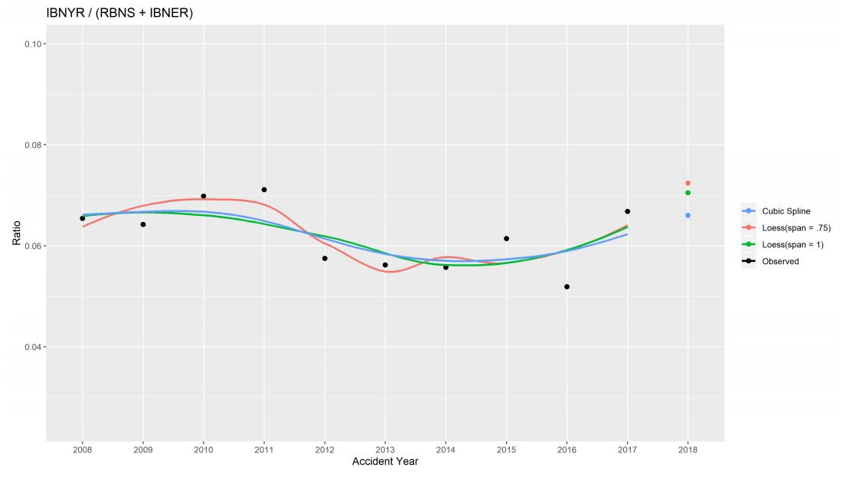
IBNYR Results

Slide 24
Conclusions
Results have a high level of accuracy.
No reliance on individual point estimates.
Early evaluation
– Allows early decisions from management
Future studies could explore the possibilities of predicting individual claim development.

Slide 25
Final Remarks
We showed the potential of ML in estimation of policyholders’ liabilities.
It’s not a one-fits-all recipe but it gives a framework of actions.
Recent advances in computer power have allowed more extensive use of data in a wide variety of areas.
We believe that it is very beneficial to explore these capabilities in the context of actuarial science.

Slide 26
Thank you for your attention
Further information available at
De Virgilis, M., Pierluigi C., Estimation of Individual Claim Liabilities. Casualty Actuarial Society, 2020.
https://www.casact.org/research/wp/papers/working- paper-Virgilis-Cerqueti-2020-01.pdf

Slide 27
Contacts:
Marco De Virgilis: devirgilis.marco@gmail.com

Slide 28
Casualty Actuarial Society 4350 North Fairfax Drive, Suite 250
Arlington, Virginia 22203
www.casact.org

