Slide 1
The Bigger short hindsight is 2020?
Identifying the 2008 GFC False Narrative
Spring 2021 CASE meeting
Robert B. Anderson
Chief Actuary
United auto insurance company
Notes:
The title may already evoke thoughts about a movie you have seen. That was of course intentional. ‘The Big Short’ was a critically acclaimed 2015 movie about the Global Financial Crisis, or “GFC”. ‘The Big Short, Part II’ was a presentation I prepared for the 2019 CAS Annual meeting. And now this presentation, “The Bigger Short, Hindsight is 2020?” is my contribution to the same subject now that 2020 is in our rearview mirror.
My hope is, by referencing the movie, that it will bring most of the audience up to speed with the topic, as everyone here either lived through the GFC, perhaps as a professional, and/or watched the movie, so I assume everyone has in their own mind some kind of basic narrative or familiarity of what happened in 2008.

Slide 2
Antitrust Notice
The Casualty Actuarial Society is committed to adhering strictly to the letter and spirit of the antitrust laws. Seminars conducted under the auspices of the CAS are designed solely to provide a forum for the expression of various points of view on topics described in the programs or agendas for such meetings.
Under no circumstances shall CAS seminars be used as a means for competing companies or firms to reach any understanding – expressed or implied – that restricts competition or in any way impairs the ability of members to exercise independent business judgment regarding matters affecting competition.
It is the responsibility of all seminar participants to be aware of antitrust regulations, to prevent any written or verbal discussions that appear to violate these laws, and to adhere in every respect to the CAS antitrust compliance policy.
Notes:
This has already been reviewed

Slide 3
Live survey question from my 2019 CAS annual meeting presentation
What was the primary cause of the 2008 financial crisis?
    A liquidity fracture in the global monetary system
    Mass defaults in sub-prime mortgages
    Proliferation of credit default swaps
    Taking Fannie Mae & Freddie Mac into receivership
    None of the Above
Notes:
To my knowledge, the 2008 GFC is the biggest single surplus shock event in the history of the US P&C insurance industry. The GFC could also be viewed by our industry as a case study of the most significant risk management breakdown in history. And while both of those things may merit our attention, the purpose of this presentation is to expose the ongoing risk management failure to correctly identify the true cause of the 2008 GFC. And the reason why that is important is because we are now left unaware of or exposed to the same problem that caused the 2008 GFC, we think it is fixed and in the past when it is still a current and present risk; thus, we currently face a substantial risk of a bigger GFC 2.0. So, this isn’t about retelling a 13 year old story, but rather it is about connecting the dots with what happened in 2008 with what is happening now so we can identify the risks we face as an industry right now.
The fact that the 2008 GFC required a Congressional Inquiry Commission to explain what happened; and, given our media created a movie attempting to explain what happened, we can’t approach this topic without the awareness that it is extremely complex and we simply will not be able to do it justice in 50 minutes, but I will attempt to do so as fast as I can, but I will try to move quickly through the slides, so we can have time at the end for questions.
(Run the survey results)
This was the opening slide at my 2019 annual meeting presentation. For this question, I remember thinking the right answer would be too obvious in a multiple choice context because, excluding “None of the Above”, we have three answers that are part of the generally accepted GFC narrative and one that isn’t, making it the clear correct answer without even understanding what it means. Thus, I thought people would pick it for that reason alone, but they still didn’t. Only about 10 of the approximately 300 people in attendance selected answer A, the correct answer.
Why is that? My guess is because the mainstream narrative is just that strong. I think the only way this happens is that people are already confident and comfortable with the narrative they have, thus, even when presented with a scenario that challenges that narrative, we have a tendency to overlook that evidence.
If you remember, the 2008 crisis was “global” and it was a “banking” crisis. Only one answer is consistent with that idea, yet it largely was not selected as the right answer. As a financial services industry, we should have at least started with the baseline that the problem is in the global money or banking system, but we didn’t. We blamed sub-prime.

Slide 4
IT WAS not sub-prime mortgages!
“Prospective subprime losses were clearly not large enough on their own to account for the magnitude of the crisis. Rather, the system’s vulnerabilities, together with gaps in the government’s crisis-response toolkit, were the principal explanations of why the crisis was so severe and had such devastating effects on the broader economy.”
  Ben Bernanke, Federal Reserve chairman, testifying to the Financial Crisis Inquiry Commission of Congress
Notes:
This is from Ben Bernanke, then Federal Reserve Chair, testifying to the Financial Crisis Inquiry Commission of Congress. When asked if it was sub-prime, he says clearly that there is no way it could be. And notice his obfuscation of responsibility, placing blame on the federal government, rather than the Federal Reserve, the monetary authorities, redirecting responsibility away from the monetary authorities.
What does Bernanke mean by “system’s vulnerabilities”? He didn’t provide any details as to what these system vulnerabilities were, yet, this is what he pins the entire crisis on and nobody asks for more details? We must recognize this as another point of Risk Management failure. That was the very purpose of the Inquiry Commission, to understand those details. How did the details then not come out of this Inquiry? Something here must be very broadly misunderstood.
So if it wasn’t subprime. What did happen? I have an analogy I use to explain. I compare the GFC to a hypothetical shock where a large portion of the vehicles in the world broke down at around the same time due to problems that seem to be originating primarily in the oil line.
All the expert mechanics got on the mainstream mechanics media and provided explanations about faulty hoses and other component pieces, engine parts from China, or poor manufacturing standards due to government regulations and interventions, proliferation of credit that inflated vehicle prices, which increased production and increased the probability for errors, something about greedy auto manufacturer and dealership executives. One thing for sure, it was the subprime hoses that caused all the other downstream problems.
But what if the problem actually had nothing to do with the hoses and everything to do with the oil? What if something changed in the chemical composition of oil that made it less effective or insufficient at doing what oil does for a vehicle? Something had changed that we couldn’t see and didn’t understand; and, it worked its way into the broader system until the problem festered and boiled over into a big risk event.
Money is what liquefies a financial system. The monetary system is not the financial system just as the oil is not the vehicle. Money is the enabler of efficient commerce and trade. It is “the machinery of exchange”, just as oil is the enabler of vehicle motion.
The problem was never mortgage-backed securities, it was never a direct problem in the domestic US financial system, but only, from our individual narrow perspectives, expressed in it. The problem was in the global monetary system. But once provided as an explanation, and we didn’t have anyone in the media, or in this situation, in Congress either, to ask the right questions, because the complex system in question was already broadly misunderstood, if not not-understood at all, then the narrative was adopted as correct by the general population, and it is our human tendency at that point to stop asking questions. Another point of risk management breakdown.

Slide 5
My Risk management journey
Notes:
Before I get back into the main topic, I want to first show why I have a passion for risk management and macroeconomics.
This slide shows:
Right side: shows that I have 10 years of formal risk management experience. And due to timing of these crises, they affected me both personally and professionally.
Left side: shows that something changed in 2007 that has permanently changed the global economic landscape, yet the narrative in the US has been that the last dozen years has been “the longest expansion in US history”. However, from my view, we’ve been in an economic depression for 13 years (I define a recession as the downswing in a cycle, but a depression as sustained slow or inhibited growth)

Slide 6

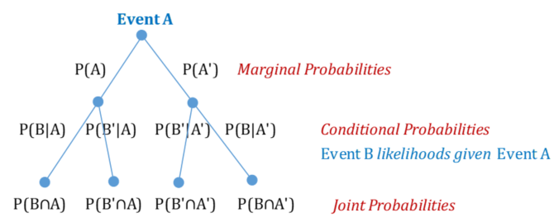
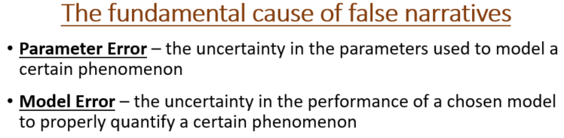
Risk management paradox
1. “Front-end” of the paradox - How do we include event sets that we don’t know about or don’t understand?
2. “Back-end” of the paradox - How do we establish ourselves as the ones with the answers while maintaining that we don’t know the answers?
Notes:
And just for a quick introduction of a few risk management concepts I have been thinking through to define this risk management paradox of how false narratives occur and how we can identify them or avoid them, I created this chart or “human reasoning cycle”.
Starting at the top of the cycle, Risk Management is a rational thinking approach to understanding relative risk.
It is the next box in the cycle where we need to intervene cognitively because humans are irrational when it comes to understanding relative risk. As an example, did you hear about the insurance agent who was swimming at the beach? Someone yelled “shark” and the agent shot out of the water, jumped into his car, didn’t put on a seatbelt, lit up a cigarette to calm his nerves, and drove off while texting all his friends about what happened. A silly example of how humans do not typically approach relative risk rationally.
If I asked you if there is anything you currently believe that could be wrong, most would answer yes, yet, when I ask for an example of something you believe that is wrong, nobody has an answer, because nobody believes anything they think is wrong. This is a paradox. False narratives arise because of this paradox. My theory on how to overcome this paradox lies in our ability to step away from this binary idea of believing we have to be either right or wrong. We have been conditioned to believe that being smart means having the most answers, but we should really be measured by the quality of our questions. We have a tendency to depend on having right answers and therefore disregard error probabilities and tend to stop asking questions. This way of thinking opens the door for false narratives.
An example of this is how we react to a referee’s call that doesn’t go our team’s way. This type of reasoning has bias or motivation. It fails to consider “what would this look like if a contradictory thesis was true?” This is an example of the front-end of the paradox. But, the difficulty often lies in that in these circumstances, people truly believe they are being objective, but it is because their objectivity is only true in the context of their binary view of reality. Thus, understanding this paradox, and how to step outside of it and think critically, is a pathway to avoiding the adoption of false narratives.
(1. Front-end of the paradox – read from slide) As actuaries, we have to think in an environment of ambiguity and theorize about things we do not know or cannot see, like how scientists theorize about quarks, or black holes. They make theories about them from what they observe around them, without actually being able to observe them explicitly. This is what I call the “front-end” of the paradox. And while I won’t get into it here, I believe Bayes Theorem provides a good foundation for a critical thinking-based solution.
(2. Back-end of the paradox – read from slide) Even if we think critically, we often still fall victim to what I call the “back-end” of the paradox, where we are easily fooled by false statements due to our binary way of thinking, that something is either right or wrong, good or bad, etc. For example, we might see our rate level indication as the right answer, when we should rather look at our actuarial conclusions in a relative manner (like in terms of likelihoods).

Slide 7
identifying the GFC false narrative
“depressions [as opposed to recessions] like this are provoked by an impediment in the machinery of exchange.”
  Henry George (1879), a US economist commenting on the extended length of the depression in the 1870s
+ This problem (the global depression) is expressed in a globally-coordinated, downward-cycling global economy (which is a mostly unexplored event set A’, inconsistent with the accepted financial industry narrative A)
+ “The machinery of exchange” is equivalently described as “the money (monetary) system”
= The problem must be provoked by an impediment in the global monetary system
What is the global monetary system?
Notes:
So now, getting back to the main topic, the 2008 GFC was a “global” crisis, and it was a “banking” crisis, not a sub-prime mortgage crisis, (read the quote) so I started looking outside of sub-prime to find answers.
This statement led me in the right direction, to conclude that the problem must be an impediment in the global monetary system, but what is that system. I set out to understand that system better.
Now, I will warn you now that this isn’t the most exciting content, but it is critical to understanding the current economic risk situation we are in, so I’ll try and liven things up a bit with a few survey questions, but please bear with me as we push through the topic of the global monetary system. I promise it will be worth it in the end.

Slide 8
The global monetary system - in questions
What currency is the primary currency used for global trade (the global reserve currency)?
    IMF’s Special Drawing Rights (SDRs) basket of currencies
    Precious metals (gold, silver)
    The Euro
    The US Dollar
    The Renminbi (Chinese Yuan)
In the US, who has the “power of the printing press” (currency creation)?
    Federal Reserve
    US Treasury
    The Banking System
    All of the Above
Notes:
I won’t have time to run all these polls, so just read through them and you can make a selection in your mind as we go along.
For the first question, when it comes to what currency is used for global trade, I am wanting to evoke some deeper questions about what it means to be a global reserve currency:
For example, when Nigeria buys energy from Venezuela, or Sweden buys beans from Colombia, or Australia busy pharmaceuticals from India, they do so in what currency?
And that is just trade, what about global lending? When a European developer in Asia borrows from a Japanese bank to start a golf course in Mongolia – in what currency is the loan? Can an expatriate living in Singapore get a US dollar denominated mortgage or business loan from a bank in Singapore?
And what about global investing? Can I have a US brokerage account and buy a US treasury from a brokerage in Peru?
What about foreign corporate payrolls? Can I work in Bangladesh and get paid in US dollars and have a US dollar bank account?
The answer is yes, yes, and yes, the US dollar is used all over the world. It is the global reserve currency. That means that foreign banks use the US dollar to intermediate almost all international transactions.
(2nd poll)
In the US, the power of the printing press, to physically print currency is legally with the US Treasury. However, they only print a small amount, which amount is given to them by dictate from the Federal Reserve, and that money is primarily used to keep enough physical currency floating in the system, so it is replacing damaged currency or growing relative to population and commerce growth. This kind of currency creation makes up a very small portion of total money creation. So while the Treasury, by dictate from the Fed creates physical currency, most currency (like ~97%) is digital, and that currency is created exclusively by the banking system. So the correct answer is technically a combination of A and B, but more accurately D, yet the best answer is probably C.

Slide 9
Who has the power of the printing press?
Currency creation:
  Federal Reserve Act 1913 prevents the Federal Reserve from “printing money”
  The US Treasury has the power of the printing press, amount dictated by the Federal Reserve, but is a relatively small amount of the total money supply, used to manage the supply of paper and coin currency
  The bank extends credit to borrowers (~97%), which creates money supply
Notes:
This is just a slide to provide information

Slide 10
The global monetary system - in questions
What regulatory body governs the global monetary system?
    Federal Reserve Bank of the United States
    International Monetary Fund (IMF)
    The Organization of World Central Banks (OWCB)
    The Bank of International Settlements (BIS)
    It is not regulated
When did the US dollar become the global reserve currency?
    1867 – end of civil war
    1913 – Federal Reserve Act
    1944 – Bretton Woods Conference (near the end of WWII)
    1972 – US deal with OPEC
    I do not know
Notes:
(run the 1st poll)
I think most people believe the Federal Reserve governs the US dollar. A is the answer you might find in a textbook. And believing they do but then learning how they don’t, will help you understand the real cause of the GFC. I made up the OWCB, so C is not the right answer. The answer is E. Nobody regulates the global money system, just let that sink in if you weren’t already aware.
(run the 2nd poll)
The answer is C. That was 77 years ago, so we are getting to the point where virtually nobody remembers a time when the monetary system was vastly different.

Slide 11
The global monetary system - in questions
In which Branch of the Government is the Federal Reserve?
    Executive
    Legislative
    Judicial
    Independent
    I do not know
Who controls the money supply?
    Investors/Depositors
    The Federal Reserve
    The “Invisible Hand” of capitalism
    The Banking System
    I do not know
Notes:
(run the 1st poll)
This is a trick question. The Federal Reserve is in neither branch, it is an independent, for-profit entity. The answer is D. Who are the owners you ask? That is a great question.
(run the 2nd poll)
This is similar to the currency creation, but a little bit different as it pertains to the ebbs and flows of money supply, but from what we talked about earlier, the best answer here as well is D, the banking system. The important point is that our current financial narrative would lead you to believe this is the Federal Reserve, but it is not.
Where this came from is that the Federal Reserve originally were charged with controlling the money supply by participation in secondary bond markets, back when we had a closed domestic money system. But even then, they weren’t creating the money supply, but they were tasked with controlling it. So they used money-demand models to measure when to buy and when to sell bonds, to inject or remove money from the system.
This should give rise to more questions, like how are all these US dollars for global trade, banking, and investments created? Who oversees this market and its transactions? Which you know now is nobody. Who are the primary money dealers (commercial banks) and intermediaries in this global market, given we know now that they are who manages the global money supply. And what is this global dollar market called? Has anyone heard of the repo market?
As you can see, this is not a system that is well-understood broadly, leaving plenty of fertile ground for a false narrative to form.

Slide 12
How is money supply created?
Credit Extension:
  1) Financial Intermediary theory (banks lend out of other people’s deposits)
  mathematically doesn’t really make a lot of sense, would be a highly constrained system
  2) Fractional Reserve theory (banks lend out of their fractional reserves)
  predominant theory – bank reserves are a misunderstood concept
  3) Credit Creation theory (banks lend out of nothing)
  this is the only theory that matches reality of how the banking system works
  Thus, if money supply is mostly controlled by banks extending credit, and if banks extend credit out of thin air, based on the risk attributes of potential borrowers, then it is the aggregate risk profile of borrowers that will ultimately have, by far, the biggest influence on money supply.
  So when the Federal Reserve tries to manage money supply, they are doing so by trying to influence bank lending behavior, but what they ultimately can’t control is the (bank’s perception of) the aggregate risk profile of borrowers.
  Extensive and scholarly research on this topic can be found here: https://professorwerner.org/
Notes:
Read from the slide

Slide 13
For what purposes do banks extend credit
Facilitating Real Economic Activity
  a) Consumption activity (using credit to purchase consumer goods & services)
    Results in inflation without growth (shifts future demand to current period)
    Example: credit cards, mortgages, car loans, student loans
  b) Business activity (using credit to produce consumer goods & services)
    Results in growth without inflation (matching current supply to current demand)
    Example: business loans
Facilitating leveraged financial transactions (using credit for asset speculation)
    Results in asset price inflation (asset bubbles).
    Increases investment returns (leverage), but can trap the speculator with too much debt (liquidity trap)
    Example: options market, repo market
Notes:
Read from the slide
1a and 2 result in economic risks and adverse consequences, so sovereigns have historically employed a few control mechanisms to harness credit creation by their banks.

Slide 14
Authority Mechanisms for managing credit creation
  Centralized Banking System (the decisions are in the hands of a few)
    Failures due to eventual debt trap (deficit spending), move to fiat currency, and ultimate collapse of the currency.
    Theirs is a problem of Solvency (the currency being viable)
    These systems don’t work well because they are unaccountable to the people they serve—they do not efficiently distribute credit needs within an economy
  Decentralized Banking System (the decisions are in the hands of many local, cooperative banks)
    Failures due to bank runs from business cycles and risk event shocks.
    Theirs is a problem of Liquidity (the currency being available during moments of high, aggregate demand for money)
    These systems work well because they understand local economies and are thus able to efficiently distribute credit needs within an economy
  -It has been historical shocks (bank runs), and the government looking to the rich/elite to provide liquidity that has tipped the scales toward the preference of centralized planning systems (controlled by the rich/elite). The long term relative risk of currency collapse is seen as preferable to the shorter term relative risk of a bank run/bank failure.
  -The US Federal Reserve is an example of a Centralized Banking system
  -Open question: Have we done a great job of understanding or managing the relative risk in this instance?
Notes:
There are two schools of thought with what I call the authority mechanism.
Read from the slide
The Federal Reserve is not managing by encouraging business investment and discouraging asset speculation or consumption), thus, this authority mechanism is not really functioning in terms of managing credit creation.

Slide 15
Monetary Mechanisms for managing credit creation
  Representative Currency System (paper currency is backed by some form of real money/commodity)
    Promotes responsible lending/borrowing behavior (less likely to use for speculation)
    Promotes currency stability
  Fiat Currency System (paper currency is unattached to a commodity, only backed by the full faith and credit worthiness of the issuer)
    Opens the door for irresponsible lending/borrowing behavior (nothing inhibiting its use for consumption or asset speculation)
    Subject to currency instability (inflation/deflation)
Notes:
However, we still have what I call the Monetary control mechanism
Representative/Non-fiat – example, checks are acceptable because they are backed by a bank account. Often, loans are “secured” or backed by some asset(s). Dollars (formerly a Federal Reserve Note) used to be acceptable because they were backed by physical gold supply. If there was too much currency created relative to gold, people would exchange their paper currency for gold (arbitrage), until the balance was restored, and the same vice versa. It is a natural control on money supply.
Fiat currency is like having a blank checkbook with an empty bank account. That check is only acceptable if it is believed the issuer will be able to honor the amount of the check. Yet, when the currency is fiat, there is no recourse for over-extending oneself (except damaged credit, which is a loss of faith).

Slide 16
Fiat Currency
Remarking on the 1971 decision by Nixon to sever the dollar from the gold standard:
“From time immemorial, money has existed, and, from time immemorial, it has been connected with a commodity, though the specific commodity has varied widely. From time to time, individual countries have cut the link and adopted fiat currencies, but almost always as a temporary response to a crisis, such as war, never as a permanent system. Of such episodes, Irving Fisher wrote in 1911, “Irredeemable paper money has almost invariably proved a curse to the country employing it.”…
…“Now, for the first time, no major currency is linked to a commodity, however loosely; every major currency is a pure fiat currency. Moreover, this system is regarded not as temporary but as the normal state of affairs. The remaining gold holdings of central banks are simply the residual grin on a vanishing gold standard.”
Milton Friedman (1990)
Notes:
This is just a quote from Milton Friedman how fiat currency has almost always proved a curse to the country employing it, but now, for the first time in history, it is the normal state of affairs for the entire global system. If the US dollar is fiat, and it is the reserve currency of the global system, then if foreign currencies are backed by a fiat currency, then they are fiat also.
Gold Reserve Act 1933 – made owning gold illegal, allowed fractional reserving, devalued the dollar relative to gold (was about $20 per ounce, raised it to $35/oz after. Now is about $1800/oz, but $20 is still just $20 – approaching 99% devalued (inflation) from 1933 – loss of purchasing power)
Nixon removed the exchangeability of US dollars for gold in 1971, making the entire world fiat currency
When were credit cards invented?
1920s – allowed for customer tab or credit, specific to institution – to use for consumption in the roaring 20s
1950 – first diner cards issued, first to be used broadly, accepted at multiple institutions – to use for consumption (for travel & entertainment – AmEx 1958)
1958 – charge card, Bank of America, licensed in California 1958, in other states in 1966, renamed to Visa in 1976-77, where establishments started integrating cash flow systems with major national banks, which ignited the proliferation of credit cards in the 1980s and 1990s.

Slide 17
A debt-based monetary system
With the extension of credit as the foundation of the monetary system, it is a debt-based system. Debt-based systems must grow continuously to avoid the effects of deflation. This makes credit creation for the purposes of consumption and leveraged financial transactions a risk to the long-term survival of an economy, and should be properly managed or “harnessed”.
Deflation is not the opposite of inflation, stability is the opposite of both inflation and deflation. Inflation, which is destructive to purchasing power, is the preferred side of instability in which to err, as deflation is so destructive to the middle class, and thus terribly destructive to an economy.
Monetary instability is an element of fiat currency only. Monetary stability should be preferred to instability, yet we accept instability (fiat currency) as the norm. Another point of breakdown due to the risk management paradox. Representative currency naturally “harnesses” credit creation activity.
The Federal Reserve’s Response
In a fiat system, where the monetary mechanism for maintaining responsible credit creation activity has been removed, this leaves the authority mechanism to solely maintain responsible credit creation. That should be their main job, to encourage limited and responsible credit creation for the purpose of consumption and leveraged financial transactions, and promote credit creation for the purpose of business investment, but the Federal Reserve does no such regulating.
The Federal Reserve rather does interest rate policy and quantitative easing (asset purchasing policy). Another breakdown due to the risk management paradox—the Federal Reserve is full of very bright economists who can build complex econometric models, but they lack the risk management acumen that would lead them toward being expert “question-askers” (open to changing their mind) rather than the prolific “answer-havers” they are. They accept their models as “accurate” despite their difficulty in modeling reality (reject contrary evidence). They fill in the gaps with false narratives, rather than adjust their model. They know they don’t control the money supply or interest rates, but they act like they do anyways.
How did this happen? How did we get here?
Notes:
So to summarize the banking and monetary system concepts,
We’ve created a system that must grow continuously, otherwise, it faces the devastating economic effects of deflation (contraction of money supply) when the economy cycles down, which is known to introduce widespread hardship into the middle class, which is broadly destructive to an economy. This risk is mitigated by maintaining these control mechanisms for monetary stability.
But with our currency fiat, the monetary mechanism control has been completely removed, leaving the management of credit extension to the authority mechanism only, meaning credit extension controls are exclusively in the hands of the authorities who create credit (the banks).
However, we believe the Federal Reserve controls it all. What they should be controlling or regulating is limited and responsible credit creation for consumption and leveraged transactions, and encourage or support credit creation for business investment, but they do no such regulating.
Thus, these elites construct a narrative with the public that they are smart and infallible. But if they were to ever misstep or lose control of what they are supposed to be doing, they have no incentive to pursue the contradictory event set that proves their fallibility, because society is depending on their infallibility.
The Federal Reserve’s current set of policies, of interest rate control and quantitative easing, is a clear indication that we’ve veered off course. We’ve got something clearly backwards with how we think a healthy, capitalist, financial system functions.

Slide 18
How did we veer off course?
1907 – bank run in US, JP Morgan asked to be the liquidity backstop
1910 – Jekyll Island meeting (JP Morgan and associates)
1913 – Federal Reserve Act (creation of Federal Reserve – 3rd attempt at US central banking)
1929 – Black Monday stock market crash, start of the Great Depression (16 years after FRA)
1932 – about 1,000 bank fails per year, Great Depression peak period
1933 – FDR executive order on gold ownership, Gold Reserve Act passed, reprices gold. Reaction to the Great Depression (governments historically manipulate the money system as an solution to economic problems)
1939 – US emerging from GD, Europe plunging into WWII (originating from impediment in machinery of exchange in 1920s Weimar Germany), US remains out of war but supplies equipment, purchased with gold (the global reserve currency)
1941 – US owns about 80% of the world’s gold. Inhibited global trade. US dollar is used more, replacing British Pound dominance. Pearl Harbor, US enters WWII
1944 – Bretton Woods Conference – 44 nations come together to reset the global monetary system, they decide to replace gold with the US dollar as the global reserve currency (Triffin’s paradox)
1950s – Non-US-allied countries prefer holding their dollars in London market rather than with US banks. London market (international finance hub) is holding US dollars and begins doing what banks do—extend credit. US dollars, unbeknownst to the US, are being created offshore.
1956 – US uses its currency status as a political weapon against England during the Suez Canal crisis. More countries move their dollar reserves outside of the US banking system (into the London market, into the shadows)
1961 – the term Eurodollar shows up in Federal Reserve meeting minutes
1968 – the term Eurodollar is being used frequently. Fed trying to figure out their responsibility. Decide on Benign Neglect
1971 – US gold supply depleting, foreign countries exchanging their dollars for gold (price was pegged). Nixon severs the dollar from the gold standard. All currencies become fiat, backed only by the full faith and credit of the US government. Global system, already void of authority mechanism (benign neglect), is now void of the monetary mechanism also. Stage was set for irrational behavior and the creation of asset bubbles
Notes:
So how did we get off course? This is a timeline of events that I don’t have time to get into, but I’ve highlighted in red some key points.
1913, the US makes another attempt at Centralized Banking. Gold is the global reserve currency.
1929, 16 years into it the FRA, the biggest financial crisis in modern history occurs, due to what? Irresponsible credit creation activity, creating a stock market bubble.
1933, the GRA provides an example of how governments tend to intervene into the money system as a solution to problems in the financial system and economy.
1941, due to wartime trade activity, the global money system is starting to break down, US owns most of the gold.
1944, the world meets at Bretton Woods to restructure the global system and they arrive at the US dollar taking the place as the reserve currency, as it was still fractionally backed by gold (from the GRA).
1940s and 50s, for several reasons, some cited here, foreign countries began depositing dollars in non-US banks, primarily in the London market. And banks started doing with those US dollars what banks do, but what they never did with real money (gold), extend credit, which means they were creating US dollar money supply, out of thin air, outside the purview of US monetary authorities. Luckily, the monetary control mechanism was still in place.
1960s, what is called the “Eurodollar”, which is US dollars that are offshore, or non-domestic dollars, starts showing up in FOMC meeting minutes. The Federal Reserve finds out what is going on, but they decide on an approach of benign neglect. US says “not their market/jurisdiction”, London says “it is not their currency”, so they neglect or ignore the risks of this system.
The global dollar money supply changes creates imbalances with the price of gold, creating arbitrage for foreign countries and they began trading in their dollars for gold.
1971, Nixon has to stop the outflow of gold, so he removes the dollar’s exchangeability with gold, removing the gold standard, and making the US dollar fiat, but this was no longer a closed domestic currency system, it was the global currency system as well, so it simultaneously removed the monetary control mechanism for the entire world. This was a big moment in history.

Slide 19
How did we veer off course?
1972 – Nixon signs OPEC agreement. OPEC oil is traded exclusively in US dollars. Dollar goes through a major inflationary (economic stagflation in the US), adjusting to the new global dollar conditions
1974 – FOMC discusses the impact of the Eurodollar, they have lost control of the money supply (they can’t do their job). M1, to M2, to M3, back to M2. Begin the shift to interest rate policy
1976 – Federal Reserve’s money-demand model producing huge forecasting errors, they commission a study of “the missing money” – paper by Stephen Goldfeld, Eurodollar identified as the problem. The US decides rather than pursuing diplomatic solutions to their Eurodollar problem, they would join in the money making opportunity (leveraged financial transactions), and continue with the benign neglect strategy.
1980s – beginning stages of global economic expansion and globalization. Movements in Russia (perestroika, glasnost) and China (Deng Xiaoping’s reforms) to move toward a more capitalist system, growing with the rest of the world on the back of the Eurodollar. The Eurodollar system and its funding market (the repo market) is now estimated to be the largest money market in the world.
1990s – unprecedented global economic growth (expansion of the Eurodollar system, emergence of the world wide web). US (largest global economic empire in history, wins Cold War), Europe (talks of an EU), Emerging markets (China, Brazil, etc) booming. More interest rate policy from the Fed. Fed takes credit for the economic success. Greenspan dubbed the maestro.
1991 – Salomon Bros. scam (30 years after Fed knows of Eurodollar system, and we are now 30 years later, and financial experts still don’t know about the Eurodollar system)
1996 – Alan Greenspan (Fed chair) – famous “irrational exuberance” speech. Talking about the proliferation of financial products, becoming near-money instruments due to passing as collateral in the repo market
1999 – Gramm-Leach-Bliley Act passed – everybody wanted to have a bank too. Over-turned Glass-Steagall (Great Depression response 1930) which re-instituted share buybacks (more irresponsible behavior)
2000-01 – Bill Clinton the only president since 1971 to run a fiscal surplus (benefiting from corporate tax revenue from the tech bubble). Tech bubble pops.
2000s – continued proliferation of various financial products, particularly MBS, and credit default swaps. These have a low risk charge and were used as collateral in the repo market
2005-07 – rising sub-prime mortgage default rates bring into question the pricing of MBSs.
2007 – August 9th, liquidity dries up in the repo market (MBSs and CDSs and other instruments suddenly unacceptable as collateral in the repo market). Repo market discovers risk. Eurodollar futures curve inverts (rate cuts are coming).
2008 – The GFC. Bear Stearns (mid March), Lehman Bros & AIG (mid September)
Notes:
1974, the FOMC minutes show a recognition that the Fed is losing control of the money supply. They try to define the Eurodollar money supply, but realize it is too complex, they abandon those designs, abandon trying to control the money supply and shift to interest rate policy, designed to control the behavior of credit extension activity of the banks. Benign neglect continues, but now under no monetary or authority control mechanisms for credit creation activity. And what happens?
1980s – globalization begins ramping up, movements toward western policies in Russia and China.
1990s – unprecedented globalization and global economic expansion. US wins the cold war and grows into the most economically dominant country in the history of the world, European countries form the EU in attempt to create a strong economic empire, China rises quickly to be a global power. All this happens on the back of this unfettered Eurodollar system.
1991, the Salomon Bros scam brings into the financial narrative that something strange is going on in the global markets, but benign neglect wins the day. Something called the internet is emerging, the global economy is about to explode with this new technology, so this is no time for responsible credit behavior.
1996 – Alan Greenspan calls this “irrational exuberance”, but nobody understands what he is talking about. They think he is talking about the forming tech bubble.
1999 GLB passed, everyone wants to have a bank. This removes GS. More irresponsible behavior, like share buybacks is not legal.
2000-01 the tech bubble bursts. Oh, I guess it was an asset bubble after all. Did we stop to figure out why these asset bubbles were happening again. Nope.
2000s – Renewed push for the American dream of being a home owner and a proliferation of sub-prime mortgages. These mortgages are bundled into securities (makes something illiquid, into liquid collateral). These MBSs dominated the collateral side of the repo market, including their derivatives, like Credit Default Swaps, largely because the Basel II banking regulations had a more favorable risk charge for MBSs over bonds, and derivatives were considered safer still. So holding more MBSs and derivatives reduced the banks’ capital requirements, incenting them to hold more. And why not, as long as they continue to exhibit properties of good repo collateral, US dollar based and highly liquid, they can be the source of almost limitless dollar funding.
Mid 2000s – rising mortgage default rates in the US spark a conversation in the global markets as to the true value of these MBSs. Complex pricing of MBSs into tranches, with each tranche exhibiting different risk and return characteristics, and calculating the tranche price levels via copula. When money dealers started wondering if they were getting truly liquid and compensatory collateral for the dollars they were lending, the risk of illiquidity of these instruments started to rise.
And that is when it all started to fall apart: August 9th, 2007.

Slide 20
Indistinguishable, but different dollar systems
Domestic offshore
Who has the power of the printing press?
  Mostly the domestic banking system – extension of credit (~97% of money “printing”)
How is money supply created?
  Credit creation theory – out of thin air, but with domestic regulatory oversight (monitoring liquidity, capacity, etc)
For what purposes is credit being extended?
  Consumption, business investment, and leveraged financial transactions
What is the mechanism for managing credit creation?
  Authority = Centralized banking system – Federal Reserve - inefficiently distributes credit needs, and is subject to solvency risks.
  Monetary = Gold standard – removed partially in 1933, then completely in 1971
Who has the power of the global printing press?
  No global central bank or treasury, just a global banking system, thus it is any bank engaged in lending in the repo market. Eurodollars are 100% created by credit extension and are 100% digital. No Reserve requirements or Leverage Ratios.
How is money supply created?
  Credit creation theory – out of thin air, plus no capital/capacity requirements or regulatory oversight exist in this market
For what purposes is credit being extended?
  Leveraged financial transactions
What is the mechanism for managing credit creation?
  Authority = Decentralized (and unregulated) banking system – benign neglect, assumed to efficiently distribute credit needs, but are subject to liquidity risks, and not subject to authority control mechanisms
  Monetary = Fiat currency, no monetary mechanism
Notes:
So, the Federal Reserve formed at a time when the US dollar was “central” to only the US domestic monetary system. At the time, the dollar was non-fiat, backed by gold.
Our currency system is now no longer representative, but fiat (which is at least taught in our textbooks, but they do not connect the dots for what that means to the monetary system and its credit creation control mechanism) and it is no longer a closed-border system either. It is our money system and simultaneously the global money system (which is not in our textbooks and is a concept essentially foreign to the educated financial class).
The true reserve currency is not the US dollar anymore, but actually the Eurodollar and its system, yet the currency in the two systems is indistinguishable from one another and therefore completely interchangeable in and out of both systems. This is the reason why the Federal Reserve lost control of managing the money supply. They couldn’t measure it.

Slide 21
FOMC December 1974 Meeting minutes
“In reply, Mr. Coombs said an effort could be made to develop such a measure, but he doubted that it would be successful. The volume of funds which might be shifted back and forth between the Euro-dollar market and the United States had become so large that shifts in those funds in response to interest rate differentials could swamp changes in dollar holdings of foreign monetary authorities…” (https://www.federalreserve.gov/monetarypolicy/files/fomcmod19740820.pdf)
Also summarized in the same meeting, “Mr. Mitchell said he could think of no time when the monetary aggregates were less useful for policy purposes than they were now…Another uncertainty in the interpretation of the monetary statistics arose in connection with Euro-dollars; he suspected that at least some part of the Euro-dollar-based money supply should be included in the U.S. money supply. More generally, he thought M1 was becoming increasingly obsolete as a monetary indicator. The Committee should be focusing more on M2, and it should be moving toward some new version of M3--especially because of the participation of nonbank thrift institutions in money transfer activities.”

Slide 22
Salomon Bros scam
Details of this scheme can be reviewed in:
“Joint Report on the Government Securities Market” January 1992
LA Times Feb. 16, 1992 article, “Taming the Bond Buccaneers at Salomon Bros”
Fortune Magazine’s Oct. 27, 1997 article, “Warren Buffett’s Wild Ride at Salomon”
NY Times’ Sept. 17, 1992 article, “Agility Counts in the Currency Chaos”
Forbes magazine’s Nov. 9, 1992 article, “How the Market Overwhelmed the Central Banks”

Slide 23
FOMC June 2000 Meeting minutes
“The problem is that we cannot extract from our statistical database what is true money conceptually, either in the transactions mode or the store-of-value mode. One of the reasons, obviously, is that the proliferation of products has been so extraordinary that the true underlying mix of money in our money and near money data is continuously changing. As a consequence, while of necessity it must be the case at the end of the day that inflation has to be a monetary phenomenon, a decision to base policy on measures of money presupposes that we can locate money. And that has become an increasingly dubious proposition.”
Alan Greenspan, Chair of Federal Reserve, admitting the Federal Reserve has long since lost control of the US dollar money supply

Slide 24
The Day the global monetary system fractured
Aug. 9, 2007 NY Times article:
“French bank BNP Paribas [the largest bank in France] has suspended three of its funds on Thursday as problems in the U.S. subprime mortgage sector are preventing it from calculating their value...It said the valuation of the funds would resume as soon as liquidity returned to the market….”
This put the entire world into a dollar liquidity trap. We had a system (the largest money market in the world) now gravely short of dollars in a world that had become gravely dependent on easy access to dollars (now in a lot of dollar denominated debt), and a funding market where money dealers would never return to their prior risky behavior to sufficiently fund the existing structure for leveraged financial transaction activity.
Notes:
MBSs were priced off their liquidity properties, that is what gave them value, their use as collateral in the repo market. And once that collateral was unacceptable by the money dealers, meaning liquidity dried up, what became the question? Demand was gone, supply was high, how are we going to calculate their value?

Slide 25
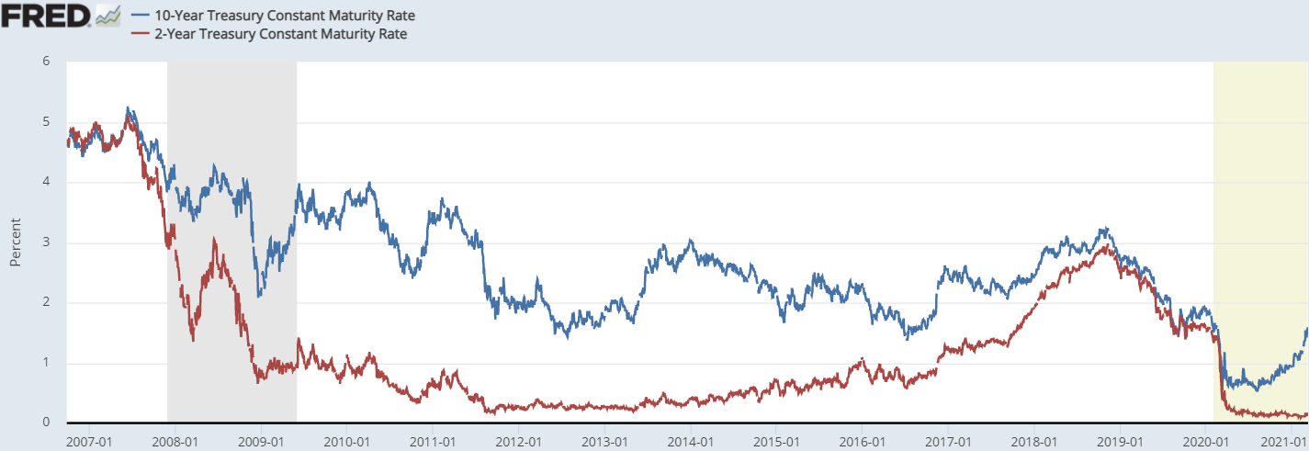
We are pawns in a Eurodollar world
August 9th, 2007 happened – repo market disruption
2007Q3 – 2009Q1 – Liquidity dries up in the repo market, the GFC brings the global economy to its knees
2009Q1 – 2009Q2 – Short reflationary period based on inflation expectations from QE1 (false signal)
2009Q2 – 2010Q4 – Global economy stumbles rather than the expected recovery. Eurozone crisis begins
2010Q4 – Short reflationary period based on inflation expectations from QE2 (false signal)
2010Q4 – 2013Q1 – Eurozone crisis intensifies, US and global economies stumble again
2013Q2 – 2013Q4 – Short reflationary period (“taper tantrum”) due to QE3 and QE4 (false signal)
2014Q1 – 2016Q2 – Emerging Market crisis, US and global economies are near recession
2016Q3 – 2018Q3 – Strongest reflationary period, potential signs of actual recovery from the GFC (“inflation hysteria”)
2018Q3 – present – Yield curve inverts, GFC 2.0 and pandemic. Now “taper tantrum” and “Inflation hysteria” again
Notes:
Red areas at the top are Eurodollar liquidity cycles, red means liquidity is tight, blue means reflation (false inflation) and green means possibly real recovery-like conditions.
On the bottom in dark blue is the periods of QE. You can see the false inflationary response each time QE is announced, until QE3, which then it is the tapering that makes the market think that recovery is finally coming, but then it doesn’t.
Then in 2017, the world central banks publicized a coordinated narrative of global growth. This was to be an inflationary launch, creating an inflation hysteria, and the markets responded with expectations of recovery, strength, and inflation, but it didn’t last long. It ended before it made it half way to recovery.

Slide 26
Why does any of this matter today?
August 9th, 2007 happened – repo market disruption
2007Q3 – 2009Q1 – Liquidity dries up in the repo market, the GFC brings the global economy to its knees
2009Q1 – 2009Q2 – Short reflationary period (“inflation” narrative) from QE1 (false signal)
2009Q2 – 2010Q4 – Global economy stumbles rather than the expected recovery. Eurozone crisis begins
2010Q4 – Short reflationary period (“inflation” narrative) from QE2 (false signal)
2010Q4 – 2013Q1 – Eurozone crisis intensifies, US and global economies stumble again
2013Q2 – 2013Q4 – Short reflationary period (“taper tantrum” narrative) due to QE3 and QE4 (false signal)
2014Q1 – 2016Q2 – Emerging Market crisis, US and global economies are near recession
2016Q3 – 2018Q3 – Strongest reflationary period, potential signs of actual recovery from the GFC (“inflation hysteria”)
May 29th, 2018 happened – repo market disruption
2018Q3 – present – Yield curve inverts, GFC 2.0 and pandemic. Now QE false reflation, “taper tantrum”, “Inflation hysteria”
GFC 1.0
Eurozone crisis
EM crisis
Yield curve inversion
Yield curve inversion
GFC 2.0
8/9/2007
Tapering announced
Globally synchronized growth
5/29/2018
Notes:
Liquidity periods at the top (including European debt crisis), QE at the bottom
1st arrow – thought QE would produce inflation/recovery, but it didn’t
2nd arrow – still thought QE would produce inflation/recovery, just needed more of it
3rd arrow – QE3 didn’t fool investors, then when Bernanke announced tapering of QE, investors now took less QE as a sign of recovery, it too ended up being a false signal, and the emerging markets plunged into recession, and the US and Europe were near recession.
4th arrow – finally after over 8 years since the GFC, economic data was showing signs of improvement all over the world. The world Central Banks, including the Fed, went out with a “globally coordinated growth” narrative, insisting we had finally healed from the GFC and now the growth and inflation would come. This created inflation hysteria. It altered expectations and people began taking more risk.
Within a year, by early 2018, danger signs began to emerge, the yield curve was flattening. The globally synchronized growth narrative was already in threat of getting stopped in its tracks and then…5/29/2018 happened.

Slide 27
How have I not heard about this?
You have heard about it. What is LIBOR?
…they fill in the gaps with false narratives, rather than adjust their model.
“The broadest facts of experience run in precisely the opposite direction from that which the financial community and academic economists have all generally taken for granted” Milton Friedman (1967)
We can easily identify the false narratives by focusing on these specific elements directly related to the problem:
  liquidity trap
  interest rates
  money printing (quantitative easing)
  economic recovery
Notes:
A question I often get is, “how have I not heard about this?” Something this big can’t possibly be invisible, this would be in the media.
Remember, this is an unregulated market, it operates in the shadows all across the globe; and,
You have heard about it. You have heard of LIBOR (London Inter-bank overnight rate). Have you wondered why is the US dollar is being followed in the London market? LIBOR is a metric from the Eurodollar market.
On a broad level, you have not heard about this because the monetary authorities have obfuscated their duties and rather than think critically about the problem, these smart economists instead come up with false narratives to explain that which is not making sense to a population that doesn’t know any better to question their narrative.
And just because you are probably still skeptical, let’s go through some of these false narratives that dominate the financial media’s storyline.

Slide 28
Liquidity trap
“A contradictory economic situation in which interest rates are very low and savings rates are high, rendering monetary policy ineffective”
This implies monetary policy was effective before interest rates got low, hence, monetary policy must have been what took them to that low point (to stimulate borrowing), but then when they got there, savings rates were high (it didn’t stimulate, implying monetary policy was already ineffective), so now the Fed is suddenly unable to move rates back up (an admission they had no control all along) nor move them down beyond the imaginary zero lower bound (to do more ineffective stimulating?).
John Maynard Keynes, the father of Keynesian economics, upon which our current economic platform is built, provides his own commentary about liquidity traps, saying, “during a liquidity trap, consumers choose to avoid bonds due to a prevailing belief that rates could soon rise, at the same time, central bank efforts to spur economic activity are hampered as they are unable to lower interest rates further to incentivize investors and consumers…”
If the market interest rate remains low, it means demand for these instruments remains high. That is basic economics.
low interest rates incentivize investors? The interest rate is a metric that reflects investors’ behavior, not the other way around.
Notes:
This is not a current narrative, but it represents the backwards nature of what is the current narrative.
Interest rates are determined by bond market forces, not by monetary policy. As demand for a bond goes up, the price goes up, and the inversely-related interest rate goes down. Everyone knows this. Thus low rates are an output, not a Federal Reserve input.

Slide 29
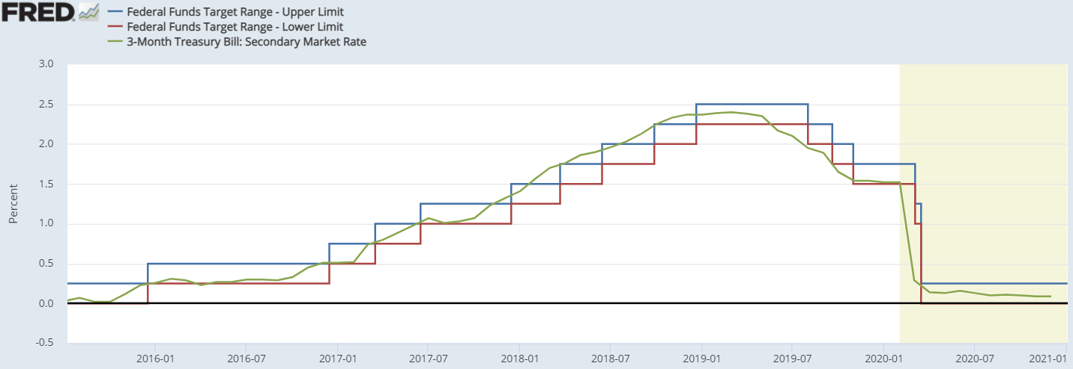
Interest rate fallacy
  Does the Federal Reserve really control interest rates? Who wags whom, the market or the Fed?
Notes:
I don’t have time to get into this, but it speaks for itself. The bond market always moves first, then the Fed follows. And we think they control these rates?
The Fed controls the Fed funds rate, and its actually a range. And even then, they get pulled around by market forces.
A similar idea would be for the Fed to increase home values so that people are more willing to take out home equity loans (stimulate borrowing). The problem is, how do they will home prices higher, especially under adverse economic conditions that created the need for this strategy in the first place? But in the case of security prices, asset prices are going up (asset bubble), and the Fed could take credit for it, lead people to believe they are creating this demand with their policies and infinite wisdom; but then even if we get that far, which we have with the bond interest rate fallacy, then how do you convince people to take out home equity loans? And it isn’t even ultimately the borrower’s choice, what I really mean is how do you convince the banks to approve those people for home equity loans?
The Fed’s strategy is to take less risky assets off their books (asset swaps, QE, LSAP, whatever you want to call it) and free up their capital for engaging in more risky behavior, like home equity loans. Does it make sense that this strategy would work to revive a housing market and push prices up even further? But that is the concept. A debt-based system has to continue growing, or it collapses on itself. And so regulatory authorities try to fabricate the growth, believing it can forever stave off the collapse, but I’m suggesting they are wrong. It doesn’t work that way. This strategy will have a disastrous end.

Slide 30
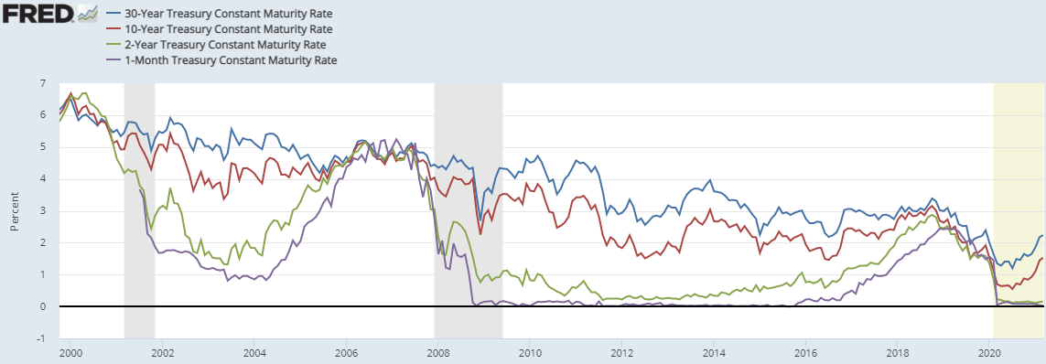
Interest rate fallacy
  Low interest rates are accommodative/stimulative?
    "Low interest rates are generally a sign that money has been tight, as in Japan; high interest rates, that money has been easy…After the U.S. experience during the Great Depression, and after inflation and rising interest rates in the 1970s and disinflation and falling interest rates in the 1980s, I thought the fallacy of identifying tight money with high interest rates and easy money with low interest rates was dead. Apparently, old fallacies never die“. Milton Friedman (1997)
Notes:
Low interest rates are an indication of illiquidity, or tight monetary conditions, in the global markets, not the other way around.
We’ve had only two short periods since 2000 that looked like possible economic recovery, and what were the rates doing during those times, compared to what the rates are doing during the other times, particularly during recessions? Interest rates are an output quantifying investor behavior, thus, this is a flight to safe assets/higher demand for safe assets/higher demand for controlling when you will need access to your dollars.
Treasuries are just dollar denominated notes, which is what the fiat dollar is now also. The dollar is basically a 0%, infinite term/zero duration treasury. The 1-month t-bill is close to 0%, 4-week term/and a 0 to 4-week duration treasury, a very similar asset. A treasury is basically just saving dollars in the context of when you think you are going to need those dollars, which helps you understand why a yield curve inverts ahead of a recession. Treasuries are a liquidity play. Think of them that way and it also makes better sense why the most liquid of them (on the run – element of duration) are the pristine collateral in the repo market.
low interest rates (= high demand for safe assets) is a signal of poor economic conditions, not a sign of credit expansion euphoria from “stimulation”. Milton Friedman commented further on this fallacy in 1990 saying, "Low interest rates are generally a sign that money has been tight, as in Japan; high interest rates, that money has been easy…After the U.S. experience during the Great Depression, and after inflation and rising interest rates in the 1970s and disinflation and falling interest rates in the 1980s, I thought the fallacy of identifying tight money with high interest rates and easy money with low interest rates was dead. Apparently, old fallacies never die“.
Yet, here we are, still 30 years after Friedman made this statement and our mainstream narrative still believes the Fed controls interest rates and that they lower interest rates to stimulate the economy. This is clearly backwards, yet how prevalent is this belief?

Slide 31
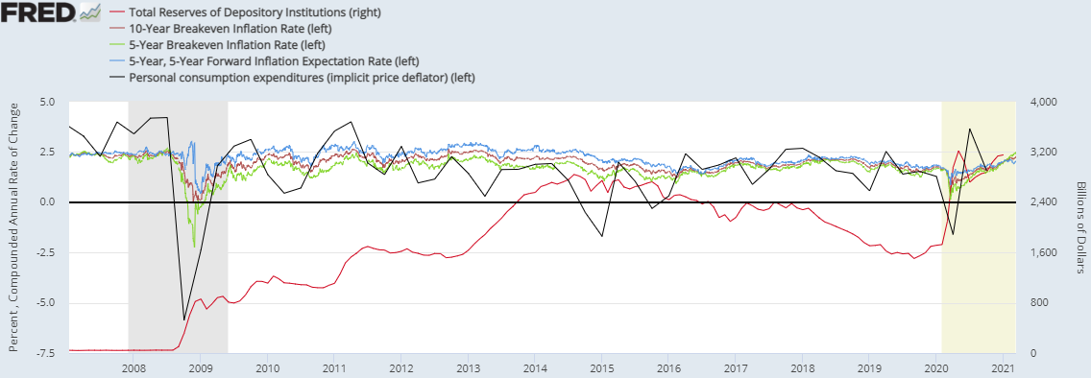
QE – the Money printing fallacy
  QE is designed to push interest rates lower (interest rate fallacy) - 2011 paper posted on the Federal Reserve’s website: (https://files.stlouisfed.org/files/htdocs/pageone-economics/uploads/newsletter/2011/201104.pdf)
  If only we had a large, liquid market based entirely on inflation expectations, we could see if QE is inflationary!
  TIPS Market data, with the PCE deflator and Bank Reserves (QE):
Repo rumble, backwardation, crash
Repo rumble, crash, backwardation, ?
Notes:
What do you hear in the media about what the Fed is doing? If money printing would cause massive inflation, but what they are doing is not generating any inflation, then what they are doing can’t be money printing. It is basic logic. What is QE? What are bank reserves? Are bank reserves money? Do these asset swaps encourage riskier behavior?
Just like the federal funds rate, QE is focused on influencing bank behavior. That is what all these policies are all about, because they all know bank lending is what controls the money supply, but do these policies work to influence bank behavior in the way they want them to behave?

Slide 32
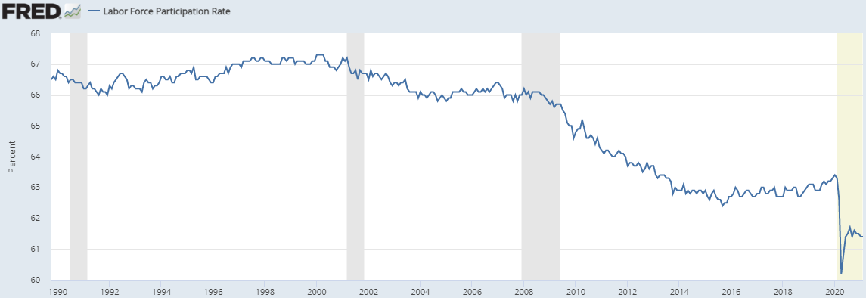
Recovery fallacy
Sept. 2008 - GFC 1.0
Mar. 2020 - GFC 2.0
These Eurodollar liquidity events are permanently damaging the most important part of our economy
Is QE actually destructive to the labor force? Let’s keep doing more QE, that should do the trick!
Notes:
And lastly, the recovery fallacy. These Eurodollar events, and particularly the subsequent QE response of the Fed, are permanently damaging the labor force.

Slide 33
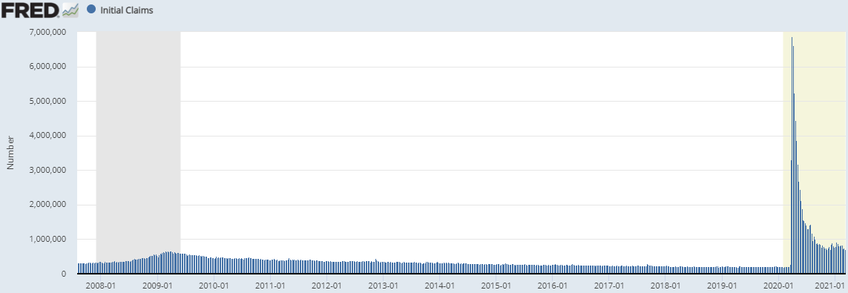
Recovery fallacy
Sept. 2008 - GFC 1.0
Previous record 665,000
Mar. 2020 - GFC 2.0
Lowest week 712,000
The US has now reached 52 weeks in a row of higher initial jobless claims than the single worst week of the 2008 GFC, which at the time was an all time record. And in the face of the CARES Act to maintain businesses and jobs. The working class is being destroyed, but hey, at least the stock market is creating a lot of capital gains for shareholders!
Notes:
Does QE help the labor force?

Slide 34
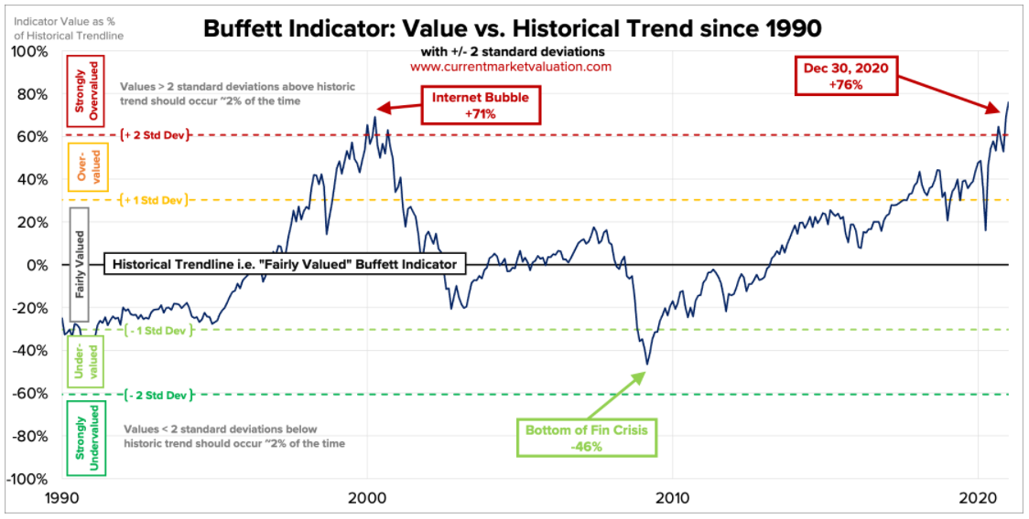
Recovery fallacy
http://www.currentmarketvaluation.com/models/buffett-indicator.php
Notes:
Is the market behavior a result of value-generating (credit extended for the purpose of business activity) or is it creating asset bubbles (credit extended for the purpose of leveraged asset-speculation)?
Note that the trend didn’t get out of the 1 StdDev range at the time of the GFC. The GFC was a liquidity event. It was different than what we traditionally think of crashes being due to asset bubbles from speculation. The Eurodollar situation created the huge tech-bubble, but when it popped, the system didn’t break down, but 2007 represents a moment where the system broke down. This liquidity issue has now taken over the markets, in fact, it has even overwhelmed asset bubbles. This isn’t necessarily a traditional asset bubble as much as it is a liquidity distortion. In moments of relative higher global dollar liquidity, there is more buy pressure on US dollar denominated, liquid assets. And when the return on lower-risk assets gets too low, speculators are more willing to use risk assets as “safe assets” as assets with properties of dollar liquidity. Liquidity is all that really matters. This is evidenced by the quick reflation of the market back up to all-time highs within just a few months after the March crash. That is unprecedented, and it is because it was strictly due to a liquidity bottleneck. However, it damaged the economy severely and now we have a high risk of a crash due to both solvency risk and liquidity risk. The cohort of possible triggers is much larger now.

Slide 35
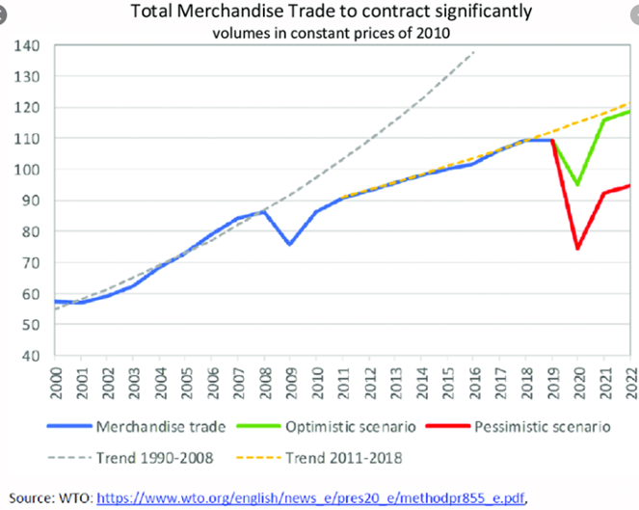
Recovery fallacy
5/29/2018
8/9/2007

Slide 36
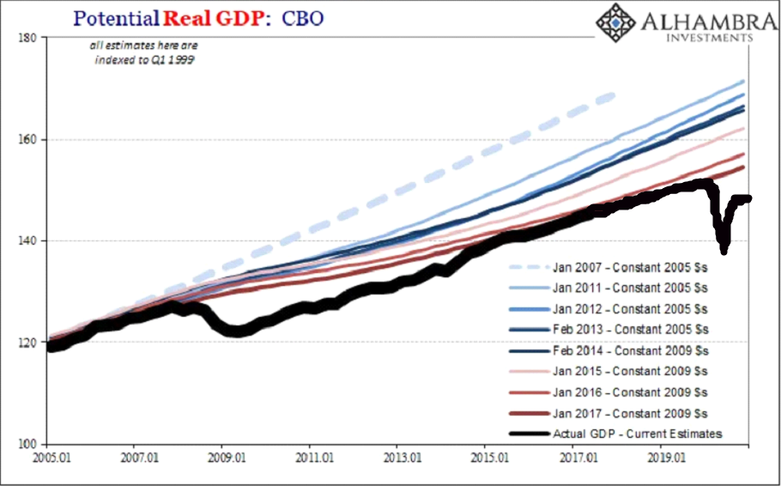
Recovery fallacy
Eurodollar liquidity events
Notes:
Credit to my friend Jeff Snider at Alhambra Investments for this chart.
The Congressional Budget Office keeps moving the goalposts.
Real GDP impacted by the to-date 4 Eurodollar cycles. The economic gap/lost potential keeps getting wider. This is not a recovery.
And how can we think this will change if we don’t do anything different? We are doing the same things, interest rate policy, which is ineffective, and QE, which has the opposite effect than we think. This is the definition of insanity. How long do we keep moving the goalposts until things get bad enough that we finally decide to fix the system. We are not even at a point of recognition of the problem, let along discussing diplomatic solutions.

Slide 37
What does this mean to the P&C insurance industry?
Investment Portfolio Risk – US dollar liquidity risks. US dollar denominated portfolio
Personnel Risk – increasingly fewer experienced professionals who lived through the changes
Economic Risk – more fraud potential, more affordability issues, broken business cycle
Regulatory Risk – potential for more availability issues resulting in more government intervention into the insurance markets
Rating Agency Risk – downgrades of company
Counter-party Risk – reinsurance companies get downgraded or experience capital pressures
Reputation Risk – reputation damage to the insurance industry (perceived price gouging)
Notes:
So to summarize what this all means.
The Federal Reserve lost control of the money system a long time ago, but they are clinging on to this narrative that they have great relevancy. Liquidity in this global money market changed permanently in 2007 in a way that the intermediaries are never going to go back to. This has created a situation of seemingly permanent deflationary conditions or permanent depression, where the entire world is stuck in a liquidity trap. And because it is our currency, this liquidity situation has taken over all US markets. The equities market used to be defined by periods of either growth or value, but stocks now move based on neither value nor growth characteristics, but rather global US dollar liquidity conditions. This explains why we are at an unprecedented point in history where we are in one of the worst economic situations in US history, yet both the bond and equity markets are at all-time historical highs. The economy and the markets both naturally and historically generally run in tandem, but now, for the first time in history, they clearly don’t. Yet the mainstream narrative, rather than identifying that something has changed, creates false narratives to realign in their minds the economics with the markets, telling us there will be inflation and recovery, but since 2007, it never comes.
Think about the Federal Reserve’s Aug 2020 public conference, where the Fed reported on the conclusions of their two year deep dive into understanding why they haven’t seen the inflation and recovery they expected after 10 years since the GFC, while simultaneously insisting the economy has recovered; what they concluded was that because their policies hadn’t resulted in them achieving their 2% inflation target for 38 of 40 quarters since the GFC, they were going to let inflation run over their 2% target to make up for the lack of inflation these same policies weren’t able to generate. And everyone bought it and started trading the inflation trade. Since August, and since all the QE and fiscal stimulus, inflation has remained well below the 2% target. At some point we have to realize that if we want inflation, we need to do something different. Japan has been doing this same thing for 30 years now with no results, but they keep doing it, they are on QE 24. The ECB is doing massive QE, and no inflation in the Eurozone either. The idea that inflation is coming meets the definition of insanity.
And we are currently living in the 4th clear, downward trending cycle of this Eurodollar world, where you hear of imminent inflation and recovery, and you forget that was the same rhetoric we heard from the Federal Reserve and the media in 2010, in 2013, 2017, and now again today. And the general population is still buying it!

Slide 38
Incorporating Monetary system risk into the RM structure
  1. Integrate monetary system risks into an Economic Scenario Generator (ESG).
  2. Include monetary system risk in your company’s risk profile so it does not get overlooked in your risk committee discussions.
  This will require critical thinking!

Slide 39
Example: corporate bond market risk
1999 Gramm-Leach-Bliley Act – deregulation of the financial industry – rescinded Glass-Steagall (1933) – this allowed for share buybacks to begin again, as it had been illegal since 1933. We’ve had asset bubble cycles ever since
2019 – “share buybacks” are the only segment with net buy-side pressure on the markets
  https://www.cnbc.com/2019/10/29/goldman-says-there-are-three-big-stock-buyers-that-will-keep-the-record-rally-going.html
  https://www.investopedia.com/5-reasons-goldman-says-banning-buybacks-is-bad-for-stocks-4684101 These represent clear departures from fundamental economics. What does that tell you about a market if it would collapse by removing a previously illegal practice that creates no economic value?
  Share buybacks are done by raising cash via issuing corporate bonds. Corporate bond market was about $7T at end of 2018, $8T for 2019, and $10.5T by end of 2020. Approx. $1T is “high-yield” rated (junk) while the remaining is “investment-grade”
  What happens when a recession hits and share buybacks stop happening?
  https://www.cnbc.com/2020/03/15/jpmorgan-bank-of-america-citigroup-suspend-stock-buybacks-due-to-pandemic.html
In a recession, cash flows go negative, earnings go negative, increasing leverage ratios and threatening downgrade. Pension funds and Insurance companies don’t hold junk bonds, but they hold a lot of BBBs. How much of the corporate bond market is BBB (one downgrade from junk)? About $5T, or about half the market
Underfunded pension funds are heavily exposed to corporate bonds due to their ~7% return mandate, but their charters also prevent them from holding junk bonds. Insurance companies similarly don’t hold junk bonds. Once downgrades start happening, and both pension funds and insurance companies are forced to sell trillions of corporates, who is going to buy these trillions of bonds? This can easily snowball into a collapse of the entire market.
Tax receipts driven by the business cycle. In a recession, tax receipts decrease. Tax receipts drive pension funding, thus these funds become even more underfunded and require an even higher return to meet the benefit demands, but those kind of fixed-income returns will not be available anywhere, and retiree benefits will have to be restructured
The Baby Boomer generation is almost entirely retired by now, and represents about 26% of the US population, many of which are living on their pension benefits. What will happen to their spending habits once their benefits have been restructured?

Slide 40
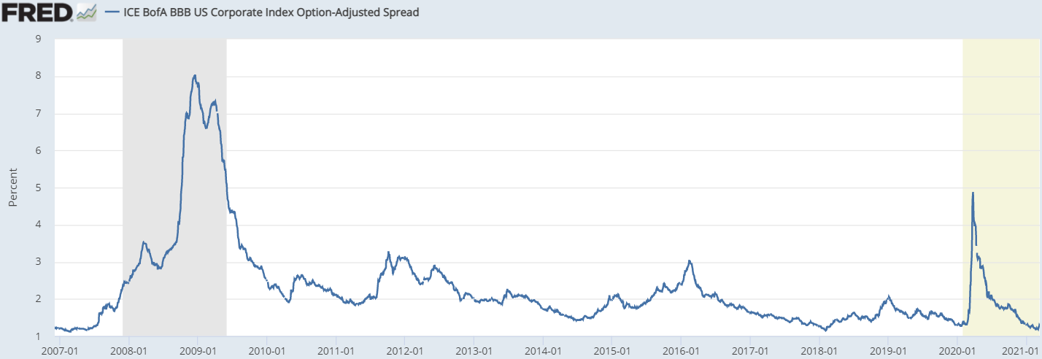
Example: corporate bond market risk
Major Euro$ Liquidity Event 1
Major Euro$ Liquidity Event 4
Major Euro$ Liquidity Event 2
Major Euro$ Liquidity Event 3
Notes:
At perhaps the worst economic position in history, the Corporate bond market is at its highest. Similar to the equities markets.
Once the next liquidity event (dollar strengthens, treasuries yields drop into negative territory) pinches the global economy, spreads will shoot back up, given current economic conditions, that we are already having squeezed margins, negative earnings, zombie companies, etc, how many will be unable to make their debt payments, how much will 10.5T of debt drag on the recovery, when will the downgrades begin, and what happens when the repo market decides this kind of collateral is unacceptable (questionable value and liquidity properties)?
This will be an attractive source of investment income for insurance companies and pension funds, but when and if this reverses, nobody will have time to get out, and any bondholders run the risk of having to realize massive asset impairment, to a degree that many may not realize, or have not quantified, how much they are exposed, nor how severe this risk could be. That is when those other risks I mentioned will arise, personnel, regulatory, rating agency risk, etc.

Slide 41
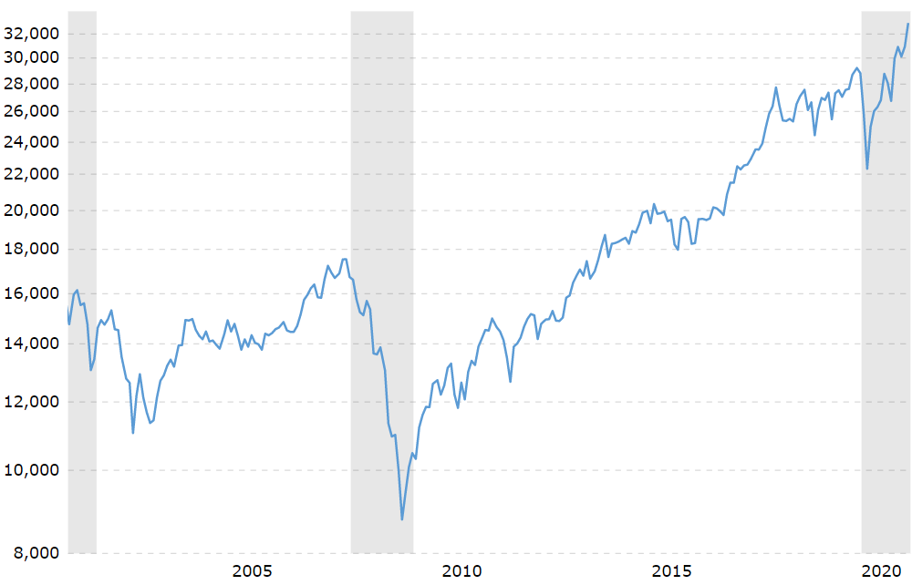
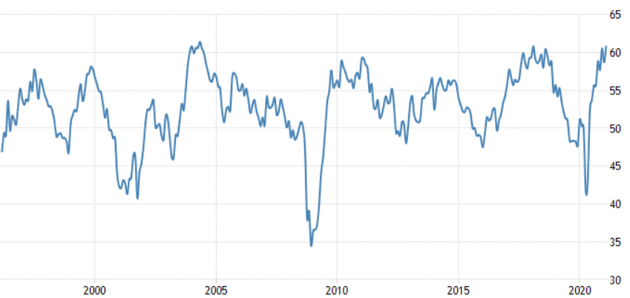
How recognizable are these Eurodollar events?
Dow Jones Industrial Average
Major Euro$ Liquidity Event 4
This is not economic value added, but rather US dollar liquidity taking over the markets, and the interest rate, inflation, and recovery fallacies bought into
Major Euro$ Liquidity Event 3
Major Euro$ Liquidity Event 1
Major Euro$ Liquidity Event 2
ISM Manufacturing PMI
Notes:
Can this keep going up? Sure, it is already separated from reality, or from principles of economic value added, so I don’t believe there is any mathematical constraint or precedent for how high it can go, but the narrative will become progressively more violent until it finally breaks, and things seem to be accelerating toward that disastrous end. How involved is the Federal Reserve now? How much “relief” are we getting from the treasury at the same time? Did governments and central banks ever do this kind of stuff when times were good?

Slide 42
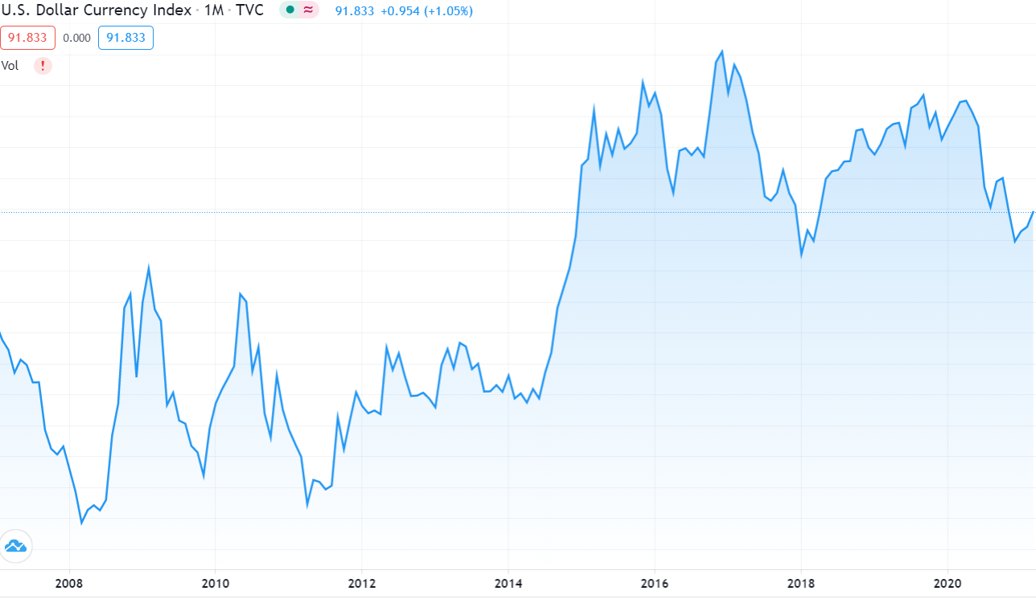
Example: Other asset classes
If you’ve understood this presentation, you will already anticipate what this means for the treasury market
The main problem – collateral shortage in the global Eurodollar system.
  Treasuries (particularly t-bills – short dated dollars) are the pristine (highly liquid, safe, and US dollar denominated) collateral in the system.
  The shortage of collateral also means a shortage of dollars (opposite the current narrative)
  Both will go through cycles of short squeezes of varying length and intensity, until the system is fixed
  DXY from 2007 to present →
  Is the dollar really crashing?
What about other asset classes like MBSs?
  most are “Agency” MBSs (gov’t backed = likely to maintain liquidity properties)
Notes:
Corporate bonds are at great risk
Treasuries must continue their 40 year bull market. Yields will likely be in the negatives before the end of the year, as they are used as collateral in the repo market and there is still a global shortage of good collateral.
Agency MBSs are also gov’t backed, so they should maintain their liquidity properties and not suffer major problems.

