Slide 1


Managing Legacy Risks in 2020
Midwestern Actuarial Forum October 1, 2020
Carolyn Fahey
AIRROC
Rita Zona, ACAS
Enstar Group
Brian Z. Brown, FCAS
Milliman, Inc.
Notes:
This is an example of the COVER WITH BLUE BACKGROUND layout.
To apply this template, from the HOME TAB click the LAYOUT BUTTON and choose COVER — BLUE BACKGROUND.
Editing text: Click in text boxes to edit text. To delete a text box, click the border of the box and delete.
Imagery: Imagery is inserted in the slide background. Imagery should be in widescreen format (16:9 aspect ratio) or cropped to fit. Please do not stretch imagery to fit the background.
Adding a background image. To insert a background image, go to Format > slide background. In the Format Background pane. Choose Picture or Texture Fill. Under Insert Picture, choose FILE if you know the desktop location of the image or CLIPBOARD if the image has been copied to the clipboard.

Slide 2

Audience Polling Question:
How do you define runoff?
Business where:
  Premiums are no longer being written.
  Any discontinued line of business
  1986 and prior
  Non-core to the group
  All of the above

Slide 3
Runoff Market – What is it?
Business that is non-core to the group
Business that is being wound down and no longer underwritten
Any discontinued line of business
Companies in runoff want to release trapped capital and achieve early finality
Carriers or business units closed to new business

Slide 4
Runoff Market Size
$791bn
Estimated Global non-life run-off liabilities
PwC Global Insurance Run-Off Survey, September 2019. www.pwc.com/globalinsurancerunoffsurvey
Developed in conjunction with AIRROC and IRLA

Slide 5
Audience Polling Question:
Is the run-off market growing?
Yes
No
Not Sure

Slide 6

Runoff Market in North America
North America runoff market is estimated to be $364 billion in liabilities for non-life insurance, according to the study performed by accounting firm PwC referenced previously.
Could be over $1 trillion if life insurance and long-term care are included.
Includes liabilities from:
Insurers
  Reinsurers
Captives
  Self-Insurers
  RRGs
Etc.

Slide 7



AIRROC’s Mission and Vision
AIRROC is a non-profit organization of insurance and reinsurance companies that have legacy business in their portfolio. AIRROC has been supporting the industry for 15 years.
AIRROC’s Vision is to be the most valued (re)insurance industry educator and network provider for issue resolution and creation of optimal exit strategies.
AIRROC’s Mission is to promote and represent the interests of entities with legacy business by improving industry standards and enhancing knowledge and communications within and outside of the (re)insurance industry.
Association of Insurance & Reinsurance Run-off Companies (AIRROC), www.airroc.org

Slide 8
AIRROC Member Companies
AIG, Allianz, Allstate, Aon, Argo Group, Arrowpoint Capital, Armour Risk, Artex, AXA Liabilities Managers, Brandywine Holdings/Chubb, Carrick Holdings, Catalina Re, CNA, Compre, Crawford, DARAG, Dominion Ins., Enstar, Federated Re, Fleming Re, Lockton Capital Markets, Munich Re, NY Liquidation Bureau, OK Dept. of Insurance, Orion, Premia Re, PRO, QBE, R&Q, Requiem, Resolute Management, Riverstone, ROM, Safety National, Sentry, Sirius, Swiss Re, The Hartford, The Home, TigerRisk, Travelers, Willis Towers Watson, Zurich

Slide 9
Audience Polling Question:
Are the typical run-off deals for large or small amounts?
Large
In the Middle
Small
Much Variation in Size
Not sure

Slide 10
Runoff Deals
Q2
2020
PwC Non-Life Insurance Runoff Deals, Q2 Update.
Notes:
Executed deals have remained relatively steady in Q2 2020 despite the potential challenges presented by completing deals during the COVID-19 pandemic, with 12 deals publicly announced, according to PwC.
With a number of smaller value deals, the overall total estimated liabilities transacting dropped from $2.1 billion in Q1 2020 to $1.3 billion in Q2 2020.
Additionally, six different consolidators have transacted during Q2 2020, bringing the total number of active market acquirers during the year to 10.
Apart from one transaction where the purchaser has not been disclosed, these were all established market participants.
PwC notes that, given the current market environment and opportunities in the sector, they expect to see some new entrants announce deals before the end of the year.
North America meanwhile has been the most active in terms of volume and value of deals, continuing recent trends, but PwC expect the UK, within Lloyd’s in particular, to see deal activity increase as the year progresses.
Whilst currently behind the figures for 2019 in terms of value, PwC says 2020 continues to be a strong transaction year and the volume of deals has outpaced the same period last year

Slide 11
Sample of Recent Deals – Growth Market
Seller / Entity |  | Buyer | Date | Deal Structure | Value
Zurich Insurance PLC |  | Catalina Holdings Ltd | 12/17/2018 | Loss Portfolio Transfer | $2 billion in gross liabilities
Maiden Holdings / Maiden Reinsurance North America, Inc. |  | Enstar Holdings LLC | 12/27/2018 | Acquisition of Novation and Retrocession Agreements | $272.4 million
Amerisure Mutual Insurance Company |  | Enstar Holdings LLC/ Allianz Risk Transfer Ltd | 2019 | 50% Quota Share Loss Portfolio Transfer | $48.4 million
AmTrust Syndicates Limited |  | Enstar Holdings LLC | 2/15/2019 | RITC Transactions | $830 million of reserves
Munich Re |  | Enstar Holdings LLC | 9/10/2019 | Loss Portfolio Transfer | $156.2 million
Zurich North America |  | Enstar Holdings LLC | 10/1/2019 | Loss Portfolio Transfer | $500 million
BorgWarner / BorgWarner Morse TEC, LLC |  | Enstar Holdings LLC | 10/30/2019 | Acquisition | $800 million in liabilities
Asia Capital Re |  | Catalina Holdings Ltd | 12/5/2019 | Acquisition | Asia Capital Re, which had US $835 million of shareholder equity, US $1.3 billion of gross liabilities including Unearned Premium Reserve, and total assets of US $2.1 billion
RenaissanceRe Holdings Ltd. / RenaissanceRe (UK) Limited |  | AXA Liabilities Managers | 2/4/2020 | Acquisition | $208 million in gross reserves
AXA / AXA XL |  | Enstar Holdings LLC | 2/27/2020 | Loss Portfolio Transfer Reinsurance Transaction | $225 million
Aspen Insurance Holdings Limited |  | Enstar Holdings LLC | 3/2/2020 | Reinsurance Cover - 770M xs 3.8B, 250M xs 4.8B | $770 million
Lyft | Enstar Holdings LLC |  | 3/31/2020 | Novation Agreement | $465 million

Slide 12
Audience Polling Question:
What business is the largest segment of the run-off sector?
  Accident and Health
  Asbestos Liability
  Construction Defect
  Environmental Liability
  Professional Liability

Slide 13
Predominant Lines of Business in the Runoff Market
Types of claims exposures | Mean
Asbestos | 41.6%
Workers’ Comp | 22.8%
Professional lines | 12.6%
Accident / health | 6.6%
Environmental | 4.0%
Product | 2.6%
Other latent | 1.9%
Construction defect | 1.5%
Other | 6.3%
From EY/AIRROC(re)insurance runoff survey: In Search of Finality

Slide 14
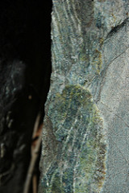
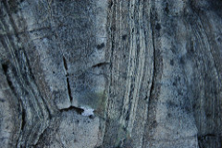
History and Background: Asbestos
Background Asbestos:
Asbestos was once considered a “miracle mineral” for its effectiveness as insulation and preventing the spread of fires
Late 19th Century: Production began to skyrocket with commercial mining operations
As early as 1906: Scientific evidence linking asbestos fibers to cancer and other diseases of the lungs
Early 20th Century: Asbestos production continued to rise, particularly accelerating during World War II
1970s: Regulatory agencies (OSHA, EPA) started calling for bans; global production would not peak until 1977
1973: Landmark legal decision in Borel v. Fibreboard. Injured workers could sue employers and asbestos manufacturers in a products liability framework rather than through the workers compensation system only
1980s: Mounting asbestos losses prompts manufacturer bankruptcies (notably, Johns-Manville in 1982)
1986: Standard ISO CGL policy form modified to exclude asbestos exposure
Today: Asbestos use has dramatically declined, but significant liability remains from pre-1986 policies. Asbestos now represents the single largest mass tort in US history
Current estimated ultimate loss to the insurance industry: $100 billion
Notes:
In 430 B.C. it was used in lamp wicks and denoted as Carpathian flax. Romans used it as a cremation garment to conserve the remains of persons of noble rank. Charlemagne used it for a table cloth that could be washed in fire.
In the 1860s it was first commercially used in the US as insulation. In 1931, a technique was developed for mixing it with cement. Then was used in brake linings that might overheat. Then widely used to cover pipes used to transmit heated air or fluids.
was used in the construction of the lower floors of the World Trade Towers, but its use was discontinued as the structures were erected to their great heights. Had the use of asbestos been continued as planned, the towers would have been slower to collapse. However, as a result, the rescuers would have inhaled more of the injurious fiber and had their lives shortened accordingly

Slide 15
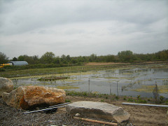
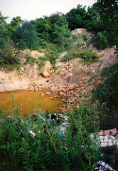
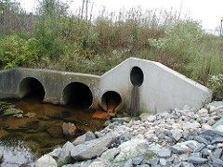
History and Background: Environmental
Background Environmental:
1980: Comprehensive Environmental Response, Compensation and Liability Act (CERCLA) signed into law, establishing the Superfund program
Goal is to clean up uncontrolled or abandoned hazardous waste sites involving releases of contaminants or other pollution
Superfund permitted the EPA to clean up toxic waste sites and hold responsible parties accountable for the costs
Superfund liability is retroactive, joint & several, and strict; any one party may be held accountable for the entire cleanup of the site if deemed responsible for any portion of the hazardous waste at the site
Defendants typically seek coverage via their CGL policies in place at the time
ISO’s CGL policy language evolved over time; early language intended to exclude pollution was deemed too broad in court, resulting in massive exposure to pollution liability
Current estimated ultimate loss to the insurance industry: $46 billion

Slide 16
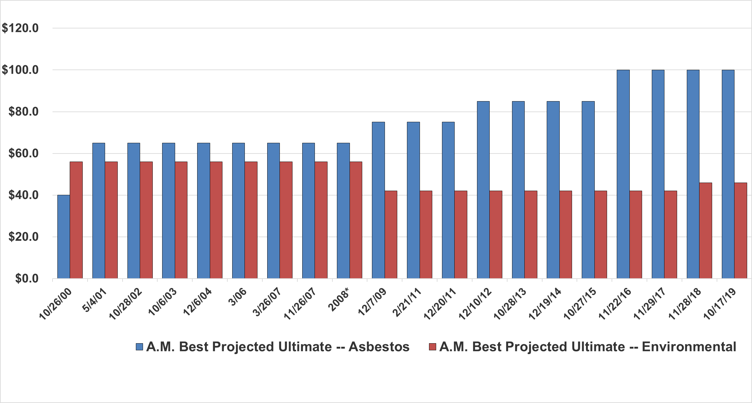
History of AM Best Ultimates
($ billions)
Source AM Best data and research.
* Estimated, no A.M. Best report available.

Slide 17
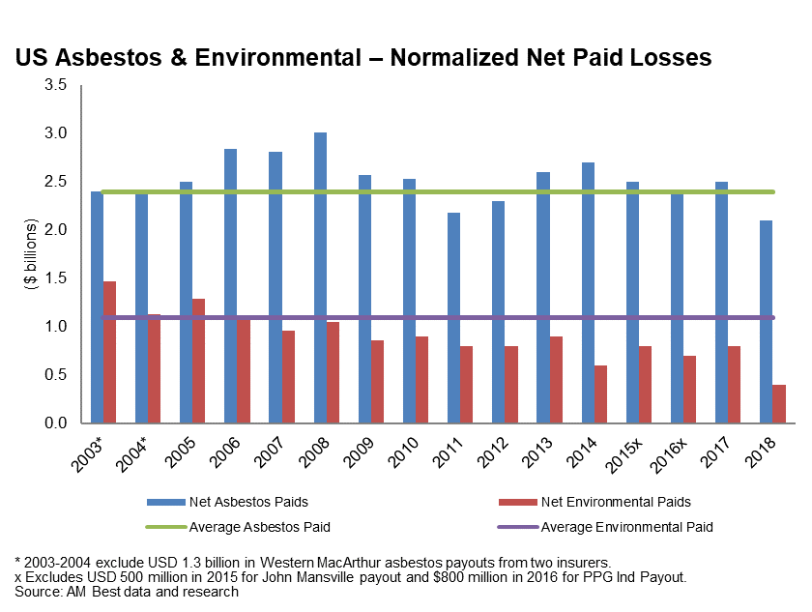
Industry Paid Losses (A&E)

Slide 18
  Audience Polling Question:
  Are standard actuarial methods used to measure typical run-off exposures?
  Yes
  No
  Not sure

Slide 19
Challenges Inherent with A&E Reserving
Traditional actuarial methodologies break down when applied to A&E exposures:
Cannot organize data into a loss development triangle
Difficulty regarding the loss itself:
  Lack of a clearly defined accident date
  Reliance upon calendar year paid methods
  Inconsistent definitions of case reserves
  Lack of cumulative data
  Long latency periods between exposure and diagnosis of disease for Asbestos
Difficulty determining who pays for losses:
  Which policies are triggered?
  How does loss get allocated between policies?
  How are coverage gaps or overlapping coverages handled?
  What happens when coverage detail is missing or vague?
Nature of A&E claims produce further challenges:
  Bankruptcies among initial defendants leading to suits against other defendants
  Insurer insolvencies leading to liability spreading to remaining solvent companies
  Vague policy language leading to substantial legal fees that frequently exceed indemnity payments
  Class action lawsuits leading to thousands of inactive claims, many of which get dismissed, but still incur legal costs
  Alternative explanations for alleged damages (e.g., smoking)
  Claims naming dozens of companies as defendants
  Venue shopping for plaintiff-friendly courts
Unique challenges in the A&E environment motivate alternative approaches which require the actuary to work closely with claims to gather information needed for reserving.

Slide 20
What methods are best to estimate run-off exposures?

Slide 21



Actuarial Methodologies to Determine Asbestos Reserves
Ground-up defendant approach
  Individual insureds
  Frequency/Severity approach by disease type
    Future claim filings
    Average settlement rates (trended)
    Expense to settlement ratios
    Dismissal rates
  Allocate to calendar years
  Apply coverage chart
Requires extrapolation
  Defendant data not sufficient
Requires IBNR loads
Aggregate approach
    Utilize industry benchmarks
        Survival Ratio
        Market Share
        Development based on AM Best
  Requires historical aggregate company and industry data
      Footnote 33
      Exclude large payments
      Account for commutations

Slide 22
Ground Up Process for Individual Defendant
Claim
Parameters
Ground-Up
Losses
Insurance
Allocation
Losses paid to date
Case reserves
Frequencies / severities
Expense ratios
Dismissal rates
Exposure characteristics
Decay curves
Projected losses for pending claims
Projected losses for IBNR claims
Result: Expected streams of future payments on an undiscounted basis
Allocation of ground-up loss to each available policy in line with coverage parameters and applicable allocation framework
Determination of losses retained by defendant (not covered by insurance)
Expected timing of payments
Ultimate goal: Derive company’s reserves based on exposures
Coverage Parameters
Insurance policy details (insurer, solvency status, policy dates, participation percentages, policy limits, etc.)
Allocation framework (all sums, pro rata, etc.)

Slide 23
Aggregate Process
Company Information
Industry Information
Benchmarking of Industry
Calendar year paid losses
Calendar year incurred losses
Company reserves
Split between Asbestos and Environmental
Not including current exposures
AM Best
SNL
Adjust for LPTs
Survival Ratio: select Industry-wide ratio and apply to company average
Market Share: determine historic ratio of paids or incurreds or reserves to industry, apply to future industry values
Completion methods: Determine factors to bring Industry to ultimate and apply to company inception to date
Ultimate goal: Derive company’s share of the industry reserves
Claims and Operations
Reserving strategy (stair stepping)
Treatment of expenses reserves
Settlement strategies
Historical perspective

Slide 24
Environmental Loss Reserving
Environmental losses are often grouped with asbestos losses for financial reporting purposes.
The two exposure types have key differences requiring different approaches:
Similarities to Asbestos
Complex allocation issues and insolvent insurers resulting in high legal fees
Bankrupt entities caused damage
Overly broad policy language resulting in coverage where coverage was never intended nor priced into rates
Differences with Asbestos
Environmental loss reserving often requires specialized environmental expertise
Asbestos claims have a much longer latency period: A polluted site is immediately apparent, while an asbestos worker may go 40 years before developing mesothelioma
Actuarial Methodologies to Determine Environmental Reserves
Ground-up Approach:
Employ Environmental Expert to evaluate clean up costs for specific sites and allocate costs among responsible parties
Use of decision tree methodology to determine expected or likely outcomes of things such as:
  Number of occurrences
  Insolvent policies include or excluded
  Different damage scenarios
  Success of coverage defenses
Aggregate Approach:
Similar methodology as for Asbestos

Slide 25
Audience Polling Question:
Allocating legacy clams to policy year is:
Simple and straightforward;
Somewhat complicated;
Extremely complicated.

Slide 26
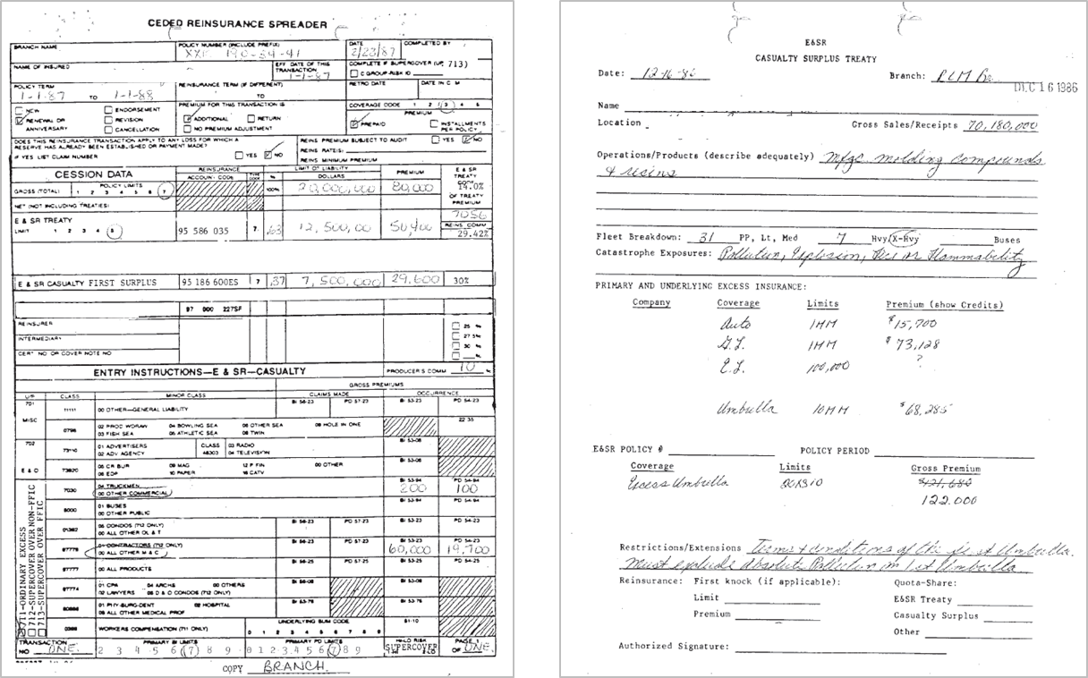
Insurance Allocation: A Difficult Task
The situation gets more complex given the age of relevant policies. Often, grainy photocopies of decades-old documents are all that remain. These complications produce considerable legal expense.

Slide 27
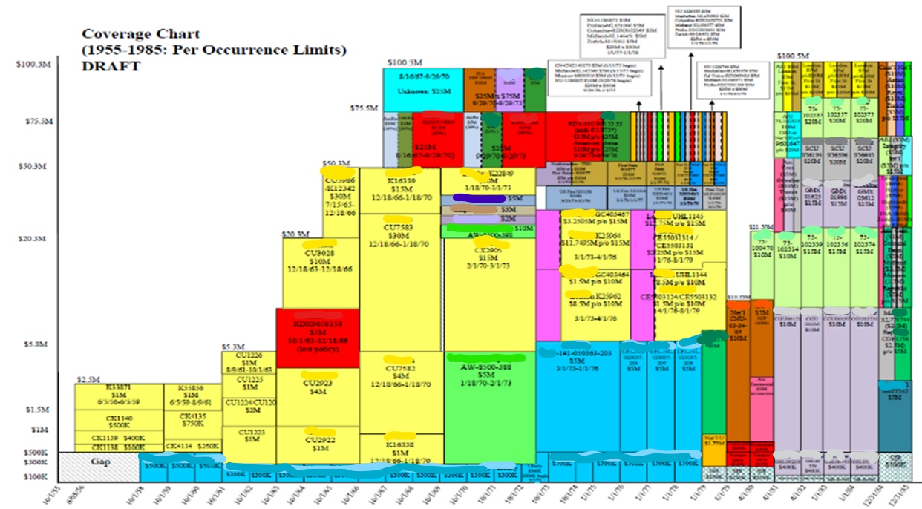
Insurance Allocation: A Difficult Task
Insurance coverage detail can get incredibly complex with multiple parties, missing documentation, insolvent insurers, disputed coverages, and other complications. Insurers’ exposure often arises via small portions in various layers of loss across dozens of different accounts.

Slide 28
For multiple years of exposure, how are claim costs allocated to year?

Slide 29
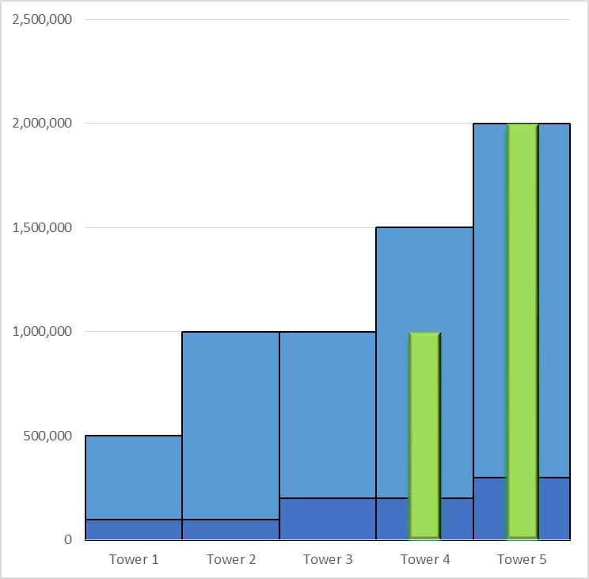
Insurance Allocation Simplified – All Sums
All Sums Allocation Example
Total Claims $3,000,000
Total Limits $6,000,000
Tower Limits Tower Costs
Tower 1 $500,000 $
Tower 2 $1,000,000 $
Tower 3 $1,000,000 $
Tower 4 $1,500,000 $1,000,000
Tower 5 $2,000,000 $2,000,000
All Sums Allocation is the simplest allocation type to conceptualize and calculate.
The insured targets specific year(s) of
coverage and damages “spike” up
through tower(s).

Slide 30
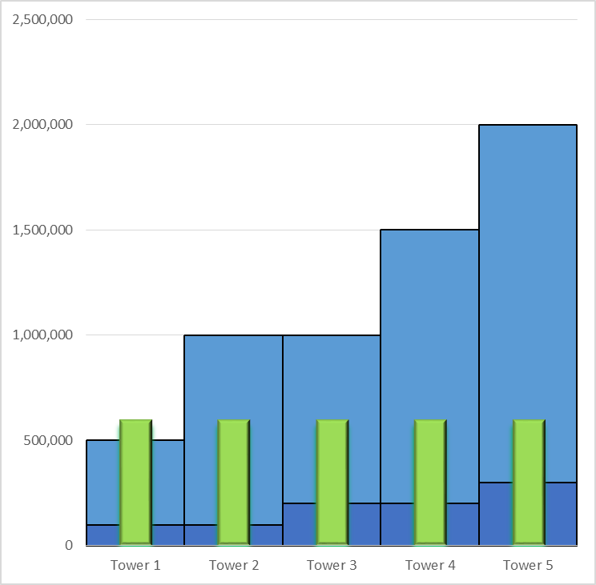
Insurance Allocation Simplified – Pro Rata
Pro-Rata Allocation Example
Total Claims $3,000,000
Total Limits $6,000,000
Years Damages/ Tower Year Damages
Tower 1 1 $3M/5 = $600,000
Tower 2 1 $3M/5 = $600,000
Tower 3 1 $3M/5 = $600,000
Tower 4 1 $3M/5 = $600,000
Tower 5 1 $3M/5 = $600,000
Pro Rata Allocation is where the allocation is based on damages divided by years of coverage and then allocated up through each tower.
Allocating can be fairly simple. Only need to know damages, trigger period, and the policy limits/attachments. The entire coverage chart is not needed.

Slide 31
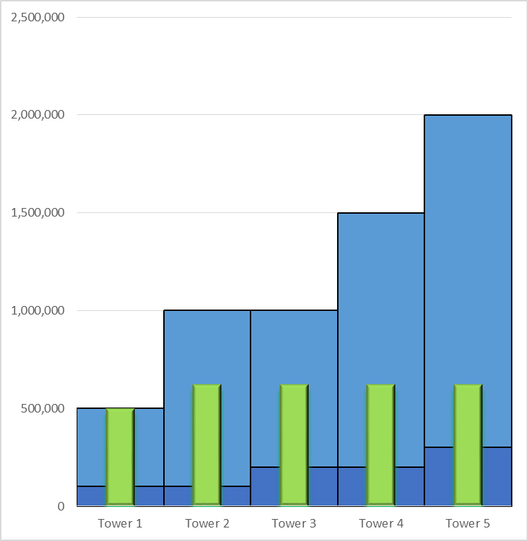
Insurance Allocation Simplified – Bathtub
Horizontal Allocation Example
Total Claims $3,000,000
Total Limits $6,000,000
Primary Lims Ex < $500K Addl Tower Total Tower
Tower 1 $100,000 $400,000 $ $500,000
Tower 2 $100,000 $400,000 $125,000 $625,000
Tower 3 $200,000 $300,000 $125,000 $625,000
Tower 4 $200,000 $300,000 $125,000 $625,000
Tower 5 $300,000 $200,000 $125,000 $625,000
Horizontal allocation is over the entire trigger
Period.
Typically, primary limits are exhausted before umbrella/excess limits are impacted. Damages are allocated up through the coverage in a straight horizontal line.
Like filling a bathtub

Slide 32
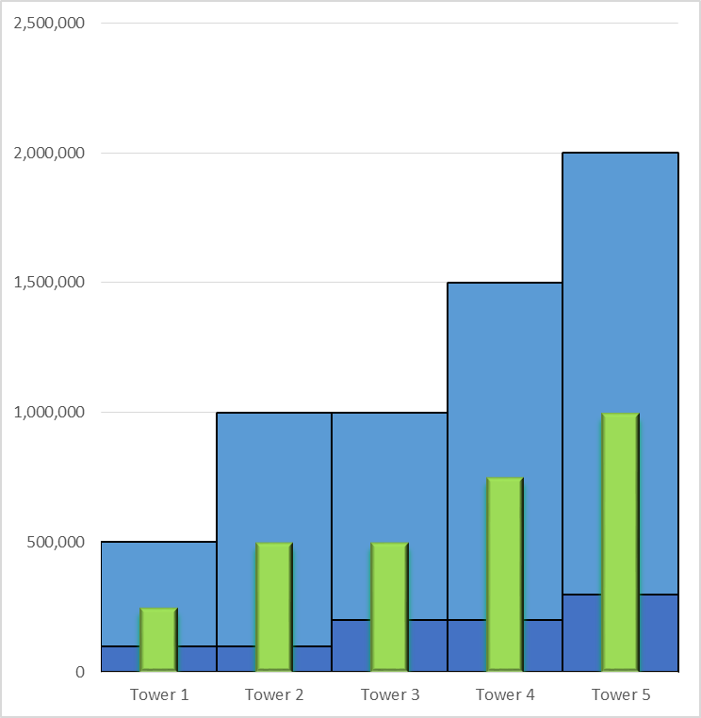
Insurance Allocation Simplified – Carter-Wallace
Carter-Wallace Allocation Example
Total Claims $3,000,000
Total Limits $6,000,000
Tower Lims/ Tower
Total Lims C-W Share Tower Damages
Tower 1 $500K/$6M 8.33% $250,000
Tower 2 $1M/$6M 16.67% $500,000
Tower 3 $1M/$6M 16.67% $500,000
Tower 4 $1.5M/$6M 25.00% $750,000
Tower 5 $2M/$6M 33.33% $1,000,000
Carter-Wallace Allocation distributes damages based on proportion of total limits in each tower.
Carter-Wallace share of damages are then
allocated vertically up through each tower.

Slide 33
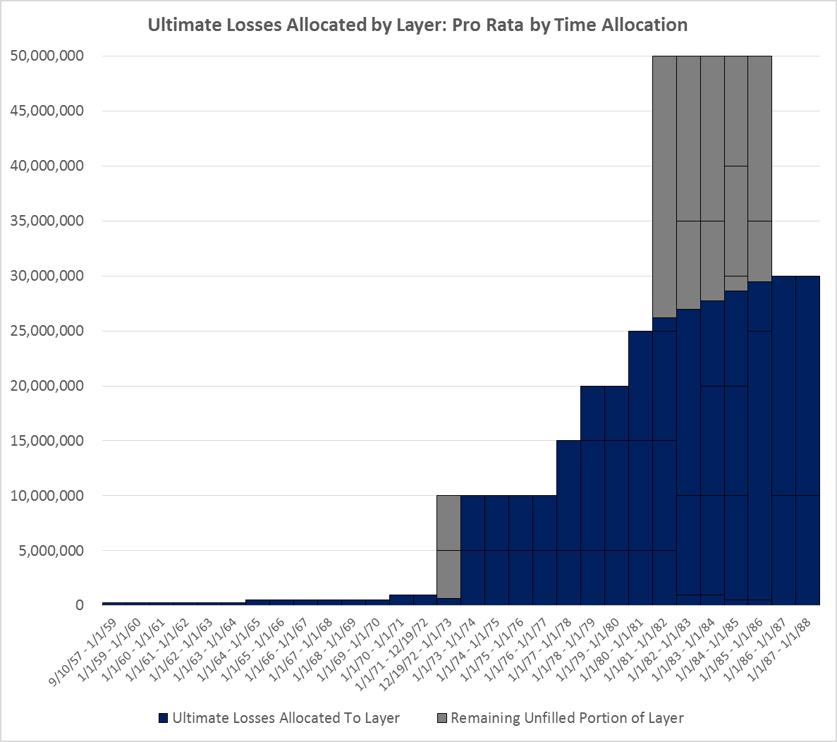
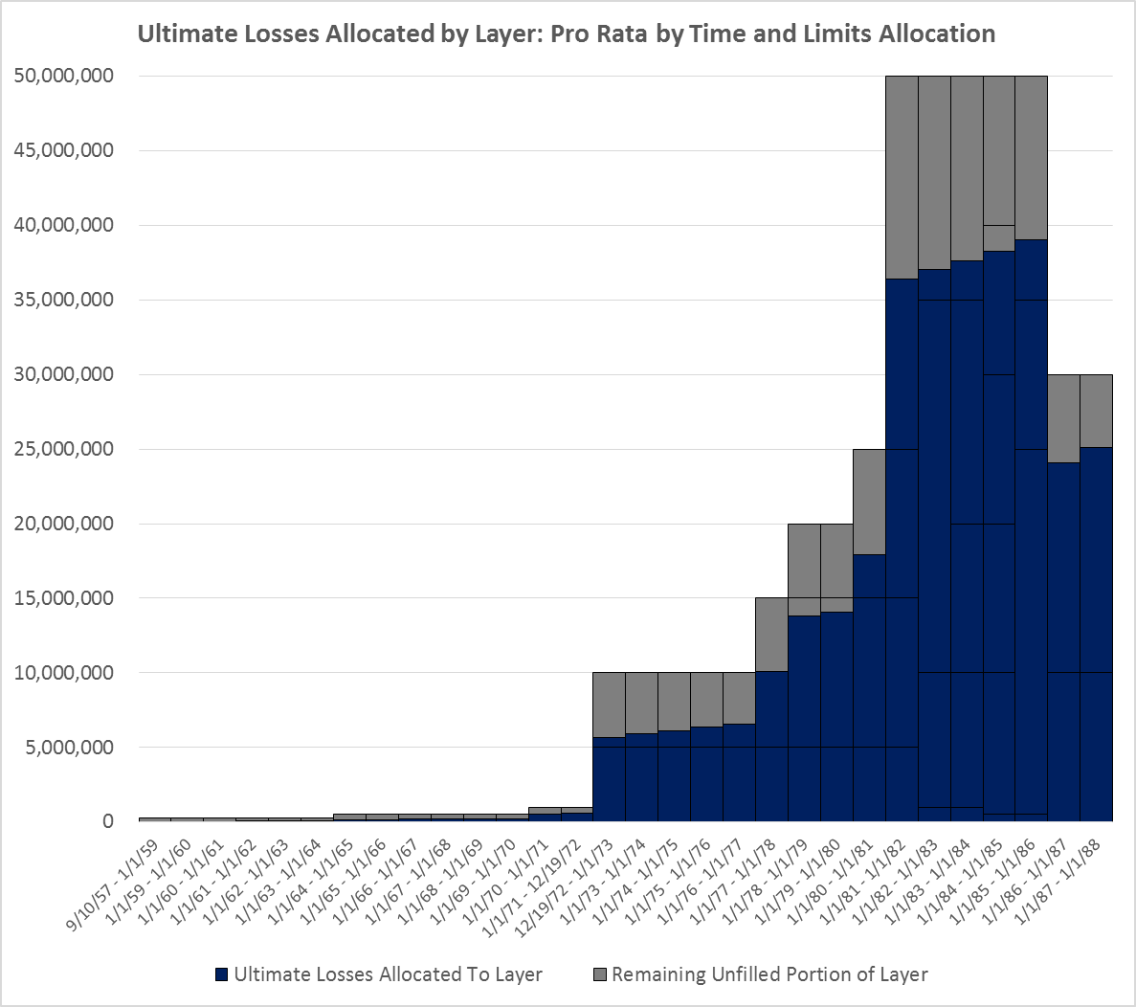
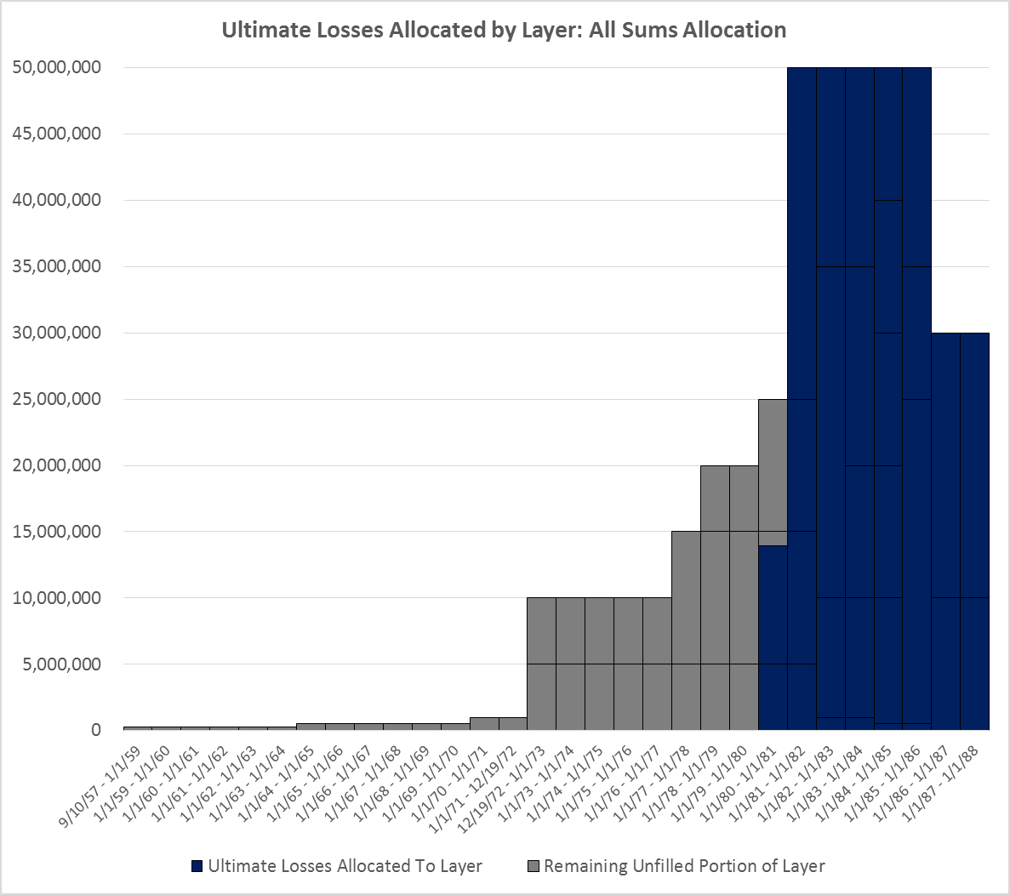
Allocation of Loss to Policy: Without Insolvencies
After deriving ultimate claims, loss must be allocated to policy. Different allocation methods can produce dramatically different indications per policy. The appropriate allocation method is a matter of legal interpretation and detailed scrutiny of policy language. Need to interact with claims to understand which law applies.

Slide 34
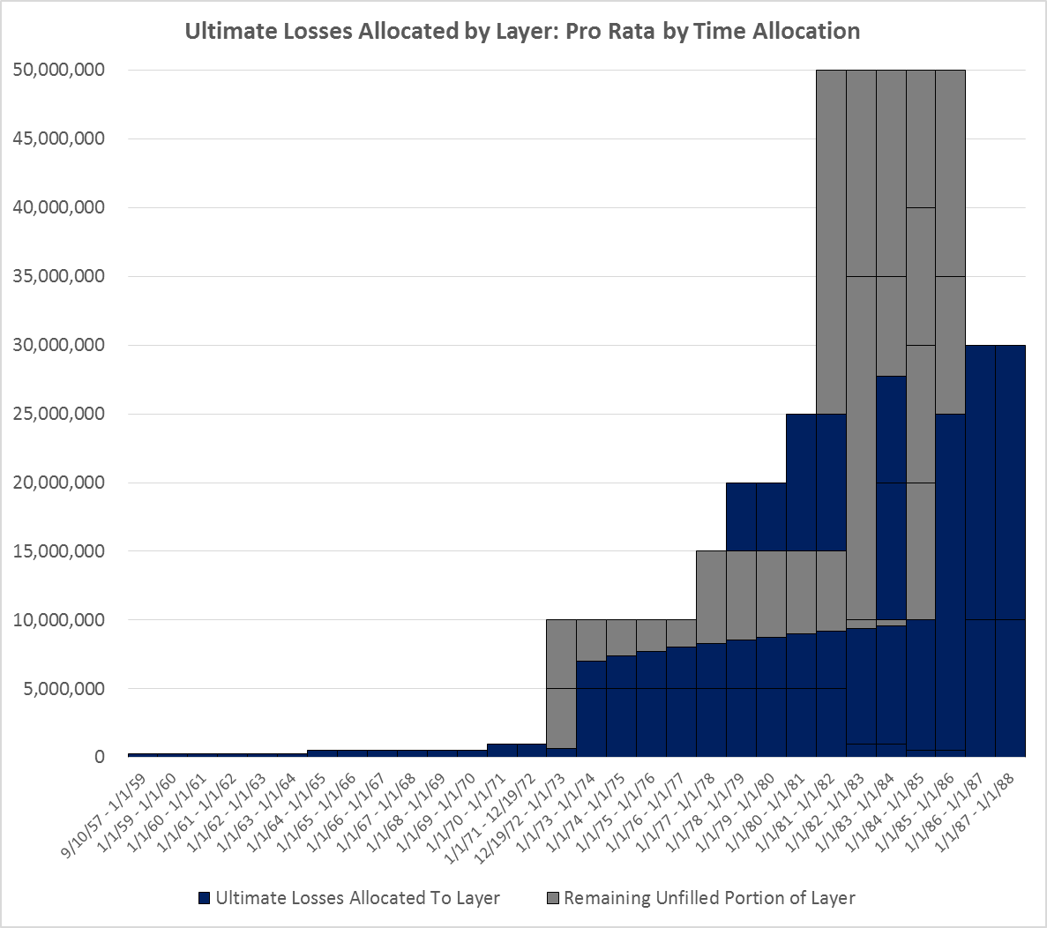
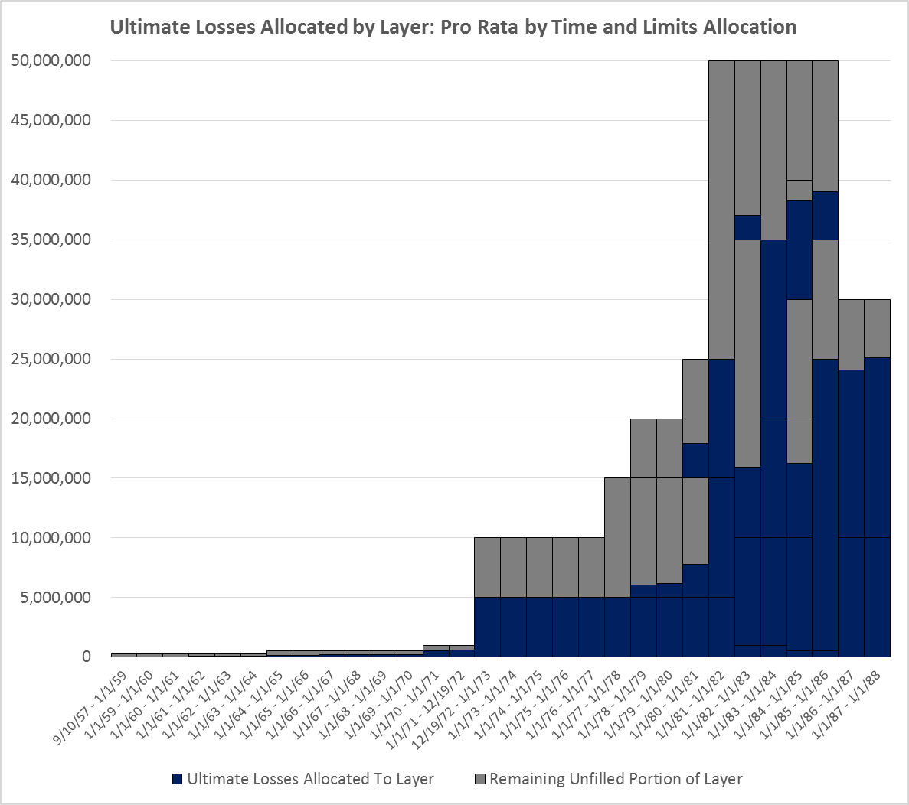
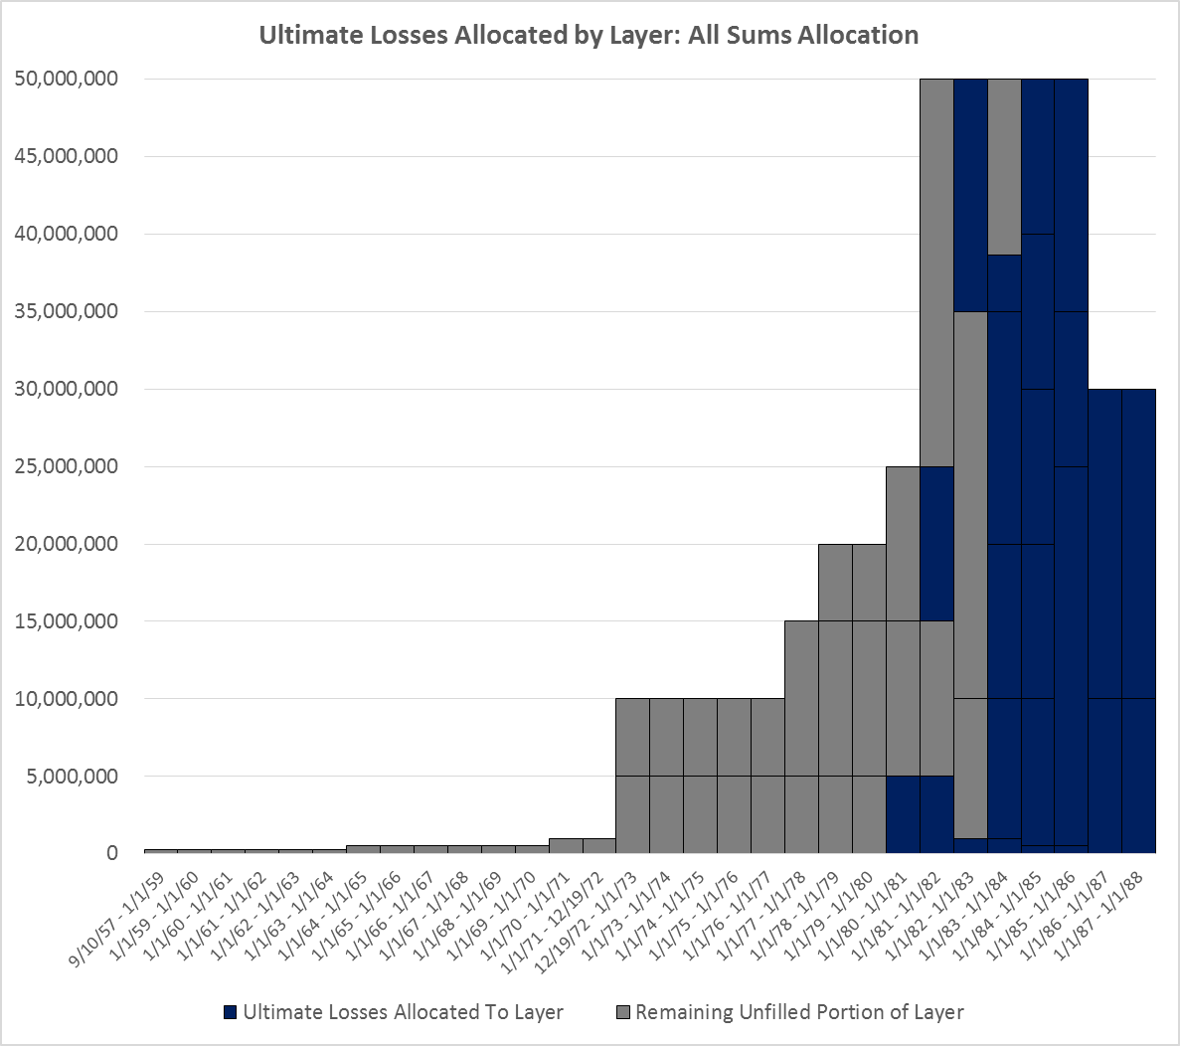
Allocation of Loss to Policy: With Insolvencies
Insolvencies complicate the allocation. Losses are allocated to policies in the same manner as before, however, coverage holes appear where losses are allocated to insolvent insurers. Coverage gaps can be spread to remaining solvent insurers or back to the defendant to retain without coverage.
Additionally, currently insolvent insurers may have partially paid loss before insolvency. The examples shown here allocate currently paid loss to all insurers, but future unpaid loss to solvent insurers only.
Need to interact with claims to know about insolvencies.

Slide 35
Why do some companies want to sell/exit their run-off exposures?

Slide 36
Seller Motivation
Reduce required capital
Limit risk of adverse development
May help rating
Management can concentrate on core on-going business
Significant legal costs
Staffing issues
Can reduce credit risk associated with reinsurance

Slide 37
What factors do reinsurance companies consider when deciding to enter into a particular deal?

Slide 38
Buyer Motivation
Generate a profit – long payout – can invest assets
Economies of scale
Claim settlement opportunities
Reduce legal spend
Build expertise

Slide 39
Questions?
Carolyn Fahey
AIRROC
carolyn@airroc.org
Rita Zona, ACAS
Enstar Group
Rita.Zona@enstargroup.com
Brian Z. Brown, FCAS
Milliman, Inc.
brian.brown@milliman.com
Notes:
This is an example of the COVER WITH BLUE BACKGROUND layout.
To apply this template, from the HOME TAB click the LAYOUT BUTTON and choose COVER — BLUE BACKGROUND.
Editing text: Click in text boxes to edit text. To delete a text box, click the border of the box and delete.
Imagery: Imagery is inserted in the slide background. Imagery should be in widescreen format (16:9 aspect ratio) or cropped to fit. Please do not stretch imagery to fit the background.
Adding a background image. To insert a background image, go to Format > slide background. In the Format Background pane. Choose Picture or Texture Fill. Under Insert Picture, choose FILE if you know the desktop location of the image or CLIPBOARD if the image has been copied to the clipboard.

