Slide 1
What’s Driving the P&C Industry?
Casualty Actuaries of New England
October 30, 2020
Steven N. Weisbart, Ph.D., CLU, Senior Vice President & Chief Economist
Insurance Information Institute ♦ 110 William Street ♦ New York, NY 10038
Tel: 212.346.5540 ♦ Cell: 917.494.5945 ♦ stevenw@iii.org ♦ www.iii.org

Slide 2
The Economy
The path of the economy will depend significantly on the course of the virus [and public confidence].
The course of the virus poses considerable risks to the economic outlook over the medium term.
A full recovery is likely to come only when people are confident that it is safe to reengage in a broad range of activities. The path forward will depend on keeping the virus under control, and on policy actions taken at all levels of government.
Source: July 29 and September 22 Statements by Federal Reserve Chair Jerome Powell

Slide 3
But Data on the Economy Can Be Unreliable
For example, take the Unemployment Rate
The announced unemployment rate in September for people 55 and over was 6.7%. This is the number of people unemployed in that age group (2.524 million) divided by the civilian labor force in that age group (37.776 million).
Sources: BLS; Insurance Information Institute

Slide 4
But Data on the Economy Can Be Unreliable
For example, take the Unemployment Rate
The announced unemployment rate in September for people 55 and over was 6.7%. This is the number of people unemployed in that age group (2.524 million) divided by the civilian labor force in that age group (37.776 million).
But in August the civilian labor force in that age group was 38.231 million. So from August to September 455,000 people 55 and over weren’t working or looking for work. Many who were unemployed likely declared themselves “retired.”
Sources: BLS; Insurance Information Institute

Slide 5
But Data on the Economy Can Be Unreliable
For example, take the Unemployment Rate
The announced unemployment rate in September for people 55 and over was 6.7%. This is the number of people unemployed in that age group (2.524 million) divided by the civilian labor force in that age group (37.776 million).
But in August the civilian labor force in that age group was 38.231 million. So from August to September 455,000 people 55 and over weren’t working or looking for work. Many who were unemployed likely declared themselves “retired.”
If they had all remained in the labor force (as unemployed), the unemployment rate for people 55 and over would have been 7.8%.
Sources: BLS; Insurance Information Institute

Slide 6
Economic Outlook
The Strength of the Economy
Will Influence the Insurance Environment
Notes:
Antitrust disclaimer – no one should express their individual plans or situation
With three major hurricanes, an earthquake and record wildfires in the third quarter of the year, following an above-average catastrophe first-half, there is talk about a “hard market” emerging.
How is a hard market defined?
A hard market occurs when insurance premiums grow substantially faster than the economy.
Premiums are measured by Net Written Premiums
The economy is measured by nominal GDP
The last hard market was 15 years ago. Are we due for another one?

Slide 7
Fighting COVID-19 has Driven the Economy into the Deepest Recession in 80 Years
Nominal GDP: Annual Change, 1971-2021F
The U.S. economy’s annual growth—not adjusted for inflation—has slowed over the last five decades.
Sources: U.S. Commerce Dept., Bureau of Economic Analysis; I.I.I. 2020 and 2021 are Blue Chip median forecasts (Oct. 2020 issue)

Slide 8
The Economy Drives P/C Insurance Industry Premiums:
Net Premium Growth (All P/C Lines) vs. Nominal GDP: Annual Change, 1971-2021
This isn’t a “hard market.” It’s driven by the tax law change.
The GDP plunge in 2020 could drag NWP down
Except for the three “hard markets” in this 50-year period,
Net Written Premiums track Nominal GDP—not year by year but fairly well.
Sources: A.M. Best (1971-2013), ISO (2014-19); U.S. Commerce Dept., Bureau of Economic Analysis; I.I.I. 2020 and 2021 are Blue Chip median forecasts, Oct. 2020 issue

Slide 9
Quarterly U.S. Real GDP Growth (at annual rates): Range of Forecasts, 2020-2021
Forecasts expect U.S. growth to recover slowly through 2021.
Sources: Blue Chip Economic Indicators, Oct. 2020 issue; Insurance Information Institute.

Slide 10
Quarterly U.S. Real GDP: Actual and Forecasts, 2019-2021F
Tough times ahead? The economy is not forecast to reach its pre-recession (2019:Q4) level until the last quarter of 2021.
$ Billions of chained 2012 collars
+7.4%
Sources: Blue Chip Economic Indicators, Oct. 2020 issue; Insurance Information Institute. Plot points for 2020:Q3 are preliminary and later are forecasts.

Slide 11
Economic Growth Depends on People Having Income and Spending It*
$ Billions
Personal Saving as a % of DPI
Nov 2019: 7.9%
Dec. 2019: 7.2%
Jan. 2020: 7.6%
Feb 2020: 8.3%
Mar. 2020: 12.9%
Apr. 2020: 33.6%
May 2020: 24.5%
Jun. 2020: 18.7%
Jul. 2020: 18.1%
Aug. 2020: 14.8%
Sept. 2020: 14.3%
Spending plunged due to lockdowns and fear of contracting the virus
In 2020:Q2 we had the largest drop in credit card balances in history--$75 billion. Consumption (70% of the economy) is cautious.
*Data are seasonally adjusted at an annual rate
Sources: bea.gov, Personal Income and Outlays, published October 30, 2020, Table 1; Insurance Information Institute.

Slide 12
Spending* Varies; Effect on P/C Insurance?
% change from February
*Data are inflation-adjusted
Sources: bea.gov, Personal Income and Outlays, published October 30, 2020, Table 7; Insurance Information Institute.

Slide 13
An Annual Rate of Nearly One Million New Homes Sold* in August and September 2020
Thousands
Since May 2020, new home sales have been rising sharply compared with the same month in prior years.
Inventory is shrinking quickly (from 6.8 months’ supply in April 2020, down to 3.6 months’ supply in September), which means that newly-constructed homes are selling faster than builders can build them.
*Seasonally adjusted, at an annual rate; Sept 2020 is preliminary
Sources: Census Burearu, Monthly New Residential Sales, September 2020, Table 1a and FRED https://fred.stlouisfed.org/series/HSN1F; Insurance Information Institute.

Slide 14
Construction Started on New 1-Family Housing Units => Recovery?
Thousands*
+22.03% over Sept 2019
Single-family home construction is above the rate reached pre-recession.
*Seasonally adjusted at an annual rate
Sources: https://fred.stlouisfed.org/series/HOUST1F ; Insurance Information Institute.

Slide 15
Personal Consumption Expenditures:
Home remodeling and new contents, Quarterly
$ Billions
2020:Q2 vs. 2019:Q4: furniture, major appliances, TVs, computers -0.4%
Data are seasonally-adjusted, annualized.
Sources: US Bureau of Economic Analysis, NIPA, Table 2.4.5U (furniture, major appliances, TVs, computers); Harvard Joint Center for Housing Studies (home remodeling); Insurance Information Institute.

Slide 16
Change in Nonresidential Fixed Investment: Implications for Commercial Insurance
Percent change from same quarter, prior year
Slower growth in exposure base bodes ill for commercial premium growth
Sources: bea.gov, news release “Gross Domestic Product: Second Quarter 2020 (Third Estimate), Table 6; Insurance Information Institute.

Slide 17
P/C Insurance Industry:
Financial Update
It’s Hard to Know Where We Stand
or Where We’re Going

Slide 18
Net Premium Growth vs. Nominal GDP, First-Half-Year Percent Change
Provisions in the Tax Cuts and Jobs Act reform led to a spike in net premiums written in 2018. If NPW is averaged over 2017-19, the annual growth rate is (a more typical) 6.9 percent.
In the last dozen years, this kind of divergence between nominal GDP and NPW has never happened!
All data through second quarter.
Sources: NAIC data sourced through S&P Global Intelligence, Bureau of Economic Affairs, Insurance Information Institute.
Notes:
Updated 6/25 – lynch
Updated 9/13 lynch

Slide 19
U.S. Inflation-Adjusted Insured Cat Losses
Harvey, Irma, Maria
2020:1H – at mid-year already the 5th worst year of the last 10. With wildfires and hurricanes in the 3rd quarter, heading toward the third worst year in the last 10.
*2020: ISO data for first half of 2020.
2010s is average of 2010 to 2019. All losses are Direct.
Sources: Property Claims Service, a Verisk Analytics business; Insurance Information Institute.

Slide 20
CAT Claims as a Percent of Total Claims,* 1st Halves, 2011-2020
CAT claims in the first half of the year are normally a product of heavy winter storms and/or destructive tornadoes. 2020 was an atypical year.
*both claims totals are net of reinsurance and include Loss Adjustment Expenses
Sources: ISO PCS; Insurance Information Institute calculations.

Slide 21
Net Underwriting Gains & Losses,
1st Halves of Each Year, 2008-2020
$ Millions
Best three years of first-half U/W gains in the past decade
Net underwriting results in the first half of the year
have been quite variable, but gains in 6 of the last 8 years.
Sources: ISO/PCI; Insurance Information Institute.

Slide 22
P/C Industry Net Income After Taxes*,
1st Halves, 2007-2020
$ Billions, 2018 dollars
In the first half of the year, after-tax net income varied.
2020 was just above the median in the last dozen years.
*adjusted for inflation using the BLS CPI calculator, to 2018 dollars
Sources: ISO, a Verisk Analytics company; Insurance Information Institute.

Slide 23
Policyholder Surplus, 2006–2019
Surplus as of 6/30/20 stood at $837.0B
($ Billions)
The industry now has $1 of surplus for every $0.79 of NPW,
near the strongest claims-paying status in its history.
The P/C insurance industry is in very strong financial condition.
Sources: ISO, A.M .Best.
23
12/01/09 - 9pm
eSlide – P6466 – The Financial Crisis and the Future of the P/C
Notes:
23

Slide 24
The Investment Story:
Lower for Longer
Depressed Yields Will Necessarily Influence Underwriting & Pricing

Slide 25
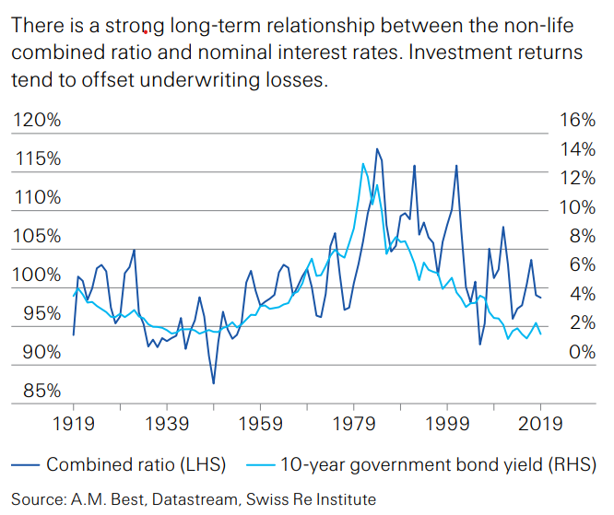
Why We Focus on Interest Rates

Slide 26
US Treasury Note 10-Year Yields*
Yields on 10-Year US Treasury Notes have been below 3% for over 8 years: 10-year U.S Treasury bonds bought in 2011 at 3.5% will be reinvested today at less than 1.0% for 10 more years
0.65%
Since nearly 50% of P/C bond/cash investments are in 5-year or longer maturities, most P/C insurer portfolios will have low-yielding bonds for years to come.
*Monthly, constant maturity, nominal rates, through August 2020.
Sources: Federal Reserve Bank at http://www.federalreserve.gov/releases/h15/data.htm; National Bureau of Economic Research (recession dates); Insurance Information Institute.
26
12/01/09 - 9pm
eSlide – P6466 – The Financial Crisis and the Future of the P/C
Notes:
26

Slide 27
BofA AA Corporate Index Effective Yields,*
2000–2020
The yield on these bonds has been lower than 3% for most of the last decade
1.48%
Since the yield on these bonds has been lower than 3% for most of the past decade, many P/C insurer portfolios will have low-yielding bonds for years to come.
*Monthly, not seasonally adjusted, through September 2020.
Sources: Federal Reserve Bank at https://fred.stlouisfed.org/series/BAMLC0A2CAAEY ; National Bureau of Economic Research (recession dates); Insurance Information Institute.
27
12/01/09 - 9pm
eSlide – P6466 – The Financial Crisis and the Future of the P/C
Notes:
27

Slide 28
Net Investment Gains Vary Mainly With Realized Capital Gains/Losses, 1st Halves, 2007-2020
$ Billions
In the first half of the year, net investment income has been steady but realized capital gains/losses have been variable.
Sources: ISO/PCI; Insurance Information Institute.

Slide 29
P/C Insurer Portfolio Yields,
2002-2020:1H
The yield on the 10-Year U.S. Treasury note is a proxy for prevailing interest rates.
Since 2008 it has generally led the P/C portfolio rate downward.
That trend now seems likely to continue for several more years.
Sources: NAIC data, sourced from S&P Global Market Intelligence; FRED; Insurance Information Institute.

Slide 30
P/C Insurer Bond Distribution,
Year-end 2009-2019
Bonds
Less Than 1 Year
Bonds
10 Years
or More
Bonds 1-5 Years
Bonds 5-10 Years
From 2009 to 2019, the percent of bonds with 1-5-year maturities rose from 36% to 41% but those with 10 or more years of maturity fell from 19% to 11%.
Sources: NAIC via S&P Global

Slide 31
Commercial Insurance Premiums

Slide 32
Commercial Lines Rate Change
(vs. Year Earlier) Since 9/09
September 2015: First Overall Decrease Since August 2011
Sources: MarketScout, Insurance Information Institute.

Slide 33
Workers Comp Premiums, 2007–2020
Remarkably, total Workers Comp premiums have declined almost continually since 2007. From January 2007 to August 2020, -11.4%. This is even more remarkable given that total private employment rose by 14.7 million through February 2020 (+6.4 million through August 2020).
Index:
Jan 2007=100
Monthly, not seasonally adjusted, through August 2020.
Sources: U.S. Bureau of Labor Statistics, Producer Price Index (WC premiums Index) and private employment; National Bureau of Economic Research (recession dates); Insurance Information Institute.
33
12/01/09 - 9pm
eSlide – P6466 – The Financial Crisis and the Future of the P/C
Notes:
33

Slide 34
CMP and Liability Premiums, 2007–2020
Since 2007, total CMP premiums have risen about 14%. The “Great Recession” slowed this increase but not the current recession. Premium increases for liability insurance were slowed by both recessions but rose by about 10% overall.
Index:
Jan 2007=100
Monthly, not seasonally adjusted, through August 2020.
Sources: U.S. Bureau of Labor Statistics, Producer Price Index (CMP premiums Index) and private employment; National Bureau of Economic Research (recession dates); Insurance Information Institute.
34
12/01/09 - 9pm
eSlide – P6466 – The Financial Crisis and the Future of the P/C
Notes:
34

Slide 35
COVID-19 and its effect on the P/C Insurance Industry

Slide 36



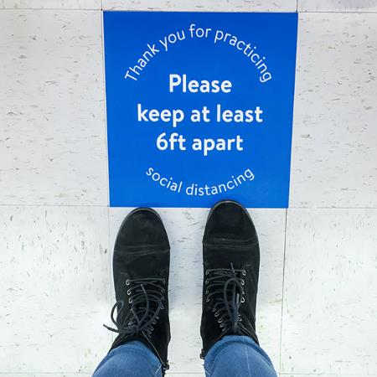
We Are Working and Playing Differently
Zoom Meetings
Restaurant
Take Out
Staying
Home
Social Distancing

Slide 37
Percent Change in Vehicle Miles Traveled
From same month, prior year
1.2%
0.9%
Is this the “new normal” in vehicle miles traveled?
-12.3%
-40.1%
In Jan and Feb 2020, VMT rose by 2.2% each. In March, mostly in the last two weeks, it fell by 19%. In May it was down 25.6%, in June 13.2%, in July 11.2%.
Monthly, through August 2020.
Sources: https://fred.stlouisfed.org/series/TRFVOLUSM227NFWA#0 ; National Bureau of Economic Research (recession dates); Insurance Information Institute.
37
12/01/09 - 9pm
eSlide – P6466 – The Financial Crisis and the Future of the P/C
Notes:
37

Slide 38
COVID-19’s Potential Claims Impact
What is all this equivalent to?
Loss estimates range from $30B (≈ one bad hurricane) to $140B (2-3 Katrinas)
COVID-19’s Potential Investment Impact
Volatile stocks, bond yields plunging
Lloyd’s estimate: $96B in investment losses
Sources: Willis Towers Watson, Insurance Information Institute..

Slide 39
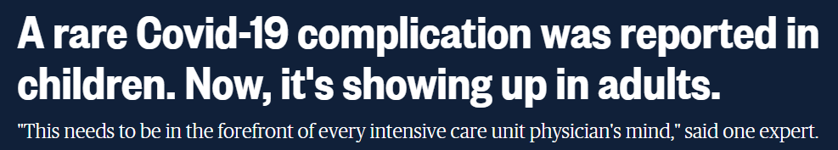
Possible Long-Term Effects
Survivors May Face Long-term effects
Organ damage (heart, lungs, brain)
Blot clots and blood vessel problems (plus heart attacks and strokes
Problems with mood and fatigue
Others
Sources: NBC News, October 16,2020; mayo clinic; insurance information institute

Slide 40
The Pandemic’s Effect
on Inflation Measurement

Slide 41
CPI Forecasts for 2020-2021
If the top forecasts are correct, bond yields should rise significantly
Note: Data are percent change from prior quarter, at an annual rate.
Sources: Blue Chip, October 2020; Insurance Information Institute.

Slide 42
Inflation Measurement: Methodological Challenges
Comparing Prices of Identical Items
Some prices can’t be compared
  New products (e.g., new drugs)
  New services (e.g. new medical treatment)
Prices of some goods or services must be adjusted to remove the price-effect of new elements
  Cars with new safety features
  Improved cell-phone service
  Higher prices for output from places of business (e.g., restaurants, factories) with new Covid-19 protection

Slide 43
Inflation Measurement: Methodological Challenges
Collection Methods
for Prices of Commodities and Services
 | March 2019 | March 2020
Collected prices | 87% | 75%
Collection mode
personal visit | 67% | 37%
phone | 9% | 12%
online | 14% | 39%
other | 9% | 16%

Slide 44
Questions?

Slide 45
Insurance Information Institute
www.iii.org
Thank you for your time
and your attention!
Notes:
45

